Slide 1
Burnt Store Isles Association
WELCOME
The 41st Annual General Membership Meeting
Nov. 14, 2024
Notes:
Welcome to the 40th annual meeting of the Burnt Store Isles Association, Inc. Thank you for coming out today. Please silence all cell phones.
Today’s meeting is not a general business meeting such as we have every month when the Board meets. This is a meeting as defined by the Bylaws and has three objectives:
Elect new officers and board members to fill the vacancies.
Pass a 2023 budget
Hear from you about topics or issues important to you
This room only has 2 microphones so if you’d like to ask a question during the meeting about a specific topic please DO NOT SHOUT OUT BUT raise your hand and wait to be recognized, then we’ll bring a wireless mic to you so that everyone can hear.
There is also time after the Board reports for general comments and questions.
And, of course I want to get you home in time to vote on your favorite in The Voice. So, let’s get started.

Slide 2
Agenda
Call to Order & Pledge
Call for Quorum
Approval of 2023 Annual Meeting Minutes
2025 Board of Directors Nomination and Voting
Bylaw Change & Lawsuit Information
2024 Projected Income Statement and 2025 Budget Approval
Officer’s Reports
Director’s Reports
Member Comments
Introduce 2025 Board
Adjourn
Notes:
First order of business is to call the meeting to order and to recite the pledge.
TURN TO NEXT SLIDE

Slide 3
Notes:
Today and tomorrow are important dates in our military history.
On this date in 1775, the Marines were first organized by the Continental Congress. And, on this date in 1954, the Marine Corp Memorial commerating the flag raising on Iwo Jima was dedicated in Arlington, VA by President Eisenhower.
Tomorrow, Friday, November 11 is Veteran’s Day where we recognize all branches of service. So to recognize the active duty or military veteran’s among us tonight, I’d like to ask them to rise and lead us in reciting the pledge of allegiance.

Slide 4
Notes:
Everyone else please rise….

Slide 5
Agenda
Call to Order & Pledge
Call for Quorum
Approval of 2023 Annual Meeting Minutes
2025 Board of Directors Nomination and Voting
Bylaw Change & Lawsuit Information
2024 Projected Income Statement and 2025 Budget Approval
Officer’s Reports
Director’s Reports
Member Comments
Introduce 2025 Board
Adjourn
Notes:
Thank you.
Introduction of Police for brief presentation
I’d like to ask our secretary if we have a quorum for tonight’s annual membership meeting. Thank you.
Next I will ask for a motion to approve the minutes from the 2023 annual membership meeting. Thank you.
For the next agenda item, I’d like to ask Bill Courtney, to come up to handle the nominating committee report and then voting on the candidates for the 2025 Board.

Slide 6
2025 Nominating Committee Chair Report Bill Courtney
Burnt Store Isles Association By-Laws, Article VII, Meeting and Elections
The Annual membership meeting of the owner members shall be held on any day in November.
Chair of the Nominating Committee presents the list of candidates.
Nominations may also be made from the floor, provided prior consent of that nominee has been obtained.
Those receiving the greatest number of votes of members present shall be declared elected to the offices to which they were nominated.
Officers and Directors elected shall assume office the following January 1st.
Notes:
Bill will review the Election Procedure, then review the candidates for each office and conduct the election.

Slide 7
2025 Nominating Committee Chair Report Bill Courtney
Officers:
President: Bill Page, 2nd 2-year term
Vice President: Pat Iorio, 2nd 2-year term
Secretary: Jan Draber
Directors:
Community Standards: Kathy Martinelli
Security: Dave Elkins, 2nd 2-year term
Social: Tracy Sage
Special Projects: OPEN
Notes:
ASK EACH TO STAND AS CALLED

Slide 8
2025 Nominating Committee Chair Report Bill Courtney
Officers:
President: Bill Page, 2nd 2-year term
Vice President: Pat Iorio, 2nd 2-year term
Secretary: Jan Draber
Directors:
Community Standards: Kathy Martinelli
Security: Dave Elkins, 2nd 2-year term
Social: Tracy Sage
Special Project: OPEN
Are there any nominations from the floor?
Notes:
ASK EACH TO STAND AS CALLED. Hearing no nominations from the floor, I call for a vote for all by acclimation from the members here gathered. All in favor please raise your voting card.

Slide 9
2025 Board of Directors
Red denotes change
Officers
President, Bill Page
Vice President, Pat Iorio
Treasurer, Lee Brandt
Secretary, Jan Draber
Publishers
Newsletter & Directory, Diane Peterson
Marketing, Dave Elkins
Past President
Bill Courtney
Directors
Community Standards, Kathy Martinelli
E-Communications, Polly Green
Legal Liaison, Brian Bender
Membership, Wendy Heath-Brandt
Planning, Bill Courtney
Security, Dave Elkins
Social, Tracy Sage
Special Projects, TBD
Notes:
Congratulations to your BSIA 2024 Officers and Board of Directors!

Slide 10
Agenda
Call to Order & Pledge
Call for Quorum
Approval of 2023 Annual Meeting Minutes
2025 Board of Directors Nomination and Voting
President’s Report -Lawsuit Information
2024 Projected Income Statement and 2025 Budget Approval
Officer’s Reports
Director’s Reports
Member Comments
Introduce 2025 Board
Adjourn
Notes:
Congratulations to the new Officers and Board members for 2025.
The next order of business is to review the 2024 projected income statement and the 2025 proposed budget.
To take us through this I’d like our Treasurer Lee Brandt to come up.

Slide 11
Proposed Bylaw Change
Section 2. Each Director shall be elected to manage and be responsible for one of the following functions via: (1) Membership; (2) Special Projects; (3) Community Relations; (4) Legal Liaison; (5) Social; (6) Neighborhood Security; (7) Community Standards; and (8) E-Communications. The immediate Past President shall remain as a non-voting director as long as he/she remains the immediate Past President.

Slide 12
Deed Restrictions Lawsuit
History of the Legal Reserve Fund
The association has contributed to legal reserves more than 20 years.
In 2014 the association voted that 10% of dues would be allocated to the Legal Reserve Fund
Recent use of the reserve has been minimal (Less than $4K annually)

Slide 13
Deed Restrictions Lawsuit
The Association voted in 2004 to accept metal that resemble tile roofs that were acceptable to the BSIA Architectural Review Committee (ARC)
Further clarification made in 2020 and 2023 as to what is acceptable for metal tile
Starting in 2003 and recently in 2022 and in 2024 the Association sent out deed restrictions to all property owners for educational purposes

Slide 14
Deed Restrictions Lawsuit
August 2023 a resident started installing a standing seam roof, we were notified by multiple residents of the violation
ARC immediately tried to contact the resident and the contractor
Resident signed waiver with the contractor that they assumed responsibility (permit)
Resident’s defense has been that the BSIA deed restrictions have expired

Slide 15
Burnt Store Isles Association
2024 Projected Income Statement 2025 Budget Proposal

Slide 16
Burnt Store Isles Association
2024 Projected Income Statement 2025 Budget Proposal

Slide 17
BSIA 2024 FINANCIAL POSITION
INCOME STATEMENT SUMMARY 11/1/2024
2024 Approved 2024 Projected Difference
TOTAL INCOME 35,800 30,851 (4,949)
TOTAL EXPENSES 35,735 43,533 (7,798)
PROJECTED OVERAGE/SHORTAGE ($12,747)
CASH AVAILABLE as of 11/1/24
OPERATING ACCOUNT 16,409
CDs 40,000
RESERVES 12,791
TOTAL CASH 69,200

Slide 18
2024 Projected Income Statement

Slide 19
2024 Projected Income Statement

Slide 20
2025 PROPOSED BUDGET
INCOME:
Annual membership dues changed at $50 (PayPal $55)
Membership income based on 500 members
Advertising income
New Construction income reduced due to economy slowing
EXPENSE:
Base inflation rate increase of 6% (Impact = $?)
Landscaping replacement project completed
Madrid Monument cut down project complete

Slide 21
2025 PROPOSED BUDGET

Slide 23
2025 Proposed BSIA Budget
Are there any questions or comments?
I would like to have a motion to approve the 2025 BSIA budget.

Slide 24
Agenda
Call to Order & Pledge
Call for Quorum
Approval of 2023 Annual Meeting Minutes
2025 Board of Directors Nomination and Voting
Bylaw Change & Lawsuit Information
2024 Projected Income Statement and 2025 Budget Approval
Officer’s Reports
Director’s Reports
Member Comments
Introduce 2025 Board
Adjourn
Notes:
Now we move on to the Officers and Director's Reports

Slide 25
Burnt Store Isles Association
President’s Report
Bill Page

Slide 26
Burnt Store Isles Association
Vice President’s Report
Pat Iorio

Slide 27
NEW HOME STARTS 2024
Single Family = 14 Approved
6 more approvals over 2023
Garage Additions = 2

Slide 28
Future Growth Possibilities in Burnt Store Isles
117 Building Lots remain

Slide 29
Burnt Store Isles Association
Treasurer’s Report
Lee Brandt

Slide 30
Burnt Store Isles Association
Secretary’s Report
Charmaine Ponkratz

Slide 31
Director’s Reports
E-Communications, Polly Green
Community Standards, Faith Ferris
Legal Liaison, Brian Bender
Membership, Wendy Heath-Brandt
Neighborhood Security, Dave Elkins
Planning, Bill Courtney
Social, Wanda Daugherty
Special Projects, Kathy Martinelli

Slide 32
Burnt Store Isles Association
E-Communications
Polly Green, Director

Slide 33
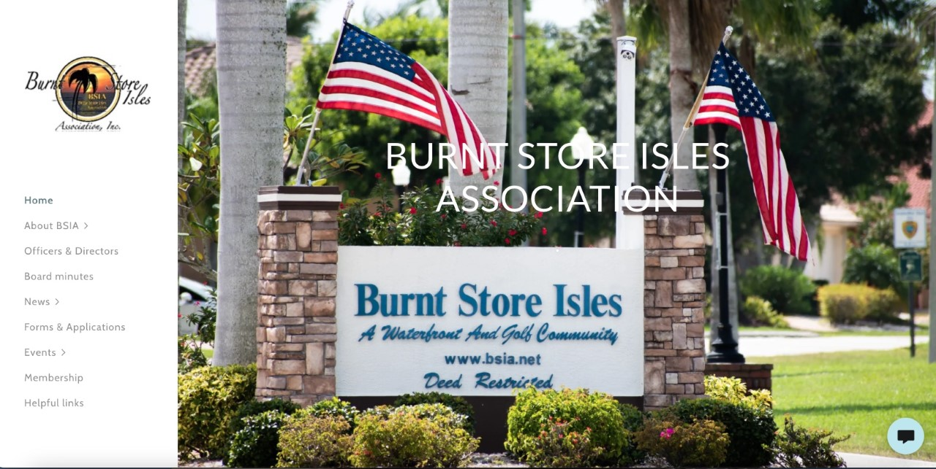

Slide 34
Burnt Store Isles Association
Community Standards
Faith Ferris, Director

Slide 35
COMMUNITY STANDARDS BASED ON MAINTAINING DEED RESTRICTIONS
Architectural Change Approvals During 2024 = 108
Certified Letters of Non-Compliance Issued Since 1/2024 = 6
When the Board of Directors make a new policy it is posted within 3 days on the BSIA website at www.bsia.net.
If the policy clarifies a Deed Restriction it is also posted within the Deed Restrictions on the website directly under the Deed Restriction Paragraph it clarifies.

Slide 36
Policy Clarifications Issued in 2024
20 ft SETBACK (Deed Restriction Paragraph 5)
BSIA will allow a pool, patio, poolcage or patio cage to the20-foot rear setback from a seawall or golf course lot property line. For the purpose of this interpretation this does not apply to sand-based patio pavers and planting areas
POLITICAL SIGNS 2024 (Deed Restriction Paragraph 18)
During the current political season, the BSIA Board has agreed to follow the City of Punta Gorda ordinance on general yard signs in that there will be no more than a combination of 4 signs and flags per property. The political signs posted in BSI can be no more than 2 ft. X 2 ft. and are to be removed within 1 week after election.

Slide 37
Burnt Store Isles Association
Legal Liaison
Brian Bender, Director

Slide 38
Burnt Store Isles Association
Membership
Wendy Heath-Brandt, Director

Slide 39
Burnt Store Isles Association
Neighborhood Security
Dave Elkins, Director

Slide 40
Burnt Store Isles Association
Planning
Bill Courtney, Director

Slide 41
Planning
Bill Courtney, Director
Notes:
Good afternoon. Much of my role is to act as a liaison with the City and various other organizations. In doing so I monitor the planned developments in Punta Gorda as well as the surrounding region. One of the tools I use is a quarterly developments report sent by email from the City - the first page of which is shown here - The report details the projects in the planning stage, under construction, or completed. It also lists the business tax receipts issued in the prior quarter which includes, among other types of new businesses, any applications for vacation rentals in the city.
In the latest report 18 projects were in the planning stage, 5 were under construction, 1 completed, and 16 new business tax receipts had been issued.
You can request to be added to the distribution list by contacting Melissa Reichert at mreichert@cityofpuntagordafl.com

Slide 42
Burnt Store Isles Association
Social
Wanda Daugherty, Director
Notes:
Wanda is not able to attend todays meeting
Fairy Hair in November
Glo Ride – December 12 – a 4-mile lighted bike ride – starting at Candia.
Christmas Party December 16 – Twin Isles Country Club.
Sunset Conch Blow – December 31 – BSIA will rent the pavilion at Gilcrest Park. Residents are encouraged to bring finger food, BYOB cooler and lawn chairs.

Slide 43
Burnt Store Isles Association
Special Projects
Kathy Martinelli, Director

Slide 44
Agenda
Call to Order & Pledge
Call for Quorum
Approval of 2023 Annual Meeting Minutes
2025 Board of Directors Nomination and Voting
Bylaw Change & Lawsuit Information
2024 Projected Income Statement and 2025 Budget Approval
Officer’s Reports
Director’s Reports
Member Comments
Introduce 2025 Board
Adjourn
Notes:
Are there any comments that you’d like to make or questions you’d like to ask about topics we may not have covered tonight?
If so, please raise your hand and a member of the Board will bring a wireless mic out to you. That way everyone will be able to hear you.
Before I introduce your 2025 Board, I’d like to thank two members who will be leaving the Board at the end of this year.

Slide 45
THANK YOU TO OUTGOING BOARD MEMBERS
Charmaine Ponkratz
Wanda Daugherty
Faith
Ferris
Notes:
Ian could not be at the meeting due to a long scheduled trip.
But Dave, please accept this BSIA Community Service Award as a simple token our the Board’s thanks for your time, effort and contributions to making BSIA a better organization.

Slide 46
Presenting Your 2025 BSIA Board of Directors
Officers
President, Bill Page
Vice President, Pat Iorio
Treasurer, Lee Brandt
Secretary, Jan Draber
Publishers
Newsletter & Directory, Diane Peterson
Marketing, Dave Elkins
Past President
Bill Courtney
Directors
Community Standards, Kathy Martinelli
E-Communications, Polly Green
Legal Liaison, Brian Bender
Membership, Wendy Heath-Brandt
Planning, Bill Courtney
Security, Dave Elkins
Social, Tracy Sage
Special Projects, TBD
Notes:
Congratulations to your BSIA 2025 Officers and Board of Directors!
If the new Board will please come forward for a picture.

Slide 47
Before we go…
Thank you for the canned and non-perishable goods you brought today!

Slide 48
THANK YOU FOR YOUR SUPPORT AND FOR TURNING OUT TODAY!
Notes:
Be save driving home.

