Slide 1
PJA TECHNOLOGIES, GmbH
Company Presentation
October 2025 | PJA Technologies GmbH

Slide 2

WHAT WE DO – OUR MAIN BUSINESS
RESEARCH
DEVELOPMENT
LICENSING
At PJA Technologies we conducted a wide range of experimental and theoretical research in selected areas of material science and engineering - to discover and design cutting edge materials technologies.
Newly developed materials with outstanding properties most often call for disruptive manufacturing technologies. At PJA Technologies we have developed these technologies. Technologies that enable production of tomorrow’s products making them better, stronger, and safer.
PJA Technologies is taking these innovative technologies to the market using either a licensing or distribution strategy. PJA Holdings will license its technology to an existing manufacturer for production at your site. You control the production and sales.
Notes:
Is this our main business?
Storyline:
We develop tomorrows products
We don‘t compete with the audiance of this paper. We do the brainwork for them and sell products „ready made“ to be introduced to the market.

Slide 3
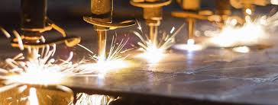
WHAT WE DO – ADDITIONAL SUPPORT
DISTRIBUTION
SUPPORT
DEVELOPMENT
PJA Technologies will also manufacture under sales and distribution agreements our ground breaking products under your brand name allowing for diversification of the product line without the risk and capital expenditure required to set up new manufacturing lines.
Whether you are licensing the products or distributing them, PJA Technologies will provide continuing training and support to your staff through the start-up phase and throughout the life of the relationship. When the agreement is signed, our work is just beginning.
At PJA Technologies, product development is a continuous process. Worldwide R&D Headquarter is located in Switzerland/Europe to insure that PJA’s technologies continue to lead the market. Future product advancements will be made available to our partners.
Notes:
Is this correct?
Message:
Our job is not done when we have a signed licence agreement.
We support our partners in different ways
Means:
Less risk
More time to study and enter market
Guaranteed supply line
….

Slide 4

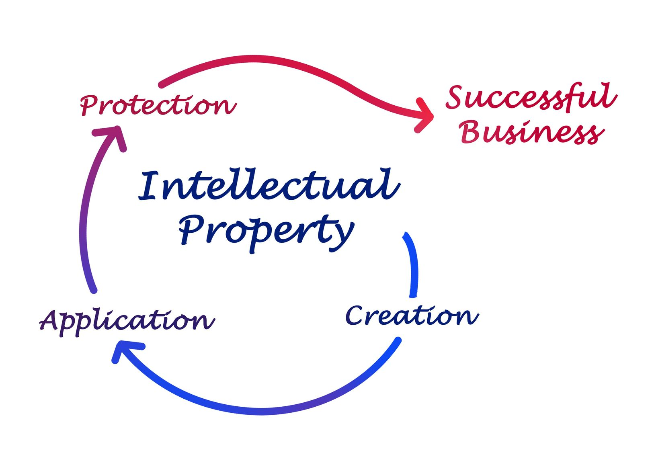
PJA TECHNOLOGIES’ CEMENT BASED PRODUCTS
BASED ON THE LATEST FINDINGS
IN MATERIALS SCIENCE & ENGINEERING
We have developed a portfolio of unique
cement based building products.
Cement Based Building Products:
Interior and Exterior Wall Cladding
Roofing Tiles: Apperance Natural Slate and other shapes
Strength, flow and Cost Optimized Concrete Formulations
Pervious Concrete
Raised Access Flooring Panels
Anti-Ballistic Panels
Airport Runway Repair
Strength Increasing Admixture

Slide 5
PJA TECHNOLOGIES‘, OUR PRODUCTS
Extruded Cement Board
PJA Technologies’ cement board is
manufactured using a patented
extrusion process which
produces a stronger board at a significantly lower
price than can be produced using existing
manufacturing processes.

Slide 6




PJA CEMENT BASED PRODUCTS
All products are protected by issued or pending patents filed in various strategic countries around the world.
PJA Technologies Products Cement Boards and Exterior Wall Cladding have undergone significant third party testing to insure compliance with applicable ASTM and EN standards.
Testing data and additional technical information are available upon request.

Slide 7
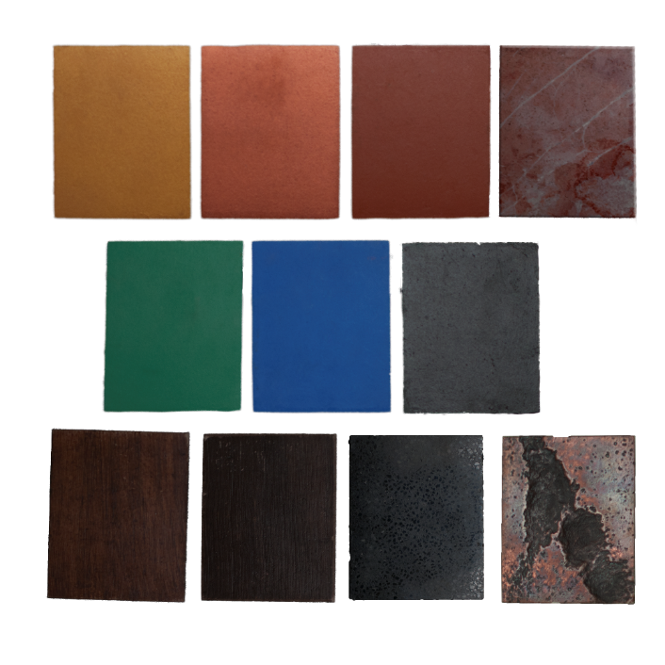
PJA EXTRUDED CEMENT BOARD
PJA Technologies’ patented extrusion process allows for the production of an advanced exterior wall cladding product at a fraction of the cost of existing cladding products. This cladding can be finished with a wide variety of print and design options to fit any project.
PJA Technologies’ extrusion process can also be utilized to produce a cladding board that is much stronger than existing boards in the market.

Slide 8
PJA Exterior Wall Cladding Advantages
Advantages
PJA Exterior Wall Cladding is priced well below the competition. The extrusion manufacturing process allows PJA Exterior Wall Cladding to be produced without the expense of competitors using the Hatschek process for manufacturing. PJA’s manufacturing process allows its product to cure naturally without relying on expensive autoclaving for strength development. PJA’s manufacturing process requires a capital investment of less than 40% of that of the competition for the same output.
PJA Exterior Wall Cladding is stronger and more consistent in quality than the competition. PJA’s extrusion manufacturing process more evenly disperses fibers throughout the end product than seen in wall cladding manufactured using other processes. The result is that PJA Exterior Wall Cladding is stronger and has more uniform strength performance.
Taken together, these two advantages make PJA Exterior Wall Cladding a higher quality product, manufactured with less overhead expense, available for sale at lower prices, and resulting in more profit to the bottom line.

Slide 9
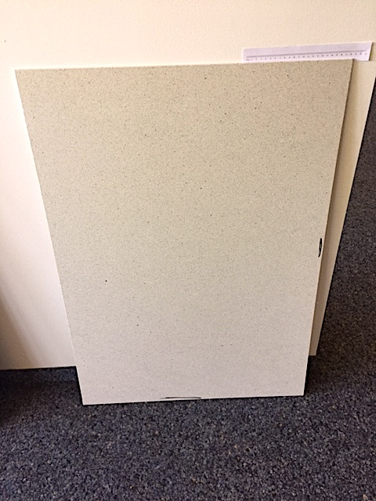
PJA Cement Roof and Wall Cladding Board
PJA has designed a cement board to compete as roof board, wall cladding, or floor substrate against other competing materials which are typically made of either gypsum or cement.
Examples of the primary competitors for this product are Georgia Pacific’s DensDeck board (gypsum), USG Securock Brand (either cement fiber or gypsum fiber construction), Hardie Board, WonderBoard, Etex or Eternit.

Slide 10
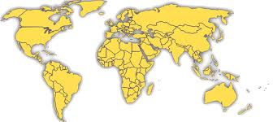
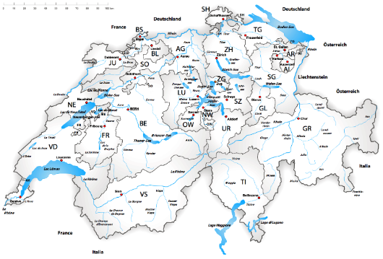
HEADQUARTERS IN SWITZERLAND
R&D CENTER
PJA Technologies Research and
Development lab and corporate
Offices are located in
Switzerland. From this location,
PJA Technologies will be able to
focus on its mission to continue
to develop and improve upon its
innovative portfolio of building
products.
PJA Technologies GmbH

Slide 11

OUR MANAGEMENT TEAM – YOUR PARTNERS

Slide 12
MANAGEMENT TEAM
Per Just Andersen, Ph.D., Managing Director & Chief Technology Officer
Per Just Andersen, Ph.D. is the Managing Director & Chief Technology Officer of the company and is responsible for product research and development.
Dr. Andersen is a renowned scientist specializing in particle optimization and related rheology of inorganic materials systems. Dr. Andersen’s improvements in concrete technology have had a significant impact on the design and approach to concrete production both in Europe and the United States.
Dr. Andersen earned Master of Science degrees from The Technical University of Denmark (1985) and the Pennsylvania State University (1987). Dr. Andersen also earned a Ph.D. from The Technical University of Denmark (1990).
Over the course of his forty-three year career, Dr. Andersen has developed 140 U.S. Patents and over three hundred related foreign patents. Dr. Andersen’s research has been the foundation for the work of four different private startup companies. He has been a key presenter at numerous industry conferences, seminars, and for private business in Europe and the United States. His work has been published in over sixty professional publications and industry reports.
Dr. Andersen has experience as a scientist, inventor, group leader, project manager, department manager, and senior consultant. As a world-renowned technical practitioner, Dr. Andersen participated in research and development related to cement and concrete on large projects such as the French/British tunnel, the Great Belt Link Connection (Denmark), the Strategic Highway Research Program (U.S.A.), and the Freedom Tower project in New York.

Slide 13
RESPONSIBILITIES UNDER COMMERCIAL RELATIONSHIP
PJA Technologies GmbH
Ongoing R&D
Patent Protection
Technical Support
Machine Vendor Interface
Sales Support
Product Pricing
Project Management
Installation and Startup
Licensee/Customer
Pay for equipment
Provide production Plant
Assist with Installation and startup
Manage and run production plant
Pay license fee
Sales & Marketing
Develop Specifications
Develop Product Distribution Plan
Provide Pricing Input

