Slide 1


MUSLIM FREE BURIAL ASSOCIATION, Inc 2015-2022 All rights reserved
SAFETY & AWARENESS
TIPS FOR WOMEN

Slide 2

PRACTICE AWARENESS
Your first, and probably most important line of self-defense is AWARENESS: Be aware of yourself and your surroundings. A Criminal uses the advantage of surprising you. Studies have shown that criminals choose targets who appear unaware of what is going on around them. By being aware of your surroundings, a potential criminal realizes that you are not an easy target

Slide 3

STOP WALKING AND STARING INTO YOUR CELL PHONE!!
This is dangerous in so many different ways:
1. Traffic
2. Unaware of your surroundings
3. Tunnel Vision Focus into Your Phone.
A criminal capitalizes on violating you when you are not paying attention to your surrounding.

Slide 4

USE YOUR INTUITION
A Women’s intuition is powerful! It gives subconscious insight into situations and people. All of us, especially women, have this gift, but very few of us pay attention to it. Learn to trust this power and use it to your full advantage. Avoid a person or a situation that does not “feel” safe — because you’re probably right!

Slide 5
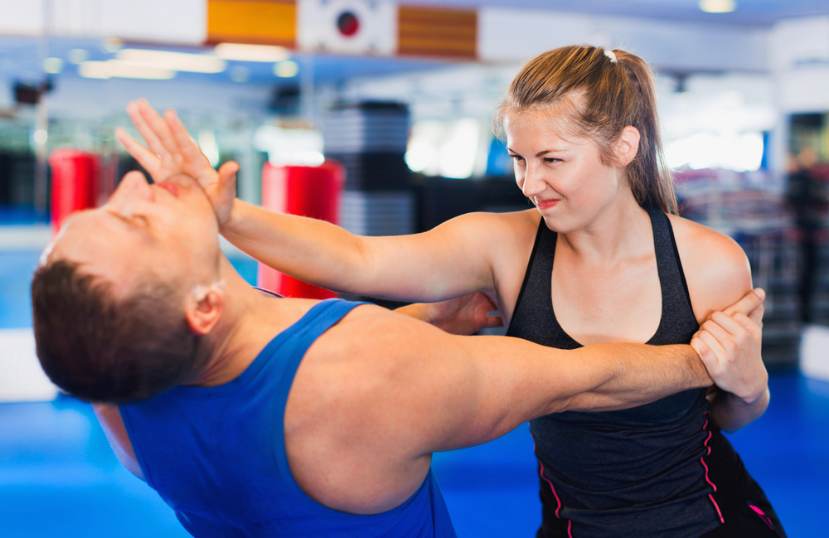
ENROLL IN SELF-DEFENSE TRAINING
Most Martial Arts Schools teach a system of self-defense traditional styles. This is fine, but will take time to learn. What you’re looking for is a “real life” self-defense program, which should include simulated assaults, preferably with a fully padded instructor, in realistic rape and attack scenarios. This will enable you to practice what you’ve learned.

Slide 6

ESCAPE, ESCAPE, ESCAPE
What if the unthinkable happens? You are suddenly confronted by a predator who demands that you go with him — be it in a car, or into an alley, or a building. It would seem prudent to obey, but you must never leave the primary crime scene with the predator. You are far more likely to be killed or seriously injured if you go with the predator than if you run away (even if he promises not to hurt you). Run away, yell for help, throw a rock through a store or car window — do whatever you can to attract attention. And if the criminal is after your purse or other material items, throw them one way while you run the other.

Slide 7
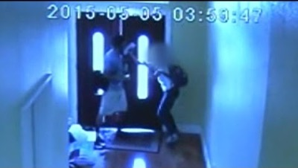
FIGHT BACK!!!
No matter how much we practice awareness and avoidance techniques, we may still find ourselves in a physical confrontation. Whether or not you have self-defense training, and no matter what your age or physical condition, it is important to understand that you CAN and SHOULD defend yourself physically. You have both the moral and legal right to do so, even if the attacker is only threatening you and hasn’t struck first. Many women worry that they will anger the attacker and get hurt worse if they defend themselves, but statistics clearly show that your odds of survival are far greater if you do fight back. Aim for the eyes first and the groin second. Remember, though, to use the element of surprise to your advantage — strike quickly, and mean business. You may only get one chance.

Slide 8
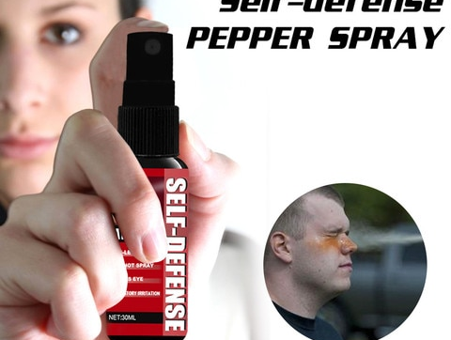
Don’t rely on pepper spray
Pepper spray, like other self-defense aids, can be a useful tool. However, it is important to understand that there can be significant drawbacks to its use. Surprisingly, 15-20% of people will not be incapacitated even by a full-face spray. Also, if you’re carrying it in your purse, you will only waste time and alert the attacker to your intentions while you fumble for it. Never depend on any self-defense tool or weapon to stop an attacker. Trust your body and your wits, which you can always depend on in the event of an attack.

Slide 9
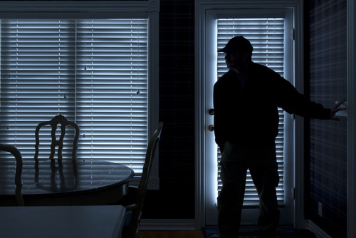
PROTECT YOURSELF FROM HOME INVASIONS
Home Invasions are on the rise. The primary way to prevent a home invasion is to never open your door, unless you either are certain you know who’s on the other side, or you can verify that they have a legitimate reason for being there (dressing up as a repair person or even police officer is one trick criminals use). In the event that an intruder breaks in while you’re home, you should have a safe room in your house to which you can retreat. Your safe room should be equipped with a strong door, deadbolt lock, phone (preferably cell phone). If you live in an apartment, lock yourself in a room, barricade the door, and call 911.

Slide 10
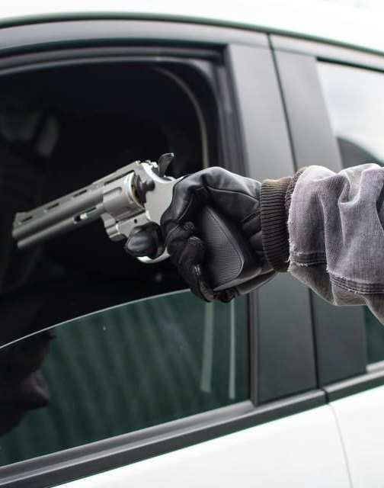
How to avoid car-jackings
Always keep all doors locked and keep windows up when driving. Most car-jackings take place when vehicles are stopped at intersections. The criminals approach at a 45-degree angle (in the blind spot), and either pull you out of the driver’s seat or jump in the passenger’s seat.
When driving, leave enough space between you and the car in front of you, just in case you need to quickly maneuver and get away.
If you get bumped from behind, make sure you pull over in a safe place with a lot of people, preferably at a Police Station.

Slide 11

SAFETY WHILE TRAVELING
Violent crimes against women happen in the best and worst hotels around the world. Predators may play the part of a hotel employee, push their way through an open or unlocked door, or obtain a pass key to the room. As with home safety, never open your door unless you are certain the person on the other side is legitimate, and always carry a door wedge with you when you travel. A wedge is often stronger than the door it secures.
Costs about $17.00 on Amazon.

Slide 12

Make good use of the internet
Although the Internet is educational and entertaining, it can also be dangerous if one isn’t careful. When communicating online, use a nickname and always keep personal information such as home address and phone number confidential. Instruct family members to do the same.

Slide 13
^{www.muslimfreeburial.org}
Muslim free burial ASSOCIATION, Inc 2002-2022 All rights reserved
IN SUMMARY:
PRACTICE AWARENESS
STOP WALKING AND STARING AT YOUR PHONE
USE YOUR INTUITION
ENROLL IN SELF-DEFENSE TRAINING
ESCAPE, RUN, FLEE
FIGHT BACK!!!
DON’T RELY ON PEPPER SPRAY
PROTECT YOURSELF FROM HOME INVASIONS
PURCHASE A DOOR STOP WHEN TRAVELING
MAKE GOOD USE OF THE INTERNET

