Slide 1

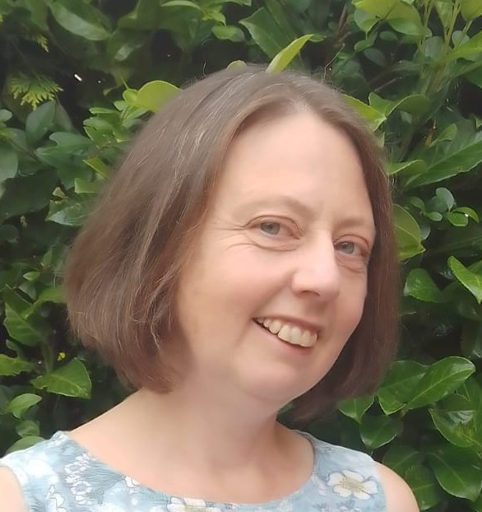
About the project
Rebecca Hughes
I have been teaching for more than twenty years, mostly in primary schools, and have a passion for teaching and learning. I chose Loris Owen’s “The Ten Riddles of Eartha Quicksmith” in the Year 6 into 7 sessions because it’s engaging, funny and paints great characters and I know it will appeal to a wide variety of students and inspire them to be creative.
Impress the Examiner https://impress.education/ supports schools with recovery and catch up programmes, intervention and exam preparation.
In one project in 2021, they were commissioned to work with students in Year 6 who were all transitioning to one secondary school. Weekly one hour lessons in English, Maths and Science over five months prepared them for the start of their secondary journey in September 2021. It was in the English lessons that the students encountered Eartha Quicksmith and Loris Owen.
It has been a delight to work with Loris, to learn more about her book, her inspiration and her writing process.
These presentations can be used individually or in a series, although session 2 follows on from session 1.

