Slide 1
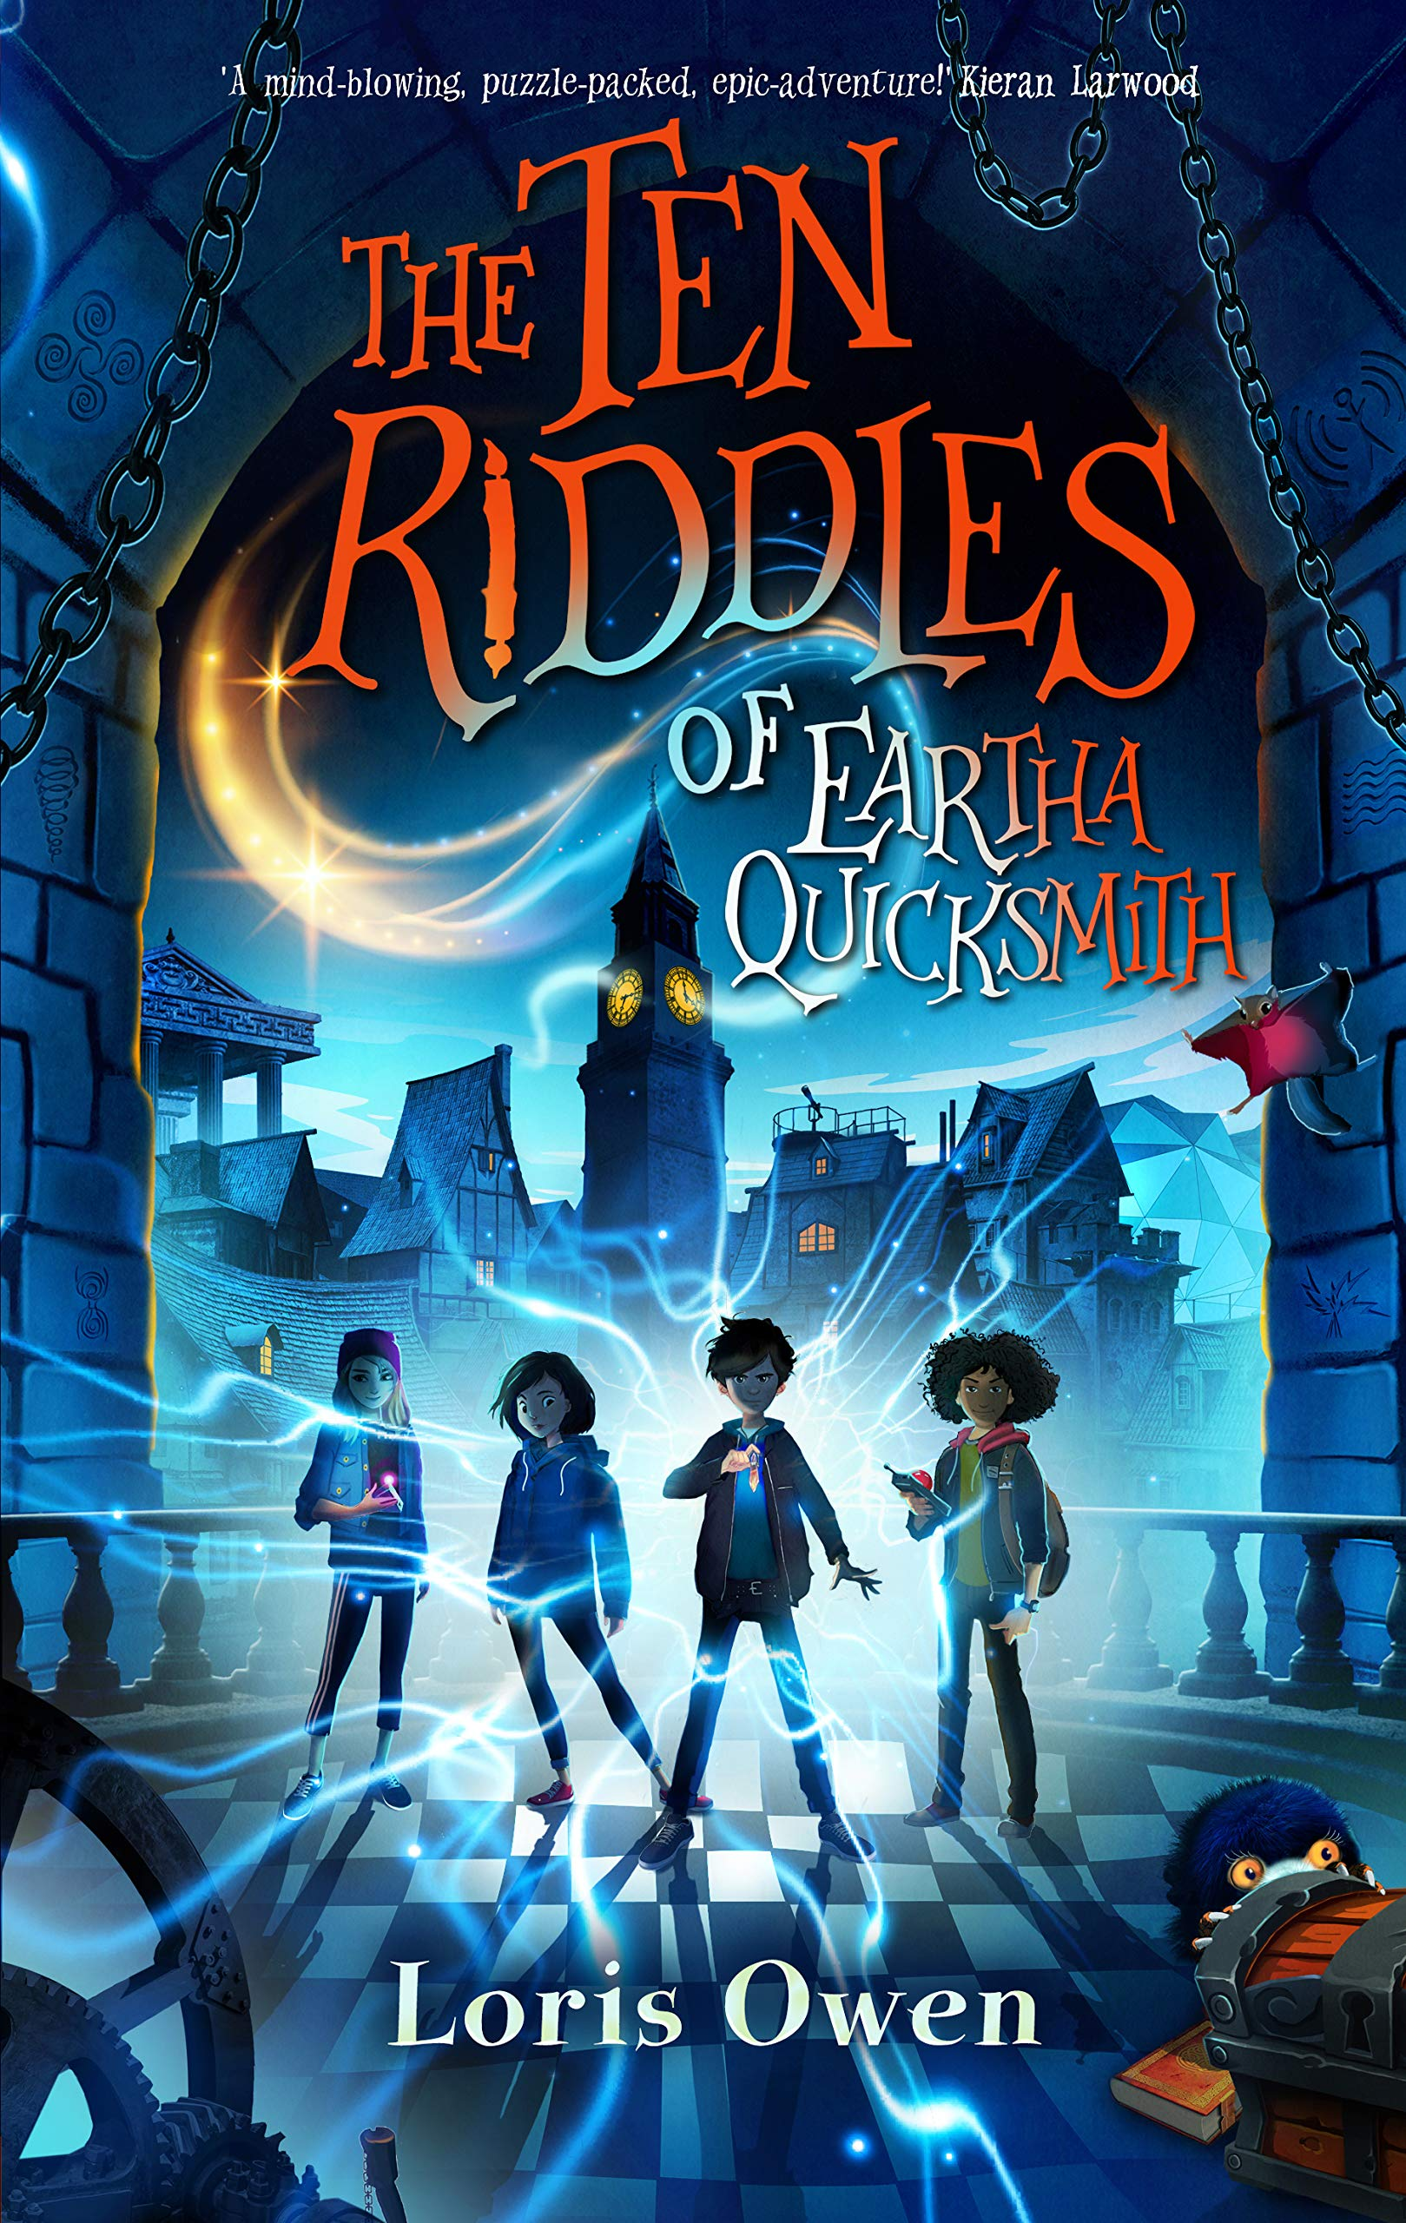
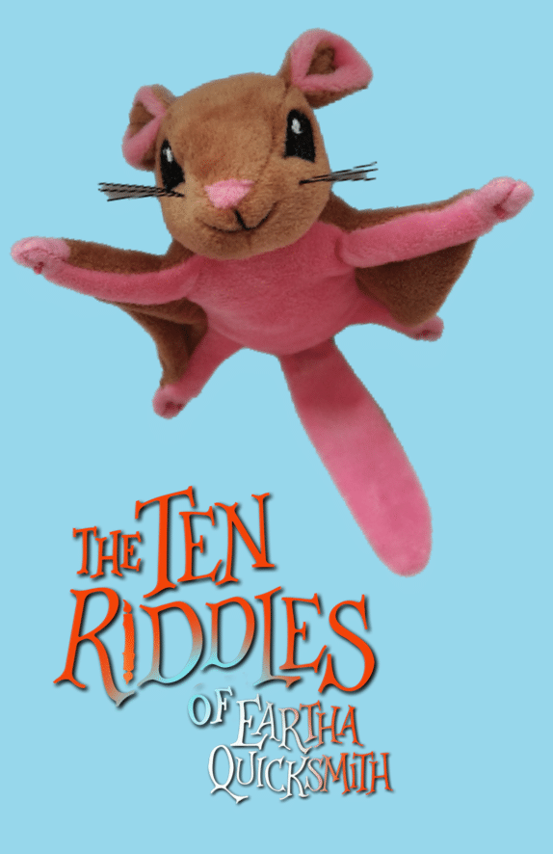
The ten riddles of Eartha quicksmith
Session 1 - Creating Characters
Rebecca Hughes in association with
Impress the Examiner

Slide 2
Learning objectives:
To explain the techniques that Loris Owen has used to introduce some of her characters.
To write an introduction to a character using one of these techniques.
Notes:
Although “to write…” is more about what is being done than being learned, in order to do this, students will need to fully understand and explain at least one of the techniques Loris Owen uses.

Slide 3
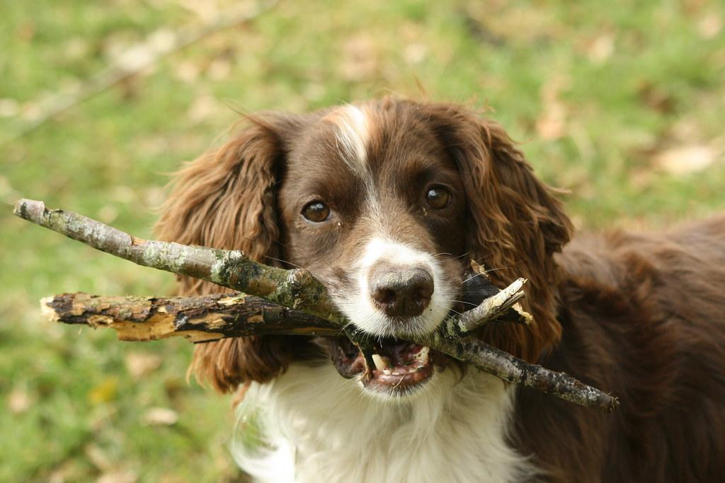
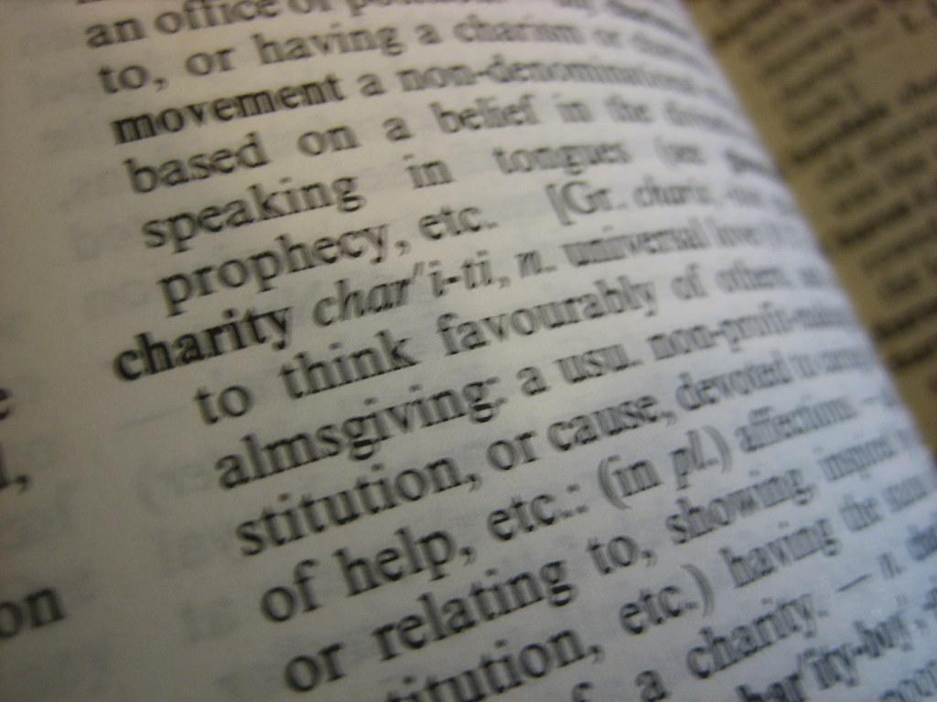
Key reading skills
Retrieval
Find or explain the meaning of words in context
Inference
Understanding and explaining why the author has made certain choices
Notes:
Before we can achieve the learning objectives on the previous slide, we need to understand what we are reading.
These are four fundamental reading skills that are needed throughout learning, and which are tested in SATS papers in Year 6…but also in Year 2, GCSE and beyond. The most straightforward of these is retrieval, then inference, then understanding and explaining the choices an author makes. Understanding vocabulary is a skill that is always needed but the level of difficulty of the words clearly changes as texts get more difficult. A bit more of an explanation:
Retrieval – you “fetch” a piece of information from a text. This is something that is explicitly stated and has to be found (and brought back to the question, hence the picture of a dog playing fetch.) An example might be (from extract 1 below), How long was it until chess club started? The answer is found directly in the text – “Chess club didn’t start for twenty minutes.”
Inference – this is where the reader has to work something out from what the author has implied. So in extract 1 below, we might be able to work out how Kip was feeling at different points from words like “challenged”, “a sense of unease”, his “hideout” and answer questions on that. The reader has to be more of a detective for inference questions than for retrieval. As a child grows, we expect more inference and less retrieval.
Finding and explaining the meaning of words in context: When we read, we rely on an understanding of the words we read to give meaning. But when we come across a word that is unfamiliar or we don’t know, we use clues such as the root word, prefixes and suffixes and the context of the sentence to work out the meaning. When answering questions in an assessment, we are often asked to explain the meaning of words or find synonyms and antonyms.
Understanding and explaining the choices an author has made is probably the most complex of these four skills, and as such is assessed to some extent in Year 6, but the focus shifts more to this area as students progress through secondary. Authors choose specific vocabulary, punctuation, sentence length, as well as literary devices such as metaphor, personification, pun or pathetic fallacy. These are designed to impact the reader in a certain way e.g. short sentences might raise the tension within a passage, and a key skill within reading is to work out what the author’s intention might be when particular choices are made, and the impact that they are intending those choices to have on the reader.
When teaching, being specific about the skills we are using is part of metacognition – learning how we learn – and can help students become more reflective. This slide can provide an introduction to this, however the lesson can be taught without this.

Slide 4
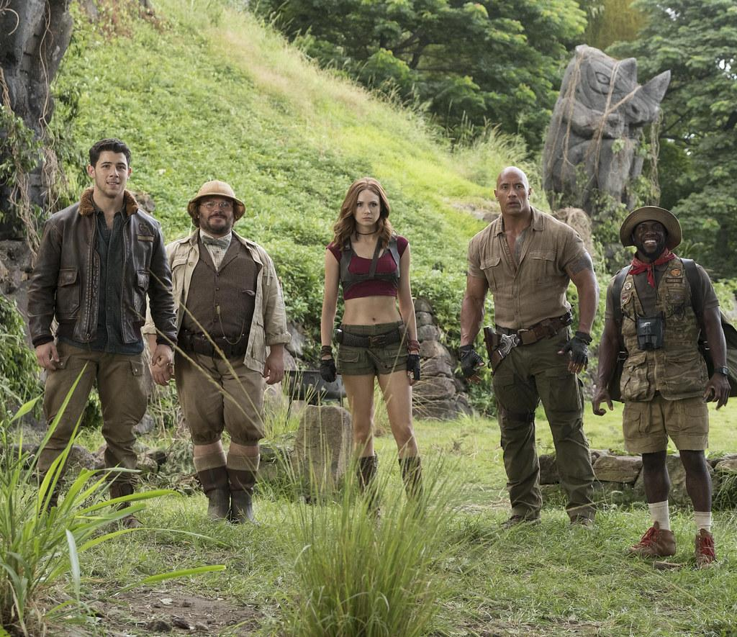
4 ways to build character
How a character speaks
What a character looks like
What the character does
How the character interacts with others
All of these can show someone’s personality… Today we are looking at how the author creates characters and will then try out one of her techniques in our own writing.
Notes:
We start by focusing on the subject for today’s session – creating characters. These are ways that can be used, and after each character analysis we can come back to this and explain which one – or more – of these was used for each character.

Slide 5
Extract 1 - Kip
The Coin
Someone’s watching me.
Kip looked down from his favourite hideout halfway up the Chess Nut Tree. A couple of Saturday joggers and dog walkers went by but they all had their eyes on the ground.
He returned to his homework, which was balanced on the flattest part of the Halfway Branch. But he’d written only a few lines when that unmistakable feeling of being watched came back, stronger this time.
There was definitely no one looking up at him. As usual, Ashleigh had disappeared with her squawking friends right after dropping him off. And Chess Club didn’t start for twenty minutes.
Who is it? he wondered.
Kip shifted his weight to scan the park behind him, then pulled back instinctively. Silently hovering between the bare branches, and swaying ever so slightly, was a flat, oval drone. It was white and metallic and about the size of Kip’s hand. Two fat antennae stuck up from the front, and on top of each antennae was a bright, emerald light that turned the nearby branches a ghostly green.
After a few seconds, Kip said, “Hello?”
The drone did not respond. Kip noticed with a sense of unease that it was expanding and contracting gently.
Looks like it's breathing.
Like a floating, futuristic beetle, the drone moved closer, weaving slowly through the branches. It stopped just as Kip could see his forehead and short-cropped brown hair reflected in its gleaming side, distorted like your face when you look into the back of a spoon.
“What do you want?” he challenged.
The reflection of his own eyes looked back - a mixture of glittery brown and light grey, as if copper and iron had half melted together.

Slide 6
Extract 1 - questions
Where is Kip?
What is he doing?
What is he waiting for?
Look at the word “squawking.” What does that suggest about Ashley’s friends?
Find and copy a phrase that tells us how Kip feels about the arrival of the drone.
What does Loris Owen do to make describing his appearance more interesting and a part of the plot line?
Why does Loris Owen use italics for part of this passage?
What words or phrases can you find that compares the drone to a living thing?
Notes:
Comprehension questions leading to…

Slide 7
Extract 1 - summary
Go back to the four ways we looked at for describing characters.
Now can you complete this sentence?
Loris Owen has described Kip using…
Notes:
Go back to the four ways of describing characters – which is the best fit? Is there more than one possibility? We know what he is doing and also what he looks like.
You may want to return to the passage again to find specific examples.

Slide 8
Extract 2 - professor mo
At first it looked as if the man had a beard, but as Kip approached he realised that his jaw and cheeks were tattooed with inky indigo brambles. Resting on the bridge of his sturdy nose were some glittery triangular spectacles, completely out of place above the fearsome facepaint. A second pair of red glasses was pushed up on the main’s forehead, and pinned to his shirt was a candle badge, just like the one in Kip’s pocket.
The tattooed man held out his arms in welcome.
“Well done!” he proclaimed, stepping forward and shaking a very confused Kip warmly by the hand. “Well done, Kip. You’ve made it in! I knew you would!”
(a little later…)
On a scale of zero to interesting, Professor Mo probably broke the scale. The spectacles he was wearing looked like they were made out of lots of miniature magnifying glasses stuck together, and seemed to rest not on his cheeks at all, but on the very tops of the tattooed indigo brambles that sprawled up from under his jaw. Today, he was wearing a bright, jigsaw-patterned shirt. And in addition to the glasses on his face, there were four pairs on cords around his neck.

Slide 9
Extract 2 - questions
What is special about Professor Mo’s glasses?
What does Loris Owen mean by “fearsome facepaint”?
The description of Professor Mo suggests he isn’t a typical teacher. How is he different from what you might expect in a normal school?

Slide 10
Extract 2 - summary
Go back to the four ways we looked at for describing characters.
Now can you complete this sentence?
Loris Owen has described Professor Mo using…
Notes:
Go back to the four ways of describing characters – which is the best fit? Is there more than one possibility? The best fit is describing what he looks like – then we can discuss the effect this has on the reader and whether his appearance would be unusual in a “normal” school!
You may want to return to the passage again to find specific examples.

Slide 11
Extract 3 - leela lee
The girl who approached had a light-hearted look in her eyes and a slightly lopsided grin over a sharp pixie chin. Her black hair was cut in a bob at shoulder length and there was a pattern of gold, turquoise and green peacock eyespots all over it. It looked as if the eyespots weren’t on the surface either - they went all the way through.
“Leela Lee,” she said. “Just found out about Strange Energy! Believe me, that’s nothing - Quicksmiths is THE best thing that will ever happen to you - better than winning a lifetime’s supply of ice-cream cake - the type of ice-cream cake you like of course - something else if you don’t like ice-cream cake - but who doesn’t like ice-cream cake - AND a butler made of ice-cream cake who follow you around all day, handing you ice-cream cake - no, even better, puppies - handing you puppies…”
She paused for breath, not quite long enough for Kip to get a word in.
“...ice-cream-cake puppies,” she said, decisively.
Kip stared at her, not sure if she’d stopped yet. He had never heard anyone talk so fast in his life, nor met anyone who used their hands so much when they spoke.
“Do you like my hair by the way?” said Leela. “You don’t have to stare, you can just ask, you know.”
Kip wasn’t sure what to say.
“She’s finished,” said Professor Mo.
“Um, what did you do to it?” asked Kip.
Leela’s smile gave Kip a feeling that her reply wasn’t going to be sensible. She cupped a hand on either side of her mouth and whispered loudly.
“Eye added a spot of Strange Energy.”

Slide 12
Extract 3 - questions
How does Leela speak?
How do you know she speaks in this way? Think about what Professor Mo says, how Kip responds and the punctuation you see in the passage.
What does that tell you about her character?

Slide 13
Extract 3 – summary
Go back to the four ways we looked at for describing characters.
Now can you complete this sentence?
Loris Owen has described Leela using...
Notes:
Go back to the four ways of describing characters – which is the best fit? Is there more than one possibility? For Leela, Loris focuses on what she says and how she speaks to give us an idea of her character. It is worth focusing on the effect this has on the other characters in the book.
You may want to return to the passage again to find specific examples.

Slide 14
all three characters – comparing how they are presented:
Can you summarise the three different ways that Loris Owen has introduced these characters?
Can you give a summary of each character from the extracts you have read?
Which character do you want to find out more about from this introduction? Can you explain why?
Notes:
Discussion.

Slide 15
character bonus
Have a look at the way Loris Owen introduces Albert (the extract is at the bottom of this presentation.)
Then consider:
How is this different from the ways she introduces the other three characters?
Why do you think she takes longer to introduce him to the reader?
What do we know about Albert, and about Kip and Albert’s relationship by the end of this extract?
Notes:
This could be an extension activity or homework.

Slide 16
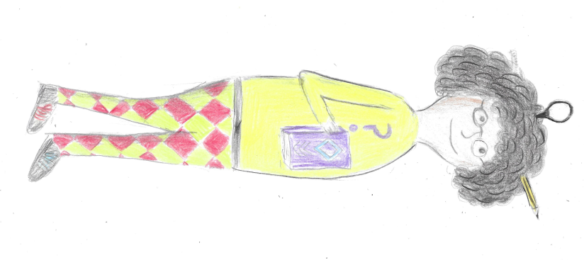
planning to write…
Imagine this is a new character at Quicksmith’s School. Do you think she is a teacher or a pupil?
Use Loris Owen’s ways to describe this character. Think about…
1. What might she say? And how might she say it?
2. How could you describe her appearance?
3. What do you think she might do? And therefore what might her character might be like? What clues does the picture give you?
4. How might she interact with others?
Illustration by Kester Hughes
Notes:
Your turn…
After discussion, you should have analysed the ways of introducing characters enough to have a go at introducing this character – one person could introduce her in two, three or four different ways or students could choose one way each. See next slide for instructions following this discussion.

Slide 17
Writing - your turn
Use one of the examples above as inspiration to write an introduction to this character.
So choose one of these three...
a) Like Kip… tell us where he is, what he is doing, and use this to describe her. Maybe she’s on a boat looking into a still lake? Maybe she’s looking in the mirror?
b) Like Leela…use what she says and how she says it to tell us more about her. Maybe she’s interested in something you know a lot about and can’t stop talking about it?
c) Like Professor Mo… highlight what is different about her from a teacher you might meet at a “normal” school. What do you notice? How can you describe it?

Slide 18
Optional extra section

Slide 19
Extract 4 – albert
The introduction to Albert is longer than the other extracts. As you read it, think about why a longer section is needed.

Slide 20
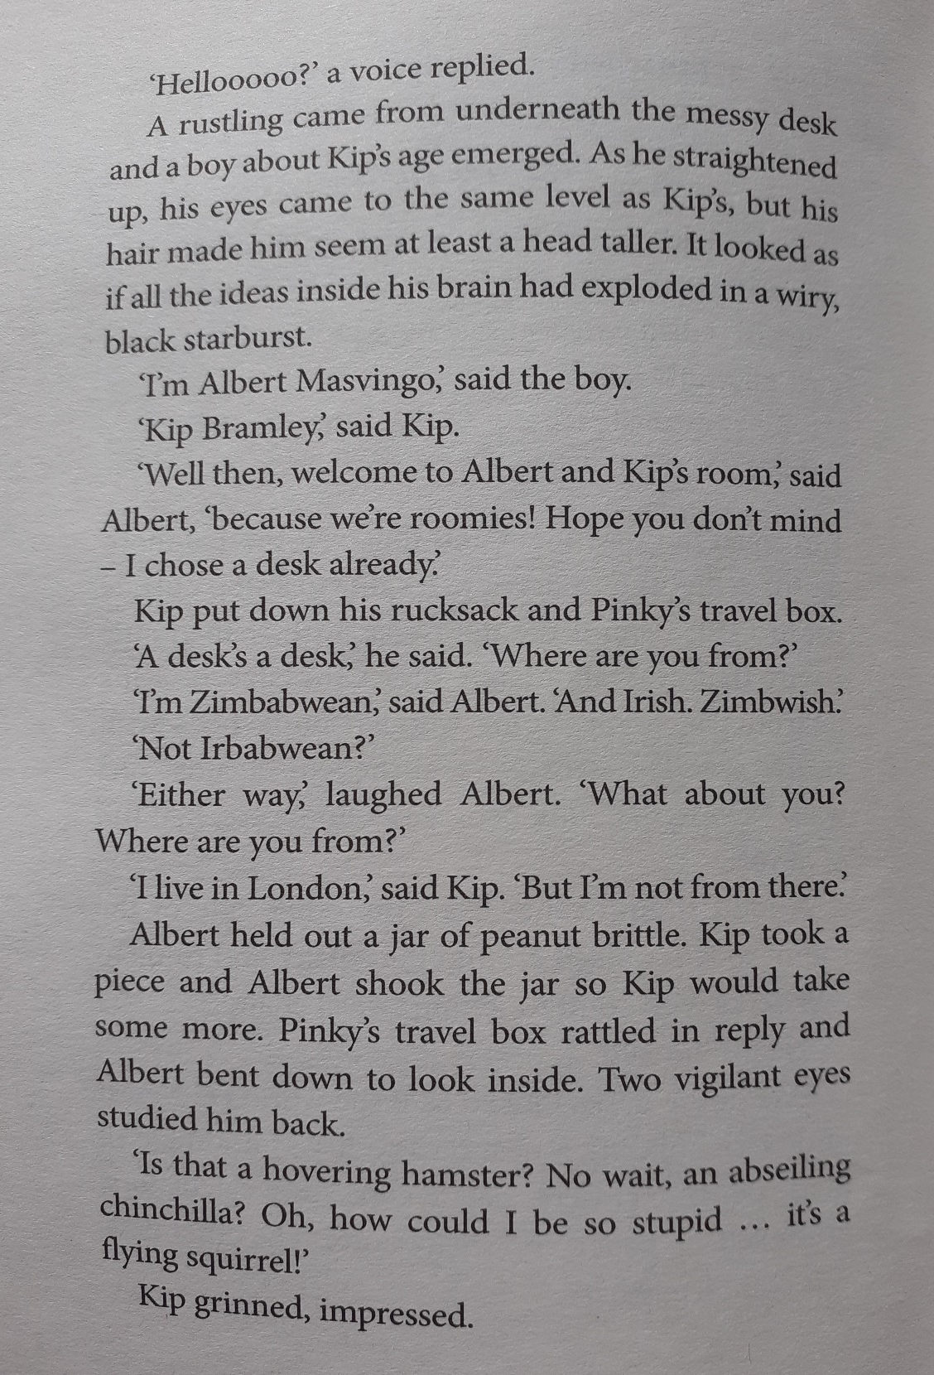
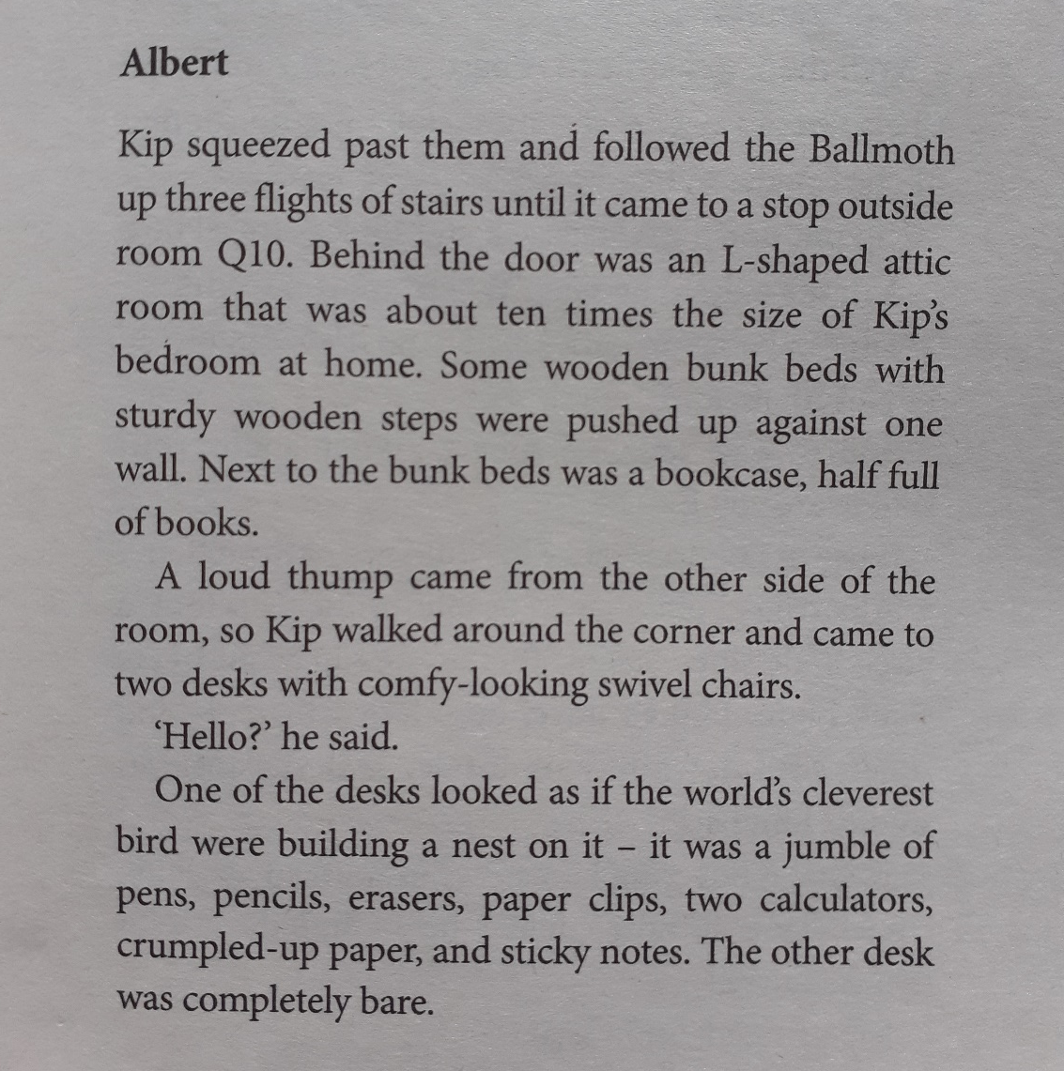
Extract 4 - Albert
The Ten Riddles of Eartha Quicksmith
Loris Owen
Pages 79 - 85

Slide 21
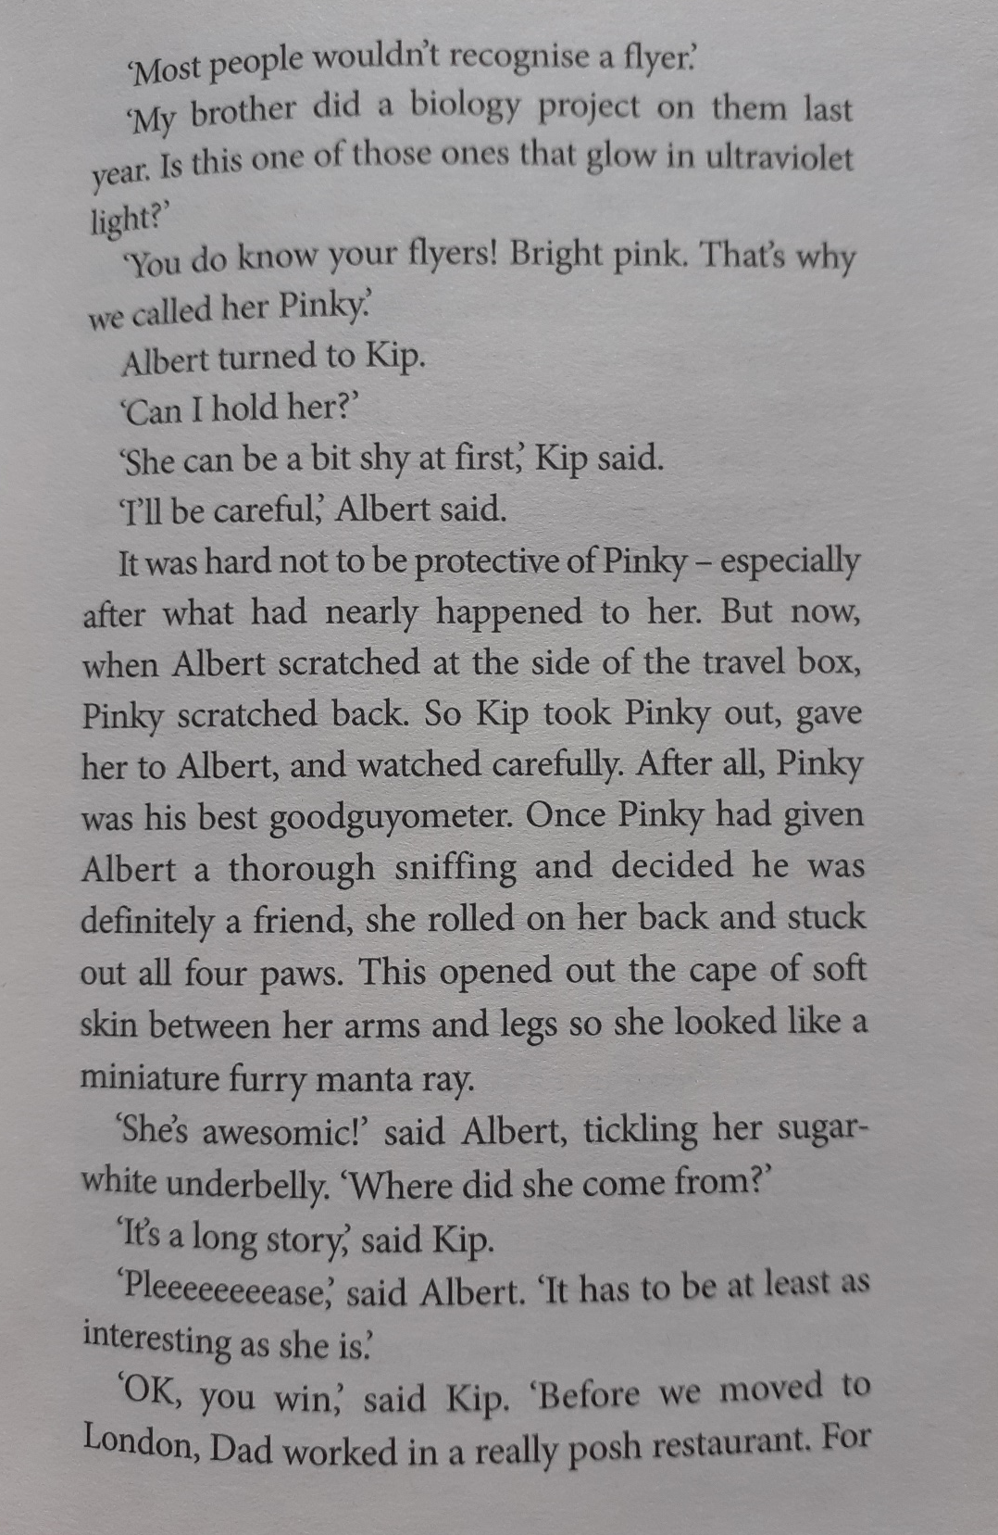
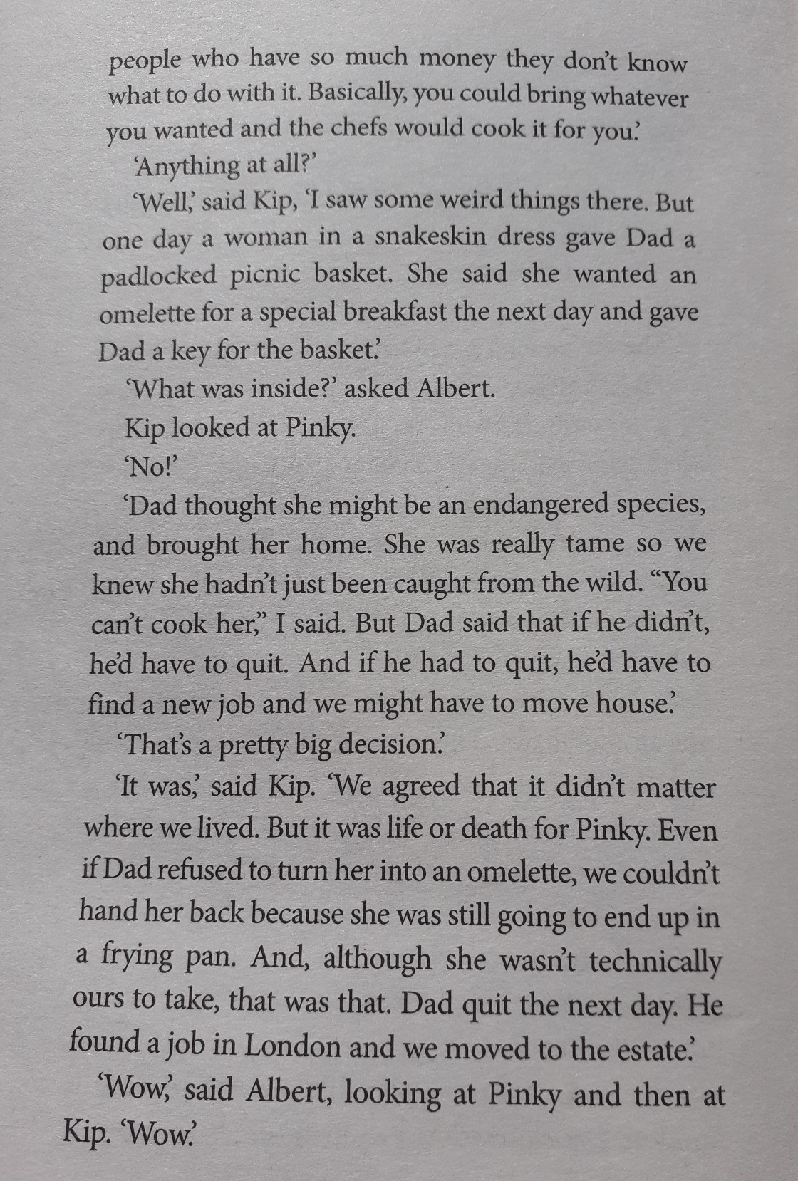

Slide 22
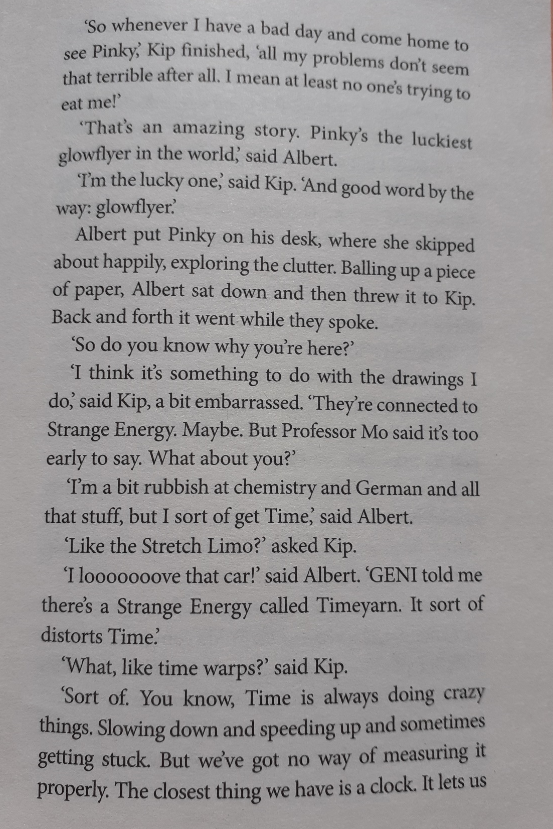
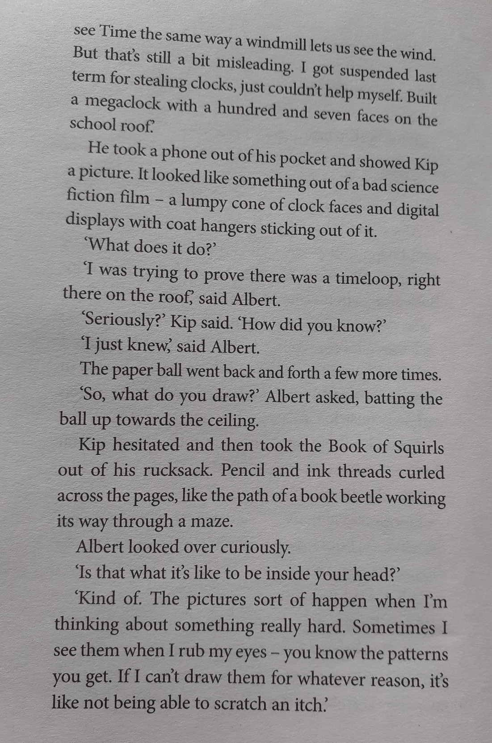

Slide 23
