Slide 1
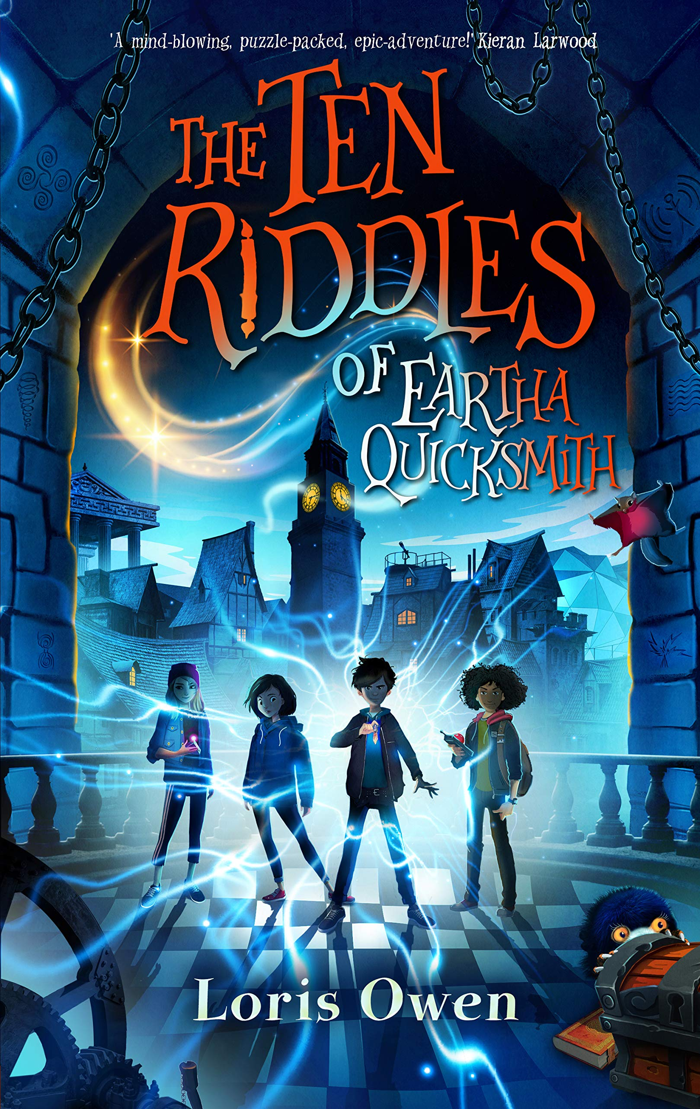
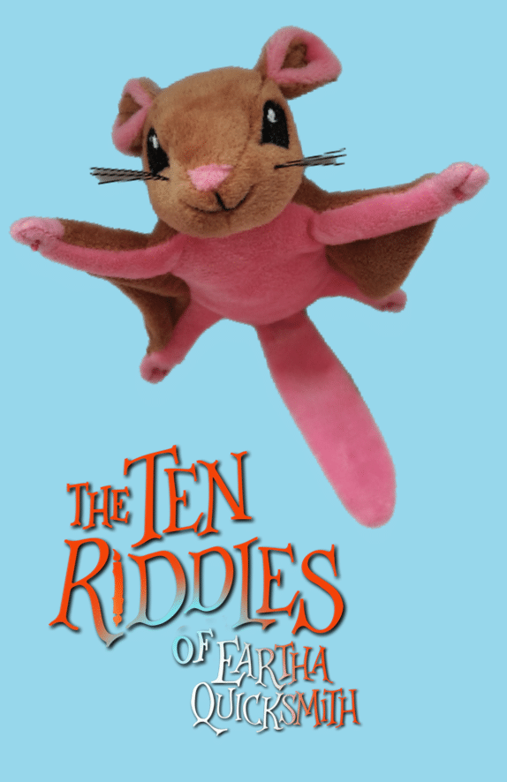
The ten riddles of Eartha quicksmith
Session 2 – Using similes wisely
Rebecca Hughes in association with
Impress the Examiner
Notes:
This is a follow up session to lesson 1.

Slide 2
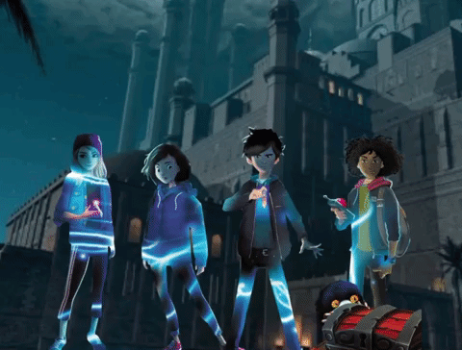
Learning objectives:
To understand what a simile is.
To evaluate similes for their effectiveness.
To use similes wisely when writing.
Notes:
Discuss what the third of these bullets means – when writing, can you have too many similes? Can you have similes that work and ones that don’t work? Will this be the same for everyone?
This will work best when following on from session 1.

Slide 3
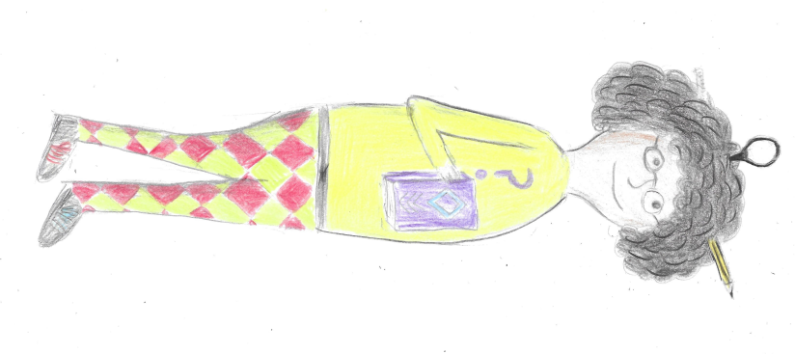
RIGHT ANSWERS OR WRONG ANSWERS?
She’s wearing a yellow top.
She’s a time traveller.
She’s wearing blue trousers.
She’s a lion tamer at a zoo.
Her name is Ethel.
She’s an olympic wrestler.
She keeps stationery in her hair.
She calls everyone “dear”
She spends a lot of time thinking.
She’s very messy and disorganised.
Her laces are odd colours.
She’s got great eyesight.
She is horrible towards everyone.
She’s scatty and disorganised.
Illustration by Kester Hughes
Notes:
A good discussion to start with, which focuses on inference from a picture. Students can discuss each of these sentences and decide if they are TRUE, FALSE or DON’T KNOW. Most will come under “don’t know” so discussion can then focus on these and look at which are more or less likely and why. For example, there is a possibility that she is a lion tamer at a zoo, but if you were an author creating a character that was a lion tamer at a zoo, it is unlikely that you would create a character with a magnifying glass and pencil in her hair who is carrying a book. There are very few wrong answers here: for example, creative students may argue that she might have great eyesight but is wearing glasses as part of a disguise…but the discussion will help to identify students who find it harder to explain inferences that they are making.
Use this discussion to highlight retrieval, inference and author choices.

Slide 4
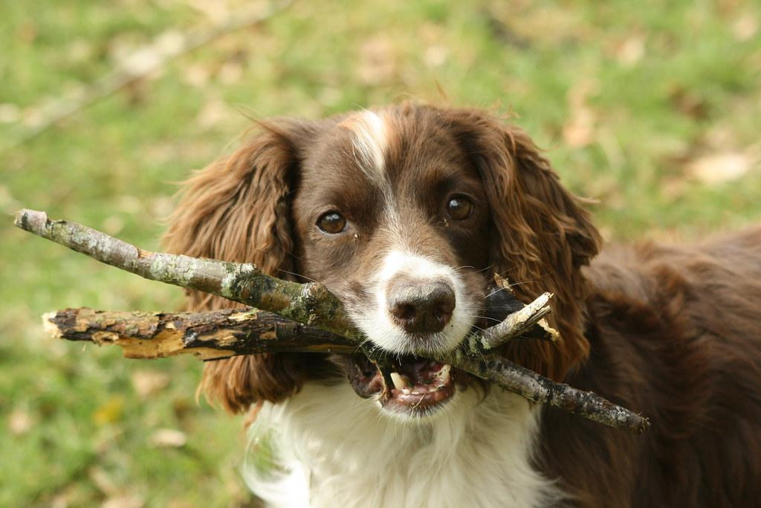
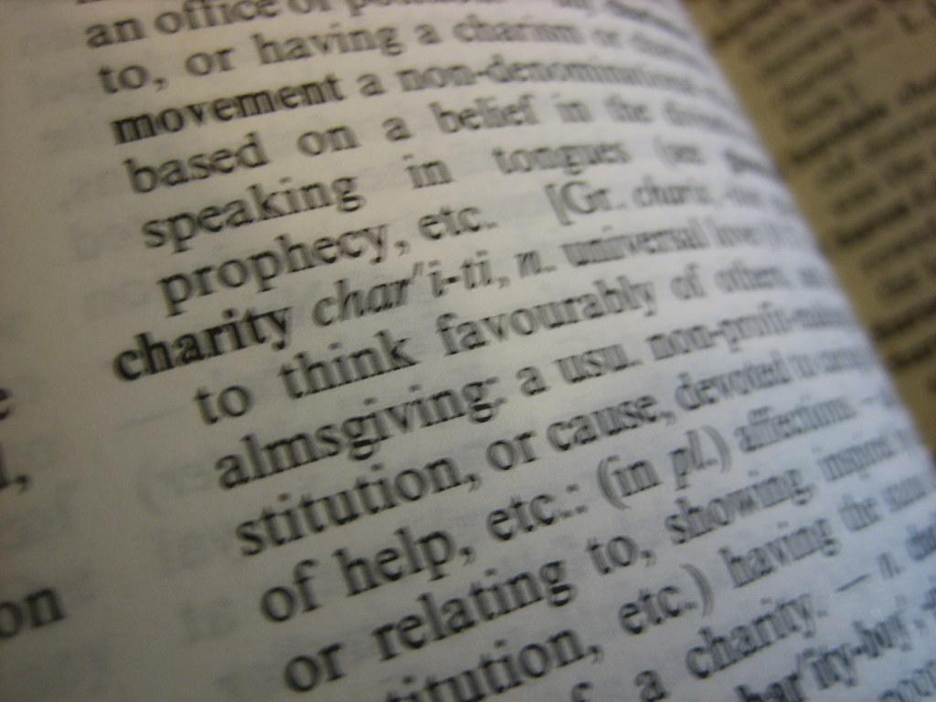
key reading skills
Retrieval
Find or explain the meaning of words in context
Inference
Understanding and explaining why the author has made certain choices
Notes:
In session 1, we used this slide to look at different skills we use when we read, both in assessments but also in every day reading for pleasure. It is worth revisiting briefly to remind students of the skills they use when they read. Today’s session takes them one step further and asks them to write, where those who are ready for the higher level skills can thoughtfully explain their own choices as a writer.
A reminder:
Retrieval – you “fetch” a piece of information from a text. This is something that is explicitly stated and has to be found (and brought back to the question, hence the picture of a dog playing fetch.) An example might be (from extract 1 below), How long was it until chess club started? The answer is found directly in the text – “Chess club didn’t start for twenty minutes.”
Inference – this is where the reader has to work something out from what the author has implied. So in extract 1 below, we might be able to work out how Kip was feeling at different points from words like “challenged”, “a sense of unease”, his “hideout” and answer questions on that. The reader has to be more of a detective for inference questions than for retrieval. As a child grows, we expect more inference and less retrieval.
Finding and explaining the meaning of words in context: When we read, we rely on an understanding of the words we read to give meaning. But when we come across a word that is unfamiliar or we don’t know, we use clues such as the root word, prefixes and suffixes and the context of the sentence to work out the meaning. When answering questions in an assessment, we are often asked to explain the meaning of words or find synonyms and antonyms.
Understanding and explaining the choices an author has made is probably the most complex of these four skills, and as such is assessed to some extent in Year 6, but the focus shifts more to this area as students progress through secondary. Authors choose specific vocabulary, punctuation, sentence length, as well as literary devices such as metaphor, personification, pun or pathetic fallacy. These are designed to impact the reader in a certain way e.g. short sentences might raise the tension within a passage, and a key skill within reading is to work out what the author’s intention might be when particular choices are made, and the impact that they are intending those choices to have on the reader.
When teaching, being specific about the skills we are using is part of metacognition – learning how we learn – and can help students become more reflective. This slide can provide an introduction to this, however the lesson can be taught without this.

Slide 5
key WRITING skills
Retrieval
Inference
Understanding and explaining why the author has made certain choices
Notes:
Last session we focused on these skills of reading. Today, we will be using these skills in our writing. We will think like authors. Some information we will tell our readers (readers will know this through retrieval), some things we will imply (which means our readers need to infer our meaning.) We will make careful choices as authors – we will choose our vocabulary, sentence structure, punctuation, sentence length, as well as literary devices such as simile, alliteration, repetition or rhyme…

Slide 6
Similes...

Slide 7
“like a floating, futuristic beetle, the drone moved closer
“The Snibbug’s voice was as deep as an ogre’s because of all the cigarettes she chain-smoked.”
“The orange glow of dawn began to spread across the sky like Kip’s favourite breakfast marmalade.”
“Skycrackle raged in the sky above them, lighting up Thag’s skin with a violent glow.”
“After an impatient hunt, he held up a chipped magnifying glass like the prized trophy of a lost civilisation.”
“Swimming around the plants were the peacocks of the sea.”
“And then his excitement returned like a boomerang.”
“Kip turned around to find a white line was materialising at their feet, forming a large circle that went all the way around the chamber a metre in from the curved wall.”
Notes:
These are all taken from “The Ten Riddles of Eartha Quicksmith.”
Which of these are similes?
And what is the purpose of a simile?
See next slide.

Slide 8
Similes...
…like…
as… as…
But why does an author choose to use a simile?
Notes:
A reminder…a simile compares something with something else, and uses one of two forms:
As…as…
Like…
For example
The Snibbug’s voice was as deep as an ogre’s because of all the cigarettes she chain-smoked.
like a floating, futuristic beetle, the drone moved closer
The purpose of a simile is for a reader to compare two things – to associate two things together – and to have a clearer picture in their mind of the thing that is being described. For example, comparing The Snibbug’s voice to an ogre’s not only tells us it was gruff and deep, but gives us a picture of something large and scary. When we know the drone is acting like a floating, futuristic beetle, it takes on more of an animated appearance: we can imagine it buzzing or getting too close and this experience not being pleasant.
(note that the sixth one is a metaphor – the discussion can include a look at metaphors if appropriate. These still compare two things but the comparison is more direct as we are told one IS the other – but metaphorically not literally.)

Slide 9
“like a floating, futuristic beetle, the drone moved closer.”
“The Snibbug’s voice was as deep as an ogre’s because of all the cigarettes she chain-smoked.”
“The orange glow of dawn began to spread across the sky like Kip’s favourite breakfast marmalade.”
“After an impatient hunt, he held up a chipped magnifying glass like the prized trophy of a lost civilisation.”
“And then his excitement returned like a boomerang.”
Notes:
Now we turn to focus on the similes themselves.
Discuss the associations made and whether these work or not. Students may well have different opinions about how effective each is or how much each appeals to them, and to prefer different ones. Encourage them to explain what effect the author was trying to create and what picture each builds up in their minds.

Slide 10
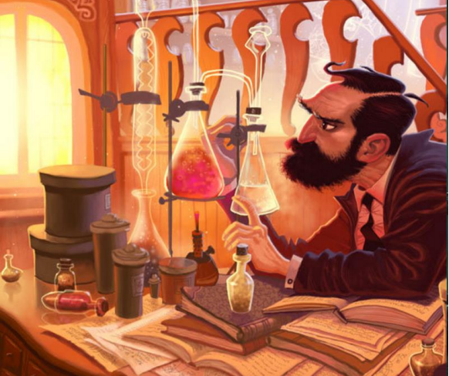
YOUR TURN!
Notes:
5 minutes…
Write down as many words as you can from this picture.
Collect these words as a class/group.
Then focus on which words might be turned into similes, without completing them e.g.
Bright – the light was as bright as…
Concentration – the professor concentrated on the flasks like…
Books – the books were piled on the table like…
Messy – the desk was as messy as…
Ne

Slide 11
The solution bubbled like bubble gum.
The solution bubbled like freshly-opened cherry-ade.
The solution bubbled as quickly as a cheetah.
The solution bubbled as quickly as water boiling over in a saucepan.
Notes:
Are all similes good?
Discuss which of these similes are better. There will be a variety of opinions, but…
Bubble gum doesn’t bubble despite its name, so this isn’t a good simile.
Although a cheetah is quick, it doesn’t form a real connection in the reader’s mind with a solution bubbling – the speed is a different kind – so that doesn’t work.
The second one implies it’s a positive substance and also tells us the colour – in a way that using coke or lemonade wouldn’t do.

Slide 12
The light streamed in through the window as bright as sunlight.
The light streamed in through the window as bright as a torch.
The bright light streamed in through the window.
Notes:
Do we always need to use a simile?
In these examples, the first doesn’t work because it IS the sunlight; the second doesn’t work because a torch isn’t as bright as the sun. The final one is better as it ensures the reader notices the light and you could go on to say “illuminating the flasks and test tubes…” to give a clearer picture.

Slide 13
Your turn to write!
Describe this picture using your notes. Magpie other people’s great ideas, and use at least two similes.
Some things to consider:
Senses (don’t forget about smells, sounds or how things feel)
Describe different aspects of the picture (the man, the books, the background, the scientific equipment or potions, the light… there are plenty of other things too!)
Judge when to use similes and how many to use. Do they add to the picture the reader gets in their head?
Notes:
Use the work done today to write a description of this picture…
Success criteria:
Can you describe the scene so the picture isn’t needed?
Can you use similes that are appropriate and that add to the description?
Can you use a variety of devices, so that similes are not used too much?

