Slide 1
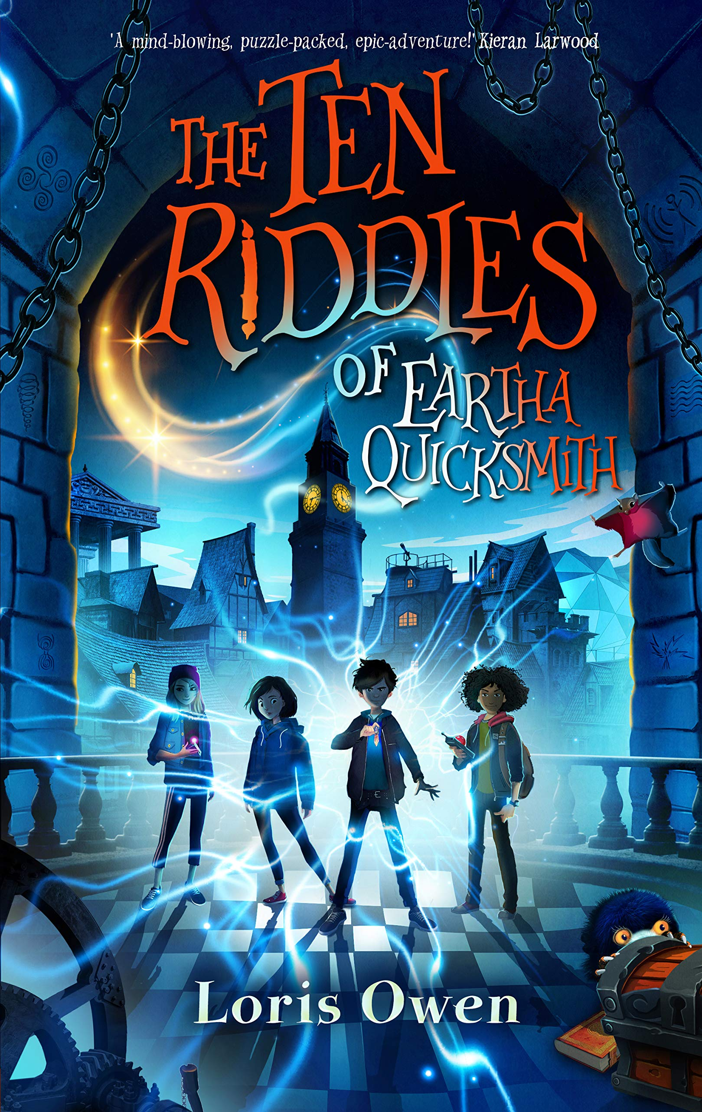
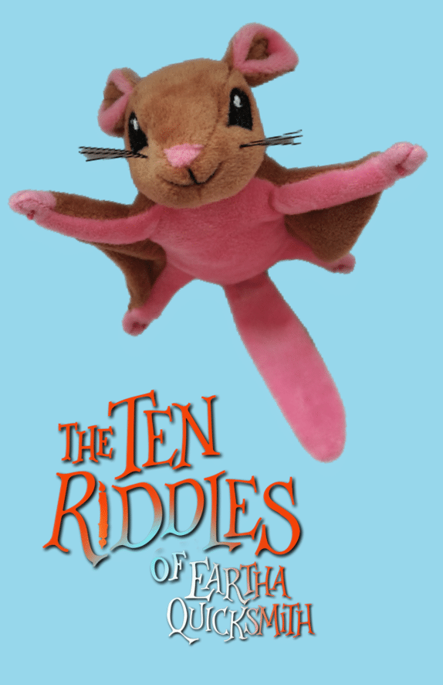
The ten riddles of Eartha quicksmith
Session 3 – focus on vocabulary
Rebecca Hughes in association with
Impress the Examiner
Notes:
This session can be completed independently of the other sessions in this series. It focuses on some of the vocabulary used in the book, looks at ways of learning new words or finding the meaning of new words and then asks students to create their own words that can then fire their imagination: these new words create new concepts which in turn can lead to new ideas and new stories.

Slide 2
Learning objectives
To recognise different strategies we can use to find the meaning of words when reading.
To create our own compound words that can be used in our own writing.

Slide 3
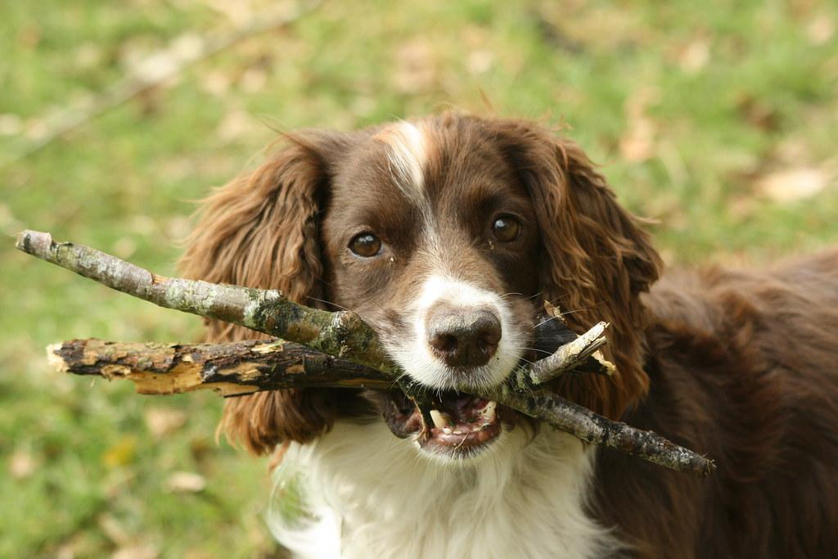
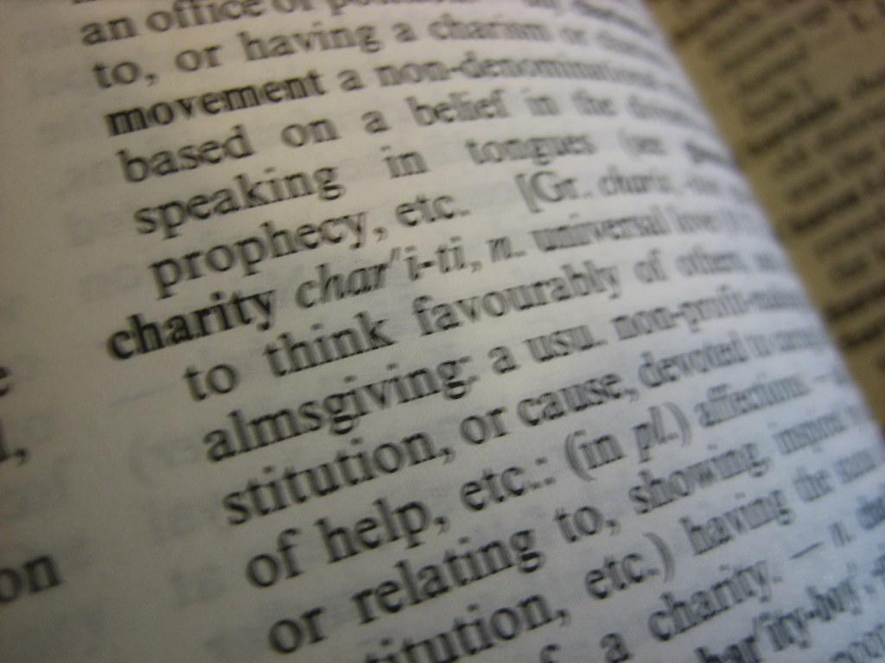
key reading skills
Retrieval
Find or explain the meaning of words in context
Inference
Understanding and explaining why the author has made certain choices
Notes:
In session 1, we used this slide to look at different skills we use when we read, both in assessments but also in every day reading for pleasure.
If students are confident in these now, this can be a very brief reminder.
A reminder if needed:
Retrieval – you “fetch” a piece of information from a text. This is something that is explicitly stated and has to be found (and brought back to the question, hence the picture of a dog playing fetch.) An example might be (from extract 1 below), How long was it until chess club started? The answer is found directly in the text – “Chess club didn’t start for twenty minutes.”
Inference – this is where the reader has to work something out from what the author has implied. So in extract 1 below, we might be able to work out how Kip was feeling at different points from words like “challenged”, “a sense of unease”, his “hideout” and answer questions on that. The reader has to be more of a detective for inference questions than for retrieval. As a child grows, we expect more inference and less retrieval.
Finding and explaining the meaning of words in context: When we read, we rely on an understanding of the words we read to give meaning. But when we come across a word that is unfamiliar or we don’t know, we use clues such as the root word, prefixes and suffixes and the context of the sentence to work out the meaning. When answering questions in an assessment, we are often asked to explain the meaning of words or find synonyms and antonyms.
Understanding and explaining the choices an author has made is probably the most complex of these four skills, and as such is assessed to some extent in Year 6, but the focus shifts more to this area as students progress through secondary. Authors choose specific vocabulary, punctuation, sentence length, as well as literary devices such as metaphor, personification, pun or pathetic fallacy. These are designed to impact the reader in a certain way e.g. short sentences might raise the tension within a passage, and a key skill within reading is to work out what the author’s intention might be when particular choices are made, and the impact that they are intending those choices to have on the reader.
When teaching, being specific about the skills we are using is part of metacognition – learning how we learn – and can help students become more reflective. This slide can provide an introduction to this, however the lesson can be taught without this.

Slide 4
Today, we will focus on
Find or explain the meaning of words in context

Slide 5
Playing with words
Loris Owen clearly enjoys words.
There are lots of examples in “The Ten Riddles of Eartha Quicksmith” where she has made up her own words or carefully chosen the vocabulary she uses.
Do you know what this is?
Notes:
Talk about a moth – ball or a ball – moth and how the creature changes from one to the other, with a change in purpose as it changes.

Slide 6
reading
Kip and his new friends Albert, Leela and Timmi are about to listen to Miss Twiss, the Professor-in-charge at Quicksmith’s School. She is about to read out a letter from the founder, Eartha Quicksmith, who disappeared in strange circumstances and who left a letter behind that could only be opened on this particular day. All those in Quicksmith’s gather to hear Miss Twiss, who is floating on a flat disc, a little like a flying skateboard, called a Skimmi.
Read pages 102 to 107 of The Ten Riddles of Eartha Quicksmith

Slide 7
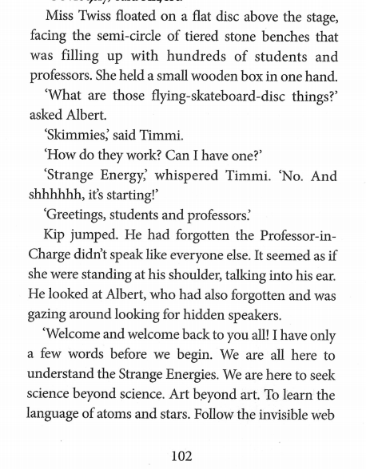
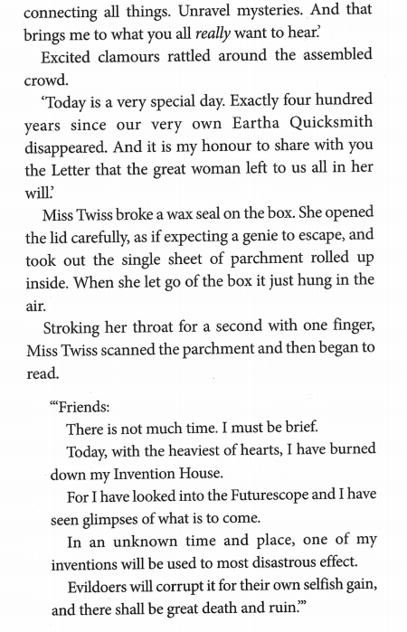

Slide 8
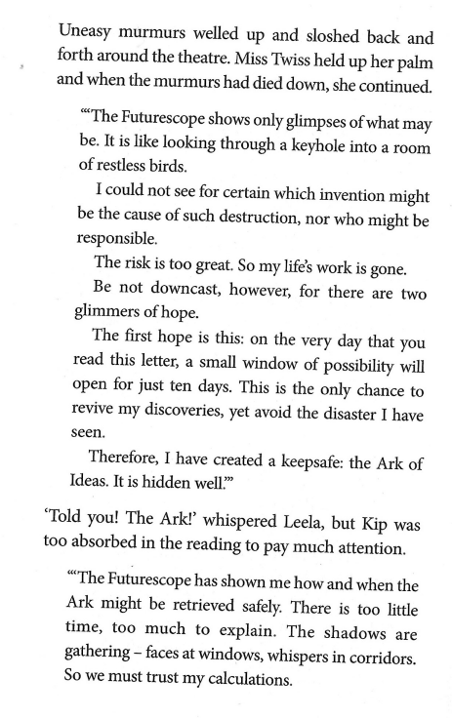
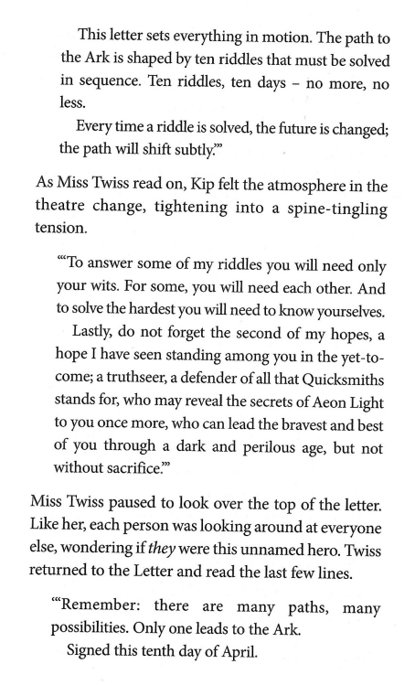

Slide 9
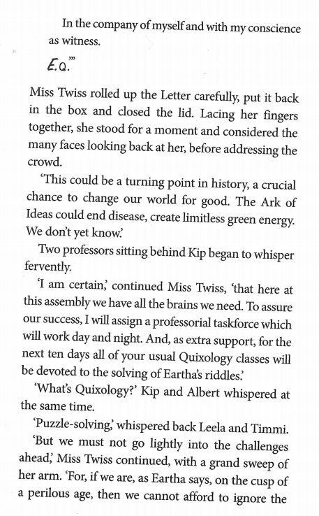
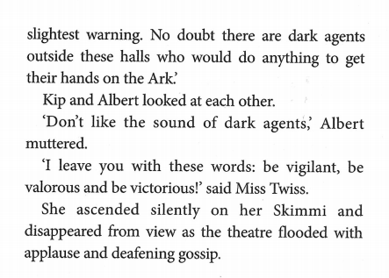

Slide 10
Understanding the text
Eartha Quicksmith disappeared 400 years ago and wrote a letter - the day has arrived.
Use the Google Form or these questions here...
Who reads the letter out to the students and professors?
What did Eartha do on the same day as writing this letter?
Why did Eartha Quicksmith burn down her invention house?
How did she know what was going to happen?
Eartha says there is a short period of time where they will be able to find her ideas. What does Eartha tell them they have to look for?
What have they got to do to find this item?
How many days do they have to find this item?
Is this going to be an easy task? Give evidence from the text to support your answer.
Notes:
Before we look at the vocabulary in detail, we need to make sure we understand the passage.
Encourage students to reflect on whether questions demand retrieval or inference.
The final question can be written as a paragraph, and time can be spent looking at how quotations from the text can be used to evidence an answer.

Slide 11
Focus on vocabulary
1 | 2 | 3
futurescope | perilous | cusp
downcast | victorious | crucial
keepsafe | valorous | wits
truthseer | vigilant | subtly
Notes:
Here are 12 words that are used within this passage.
Do any have anything in common?
Discuss with students the following:
Column 1 – these are all compound words e.g. future+scope which can help us work out the meaning
Column 2 – you can find the root word of all of these, e.g. peril, which can help us work out the meaning.
Column 3 – without knowing the context, it is hard – impossible? – to work these out.

Slide 12
What are the root words of these words?
word roots
I have seen standing amongst you in the yet-to-come a truthseer, a defender for all that Quicksmiths stands for, who may reveal the secrets of Aeon light to you once more, who can lead the bravest and best of you through a dark and perilous age...
I leave you with these words: be vigilant, be valorous and be victorious!
Notes:
Using root words when we are finding the meaning of new vocabulary.
Discuss root words – peril, vigil, valour, victor(y)
Find in dictionary and use these to work out the meaning of these words.

Slide 13
What do you think these words mean in context?
word context
If we are…on the cusp of a perilous age, then we cannot afford to ignore the slightest warning.
This could be a turning point in our history, a crucial chance to change our world for good.
To answer some of my riddles, you will need only your wits.
Every time a riddle is solve, the future is changed; the path will shift subtly.
Leela began to pluck the strings and blow into the mouthpiece, producing a chaotic melody, with a comical, sproingy lilt.
Notes:
Can you work out the meaning of these words in context?
Use a dictionary to check your ideas.

Slide 14
compound words
futurescope
downcast
keepsafe
truthseer
Notes:
Only one of these can be found in the dictionary – the rest are Loris Owen’s creations!
Can you work out what they might mean? Can you find them in the passage? Do you still think your first idea was right?

Slide 15
MakE your own compound words
dragon maker
weaver fly
wave beast
cloud reader
stream charger
taker river
friend ache
angel teller
thought music
memory book
mind idea
rain heat
mood truth
chance smile
thunder sun
change story
Notes:
Now it’s our turn to be creative!
Use one from the red and one from the blue to make a compound word. Is the meaning of your new word obvious? Some will work better than others.

Slide 16
Truthstream:
When you say lots of things which are true, maybe unadvisedly? For example, a truthstream of words came gushing out of Josh's mouth before he could stop himself.
Thoughtriver:
a flowing source of many, amazing ideas.
Music-river:
When you step into a music river, you hear the most beautiful, haunting melodies. You forget them all as soon as you step out of the river again.
Book-fly:
A creature that spoils the book you’re reading in a language so fast you can't even hear it. It just comes out as a buzz.
Notes:
Some examples…

Slide 17
Define your words
mind + wave = mindwave
heat + river = heatriver
rain + cloud = raincloud
thought + ache = thoughtache = when you are trying very hard to remember something and can’t quite grasp it...

Slide 18
writing challenge
Choose your favourite compound words and use them to write a short story or a scene from a longer story.
You could either create a new scene for the characters from “The Ten Riddles” or create your own characters and plot.

