Slide 1
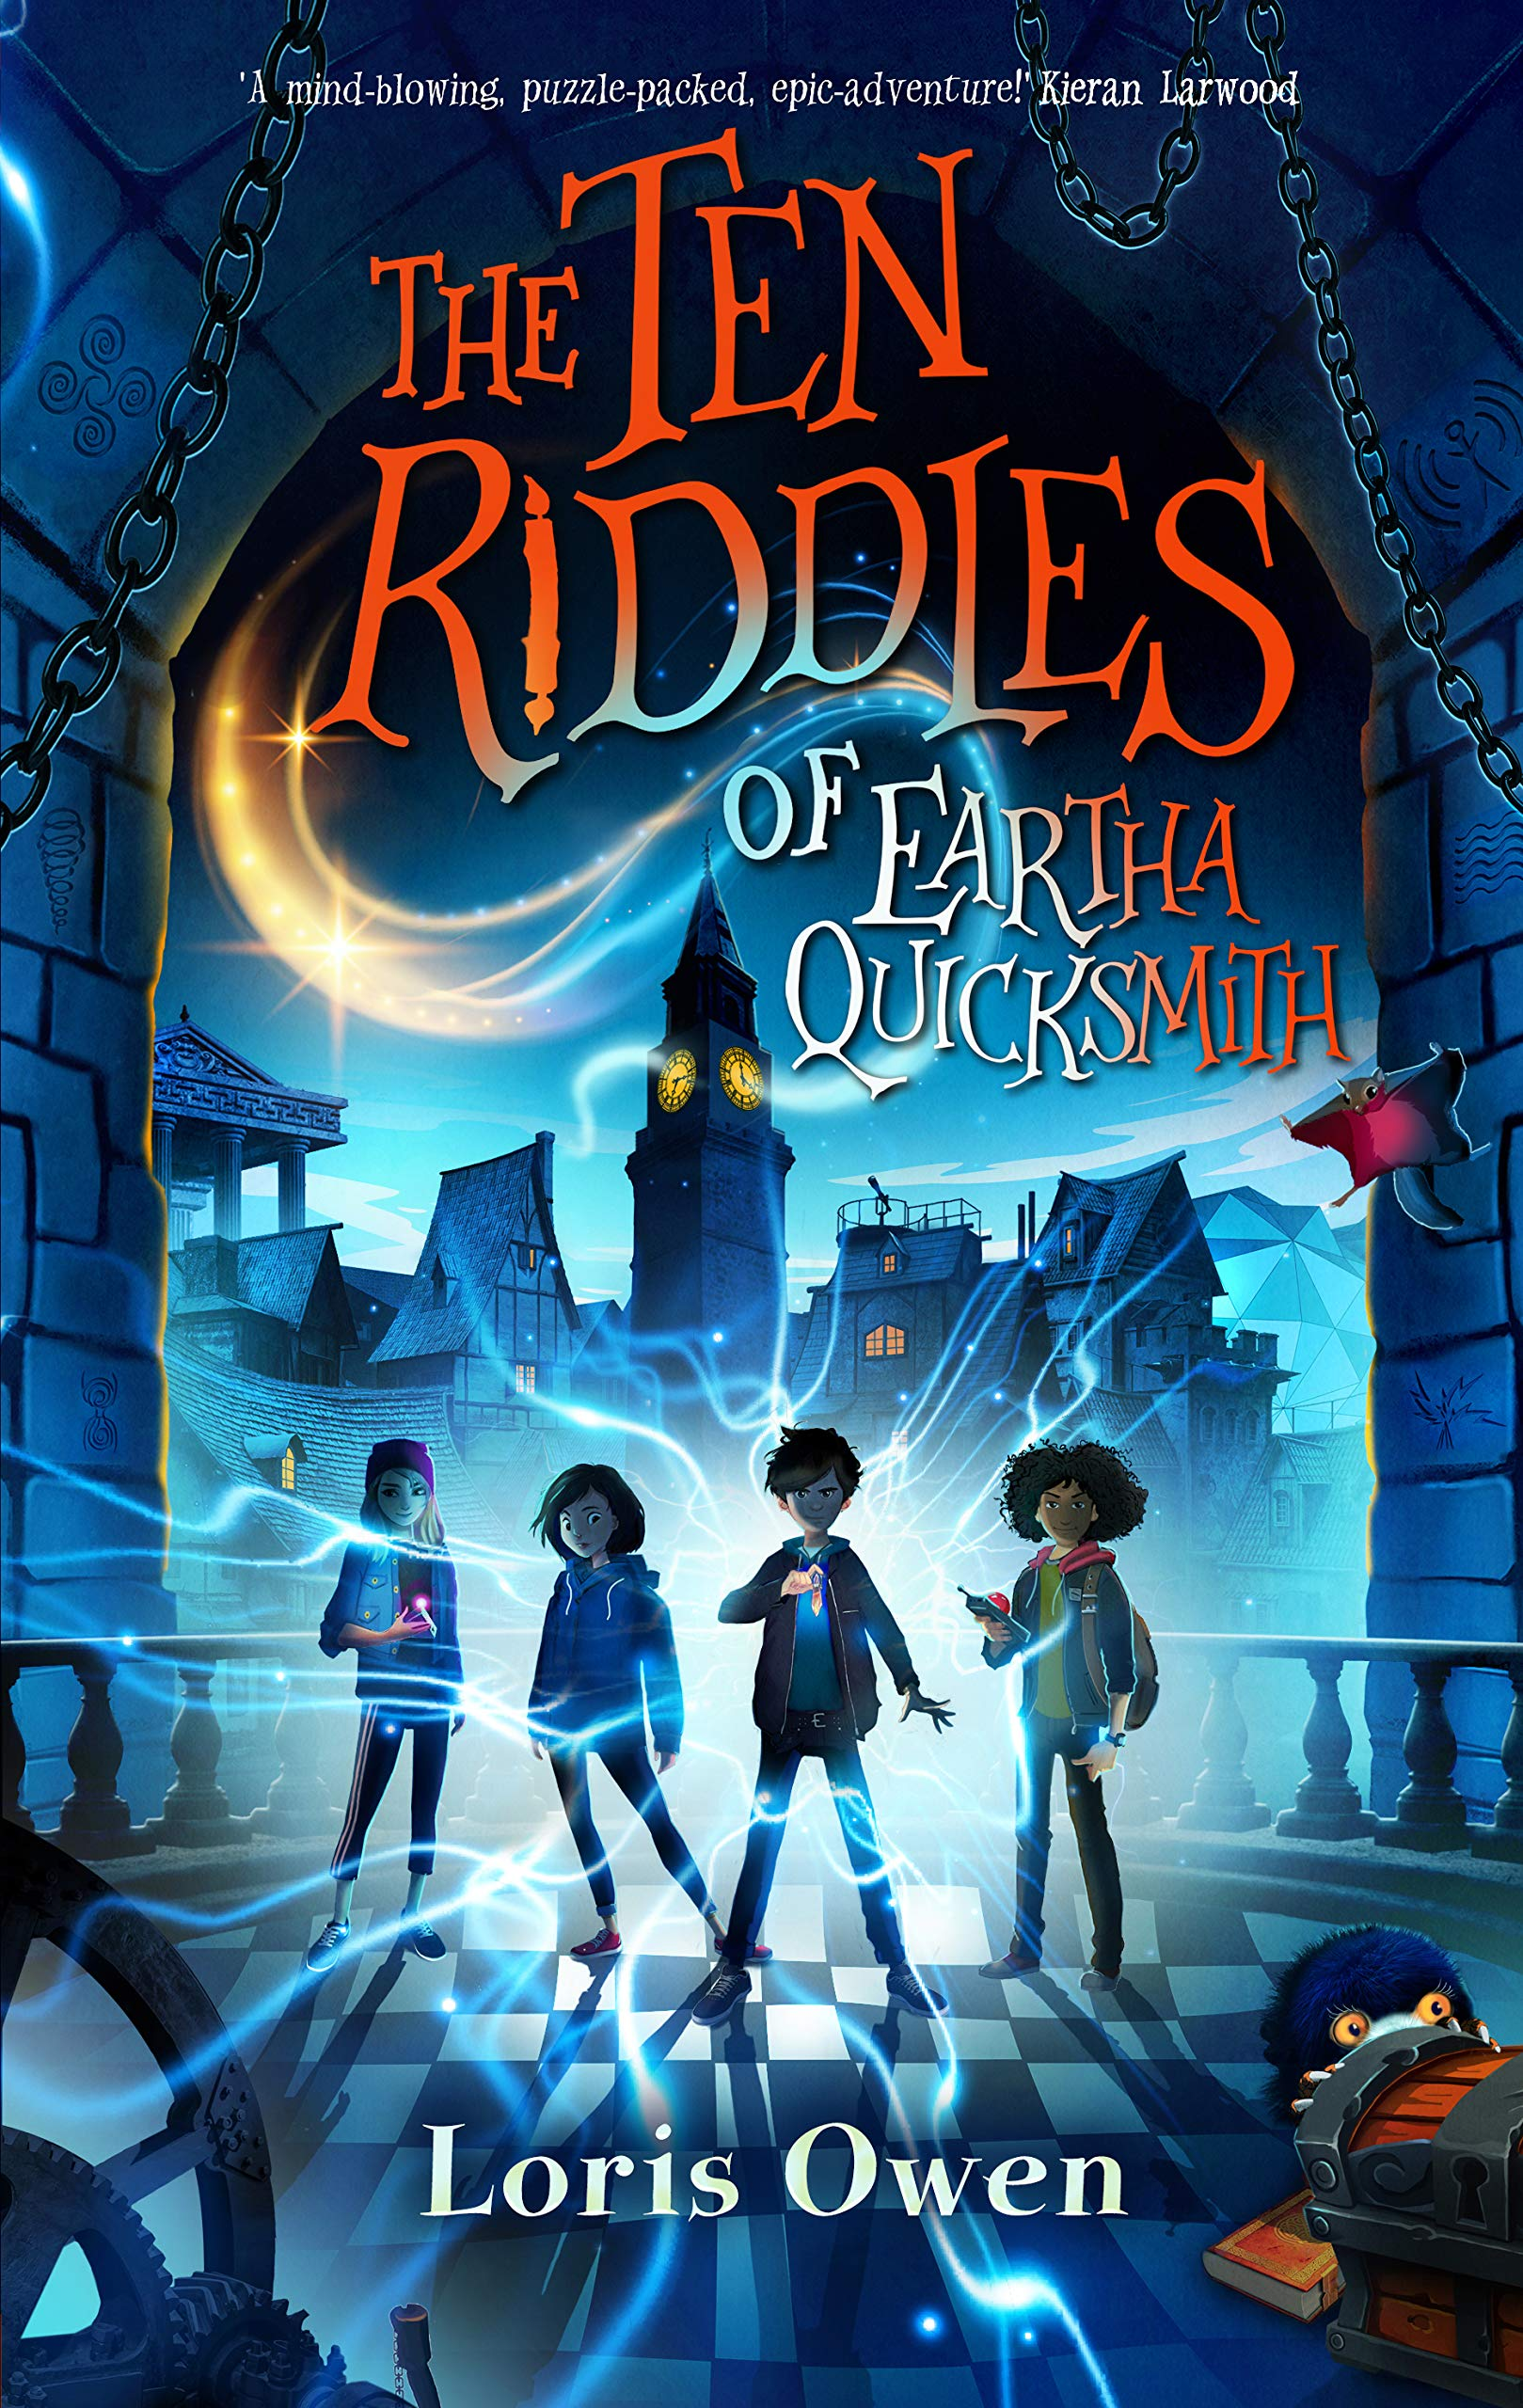
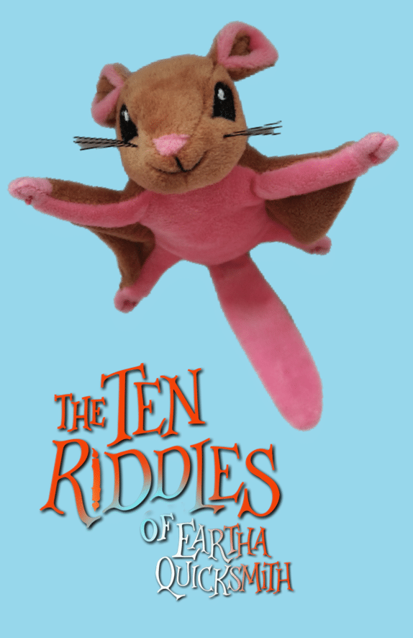
The ten riddles of Eartha quicksmith
Session 4 – story structure
Rebecca Hughes in association with
Impress the Examiner
Notes:
This can be used independently from the other sessions in the series.
In narratives, there is almost always a structure that involves beginning the story, rising action, the climax and then falling action until the problem is solved and the denouement is reached. Stories are generally more satisfying to readers if there is a change from the beginning to the end of the story, e.g. the character has learnt a lesson and changed in some way, or a crime has been solved, or two people have fallen in love and (we are now promised) will live happily ever after.
Although you can generally see this at a macro level within a story as a whole, this structure can be seen in sections of text too – there is very rarely only one problem to be solved in a novel. This session explains the story structure, which many students will have met previously in different forms, such as a story mountain, and then looks at how the structure is formed within one section of “The Ten Riddles of Eartha Quicksmith.”

Slide 2
Learning objectives
To understand how a story is structured across a whole novel.
To recognise how this structure is replicated in smaller parts of a story throughout it.
To understand how an author creates this structure in a section of the story, for example how tension is raised.

Slide 3
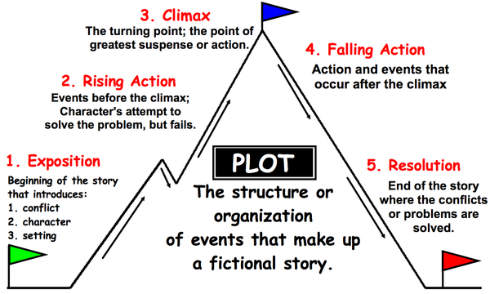
Notes:
This is a pictorial representation of the structure of many stories.
Go through this with students and ensure this is clear.
You may like to use some stories students are familiar with already, such as fairy tales or books that they have read recently to anchor this theory in what they already know.

Slide 4
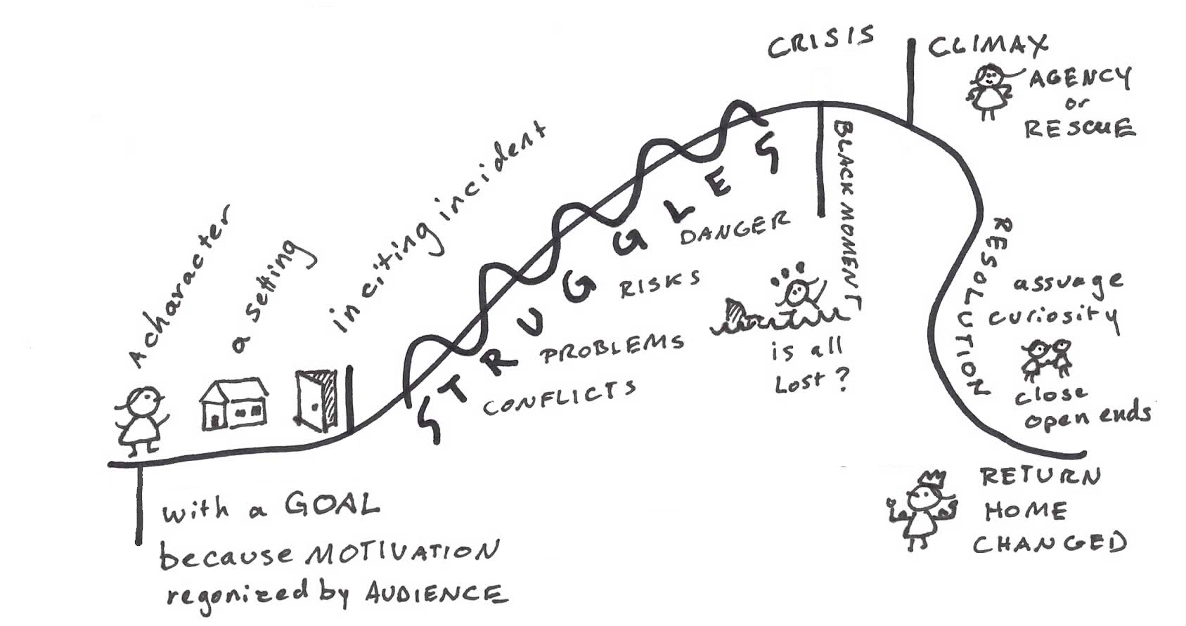
Notes:
This is a story arc/narrative arcs and a similar idea with a different representation.
In stories there are also mini narrative arcs within a story.
We are going to use one of these today to analyse the structure of a section of the story.

Slide 5
reading
The four friends (together with everyone else at Quicksmiths) are busy trying to solve the 10 riddles. They are given one at a time, and as soon as they solve one, they are given the next. Kip and his friends have just solved riddle 7 - “Find the Sea of Silence”... the Mowl (Leela’s quirky pet) found a crescent shape which fitted into the “C” of silence on the spine of a book.
Let’s read what happens when they fit the C into the spine...
The Ten Riddles of Eartha Quicksmith p.310-311
Notes:
In order to analyse the structure of a section of “The Ten Riddles of Eartha Quicksmith” we need to read a section.
This has been written out over the next few slides.

Slide 6
“Oh riddle number eight,” called Leela, “come out, come out, wherever you are.”
As she clicked the silver C into place on the black leather, Kip felt the floor of the study shake slightly under his feet.
“Watch out!” shouted Timmi, pulling Albert back.
Just in front of them, a square section of floor about the size of a Skimmi was beginning to lift. At first, Kip thought it was a platform but, as it kept on rising, he realised it was a large wooden cube. It levitated completely out of the floor and hovered at about chest height, while the gap left behind in the floorboards sealed itself up.
Before their eyes the cube dissolved into dust. Too amazed to speak, they simply watched as this cloud began to whirl like a swarm of tiny insects. Gradually, the dust came back together and solidified again into a giant floating skull.

Slide 7
The mowl ch-charked.
Attached to the bottom of the skull, in a crossbone arrangement, were a sand timer and a glass tube. The tube had three compartments, each containing a separate fluid – oily yellow, bright red and putrid green.
“I’d say something happens if those liquids mix together,” Albert said. “Something not good.”
“Poison gas?” asked Leela. “Or an explosive?”
“The clockwork soldiers and now this,” said Timmi. “Who do you think Eartha set these traps for?”
“Doesn’t matter. We still have to get past them to reach the Ark,” Leela said, picking at a fingernail.

Slide 8
Kip stared into the skull’s hollow eye sockets.
“We have to trust ourselves. We don’t know what Eartha saw in her Futurescope or why she set these traps. Maybe it was to keep Scaleface away. Or Thag. But don’t forget we’re the good guys.”
“And we’ve got this far together,” said Albert, nodding.
Almost as soon as he’d spoken, the timer flipped to a vertical position. Sand started dribbling through its bottleneck and flame-red words glowed on the skull’s forehead.
Notes:
How has the author heightened the tension?
It’s a skull
Crossbone
Sand timer
Mix of liquids - but we don’t know the effect
The sand timer turns
Think about the narrative arc…
This section started with the solving of riddle number 7.
Immediately the tension is raised - we are climbing the narrative arc to the climax of the action...this is the problem that needs to be solved...by solving the next riddle...
Can you find 3 ways
How does this fit in the narrative arc…

Slide 9
Analysing the text
Can you create a narrative arc being specific about this section of the text? Draw one!
How has the author heightened the tension?
Notes:
Think about the narrative arc…
This section started with the solving of riddle number 7. Riddle 8 is about to be revealed and immediately the tension is raised getting ready for us to see the next riddle - we are climbing the narrative arc to the climax of the action...this is the problem that needs to be solved...by solving the next riddle... Discuss this together and create a diagram that is specific to this section of the text.
As part of this, look at ways Loris Owen has heightened the tension in the rising action, for example:
It’s a skull
Crossbone
Sand timer
Mix of liquids - but we don’t know the effect
The sand timer turns

Slide 10
The eighth riddle...
VIII
I have a radius but can be many shapes,
I have a tail but can’t wag it
I have a collar but no shirt
I have a cap but not on my head
And something about me is funny
Notes:
If students have read the book they will know the answer to this riddle. If not, take one line at a time and try to work out what the answer is. If students don’t know where to start, encourage them to think of more than one meaning for the words in the riddle…

Slide 11
“A circle has a radius,” Timmi said. “But a circle’s a circle. How can it be many shapes? That just doesn’t make sense.”
“Let’s move to the next line,” said Leela.
“Tail and collar,” Albert blurted out. “A dog! But why wouldn’t a dog wag its tail?”
“A sad dog?” said Timmi.
“That doesn’t sound like an Eartha answer,” said Leela.
“And it doesn’t explain the radius,” agreed Kip. “Or the cap.”
“How about jesters? They have caps,” said Albert. “And they’re funny.”
“A sad dog jester?” Timmi suggested.
“That can’t be it,” said Leela. “Keep trying while I look for clues.”
Notes:
As you read through the next section with students, take it slowly and look at:
How the tension is raised
Where on the narrative arc we are
How the characters interact to help move the story on.
There are some suggestions for discussion on the slides but it is important to take the lead from the students.

Slide 12
She paced around the skull and stopped on its left side.
“There’s a kind of funnel here,” she said, “where its ear would be.”
Before anyone could stop her, Leela put her lips to the funnel and said, “Hello?”
There was an ominous click and one of the partitions in the glass tube broke. The oily yellow and bright red liquids mingled to form an evil-looking sludge. Leela squealed with fear.
“Oh no! What did I do?” she wailed. “I’m sorry - I got all excited - had a hunch it would do something - I was just seeing how it worked - I didn’t know I would break the thingy - stupid skull - stupid me - I’m so sorry - I promise I won’t do anything else…”
Notes:
You could think about:
How has the tension increased?
Why is Leela’s speech punctuated with all those dashes?
What are the relationships like between the friends?
How is Leela feeling? How would you feel if you were Leela?
How do you think the others will react to Leela?

Slide 13
“It’s OK. It’s OK,” said Kip. “There’s still one divider left in the tube. Everyone stay calm until we’re totally sure of our answer.”
Kip had never seen Leela look so angry, but he knew she wasn’t angry with him. She took two steps back from the skull and stared at it furiously. Its blank grin didn’t change.
“Does anyone want to leave?” Kip said. “It’s not too late.”
“Never!” said Albert, and Leela and Timmi both nodded.
“Halfway down,” said Kip, looking at the sand in the timer. “Come on, think.”
Albert started tapping on his forehead with his knuckles as if he were trying to knock the answer out. It made a dull, thumping rhythm.
Notes:
Read this slide and the next slide and then pause for discussion.

Slide 14
“Albert,” said Timmi, “Your skull is really thick. And loud. And annoying.”
“My skull does have feelings you know.”
“Actually, maybe you’re on to something,” replied Timmi. “What if the skull itself is a clue?”
“Go on,” said Kip.
Notes:
You could discuss:
How the tension is raised further
What the relationships are like between the characters
What might happen next? If you were the author what would you do?
How does the author show that we’re about to get the solution?

Slide 15
“Well, a skull is a type of bone…”
“Technically, yes,” said Albert.
“...and isn’t there a radius bone in your leg?”
“Arm, I think,” said Leela.
“Right,” Timmi said. “And isn’t that bit at the bottom of your spine your tailbone?”
“Ooo! Ooo! Collar bone!” shouted Albert.
“Cap? Cap?” said Kip, mentally running through the bones in his body. “Kneecap!”
“And funny bone!” said Timmi. “That has to be it!”
She stepped up to the skull’s funnel-ear, looked at the others for approval, and quietly uttered her answer: ‘skeleton’.
Notes:
Consider:
How do they work it out?
How does it show the relationships between the four friends? (Solving it by listening to each other then using what one has said to help another character take the next step.)
What do you think will happen next?

Slide 16
There was a click and Leela swallowed another squeal as the sand timer slowly began to move back to its crossbone position.
“So is that it?” she gasped. “Were you right?”
“I think so!” said Timmi, hugging Leela, and then Albert and Kip.
Like the cube before it, the skull dissolved into the dust that began to spin around it in a stormy blur. Little by little, this wild tornado slowed down again and reformed into a new shape: a galleon.
The polished wood of the hull was almost black. On its deck were several treasure chests, spilling out their contents. At the helm was a ship’s wheel and a jewelled compass edged with gold, ruby, emerald, diamond and sapphire.
Notes:
This is what happens after the riddle is solved.
Discuss how this fits into the narrative arc and how the tension is immediately released. Be specific about how Loris Owen does this – for example we have had lots of speech and short sentences which has created pace; now there is a lot more description which enables the reader to slow down and figuratively look around and observe what is happening, slowing the pace right down.
We have now solved the eighth riddle. As Eartha has ten, what will happen next? Discuss how it is likely that a new arc will begin with the tension being raised all over again.

Slide 17
Leela cradled the mowl tightly in one arm and stroked his feathers.
“No touching the shinies,” she said.
Masts began to sprout from the galleon’s deck, and sails unfurled. From the very tallest mast, a pirate flag rolled down. Under its skull-and-crossbones emblem, sewn in bone-white thread on the black silk, was the ninth riddle.
Notes:
This is what happens after the riddle is solved.
Discuss how this fits into the narrative arc and how the tension is immediately released. Be specific about how Loris Owen does this – for example we have had lots of speech and short sentences which has created pace; now there is a lot more description which enables the reader to slow down and figuratively look around and observe what is happening, slowing the pace right down.
We have now solved the eighth riddle. As Eartha has ten, what will happen next? Discuss how it is likely that a new arc will begin with the tension being raised all over again.

Slide 18
The ninth riddle...
Set a course for GREED.
Notes:
This is riddle 9. Discuss what it might mean.
What might the solution be? This is an opportunity for lots of group or paired discussion and creativity.
You could then either show the students the next slide – if their ideas don’t lend themselves to an interesting story – or miss the next slide out and create a WABOLL (what a bad one looks like – a model of a poor text) based on their ideas before asking them to write.

Slide 19
How might you show that solution?
“I know!” shouted Albert. “You have to fit the gems into the pattern that spells out GREED!”
Gold...ruby...emerald...emerald...diamond.
He fitted them in and that was that. Done. Riddle solved. Riddle number 10 appeared.
Notes:
This is how Loris Owen solves the riddle – Albert works out that the gems need to fit into the pattern of the letters G-R-E-E-D.
The example on this page is a WABOLL (“what a bad one looks like” or a model that doesn’t work.)
Read and discuss why this is not good – no rising action, no tension, no interaction with characters, no idea of how he came to that solution, where he put the gems, whether they had any wrong ideas on the way to this, what happened when the gems fitted…)
Look at what is missing – all of the above – and plan:
How would you write this as the next section of the story? Think about the narrative arc – look at the next slide if this needs more explanation.

Slide 20
Consider the story arc or narrative arc...
Notice that the first slope - the one that goes up - is much longer than the one going down...
That means we need time to build up the tension...
Notes:
This may be needed is students are struggling to grasp the level of detail needed when writing.

Slide 21
Over to you!
Please write your own version of how the four friends solve the ninth riddle.
Remember to use ways to build tension. Think about adding…
Speech and so the interactions between the characters
Description of what is happening or how people are feeling
Something that goes wrong when they are trying to solve the problem (maybe there are two gems that start with E?)
Ways of raising tension (for example asking rhetorical questions, using similes or metaphors or powerful language)
Notes:
Once students have written their section of the story, you might want to compare it with how Loris Owen takes the story forward.

