Slide 1
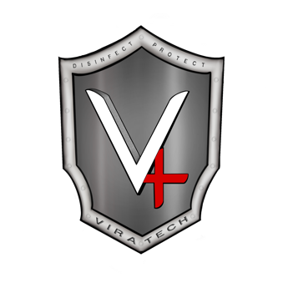

Slide 2
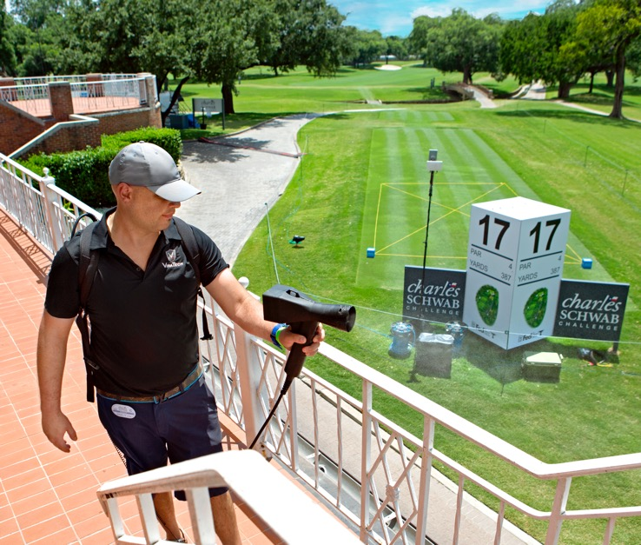
Why ViraTech?
ViraTech is the new standard of clean for every space. Our system eliminates 99.999% of germs in the most efficient and powerful way possible.
We utilize the disinfectant industry’s most cutting-edge technology (electrostatic disinfectant sprayers) to apply ViraTech’s proprietary, nontoxic chemistry solution.
Serviced top-tier businesses in multiple states in the US that can be identified as Vira-Checked by the signage on the front of their businesses or home pages of their websites.

Slide 3
What is ViraTech’s Solution?
EPA and OSHA Registered
Non-Toxic, Green Product
Bio-friendly, Eco-friendly, Environmentally Friendly
A Virucide, Bactericide, Fungicide, and Sanitizer
Deodorizer
Pet-Safe
Highest Efficiency Application in the Industry

Slide 4
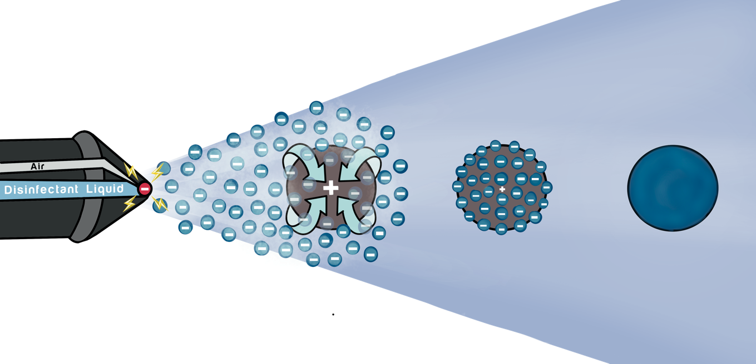
The Science of Electrostatic Spraying
Electrostatics is a branch of physics that regards the properties of slow-moving electric charges. This is the same phenomena demonstrated when you see lint attracted to clothes, or when a dryer sheet sticks to a blanket from the dryer.
Our sprayers apply an electrostatic charge to the particles of disinfectant, resulting in a behavior similar to that of dust clinging to a TV screen. To put it simply, the electrostatic system provides a comprehensive, total coverage to a surface by clinging to every dimension of an area (i.e. it wraps around the target area).

Slide 5
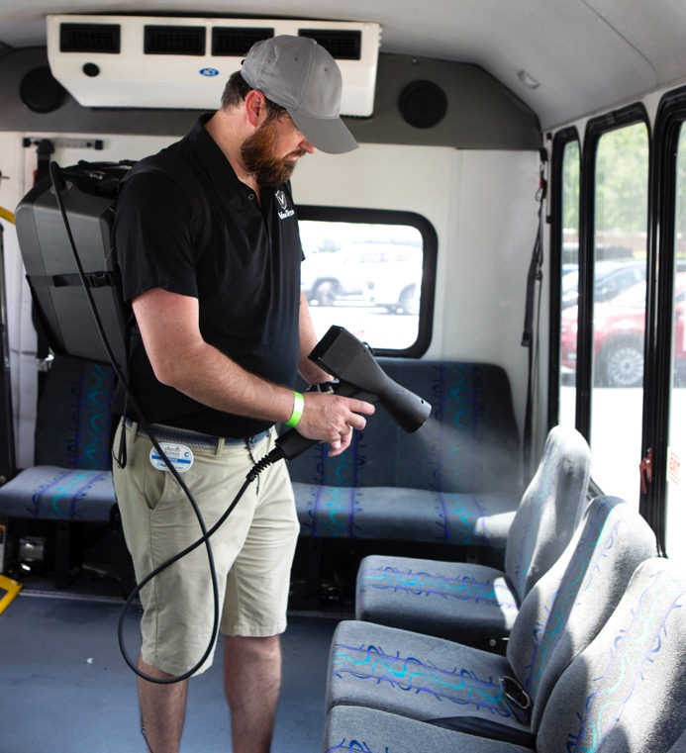
Benefits of Electrostatic Spraying
Electrostatics was adopted from the automotive and agricultural industries, and is now being integrated into the infection prevention and control industry as a tool to break the chain of pathogen mobility.
Our powerful electrostatic sprayers are a new, promising technology in the industry of infection prevention and control. This technology utilizes electrostatic application systems to distribute an EPA-approved disinfectant that makes for proper surface disinfection.

Slide 6
The Chemistry of CLO2
Chlorine dioxide (CLO2) is a neutral chlorine compound. While the name may create the idea that chlorine dioxide and chlorine itself are related, CLO2 is actually very different, both in its behavior and structure.
One of the key qualities of chlorine dioxide is its superior solubility in cold water. The chemical does not hydrolyze (undergo a chemical breakdown reaction) when it interacts with H2O (water). Instead, CLO2 maintains its structural integrity as a gas. Another way of thinking about it is that chlorine dioxide is 10 times more soluble than regular chlorine.
Chlorine dioxide has been recognized as a disinfectant since the early 1900s and has been approved by the US Environmental Protection Agency (EPA) and the US Food and Drug Administration (FDA) for applications.
It has been demonstrated effective as a bactericidal, fungicidal, virucidal agent, as well as a deodorizer.
EPA register sanitizer (EPA No. 9804-1). Meets Federal OSHA regulations (29 CFR 1910.134 and (29 CFR 1910.1000) for spraying applications. No known mutagenicity or carcinogenicity. Hospital-grade disinfectant.

Slide 7
The Benefits of CLO2 Solution

Slide 8
Comparison
After proper application performed through electronic misting by a ViraTech Service Technician, our chlorine dioxide (CLO2) based solution will disinfect, deodorize, and sanitize surfaces and spaces.
We can provide your facility with a safer, convenient system to reduce the spread of pathogens and communal infections by using a proprietary blend of chemistry composed of CLO2, an organic activator, and water.

Slide 9
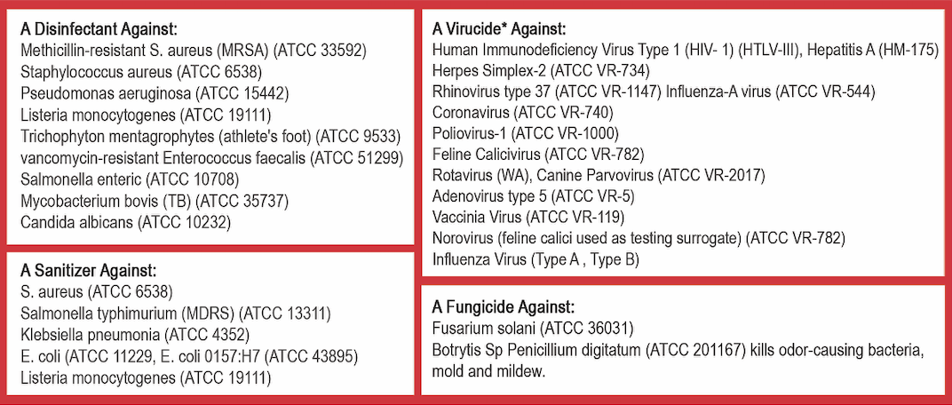
ViraTech Efficacy List
ViraTech’s CLO2 solution eliminates viruses, bacteria, mold, fungus, and mildew.
Additionally, our spray solution is a disinfectant, virucide, fungicide, and sanitizer against these germs:

Slide 10
Contact Us
North Texas
(Head Office)
800-705-6265
info@viratechusa.com
Oklahoma
405-252-1072
grantm@viratechusa.com
Rio Grande Valley
956-391-9446
luisf@viratechusa.com
East Texas
903-307-7111
cheryla@viratechusa.com
Colorado
917-514-9628
saras@viratechusa.com
Nebraska
402-709-3693
jims@viratechusa.com
West Texas
325-304-1979
robertg@viratechusa.com
California
949-322-5517
scottr@viratechca.com
Central Texas
817-584-7948
charlesr@viratechusa.com

