Slide 1
Tribal Law 101: A Basic Overview of Tribal Law in Arizona
Prepared for AZCourt Help
by
Candace French
The information provided in this presentation is not legal advice and does not establish a client attorney relationship.
Persons seeking legal advice should seek the assistance of an attorney for their legal needs.

Slide 2
Goals of this Presentation
Provide basic facts regarding American Indian tribes, their legal status, and their government structure
Provide the definition of “Indian Country”
To give a brief overview of instances where someone may become involved in a legal matter being adjudicated in tribal court:
Criminal Matters
Business Matters
Family and Domestic Matters
Probate Matters
Provide resources for legal matters in tribal courts

Slide 3
Basic Facts on American Indian Tribes
The Federal Register lists all Federally Recognized Indian Tribes. There are currently 574 Tribes listed. See 85 FR 5462 (1/30/20).
Arizona has 22 Federally Recognized Indian Tribes.
Together, Arizona’s Tribes occupy over 19,000,000 acres of land, roughly 26.99% of land in the State, a greater percentage of land than any other State in the continental United States. See Tracy v. Superior Court of Maricopa County, 168 Ariz. 23, 36 (1991).
Indian Tribes control 56 million acres of land in the continental United States and substantial natural resources.

Slide 4
Legal Status of an Indian Tribe
A federally recognized tribe is a legal designation that establishes certain relationships between the Tribe and the federal government.
Recognition is “a formal political act, it permanently establishes a government-to-government relationship between the United States and the recognized tribe as a ‘domestic dependent nation,’ and imposes on the government a fiduciary trust relationship to the tribe and its members.” H.R. Rep. No. 103-781, 103rd Cong., 2d Sess., 2 (1994).
Recognition “imposes upon the Secretary of the Interior specific obligations to provide a panoply of benefits and services to the tribe and its members. In other words, unequivocal federal recognition of tribal status is a prerequisite to receiving the services provided by the Department of the Interior’s Bureau of Indian Affairs (BIA), and establishes tribal status for all federal purposes.” H.R. Rep. No. 103-781, 103rd Cong., 2d Sess., at 3 (1994).
There are also state-recognized tribes who are as the designation implies, recognized by a state but lack federal recognition. Examples include the Lumbee Tribe of North Carolina, Eastern Pequot Tribal Nation and Addai Caddo Tribe. This presentation focuses on federally recognized tribes in Arizona.

Slide 5
Indian Tribes in Arizona
Ak Chin Indian Community of the Maricopa (Ak Chin) Indian Reservation
Cocopah Tribe of Arizona
Colorado River Indian Tribes of the Colorado River Indian Reservation (Arizona and California)
Fort McDowell Yavapai Nation
Fort Mojave Indian Tribe (Arizona, California and Nevada)
Gila River Indian Community of the Gila River Indian Reservation
Havasupai Tribe of the Havasupai Reservation
Hopi Tribe of Arizona
Hualapai Indian Tribe of the Hualapai Indian Reservation
Kaibab Band of Paiute Indians of the Kaibab Indian Reservation
Navajo Nation (Arizona, New Mexico and Utah)
Pascua Yaqui Tribe of Arizona
Quechan Tribe of the Fort Yuma Indian Reservation (Arizona and California)
Salt River Pima-Maricopa Indian Community of the Salt River Reservation
San Carlos Apache Tribe of the San Carlos Reservation
San Juan Southern Paiute Tribe of Arizona
Tohono O’odham Nation of Arizona
Tonto Apache Tribe of Arizona
White Mountain Apache Tribe of the Fort Apache Reservation
Yavapai-Apache Nation of the Camp Verde Indian Reservation
Yavapai-Prescott Indian Tribe

Slide 6
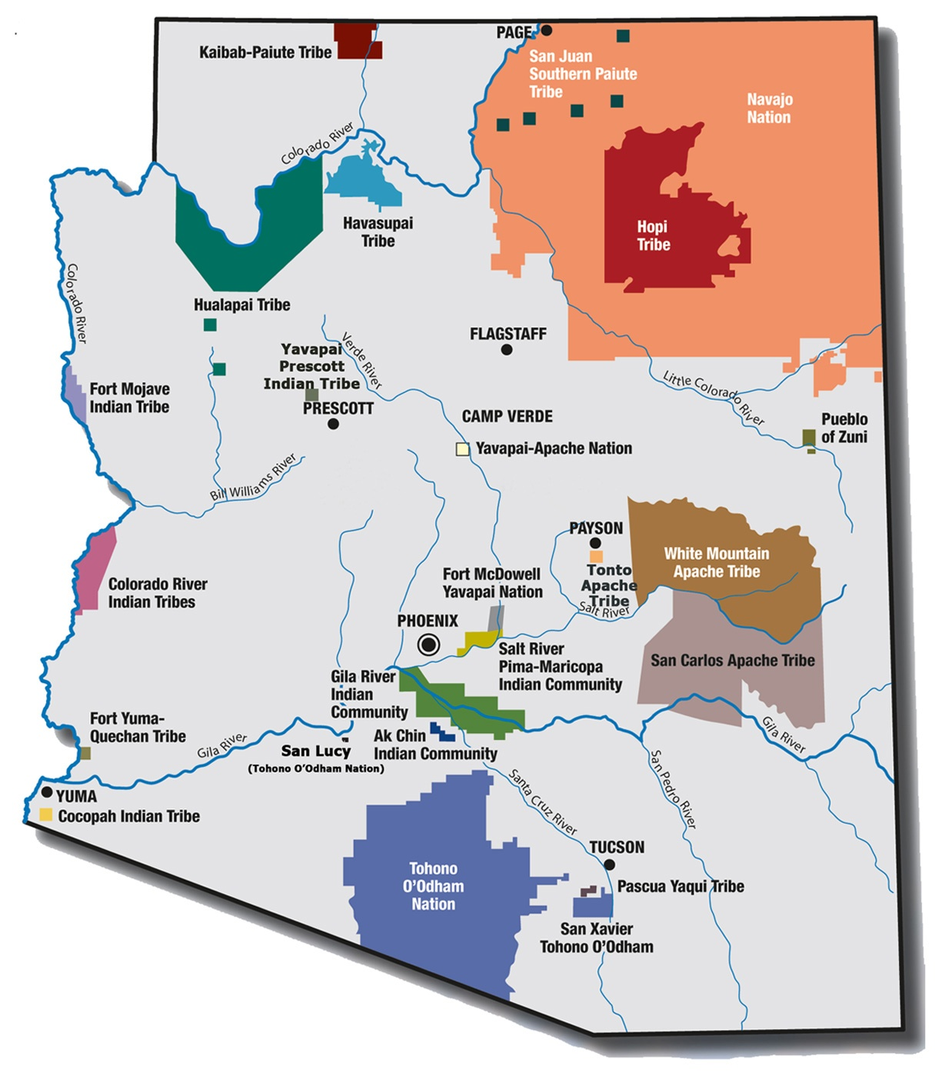
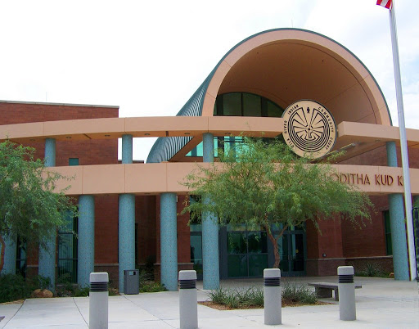
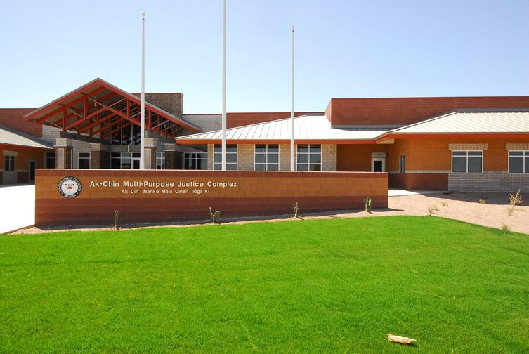
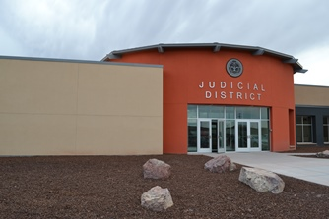

Slide 7
Tribal Governments
Indian Tribes “are distinct, independent political communities, retaining their original natural rights in matters of local self-government.” Santa Clara Pueblo v. Martinez, 436 U.S. 49, 55 (1978).
An Indian Tribe is free to maintain or establish its own form of government. See 1-4 Cohen’s Handbook of Federal Indian Law § 4.01 (2017).
Each Tribe may determine its membership, enact criminal and civil laws, levy taxes, control tribal property, exercise powers delegated by Congress, and adjudicate tribal disputes.
Tribal government structures vary. Some have very familiar structures like a three-branch form of legislative, executive, and judiciary, while others have only a Tribal Council which has the sole authority.
Tribes may also establish governmental entities to regulate certain areas such as gaming enterprises, tax commission, etc.

Slide 8
What is Indian Country?
Indian Country, 18 U.S.C. § 1151, is defined as:
(a) all land within the limits of any Indian reservation under the jurisdiction of the United States Government, notwithstanding the issuance of any patent, and, including rights-of-way running through the reservation,
(b) all dependent Indian communities within the borders of the United States whether within the original or subsequently acquired territory thereof, and whether within or without the limits of a state, and
(c) all Indian allotments, the Indian titles to which have not been extinguished, including rights-of-way running through the same.

Slide 9
Crimes in Indian Country
Very complicated jurisdictional issues
Tribe?
Federal Government?
State?
Criminal jurisdiction is dependent on the Indian status of perpetrator and victim as well as the type of crime committed.
Tribal courts may vary in their jurisdiction and sentencing authority i.e. TLOA & VAWA.
Source: Tribal Court Clearinghouse General Guide to Criminal Jurisdiction in Indian Country

Slide 10
Addressing Criminal Matters in Tribal Court
Criminal systems are very similar to state criminal courts. Usually a tribal prosecutor or police officer represents the Tribe. Some tribal communities have public defenders or court advocates available for indigent defendants.
Defendants can obtain their own private counsel (out of pocket) for criminal matters BUT… some tribal courts require attorneys to be admitted to practice in that tribal court i.e. Navajo Nation, Salt River Pima-Maricopa Indian Community, Gila River Indian Community, Tohono O’odham Nation.
If pro se:
read tribal criminal code section
locate, review and follow any court rules
follow timelines
conduct discovery
opportunity to plea
prepare your case i.e. review police report, find witnesses and other evidence
submit motions if needed i.e. Jurisdictional issue? Was the crime committed within the tribal boundaries? Is the complaint proper? Was there proper service?
attend all events i.e. arraignment, hearings, and trial
The Tribe/prosecutor has the burden of proof to demonstrate that you have committed a crime.

Slide 11
Victim’s Rights
Some Tribes have adopted Victims’ Rights Ordinances
Protects the rights of victims to be present at hearings, to be free of harassment, to be infirmed of perpetrator's release, and other provisions.
If you find yourself being a victim of a crime in Indian Country, there are resources available.
Usually if a major crime has been committed, a federal victim advocate is available.
If you are victim to a crime that is subject to tribal court jurisdiction, there may be a tribal program to guide you through the criminal process and other issues related to victimization.
Example: Gila River Indian Community Crime Victim Services
Services may include assistance with filing a civil protective order, counseling, safety planning, victim’s compensation requests, transportation to court, referrals to non-tribal resources (foodbanks, shelters, clothing)

Slide 12
Doing Business in Indian Country
Many tribes have their own business laws such as:
Preferential hiring of tribal members, American Indians, or spouses of tribal members
Procurement laws and regulations
Business licenses
Taxes
Many non-Indian businesses will become involved with tribal communities for goods or services.
Tribes carry out business activity through different entities. The nature of the entity will affect the legal rights and remedies available to a non-Indian party.
Types of Entities:
Government itself or a government instrumentality
Section 17 Corporation (under the I.R.A., 25 U.S.C. § 477)
Tribal entity
Tribally chartered corporation
State corporation
Contractors and material suppliers should determine the exact entity with which they are contracting. Contractors and suppliers should obtain and review all governing and organizational documents.

Slide 13
Business Transactions that land in Tribal Court
Remember that Tribes and certain governmental entities are protected by sovereign immunity.
Tribes may waive their sovereign immunity, but such waiver must be clear and unequivocal. Waiver must also be undertaken by entity with the authority to waive sovereign immunity.
What law governs?
For non-Indian contractors working on the Reservation, Tribal law will apply, except:
In Montana v. United States, the Supreme Court held that Indian tribes lack civil authority over the conduct of non-Indians on non-Indian fee lands within a Reservation except for two exceptions. 450 U.S. 544, 565 (1981).
The two exceptions set forth by the Court in Montana are that (1) a tribe may regulate, through taxation, licensing, or other means, the activities of nonmembers who enter consensual relationships, through commercial dealings, contracts, leases, or other arrangements, with the tribe or its members; and (2) a tribe may exercise civil authority over the conduct of non-Indians on fee lands within its reservation when that conduct threatens or has some direct effect on the tribe’s political integrity, economic security, or health or welfare. 450 U.S. at 565-566 (emphasis added).
If the contractor has a contract with an Indian Tribe for performance within the Reservation, the Tribe will have the power to regulate the activities, which includes licensing and taxing, and adjudicating disputes.

Slide 14
Family Law in Indian Country
Tribes have their own laws regarding domestic relations and children:
Marriage
Divorce and Separation
Protection Orders
Child Custody
Banishment
Guardianship
Processes, laws, and remedies will vary from tribe to tribe i.e. some courts follow traditional laws over common law and codified law
Tohono O’odham Nation
Navajo Nation
Tribal laws and court opinions may be found on tribal website or tribal court websites. Make sure you are reading the most recent code/rule.
Generally, for civil matters the entire process will begin with a petition to the court asking for something to happen and provides the reasons why and the court’s ability to do what the petitioner is asking.
Usually a filing fee associated. Look to court’s schedule of fees.
For many family law issues, the court will have fillable forms for petitioner and respondent along with instructions.
If you need assistance, contact an attorney or tribal court advocate.
The Courts cannot instruct you, assist you, or advise you.

Slide 15
Probate Law in Indian Country
Many American Indians have off-reservation property, tangible property, intangible property, or restricted property held in trust (allotted lands) or receive income from these restricted lands at the time of death.
Probate issues can become very complicated due to land status, other property status, heirship, tribal customs, whether the person has a will or not and whether the tribe has a probate code or not.
Tribal courts cannot probate off-reservation property i.e. house in Flagstaff
State court
Tribal jurisdiction for probate purposes is limited to territorial boundaries and residency requirements.
Sometimes federal probate is required.
Tribes vary on the validity of wills, intestacy (when someone dies without a will), who is considered an heir, whether property is considered marital property, whether the surviving spouse can inherit property, etc.
Probate begins with a petitioner asking the court to disburse a decedent's property with or without a will. In the most basic form, the process will usually proceed with an executor being appointed, notice being sent out to the interested parties, a time for persons to contest or respond to the petition, hearing, order by the judge and sometimes appeal.
When dealing with probate issues be mindful that death may be a sensitive topic for tribal communities. Estate planning may not be practiced as widely as it is outside of Indian Country.

Slide 16
Other considerations when in tribal court
Do you need an interpreter? Self, victim, witnesses
Finding tribal laws, opinions, or forms might not be that easy, be patient and ask for help/research.
Paper filing is the norm. Some courts may accept fax and email.
Sometimes a tribal court will adopt laws from other jurisdictions, especially if there is no tribal law or case on point i.e. evidence rule
Be mindful of the hierarchy of authority
Traditional, natural, fundamental law and customs
Tribal Constitution
Codified and common law
State laws
The way things are done in one tribal court might not be the same in another tribal court.

Slide 17
Legal Resources for Addressing Issues in Indian Country and Tribal Courts
Navajo Nation Bar Association
DNA-People’s Legal Services
Four River’s Indian Legal Services
ASU Indian Legal Clinic
Community Legal Services – Native Health of Phoenix
Native American Rights Fund (NARF)
Law Libraries
State Bar of Arizona Find-A-Lawyer

