Slide 1



Functional Safety Case Study
www.stolzltd.com

Slide 2






Case Study – Steam and Water Project
Original Design for Refinery Steam Supply
2 x Aged onsite steam boilers
Supplementation from 3rd party coal fired power station
New Design for Refinery Steam Supply
2 x New onsite redundant pairs of steam boilers
1 x New onsite steam turbine
New supporting ancillary systems
No requirement for 3rd party supplementation
Steam
Steam
STOLZ Functional Safety Support

Slide 3

Case Study – Steam and Water Project
New Design Functional Safety Overview
Functional Safety Design Summery
>200 SIFs across all systems
Pressure, temperature, level, flow and overspeed types
Various SIFs used for startup, purging and pre-ventilation sequencing
4 independent instrument equipment houses incorporating satellite control rooms
Independent logic solvers with interlocking functions between each other
4 independent DCS Interfaces with SIF maintenance overrides
An emergency shut down push button system for the entire steam process
STOLZ Functional Safety Support

Slide 4
Case Study – Steam and Water Project
Stakeholders and STOLZ Role
End User
(Our Client)
Global Projects Team
Site Projects Team
Central Engineering
Operations
Site FS SPA
Sub-Contractors
HAZOP/LOPA
I&C / FS Design
Field Equipment Install.
Logic Solver Install.
Suppliers
Sensors
Logic Solvers
Final Elements
VSDs.
Main Contractor
Projects
Maintenance
STOLZ Role
General functional safety mentoring and training
Identify and Review FS related documentation – build of the SIS life cycle folders
Closing out FSA 2 actions
Preparation and support for FSA 3, managing the close out of resultant actions
Preparation and support for notified body (TÜV Nord) assessments
MoC for functional safety hardware and software changes
Support planning of all SIS testing – based on initial testing strategy
Review and develop a new optimised SIS testing strategy
STOLZ Functional Safety Support

Slide 5
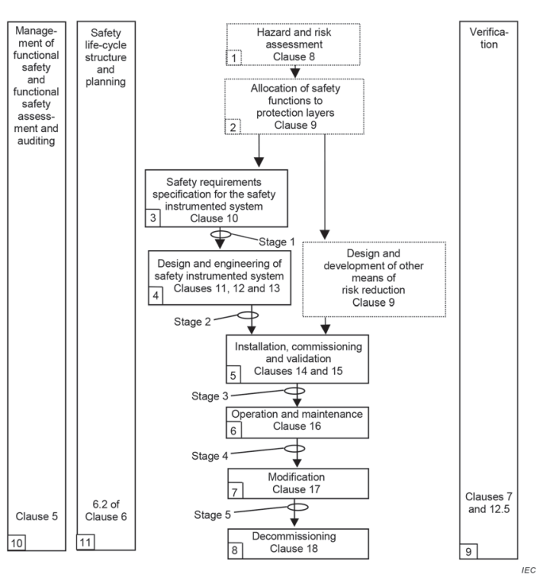
STOLZ Points for Optimisation
Review the risk assessment and LOPA to understand the specific requirements and the required risk reduction factor which has determined the target SIL.
Develop comprehensive SRS that can be understood by all parties i.e. FS engineers, process engineers, technicians executing the proof tests.
Produce reliability SIL calculations with STOLZ software considering:
  Segmented testing
  Voting configurations
  Device diagnostics
  Useful life of equipment
  Availability of equipment from operations
Produce SIF proof test procedures:
  Technically friendly for operations and technicians to follow
  Incorporating specifics from equipment functional safety manuals
  Satisfying functional safety standard and any company global or site standards.
Diligent impermeant risk assessments, maintenance deferrals and equipment upgrades managed through an independent MoC process.
Independent Functional Safety Assessments.
STOLZ Functional Safety Support

Slide 6
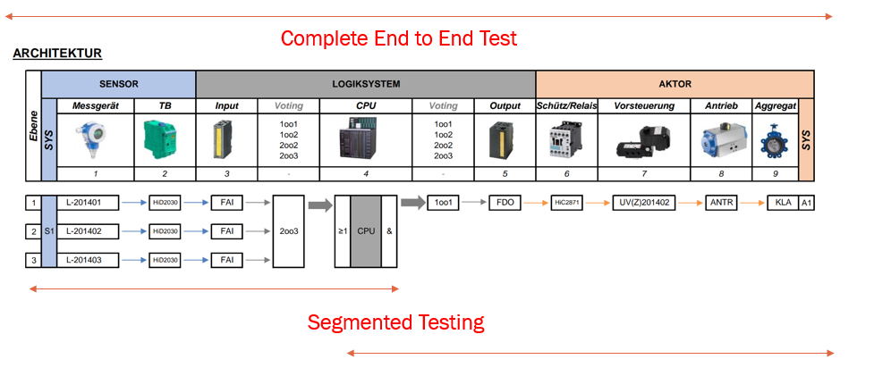
STOLZ Examples of Optimisation
Segmented Testing Approach – Principle to revile any undetected dangerous failures
Notes:
Any specific device checks from the manufactures safety manual to be completed first.
Calibration of sensors second.
Conclude with SIF function check as per procedure.
STOLZ Functional Safety Support

Slide 7
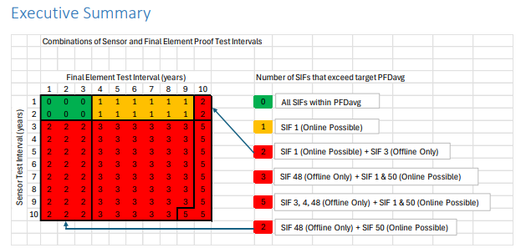
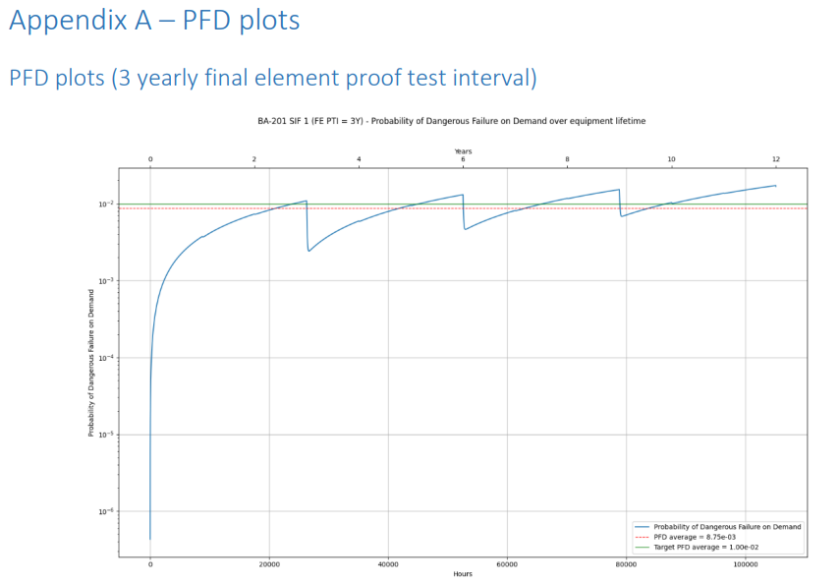
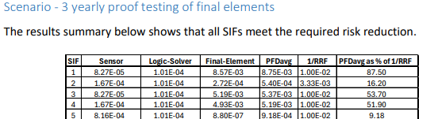
STOLZ Examples of Optimisation
Reliability Calculation development
  Consideration of availability of equipment from Operations
  Segmented testing - breaking the loop into sensor, logic solver and final element
  Modelling voting configurations
  Device diagnostics
  Useful life of equipment
STOLZ Functional Safety Support

