Slide 1
An Easy Guide to Digraphs for English Learners
Understanding letter combinations that form single sounds
© Word Branch ESL 2025
Notes:
AI-generated content may be incorrect. --- This presentation introduces English learners to digraphs—two letters that combine to make one sound. We will cover what digraphs are, common consonant and vowel digraphs, and helpful tips for reading and writing them.

Slide 2
Agenda Items
What Is a Digraph?
Common Consonant Digraphs in English
Common Vowel Digraphs in English
Tips for Reading and Writing Digraphs
Notes:
We will begin by defining digraphs and highlighting their difference from single letters. Next, we will explore common consonant and vowel digraphs with examples and sounds. Finally, we will share practical tips to help you recognize and use digraphs correctly.

Slide 3
What Is a Digraph?
Notes:
Understanding what a digraph is foundational for mastering English pronunciation and spelling. This section clarifies the concept and compares digraphs with single letters.

Slide 4

Simple Definition of Digraphs
Definition of Digraphs
Digraphs are pairs of letters that create one distinct sound together.
Example of Digraph
The letters 'ch' in 'chair' represent a single sound different from individual letters.
Purpose of Digraphs
They represent sounds that single letters cannot clearly express alone.
Notes:
--- A digraph is a pair of letters that together represent one sound, such as 'ch' in 'chair'. They help form sounds that single letters alone cannot represent clearly. Image source: Microsoft 365 content library

Slide 5
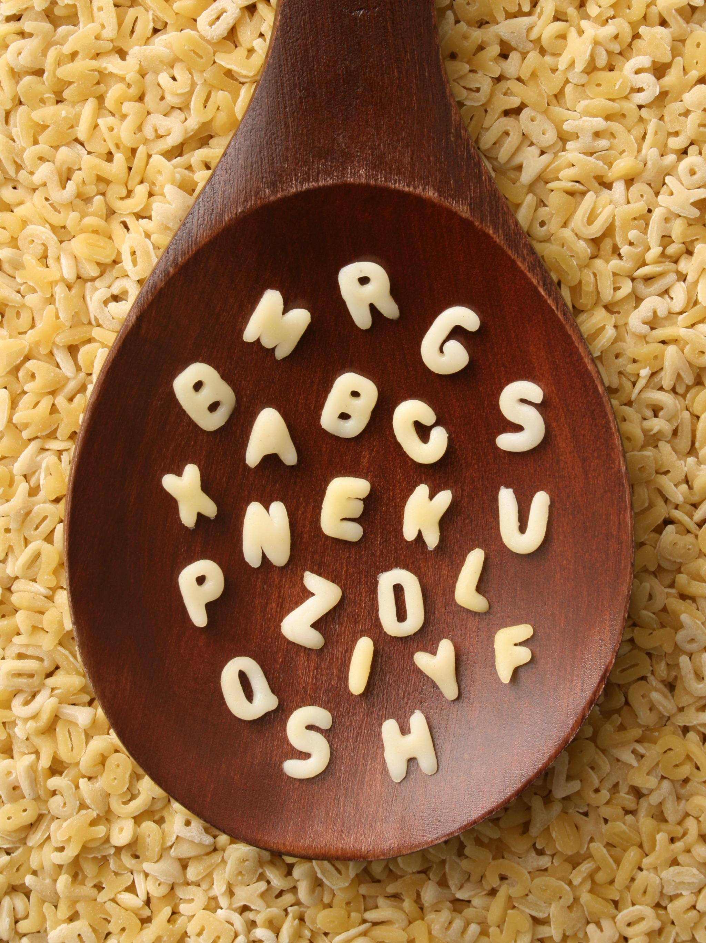
Difference Between Single Letters and Digraphs
Single Letters
Single letters represent individual sounds in spoken language and are the basic units of writing.
Digraphs
Digraphs are pairs of letters that create a unique single sound different from their individual components.
Example: 'sh'
'Sh' is a common digraph producing a distinct sound separate from 's' and 'h' individually.
Notes:
--- Unlike single letters, digraphs combine two letters but produce a single unique sound. For example, 'sh' is one sound different from 's' and 'h' separately. Image source: Microsoft 365 content library

Slide 6
End of Sample
The full PowerPoint, as well as others, will be available in the courses or can be purchased separately.
Notes:
Digraphs are essential building blocks in English reading and writing. By understanding their sounds and practicing regularly, learners can improve their language skills confidently.

