Slide 2
https://youtu.be/hPHILN_rjZo

Slide 3
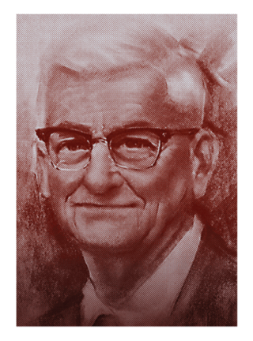
“Communication…leads to the discovery of hidden abilities … broadens the person’s conception of how to live with people. …It brings out for use the leadership traits and abilities, and thus helps to prepare the individual to be a leader.”
Ralph C. Smedley Personally Speaking

Slide 4
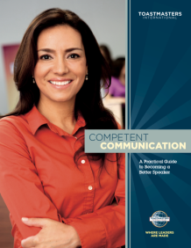
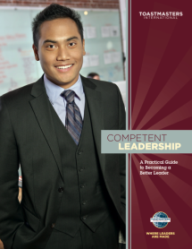
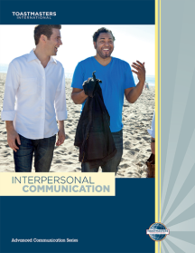
Education in Toastmasters

Slide 5
“We learn in moments of enjoyment.”
Ralph C. Smedley

Slide 6
Toastmasters Learning Revitalized
High value
Fun
Customized to your needs
Flexible
Competency-based
Resource-rich
Meaningful, effective evaluations

Slide 7
You Choose the Experience
Tailored, self-paced learning
Flexibility to choose experience
Greater access to materials
Expanded resources
Real-world applicability

Slide 8
Introducing Pathways!
https://youtu.be/b-bNl5z-wY4

Slide 9
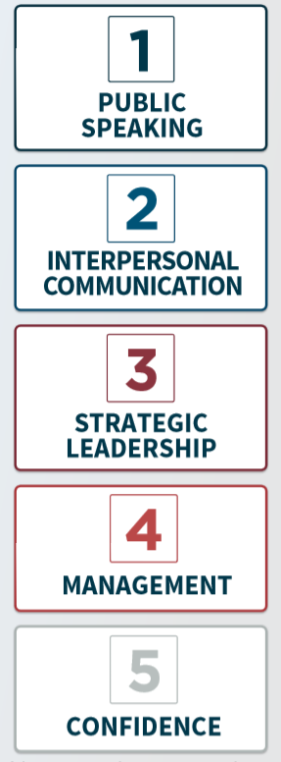

Slide 10
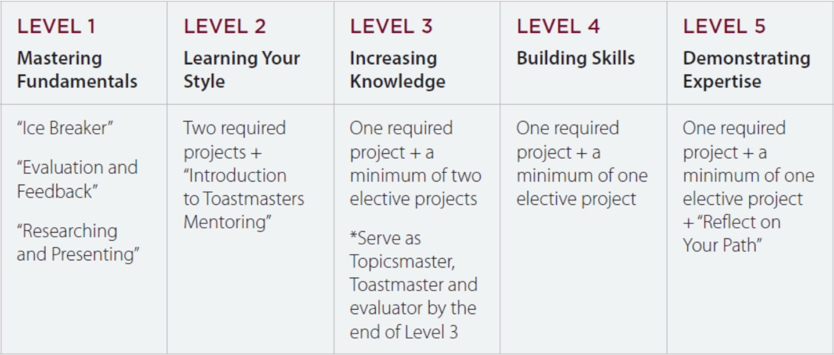
Levels and Project Types

Slide 11
59 Projects
English
Simplified Chinese
Traditional Chinese
Japanese
Spanish
Portuguese
French
German
Arabic
Accessibility for sight-impaired: Phase 2

Slide 12
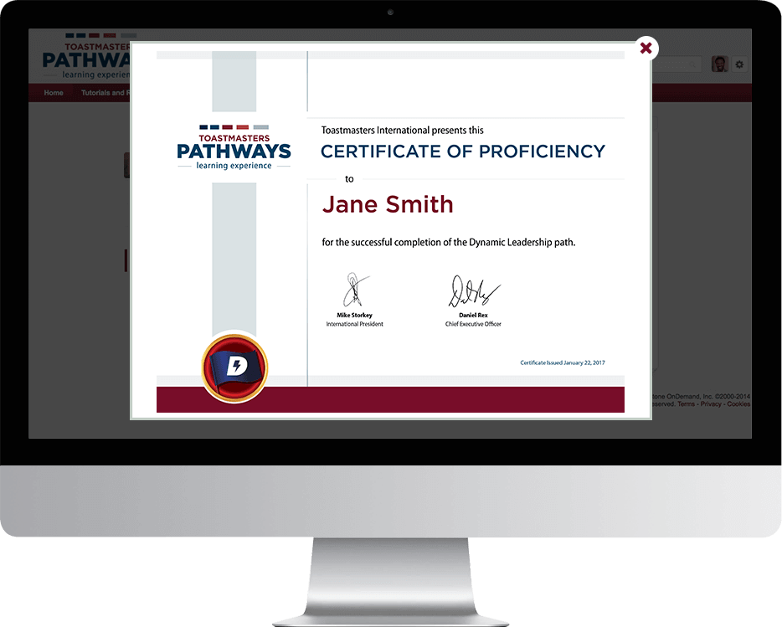
Badges and Awards

Slide 13
Evaluations

Slide 14
Evaluations

Slide 15
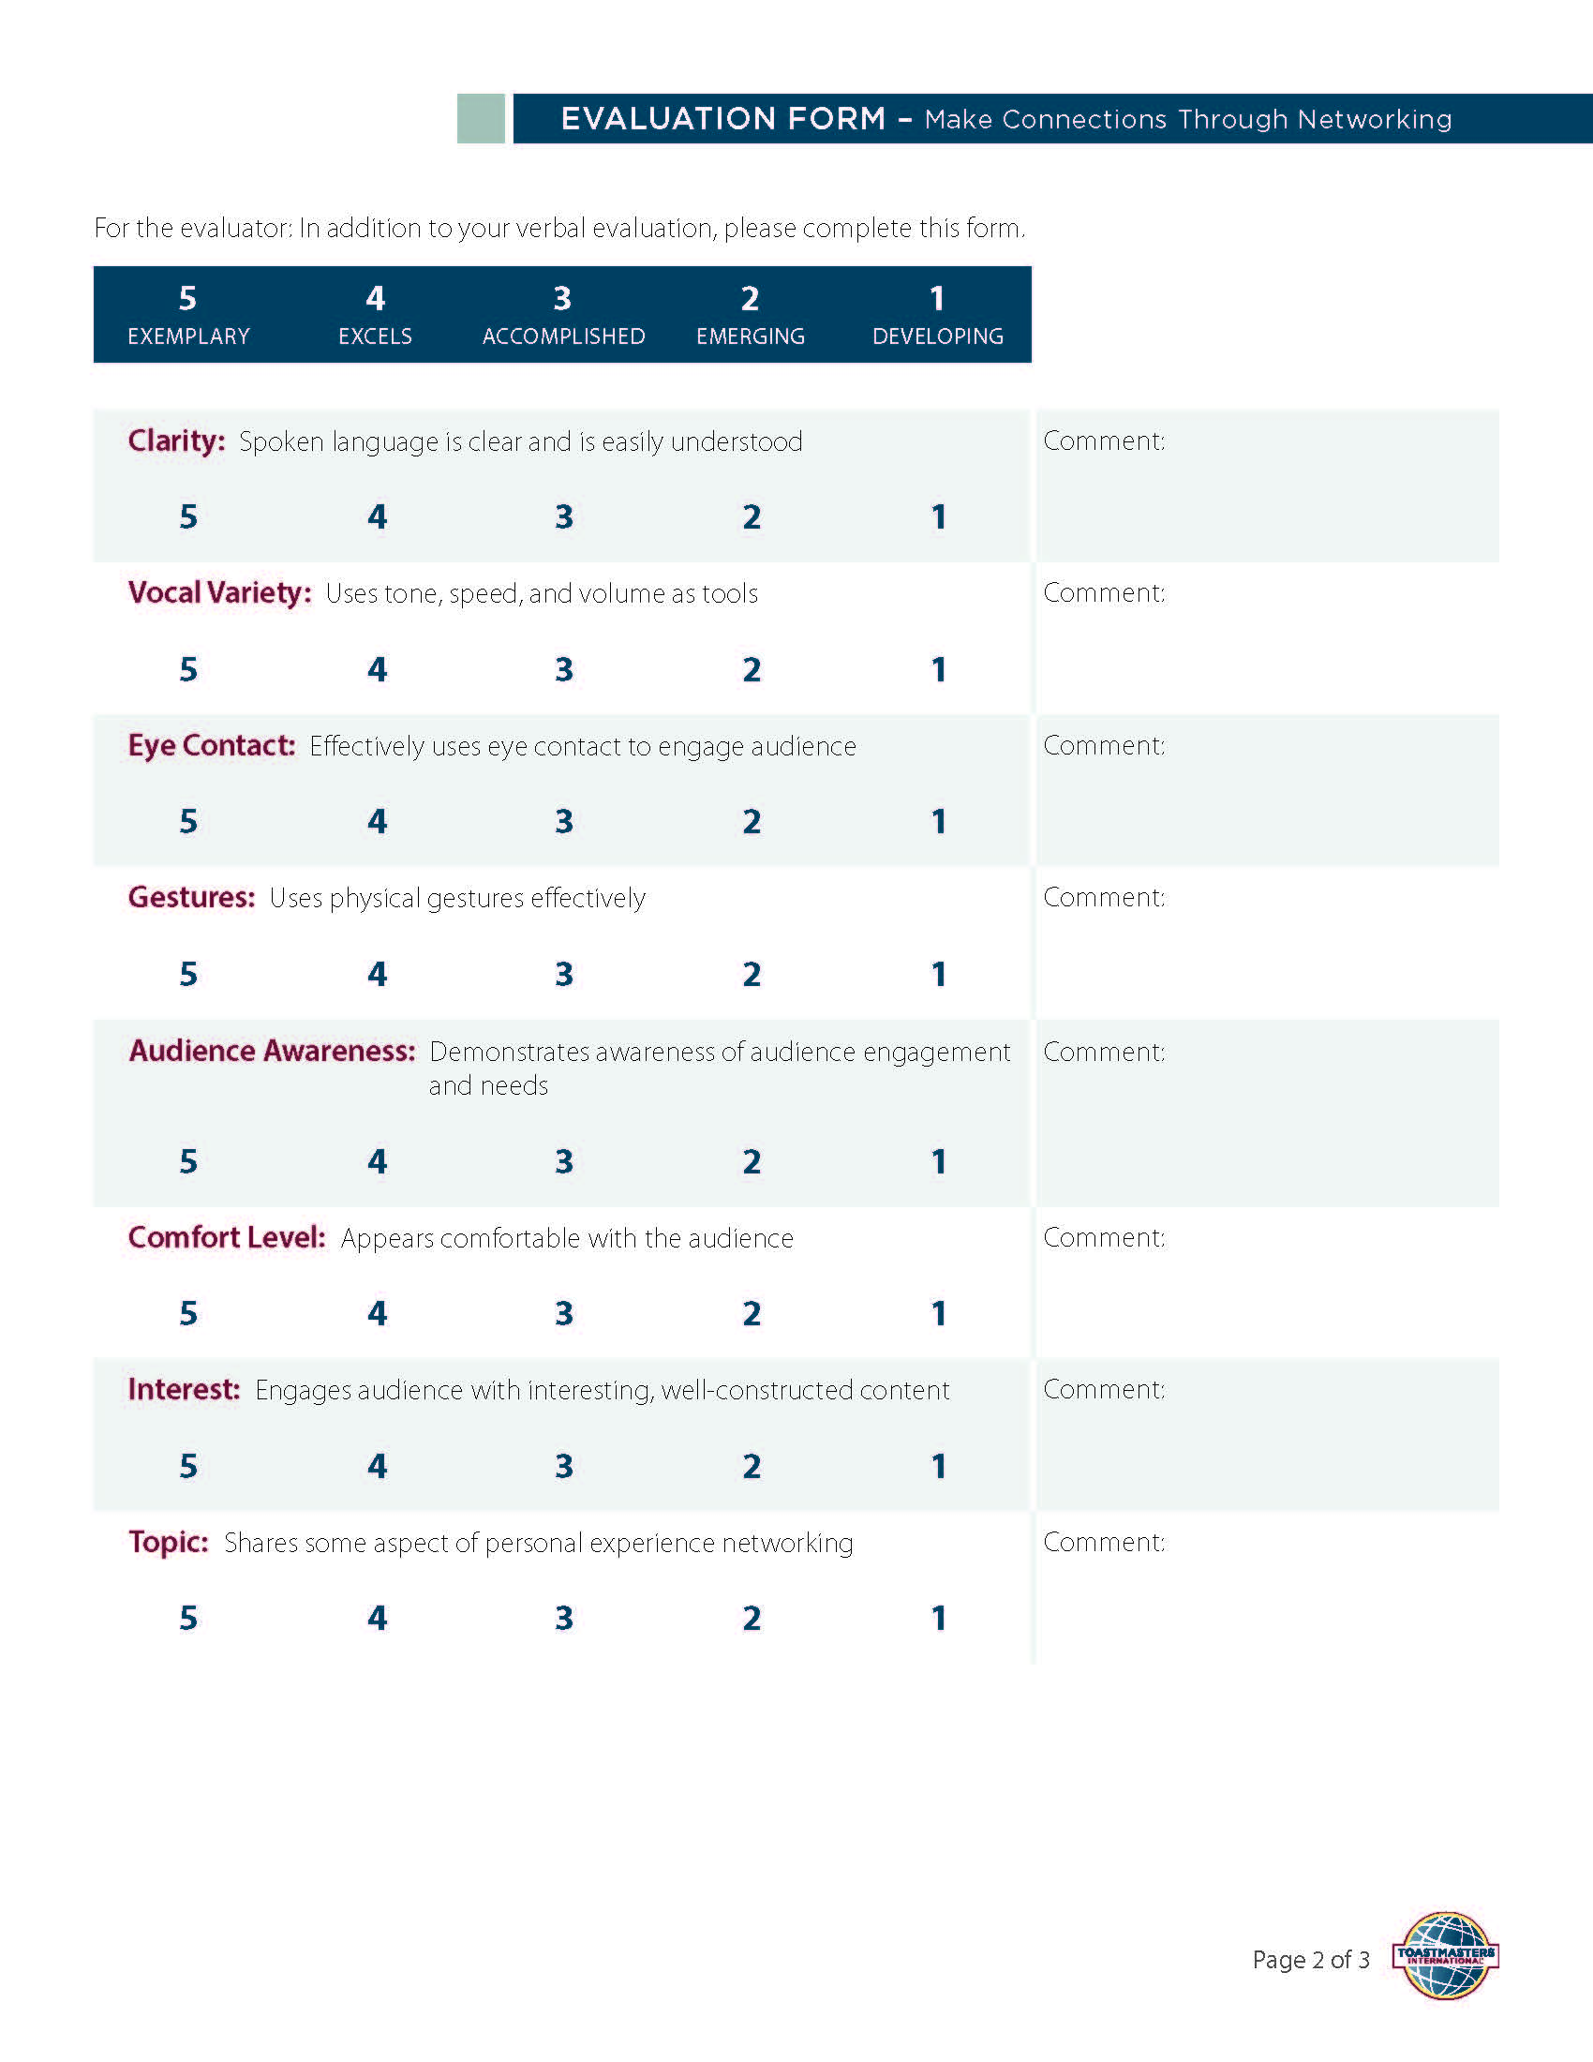

Slide 16
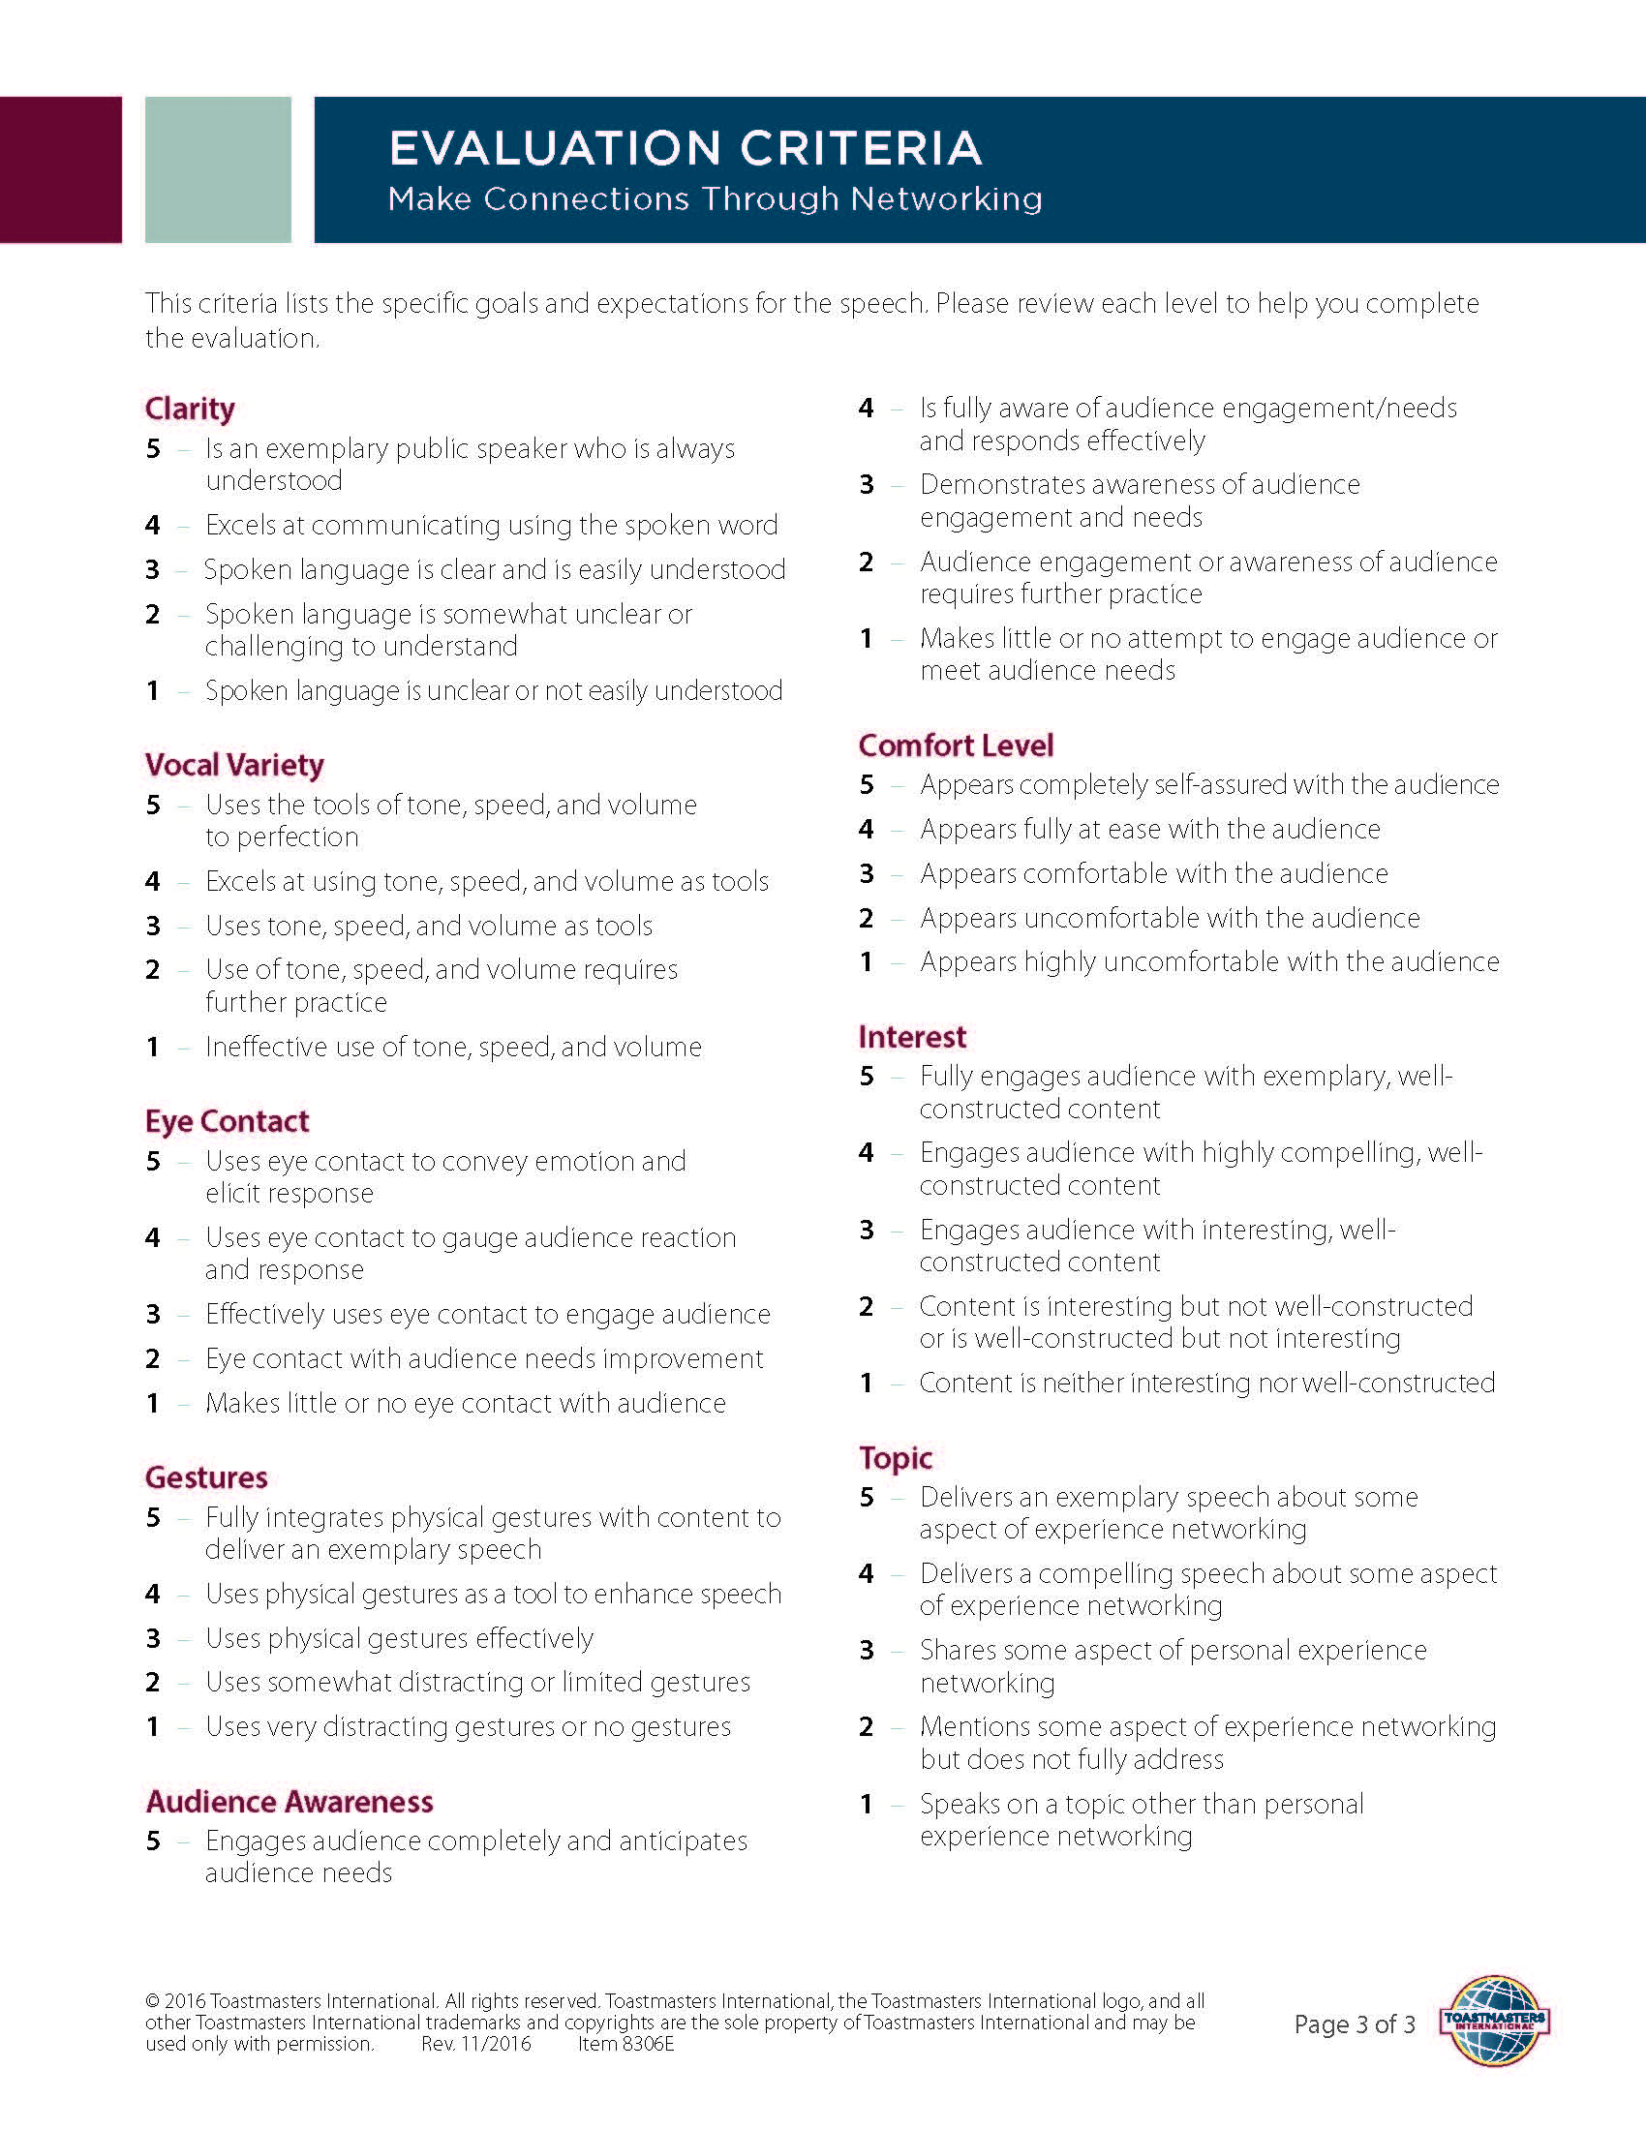
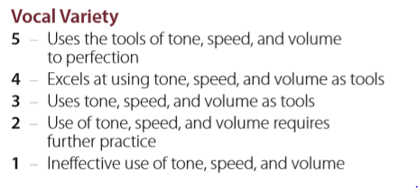

Slide 17
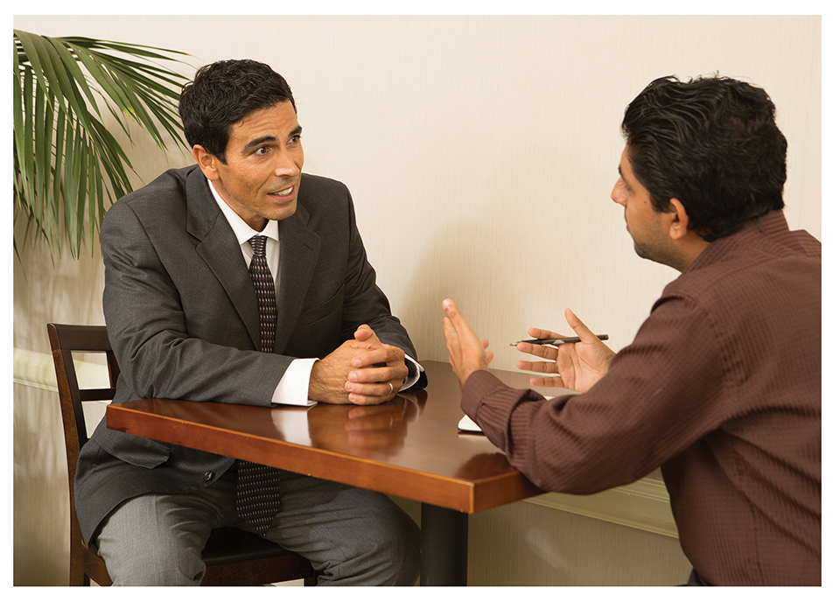
PATHWAYS MENTOR PROGRAM

Slide 18
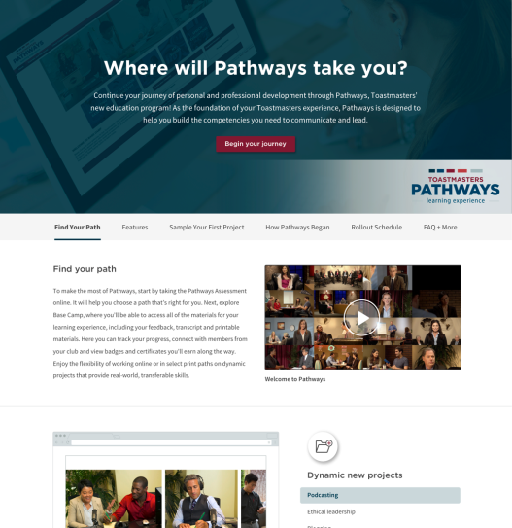
Getting Started

Slide 19
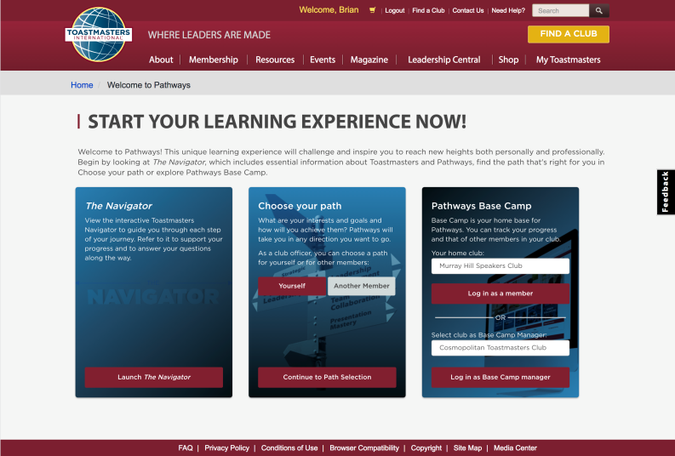
Log In, Learn More
Insert video

Slide 20
Your Guide to Pathways

Slide 21
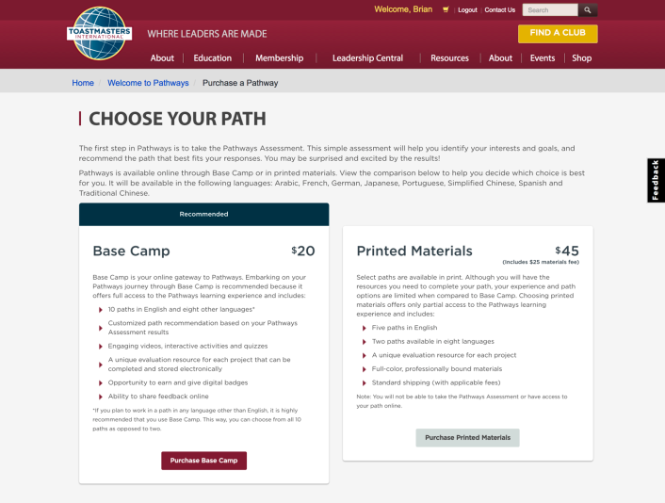
Online or Print

Slide 22
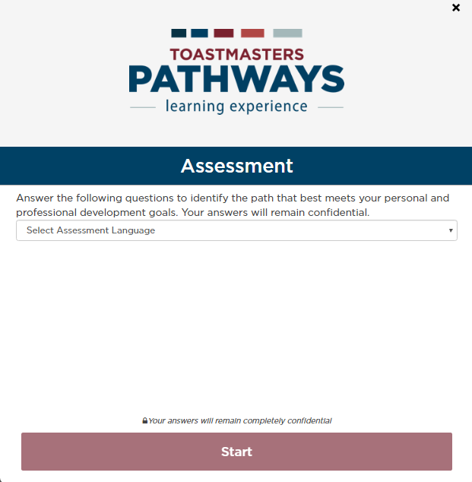

Slide 23
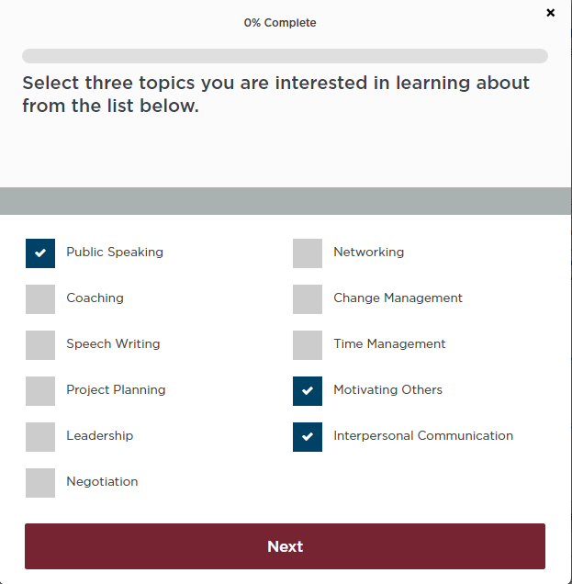

Slide 24
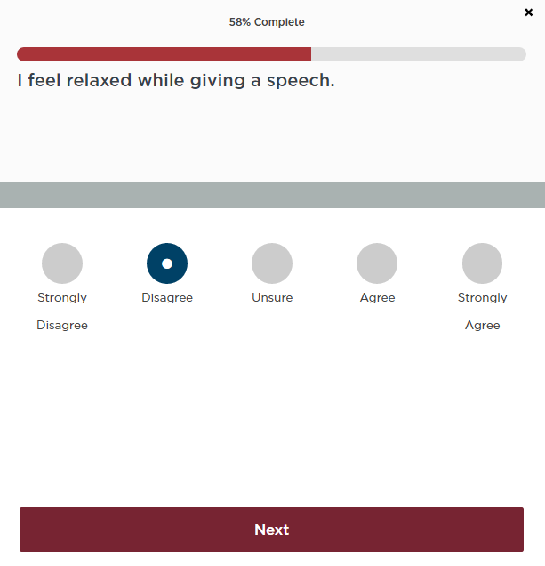

Slide 25
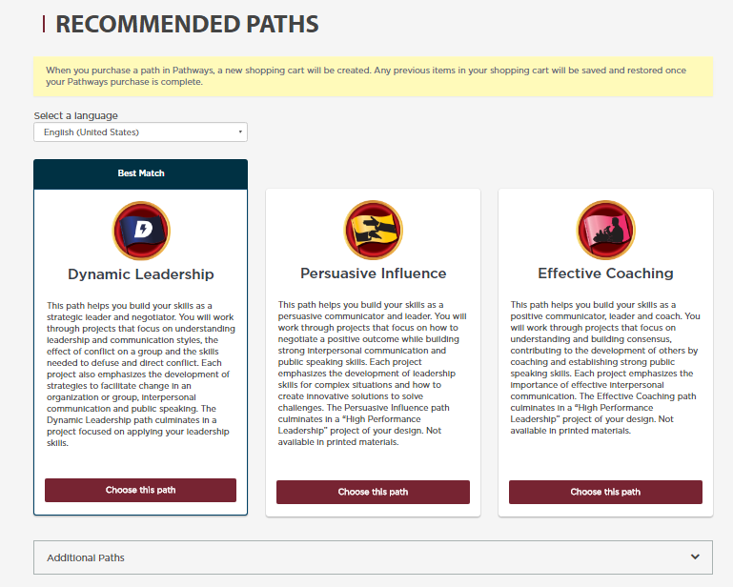

Slide 26
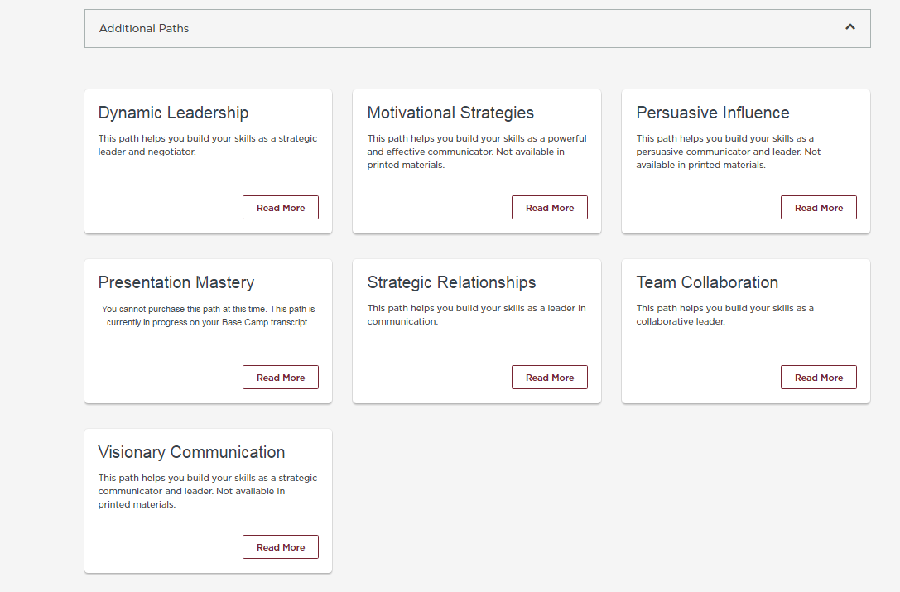

Slide 27
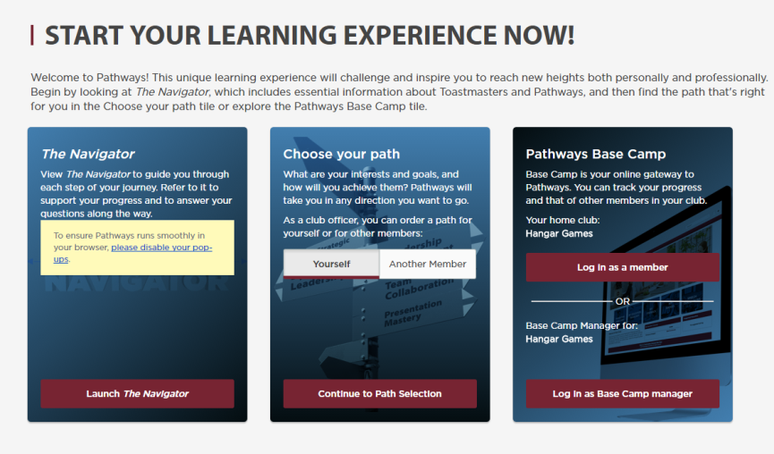
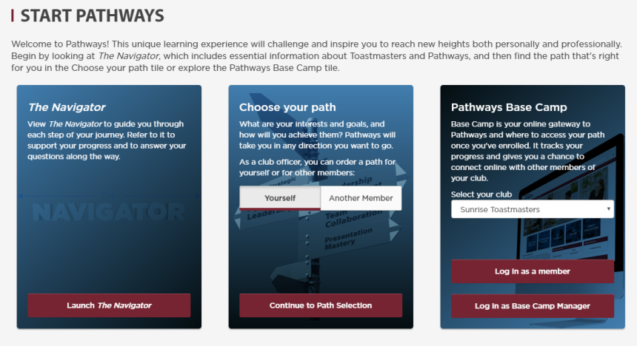

Slide 28
REACHING YOUR CURRENT EDUCATION GOALS

Slide 29
Pathways Doesn’t Change the Club Meeting

Slide 30
Distinguished Club Program

Slide 31
Local Support Team
District Leadership Team
Chief Ambassador
Ambassadors
Pathways Guides

Slide 32
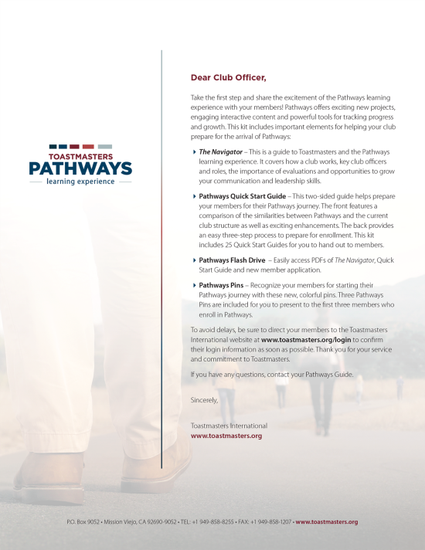
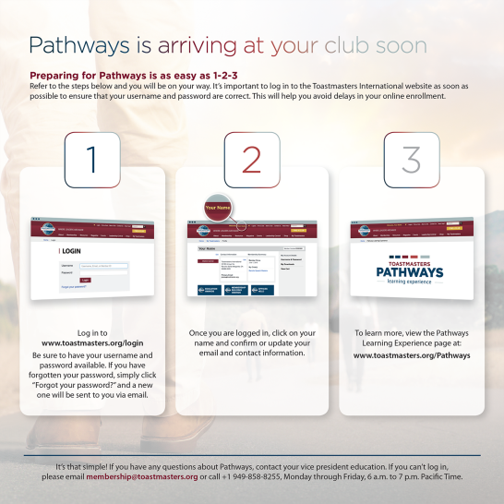
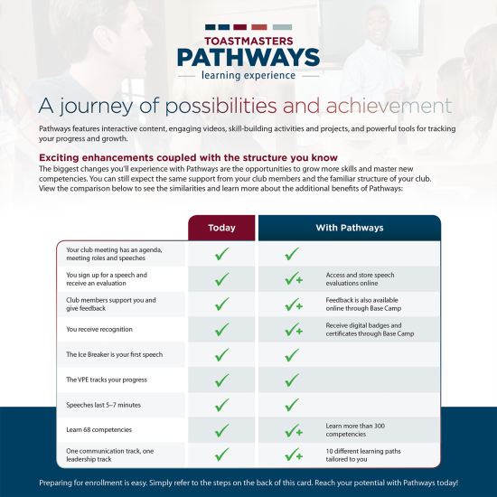
How to Get Started

Slide 33
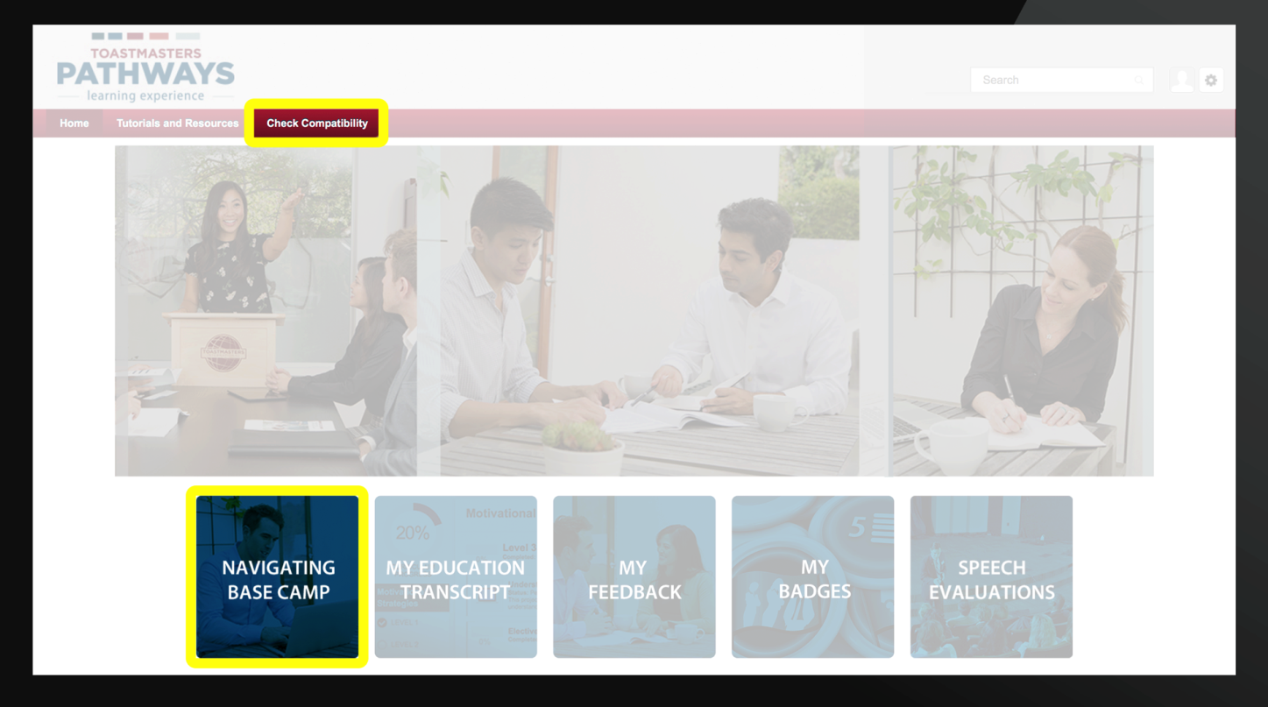
OTHER HELPFUL TIPS

Slide 34
CONTINUED SUPPORT

Slide 35
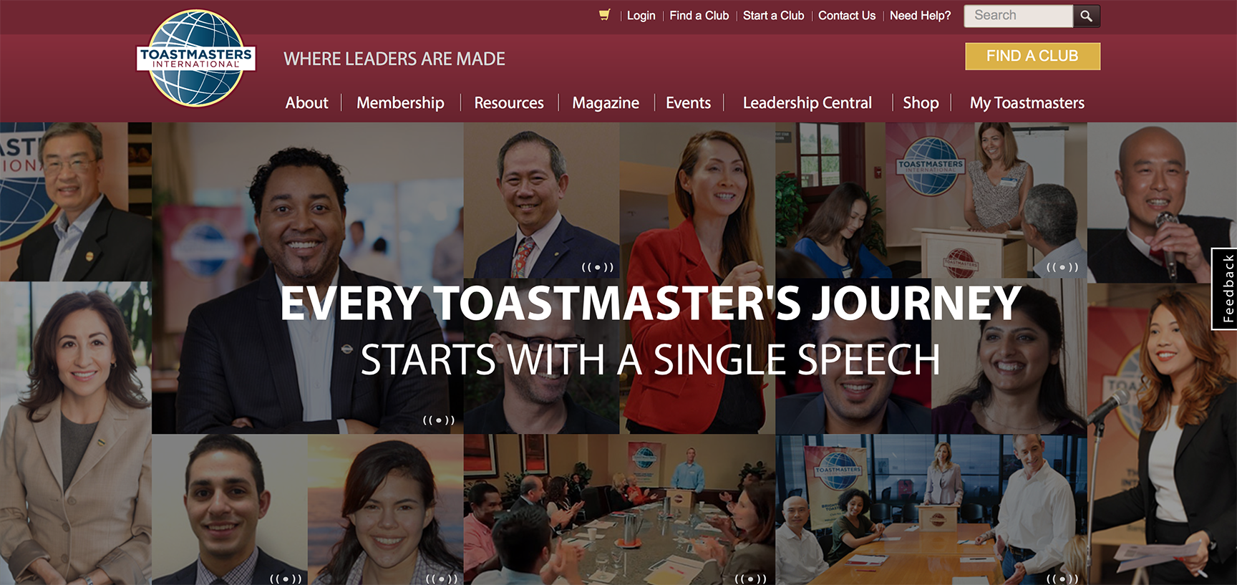
LET’S LOG IN TOGETHER

