Slide 1
ADS Equipment

Slide 2
Onboard Piloted Aircraft, Drones, and Land/Water Vehicles

Slide 3
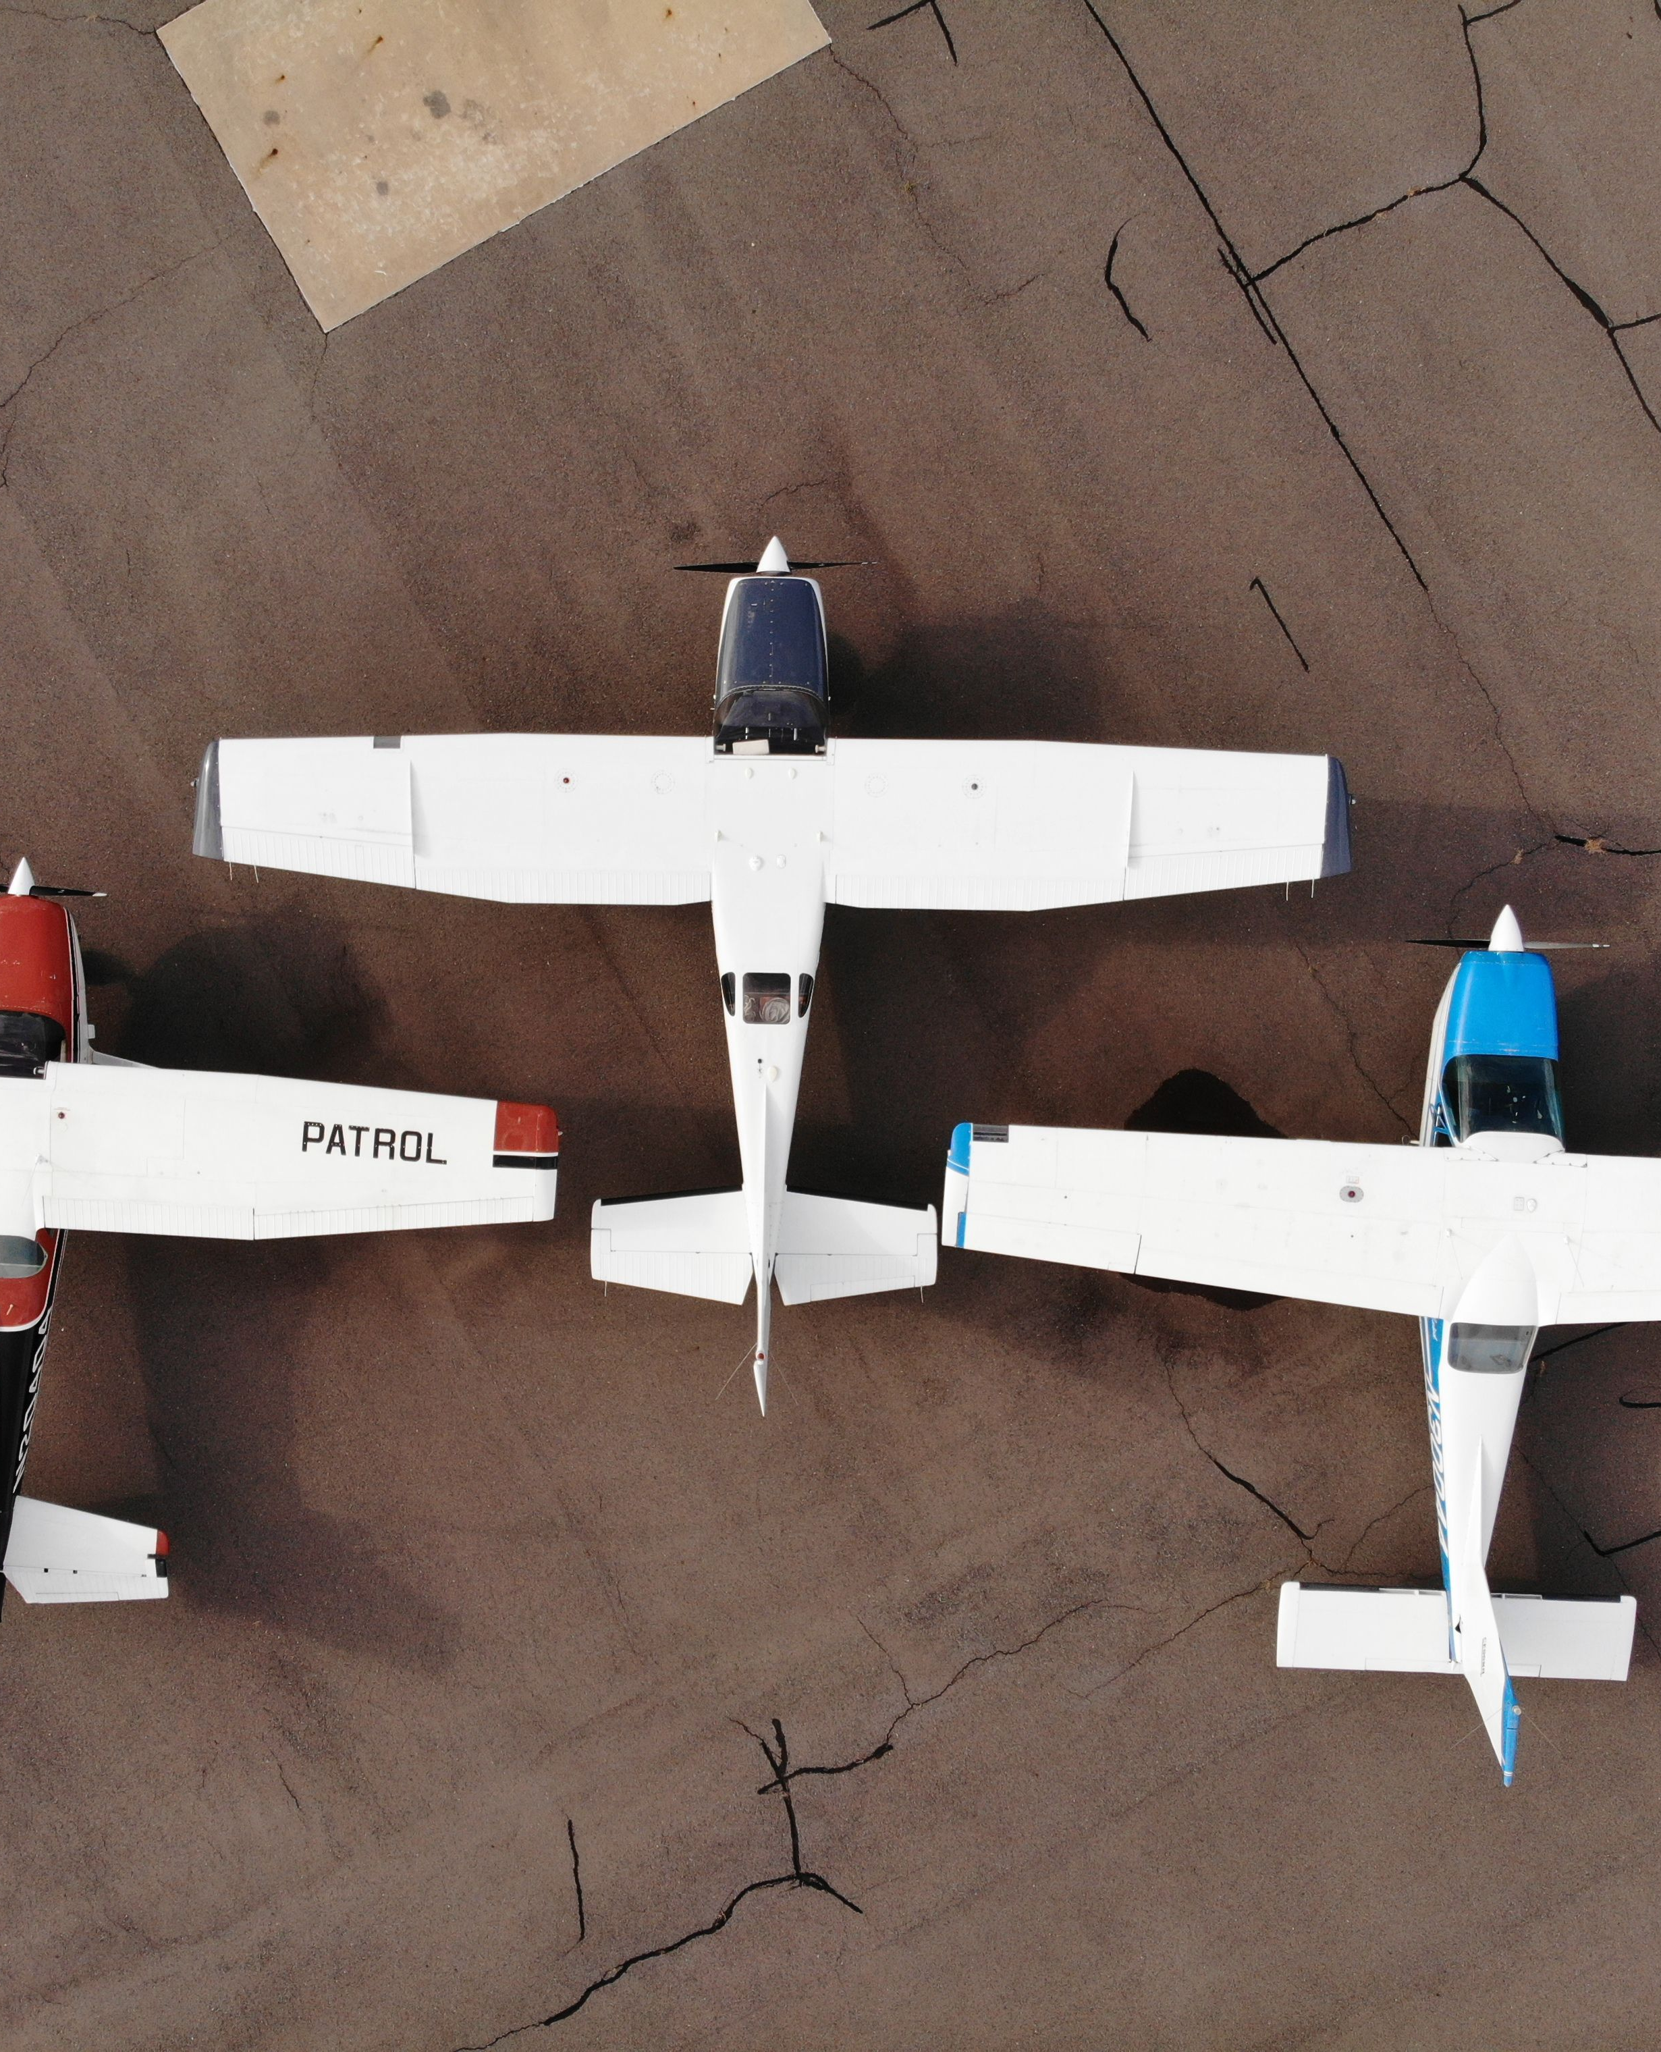
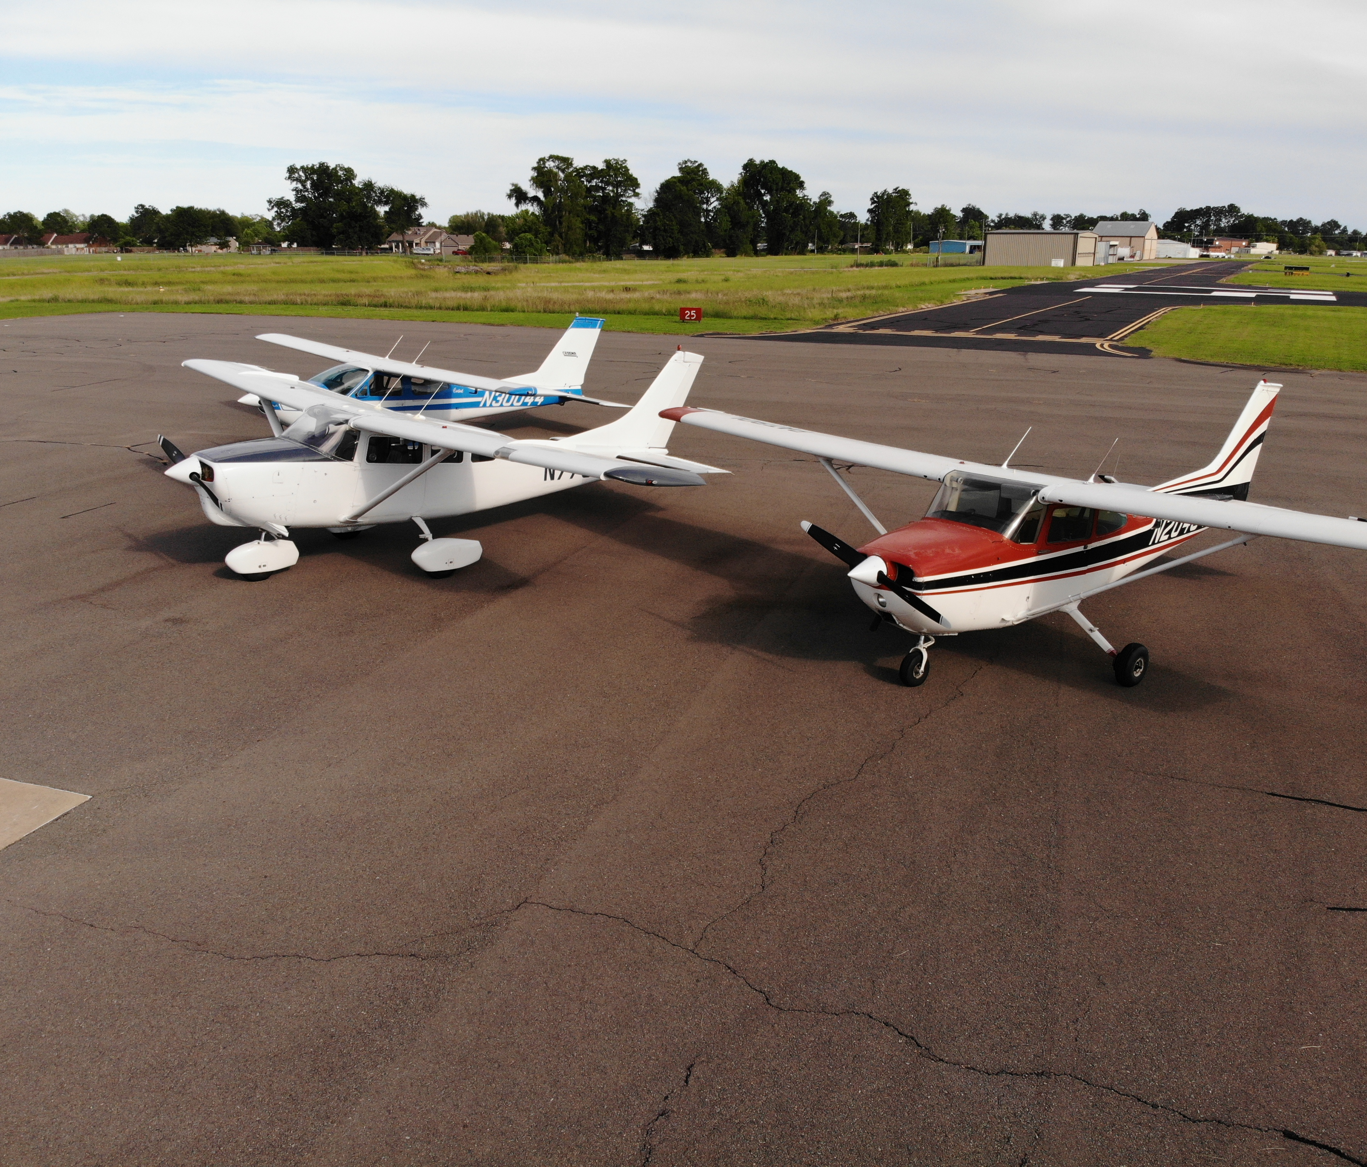
Part of ADS’s piloted aircraft fleet including (left to right) Cessna 177, 206 and 172

Slide 4
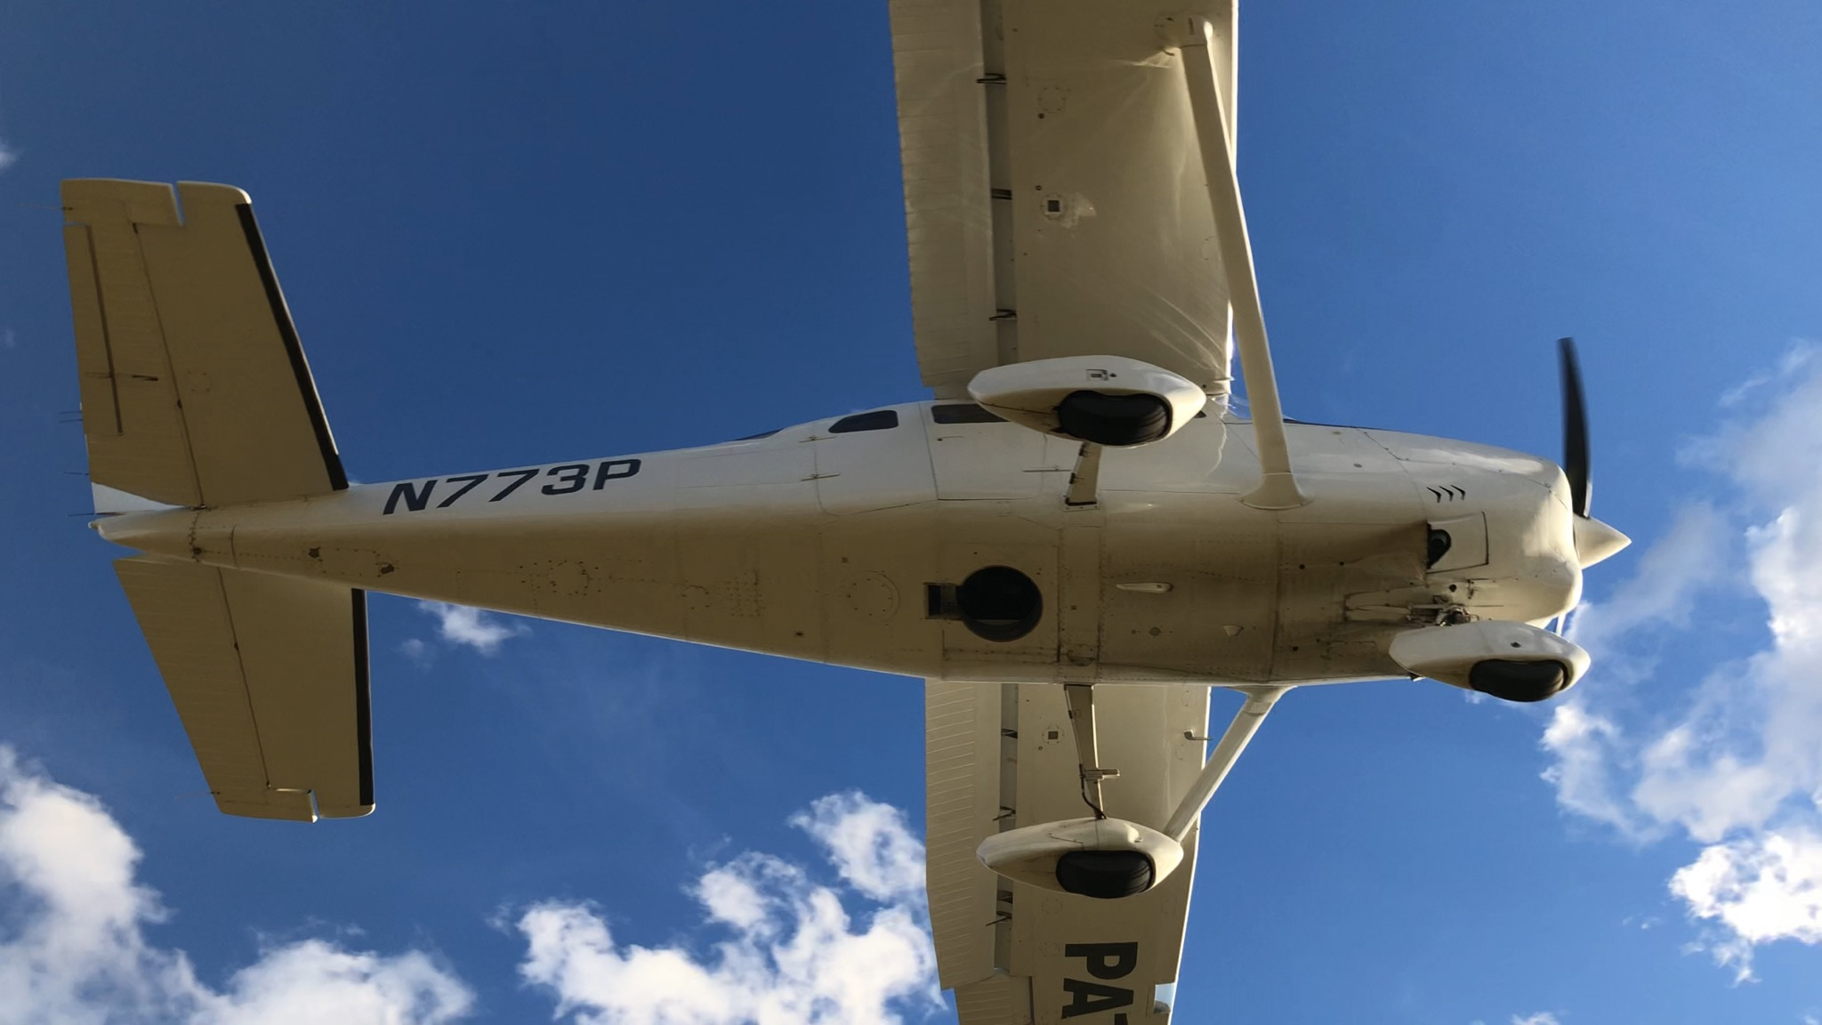
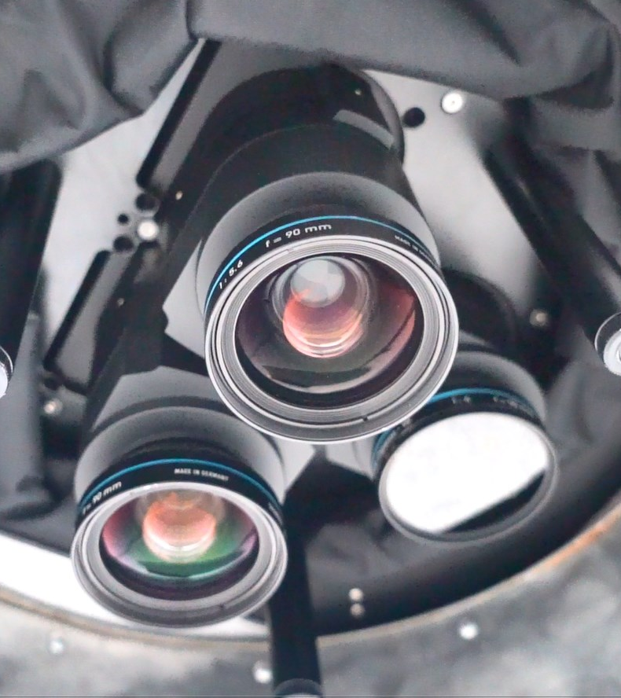
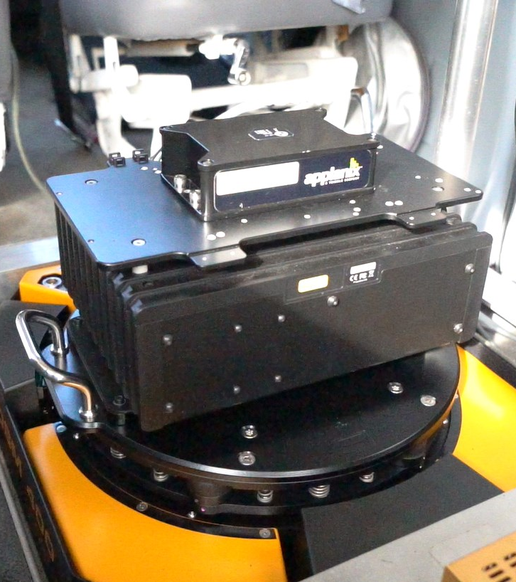
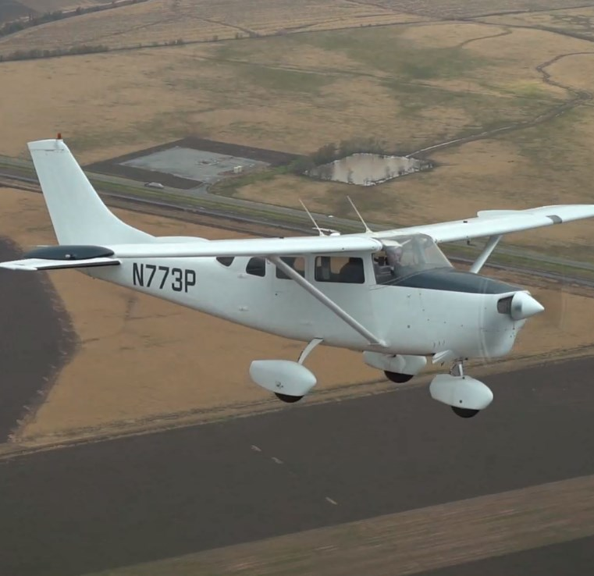
Cessna 206 with belly opening for ADS’s Phase One and it’s gimbal mount

Slide 5
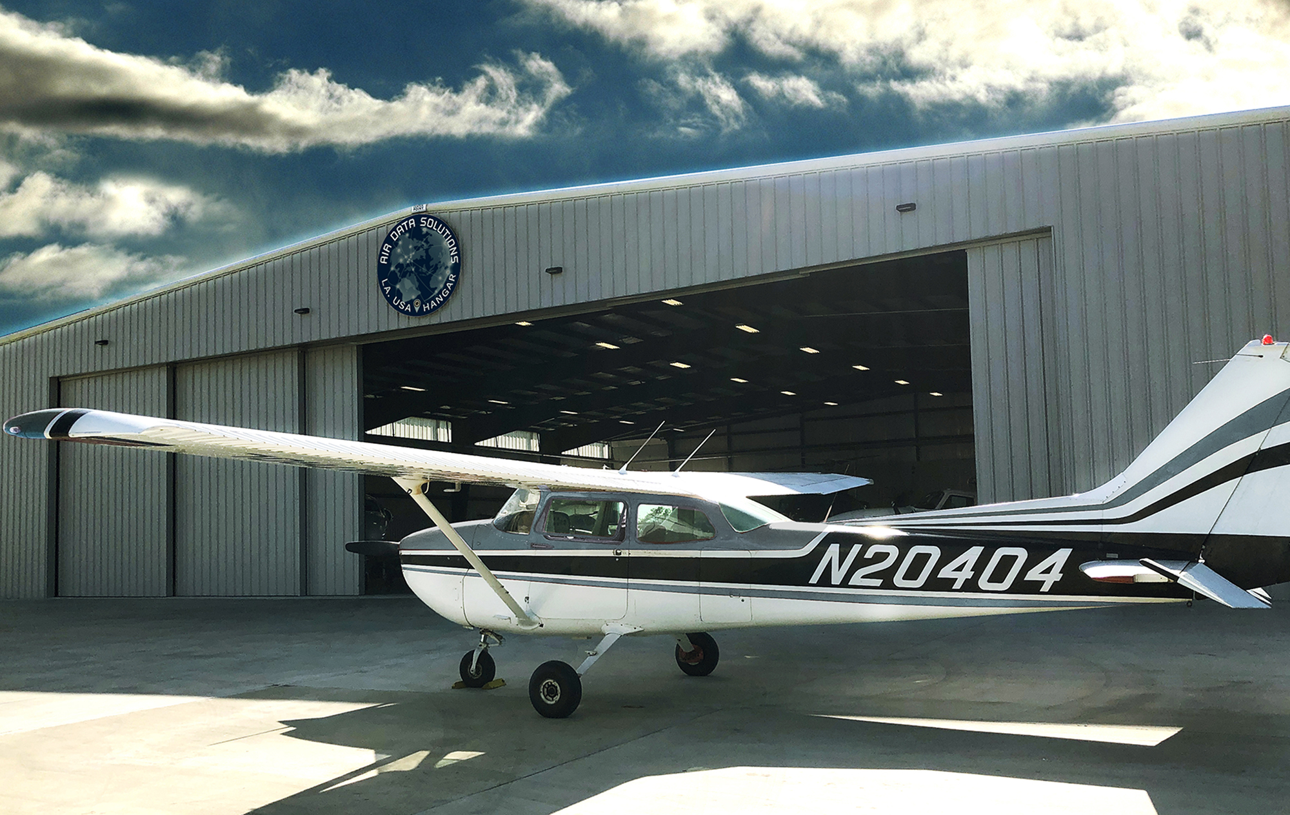
ADS’s Cessna 172 in front of our hanger.
This aircraft is used for pipeline patrol, leak detection, imagery, flight training

Slide 6
FOXTECH BS VTOL/FW HYBRID DRONE
Long Endurance Drone Aircraft
Used to carry natural color, color infrared and thermal scanner

Slide 7
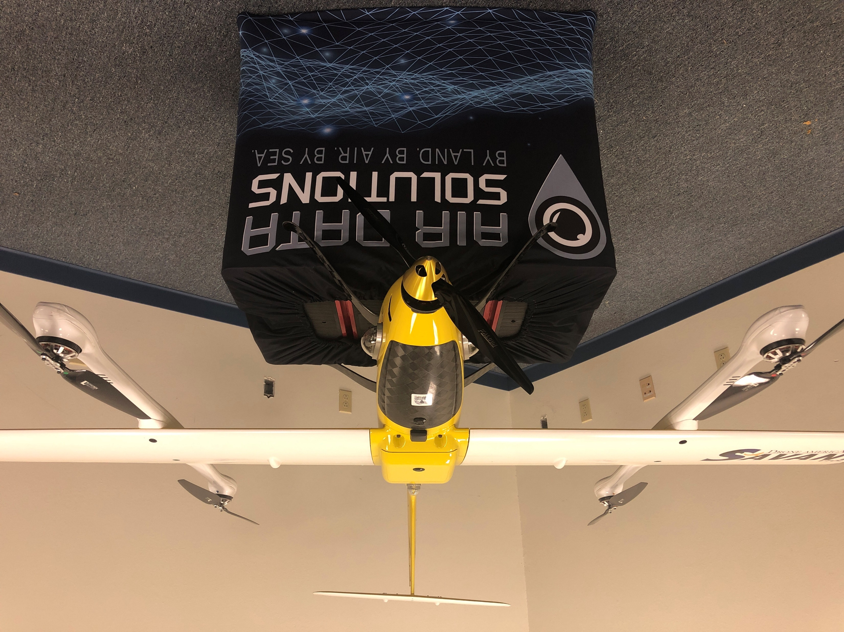
Savant aircraft is an all electric powered fixed-wing aircraft with both Vertical Take-Of and Landing and long-range extended flight time.
It can carry many of ADS’s cameras

Slide 8
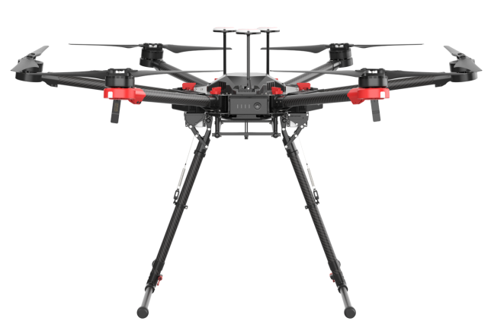
M600 Heavy Lift drone

Slide 9
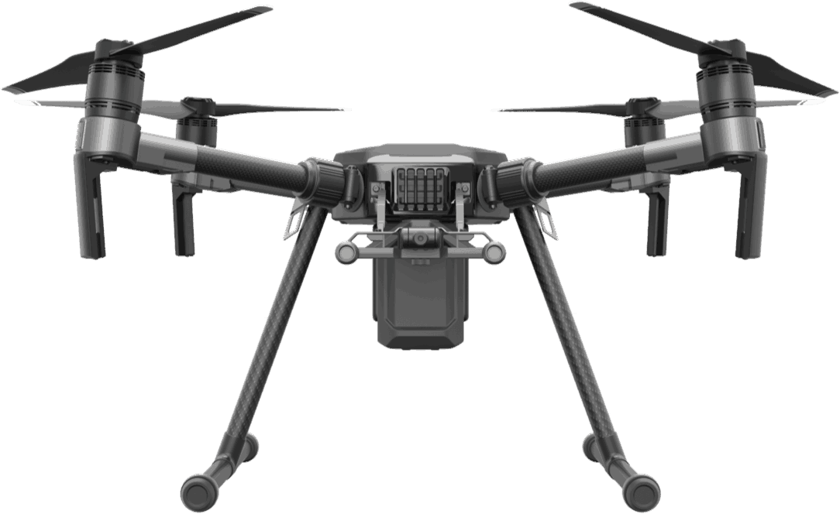
M210 medium lift drone

Slide 10
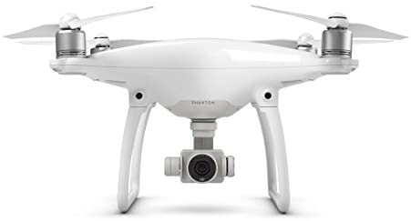
ADS has multiple DJI Phantom Series drones

Slide 11
Lowe 20 ft Pontoon Hydrographic Survey Boat

Slide 12
Cameras and Scanners

Slide 13
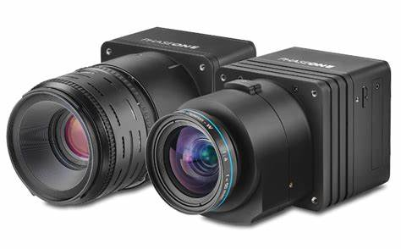
Phase One iXU-RS-1000
Aerial mapping cameras ((natural color (RGB) and Near Infrared)) cameras.
These cameras are flown in a manned aircraft and can collect pictures covering approximately 100,000 acres (150 sq. miles) per hour.

Slide 14
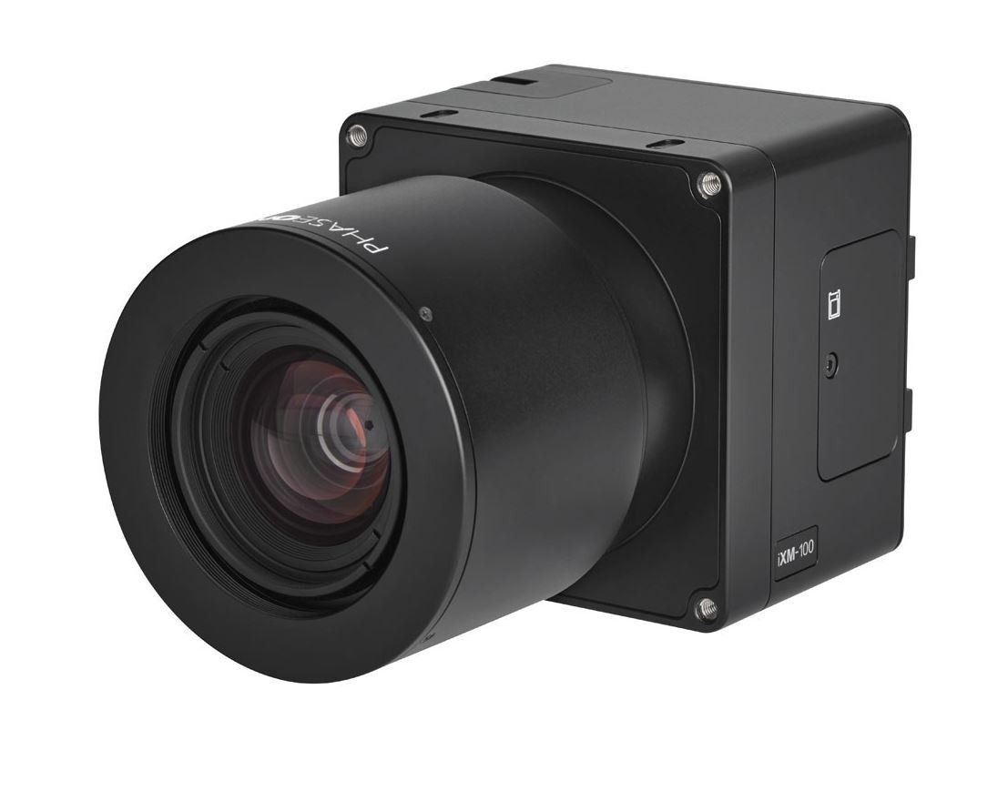
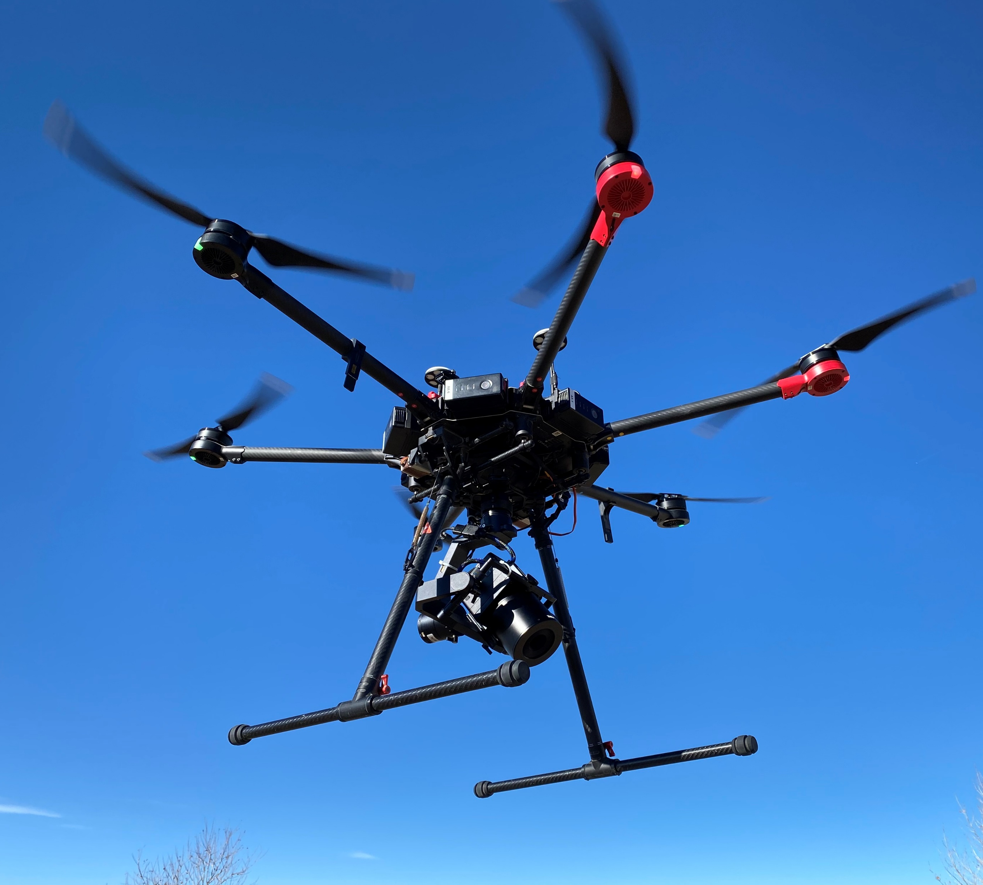
Phase One iXM 100MP
Natural color ultra-high-resolution camera
Flown on a DJI 600 PRO.
Can acquire imagery covering an area up to approximately 500 acres per day.

Slide 15
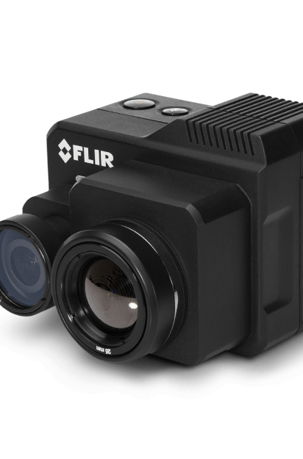
High Definition DUAL-SENSOR THERMAL and visible light CAMERAs
Flown on heavy lifting drones and piloted aircraft

Slide 16
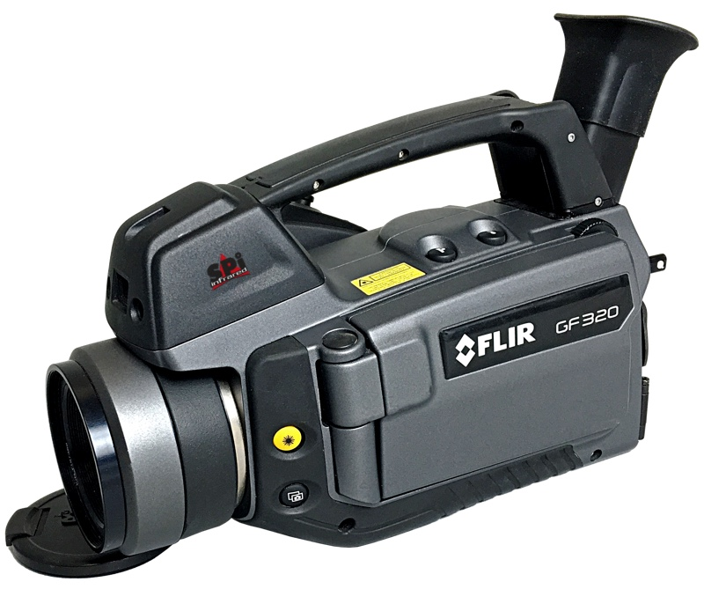
FLIR GF320 THERMAL CAMERAL
Optical Gas Imaging (OGI) for detecting methane gas leaks

Slide 17
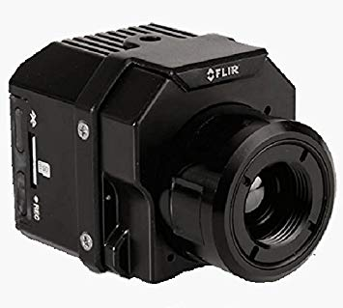
FLIR VUE PRO R
Radiometric Drone Thermal Camera
Flown on ADS’s heavy lifting drones

Slide 18
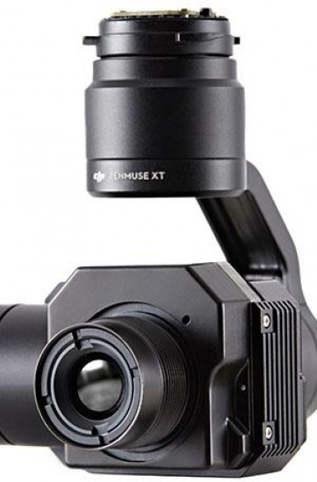
ZENMUSE XTR 640x512 9 mm Thermal Scanner
This scanner is flown on ADS’s medium sized drones that are custom designed to receive the connecting adapter for this scanner.

Slide 19
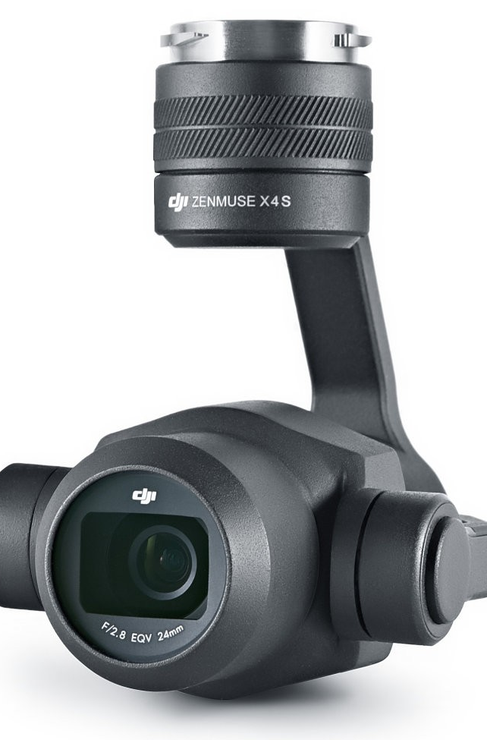
Zenmuse X4 S
Natural Color Camera
Custom adapted for our medium sized drones.

Slide 20
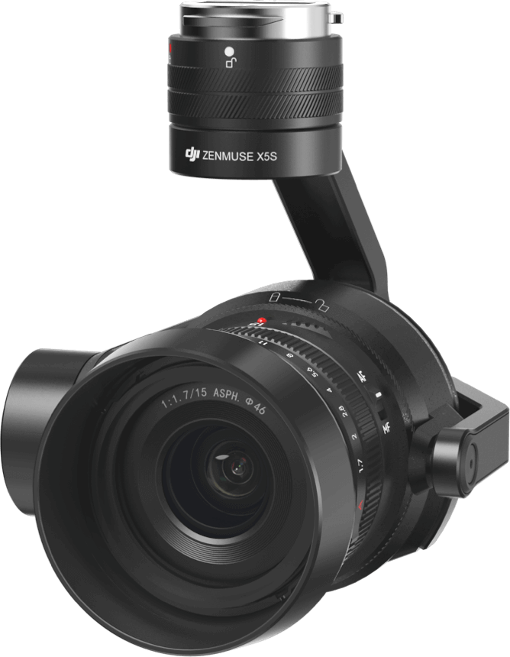
ZENMUSE X5S
Natural Color Camera
Custom adapted for our medium sized drones.

Slide 21
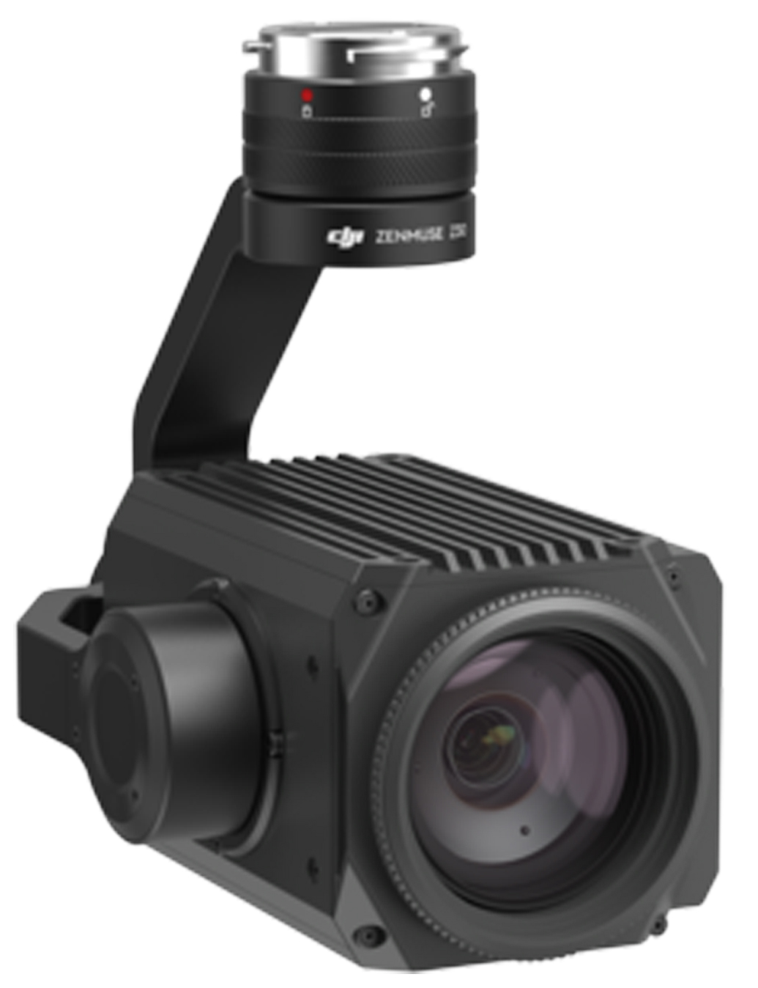
ZENMUSE Z30 NATURAL COLOR CAMERA
Custom adapted for our medium sized drones.

Slide 22
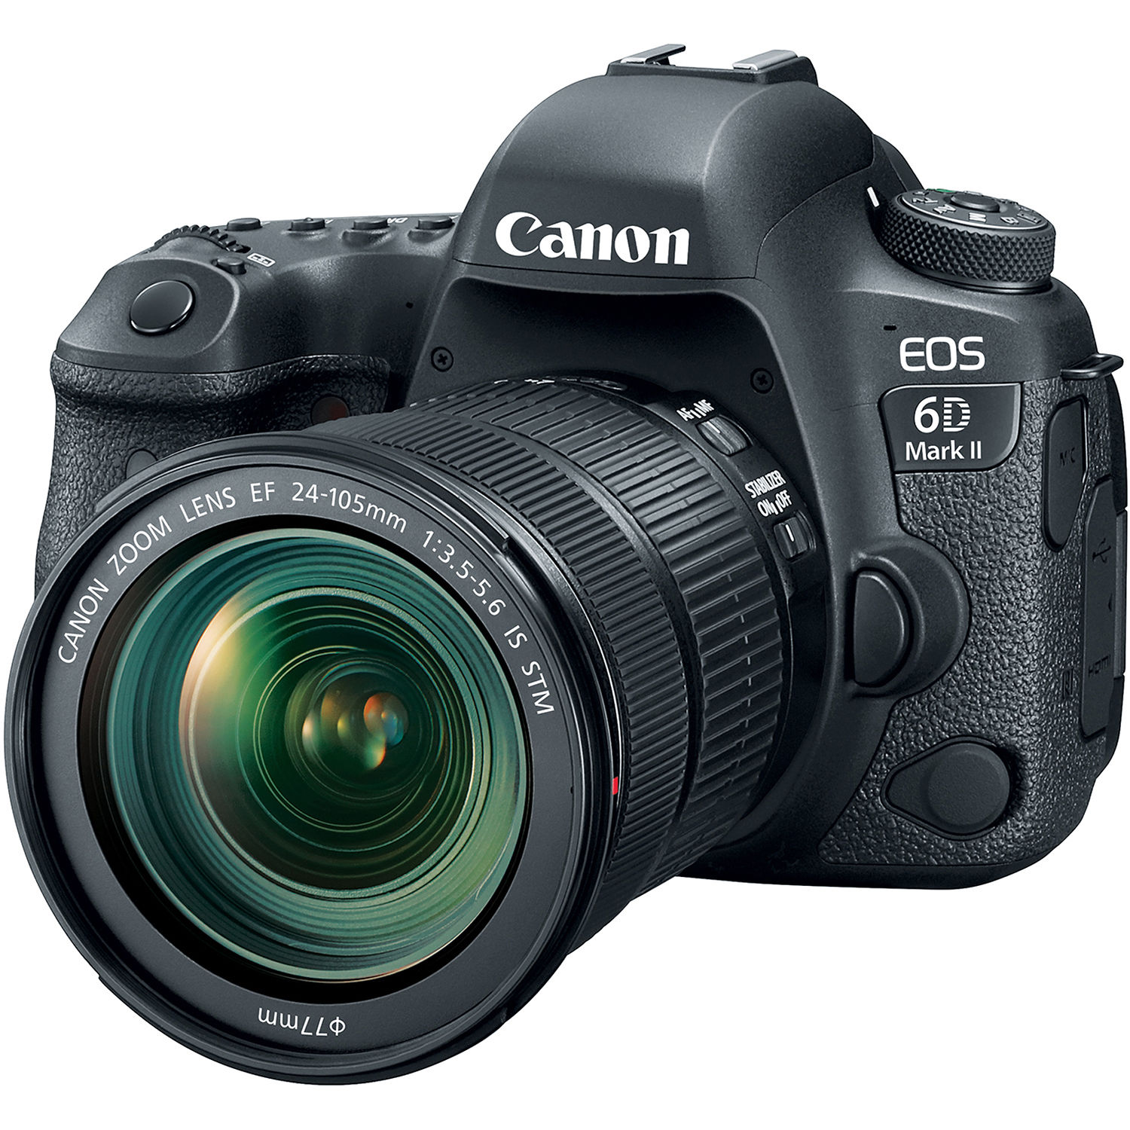
Canon 6D Full Frame 20.2 MP. ADS has the camera in
Natural Color
Rededge
Color Infrared
Flown on heavy lifting drones and piloted aircraft

Slide 23
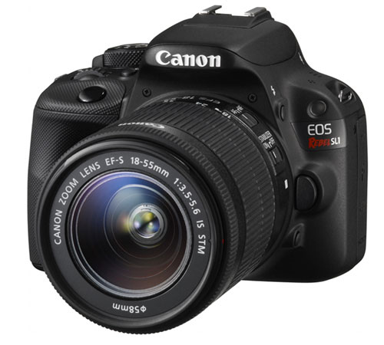
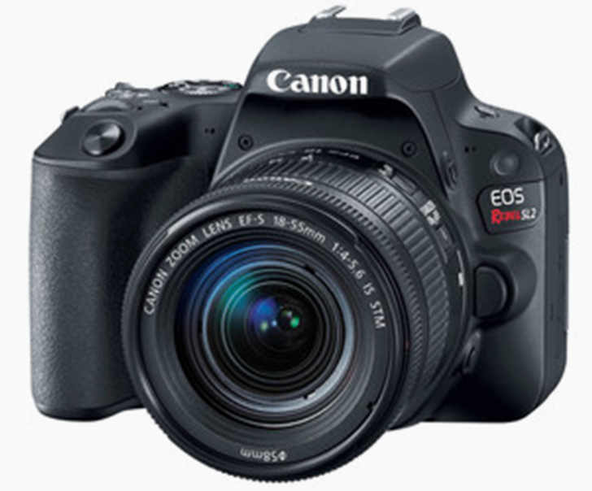
Canon SL1 18MP
Canon SL2 24.2MP
These Canon light weight cameras are flown on heavy and medium weightlifting drones. Using these cameras, ADS can acquire imagery in natural color, rededge and Color Infrared.

Slide 24
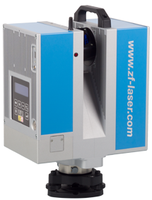
LIECA HDS6000 LIDAR SCANNER
Ground based lidar for precision as built modeling

Slide 25
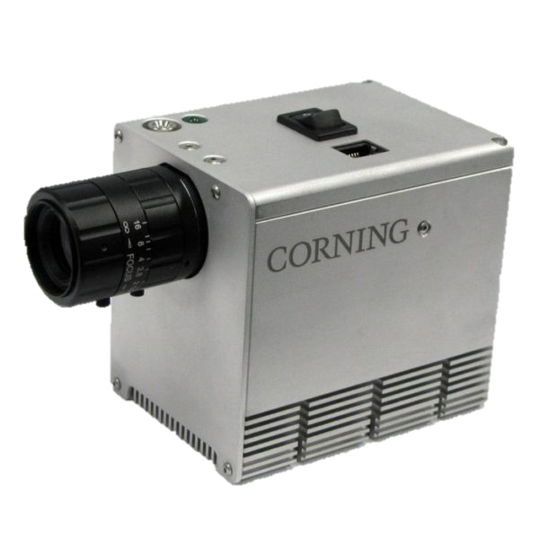
CORNING 410 SHARK HYPERSPECTRAL SCANNER
Used for research and crude oil leak detection

Slide 26
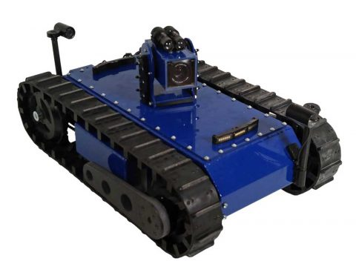
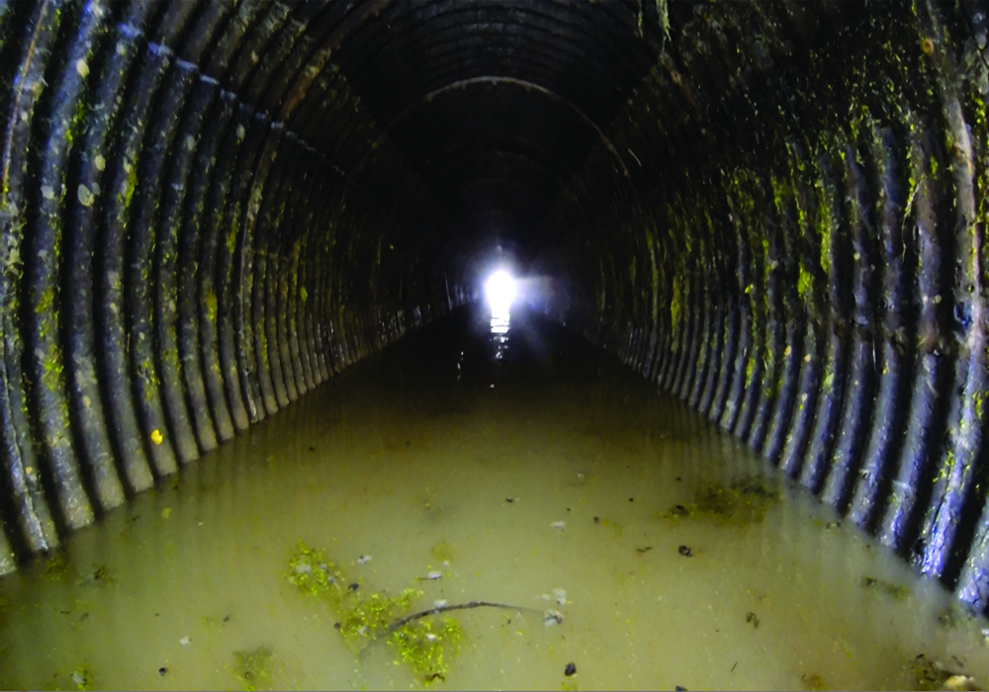
SUPERDROID CULVERT REMOTE OBSERVATION VEHICLE
Remote operated vehicle for culvert and pipe inspection

Slide 27
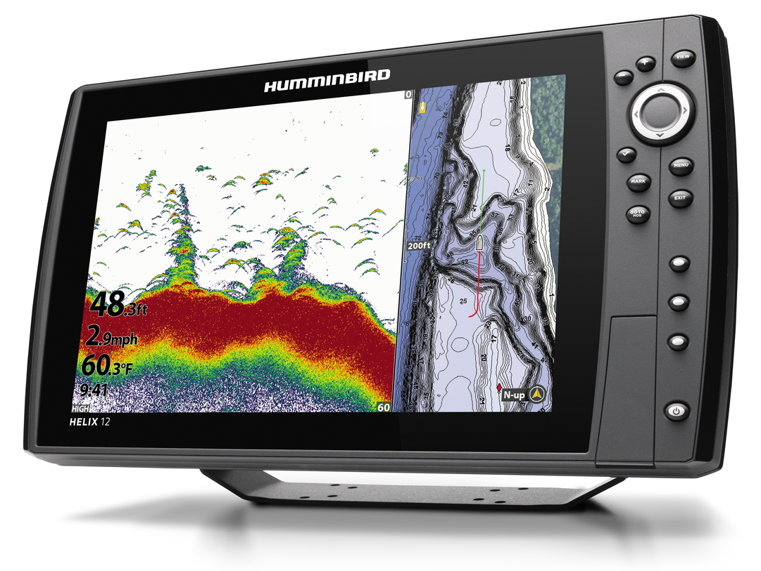
HUMMINGBIRD HELIX 12 SONAR
Mapping lake and river bottoms

Slide 28
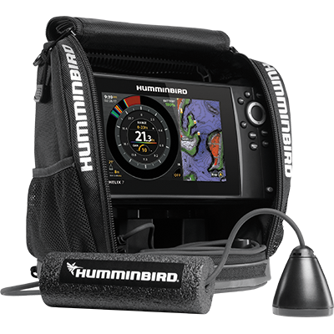
HUMMINGBIRD HELIX 7 SONAR
Supplement to Helix 12
Used for under water structural mapping

Slide 29
Examples of Software Used by ADS for image analysis and environmental modeling

Slide 31
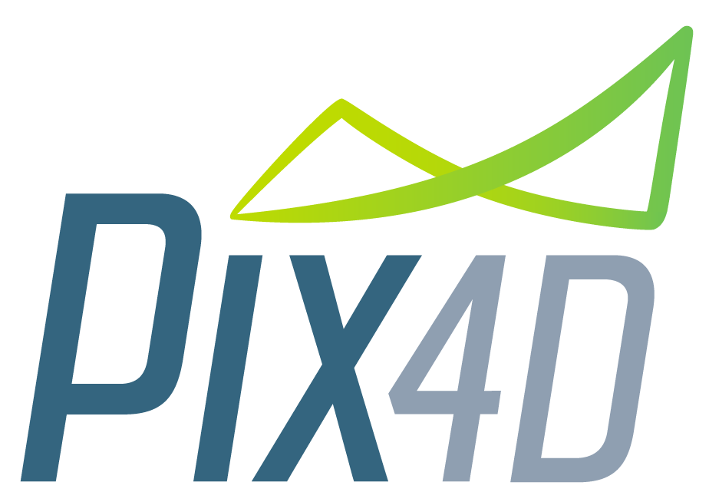
One of the software programs used to create orthomosaics from drone and piloted aircraft acquired imagery

Slide 32
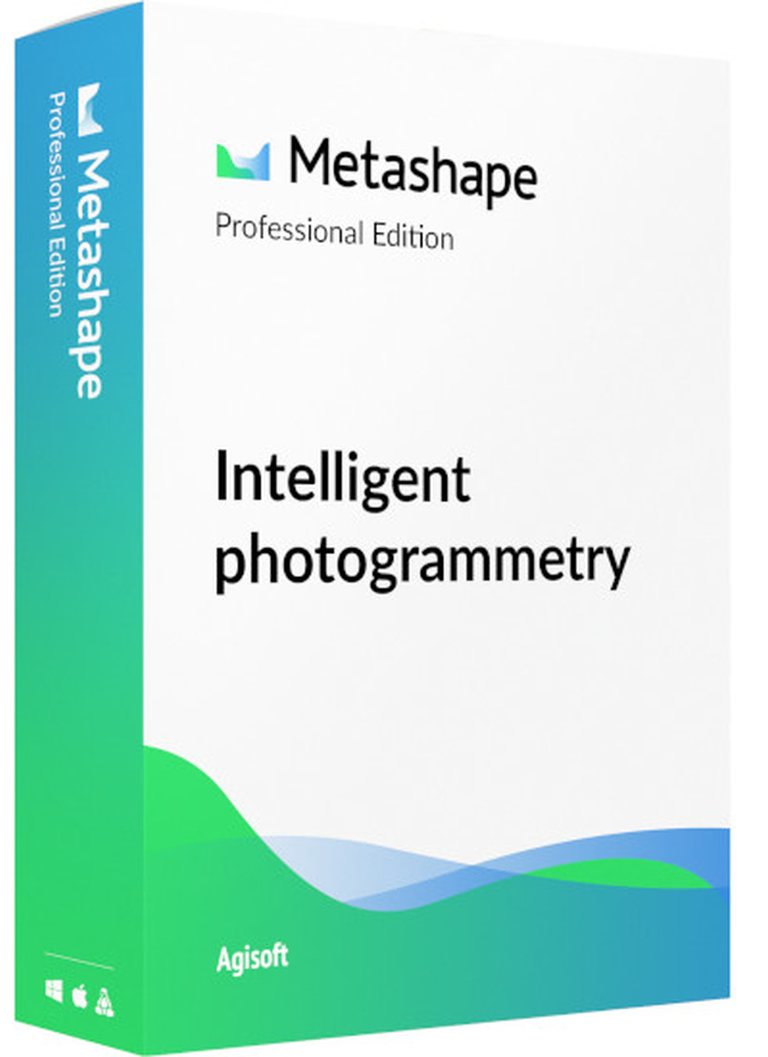
A software program used for photogrammetric analyses of aerial imagery

Slide 33
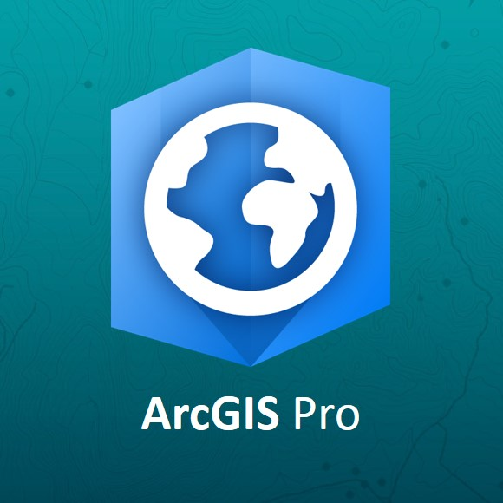
Geographic Information Software used for geographic analytical analyses including environmental modeling and data extraction.

Slide 34
Geographic Information and Image Analysis Software

Slide 35
Image processing software for data mining, machine learning and hyperspectral image analyses.

