Slide 1
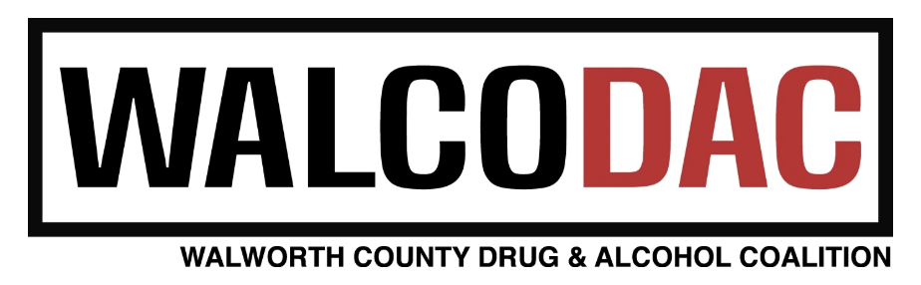
Naloxone Administration Training
Division of Care and Treatment Services

Slide 2
Today’s Trainer
Mike Hinske- State Certified Trainer for Naloxone Administration

Slide 3
Section A
What is an opioid?

Slide 4
Opioids
An opioid is any drug that contains opium (or its derivative).
Opioids can be:
Natural or synthetic.
Prescription medications or illegal drugs.
Pills, capsules, powder, dermal patches, or liquid.
Swallowed, smoked, snorted, or injected.

Slide 5
About Opioids
Opioids:
Manage pain, suppress coughs, and treat opioid use disorder (addictions).
Cause feelings of euphoria, contentment, and/or detachment.
Have effects lasting from 3 to 24 hours.
In excessive amounts, opioids can suppress a person’s ability to breathe.

Slide 6
How Opioids Work
Opioids bind to and activate receptors in the brain, triggering the release of dopamine – a neurotransmitter linked to learning, pleasure, and reward.
Overtime, opioid use changes both the amount and sensitivity of dopamine receptors causing users to need a continuous supply of opioids to feel “normal.”
Notes:
Our bodies produce substances that are very similar to opioids; these are known as endogenous opioids or endorphins. Exogenous opioids, such as heroin and methadone, bind to the same receptors as endogenous opioids, which explains their powerful effect on human beings.
Opioids release an excess of dopamine into the body. Dopamine is a neurotransmitter (brain chemical) involved with learning, motivation, pleasure, and reward. Opioids change the amount and sensitivity of dopamine receptors and can make people feel euphoric; in addition, opioids can suppress pain and reduce anxiety. Eventually, users require an opioid to continuously occupy the opioid receptor in the brain, or they develop withdrawal symptoms.

Slide 7
Opioid
Opioid fits exactly on receptor
Opioid receptor in brain

Slide 8
Examples of Prescription Opioids
Generic Name | Brand Name
Oxycodone | Oxycontin®, Percocet®, Roxicodone®
Oxymorphone | Opana®
Hydrocodone | Vicodin®, Lorcet®, Zohydro®, Zortab®
Hydromorphone | Dilaudid®
Morphine
Meperidene | Demerol®
Codeine | Tylenol® 3 & 4
Buprenorphine | Suboxone®, Subutex®, Zubsolv®
Methadone
Fentanyl | Duragesic®

Slide 9
Examples of Illicit Opioids
Heroin
  Non-pharmaceutical fentanyl (Illicitly produced, synthetic drug)
  Pill form packaged to look like prescription medications
  Powder form looks similar to heroin
  May be hundreds of times more potent than heroin
  Fentanyl can be extremely deadly!
Notes:
Fentanyl is also being mixed with other drugs including cocaine, methamphetamine, and even marijuana - putting people who do not typically use opioids at higher risk of overdose.
It is important to remember that it is not just people who have substance use disorders who are susceptible to an opioid-related overdose. Anyone who takes opioids is at risk of an overdose, especially older adults, who may confuse their doses.
A note on fentanyl exposure: Overdosing on fentanyl just by touching it or by simply being in proximity to it is extremely unlikely, if not impossible. Yet overdose by contact has been a persistent myth about fentanyl since it began supplanting heroin in much of the US’s illicit opioid supply. Still, these stories and the myth they perpetuate really matter. They suggest that helping people who use drugs can be dangerous. That can lead to unnecessary caution or new requirements, like forcing officers to put on certain equipment when they respond to an overdose — which could then lead to people in need of quick, unhesitating emergency help getting hurt or killed as they wait. Fentanyl is only dangerous when it’s genuinely ingested — by snorting it or injecting it into the bloodstream. The American College of Medical Toxicology published a position statement (https://www.acmt.net/cgi/page.cgi/_zine.html/The_ACMT_Connection/ACMT_Statement_on_Fentanyl_Exposure) noting as much in 2017, finding that “it is very unlikely that small, unintentional skin exposures to tablets or powder would cause significant opioid toxicity, and if toxicity were to occur it would not develop rapidly, allowing time for removal.”
If you get fentanyl on your skin, simply use soap and water to wash it off.
All that being said, it is always important to make sure that you and others are safe when responding to an overdose. Use a rescue breathing mask if available, turn the lights on to avoid unintentional needle sticks, do not touch your eyes, mouth, and nose after touching any surface potentially contaminated with fentanyl.

Slide 10
Section B
Recognizing an Opioid Overdose

Slide 11

Signs and Symptoms of Opioid Overdose
Unresponsive/unconscious
Breathing slow, shallow, or not at all
Pulse slow or erratic
Loud snoring or gurgling noises
Body very limp
Skin pale/gray, clammy
Lips/fingertips/feet blue(ish)
Notes:
Time is very important when an unconscious person is not breathing. Permanent brain damage begins after only 4 minutes without oxygen, and death can occur as soon as 4 to 6 minutes later.
Not all of these symptoms may be present at the time of life-threatening overdose. Focus on looking for low, shallow, or no breathing.
Note that these symptoms could also be present in a patient suffering from cardiopulmonary arrest from another condition. Severe hypoglycemia or a heart attack may also present similarly. This is one reason why it is important to call emergency medical services immediately when these symptoms are present. Naloxone will not help a person experiencing these symptoms for a medical condition other than an opioid overdose.

Slide 12
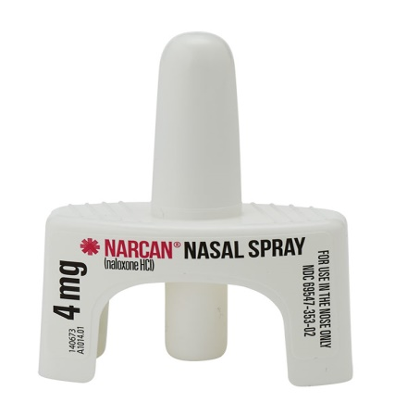
What is naloxone?
Naloxone is a medicine that
reverses opioid overdose by
restoring breathing.
Notes:
It is important to stress these points as they address some of the most common misconceptions about naloxone.

Slide 13
How does naloxone work?
The brain has many receptors for opioids. When too much of an opioid fits on too many receptors, an overdose occurs.
Naloxone knocks opioids off opioid receptors and binds to receptors for a short time. This blocks the opioids’ effects, quickly restoring breathing.

Slide 14
Naloxone
Opioid
Naloxone
Opioid receptor in brain
Notes:
Here’s an example of how naloxone works in the brain to block opioids and reverse the effects of an overdose.
Everyone has used magnets on their refrigerators. You basically have two types of magnets: the free, advertising magnet from your local realtor or pizza shop which doesn’t hold anything up on the fridge, and the really strong magnets you can hang your kids’ art projects from. Opioids are like the pizza magnet. They attached to the receptors in the brain, but the attachment is not that strong. Naloxone is an industrial strength magnet. It comes into the brain, kicks the opioids off the receptors, and then blocks the receptor. The opioids are still in the brain, but because the receptors they attach to are being blocked by the naloxone, they just float around. Naloxone wears off sooner than the opioids however, which means the opioids can reattach and someone can go back into an overdose. This is why calling 911 is so important.
The effectiveness of naloxone is also impacted by the amount and potency of drugs already in the system. More opioids in the system means more opioid receptors are blocked, making more naloxone necessary to “clear” the receptor.

Slide 15
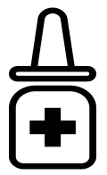
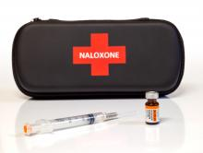
Naloxone Storage (all forms)
Store in original package at room temperature; 60°- 80°(avoid extreme temperatures)
Avoid exposure to light
Keep naloxone easily accessible in case of emergency
Notes:
Do not allow naloxone to freeze or attempt to use if it does freeze. If the naloxone is cloudy, it may be an indication that it is no longer usable.
Keep naloxone in a safe place away from children and pets, but easy to access in case of emergency.

Slide 16
Section C
Responding to an Opioid Overdose

Slide 17

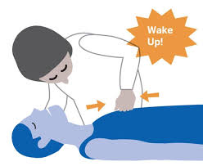
Shake and Wake
Noise
Shake the person’s shoulders and yell: “Are you all right? Wake Up!”
Pain
Do a sternum rub: Make a fist and rub your knuckles firmly up and down the breastbone.
Notes:
Some people use the term “Shake and Wake” others say “Rouse and Stimulate” – Shake and wake focuses on making a loud noise and shaking the person to elicit a response; rouse and stimulate encourages performing a chest rub if you get no response to the noise /shaking stimuli. The purpose is to ensure the person is in fact in medical distress.

Slide 18
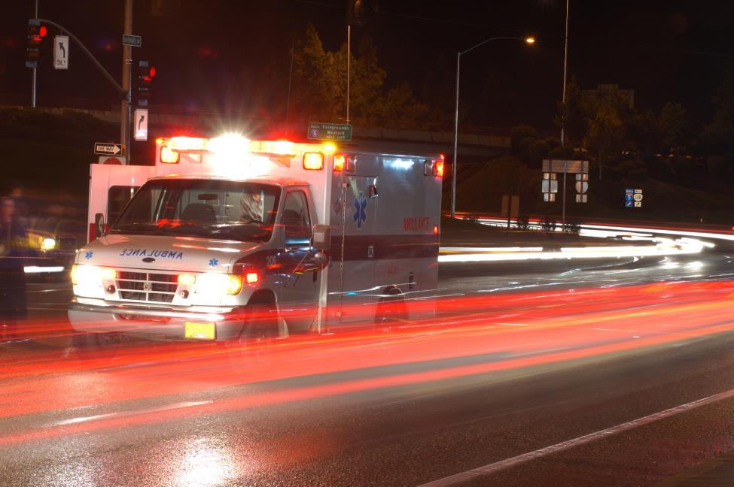
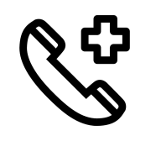
Call 911
Get emergency medical help for someone experiencing an overdose! Why?
Naloxone is only temporary.
Person may have complications or other health problems.
It may be a non-opioid overdose situation.
Notes:
Calling 911 is especially important with the rise in fentanyl. As was mentioned, it is extremely potent and as a result, it may take several doses of naloxone in order to reverse the overdose effects.
Naloxone is only temporary; it is like pushing the pause button on a remote control. It will eventually wear off, and if there are still large amounts of opioids in the system, the person can fall back into an overdose.
The 911 dispatcher can also talk you through caring for the patient including providing rescue breaths and administering naloxone (if available) until EMS arrives.

Slide 19
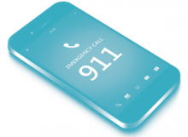
Call 911: What to Say
Tell 911 operator:
  Where you are
  What you observed (example: person
  is turning blue, won’t wake up)
  Tell emergency responder onsite:
  Drugs/substances the person used
  Naloxone administered – how much and when

Slide 20

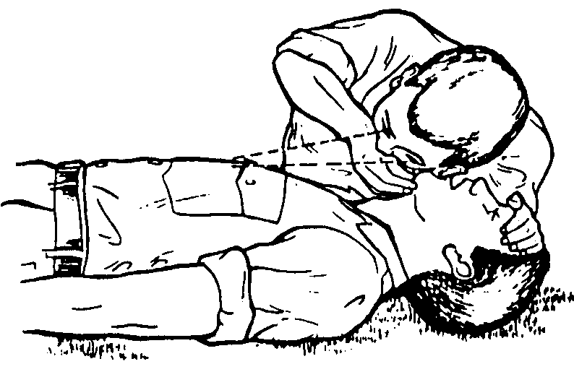
Rescue Breathing
Assess Breathing: Look, listen and feel for breathing
If the person is not breathing or is breathing slowly. Do the following:
Notes:
Slow breathing for an adult is approximately less than one breath every five seconds.

Slide 21
Rescue Breathing
1. Lay the person on their back
2. Check the airway and open if necessary. Remove any objects from the mouth
3. Tilt head victims head back and lift chin
4. Cover person’s face with a mask if available- (You will all receive one today)
5. Pinch nose closed
6. Give one breath every 5 seconds for 30 seconds
7. If the person is still not breathing on their own administer naloxone

Slide 22
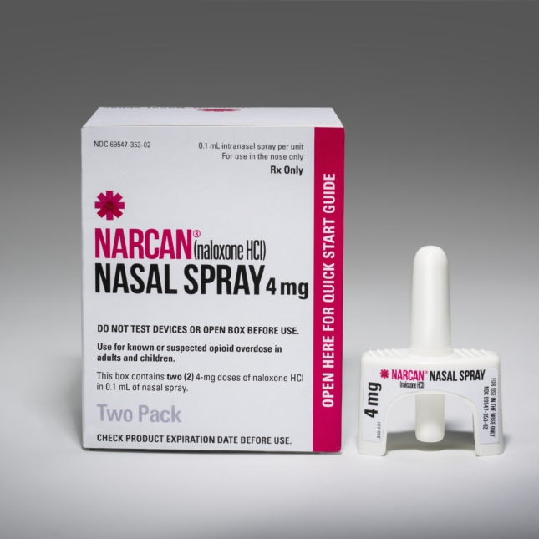
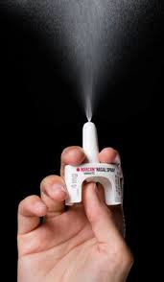
NARCAN® Nasal Spray

Slide 23


NARCAN® Nasal Spray
Remove NARCAN® nasal spray from box. Peel back tab with circle to open.
Hold NARCAN® nasal spray with your thumb on the bottom of the plunger and your first and middle fingers on either side of the nozzle.
Notes:
The box of nasal Narcan® includes instructions. There are also instructions in each individual dose of nasal Narcan®.

Slide 24


NARCAN® Nasal Spray
Tilt person’s head back and support person under neck.
Gently insert tip of nozzle into a nostril until your fingers on either side of the nozzle are against the bottom of the nose.
Press plunger firmly to administer. Full dose into one nostril.
Notes:
It is not uncommon for some of the Narcan® or mucus to run out of the nose when administering it.
With some other forms of naloxone it was necessary to “prime the injection” before administering it. This is NOT the case with nasal Narcan®. Once you push the plunger naloxone will be administered – just like an atomizer nasal spray that you might use for allergies.

Slide 25
NARCAN® Nasal Spray
Allow 2 to 3 minutes for the naloxone to work. Continue resuscitation as necessary.
If breathing is not restored after 2 or 3 minutes, give another dose of naloxone in the other nostril. Continue resuscitation as necessary.
Stay with the person and provide care as directed until medical help arrives.
Notes:
Note: if you need to give another dose of nasal naloxone, use the other nostril.

Slide 26
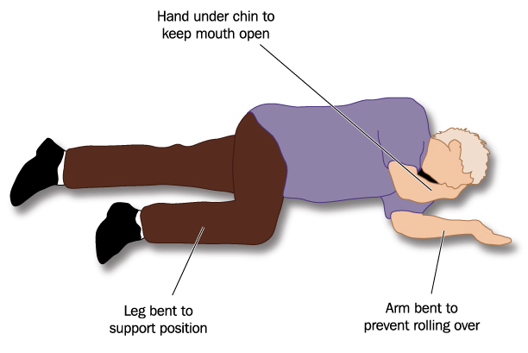
Recovery Position
If you have to leave the person (even briefly) put him/her into the recovery position or if the person begins breathing on their own.
This keeps the airway clear and prevents choking or aspiration if vomiting occurs.

Slide 27

Care for the Person
After receiving naloxone, a person may:
Feel physically ill or vomit.
Feel withdrawal symptoms (unpleasant but not life‐threatening).
Become agitated and upset.
Have a seizure (this is rare).
Overdose again.
Notes:
The effects of naloxone are temporary. If a person has consumed a large amount of opioids, or if the opioids included fentanyl, overdose symptoms may return even after administering naloxone. This is one reason it is so important to call 911 for further medical assistance.
A person who has overdosed should be monitored for at least 2 hours, or more to ensure overdose symptoms do not return.
Some individuals may be combative or agitated when revived. This is more common with intramuscular, or high dose naloxone administration (most commonly administered by EMS), and less common with nasal naloxone.

Slide 28

Care for the Person
Stay with the person until medical help arrives.
Put the person in the recovery position.
Keep the person calm.
Encourage the person not to take more
opioids.
If overdose happens again, give another
dose of naloxone.
Notes:
As naloxone wears off, the opioid high can return, this includes the chance of the overdose returning.

Slide 29
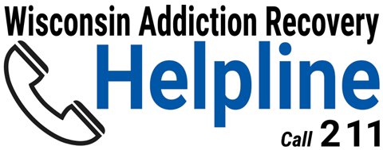
Help is Available
Share resources regarding treatment and recovery services.
Wisconsin Addiction Recovery Helpline
  Call: 211
  Visit: addictionhelpwi.org
Notes:
When some one overdoses, they may be more willing to seek help. This may be a good opportunity to share resources about treatment options. Know what resources are available locally.

Slide 30
A Visual of the Process
https://youtu.be/t9Q9JHjz2bQ

Slide 31
Additional Resources
Wisconsin Department of Health Services https://www.dhs.wisconsin.gov/opioids/index.htm
https://www.dhs.wisconsin.gov/opioids/naloxone-faq.htm
https://www.dhs.wisconsin.gov/opioids/narcan-direct.htm
Harm Reduction Coalition https://harmreduction.org/?s=overdose+prevention+best+practices
Prescribetoprevent.org
https://prescribetoprevent.org/

Slide 32
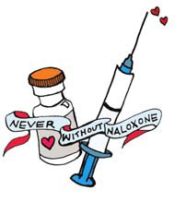
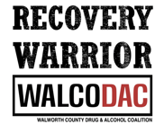
Contact
Walworth County Drug and Alcohol Coalition
Walco DAC
walcodac@gmail.com
www.walcodac.com
Notes:
When training others add your own contact information.

