Slide 1

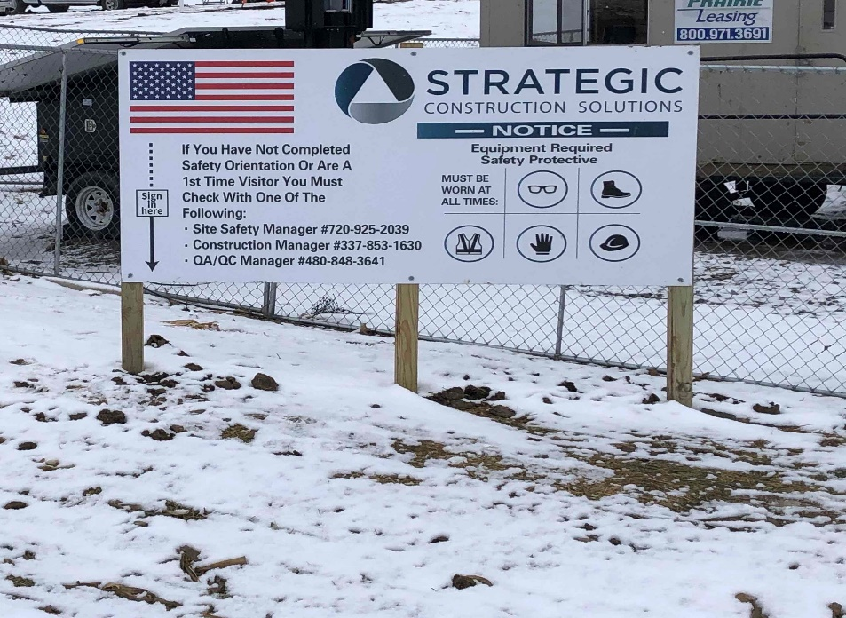
Site Safety Orientation
True North Project
Site Safety Orientation

Slide 2

Today We Will…
Review key philosophy, principles, and fundamentals of SCS safety
Review site background, community, history, and any safety issues in the site environment
Review site rules
Site Safety Manager- Ruben Tibbs 281-507-0202

Slide 3
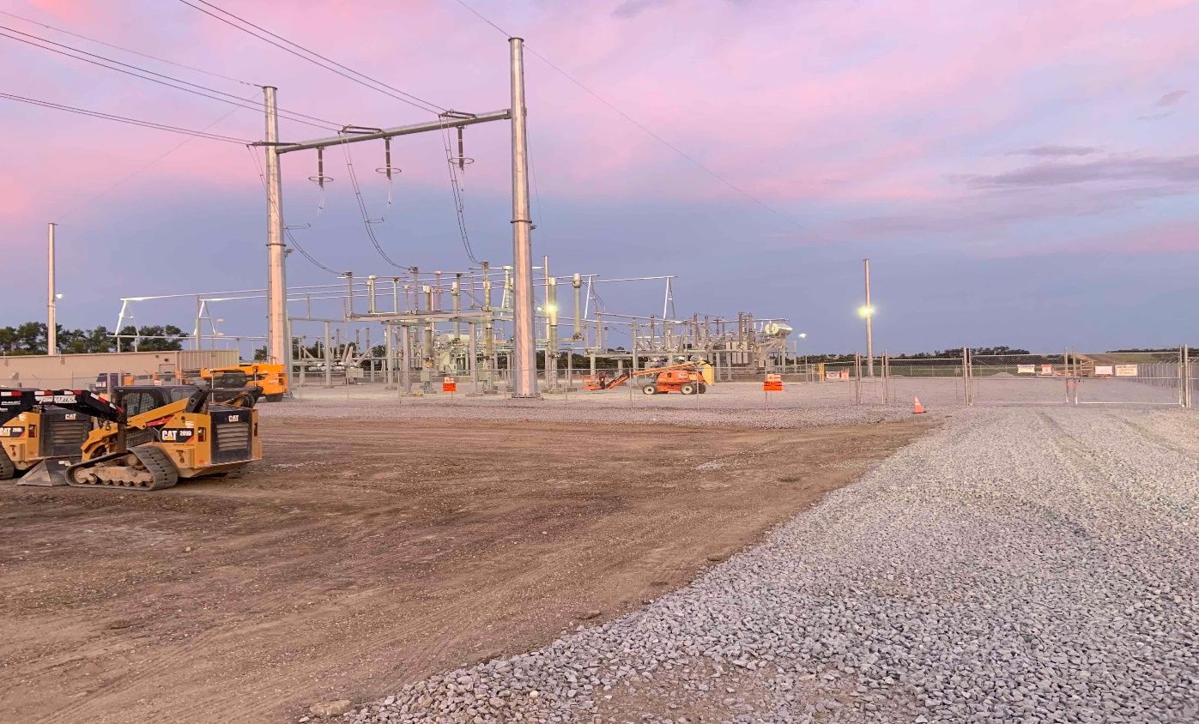
Safety Philosophy, Principles, and Fundamentals

Slide 4
Removal from Site
Zero tolerance for blatant, willful violations of company policies regarding certain aspects of:
  Fall protection
  Excavation and trenching
  Lockout/tagout(LOTO)
  Confined space entry
  Motor vehicle operation or equipment operation
  Crane and erection safety
  Working near energized power lines without proper safeguarding
  Drugs and/or alcohol abuse
  Not tied off on top of nacelle or inside of hub
  Fighting
  Abuse of landowners

Slide 5
Definitions
Substation: is a high-voltage electric system facility. It is used to switch generators, equipment, and circuits or lines in and out of a system. It also is used to change AC voltages from one level to another, and/or change alternating current to direct current or direct current to alternating current
High voltage transmission lines: deliver electricity over long distances. The high voltage is required to reduce the amount of energy lost during the distance. Unlike other energy sources such as natural gas, electricity can't be stored when it is not used.
Stormwater Pollution Prevention Plan (SWPPP): is a plan created by constructors to show their plans for sediment and erosion control. Typically these plans are part of an overall design that details procedures to be followed during various phases of construction
Best Management Practices (BMPs): is a term used in the United States and Canada to describe a type of water pollution control
JHAs: An analysis of the hazards and risk associated which focus on identifying and controlling hazards. ... The process will identify existing and potential hazards and assessing the risk and identify methods to eliminate or protect against the hazard.

Slide 6
SCS’s Safety Philosophy
Champion safety as our highest priority. Event free operation can only be attained if safety is reflected in every behavior – personnel safety, contractor safety, and public safety
Foster a safety culture in which everyone believes and demonstrates that accidents, injuries and illnesses are preventable and everyone understands their responsibility for maintaining such a workplace
Ensure personal accountability by employees and contractors in ensuring their safety, the safety of those working around them, and the safety of the public
  Believe you can make a difference
  Demonstrate a desire and commitment to continuously improve
We believe that employee and contractor safety are synonymous, as both hold the same responsibilities to ensuring we remain safe in all of our work environments

Slide 7
SCS’s Safety Principles
Employees are expected to take an active role in their personal safety
All safety incidents can be avoided if appropriate use of safety processes, procedures, tools and past experiences are shared and communicated
As a company, we aspire to ensure employees return from work each day as healthy as they come
“Our work is never so urgent, nor our schedule so important, that work cannot be performed safely”
Uphold a “Zero Tolerance” culture

Slide 8
SCS’s “Zero Tolerance” Culture
Unsafe behaviors are corrected and coached immediately
Unsafe conditions are reported and corrected as soon as possible
Working any other way is not acceptable

Slide 9
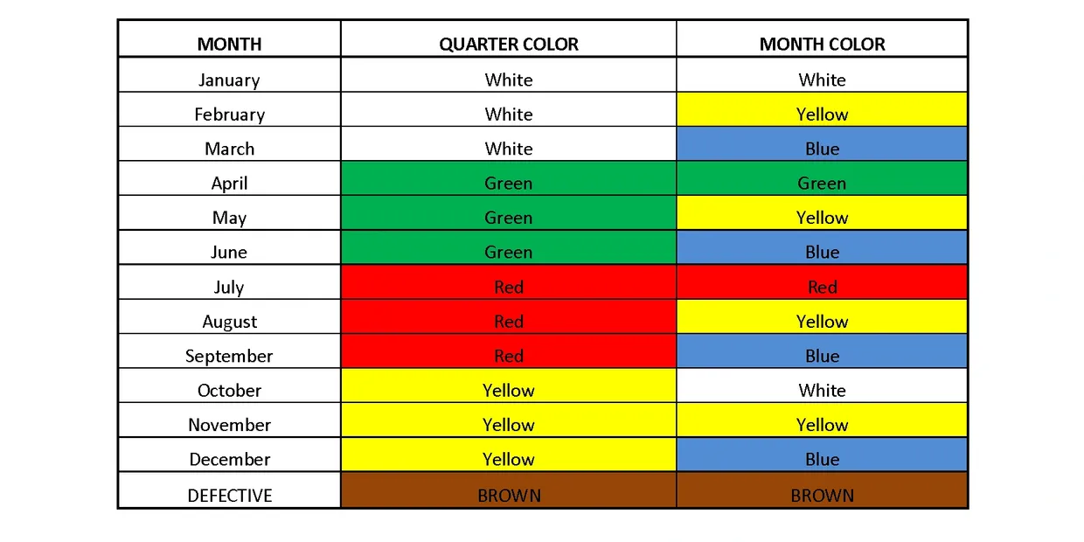

Inspection Color Codes
At the beginning of each month SCS and any of our sub contractors will do a site wide roll back and bring in all tools, extension cords, ladders, welding leads, harnesses, lanyards, ETC for inspection and to get re color coded.
The first WORKING DAY of every month will be the jobsite roll back and inspection update and color codes.

Slide 10

Safety Fundamentals
Accept personal accountability for your safety and those working around you
All personnel are responsible for continually assessing their safety work practices
Focus on hazard identification/assessment then hazard prevention/control
Report all work-related injuries, illnesses, unsafe conditions or practices and near misses to supervision and site management

Slide 11

Safety Fundamentals (Cont’d)
Be responsible for your own safety
  Don’t put yourself in potentially dangerous situations
Assess the hazards (Job Hazard Analysis Checklist will be covered this in more detail)
  Be aware of your surroundings
  Ensure a clean and uncluttered workspace (good “housekeeping”)
  Identify potential for “events”
    Slips, trips, falls
    Struck or struck by (falling objects, sharp objects, etc.)
    Over exertion (lifting, pushing, pulling, reaching, twisting, climbing)
    Cumulative trauma/repetitive motion
Control or prevent the hazard
  Remove/disable the potential hazard
  Change behavior or process to mitigate the hazard

Slide 12

Safety Fundamentals (Cont’d)
Know and understand SCS’s safety principles, human performance principles, and human error prevention
Leverage Human Performance Tools to enable you to be safer and create a safer environment for others
Utilize checklists, forms, and other tools (Job Hazard Analysis, Pre-Job Briefings, Tailgate Meetings, etc.) if they apply and can help you create a safer environment
Consider and use the appropriate equipment and personal protection for any work
Conduct thorough investigations of incidents

Slide 13

Safety Fundamentals (Cont’d)
All personnel should maintain a “questioning attitude” and always look to answer the 4 Critical Questions…
What are the CRITICAL STEPS in the task?
What are the ERROR LIKELY situations?
What is the WORST THING that can go wrong?
What DEFENSES are we relying upon?

Slide 14

Safety Fundamentals (Cont’d)
Human Performance Tools
Self-Check (STAR) – Stop, Think, Act, Review
Peer Check
First Check
Concurrent Verification
Independent Verification
Workers Observing Workers (WOW)
Pre-Job Brief (PJB)

Slide 15

Safety Fundamentals (Cont’d)
Self-Check (STAR)
Stop – Pause before performing your task, to enhance the attention to detail. Attempt to eliminate current or potential hazards.
Think – Understand specifically what is to be done before performing the task. Question the situation by trying to identify all information pertinent to the task or job. Determine if the task is appropriate for the given conditions and consider both the expected responses and results. Decide what contingency plans are required and get responses to any unanswered questions.
Act – Conduct the activity as intended or agreed to.
Review – Verify that the actual response is the expected response/result. Take the agreed-to contingency action is the actual response was unexpected.

Slide 16

Safety Fundamentals (Cont’d)
Workers Observing Workers (WOW)
Observe yourself and your colleagues
Ensure employees and contractors take a personal interest in the safety of anyone working within an SCS facility
Actively provide feedback to anyone when unsafe behaviors and unsafe acts are observed (below are some suggested approaches)
  Leverage humor to help coach any unsafe behaviors
  Show you care about your colleagues’ safety
  Assume they don’t realize what is unsafe about their behavior
  Ask permission to provide some feedback on the situation or behavior
  Positively reinforce those behaviors that are good
  Lead by example

Slide 17

Safety Fundamentals (Cont’d)
Pre-Job Brief (PJB)
Performed for all physical work activities
Purpose
  Ensure all affected personnel understand the scope and expectations of a given work activity
  Create an environment of open, candid communication where the work can be discussed and evaluated for all to understand
Conducted before the start of each job, and involves all workers that will be participating on the particular job
Cover at least the following:
  Hazards associated with the job
  Work procedures involved
  Special precautions
  Energy source controls
  PPE requirements

Slide 18

Safety Fundamentals (Cont’d)
Pre-Job Brief (PJB) – Cont’d
At least one PJB conducted before each day, or before a new shift begins work
  Additional PJB shall be held if any significant changes occur which might affect the safety of the employee
Working alone does not prevent you from conducting your own, informal PJB, using the same evaluation criteria and elements
Site employees are responsible for ensuring that these are being held, and that they are being done correctly and appropriately (even if the contractor is leading and owning the PJB)
PJB should answer the “4 Critical Questions” (reminder below)
  What are the critical steps in this task?
  What are the error likely situations?
  What is the worst thing that can go wrong?
  What defenses are we relying upon?

Slide 19

Safety Fundamentals (Cont’d)
Pre-Job Brief – An Example of “What Good Looks Like”
  PJB leader has adequately prepared for the PJB – knows the content, the hazards, and the work
  PJB is done in an appropriate location that allows personnel to pay attention and hear the review
  All required attendees are present and attentive
  Brief properly covers
    Job purpose, expected results, and scope
    Roles and responsibilities of personnel involved
    Human performance tools discussed and reviewed
    Actions and safe practices to prevent any errors and review of error-likely situations
    Review and discussion of potential hazards
    Review of communication requirements
    Review of any safety or environmental requirements
    Discussion of conditions that would result in work stoppage or supervisor notification
    Review of any lessons learned from recent or similar jobs
    Review, and answer of the 4 “Critical Questions”
  PJB leader does not employ a sense of urgency that promotes the atmosphere of time pressure to complete the task
  PJB leader solicits participation

Slide 20
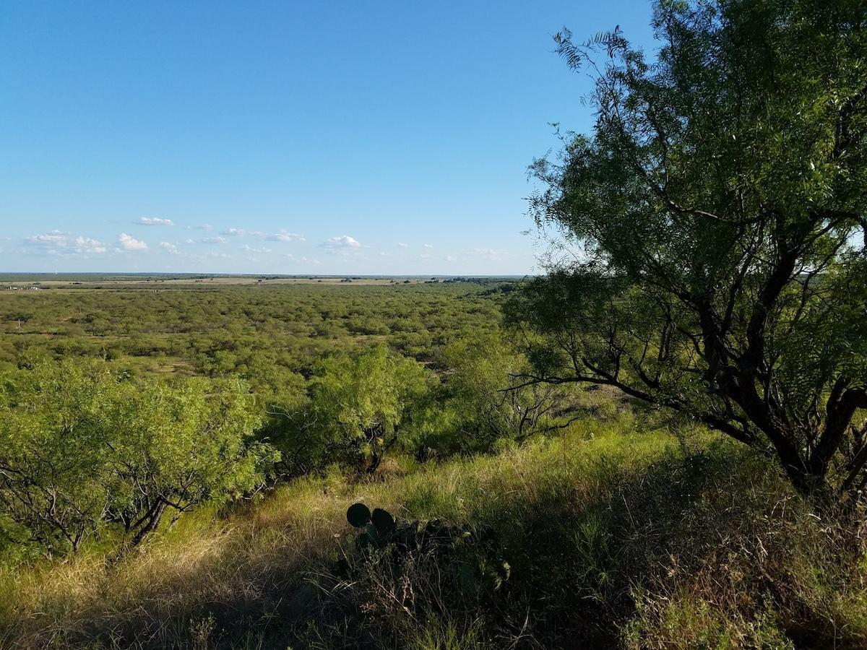
Site Background, Community, History, and Environment

Slide 21
Site Background and History
Avangrid Renewables has started construction of the XXXMW True North solar project, its second hybrid project in North America to integrate a renewable energy plant with utility-scale battery storage.
Located 30 minutes East-South East of Waco Tx area in Falls County, the True North Solar Substation project comprises a XXX MW AC solar-powered electrical generation facility.
The host town is Otto which is known as a ghost town and is on the Texas registry .

Slide 22

Site Background and History (CONT’D)
Site currently used for agricultural farm land.
Tree Cover- Moderate to thick: mesquite, hackberry, china berry, willow
Underbrush-Moderate; lote bush, prickly pear, tasajillo, broom weed
Site workers should be aware of local agricultural activities.
Known hazards include farm equipment, spray from pesticides, herbicides, fungicides and fertilizers.
Always stay upwind of any spray activities
Steep drainages ditches along roadways.
Gravel roadways with heavy equipment traffic.

Slide 23

Community Relations
Maintain a “Good Neighbors” perspective
  Observe speed limits (beyond limits already in place at the site)
  Maintain respect for the land and natural preserves in the area
  Act in a professional manner, representing your company, and SCS, in a positive light with the local community
  Avoid backing up in non participants driveways
Protesters / Media
  Do not engage
  Call an SCS/ AVANGIRD RENEWABLES representative or your supervisor

Slide 24
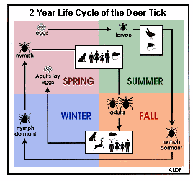
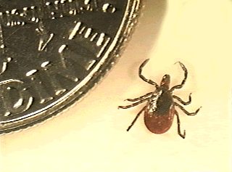
Environment and Safety
Ticks and spiders in the area
  Over 20 species of ticks found in Oregon
    An average of 85 cases per year of Lyme Disease confirmed in Texas (2000 to 2020) ( min=11; max=276
Black Leg Tick (Deer Tick)

Slide 25


Environment and Safety (CONT’D)
Spiders
Types of Spiders
House spiders consist mostly of these four types of spiders;
Black Widow – Venomous house spiders, Bulbous, shiny black with, red hourglass on its abdomen. Builds chaotic webs.
Wolf Spider – Harmless house spiders, Very large, 1 inch in length, tan stripe. Does not hang out in webs.
Hobo Spider – Harmless house spiders, very skinny, long legs, light brown. Builds webs throughout the home. Builds chaotic webs

Slide 26
Environment and Safety (Cont’d)
Best method of removal
Attempt to remove tick or critter with tweezers
  Do not leave the head
  Apply antibiotic
  Seek medical treatment if rash or swelling occurs
  Keep the tick for the medical examiner
Spider nesting can often be found in or under:
  Conex boxes
  Pallets
  Office boxes
  Wooden pallets
  Delivered or stages supplies and equipment
  Wooden spools
  Port-a-potties/Check under the seat
  Typically warm areas

Slide 27
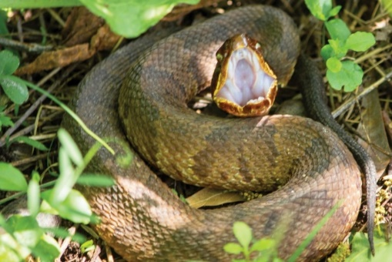
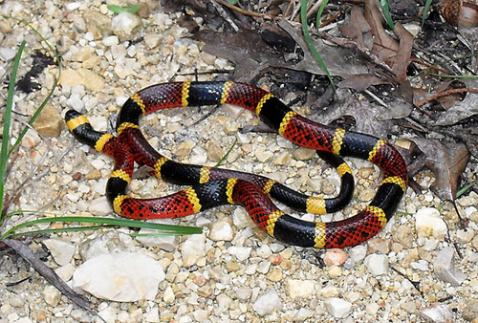
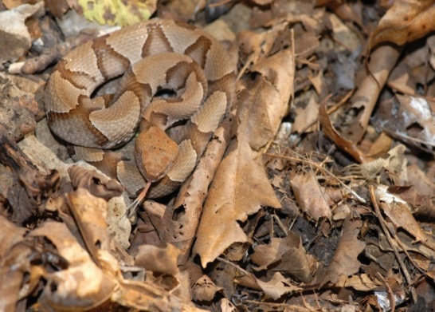
Environment and Safety (Cont’d)
Venomous Snakes
Western Rattlers Western rattlesnakes feed mainly on small mammals, including mice, gophers, squirrels and rabbits, but will also take birds lizards, and amphibians.
Cottonmouth Agkistrodon piscivorus is a species of pit viper in the subfamily Crotalinae of the family Viperidae. It is one of the world's few semiaquatic vipers, and is native to the southeastern United States. As an adult, it is large and capable of delivering a painful and potentially fatal bite.
Texas Coral Micrurus tener, commonly known as the Texas coral snake, is a species of venomous snake in the family Elapidae. The species is endemic to the southern United States and northeastern and central Mexico.
Copperhead Agkistrodon is a genus of venomous pit vipers commonly known as American moccasins. The genus is endemic to North America, ranging from the Southern United States to northern Costa Rica. Eight species are currently recognized, all of them monotypic and closely related.

Slide 28
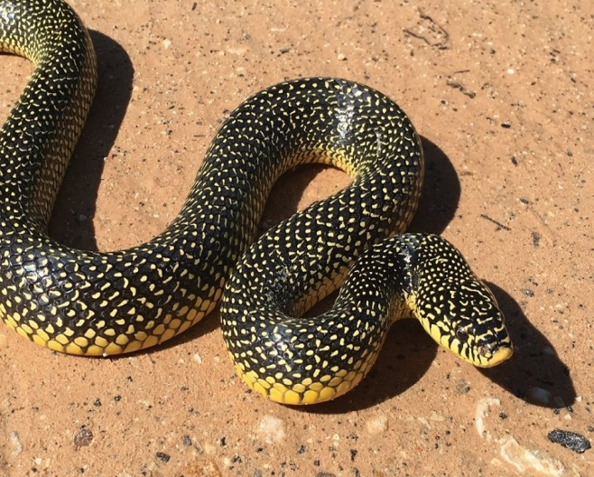

Environment and Safety (Cont’d)
Nonvenomous Snakes
Gopher Snake The gopher snake occurs in a wide variety of habitats, from deserts and grasslands to woodlands and open forests. It frequents agricultural regions, especially where there is brushy cover such as fence rows. Diet varies according to size, with young eating insects, lizards, rodents, and birds and their eggs. Adults can take larger prey, occasionally as large as rabbits.
Rubber Boa The rubber boa occurs in a variety of habitats, from desert scrub, foothill woodlands, and grasslands through deciduous and coniferous forests. In the Coast Range, it is found commonly in forest clearings that contain rotting stumps and logs. It is absent from the immediate vicinity of the coast north of Coos Bay. Rubber boas are constrictors and eat small mammals, especially young mice and shrews.
King Snake This snake is most common in thick vegetation along water bodies, but ranges into farmland, chaparral, and deciduous and mixed coniferous woodlands in the Rogue and Umpqua river valleys of southwestern Oregon. Common kingsnakes usually feed on other snakes, but have been known to take small turtles, birds and their eggs, frogs, lizards, reptile eggs, and some small mammals.
Garter Snake This species is found in a variety of habitats. To make matters more confusing, four subspecies are found in Oregon, each of which has somewhat different habitat preferences. All can be found in moist areas such as marshes and lake or stream margins, but two may occur some distance from water. The diet varies among subspecies; the more aquatic forms feed on fish, frogs, tadpoles, and leeches, which are eaten in the water. Terrestrial forms take frogs and toads, but also lizards, small mammals, salamanders and slugs.

Slide 29

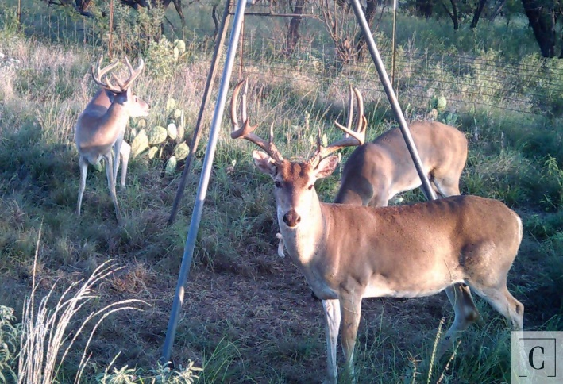

Environment and Safety (Cont’d)
Deer
Deer are very likely in the area. What happens to a deer when you hit it?
  If possible, pull over to the side of the road, and turn on your hazard lights. If you must leave your vehicle, stay off the road and out of the way of any oncoming vehicles.
  Deer are most active at dusk and dawn. Usually times when you or your vehicle may be less visible to other motorists.
  Call the police.
*If you are driving and a deer is to come out of the woods and you hit it and sustain bodily injury, then no you cannot sue the deer. As indicated, the deer does not have any insurance nor obviously any assets to go after. The same can be said for hitting a moose.*

Slide 30
Environment and Safety (SWPPP)
    What is SWPPP?
  A Storm water Pollution Prevention Plan (SWPPP) is a site-specific, written document signed by a company executive that (1) identifies all of the activities and conditions at their site that could cause water pollution, and (2) details the steps the facility will take to prevent the discharge of any unpermitted pollution.
If the construction site is less than 1 acre: you do not need coverage. No SWPPP is required.
If the construction site is between 1 acre and 5 acres: a SWPPP and Construction Notice posted at the site is required. A construction notice to the local municipal storm water permitting department (MS4) is required.
If the constructions site is more than 5 acres: a SWPPP, Notice of Intent, Notice of Termination, and Construction Notice posted at the site are required.

Slide 31
Environment and Safety (SWPPP)
Who should manage and why should I have a SWPPP/ CSWPPP in place?
Industrial and Manufacturing facilities, and Construction Site Operators (generally, the person who has operational control) can manage your storm water discharges through preparation of Storm Water Pollution Prevention Plan (SWPPP) or a Construction Storm Water Pollution Prevention Plan (CSWPPP).
A SWPPP is more than just a sediment and erosion control plan; It describes all the operator’s activities to prevent storm water contamination, control sedimentation and erosion, and comply with the requirements of the Clean Water Act. The EPA and TCEQ can issue fines up to $32,500/per day, per violation. If you comply with all SWPPP/ CSWPPP regulations, then you will not have to worry about possible fines and down time in the future.

Slide 32
Environment and Safety (SWPPP)
Inspections are required at a minimum frequency of at least once every 14 calendar days and within 24 hours of the end of a storm event of 0.5 inches or greater during active construction activities. An alternative inspection schedule of once every seven (7) calendar days is also available. If this alternative schedule is developed, then the inspection must occur regardless of whether or not there has been a rainfall event since the previous inspection. Where sites have been temporarily stabilized, inspections must be conducted at least once every month. Special provisions allowing for representative inspections are provided for long, linear projects where access along the site is limited and travel along the site may damage stabilized areas or cause potential for erosion.
An operator may terminate coverage when certain conditions are met. In establishing vegetation to achieve final stabilization, an operator is not required to utilize the same vegetation that was previously utilized at the site, provided that the stabilized area contains at least 70% coverage of the original percentage of coverage of land for the disturbed area, and provided that the operator utilizes vegetation appropriate for the area that provides acceptable coverage. The permit also allows construction operators located in arid, semi-arid, or drought-stricken areas the flexibility to implement non-vegetative erosion control measures if vegetative controls are not feasible.

Slide 33
Environment and Safety (SWPPP)
  BMP Examples:
Temporary seeding: Vegetation such as grass grows quickly to hold the soil in place preventing erosion due to wind current or stormwater.
Permanent seeding: Vegetation is used during construction to prevent soil erosion and remains as part of the final landscaping.
Mulching: Material such as hay, grass, wood chips, gravel or straw is placed on top of the soil to prevent erosion.
Earth dikes: Earth dikes use soil to divert uncontaminated water from contaminated areas, or they allow contaminated flow to be deposited in sediment trapping devices.
Silt fences: A trapping device captures sediment on one side of the fence while allowing water to flow through.
Sediment traps: Sediment settles out in a specified area such as an empty pond.
Sediment basins: Sediment basins allow sediment to settle out in a specified area but require a controlled release of the water flow
Minimize disturbance: Use logging methods and equipment that minimize soil disturbance. Plan and design skid trails, yard areas and truck access roads to minimize stream crossings and avoid disturbance of the forest floor.

Slide 34
Environment and Safety (SWPPP)
Examples of maintaining a proper site SWPPP Program
  • Routine site inspections
  • Rain gauge monitoring
  • Maintenance of Best Management Practices (BMPs) and erosion controls
  • Good housekeeping measures
  • Maintenance of exposed inventory lists
  • Updating site map development and maintenance as needed
  • Spill kits readily available for response
  • Spill log updated and reported for statistical data

Slide 35
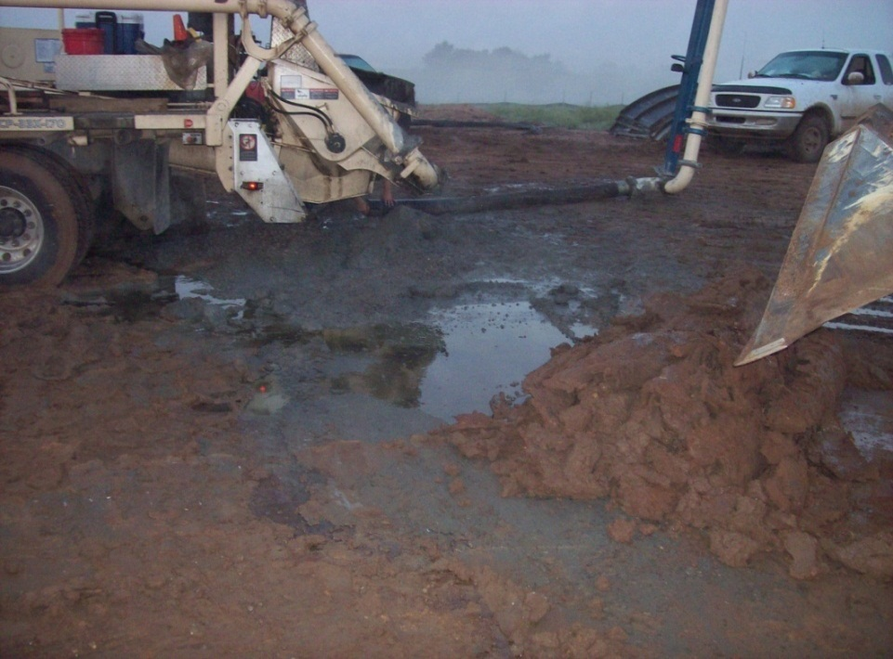
Environment and Safety (SWPPP)
  Spills
  Each contractor must have a spill kit (where is yours?)
  Spills stopped / contained immediately and reported to SCS Safety Dept. according to SPCC plan
  In accordance with state and county 110% of spoil taken out and properly disposed with cradle to grave receipt.

Slide 36
Extreme Weather
Always be aware of the weather conditions, and the weather forecast, at your site and in your work area
Site management makes weather-related “Stand Down” determinations, BUT…
  All personnel have an obligation to stop work if extreme weather is observed and they have not yet been notified by site management
Lightning
  Work will not be done in or around wind turbines during lightning storms
  A lightning strike within 30 miles of the wind turbine will constitute a “Stand Down”. Civil will “Stand Down” when lightning is within 15 miles of site.
  Workers observing lightning or who are notified by their supervisor of a lightning strike will assemble according to the site emergency evacuation plan
  “Stand Downs” will last 30 minutes past the last lightning strike within 30 miles of the wind turbine , 15 miles for civil or longer if deemed necessary by site management

Slide 37
Extreme Weather (Cont’d)
High Wind
  Weather monitoring should be conducted during all work in progress
  Work in progress should be halted prior to wing speeds reaching the limits mentioned below if the wind speeds are increasing and/or are forecasted to achieve or exceed the limits mentioned
  Limitations mentioned are guidelines – more specific wind speed limitations can be obtained by site management for the given turbine manufacturer

Slide 38
Extreme Weather (Cont’d)
Tornado
  Extremely likely in this area of the country
  Seek a storm shelters if one is accessible
  Seek refuge in low lying areas such as a ditch
  Do not shelter in vehicles, equipment or trailers.
Ground Fire
  Range, grass, crop and forest fires can be fast moving and endanger personnel working on or near sub’s and T-Lines
  Air quality should be taken into consideration when fires are present
  Any ground fires shall be reported to site management immediately

Slide 39
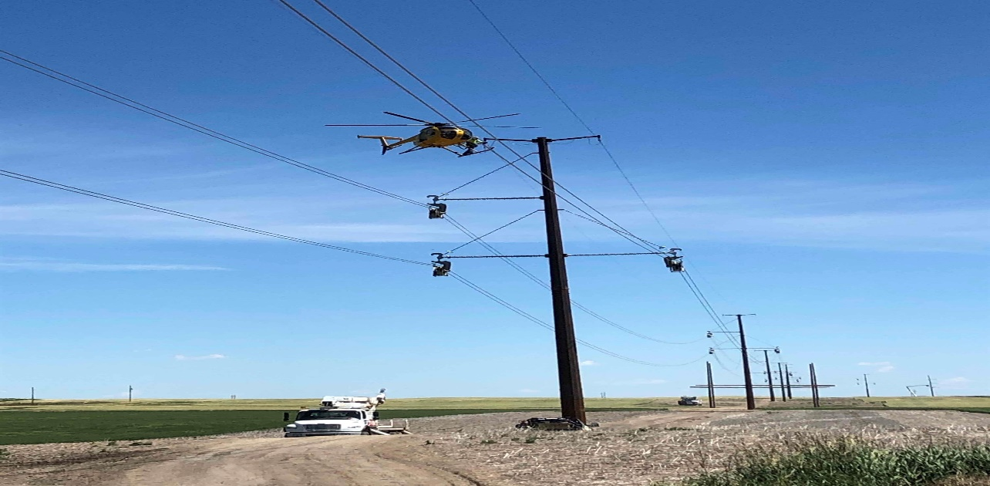
Site Safety Rules

Slide 40

Client Site Safety Rules
Avangrid Renewables follows CLOSELY Exhibit J1 which is similar to SCS site specific safety plan.
  AVANGRID RENEWABLES EXHIBIT J1 CAN BE FOUND ON OUR APP/WEBSITE UNDER THIS PROJECT TAB.
Ensure you sign onto a JHA everyday prior to doing any work regardless if you are late or new.
ALL HOT WORK MUST BE COMPLETED WITH A SPOTTER
Challenge anyone on the jobsite to see if they have reviewed and signed the JHA for the day. (If they have not, they put you in danger..)
Avangrid and SCS follow the local burn restrictions to include no smoking or smoking in designated smoking areas.
Always have a fire extinguisher within 75 feet of your work area, on any piece of equipment being used and when doing any hot work.
Turn on hazard lights when driving into the site, and while onsite, at all times.
Ensure EVERY employee has completed site orientation.
All visitors MUST check in with site safety prior to entering site.
All personnel have a stop work obligation

Slide 41
Basic Site Safety Rules
Personnel on site must be 18 years or older
  No pets and/or children
No firearms/weapons/knives allowed on site
Illicit drugs and paraphernalia are prohibited
Alcohol is not allowed
Smoking/tobacco use only in designated areas
Ensure you are fit for duty
Obey all signs/posters and barricades
Jewelry and/or loose clothing not permitted
No horseplay/running/fighting
No reckless driving in snowy, icy, or muddy conditions
All personnel have a right to refuse unsafe work
All personnel have a stop work obligation

Slide 42

Basic Site Safety Rules (Cont’d)
Maintain good housekeeping
Speed limit when passing houses is 35 mph on county roads unless marked “25”
Speed limit in lay down yard area is 5 mph
Training records and attendance are maintained on site and available to SCS upon request
  Personnel shall only perform tasks upon which they have been trained to perform safely
  Additional training see your supervisor or safety representative.
All visitors report to the SCS site office
Visitors receive Orientation Site Specific Briefing
  Must be accompanied by a representative from the company they are visiting who has completed orientation
All incidents are reported & investigated
Site maintains a post-accident Drug and Alcohol screening process

Slide 43
Basic Safety Rules – Substance Abuse
SCS reserves the right to have drug and alcohol screenings conducted in the following times:
  Pre-Access – within 30 days of starting work on an SCS Project
  Annual – for project lasting more than 12 months
  Post Incident – after any incident that causes serious personal injury to self or others, property damage in excess of $1,000, or motor vehicle accident as defined by the FMCSA.
  Reasonable Suspicion – as observed by contractor or SCS management
  Unannounced – any or all site employees at the sole discretion of SCS Random – as required by DOT, other laws or the contractor policy

Slide 44
Basic Safety Rules – Substance Abuse (Cont’d)
Prescription drugs and over the counter (OTC) medications are permissible if the following conditions have been met:
  Prescription drugs have been prescribed by a licensed physician for the person in possession of the drugs
  The prescription is not expired and was filled by a licensed pharmacist for the person possessing the drugs
  The individual notifies their supervisor that they will be in possession of or using, impairment-causing prescription drugs or OTC substances and appropriate steps are taken to accommodate the possible impairment
SCS may also require the Contractor to conduct a search or inspection of any person on-site to include any vehicles or containers for alcohol, drugs or paraphernalia

Slide 45
Basic Safety Rules – Housekeeping
Contractors required to provide:
  Containers (dumpsters)
  Collection, separation, and elimination of construction waste
  Please use your own waste containers and not other company’s
Work areas policed daily and as work progresses
  Scrap/reusable lumber stored neatly
  Nails/screws removed
Containers for garbage or oily waste must have covers

Slide 46
Basic Safety Rules – Safe Driving
No personal vehicles are allowed in work areas; only company vehicles and rentals
  Must be labeled with company name or logo
Drivers must be:
  Licensed
  Medically fit
  Well rested
  Observant and adjust driving to prevailing road conditions
  Not under the influence…
Passengers
  Number of passengers does not exceed manufacturer’s specifications for the vehicle
  Functional seat belt for each passenger
  No persons permitted to ride in bed of pick-ups, trailers, etc.

Slide 47
Basic Safety Rules – Safe Driving (Cont’d)
Cargo/Loads
  Vehicles not loaded in excess of manufacturer’s specifications
  All loads secured to prevent displacement
  Loads do not extend beyond vehicle boundaries unless:
  Flagged, lighted, pilot vehicle, ground guide, etc,
Seat Belts
  Worn by driver/operator and all passengers
  Driver’s responsibility
Mobile Phones/Radios
  No two-way communication while driving, operating equipment, etc
  Exception for radio use for crane/equip operators
  Pull off road to take call or leave work area
  Bluetooth devices are permissible in vehicles…not equipment or while working

Slide 48
Basic Safety Rules – Safe Driving (Cont’d)
Vehicle Maintenance
  Ensure that vehicles and equipment are of good, sound working condition
  All passenger vehicles driven to and on the jobsite must be street legal and current on registration, inspection and insurance
Motorcycles
  Only to be used for commuting to and from the lay down yard / office parking lot and not ridden into work zones or tower areas.

Slide 49
Basic Safety Rules – Stop Work Obligation
Every worker is authorized and, has the obligation to STOP WORK for unsafe acts and/or conditions
Every worker has the right to refuse an unsafe Work Order
Does not matter who, what, where, or when
You see it – you own it; safety is all of our responsibilities
Uphold a “Zero Tolerance” culture

Slide 50
Safety/Planning Meetings
Several safety meetings to be held on site and enable a safe environment
  Tailgate or Toolbox meetings – Supervisors and personnel. Meet weekly to discuss work and safety concerns.
  JHA Review – Supervisors and personnel. Conduct prior to beginning the day’s work or beginning a new task; discuss the specific task and safety work.
  All Hands Safety Meeting –Wednesday at 7:00am/All site personnel. Meet weekly to receive safety message from Project Manager.
  Safety Team Meeting – Site Safety Leads. Meet weekly to discuss trends and focus efforts of site observation and inspection programs.

Slide 51
Job Hazard Analysis (JHA)
Ensure that any JHA involves personnel that have valuable input. These can include:
  Supervisors
  Workers who have performed the task previously
  Subject matter experts (e.g. training specialists)
Break down the job into its basic steps or tasks
  Describe the sequence of steps to ensure clarity among all workers for the particular job
  Balance detail appropriately - each step should accomplish a major task
Identify hazards, ensuring the use of past experience to help inform hazard identification

Slide 52
Job Hazard Analysis (JHA) – Cont’d
Potential sources of hazards include:
  Line of Fire
  Material Handling, Walking and Working Surfaces
  Industrial Hygiene
  Ergonomics
  Energy Isolation
  Hazardous Materials
  Fire
  Weather
For each hazard, list the measures to be taken to protect the worker from the particular hazard. These could include:
Engineering controls (e.g. barriers and guards)
Administrative controls (e.g. written procedures)
Use of PPE

Slide 53
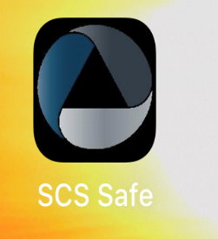
Job Hazard Analysis (JHA) – Cont’d
The JHA can be accessed with your smart phone or tablet. On your smart phone go to www.scssafe.com , then project tab. Scroll down to your current job site and select the site. Click the blue tab in the “Job Hazard Assessment (JHA)” section and fill out the form and click submit at the bottom.
Once completed the JHA will be printed off and placed in the JHA mailbox at the entrance of the jobsite.

Slide 54
Line of Fire
Line of Fire – when a person places their body or body part in a position where they can be struck, sprayed, cut, burned, pinched or punctured.
To avoid Line of Fire incidents:
  Visualize the tasks you and others are about to perform
  Place body parts in positions that cannot be cut, struck sprayed, etc.
  Do Not stand or walk under a suspended load or overhead workers
  Cut away from your body (Use cut resistant gloves)
  Always use doorknobs or handles, do not hold on side of doors/drawers
  Anticipate what could be struck and if you or others are in the Line of Fire
  Ask “What is the worst thing that can happen?”

Slide 55
Personal Protective Equipment (PPE)
Minimum PPE while on the job site is as follows:
  Approved safety glasses with side shields
    Use zero-tint (clear) safety glasses when working in an indoor work environment unless tints are required for the task
  Hard hats
    No inappropriate/vulgar stickers
    Hard hats must be worn with bill facing forward
  Safety Toed foot wear
  High visibility vest, shirt or jacket
    Must be work at all times outside of any building, trailer, etc. (even in the parking lot)
  Gloves, face shield, etc. dependent upon job hazard analysis (JHA), and your company policy above and beyond JHA
  Cut proof gloves must be used for any job using a knife or potential for hand cuts.

Slide 56
Personal Protective Equipment (PPE) – Cont’d
Minimum PPE (cont’d)
  General construction attire consisting of natural fiber garments (sleeve length minimum 4”, long pants, or coveralls)
For climbing at heights:
  Safety harness including:
    Personal full-body fall arrest system
    Rated safety lanyard with 100% tie off capabilities
    Side D Rings/Hip Pads
    Front D Ring
    Suspension trauma straps / stirrups
  Gloves approved for work being performed
  Hard hat or Petzl style helmet
Additional PPE may be required by supervisor or as work conditions require (e.g. hearing protection in all designated areas and/or where noise levels are greater than 85dB)

Slide 57
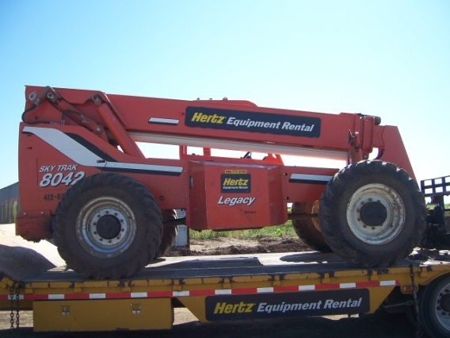
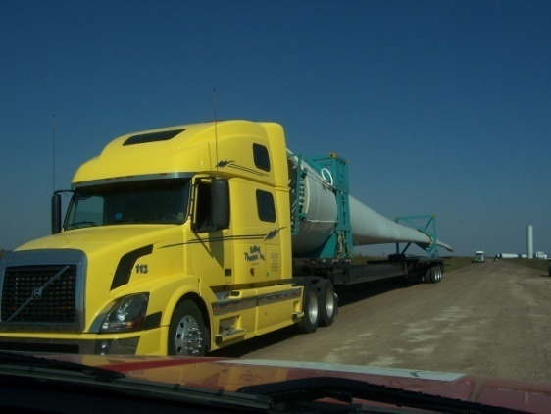
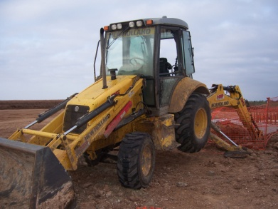
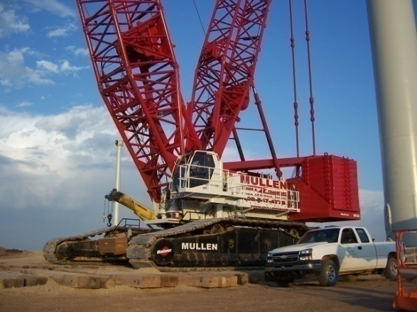
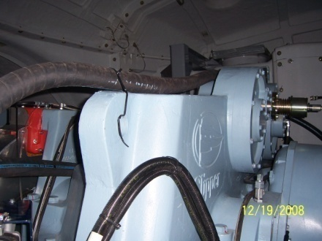
Equipment
This equipment doesn’t have a brain, so please use yours!

Slide 58
All Equipment Including Cranes, Rigging and Lifting
All operations comply with Manufacturer’s specifications
  No additions and/or modifications without Manufacturer’s approval
  Equipment must inspected daily prior to operation or tag out of service if defects are found.
Cranes & rigging inspected by competent person
  Daily Crane Inspections – Documented
  All rigging tested, examined, certified (documented)
  Annual inspection documented and submitted to SCS prior to use
  All rigging inspected prior to each use
Manufacturer’s Handbook in cab
Qualified/Certified operator documented

Slide 59
Equipment – Cranes and Lifting (Cont’d)
Tag lines used on all lifts
Operation > 10 feet from energized power line
Operator is in cab when load is hoisted
Crane hooks must have safety latches
One qualified Signal Person per operator
Operator obeys stop signal from anyone
Hand signals (or radio communication) shall be per the applicable ANSI standard

Slide 60
Equipment – Cranes and Lifting (Cont’d)
Fire extinguisher (5BC or greater) in cab
Cranes traversing public roads must have escort
Cranes must have a spotter when walking
Barricades must be in place for lift zones
  Swing zone must be barricaded or designated spotter in place
No unauthorized entry into lift zones or passing through without the lift supervisor’s permission
  Unauthorized personnel must be out of fall area until secured

Slide 61
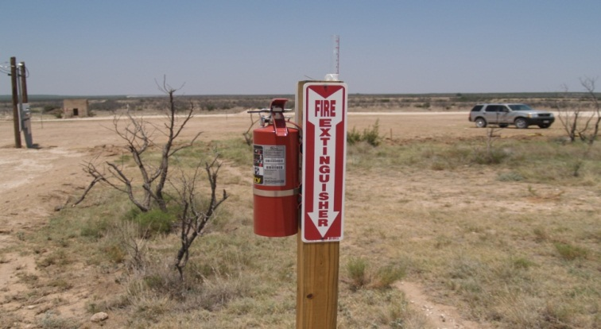

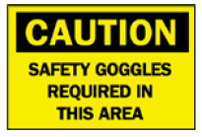
Signs, Signals, and Barricades
Signs and warnings shall be in the local language and/or use pictorials to communicate hazard
  Red and white signage (may have black writing in it) identify a “DANGER” hazardous area that should not be crossed. Unauthorized access may result in death or serious injury.
  Orange signage (may have black in it) identify a “WARNING” hazardous area that should not be crossed. Unauthorized access may result in death or serious injury.
  Yellow signage (may have black in it) identify a “CAUTION” hazardous area. Unauthorized access may result in minor to moderate injury. Caution signs may also be used to alert to unsafe practices.

Slide 62
Signs, Signals, and Barricades (Cont’d)
Contractor/Subcontractors responsible for erecting any signage shall indicate the hazard, name of the Contractor/Subcontractor, and name of person erecting the signage
Observe and adhere to all warning signals and barricades
Properly post/erect signs, signals or barricades to advise personnel of hazardous conditions in work areas
Barricades shall be constructed to withstand adverse weather conditions and construction traffic
  Rigid barricade constructed of wood or similar material shall be erected when excavating next to roadways, sidewalks, driveways, other heavily traveled areas, or where site conditions warrant.
  Orange plastic safety fencing with t-post should also be used around foundation excavations.

Slide 63
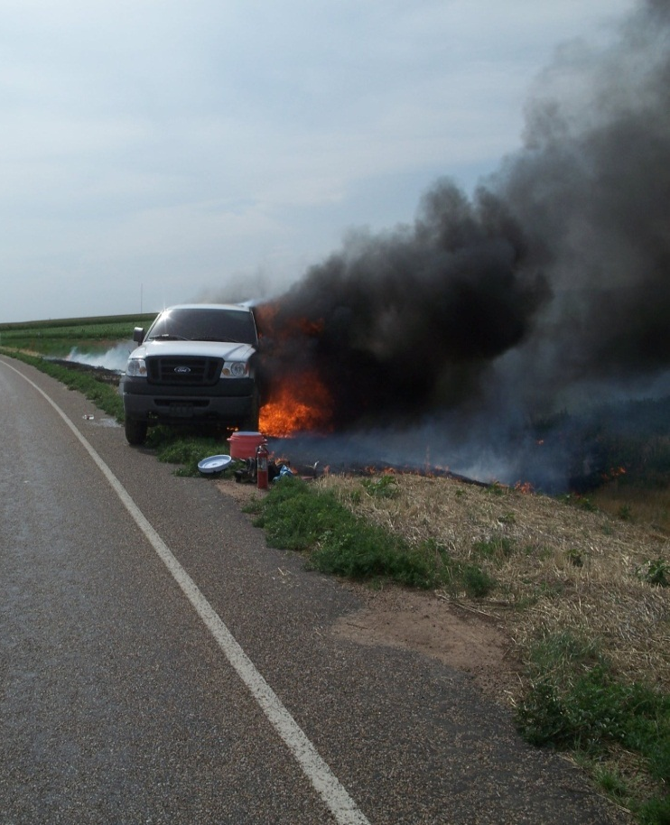
Fire Prevention and Protection
Employees should be trained to recognize fire hazards
Keep combustible and flammable materials away
from ignition sources
Maintain clear access to fire protection
equipment and emergency exits
Do not refuel equipment while it is running or hot
Smoking is only permitted in designated areas
(never in buildings or enclosed areas)
Ensure engine exhaust away from vegetation
and a portable FE in all on-site vehicles
We don’t expect you to be a fire fighter; know your limitations

Slide 64
Fire Prevention and Protection (Cont’d)
Ensure vegetation does not accumulate under vehicle
Employees expected to use fire extinguishers shall be properly trained in use, capabilities and limitations
Fire extinguishers shall be readily available in all work areas
  Fire extinguisher (20B) < 25’ from any portable gas powered equipment
  Fire extinguisher (20B) < 10’ from any door for inside storage of flammable Material
  Fire extinguisher (20B) 25-75’ feet from outdoor fuel storage
  Fire extinguishers shall be inspected monthly
All work vehicles shall have a fire extinguisher
Portable storage (greater than 55 gal) double walled or 150% secondary containment and grounded

Slide 65
Hot Work
All hot work shall be done in accordance with a hot work permit
A trained fire watch shall be used when hot work is performed
Combustible and flammable materials shall be removed from the area prior to the start of any hot work
Employees assigned as fire watch shall have a fire extinguisher readily accessible
Fire watch duties shall extend 30 minutes after completion of hot work
All employees shall be properly trained on fire watch duties.

Slide 66
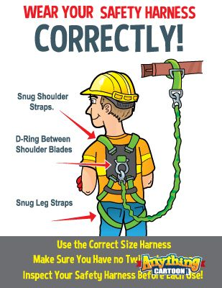
Working at Heights
Guardrails of standard construction are the preferred method of fall protection
Use fall protection equipment at unguarded heights greater than 6 feet or where the employee is subject to any fall which could cause injury, such as, working over dangerous equipment or over swift moving water. To include:
  Unguarded/ leading edges
  Wall and Floor openings

Slide 67
Working at Heights (Cont’d)
When guardrails are not present or are not of standard construction a personal fall arrest system is required.
ABC’s of Personal fall arrest systems:
  Anchor point designed to with stand twice the intended load or 5000 lbs
  A full Body harness meeting the requirements of ANSI 359.1
  Connectors such as lanyards, retractable lanyards, or ladder safety devices that are compatible with the other components in the system
Employees shall have training necessary to:
  Identify potential fall hazards
  Select appropriate fall protection devices
  Don and doff the equipment
  Perform the daily or pre-use inspection
  Select the proper ladder for a job and use it correctly

Slide 68
Working at Heights (Cont’d)
Ladders
  Select the proper ladder for the task to be performed
  Use the ladder according to its design and within limitations
  Use ladder safety devices on fixed ladders as provided
  Maintain three points of contact at all times
  Extension ladders extended 3 feet beyond landing
  Exception within the nacelle but must be tied off
  Do not use top two rungs of step ladders
  Extension ladders – 4:1 rule
  Portable wooden and metal ladders are not permitted
  Inspect before use
  Properly stored when not in use
  Portable ladder class 1A and class 1AA are only allowed on site
  https://www.youtube.com/watch?v=w3gTKdJnMHk

Slide 69
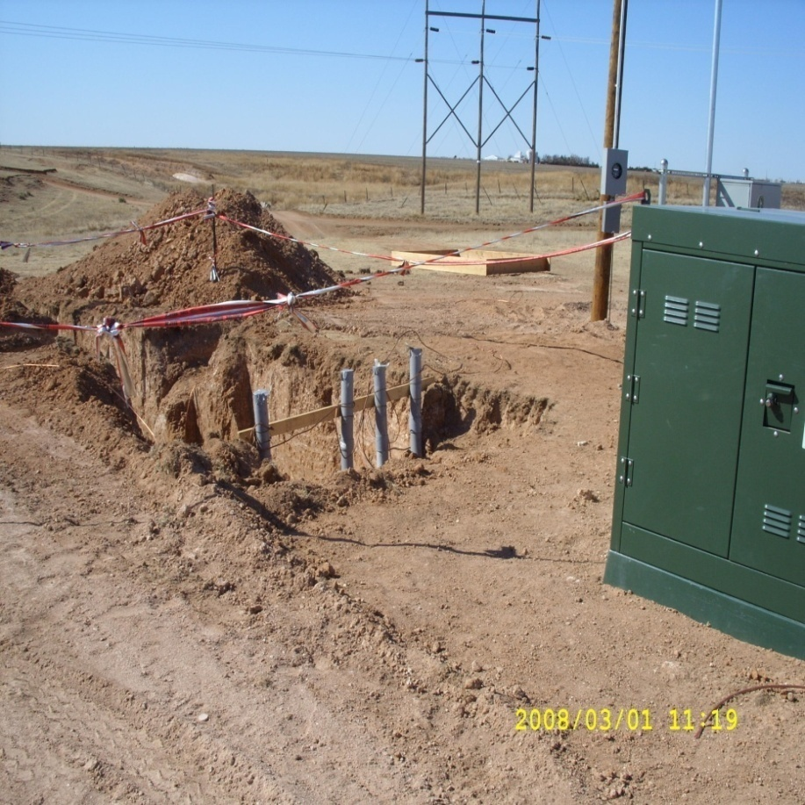
Excavations
The Competent Person for excavations shall determine what is needed to complete safe excavation work
Excavations shall have an Excavation
permit along with an Excavation Log
A soil check should be a prime factor to
determine whether to shore, slope, or step
back or utilize a trench protection system
A study of flood level and tidal changes will
also be a factor in determining if a water
hazard exists and if a dewatering system
is needed
Prior to any excavation, an effort shall be
made to determine whether underground
installations (i.e. sewer, telephone, water,
electric, etc.) will be encountered.
  Utility companies shall be contacted
  and advised of proposed excavation work prior to the start of actual excavation

Slide 70
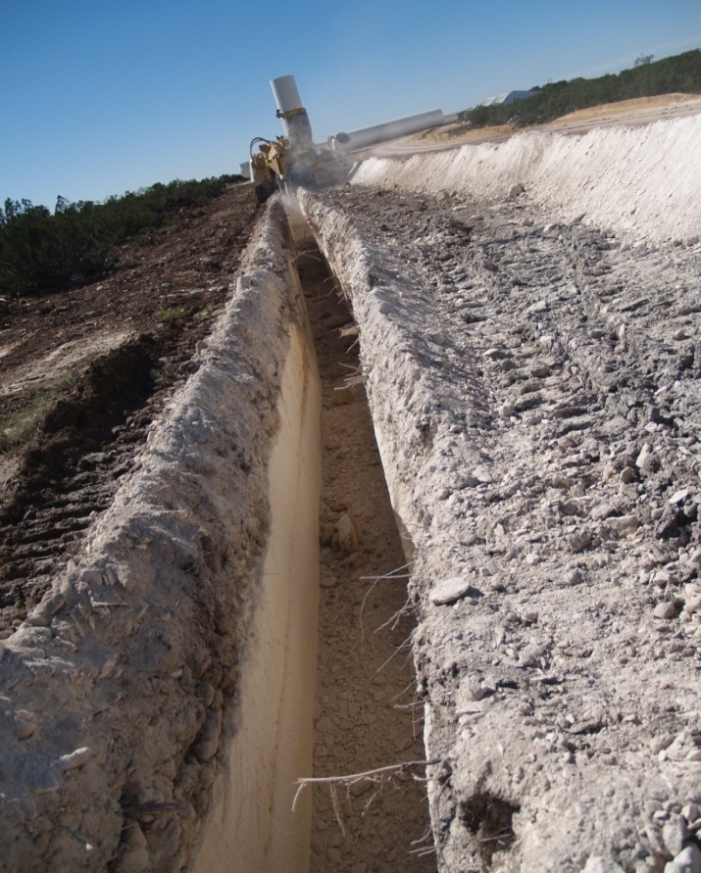
Excavations (Cont’d)
Additional shoring or protection shall be used when there is a risk of cave-in, fall-in, or collapse
Open excavations shall be barricaded with
diamond-weave plastic fencing
Walkways, bridges, crosswalks, and roadways
shall be provided as needed and shall follow the
standard guard rail requirements
Proper access and egress into any trench four feet
or more in depth will be provided and maintained,
and shall be located at intervals no more than
25 feet lateral travel
A competent person shall inspect excavations on
a daily basis, or more frequently when additional
hazards are present

Slide 71
Confined Space Entry
All confined spaces, including both “permit-required” and “not permit required”, shall be properly labeled
A Confined Space is a space that contains all of the following:
  Is large enough for an employee to enter and perform the assigned work
  Has limited means of access and egress
  Was not designed for continuous occupancy
A permit is required for any confined space that has one or more of the following criteria:
  Contains or has a potential to contain hazardous atmosphere
  Contains a material that has the potential of engulfing an entrant
  Has in internal configuration such that an entrant could be trapped or asphyxiated by inwardly converging walls or by a floor which slopes downward and tapers to a smaller cross-section
  Contains any other recognized serious safety or health hazard

Slide 72
Confined Space Entry (Cont’d)
Work performed in a Permit Required Confined Space (PRCS) shall be done in accordance with the permit
All PRCS work shall be done with a trained attendant stationed outside of the space
A copy of the permit shall remain posted in the work area for the duration of the entry
A qualified rescue team must be available whenever entry into a PRCS is made

Slide 73
Electrical Safety
All equipment should be locked out to prevent unexpected startup or the release of stored energy
Equipment not capable of lockout may be tagged out if a formal procedure for control of tags is in place
LOTO guidelines:
  Approvals – LOTO must be approved by site management and done in conjunction with an approved plan for isolating affected energy sources
  Installing Locks – all personnel affected by the LOTO will install a personal lock in the event a lock system is used
  Locks and Tags - will be durable, standardized, substantial and identifiable
  Forms – all personnel involved must read the LOTO and sign on and off the LOTO form

Slide 74
Hazard Communication
All chemical hazards shall be communicated with employees through a comprehensive program including labeling, safety data sheets (SDS) and employee training.
Employees will be informed by the site management or supervision of new hazardous chemicals being introduced into the work environment in which they will be exposed.
All chemical containers brought onsite shall be properly labeled with:
  Chemical name
  Manufacturer name and contact information
  Hazards warnings
Employees shall review the Safety Data Sheet (SDS) for any new chemical prior to initial handling or exposure to the chemical.

Slide 75
Hazard Communication (Cont’d)
Copies of the Contractor SDS are to be maintained and readily available.
All copies of SDS are also maintained on the SCS safe App and website under the SDS tab. (If you don’t see yours required SDS there please inform the Site Safety Manager so we can update that.)
All personnel shall be provided with Hazard Communication Training prior to initial assignment and as frequently as needed to ensure understanding and compliance with Hazard Communications
*YOU CAN GOOGLE ANY SDS OUT THERE!!*

Slide 76
Medical/First Aid
Contractors must arrange for a competent medical/first aid care to anyone who may be injured in connection with his or her work
Where Emergency Medical Services are not immediately available (i.e. within 7 minutes), contractors must establish a trained, properly equipped medical response available during work hours to respond to a medical emergency on the project (Follow the Site Emergency Response Plan)
SCS will have at least one employee with a current First aid, CPR/AED certification and access to a standard first aid kit. This will not meet the requirement for contractor employees’ access to emergency medical services.

Slide 77
Bloodborne Pathogens
What is it?
  …..pathogenic microorganisms that are present in human blood and cause disease in humans. These pathogens include, but are not limited to, hepatitis B (HBV), hepatitis C (HCV) and human immunodeficiency virus (HIV).
Only trained employees shall administer 1st Aid whereby pathogens reasonably exists.
  1st Defense: Distance. When at all possible, have injured clean their own wounds, apply compresses, clean up spilled body fluids, etc.
  2nd Defense: PPE. Latex gloves and micro-shields with one-way valves in all primary 1st Aid boxes.

Slide 78
Accidents and Incidents
48
HRS
6. Safety Director– receives final report and associated information
48
HRS
5. SR Management – reviews the results and identifies if any further corrective actions should be incorporated
24
HRS
4. Safety Professional – receives the electronic report and information and reviews for any additional questions or corrections
3. Site Management – reviews the information for the incident report and submits the information through the system
24
HRS
END
7. Safety Alert– generates a safety alert email that goes out to all sites to help share in any lessons learned
2. Site Safety – receives notice that an event occurred, and helps collect information for the incident report and notifies the client using form on app.
1
HRS
1. Event – A safety event occurs in the site or facility
START

Slide 79
COVID-19 Prevention and Control
Employees or contractors should adhere to all governmental (e.g. Center for Disease Control) guidance and their company policies as to steps to aid in pandemic prevention, which should include no less than:
Wash your hands with soap and water for 20 to 30 seconds at a minimum on a regular basic or use hand sanitizer if soap and water are not readily available
Employees and contractors are encouraged to keep work stations and surfaces clean on an hourly and daily basis.
Maintain social distancing when working around other employees. All employees are to arrange workstations to maintain 6-foot distance at a minimum with designated visual barriers in office and trailers. When discussing field work, strive to maintain the 6-foot or greater distance while in field location especially during safety meetings or any other required assembly type scenario or event.
If any employee or contractor has additional questions please refer to SCS COVID-19 policy or to your companies COVID-19 policy

Slide 81
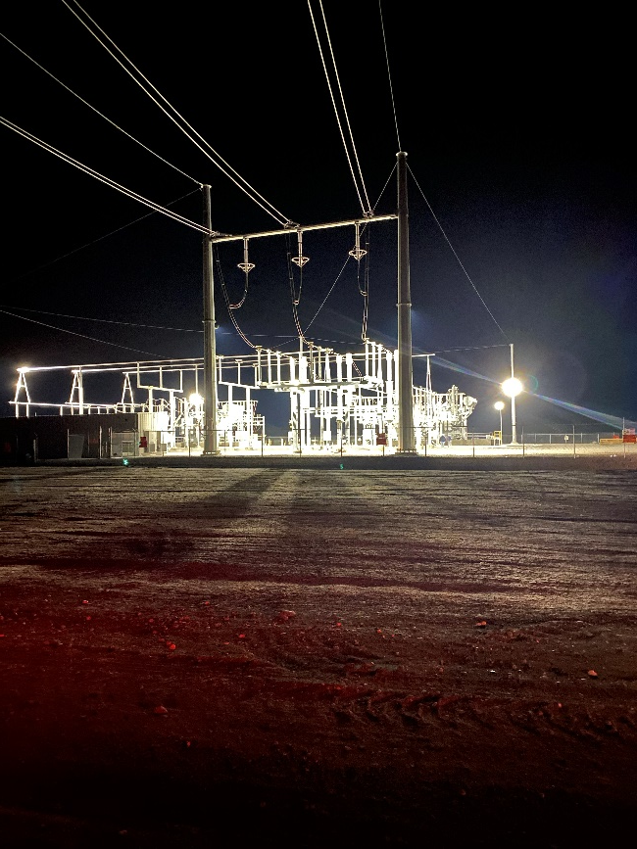
Before you go!
Be sure to sign:
-Orientation Sign In Sheet
-Site Specific Safety Plan Sheet
-Emergency Response Plan
Collect:
-Orientation Sticker
WORK SAFE!!!

Slide 82

Questions?
Our work is never so urgent, nor our schedule so important, that work cannot be performed safely.

