Slide 1
PROTECTING OUR DEMOCRACY
Quaker Call to Action Event
December 5, 2023

Slide 2
Protect Our Election – Our Mission
Launched in 2020 with a specific focus on our democracy’s most overlooked and under-supported resource: local election officials
In the leadup to and aftermath of the 2020 General Election, we connected voters with their local officials to build positive relationships
We have evolved along two parallel paths:
Supporting the election officials who do their job the right way by providing digital tools and resources
Assessing the risk posed by “election infiltrators” who seek to introduce bias, ignorance, chaos, and anti-democratic sentiment to our electoral process
We have established national partnerships with groups like Choose Democracy, The Union, The Carter Center, Protect Democracy, the Global Disinformation Index, and the Election Reformers Network

Slide 3
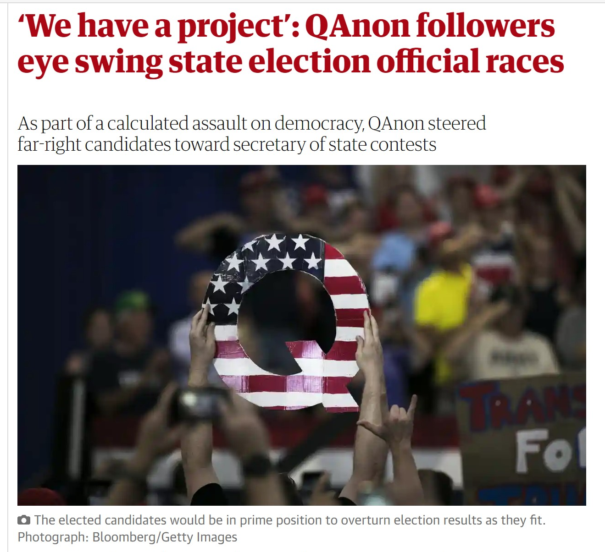
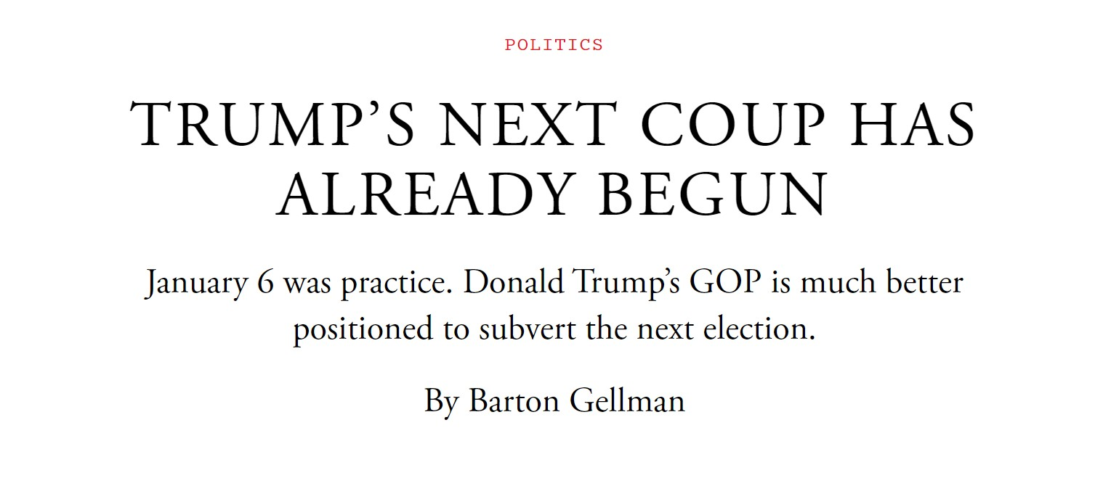
The Threats To Democracy

Slide 4
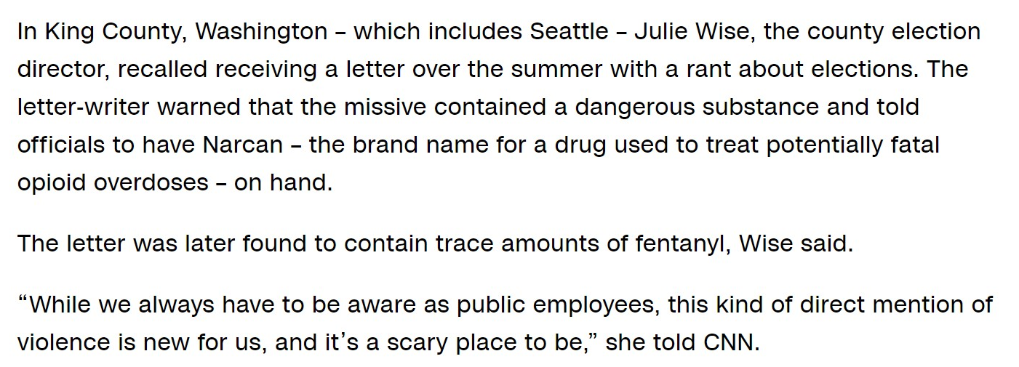
The Threats To Democracy

Slide 5
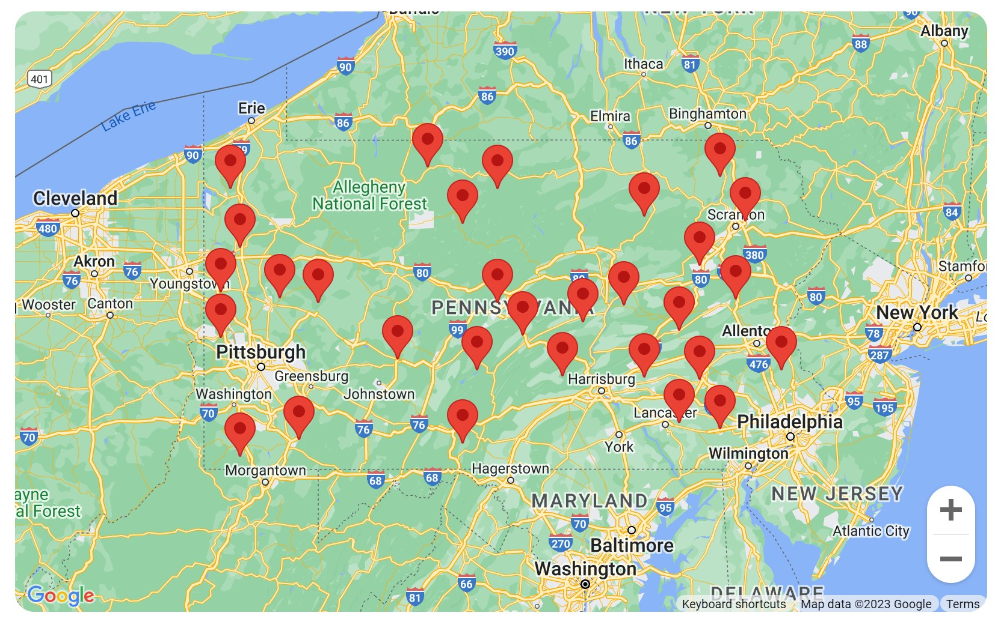
The Threats To Democracy
Example: 35 of PA’s 67 counties have had turnover in the role of election director since 2021

Slide 6
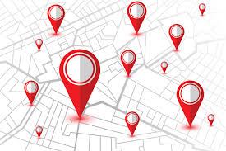
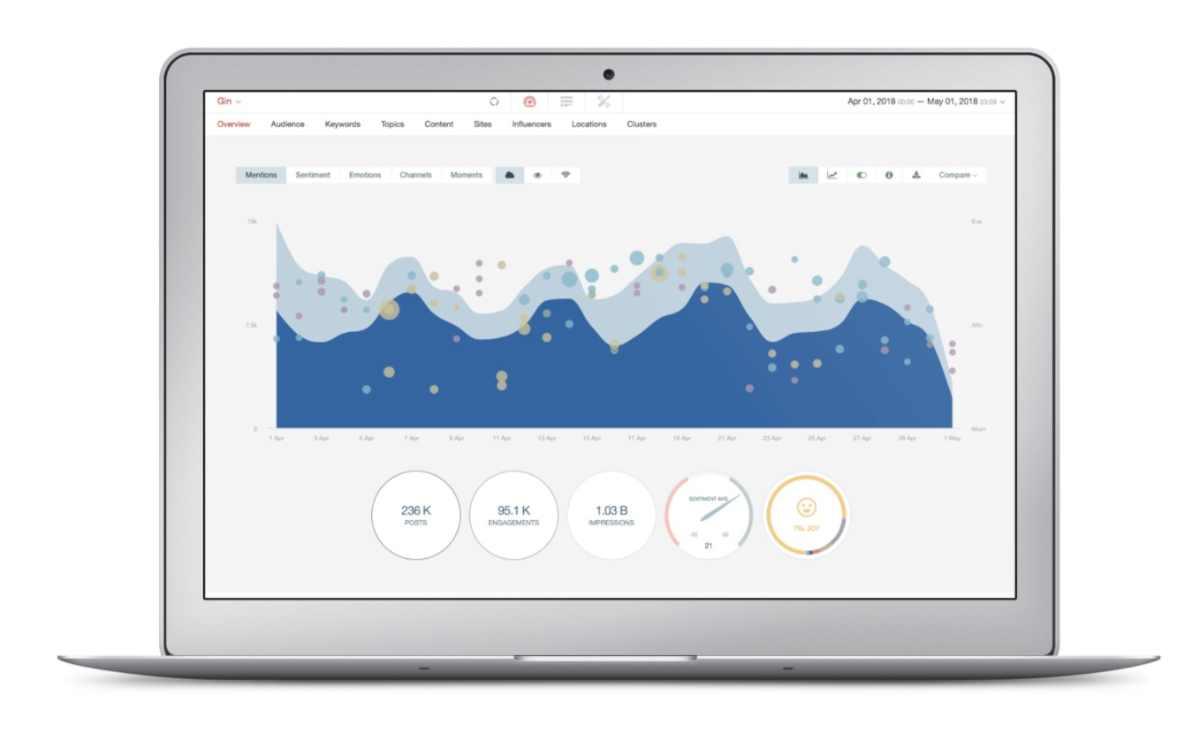
Protect Our Election – Our Intel
Thanks to our dedicated volunteers, Protect Our Election has been able to assemble a uniquely detailed look at the people who are in a position to impact election administration
We’ve spent months combing through public records, media coverage, and social media posts to identify potential trouble spots at the local levels
We are now updating our findings to reflect the results of the 2023 election cycle and to help grassroots organizations prioritize counties, towns, and precincts next year and beyond
Do you enjoy Internet research? We need your help!

Slide 7
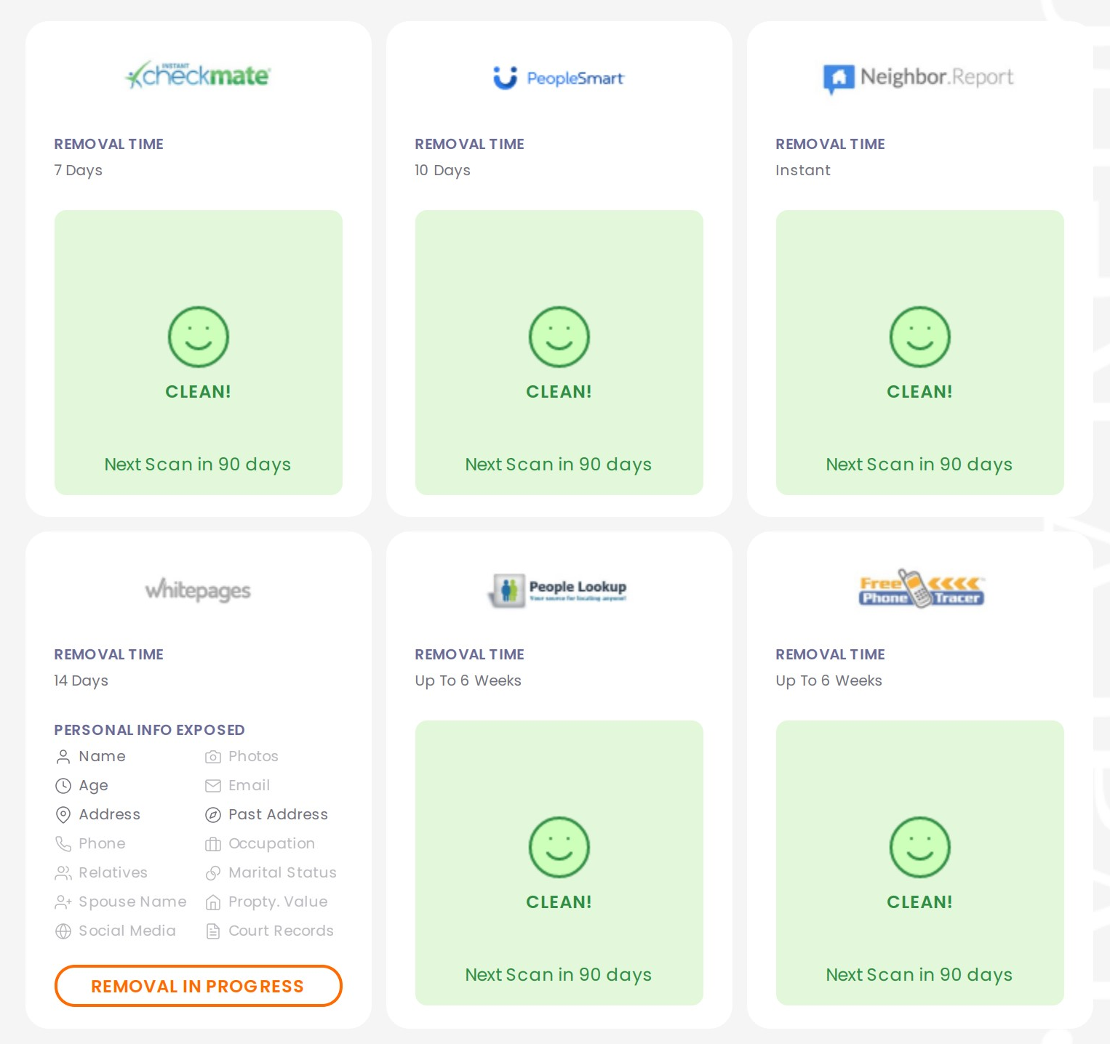
Pro Bono Services
Our ‘We Are Democracy’ campaign helps fill a significant resource gap by offering three free digital services to election offices:
Social media listening report: a weekly or bi-weekly briefing on topics and trends relevant to election administration
Real-world threat assessment: a sobering look at where online chatter may morph into real world protests, intimidation, and/or violence
Personal data protection: a program designed to remove items like home addresses and personal phone numbers from public data broker sites

Slide 8
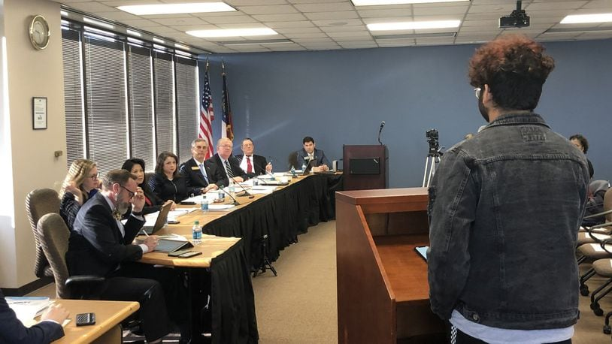
Protect Our Election – Take Action
Sign up for PoE alerts (link)
Follow Protect Our Election (and other accounts found here) on social media and help us amplify the truth
Act as a conduit to your local party organizers and help pass along our research
Attend county or town election board meetings
Share information from the ground with us
Join our Volunteer Research Team to help fill in the blanks and identify potential election deniers
Consider a donation to support PoE’s ‘We Are Democracy’ campaign - a contribution of $80 can single-handedly protect one election official from harassment

Slide 9
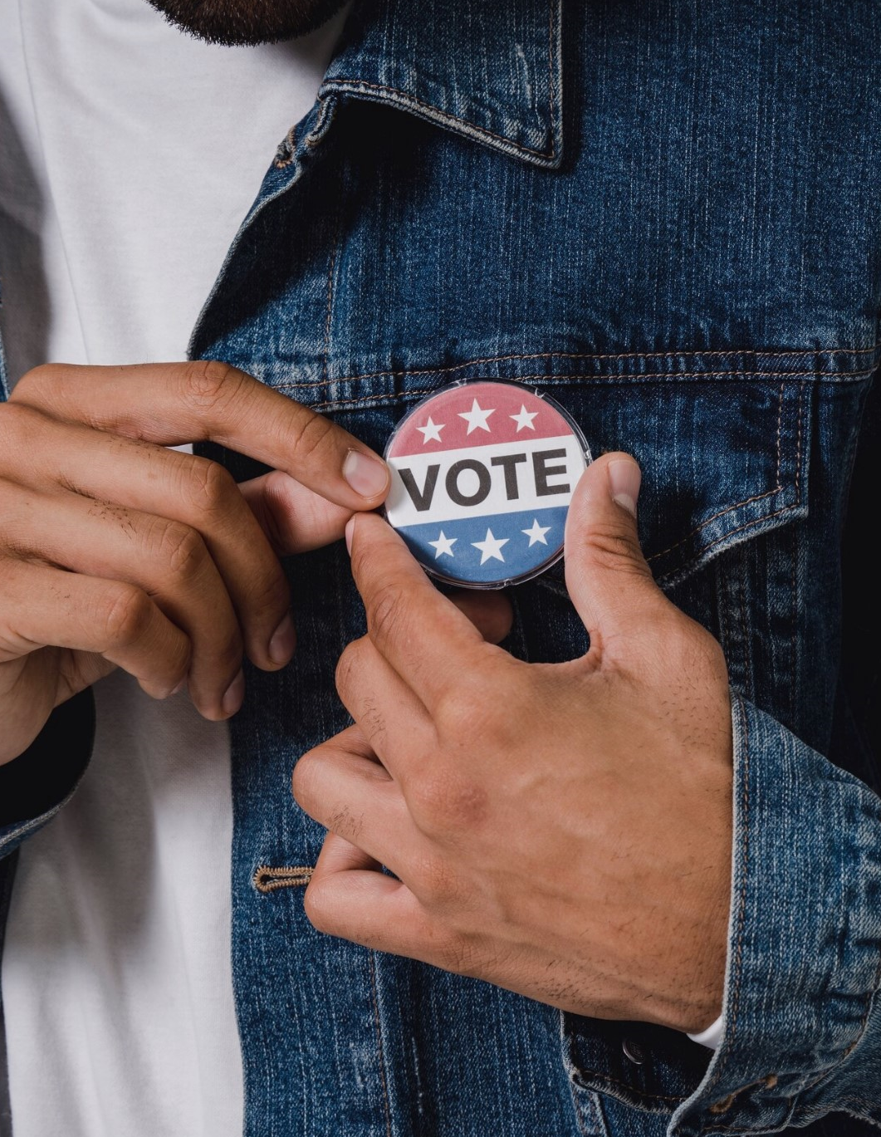
VoPro Pros (Voter Protection Pros)
Grew out of a passion for pro-democracy work in 2020
Now over 1,000 professional-grade volunteer members, organizers, and activists
Committed to empowering everyone to take part in the democratic process
VPP believes in voter protection by everyone for everyone, especially for those who are systematically disenfranchised from the voting process
https://www.vopropros.com/

Slide 10
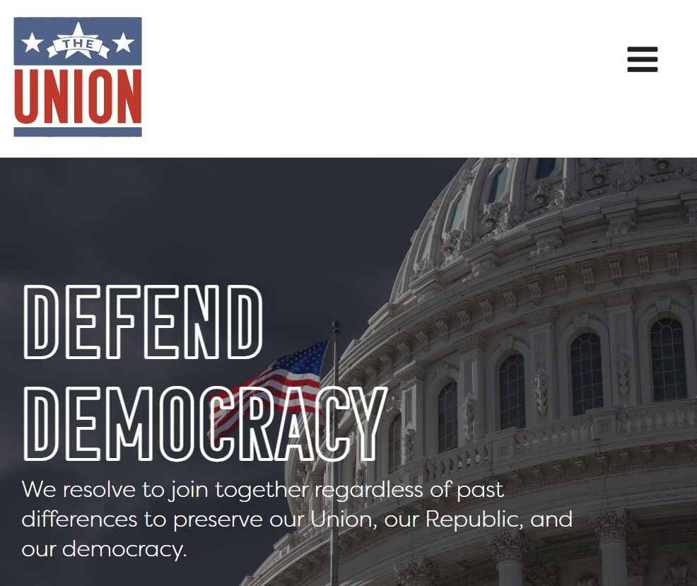
The Union
A pro-democracy coalition of grassroots supporters and organizations dedicated to defending our democracy from the Trumpist authoritarian movement
We must set aside partisan disputes so our democracy can survive long enough for us to have those debates again
Even an hour helping a local organization register voters or fight misinformation will help save democracy
https://jointheunion.us/

Slide 11
How You Can Help
Volunteer your time to recruit election volunteers. Make phone calls to encourage others to volunteer and participate in the election process.
Volunteer on any state’s voter hotline, helping to answer questions people have about the process.
Volunteer your time to research ballot submission processes to help improve voter education and outreach
Volunteer your time to contact voters whose absentee ballots have been rejected and need to be cured in order to count.
Volunteer your time to drive voters in need of assistance to the polls.
Phone-banking, text-banking, postcard-writing, and more!
Stay informed on voter suppression activities by subscribing to Democracy Docket. Get their free weekly newsletter here - www.democracydocket.com/subscribe

Slide 12
Deeper Commitments
Become a paid poll worker in your county. When a county doesn't have enough poll workers, they may close polling locations. Complete an application here to get started: www.powerthepolls.org/signup
Volunteer as a poll observer/watcher. This role can very from state to state, but political parties are allowed to have representation inside polling locations to monitor the process. Shorter time commitment, but important to the election process. You can sign up for this volunteer role through the voter protection team of your political party. More information can be found here: https://www.eac.gov/election-officials/poll-watchers

Slide 13
Q&A/Links
https://www.protectourelection.com/take-action-support-democracy
https://www.protectourelection.com/research-team
https://www.vopropros.com
https://jointheunion.us/
https://www.ncsl.org/research/elections-and-campaigns/election-administration-at-state-and-local-levels.aspx

Slide 14
Election Administration 101
State-level oversight is different everywhere:
26 states have an elected official with authority over elections
24 states have an appointed official or board with authority over elections
Local-level oversight is different everywhere:
Some states have relatively streamlined hierarchies, with a single public official in charge of election administration at the county-level
Other states have messier org charts, with one or more county-level boards overseeing an appointed/hired administrative officer
And some states do all of this at the local/municipal level
Poll workers are generally temporary paid employees who are trained and approved to conduct elections at the precinct level
Poll observers/watchers are typically partisan appointees who are allowed inside the polling place to observe the process

