Slide 1
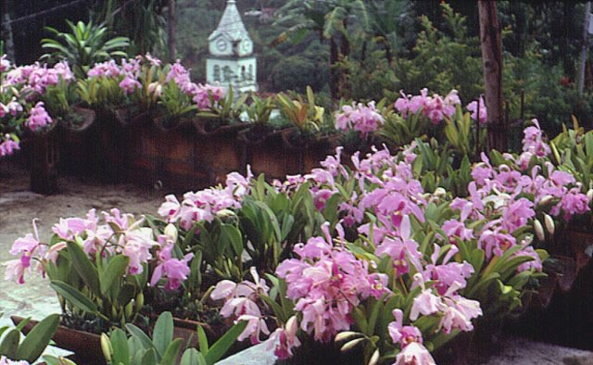
Colombian Cattleyas: Morphology, Color Variations and Biogeography
Gustavo A. Aguirre
Medellín - Colombia

Slide 2
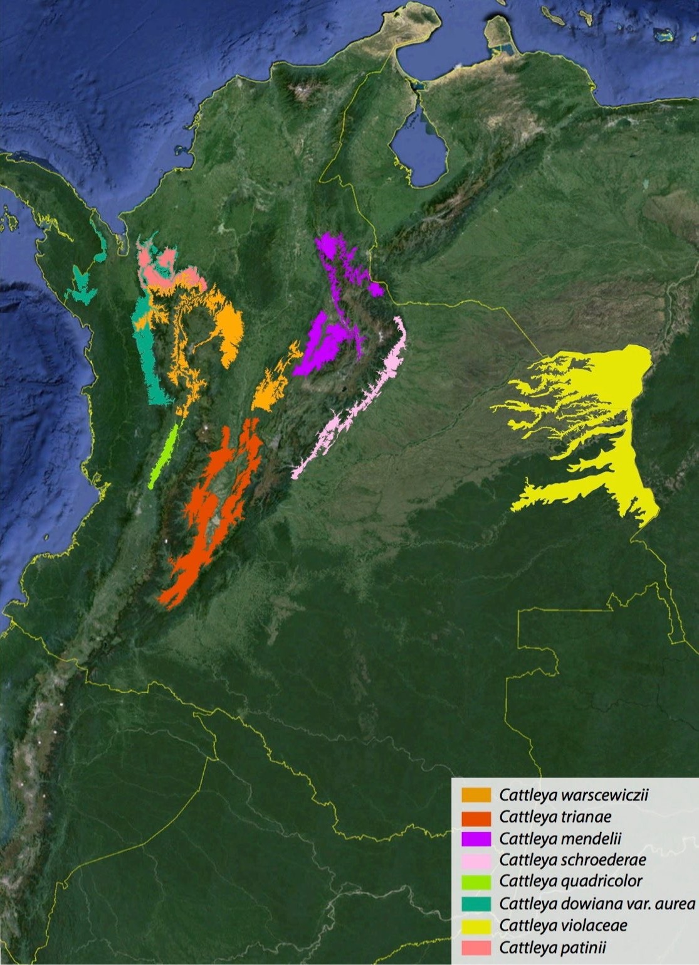
Species of Cattleya
Geographical distribution

Slide 3
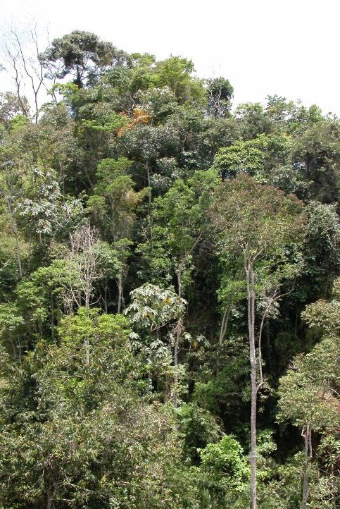

Natural Habitat
View of the forest where most cattleyas,
except C. violacea,
grow

Slide 4
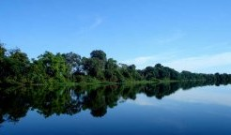

Natural habitat
Cattleya violacea

Slide 5
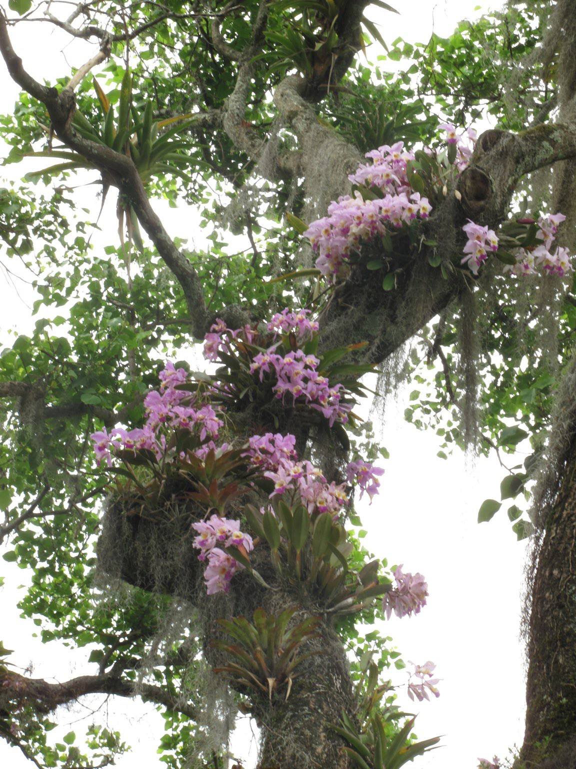
Natural habitat
On a living tree

Slide 6
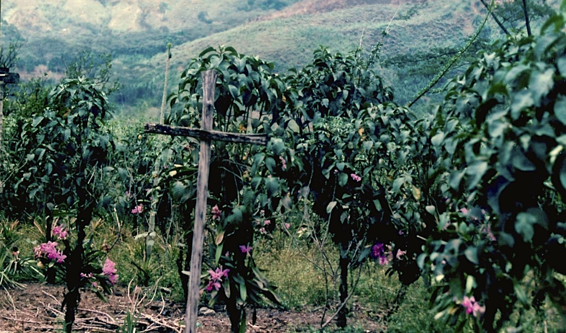
Native people growing their loved 'carleyas'
Bushes sown for support of the plants of Cattleya warscewiczii

Slide 7
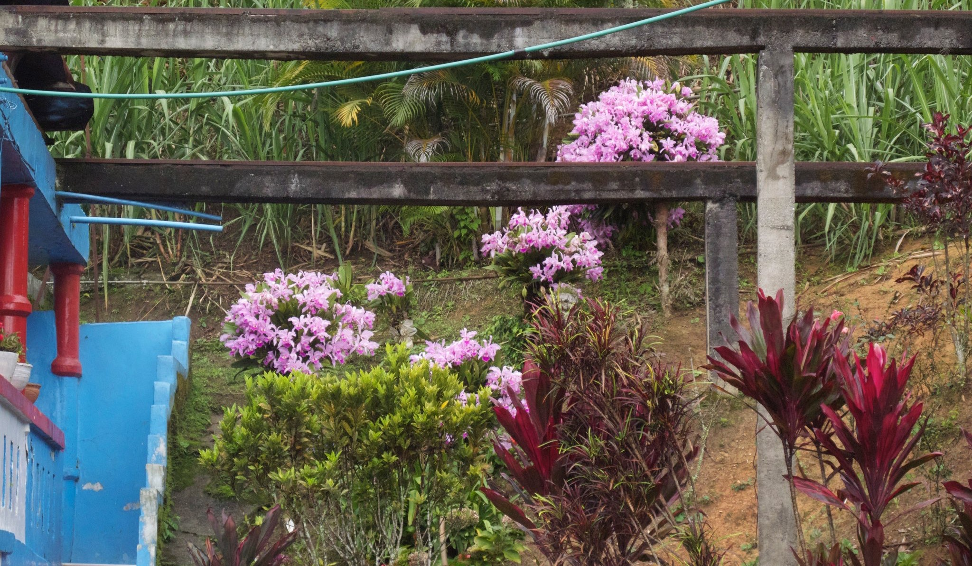
Big inflorescences
Or in the front of the house

Slide 8
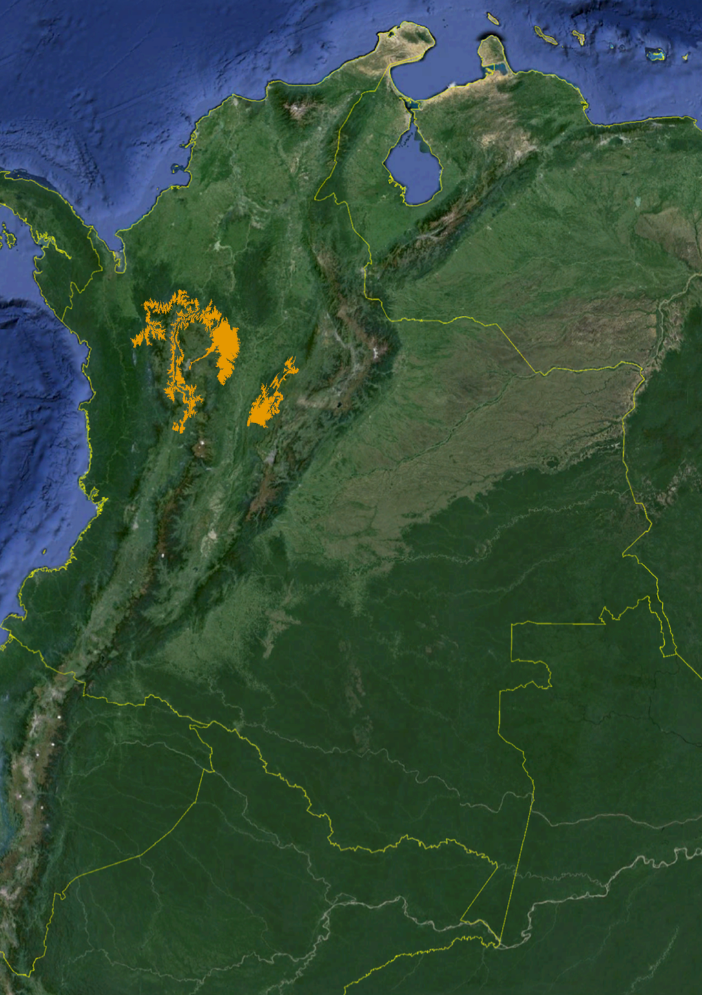
Cattleya warscewiczii
Rchb. F. 1854
Generalities
Location | This species is distributed in the north of the western Andes Cordillera and in the central west slope of the Andes Central Cordillera.
Altitude | 1500´ - 4500´ ASL
Temperature | 60°F – 90°F
Humidity | 70% - 80%
Other climatic features | Dry season from mid December to mid march and and wet season from mid March to mid June
Growing tips | Warm with mid environmental humidity, good air circulation and light.
Size and type of the plant | Big and monofliated.

Slide 9
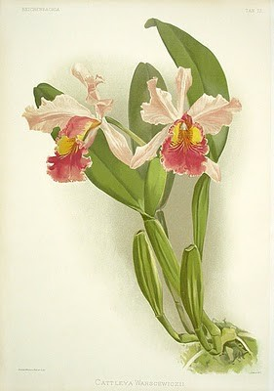

Cattleya warscewiczii
Flower features
Typical color of the flower | Lavender petals and sepals, lip with trapezoidal, rounded and flat. Purple in the front with two yellow ‘eyes’ emerging from the tube.
Color variations | Dark, cegata, oculata, marmorea, marginata, tesellata, concolor, semialba light and dark alba, coerulescens and coerulea.
Average size of the flower | 7” to 9”
Common number of flowers by spike | 4 to 7
Best characteristics of the flower | Size, quantity and upright spike.
Other characteristics of the flower | Lip tube constrains before it opens, trapeziodal form. Blooms from finishing maturation of the new pseudobulbs, six month later pseudobulbs don't bloom nor form spathe.
Blooming time | February to May

Slide 10
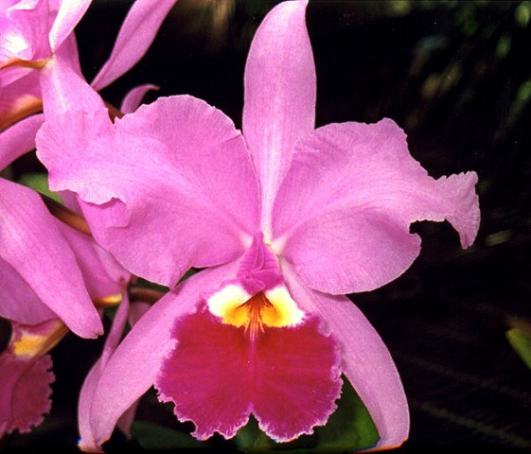

Cattleya warscewiczii
‘Peña Blanca’

Slide 11
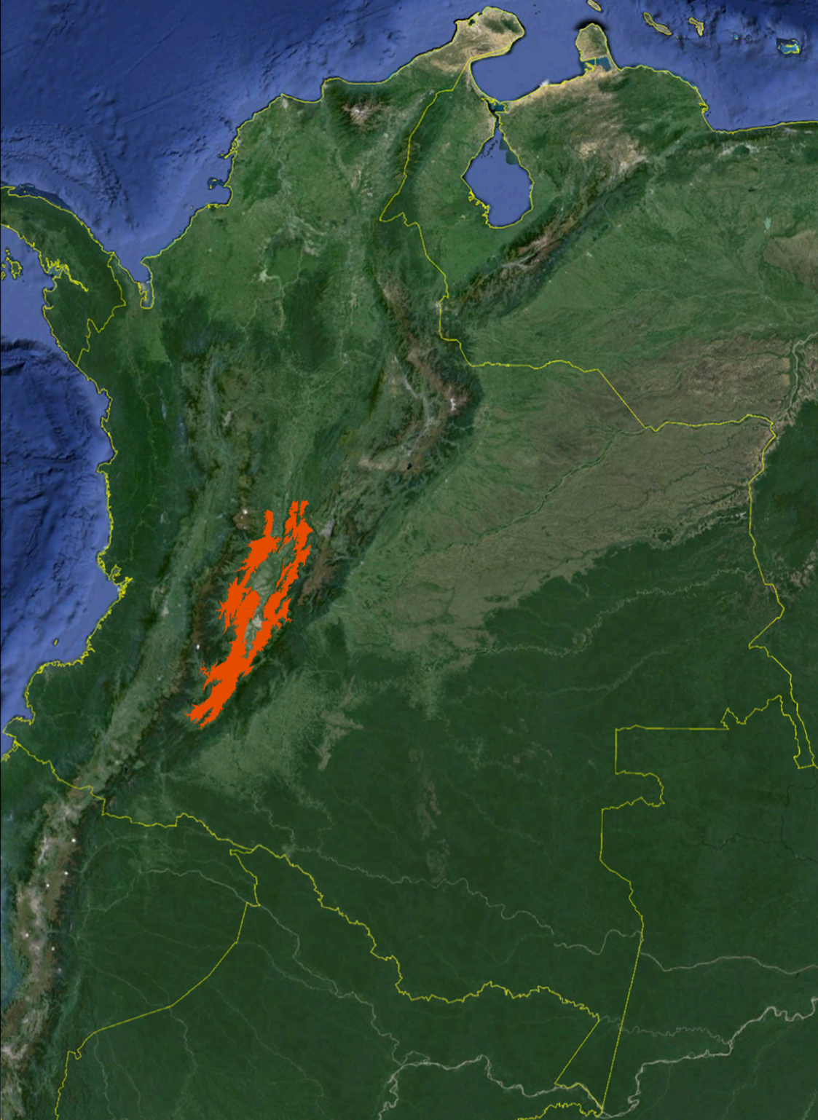

Cattleya trianae
Lndl. & Rchb. F. 1860
Generalities
Location | The distribution of this splendid species is in the central eastern slope of the Andean Central Cordillera and in the western southern slope of the Andean East Cordillera.
Altitude | 2,300’ - 5,500’ ASL
Temperature | 60°F – 90°F
Humidity | 60% - 80%
Other climatic features | Dry season December to March and July to September rainfall up to 1,500 mm
Growing tips | Warm with mid environmental humidity, good air circulation and light.
Size and type of the plant | Big and monofliated.

Slide 12
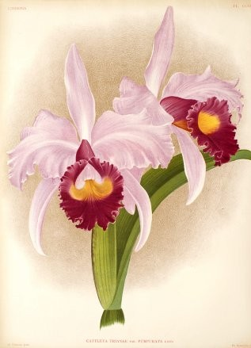

Cattleya trianae
Flower features
Typical color of the flower | Lavender sepals and petals, yellow, lavender and purple lip, purple in the front, yellow in the inner side and lavender in the outer side of the throat.
Color variations | Dark, splash, pelorica, bull's blood, cuasiconcolor, concolor, cuasialba, semialba light and dark, alba and coerulea.
Average size of the flower | 6” to 8 "
Common number of flowers by spike | 2 to 4
Best characteristics of the flower | Very good shape and a lot of color variations
Other characteristics of the flower | Round frontal part of the lip. Blooms from mature pseudobulbs.
Blooming time | All year round, most on November and May

Slide 13
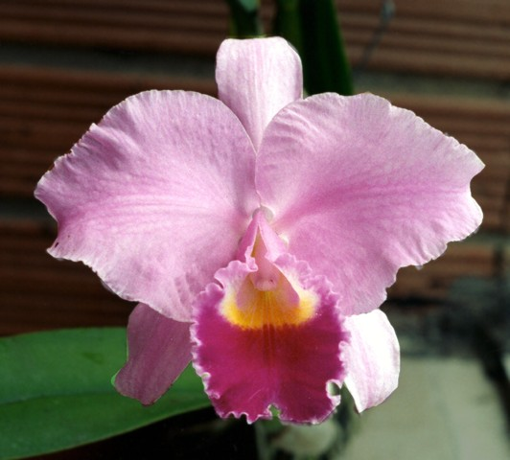

Cattleya trianae
'Jaramillo'

Slide 14
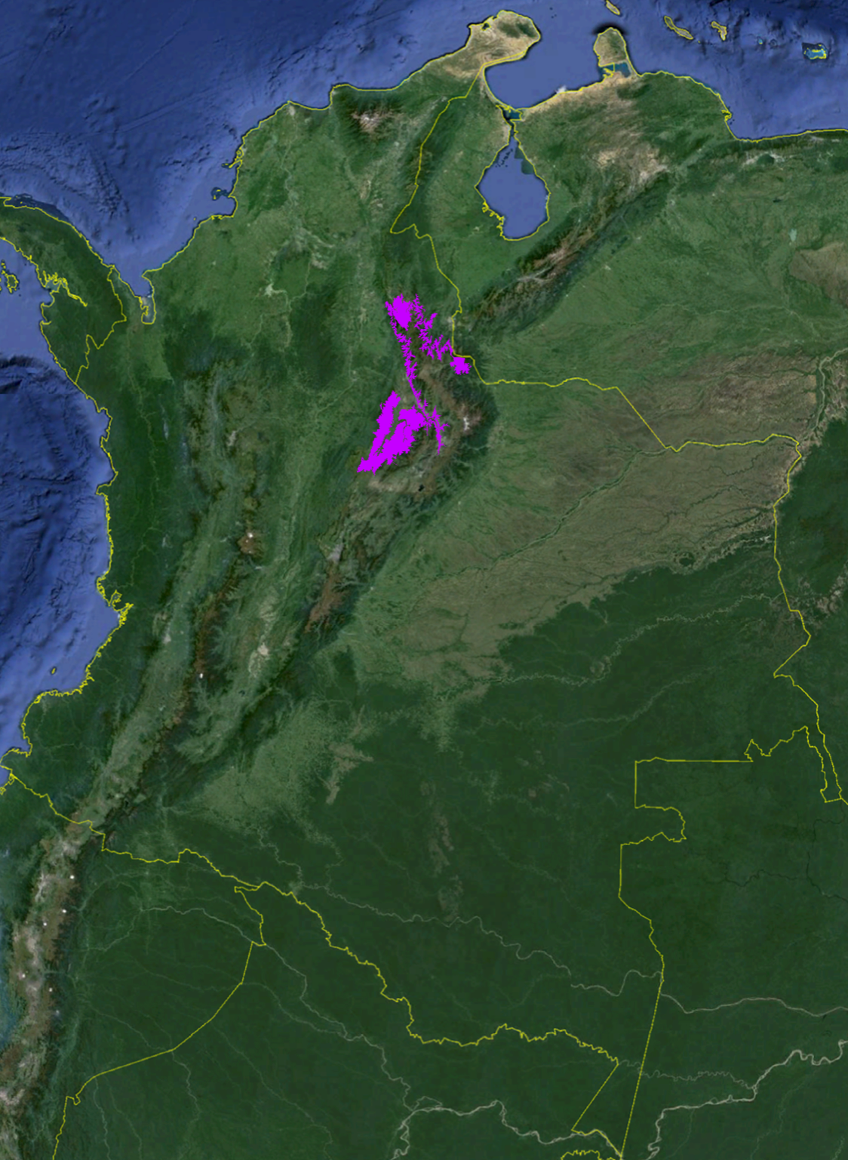
Cattleya mendelii
Dombrain 1872
Generalities
Location | The distribution of this species is the north of the west slope of Andes Eastern Cordillera
Altitude | 4,500’ - 6,500’ ASL
Temperature | 60°F – 80°F
Humidity | 80% - 90%
Other climatic features | Dry season December to March and July to September rainfall up to 1,500 mm
Growing tips | Temperate to cold with high environmental humidity, good air circulation and light.
Size and type of the plant | Big and monofliated.

Slide 15
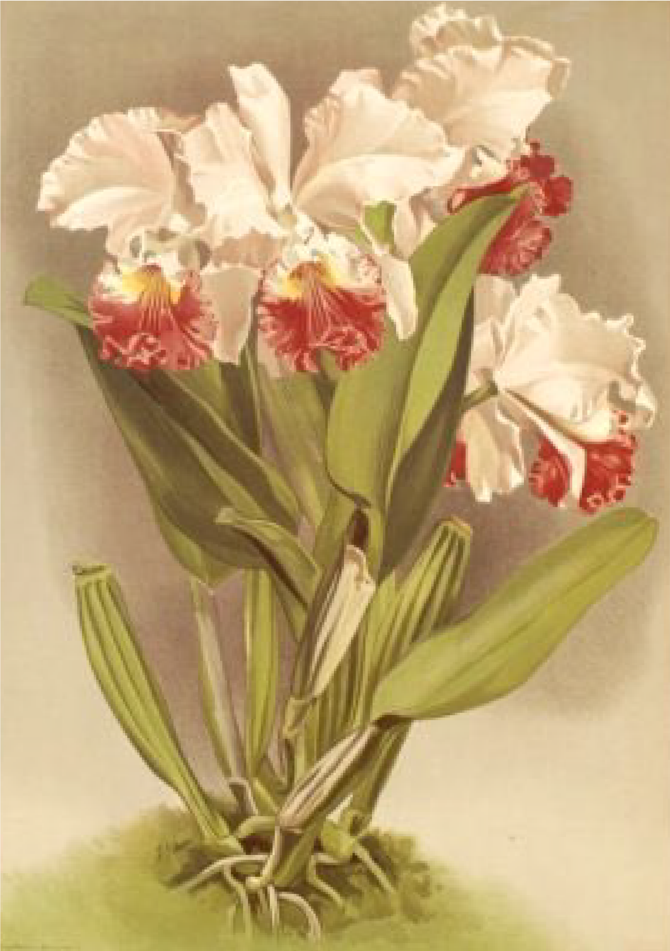

Cattleya mendelii
Flower features
Typical color of the flower | Lavender wide petals and sepals, the petals. The lip is impressive with a crispy purple border in the of the frontal portion and most of the times white external side of the throat.
Color variations | Dark, splash, aurea, cuasiconcolor, concolor, cuasialba, semialba light and dark, semialba coerulea light and dark, alba and coerulea.
Average size of the flower | 6” to 8”
Common number of flowers by spike | 3 to 5
Best characteristics of the flower | Wide petals, strong substance, crispy frontal part of the lip, excellent presentation in the spike.
Other characteristics of the flower | Very nice color patterns. Blooms from six month and new pseudobulbs at the same time.
Blooming time | March to May.

Slide 16
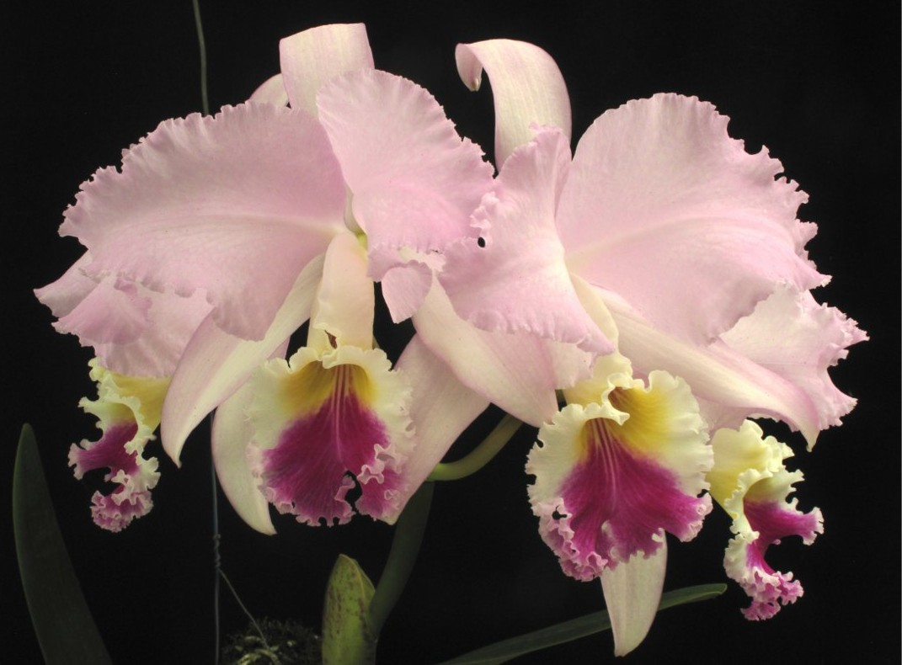

Cattleya mendelii
‘Leal’

Slide 17
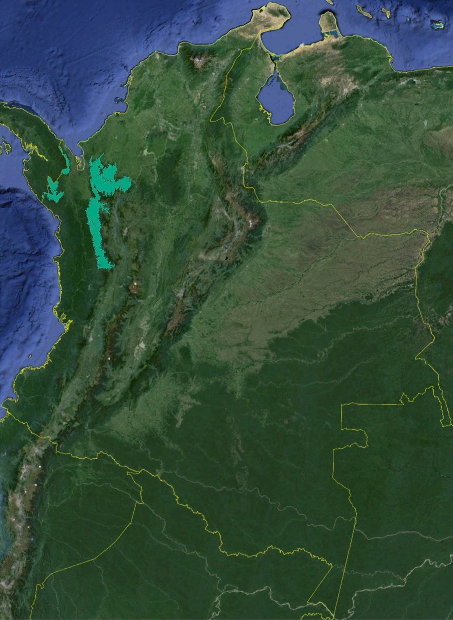
Cattleya dowiana var. aurea Bateman 1866
Generalities
Location | The distribution of this species is in the northern western slope of the Andes West Cordillera and in the north of it
Altitude | 1,000’ - 4,000’ ASL
Temperature | 60°F – 90°F
Humidity | 70% - 90%
Other climatic features | Dry season from December to March and July to September.
Growing tips | Warm with high environmental humidity, good air circulation and light. Very sensitive to rot by fungus and bacteria .
Size and type of the plant | Big and monofliated.

Slide 18
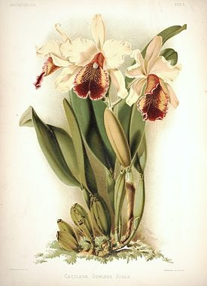

Cattleya dowiana
var. aurea
Flower features
Typical color of the flower | The color of the flowers is different from the others, the tepals are bright yellow and the lip red with yellow stripes, sometimes so wide in the frontal part, that mix up in a uniform golden yellow zone.
Color variations | Aurea and rosea.
Average size of the flower | 6” to 8”
Common number of flowers by spike | 2 to 4
Best characteristics of the flower | Impressive general color and pattern on the lip. Strong smell.
Other characteristics of the flower | Sometimes with red irregular stain in the inner and proximal part of the petals.
Blooming time | May to July.

Slide 19
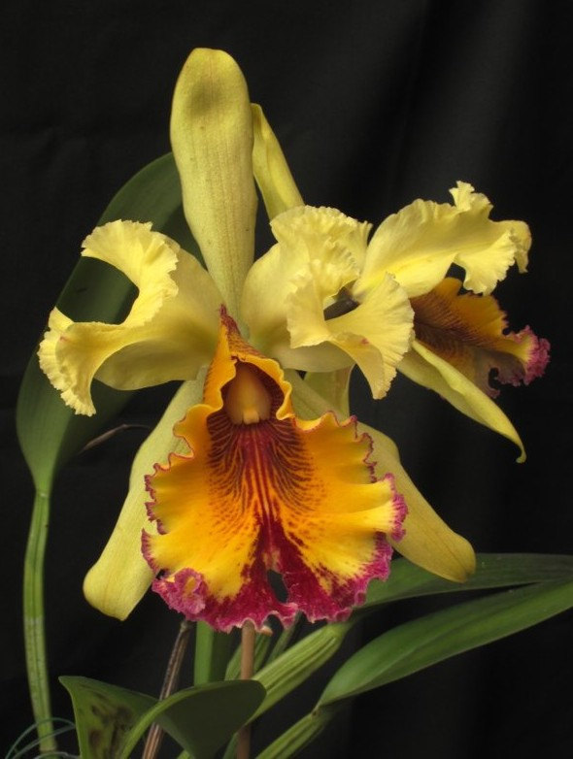

Cattleya dowiana
var. aurea
‘Kationé’

Slide 20
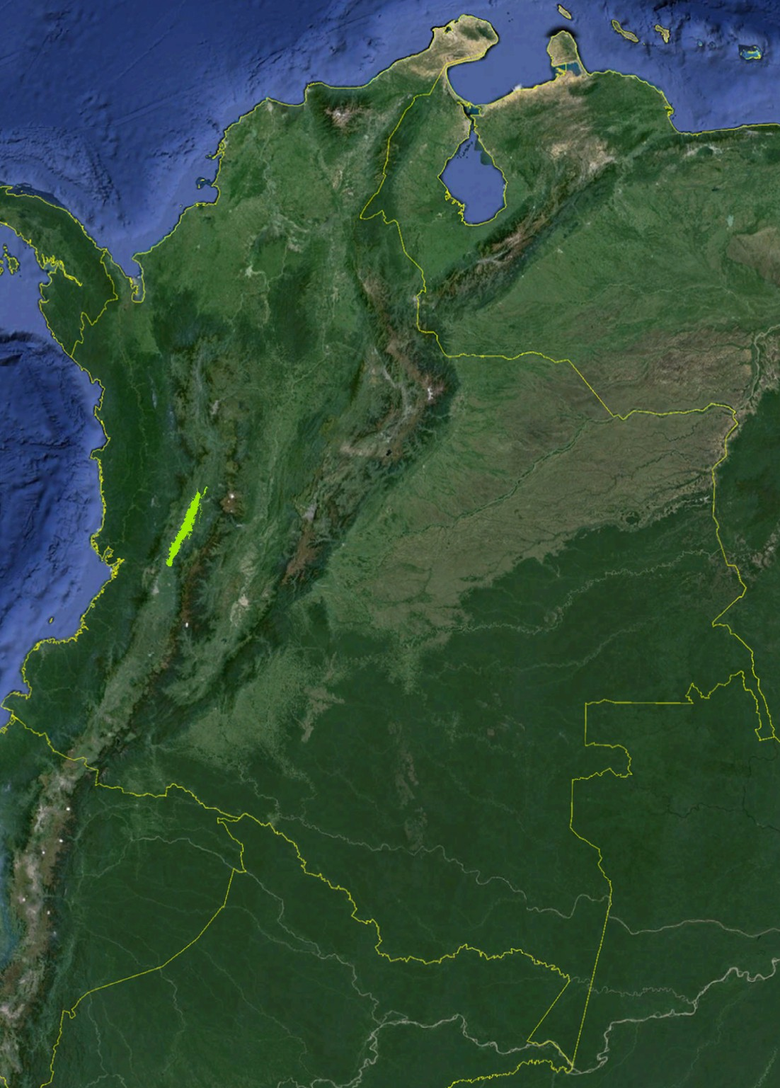
Cattleya quadricolor
Bateman 1864
Generalities
Location | This species is endemic of the Cauca river valley, in the eastern central slope of the Andes Central Cordillera and in the western central slope of the Andes West Cordillera,
Altitude | 2,600’ - 3,400’ ASL
Temperature | 65°F – 90°F
Humidity | 70% - 80%
Other climatic features | Dry season from December to March and July to September.
Growing tips | Warm with mid environmental humidity, good air circulation and light.
Size and type of the plant | Large and thin monofoliated.

Slide 21
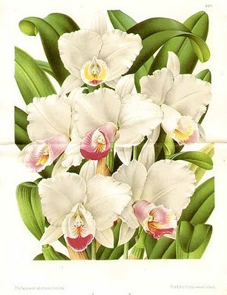

Cattleya quadricolor
Flower features
Typical color of the flower | Tepals lavender, colorful purple, pink and yellow lip with the tube semi opened in the front.
Color variations | Dark, splash, aurea, concolor, semialba light and dark, alba and coerulea
Average size of the flower | 5" to 6"
Common number of flowers by spike | 2 to 3
Best characteristics of the flower | Wide petals and strong smell.
Other characteristics of the flower | Slighty closed, strong sweet perfume.
Blooming time | July to september, not precise

Slide 22
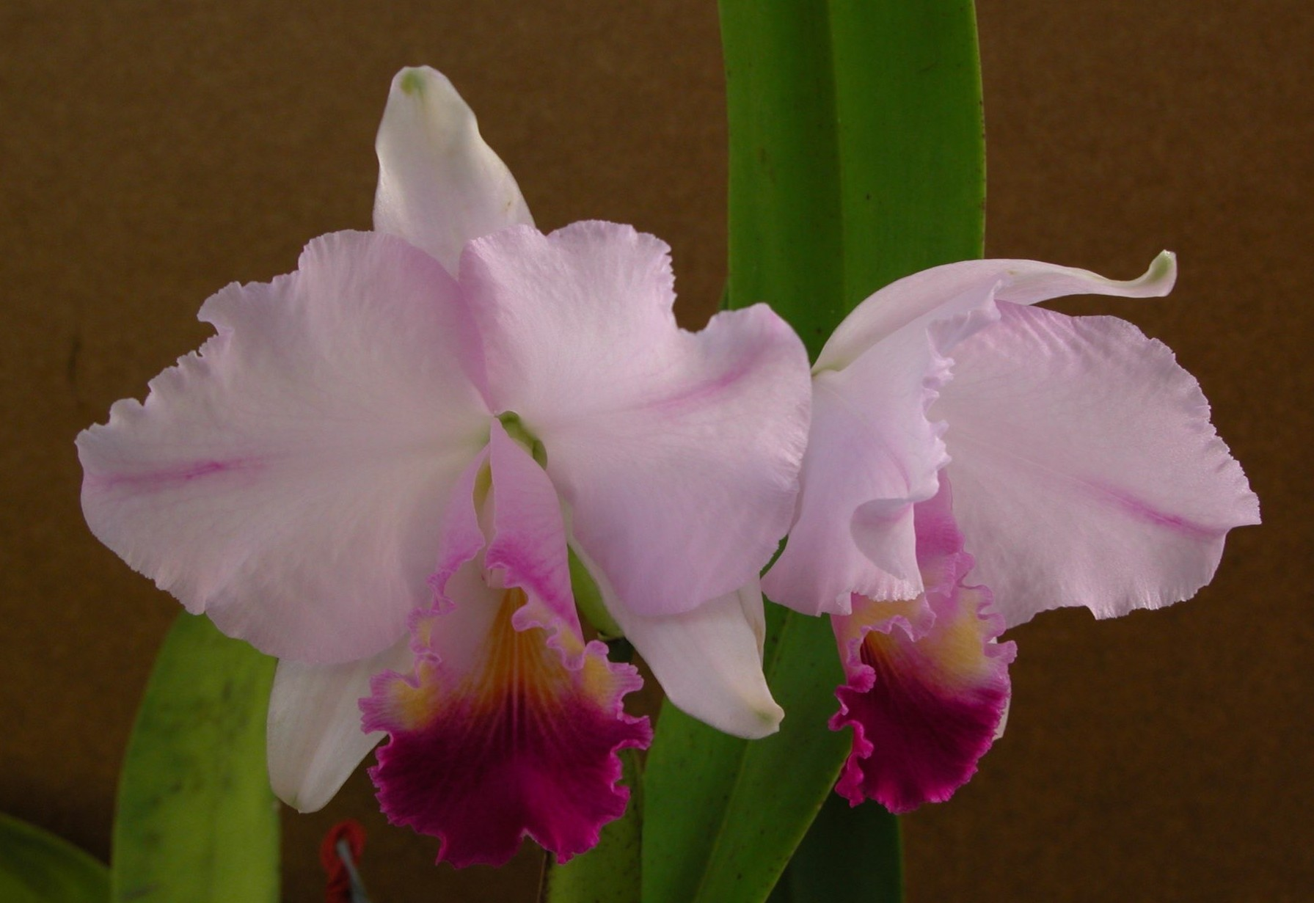

Cattleya quadricolor
var. pincelada 'OKF2233'

Slide 23
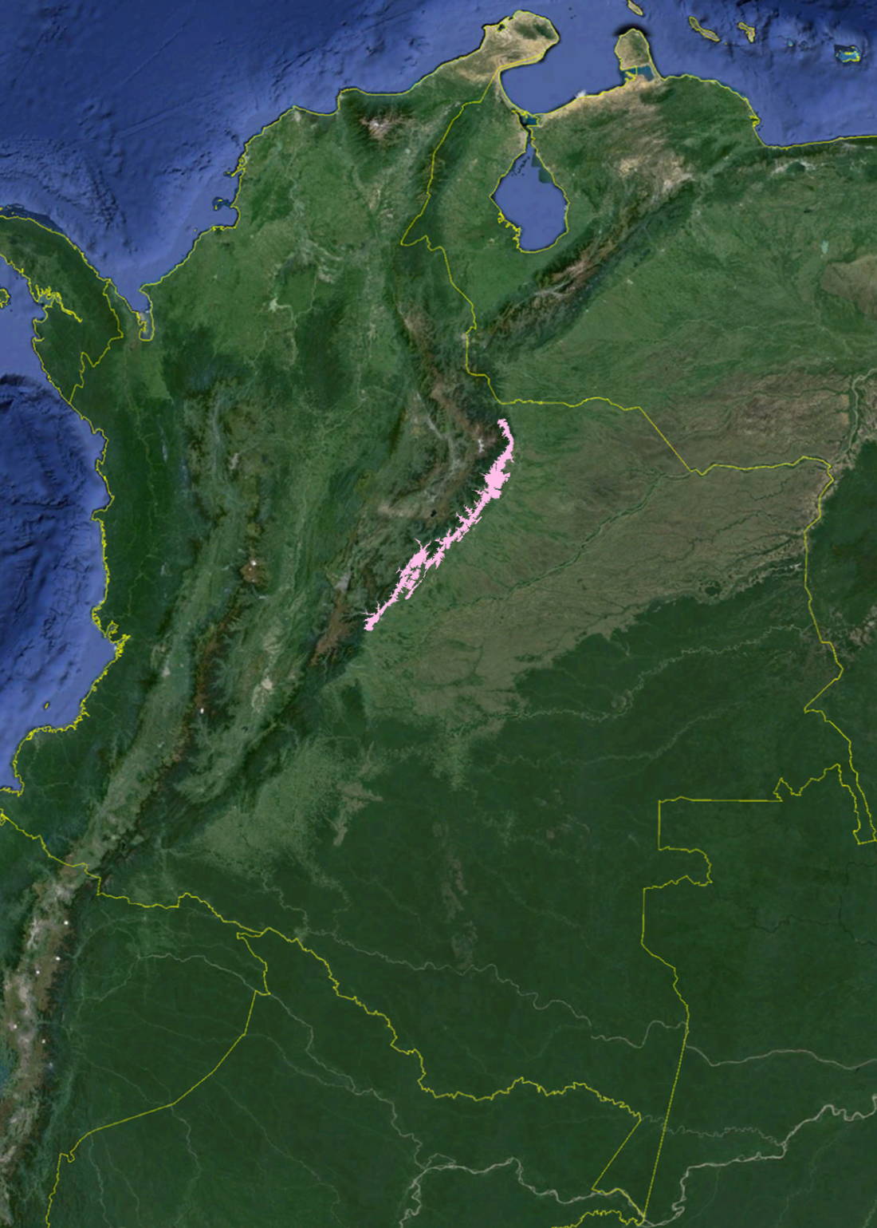
Cattleya schroederae
Rolfe 1895
Generalities
Location | This species is distribuited in the north of the east slope of the Andes East Cordillera
Altitude | 3,000’ - 5,000’ ASL
Temperature | 60°F – 90°F
Humidity | 80%
Other climatic features | Dry season from December to March and July to September.
Growing tips | Warm with high environmental humidity, good air circulation and light.
Size and type of the plant | Mid and monofoliated. The new leave has a light white dust.

Slide 24
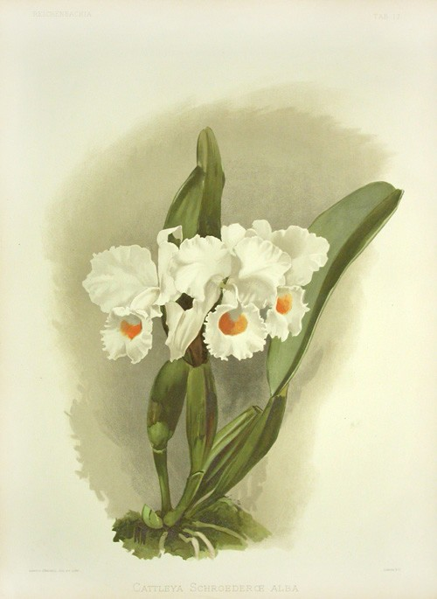

Cattleya schroederae
Flower features
Typical color of the flower | Flowers normally concolor, light pale lavender with round lip and dark yellow throat.
Color variations | Dark, purpurea, alba and coerulea.
Average size of the flower | 6” to 8”
Common number of flowers by spike | 3 to 5
Best characteristics of the flower | Strong yellow to orange color in the center of the lip.
Other characteristics of the flower | Very delicate anis scented perfume.
Blooming time | November to January.

Slide 25
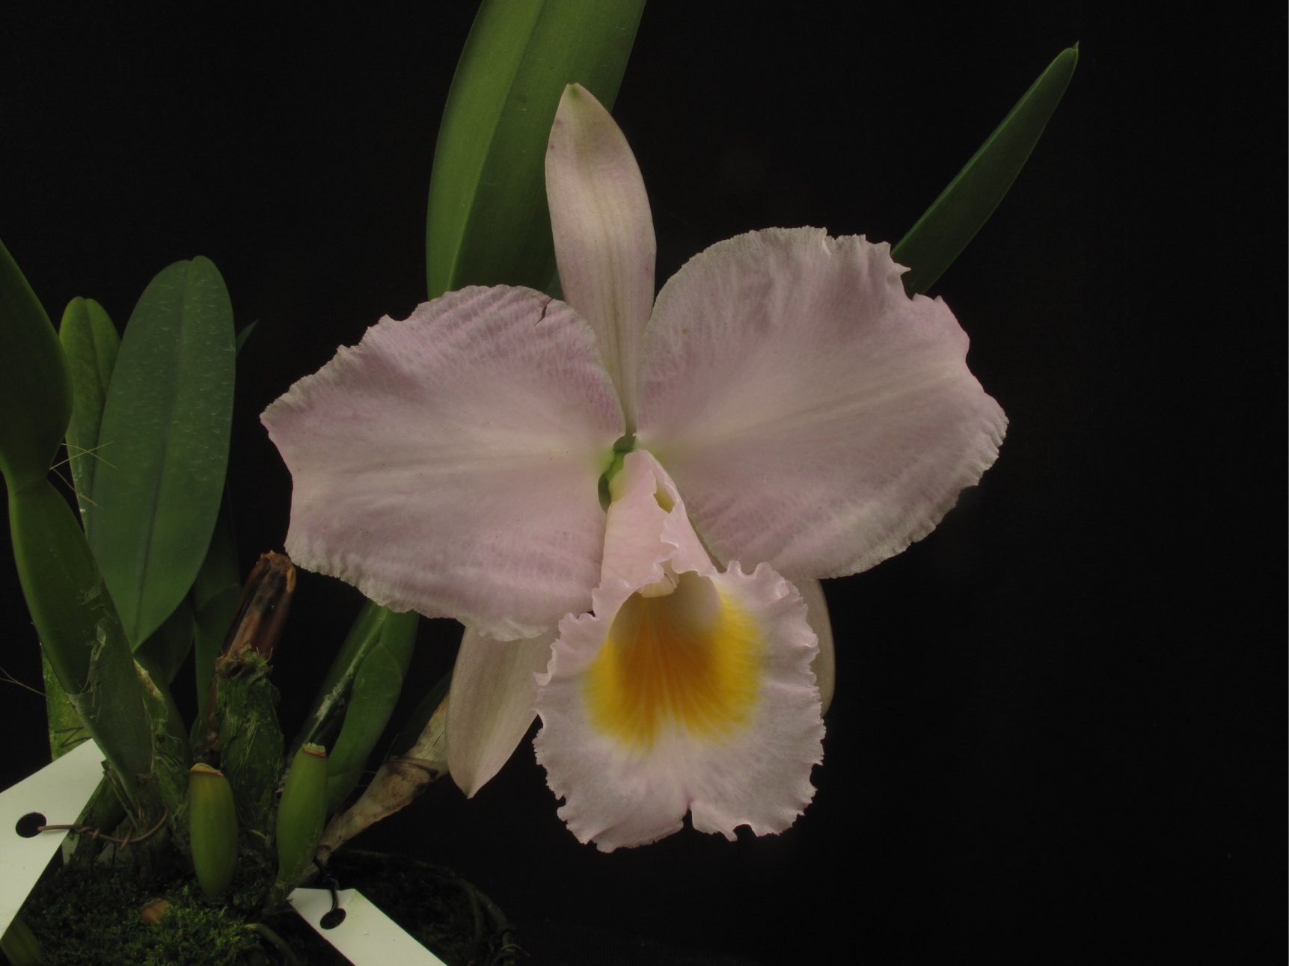

Cattleya schroederae
'Porcelana'

Slide 26
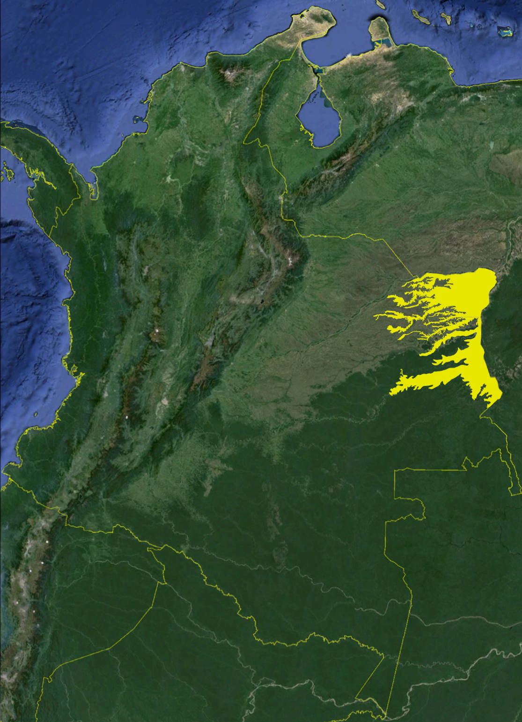
Cattleya violacea
(HBK) Rolfe 1889
Generalities
Location | Orinoquian and Amazonian regions, in Colombia and its border countries Venezuela, Guyanas, Brasil, Peru and Bolivia,
Altitude | 650’ - 2,300’ ASL
Temperature | 70°F – 100°F
Humidity | 60% to 80%
Other climatic features | Dry season of three months and wet season, both very defined
Growing tips | Warm with high environmental humidity, good air circulation and light. Need a dry season after the new growth stops.
Size and type of the plant | Mid and bifoliated.

Slide 27
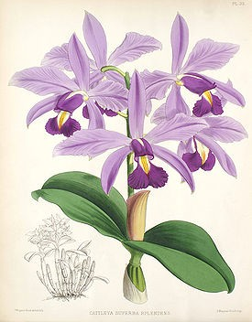

violacea
Cattleya
Flower features
Typical color of the flower | Flowers brilliant lavender petals and sepals, lip dark purple with yellow and white.
Color variations | Not known in Colombia.
Average size of the flower | 3” to 4”
Common number of flowers by spike | 3 to 5
Best characteristics of the flower | Brilliant color, flat flower.
Other characteristics of the flower | Star like flower.
Blooming time | June to August.

Slide 28
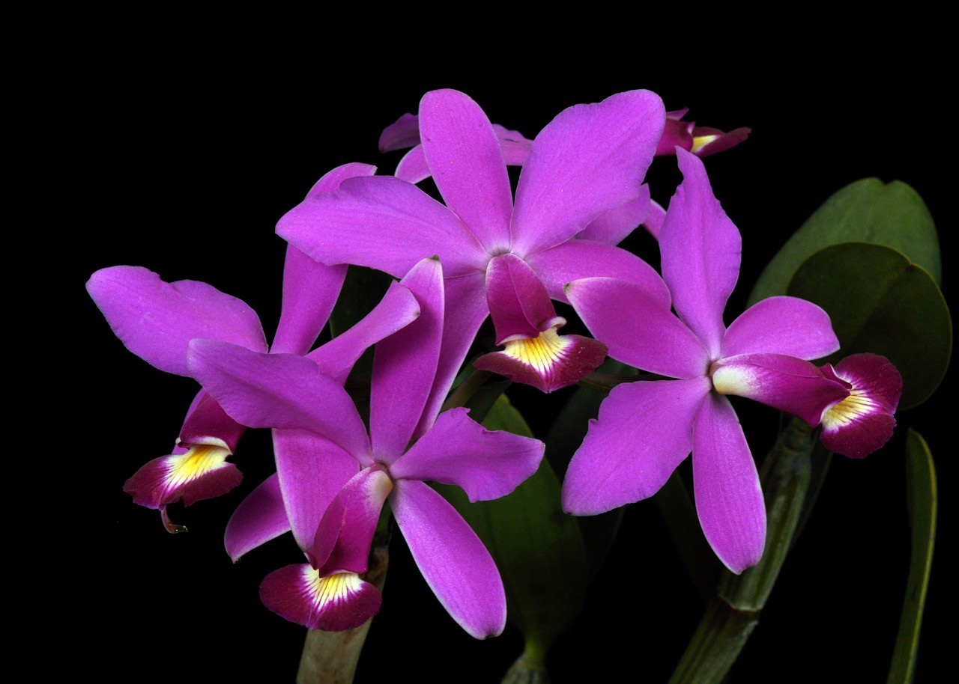

violacea
Cattleya

Slide 29
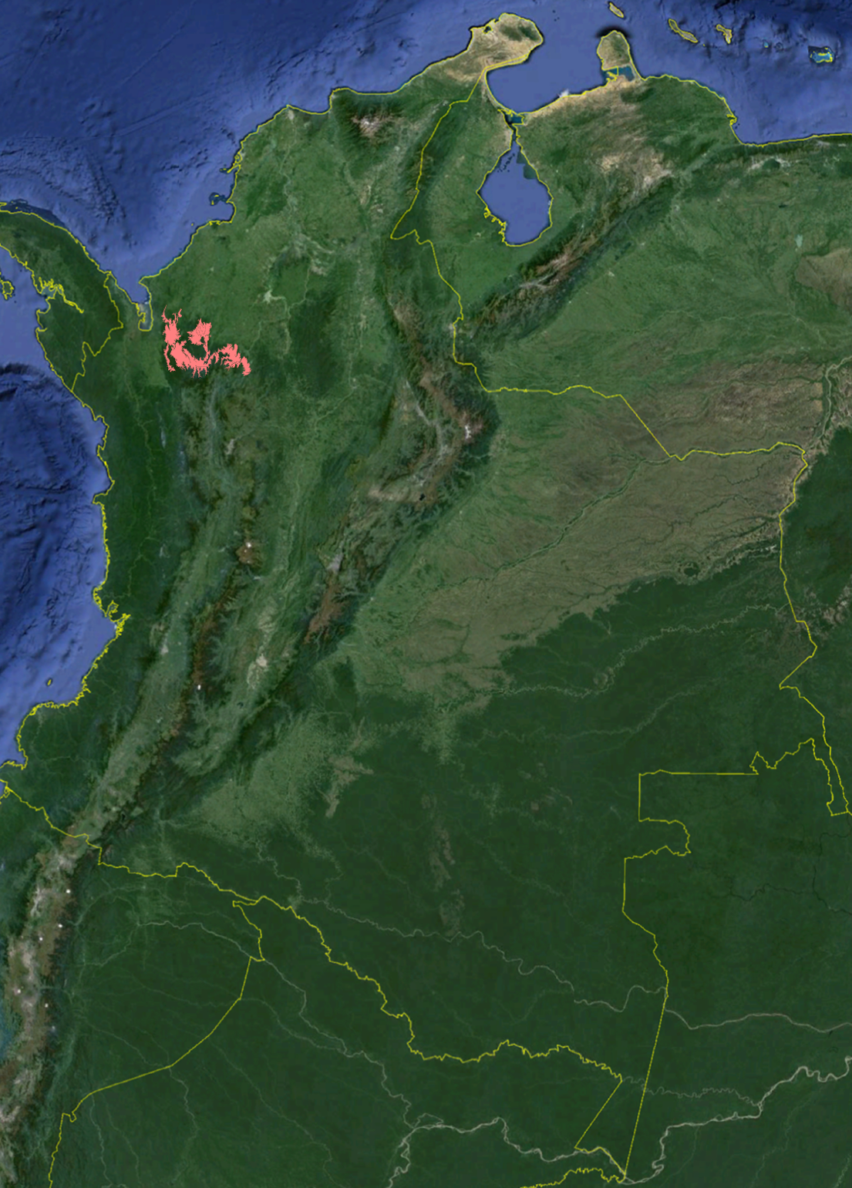
Guarianthe patinii (Cogn.) Dressler & W. E. Higgins
Generalities
Location | North of the Western Andean Cordillera of Colombia and in Costa Rica, Panamá, Venezuela y Trinidad y Tobago.
Altitude | 650’ - 1,600’ asl
Temperature | 70°F – 100°F
Humidity | 80%
Other climatic features | Dry and wet seasons
Growing tips | Few times grown, hor and well drained
Size and type of the plant | Mid and bifoliated.

Slide 30
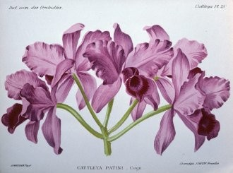

Cattleya patinii
Flower features
Typical color of the flower | Small purple flowers, sometimes autogamous.
Color variations | Alba.
Average size of the flower | 3”
Common number of flowers by spike | 6
Best characteristi cs of the flower | Many flowers per spike.
Other characteristics of the flower | Small flowers, many times cleistogamous.
Blooming time | October to December

Slide 31
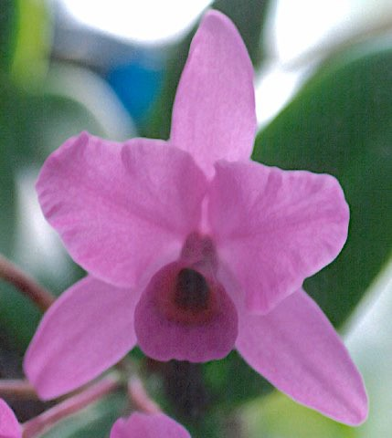

Cattleya patinii
‘Ignacio’

Slide 32
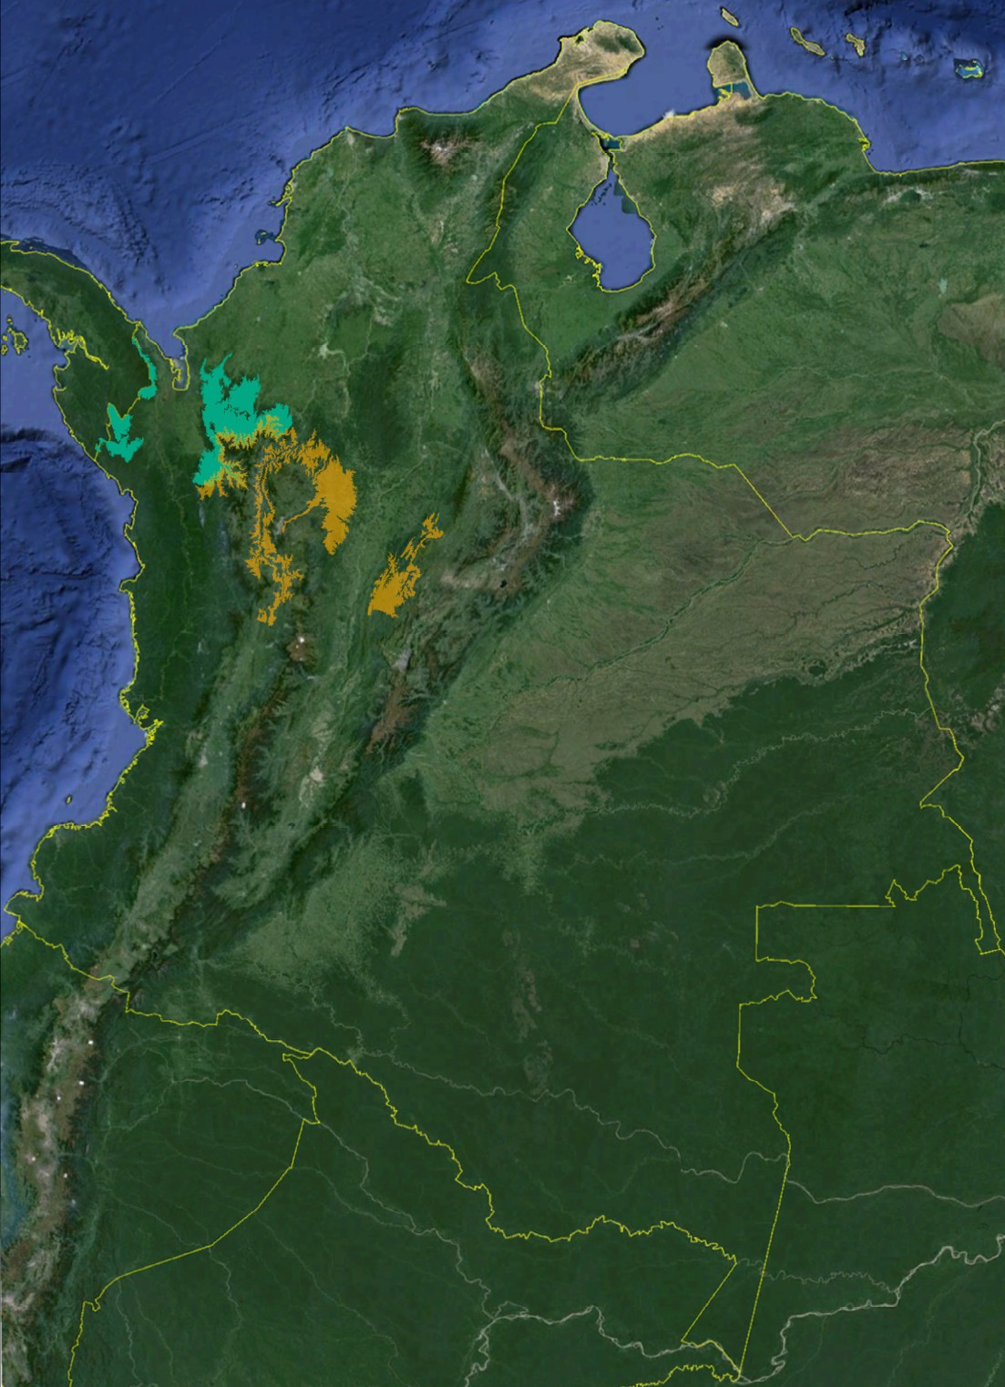
Cattleya xHardyana
Williams 1886
Generalities
Location | North of the Andes West Cordillera
Altitude | 2,500’ - 4,500’ ASL
Temperature | 60°F – 90°F
Humidity | 80%
Other climatic features | Dry season from December to March and July to September.
Growing tips | Warm with high environmental humidity, good air circulation and light.
Size and type of the plant | Big and monofliated.

Slide 33
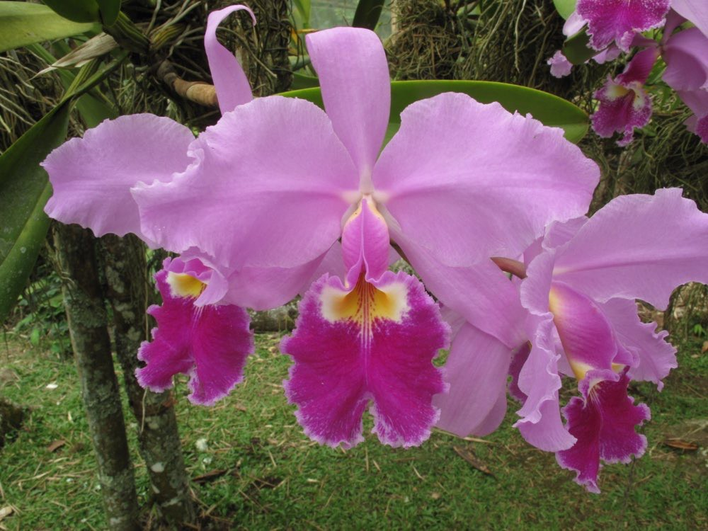

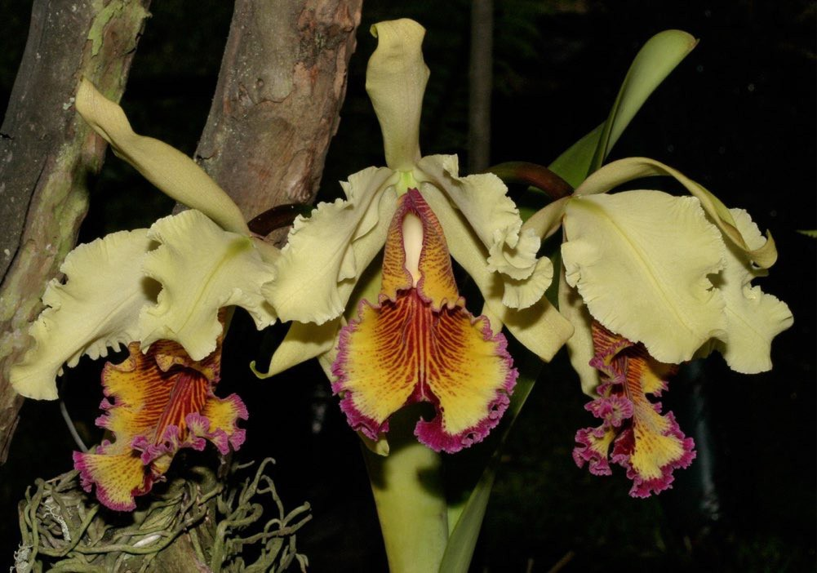

Cattleya xHardyana
This is the natural hybrid between Cattleya warscewiczii and Cattleya dowiana var. aurea, occurs in a particular area were both species are
native.
Very showy, enhace the lavender color of the latter.
Flower features
Typical color of the flower | Flowers brilliant lavender with dowiana type lip with warscwiczii colors, but darker.
Color variations | Semialba.
Average size of the flower | 6” to 8”
Common number of flowers by spike | 3 to 5
Best characteristics of the flower | Strong lavender,and purple colors.
Blooming time | Free flowering.

Slide 34
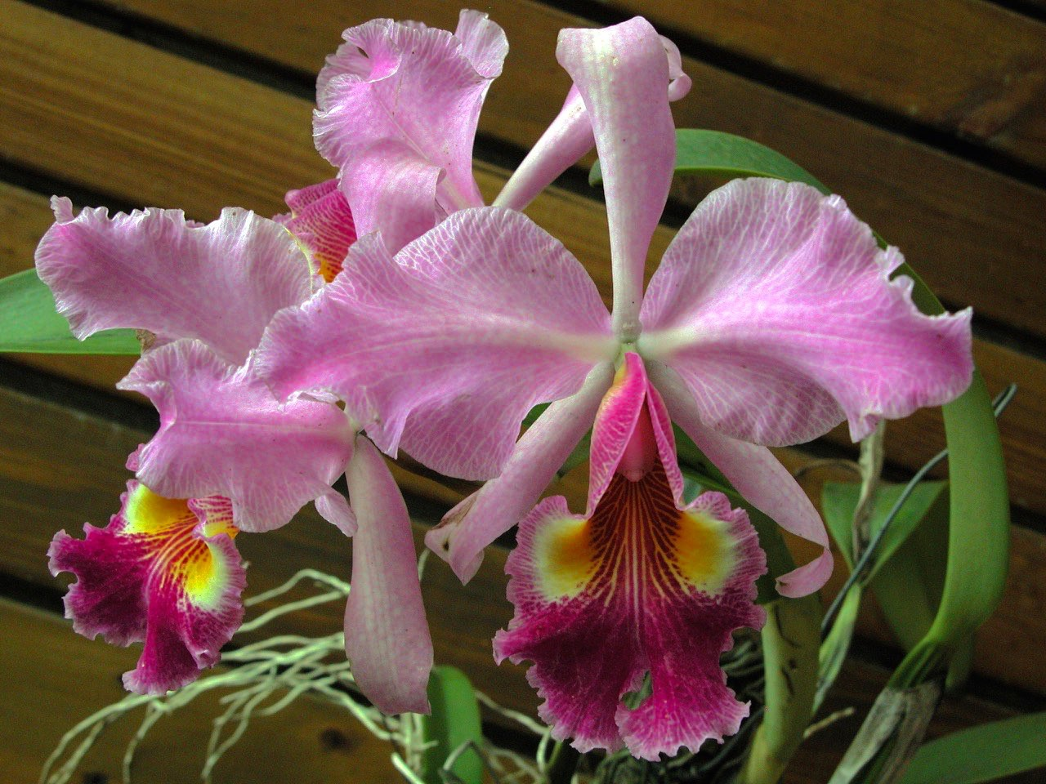

Cattleya xHardyana
‘OKF9104’

Slide 35
Table with general characteristics of Colombian Cattleya species
Species | Typical color | Color forms or variations found in Colombia | Remarkable features of the lip of the typical flower. | Other features of the plants | Climatic conditions
Cattleya deckeri | Purple. | Alba. | Small and purple. | Bifoliated | Hot with severe dry and rainy seasons
Cattleya dowiana var. aurea | Yellow + red. | Rosea. | Big with veins and solid portions of yellow on a garnet red background. | Unifoliated | Warm with mild dry and rainy seasons.
Cattleya xHardyana | Dark lavender + red + yellow. | Semialba. | Big with veins and solid portions of yellow on a red background. | Unifoliated | Warm with mild dry and rainy seasons.
Cattleya mendelii | Lavender + purple + yellow + white. | Alba, semialba dark, light, coerulescens and coerulea, aurea, splash, dark, cuasiconcolor, concolor and coerulea. | Round and crispy, frontal portion colored with white and purple, sometimes with pink shadows on the border, whittish veins coming from the inner tube and outer face of the tube most of cases white. | Unifoliated | Intermediate with mild dry and rainy seasons, likes high humidity in the air.
Cattleya quadricolor | Lavender + purple + yellow + white. | Alba, semialba dark, light and coerulea, splash, cuasiconcolor, concolor and coerulea. | Frontal portion round, suffusely colored with intense purple and sometimes white and coming from the inner side of the tube yellow and pink. Outer side of the tube generally pink. | Unifoliated | Warm with mild dry and rainy seasons.
Cattleya schroederae | Lavender + orange. | Alba, dark and purpurea. | Interior of the tube and frontal portion of the lip solid yellow yolk surrounded by lavender. | Unifoliated | Warm with mild dry and rainy seasons.
Cattleya trianae | Lavender + purple + yellow. | Alba, cuasialba, semialba light and dark, cuasialba, dark, cuasiconcolor, concolor, splash, peloric, dark(sangre de toro) and coerulea | Frontal portion vanished dense purple, yellow tube at the opening and purple. | Unifoliated | Warm with mild dry and rainy seasons.
Cattleya violacea | Purple + yellow + white. | Not known. | Small and purple. | Bifoliated | Hot with severe dry and rainy seasons
Cattleya warscewiczii | Lavender + purple + yellow. | Alba, semialba dark and light, dark, concolor, oculata, cegata (blind), oculata (one big eye), marginata (pink margin in the lip), marmorea (marble like color pattern in the lip), coerulescens and coerulea. | Frontal portion in dense purple drops , veins and two 'eyes' in the opening of the yellow tube. | Unifoliated | Warm with mild dry and rainy seasons.

Slide 36
The End
Thanks for your kind attention and gentile invitation!
My acknowledges to whom had contributed with photographs and any other information to this research: Sociedad Colombiana de orquideología, plates of
Reichenbachia and my late friend José I. Acosta.
GUSTAVO ADOLFO AGUIRRE A.
E-mail: orquideaskatia@gmail.com Medellín - Colombia

