Slide 1

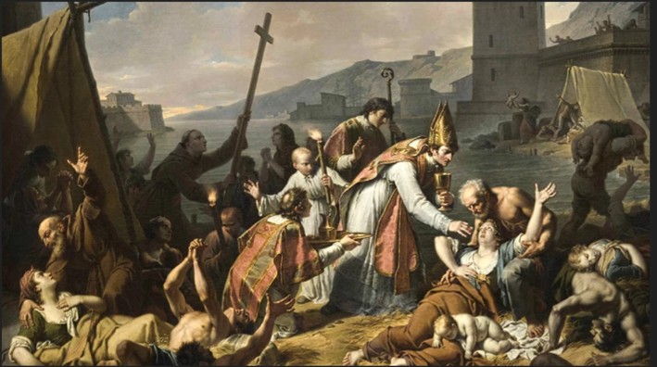
Pandemic Plan for the Church
Ministering to the Community in a Time of Crisis
The Role of the Church
In a Pandemic
outrunningthehorses.com

Slide 2

“It is our care of the helpless,
our practice of loving kindness that brands us
in the eyes of many of our opponents.
‘Only look,’ they say, ‘look how they love one another!’”
Tertullian
outrunningthehorses.com

Slide 3
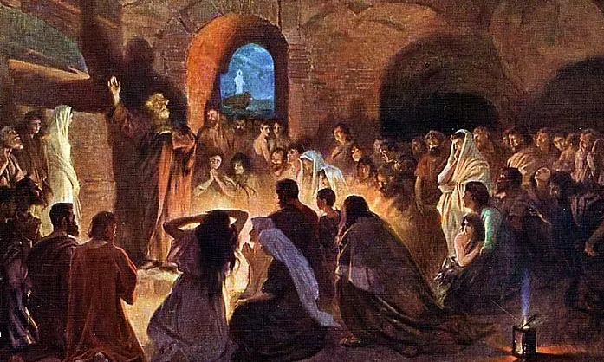
The Role of the Church
Ministering to the Community in a Time of Crisis
Introduction
  Church history tells us that Christianity grew and thrived during difficult times.
  While still young and developing, the early Christian Church grew to a worldwide entity despite great hostility and resistance.
outrunningthehorses.com

Slide 4
The Role of the Church
Ministering to the Community in a Time of Crisis
Introduction
  Throughout this period, in addition to the persecution, there were recorded plagues.
    The early Christian Church achieved unprecedented growth during the second and third centuries A.D.
    Numerous historical and sociological explanations have been written to account for this phenomenon.
outrunningthehorses.com

Slide 5
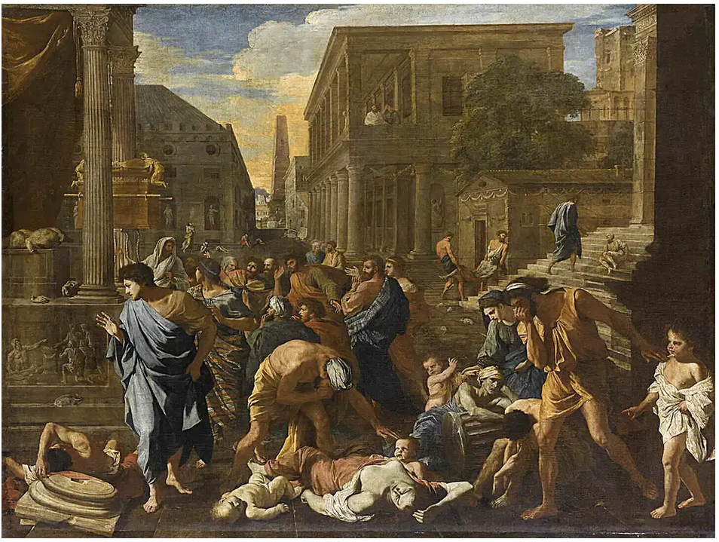
The Role of the Church
Ministering to the Community in a Time of Crisis
The Plague of Cyprian
  250 AD to 270 AD
    Believed to be Smallpox
    At its height, 5,000 people died each day in Rome
    People lived in terror
    The pagans blamed and persecuted the Christians
outrunningthehorses.com

Slide 6
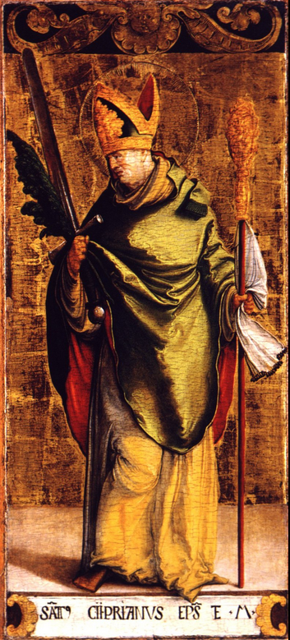
The Role of the Church
Ministering to the Community in a Time of Crisis
The Plague of Cyprian
  Cyprian, the Bishop of Carthage
    Pagans abandoned their family members who became sick in the streets
    Christians were instructed by Cyprian to care for the sick and bury the dead, including the pagans
outrunningthehorses.com

Slide 7
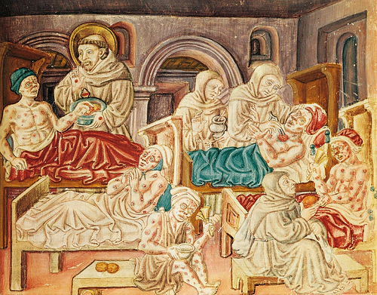
The Role of the Church
Ministering to the Community in a Time of Crisis
The Plague of Cyprian
  Christianity spread
    Christian values of love and charity were expressed by the practices of social service – creating a network of medical care
outrunningthehorses.com

Slide 8
The Role of the Church
Ministering to the Community in a Time of Crisis
The Plague of Cyprian
  Christianity spread
    Christians offered a satisfactory explanation for the catastrophic events
    Even with minimal medical care, the survival rate among Christians was substantially higher
outrunningthehorses.com

Slide 9
“All day long some of them [Christians] tended to the dying and to their burial, countless numbers with no one to care for them. Others gathered from all parts of the city a multitude of those withered from famine and distributed bread to them all, so that their deeds were on everyone’s lips, and they glorified the God of the Christians.
Eusebius the Historian
outrunningthehorses.com

Slide 10
“Most of the Christians in our city showed unbounded love and loyalty, never sparing themselves and thinking only of others. Heedless of danger, they took charge of the sick, attending their every need, helping and comforting them — and with them departed this life serenely happy; for they were infected by others with the disease, drawing on themselves the sickness of their neighbors and cheerfully accepting their pain.”
Pope Dionysius of Alexandria 260 AD
outrunningthehorses.com

Slide 11
The Role of the Church
Ministering to the Community in a Time of Crisis
The Brotherhood of Parabaloni
  Under Pope Dionysius the Great, a brotherhood formed called the Parabaloni.
  Following the example of Epaphroditus, they voluntarily undertook the care of the sick and the burial of the dead.
  They received their name from the fact that they risked their lives (paraballesthai ten zoen) by exposing themselves to contagious diseases.
outrunningthehorses.com

Slide 12
  “At all events most of the brethren through their love and brotherly affection for us spared not themselves nor abandoned one another, but without regard to their own peril visited those who fell sick, diligently looking after and ministering to them and cheerfully shared their fate with them, being infected with the disease from them and willingly involving themselves in their troubles.”
  Pope Dionysius of Alexandria
outrunningthehorses.com

Slide 13
  “But the Gentiles behaved quite differently. Those who were beginning to fall sick they thrust away, and their dearest they fled from, or cast them half dead into the roads: unburied bodies they treated as vile refuse; for they tried to avoid the spreading and communication of the fatal disease, difficult as it was to escape for all their scheming.”
  Pope Dionysius of Alexandria
outrunningthehorses.com

Slide 14
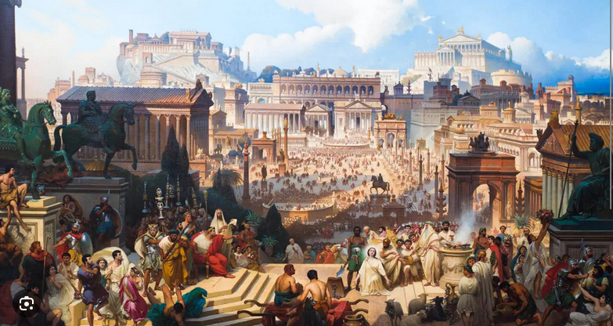
The Role of the Church
Ministering to the Community in a Time of Crisis
Imperial Period of Roman Empire (27 BC – 427 AD)
  In densely populated cities, disease was a normal part of life
    Influenza, malaria, smallpox, measles, viral hemorrhagic fever have all been cited as maladies Romans suffered
outrunningthehorses.com

Slide 15
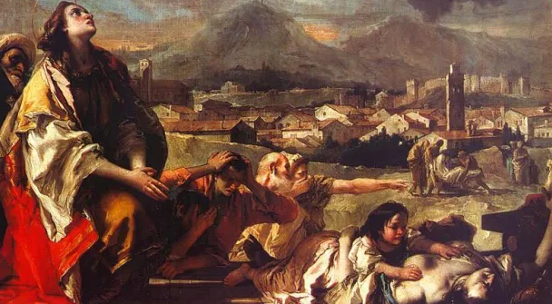
The Role of the Church
Ministering to the Community in a Time of Crisis
Roman Emperor Julian circa 360 AD
  Embarked on a mission of religious reform
  His aim was to destroy Christianity and revive pagan traditions
  Christians suffered from the diseases along with persecution
outrunningthehorses.com

Slide 16
The Role of the Church
Ministering to the Community in a Time of Crisis
Roman Emperor Julian circa 360 AD
  Observed the kindness of Christians and the advancement of their cause
  Wrote a letter to his chief priest Galatia Arsacius
    Charged him to instruct priests to practice a similar lifestyle
outrunningthehorses.com

Slide 17
“The religion of the Greeks does not yet prosper…
Why then do we not observe how the kindness of Christians to strangers, their care for the burial of their dead, and the sobriety of their lifestyle has done the most to advance their cause?”
Roman Emperor Julian ca 360 AD
outrunningthehorses.com

Slide 18
“I think that when the poor happened to be neglected and overlooked by the priests, the impious Galileans observed this and devoted themselves to benevolence. The impious Galileans support not only their own poor, but ours as well, everyone can see that our people lack aid from us.”
(Galileans was a term used for Christians as Jesus was from Galilee.)
Roman Emperor Julian
outrunningthehorses.com

Slide 19
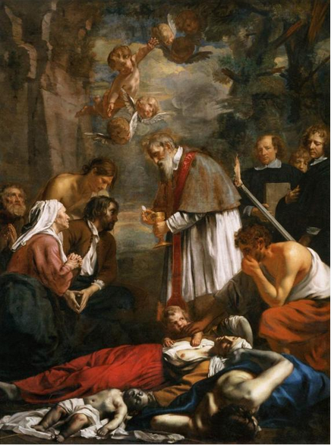
The Role of the Church
Ministering to the Community in a Time of Crisis
Historians and Epidemiologists have determined:
  Superior survival rates would have produced a much larger proportion of Christians who were immune.
  Who could, therefore, pass among the afflicted with seeming invulnerability.
outrunningthehorses.com

Slide 20
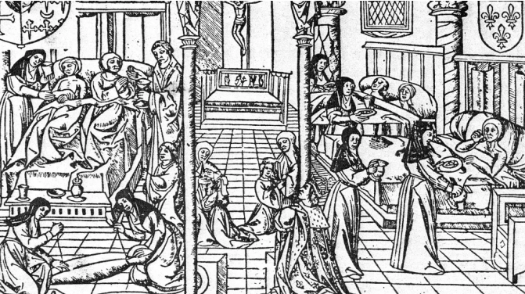
The Role of the Church
Ministering to the Community in a Time of Crisis
Historians and Epidemiologists have determined:
  Christians actively nursing the sick were likely to have contracted the disease early and to survived it due to care.
  In this way, a whole force of miracle workers was created to heal the dying.
outrunningthehorses.com

Slide 21
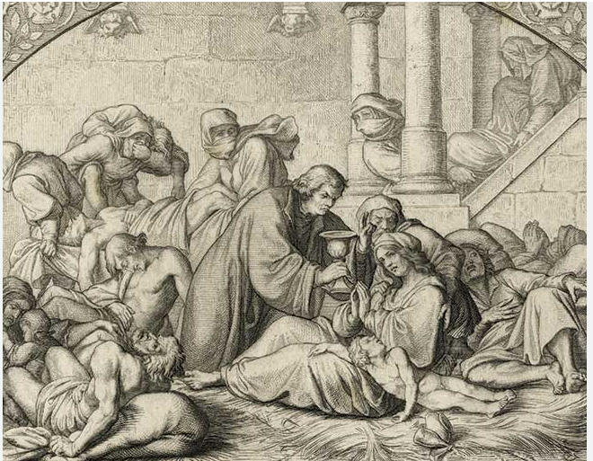
The Role of the Church
Ministering to the Community in a Time of Crisis
Epidemiologists have determined
  Basic health care, such as:
    Adequate water
    Warmth
    Food
    Can result in as much as a 30 percent higher survival rate.
outrunningthehorses.com

Slide 22
The Role of the Church
Ministering to the Community in a Time of Crisis
Epidemiologists have determined
  Basic care was enough to increase the ratio of Christians to pagans.
  Pagans who were cared for by Christians also experienced a higher survival rate.
  These survivors then would have loving relationships with Christians in place of the suspicions of the past.
  Conversion rates soared.
outrunningthehorses.com

Slide 23
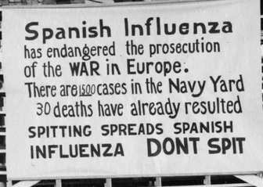
The Role of the Church
Ministering to the Community in a Time of Crisis
1918 Influenza
  Due to war efforts, the USA did not keep many written records
  Canada however kept many records from the pandemic and of those who endeavored as volunteers
outrunningthehorses.com

Slide 24
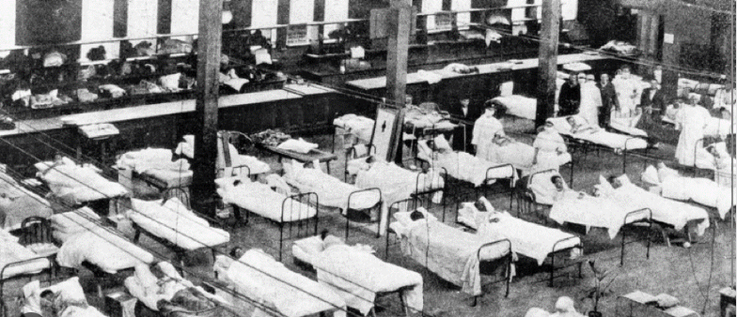
The Role of the Church
Ministering to the Community in a Time of Crisis
1918 Influenza
  Nurse ranks were depleted as the case load increased
  Many serving overseas in the war effort
  Others fell ill to the influenza
outrunningthehorses.com

Slide 25
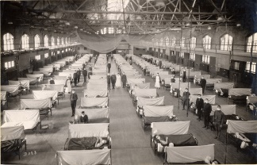
The Role of the Church
Ministering to the Community in a Time of Crisis
1918 Influenza
  Hospitals were inundated
  People were turned away
  Staff hours were lengthened
  The ill were discharged
outrunningthehorses.com

Slide 26
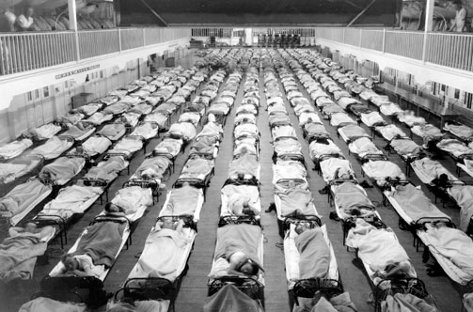
The Role of the Church
Ministering to the Community in a Time of Crisis
1918 Influenza
  Healthcare workers were overwhelmed
  Providers became ill themselves
  Many stayed home in fear
outrunningthehorses.com

Slide 27
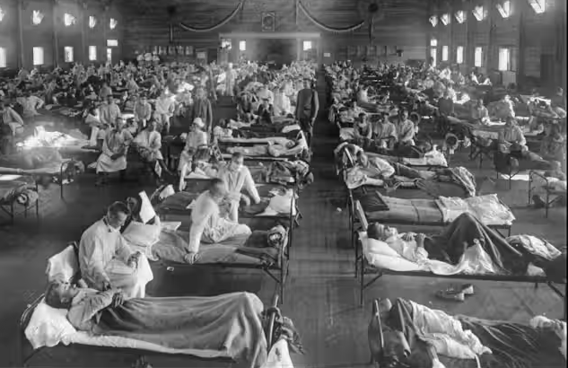
The Role of the Church
Ministering to the Community in a Time of Crisis
1918 Influenza
  Stressed doctors did not register cases
  Paperwork was not maintained
  There was a shortage of basic supplies
  Hallways, churches, and gymnasiums became makeshift accommodations
outrunningthehorses.com

Slide 28
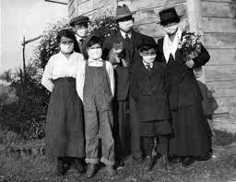
The Role of the Church
Ministering to the Community in a Time of Crisis
1918 Influenza
  Entire families were wiped out
outrunningthehorses.com

Slide 29
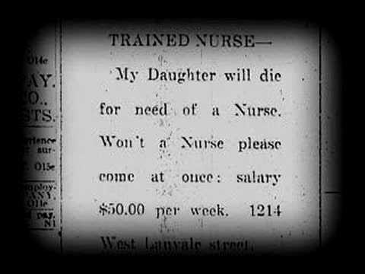
The Role of the Church
Ministering to the Community in a Time of Crisis
1918 Influenza
  Many people died for want of basic care
  Advertisements and announcements were put in the paper calling for help
outrunningthehorses.com

Slide 30
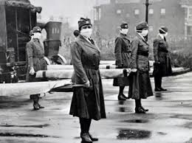
The Role of the Church
Ministering to the Community in a Time of Crisis
1918 Influenza
  Volunteers were called upon
    Out of work people trained as nurses
    Women volunteered for emergency transport
    Neighbors cared for the sick
outrunningthehorses.com

Slide 31

“People are actually dying in considerable numbers without the care and attention that even the meanest stranger within our gates is entitled to. Hospital staffs were worn out to the stage where they sometimes were unable to provide what was needed. Do those who could give assistance realize how greatly their services are required?”
Mayor Gale, Vancouver
outrunningthehorses.com

Slide 32
“People died last night because they had no one to look after them last week when they had nothing but a mild case of influenza. People will also die next week unless they have someone to take care of them tonight.”
Mayor Harold Fisher, Ottawa
outrunningthehorses.com

Slide 33
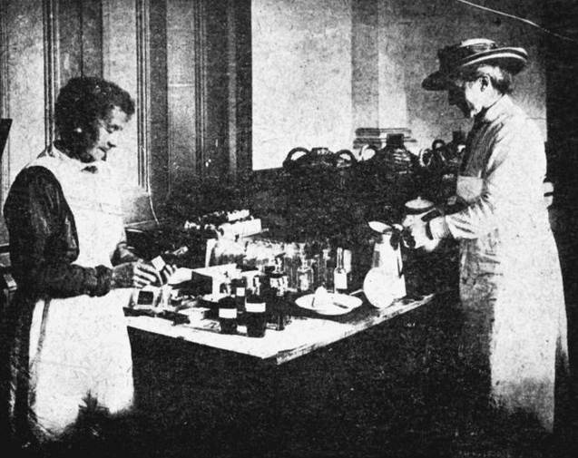
Outlook, Saskatchewan
Ministering to the Community in a Time of Crisis
Mrs. Gladys Nelson from the small town of Outlook
  Cooked meals for those unable to feed themselves
  She worked so hard she was made an honorary member of the St. Johns Ambulance Society
  Only three people died in Outlook
outrunningthehorses.com

Slide 34
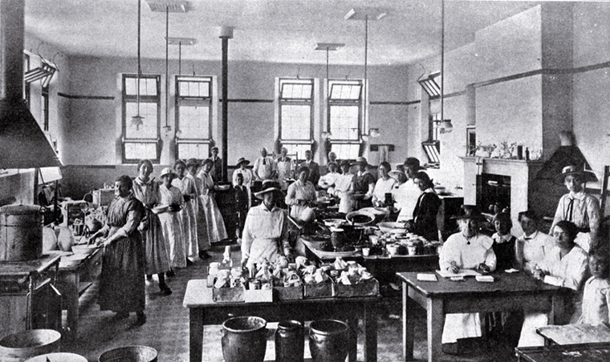
The Role of the Church
Ministering to the Community in a Time of Crisis
Many women from various churches cooked meals and delivered them to families.
outrunningthehorses.com

Slide 35
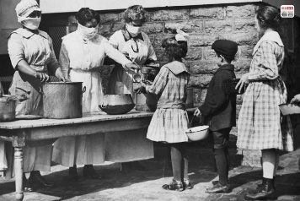
The Role of the Church
Ministering to the Community in a Time of Crisis
It was determined that these efforts saved many lives.
outrunningthehorses.com

Slide 36
“When trained help cannot be secured, untrained help will be taken. For in many homes in Toronto now there are whole families who have been taken down with the influenza who have no one to help them, and a woman who has had no experience can give medicine and prepare meals, etc…”
N.A. Gibson,
Secretary Home Bureau of Nursing
outrunningthehorses.com

Slide 37
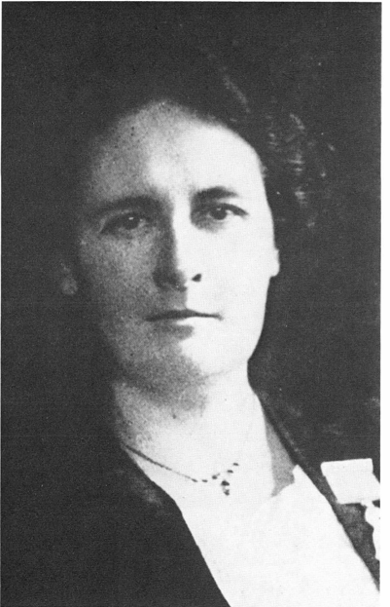
Toronto, Ontario
Ministering to the Community in a Time of Crisis
Dr. Margaret Patterson
  Began a lecture series
    Intensive two-day course
  Training women in the basics of patient care
  Focused on respiratory health, fevers, and treating patients in the home
outrunningthehorses.com

Slide 38
Toronto, Ontario
Ministering to the Community in a Time of Crisis
Dr. Margaret Patterson
  Volunteers packed large auditorium
  Overflow into corridors
  By end of first day, 100 were attending people with influenza
  Over 1000 female volunteers within two days
outrunningthehorses.com

Slide 39
Toronto, Ontario
Ministering to the Community in a Time of Crisis
Dr. Margaret Patterson
  Graduates received a pin
  Dr. Peterson named the volunteers “Sisters of Service”
  Provided care to approximately 1,000 families
  Program was taken to other parts across Ontario
outrunningthehorses.com

Slide 40
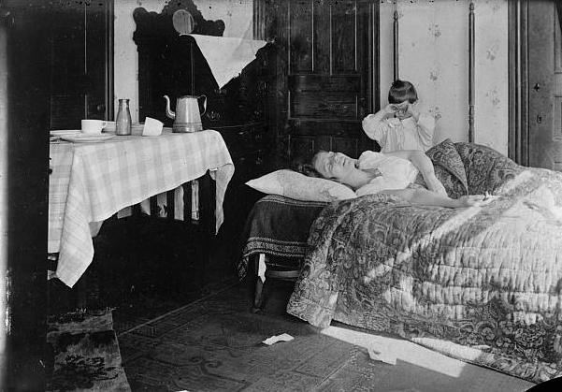
Toronto, Ontario
Ministering to the Community in a Time of Crisis
Dr. Margaret Patterson, “Sisters of Service”
  Many graduates found themselves in appalling conditions
  Family members were all sick, with adults unable to care for the younger
outrunningthehorses.com

Slide 41
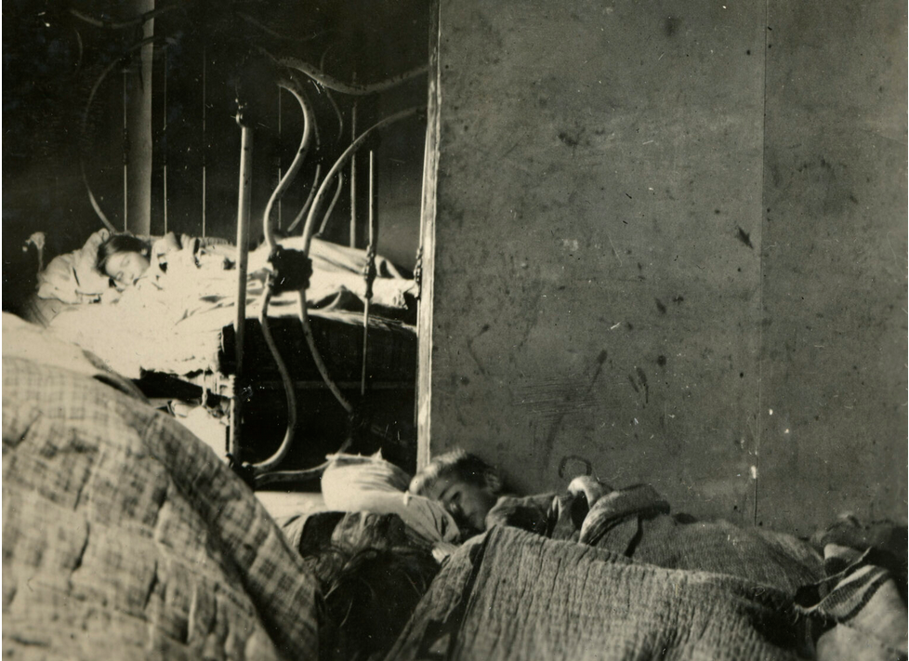
Toronto, Ontario
Ministering to the Community in a Time of Crisis
Dr. Margaret Patterson, “Sisters of Service”
  With multiple family members sick, they found the conditions appalling
  For many, it was a soul- searching experience
outrunningthehorses.com

Slide 42
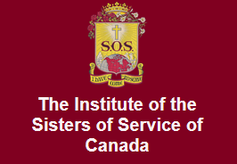
Toronto, Ontario
Ministering to the Community in a Time of Crisis
Sisters of Service
  Catherine Donnelly, a graduate of one of the lectures
  After training volunteered to nurse the sick in their homes
    Came to realize the great lack of spiritual resources for families
  Founded Canadian Catholic Women’s Religious Order (SOS) still active today
outrunningthehorses.com

Slide 43
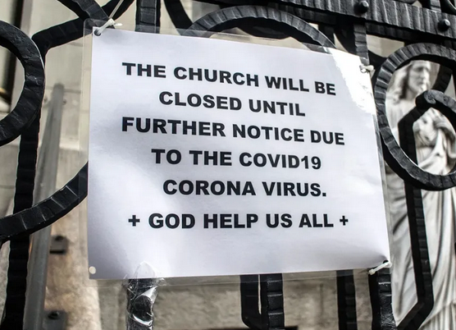
Church Volunteerism
Ministering to the Community in a Time of Crisis
COVID-19
Leaders look back stating:
  “Were we ready? Of course not. We had no time.”
  “We weren’t ready, we still aren’t ready.”
  One article used the word “decimated” when describing the volunteer sector
outrunningthehorses.com

Slide 44
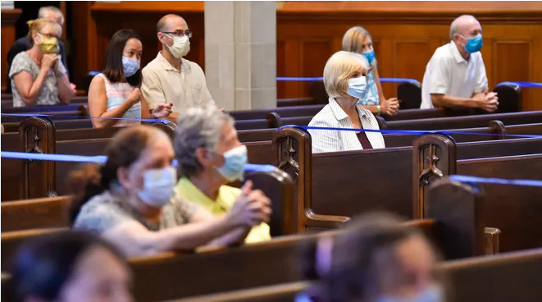
Church Volunteerism
Ministering to the Community in a Time of Crisis
COVID-19
  Many longtime volunteers backed away
  Those willing to serve were still unpredictable
  Likelihood of illness or exposure at home
  Many volunteers called out sick
outrunningthehorses.com

Slide 45
Church Volunteerism
Ministering to the Community in a Time of Crisis
Hurricane Helene, September 2024
  Widespread catastrophic damage to Southeastern U.S.
  Non-profit disaster relief organizations and local churches banded together
  Organizations included:
    Samaritan’s Purse
    Baptists on Mission
    Mercy Chefs
outrunningthehorses.com

Slide 46
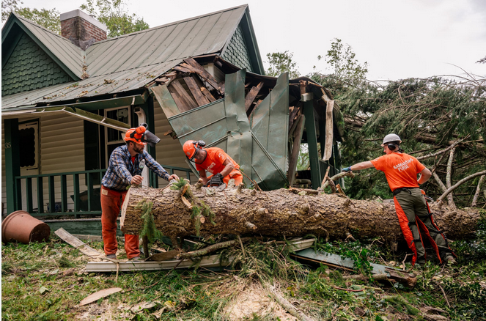
Church Volunteerism
Ministering to the Community in a Time of Crisis
Hurricane Helene, September 2024
  Volunteers helped with:
    Clean-up
    Rebuilding
    Distribution of food, water, blankets
    Many brought specialized skills
      Chainsaw teams
      Laundry services
      Medical professionals
outrunningthehorses.com

Slide 47
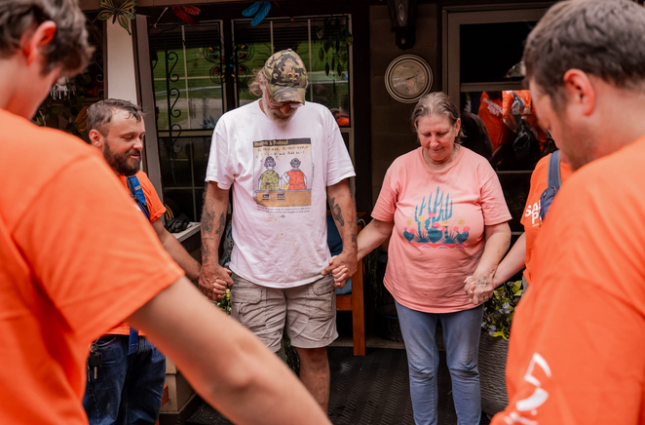
Church Volunteerism
Ministering to the Community in a Time of Crisis
Hurricane Helene, September 2024
  Volunteers not only brought hands on help, even more importantly, they brought spiritual encouragement and the gospel of our Lord, Jesus Christ.
outrunningthehorses.com

Slide 48
Conclusion
Ministering to the Community in a Time of Crisis
Throughout ancient and modern history there are recorded the sacrificial acts of those who risked everything to further the cause of the Kingdom.
These acts, though many performed individually, had an eternal impact on those who were suffering.
In God’s sovereign ways, through disasters, plagues, and persecution, by loving our neighbors, Christianity is spread.
outrunningthehorses.com

Slide 49

outrunningthehorses.com

Slide 50
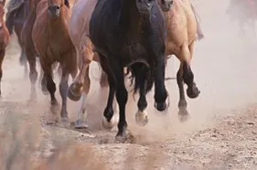

“If you have run with footmen, and they have tired you out,
then how can you compete with horses?
If you fall down in a land of peace,
how will you do in the thicket by the Jordan?”
Jeremiah 12:5

Slide 51
For more presentations like this
or for more information
please visit
outrunningthehorses.com

