Slide 1

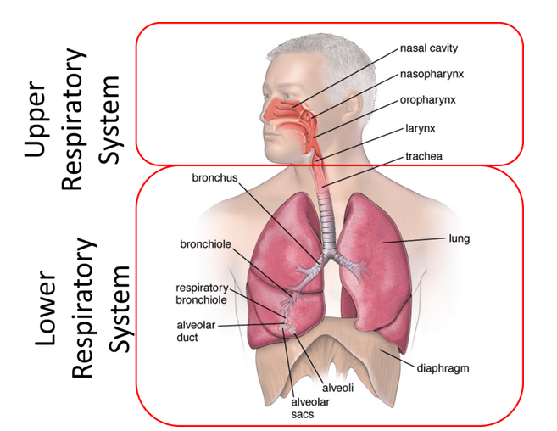
Pandemic Plan for the Church
Ministering to the Community in a Time of Crisis
Respiratory System
Anatomy & Physiology
outrunningthehorses.com

Slide 2
Respiratory System
Ministering to the Community in a Time of Crisis
Introduction
This presentation will cover the anatomy and physiology of the respiratory system
Anatomy is the study of body structure
Physiology is the study of body function
Understanding these will help in the assessment and treatment of an ill person
outrunningthehorses.com

Slide 3
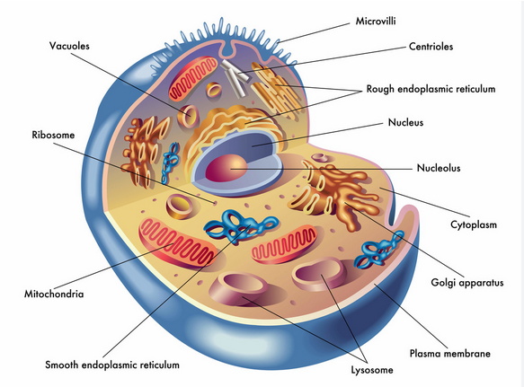
Respiratory System
Ministering to the Community in a Time of Crisis
The Cell
Basic building block of the human body
All cells contain structures that perform specific functions
outrunningthehorses.com

Slide 4
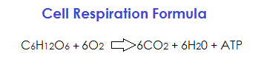
Respiratory System
Ministering to the Community in a Time of Crisis
The Cell
Metabolism is the conversion of glucose and other nutrients into energy inside the cell
Oxygen is used by the cell to metabolize glucose into energy
outrunningthehorses.com

Slide 5
Respiratory System
Ministering to the Community in a Time of Crisis
The Cell
We breathe to allow for the ventilation of atmospheric air (approximately 21% oxygen) to provide gas exchange at the cellular level
Oxygen (O2) is inhaled and taken into the blood stream and carbon dioxide (CO2) is picked up from the blood and expelled through exhalation
outrunningthehorses.com

Slide 6
Respiratory System
Ministering to the Community in a Time of Crisis
The Cell
When this exchange is compromised, hypoxia can occur
Hypoxia is when there is not enough oxygen for the body’s tissues and cells to function properly
This can be a serious medical issue
Prolonged hypoxia can lead to loss of consciousness and even death
outrunningthehorses.com

Slide 7
Respiratory System
Ministering to the Community in a Time of Crisis
The Cell
There are many causes of hypoxia, including:
Breathing problems such as COPD
Environmental factors such as carbon monoxide poisoning
Circulatory issues with the heart or blood vessels
Obstruction from mucous or pus caused by pneumonia
outrunningthehorses.com

Slide 8
Respiratory System
Ministering to the Community in a Time of Crisis
Respiratory Anatomy
The Respiratory System is comprised of upper and lower parts
They are divided below the larynx
outrunningthehorses.com

Slide 9
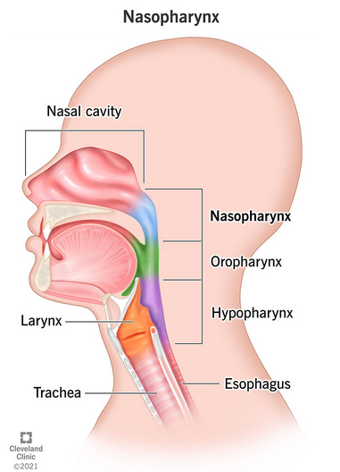
Upper Respiratory Tract
Ministering to the Community in a Time of Crisis
Anatomy
Nasopharynx
Area behind the nose
Air enters the body through the mouth and nose
It moves down from the nose through the nasopharynx
outrunningthehorses.com

Slide 10
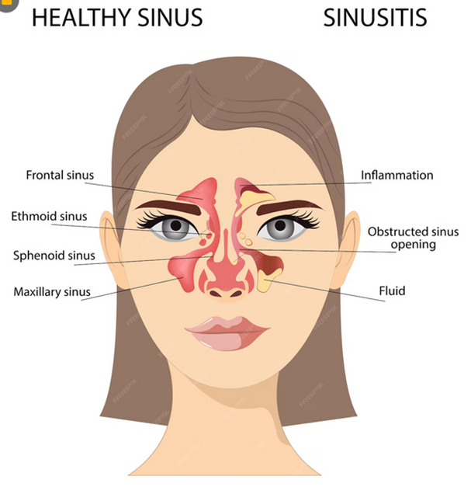
Upper Respiratory Tract
Ministering to the Community in a Time of Crisis
Anatomy
The sinuses
Located in the nasopharynx
Air filled spaces lined with mucous membranes
Air is filtered, dust and other particles are trapped, as well as being warmed
outrunningthehorses.com

Slide 11
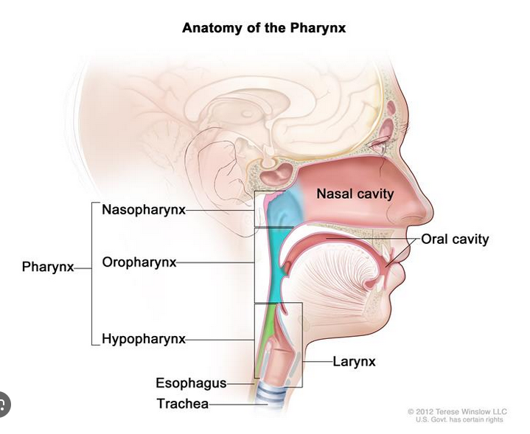
Upper Respiratory Tract
Ministering to the Community in a Time of Crisis
Anatomy
Oropharynx
Area behind the mouth
Air also enters the body through the mouth then through the oropharynx
The pharynx (the throat) is the area that encompasses both the nasopharynx and the oropharynx
outrunningthehorses.com

Slide 12
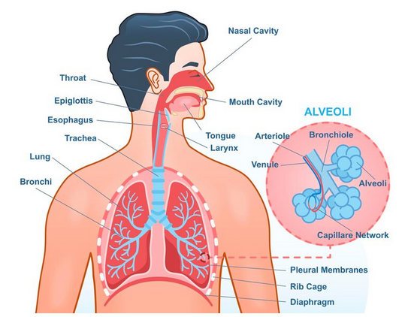
Upper Respiratory Tract
Ministering to the Community in a Time of Crisis
Anatomy
The Larynx
Below the epiglottis
Also known as the voice box
Contains the vocal cords
outrunningthehorses.com

Slide 13
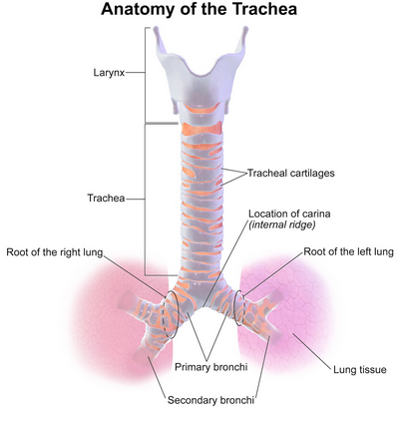
Lower Respiratory Tract
Ministering to the Community in a Time of Crisis
Anatomy
The trachea
Also known as the windpipe
A tube that carries the inhaled and exhaled air to and from the lungs
outrunningthehorses.com

Slide 14
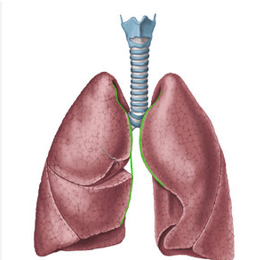
Lower Respiratory Tract
Ministering to the Community in a Time of Crisis
Anatomy
The Lungs
Located in the thoracic cavity
The lungs are organs in which the exchange of atmospheric oxygen and the waste carbon dioxide take place
outrunningthehorses.com

Slide 15
Lower Respiratory Tract
Ministering to the Community in a Time of Crisis
Anatomy
The Lungs
Oxygenated blood is carried from the lungs to the heart, then is pumped to the body
Deoxygenated blood returns to the heart from the body, then to the lungs for the waste carbon dioxide to be expelled
outrunningthehorses.com

Slide 16
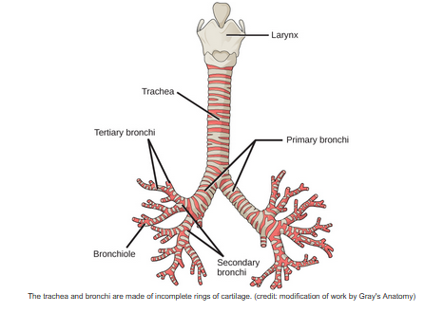
Lower Respiratory Tract
Ministering to the Community in a Time of Crisis
Anatomy
Bronchi
Begin where the trachea meets the lungs
It splits (bifurcates) into two branches called bronchi
Each branch is called a bronchus and goes to each lung
outrunningthehorses.com

Slide 17
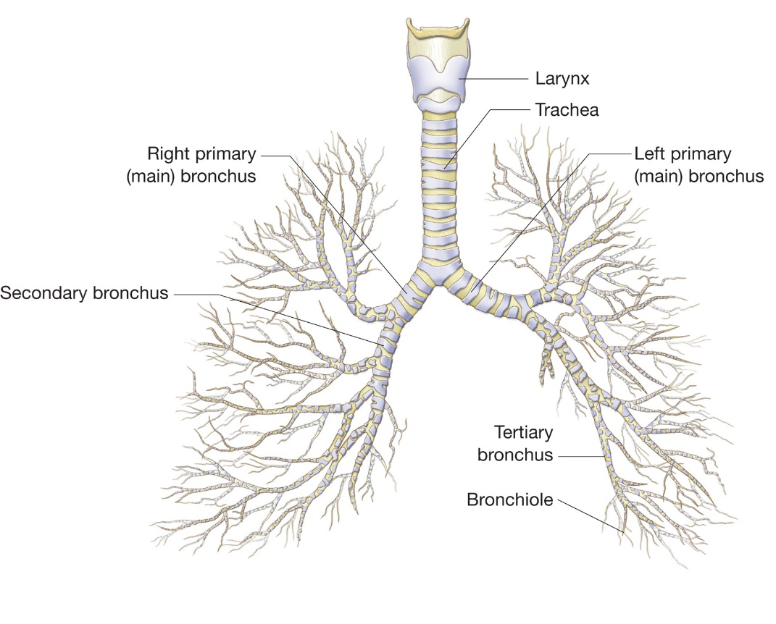
Lower Respiratory Tract
Ministering to the Community in a Time of Crisis
Anatomy
Bronchioles
Bronchi continue to branch off and split into smaller branches called bronchioles
As these bronchioles continue to branch and split, the air passages continue to get smaller
outrunningthehorses.com

Slide 18
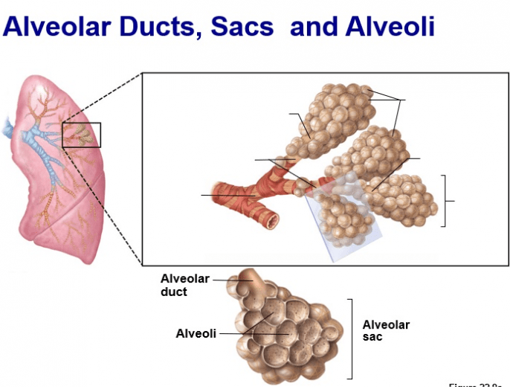
Lower Respiratory Tract
Ministering to the Community in a Time of Crisis
Anatomy
Alveoli
The small air sacs at the end of the bronchioles
They are crucial for gas exchange
outrunningthehorses.com

Slide 19
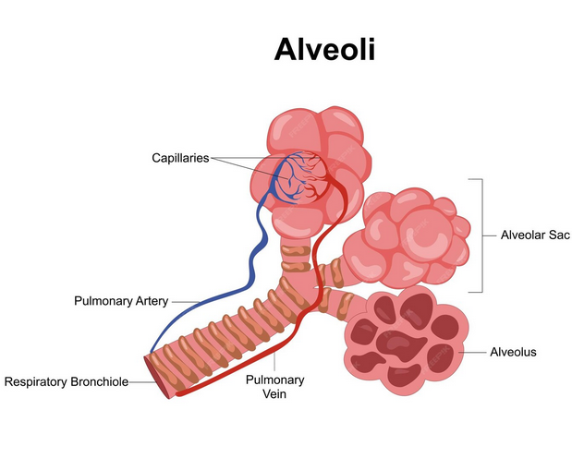
Lower Respiratory Tract
Ministering to the Community in a Time of Crisis
Anatomy
Alveoli
Expand during inhalation to take in O2
Contract during exhalation to release CO2
outrunningthehorses.com

Slide 20
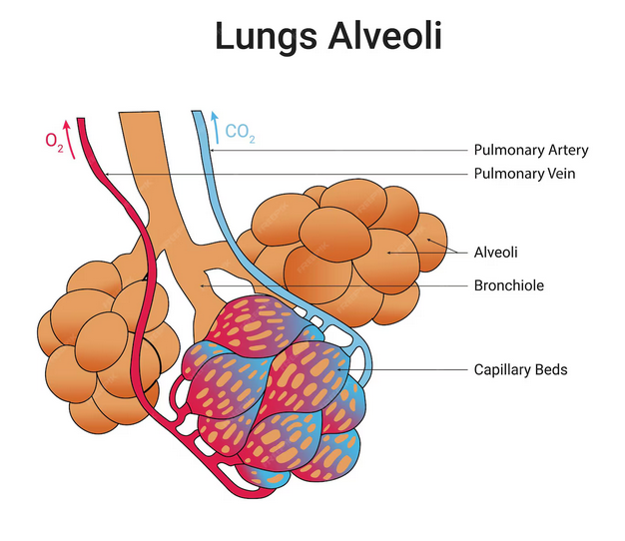
Lower Respiratory Tract
Ministering to the Community in a Time of Crisis
Anatomy
Alveoli
Oxygenated blood is carried from the lungs to the heart, then is pumped to the body
Deoxygenated blood returns from the body to the heart, then to the lungs for the waste carbon dioxide to be expelled
outrunningthehorses.com

Slide 21
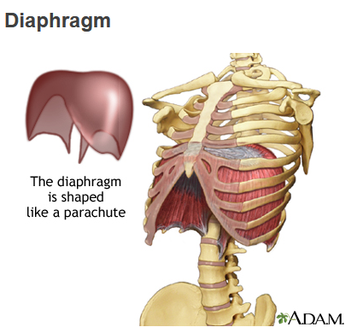
Lower Respiratory Tract
Ministering to the Community in a Time of Crisis
Anatomy
The Diaphragm
A large muscular structure
Divides the chest cavity from abdominal cavity
outrunningthehorses.com

Slide 22
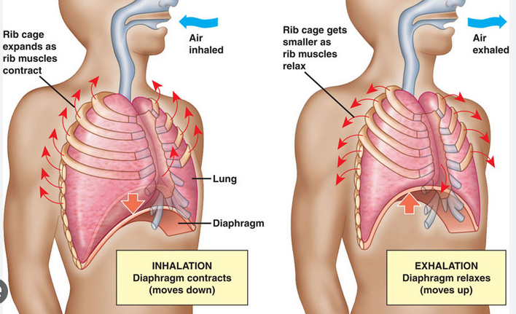
Lower Respiratory Tract
Ministering to the Community in a Time of Crisis
Anatomy
The Diaphragm
With intercostal rib muscles create negative and positive pressure to enable inhalation and exhalation
outrunningthehorses.com

Slide 23
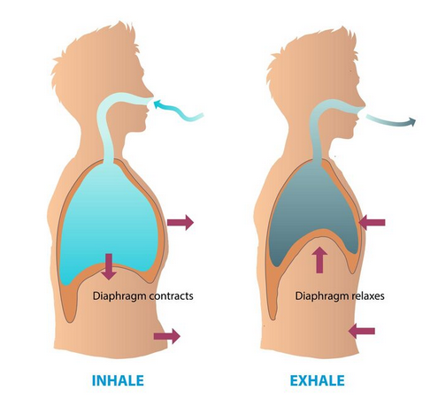
Respiratory System
Ministering to the Community in a Time of Crisis
Physiology
Inhalation
Is an active process involving the muscles of the rib cage and the lowering of the diaphragm
When these engage, they cause negative pressure drawing in atmospheric air into the lungs
outrunningthehorses.com

Slide 24
Respiratory System
Ministering to the Community in a Time of Crisis
Physiology
Exhalation
Is a passive process in which the muscles relax and the diaphragm rises
Positive pressure is formed, pushing the air out of the lungs
outrunningthehorses.com

Slide 25
Respiratory System
Ministering to the Community in a Time of Crisis
Physiology
The function of the respiratory system is to facilitate the action of inhalation and exhalation, and to affect the process of ventilation, the exchange of gasses.
outrunningthehorses.com

Slide 26
Respiratory System
Ministering to the Community in a Time of Crisis
Physiology
Ventilation
The actual process of gas exchange in the alveoli
During inhalation, air is brought down to the alveoli
Each single alveolus has a thin wall, only one cell thick
They are surrounded by pulmonary capillaries which bring circulating blood to the alveoli
outrunningthehorses.com

Slide 27
Respiratory System
Ministering to the Community in a Time of Crisis
Physiology
Ventilation
Occurring at the same time:
Oxygen is passed through to the pulmonary capillaries
To be brought to the bloodstream and to the body’s tissues
Carbon dioxide from the body is passed from the capillaries into the alveoli
To be expelled through exhalation
outrunningthehorses.com

Slide 28
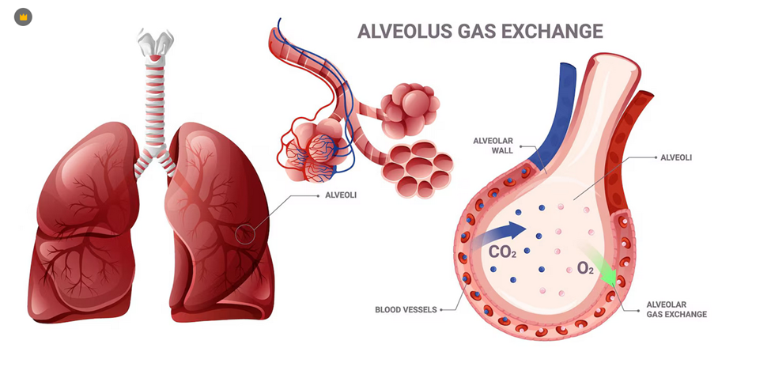
Respiratory System
Ministering to the Community in a Time of Crisis
Physiology
Ventilation
outrunningthehorses.com

Slide 29
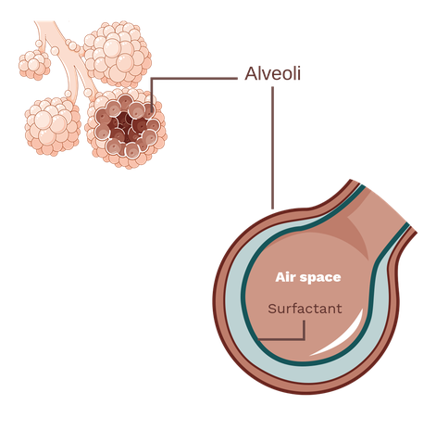
Respiratory System
Ministering to the Community in a Time of Crisis
Physiology
Surfactant
A substance produced by alveolar cells
It coats the inner surface of the alveoli
.
outrunningthehorses.com

Slide 30
Respiratory System
Ministering to the Community in a Time of Crisis
Physiology
Surfactant
Allows the surface to be more pliable when inflating during inspiration
Prevents the alveolus from collapsing during expiration
Aids in the ease of breathing
outrunningthehorses.com

Slide 31
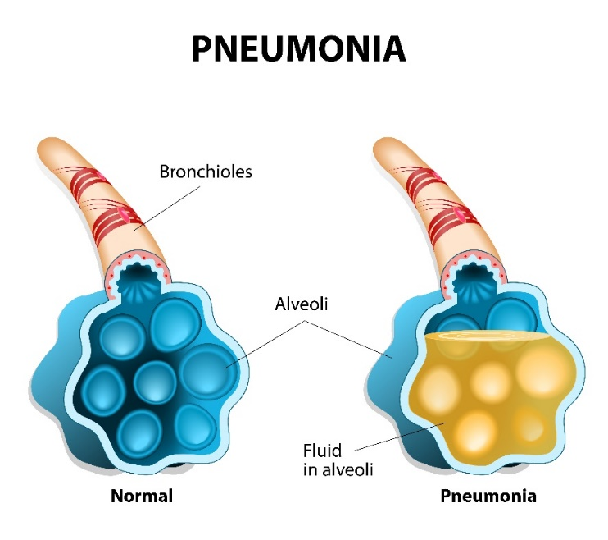
Respiratory System
Ministering to the Community in a Time of Crisis
Physiology
Pneumonia
If the alveoli become compromised by infection such as pneumonia, fluid, or pus will gather in the alveolus affecting gas exchange
outrunningthehorses.com

Slide 32
Respiratory System
Ministering to the Community in a Time of Crisis
Common Upper Respiratory Tract Diseases
Common Cold
Influenza
Strep Throat
Sinusitis
Laryngitis
Tonsilitis
outrunningthehorses.com

Slide 33
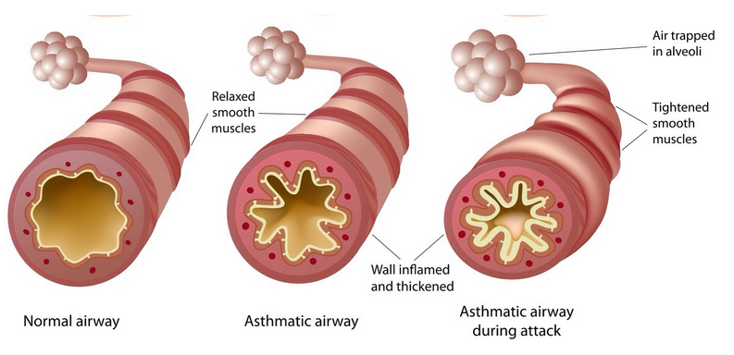
Respiratory System
Ministering to the Community in a Time of Crisis
Common Lower Respiratory Tract Diseases
Asthma – a chronic disease in which certain triggers can cause the airways to become inflamed and fill with mucus.
The airways narrow, and breathing can become difficult
outrunningthehorses.com

Slide 34
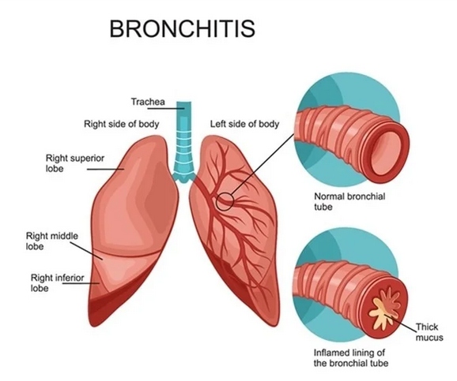
Respiratory System
Ministering to the Community in a Time of Crisis
Common Lower Respiratory Tract Diseases
Bronchitis – is swelling in the bronchi
Bronchi fill with sticky mucus, making it difficult to breathe
It causes a cough with mucus which can last two to three weeks
It is usually caused by a virus
outrunningthehorses.com

Slide 35
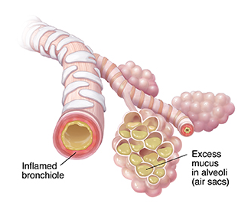
Respiratory System
Ministering to the Community in a Time of Crisis
Common Lower Respiratory Tract Diseases
Pneumonia – is inflammation of one or both lungs that can be caused by bacteria or a virus
The alveoli fill with pus and mucus
The swelling of the air sacs makes them unable to expand easily and inhibits gas exchange
outrunningthehorses.com

Slide 36
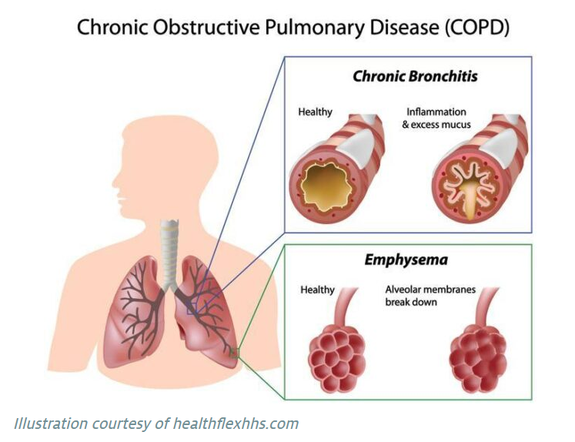
Respiratory System
Ministering to the Community in a Time of Crisis
Chronic Obstructive Pulmonary Disease (COPD)
A chronic progressive lung disease
Causes the airways in the lungs to become swollen and blocked
Shortness of breath and increasing difficulty with everyday activities are two common problems
Emphysema and chronic bronchitis are two common diseases that cause COPD
outrunningthehorses.com

Slide 37
Respiratory System
Ministering to the Community in a Time of Crisis
Conclusion
Many of those who died from the 1918 Influenza, and those who recently from the HPAI H5N1 virus succumbed through pneumonia and acute respiratory distress syndrome (ARDS)
This is because the primary target for replication of these viruses is the respiratory epithelial cells (cells that line the cavity of the body)
Understanding the respiratory system and how it works will help us to recognize, treat, and even prevent complications to this illness
outrunningthehorses.com

Slide 38

outrunningthehorses.com

Slide 39
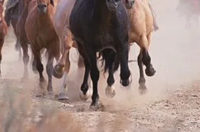

“If you have run with footmen, and they have tired you out,
then how can you compete with horses?
If you fall down in a land of peace,
how will you do in the thicket by the Jordan?”
Jeremiah 12:5

Slide 40
For more presentations like this
or for more information
please visit
outrunningthehorses.com

