Slide 1
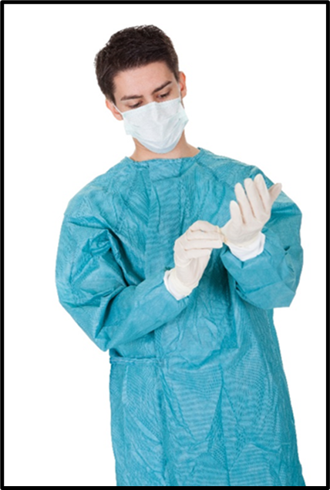
Pandemic Plan for the Church
Ministering to the Community in a Time of Crisis
Infection Control
Personal Protection
outrunningthehorses.com

Slide 2
Outrunningthehorses.com
These PowerPoint Presentations are written and provided to prepare the Body of Christ for disasters such as the current pandemic
These trainings are meant to enable people to safely care for themselves and minister to their neighbors
By being properly equipped we are then able to bring the gospel of our Lord, Jesus Christ into the situation
For more information, please visit outrunningthehorses.com
outrunningthehorses.com

Slide 3
Infection Control
Infection control is the discipline concerned with preventing the spread of infection
It is essential to practice this discipline without exception
outrunningthehorses.com

Slide 4
Infection Control
Introduction
  Disease is spread by the transmission of pathogens
    A pathogen is a virus, bacteria or any other microorganism that has the ability to cause illness
    Pathogens spread differently depending on their method transmission from person-to-person
outrunningthehorses.com

Slide 5
Infection Control
Introduction
  Pathogens spread differently depending on their method of transmission from person-to-person
    Regardless of the method of transmission, standard precautions are the basic, minimum precautions to take for all patient contact
outrunningthehorses.com

Slide 6
Infection Control
Introduction
  Encouraging Christians to visit the sick without knowledge and training on proper precautions would be foolhardy
  The discipline of infection control should be considered standard operating procedures and should never be compromised
outrunningthehorses.com

Slide 7
Infection Control
Objectives
The following will be discussed
  Lessons learned from SARS, MERS, and Ebola
  Universal ways to avoid infection
  Standard Precautions
  Proper Hand Hygiene
  Respiratory Hygiene
  Personal Protective Equipment
  Ways Infection can spread
outrunningthehorses.com

Slide 8
Infection Control
Objectives
The following will be discussed
  Respiratory Protection
  Disinfecting Surfaces
  Laundry
  Using Bleach
  Proper Disposal of Waste
outrunningthehorses.com

Slide 9
Infection Control
Lessons Learned
Lessons Learned from SARS, MERS, Ebola
  Many lessons can be learned from the 2003 outbreak of SARS
    Observations of healthcare workers displayed numerous violations in infection control
    This led to the lack of containment and the spread of SARS across continents
outrunningthehorses.com

Slide 10
Lessons Learned
Lessons Learned from SARS, MERS, Ebola
  The spread of MERS in Saudi Arabia and South Korea occurred mostly in the hospital setting
    It is determined the source of these is the lack of compliance of healthcare workers practicing strict infection control
outrunningthehorses.com

Slide 11
Lessons Learned
Lessons Learned from SARS, MERS, Ebola
  The spread of Ebola in Texas was due to an employer not providing the proper protection equipment (PPE)
    Employers bear responsibility as well
outrunningthehorses.com

Slide 12
Lessons Learned
Lessons Learned from SARS, MERS, Ebola
  These lessons should urge all those who care for the sick to maintain strict adherence to infection control measures
  As the Church encourages those to reach out to our neighbors, we as leaders too must ensure proper procedures are followed
outrunningthehorses.com

Slide 13
Infection Control
Ways to avoid infection:
  Avoid touching your face.
  Cover your nose and mouth with a tissue when you cough or sneeze, throw the tissue away in a waste basket.
  If a tissue is not available, cough or sneeze into the sleeve of your bent elbow.
  Good hand hygiene – wash your hands often with soap and water, especially after you sneeze or cough.

Slide 14
Infection Control
Ways to avoid infection:
  Use disposable paper towels for hand washing, or designate cloth towels to family members.
  Use an alcohol-based hand rub if soap is not available.
  Instruct others to use good sneeze and cough etiquette.
  Avoid being close-up and face to face with someone who is sick – try to keep a six-foot distance between you and the patient.

Slide 15
Infection Control
Ways to avoid infection:
  Place the chin of a small child on your shoulder in case they cough or sneeze.
  Wear a facemask or respirator.
  Place a facemask on the patient as well.
  Contact your healthcare provider about taking antiviral medication for both the patient and yourself.

Slide 16
Infection Control
Ways to avoid infection:
  If possible, avoid having someone with increased risks to be a caregiver, such as a pregnant woman, or a person with comorbidities.
  If possible, have only one member in the household be the care giver.
  Ensure good ventilation in common areas of the house, open windows in kitchen, living areas, and bathrooms.

Slide 17
Standard Precautions
Standard precautions are the basic, minimum precautions to take to reduce the risk of spread of a disease
  This basic level of infection control should be practiced in the care of ALL patients
outrunningthehorses.com

Slide 18
Infection Control
Standard Precautions
Standard Precautions include:
  Proper hand hygiene
  Respiratory Hygiene
  Personal Protective Equipment
outrunningthehorses.com

Slide 19

Infection Control
Standard Precautions
Proper Hand Hygiene
  Viruses can be spread by touching a contaminated surface then touching mucous membranes
    Eyes
    Nose
    Mouth
outrunningthehorses.com

Slide 20

Infection Control
Standard Precautions
Proper Hand Hygiene
  Proper hand hygiene is the best defense in controlling spread of infection
    Requires good hand washing
outrunningthehorses.com

Slide 21
Infection Control
Standard Precautions
Hand washing tips
  Total amount of time should take about 40-60 seconds
  Remove hand and arm jewelry
    Jewelry is very hard to clean, and bacteria and viruses can hide beneath and in the crevices of rings and bracelets, even with good hand washing
  Wet hands with warm water
outrunningthehorses.com

Slide 22
Infection Control
Standard Precautions
Hand washing tips (continued)
  Apply liquid or foam soap
    Do not use bar soap as it may hold bacteria
  Vigorously lather all surfaces of hands for a minimum of 15 – 30 seconds rubbing to remove dirt and bacteria
  Pay particular attention to fingertips, between fingers, backs of hands and base of the thumbs
    These are commonly missed areas
outrunningthehorses.com

Slide 23
Infection Control
Standard Precautions
Hand washing tips (continued)
  Using a rubbing motion, thoroughly rinse soap from hands
  Dry hands by blotting hands gently with a paper towel
  Turn off taps with a paper towel, to avoid recontamination of your hands
  If you use a hand dryer, do not use your clean hands to press the buttons to turn it on
outrunningthehorses.com

Slide 24
Infection Control
Standard Precautions
Proper Hand Hygiene
  Alcohol-Based Hand Rub
    Alcohol sanitizer is the preferred method for decontaminating hands
    Hand washing with soap and running water should be performed when hands are visibly soiled
outrunningthehorses.com

Slide 25
Infection Control
Standard Precautions
Proper Hand Hygiene
  Indications for hand hygiene:
    Before and after any direct patient contact and between patients
    After touching blood, body fluids, secretions, excretions, non-intact skin, and contaminated items, even if gloves are worn
    Immediately after gloves are removed
outrunningthehorses.com

Slide 26
Infection Control
Standard Precautions
Proper Hand Hygiene
  Indications for hand hygiene (cont’d):
    During patient care, when moving from a contaminated to a clean body site of the patient
    After handling any objects in the immediate vicinity of the patient
outrunningthehorses.com

Slide 27

Infection Control
Standard Precautions
Proper Hand Hygiene
  Indications for hand hygiene (cont’d):
    After personal bodily functions, such as using the toilet or blowing one’s nose.
    Before preparing, handling, serving or eating food
outrunningthehorses.com

Slide 28
Infection Control
Standard Precautions
Respiratory Hygiene
  Instruct people with respiratory symptoms to cover their coughs and sneezes
    They should do so into the bend of their elbow, not into their bare hands
      Even better they should use a tissue or a mask
      These should be properly disposed
outrunningthehorses.com

Slide 29
Infection Control
Standard Precautions
Respiratory Hygiene
  Hand hygiene after contact with respiratory secretions should be performed
  Respiratory etiquette should be practiced by all people, not just the patient
    Masks and tissues should be in abundant supply
outrunningthehorses.com

Slide 30
Infection Control
Ways Infection Can Spread
The type of personal protective equipment (PPE) used will be determined by the mode of transmission of the disease
  Three types of transmission:
      Contact
      Droplet
      Airborne
outrunningthehorses.com

Slide 31
Infection Control
Ways Infection Can Spread
Contact Transmission
  Having direct contact with the ill person can facilitate direct contact transmission
    Skin-to-skin
  Indirect contact transmission occurs by touching a contaminated surface or object
outrunningthehorses.com

Slide 32

Infection Control
Ways Infection Can Spread
Contact Transmission
  Contaminated surfaces can include:
    Tops of furniture
    Kitchen, and bathroom counter tops
    Thermometers
    Bed and linens, etc.
    Patient’s belongings
outrunningthehorses.com

Slide 33
Infection Control
Ways Infection Can Spread
Contact Transmission
  Pathogens may be carried in:
    Draining wounds
    Secretions
    Pressure ulcers
    Tubes such as ostomy or feeding tubes
    Bags draining body fluids including Foley bags
    Feces
    Generalized rash/skin lesions
outrunningthehorses.com

Slide 34
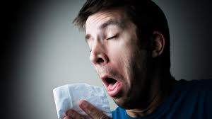
Infection Control
Ways Infection Can Spread
Droplet Transmission
  Occurs when pathogens are carried in large droplets within three feet or more of the infected person
  This can occur with coughing, sneezing, and talking
outrunningthehorses.com

Slide 35
Infection Control
Ways Infection Can Spread
Airborne Transmission
  Occurs when the pathogen is contained in very small, fine particles of evaporated droplets or dusts
  Because these particles are smaller and lighter, they can remain in the air for a longer length of time and can travel along currents farther than droplets.
outrunningthehorses.com

Slide 36
Infection Control
Ways Infection Can Spread
Airborne Transmission
  Examples of pathogens carried in airborne transmission are:
    Influenza (Seasonal, H5N1, H7N9)
    Coronavirus (SARS-CoV-2, MERS)
    Tuberculosis
    Measles
    Chickenpox
outrunningthehorses.com

Slide 37
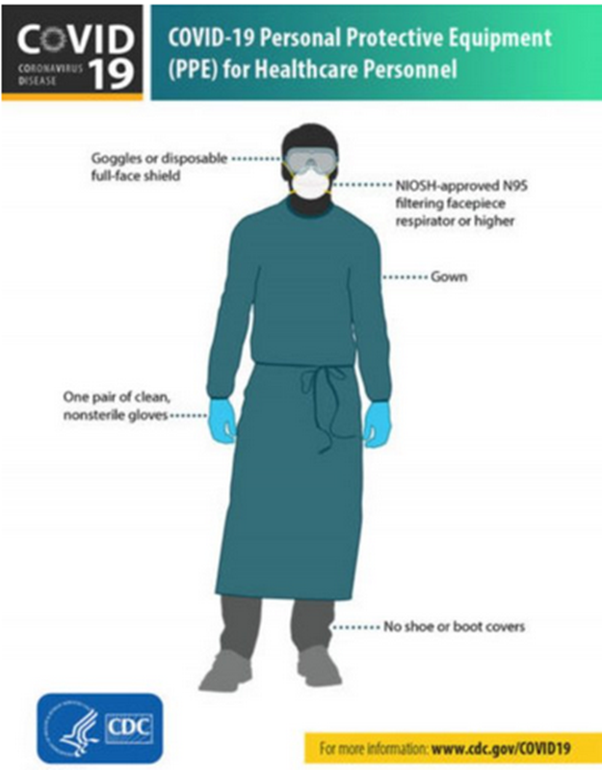
Infection Control
Personal Protective Equipment (PPE)
Personal Protective Equipment (PPE)
  PPE is designed to protect the wearer from injury or the spread of infection or illness
  The type of illness and care should determine the type of PPE to be worn
outrunningthehorses.com

Slide 38
Infection Control
Personal Protective Equipment (PPE)
Personal Protective Equipment (PPE)
  First ASSESS THE RISK
  Determine and don the necessary PPE
  BEFORE any patient care takes place
outrunningthehorses.com

Slide 39
Infection Control
Personal Protective Equipment (PPE)
Who should use Personal Protective Equipment?
  All individuals who provide direct patient care
  All family members coming in contact with patient
  All visitors coming in contact with patient
  Anyone handling linens, utensils, equipment, trash that comes from the patient’s area
outrunningthehorses.com

Slide 40
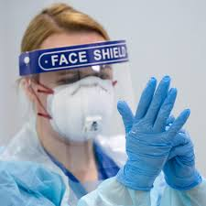
Infection Control
Personal Protective Equipment (PPE)
Selection of Personal Protection Equipment
  Determining the type of PPE is based on the type of care that will be provided.
outrunningthehorses.com

Slide 41
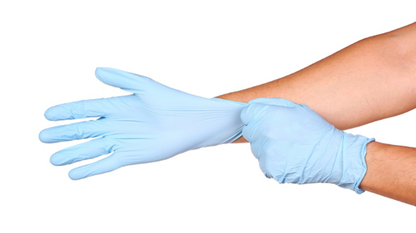
Infection Control
Personal Protective Equipment (PPE)
Disposable Gloves
  Use of gloves made of
    Latex
    Vinyl
    Nitrile
    Or other synthetic materials as appropriate
outrunningthehorses.com

Slide 42
Infection Control
Personal Protective Equipment (PPE)
Disposable Gloves
  When there is contact with:
    Blood and other bodily fluids
      Secretions
      Excretions
      Mucous membranes
      Including respiratory secretions
outrunningthehorses.com

Slide 43
Infection Control
Personal Protective Equipment (PPE)
Recommendations for use:
  Change between tasks and procedures on the same patient after contact with potentially infectious material
  Remove after use and discard, before touching non-contaminated items and surfaces, and before going to another patient
outrunningthehorses.com

Slide 44
Infection Control
Personal Protective Equipment (PPE)
Recommendations for use:
  When gloves are torn, cut, or punctured they should be removed and replaced.
  Gloves do not eliminate the need for hand washing
    Perform hand hygiene immediately after removal.
outrunningthehorses.com

Slide 45
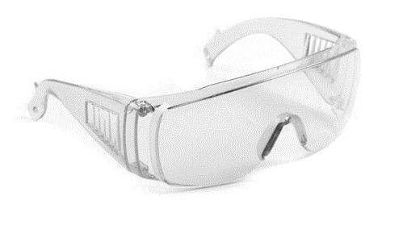
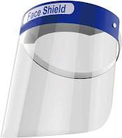
Infection Control
Personal Protective Equipment (PPE)
Goggles, Face Shields, Facial Protection
  When a pathogen is airborne transmitted the caregiver should protect themselves from sprays of infectious material
  Goggles or face shields should be worn
outrunningthehorses.com

Slide 46
Infection Control
Personal Protective Equipment (PPE)
Goggles, Face Shields, Facial Protection
  Wear a surgical or procedure mask and eye protection (face shield, goggles) to protect mucous membranes
  Eyeglasses worn daily are not as effective as goggles
    Goggles protect eyes from the front and the sides
outrunningthehorses.com

Slide 47
Infection Control
Personal Protective Equipment (PPE)
Goggles, Face Shields, Facial Protection
  A face mask does not provide the protection needed to safeguard the caregiver
    Requiring the sick person to wear a face mask will help keep the larger droplets from spreading
  If an N95 mask is not available, a face shield is recommended
outrunningthehorses.com

Slide 48
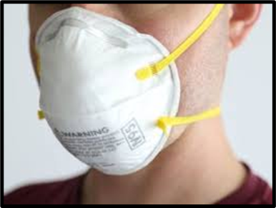
Infection Control
Personal Protective Equipment (PPE)
Goggles, Face Shields, Facial Protection
  Respirators
    Face masks are not effective against a small particle such a virus
    The use of NIOSH 95 Particulate Filtering Respirators is recommended
    An N95 respirator filters at least 95% of airborne particles
outrunningthehorses.com

Slide 49
Infection Control
Personal Protective Equipment (PPE)
Goggles, Face Shields, Facial Protection
  Respirators
    The effective use of these face masks requires fit testing to ensure a proper fit
    Contact your local health department, occupational medical provider, urgent care, or fire department to inquire about fit testing for your church
outrunningthehorses.com

Slide 50
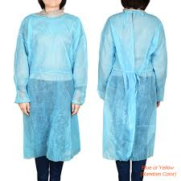
Infection Control
Personal Protective Equipment (PPE)
Gowns
  When it is anticipated that soiling of clothes with blood or other bodily fluids, including respiratory secretions
outrunningthehorses.com

Slide 51
Infection Control
Personal Protective Equipment (PPE)
Gowns – Recommendations for Use:
  Can be disposable or reusable and made of washable cloth
  Should be the appropriate size to fully cover the areas requiring protection
  Any situation that requires a gown also requires gloves, a mask and goggles
outrunningthehorses.com

Slide 52
Infection Control
Personal Protective Equipment (PPE)
Gowns – Recommendations for Use:
  Remove soiled gown as soon as possible
    Placed in a laundry receptacle or waste container, designated for soiled gowns
    Do not mix with other laundry
    When removing a gown, do so using extreme care so not to shake, rub, or splash and bodily fluids onto yourself
    Hand hygiene should follow
outrunningthehorses.com

Slide 53
Infection Control
Conclusion
When performing any patient care standard precautions are to be used at all times
Dependent on the pathogen and its mode of transmission, additional PPE should be used to prevent spread of the disease
By assessing the risk will determine the type of PPE to use
outrunningthehorses.com

Slide 54
Infection Control
Conclusion
The current COVID-19 and Avian Influenza viruses circulating can be transmitted through airborne droplets
The PPE required for performing patient care for this pathogen is:
  Disposable gloves
  Goggles/Face Shield
  Surgical mask or N95
  Gown
  Face mask on the patient
outrunningthehorses.com

Slide 55
Infection Control
Conclusion
Ministering to the Community in a Time of Crisis
Lessons learned from SARS, MERS, and Ebola state that outbreaks are caused by healthcare providers and caregivers not using proper precautions and adhering to strict infection control guidelines
outrunningthehorses.com

Slide 56
Infection Control
Conclusion
If we as Christians reach out to our neighbors in this time of crisis, we must be wise and adhere to infection control measures
outrunningthehorses.com

Slide 57

Questions?
outrunningthehorses.com

Slide 58

For more presentations like this
or for more information
please visit
outrunningthehorses.com
outrunningthehorses.com

