Slide 1


Pandemic Plan for the Church
Ministering to the Community in a Time of Crisis
Caring for the Sick
Part One
outrunningthehorses.com

Slide 2
Caring for the Sick
Disclaimer
This information is for educational purposes only and does constitute professional medical advice or diagnosis.
Consult your medical provider if there are any questions or concerns.
outrunningthehorses.com

Slide 3
Caring for the Sick (Part One)
Introduction
Studies have shown that even basic health care such as adequate water, food, and warmth can result in a much higher percentage rate of survival of a disease.
During the 1918 Influenza, it was determined that many died simply because there was no one to look after the sick and provide them these basic essential needs.
outrunningthehorses.com

Slide 4
Caring for the Sick (Part One)
Introduction
The elements of caring for the sick may change dependent on the pathophysiology (the process of the disease in the human body) of the virus or disease.
COVID-19 and seasonal influenza present with similar symptoms, as well as the current strain of the circulating Avian H5N1 Influenza.
outrunningthehorses.com

Slide 5
Caring for the Sick (Part One)
Introduction
Risks to Consider
Calling on Christians to care for people in a pandemic situation is asking them to put their own lives at risk dependent on the lethality of the circulating virus.
A deep, personal conviction must be present to serve in this manner
outrunningthehorses.com

Slide 6
Caring for the Sick (Part One)
Topics to be discussed in Part One:
How to Protect Yourself
Isolation, Quarantine, Incubation Period, Contagious Period
Where to Place the Sick Person
Signs and Symptoms
Prescriptions Medications
When to Seek Medical Attention
outrunningthehorses.com

Slide 7

Caring for the Sick How to Protect Yourself
If a vaccine is available, consider becoming vaccinated against the circulating strain
outrunningthehorses.com

Slide 8
Caring for the Sick How to Protect Yourself
Non-pharmaceutical ways to protect yourself and others:
Good hand hygiene
Use disposable paper towels
Use alcohol-based hand rub if soap is not available
Avoid touching your face
Use proper respirator etiquette
Instruct others to use proper respiratory etiquette
Try to keep a six-foot distance between you and the patient
outrunningthehorses.com

Slide 9
Caring for the Sick How to Protect Yourself
Non-pharmaceutical ways to protect yourself and others:
Place the chin of a small child on your shoulder in case they cough or sneeze
Do not share personal household items (towels, pillow, utensils
Wear a face mask or respirator
Place a face mask on the patient as well
Clean and disinfect frequently touched surfaces
Eat good foods, drink plenty of fluids, get ample rest
outrunningthehorses.com

Slide 10
Caring for the Sick
Keep these in mind:
If possible, avoid having a caregiver with increased risks, such as a pregnant woman
Have only one member of the household be the caregiver
Ensure good ventilation in common areas of the house, open windows in the kitchen and bathrooms if possible
Do not have sick people provide care for infants, children or the elderly
Monitor yourself and family members for symptoms
outrunningthehorses.com

Slide 11
Caring for the Sick How to Protect Yourself
Personal Protection Equipment (PPE)
The illnesses being discussed are airborne transmitted.
Please see the Personal Protection Equipment section in the document and PowerPoint presentation titled “Infection Control” for more information
outrunningthehorses.com

Slide 12
Caring for the Sick How to Protect Yourself
Personal Protection Equipment (PPE)
The PPE required for an airborne transmitted disease are:
Clean, non-sterile gloves
Face mask
Goggles or face shield
Clean gown – disposable or fabric that is washable
Put a face mask on the patient
outrunningthehorses.com

Slide 13
Caring for the Sick Isolation/Quarantine/Incubation/Contagious Periods
Isolation/Quarantine/Incubation/Contagious Periods
Isolation and quarantine are strategies for separating individuals with a confirmed contagious disease
Isolation – applies to individuals who are sick or have tested positive for a contagious disease. It involves separating them from others
Quarantine – applies to separating individuals who have been exposed to a contagious disease but are not yet sick
outrunningthehorses.com

Slide 14
Caring for the Sick Isolation/Quarantine/Incubation/Contagious Periods
Isolation/Quarantine/Incubation/Contagious Periods
You can end isolation if you're fever-free (without meds) for 24 hours and symptoms are improving.
outrunningthehorses.com

Slide 15
Caring for the Sick Isolation/Quarantine/Incubation/Contagious Periods
Isolation/Quarantine/Incubation/Contagious Periods
Incubation Period – the time between exposure to a pathogen and the first appearance of symptoms.
Contagious Period is the timeframe when an infected person can transmit a disease to others. It often begins 1-2 days before symptoms appear and can last 5-7 days after the sickness starts.
outrunningthehorses.com

Slide 16
Caring for the Sick Isolation/Quarantine/Incubation/Contagious Periods
Seasonal Influenza
Incubation period is typically 1-4 days after exposure to the virus
Isolation should be at least 24 hours after fever has resolved (without the use of fever reducing medication) and symptoms are improving
Contagious period can begin from one day before symptoms appear and up to five to seven days after becoming sick
A person is most contagious during the first three days of illness
outrunningthehorses.com

Slide 17
Caring for the Sick Isolation/Quarantine/Incubation/Contagious Periods
COVID-19
Incubation period typically ranges from 2 -14 days after exposure to the virus. Symptoms often appear withing 3-5 days on average
Isolation for COVID-19 should take place for at least 24 hours after fever has resolved (without the use of fever reducing medication) and symptoms are improving
Contagious period begins for 1–2 days before symptoms start and up to 8–10 days after, with the highest risk in the first few days of illness
outrunningthehorses.com

Slide 18
Caring for the Sick Isolation/Quarantine/Incubation/Contagious Periods
H5N1 (Avian Influenza)
Incubation period in humans is typically 3 to 5 days, but can range from 2 to 10 days, some reports suggesting up to 17 days.
Due to this variability, exposed individuals should monitor for symptoms for 10 days
Isolation should take place immediately if symptoms develop
Contagious period begins for 1–2 days before symptoms start and up to 8–10 days after, with the highest risk in the first few days of illness
outrunningthehorses.com

Slide 19
Caring for the Sick Where to Place the Sick Person
When caring for a sick person it is imperative to limit contact with those who are healthy
Place the sick person in a room separate from others
A spare bedroom with its own bathroom is preferable
Do not place the person in a room shared by others, especially common living areas
The room should have good ventilation
outrunningthehorses.com

Slide 20
Caring for the Sick Where to Place the Sick Person
Keep the door closed
Limit visitors to just the caregiver
Avoid close contact; keep a distance of six feet if possible
The room and the bathroom should be cleaned daily.
Please see the chapter on “Infection Control” for more information on “Disinfecting Surfaces”.
outrunningthehorses.com

Slide 21
Caring for the Sick Where to Place the Sick Person
If the infected person must enter common areas or come in contact with others, they should:
Wear a face mask
Practice proper respiratory etiquette
Practice proper hand hygiene
Keep a distance of six feet from others if possible
outrunningthehorses.com

Slide 22
Caring for the Sick Signs and Symptoms
Signs and symptoms of an illness are ways to discern and help diagnose illness in a person.
Signs are objective, observable, or measurable indicators such as a fever, rash, or high blood pressure, swelling, coughing, vomiting etc.
Symptoms are the subjective experiences reported by the patient, such as pain, dizziness, fatigue, nausea, numbness, etc.
outrunningthehorses.com

Slide 23
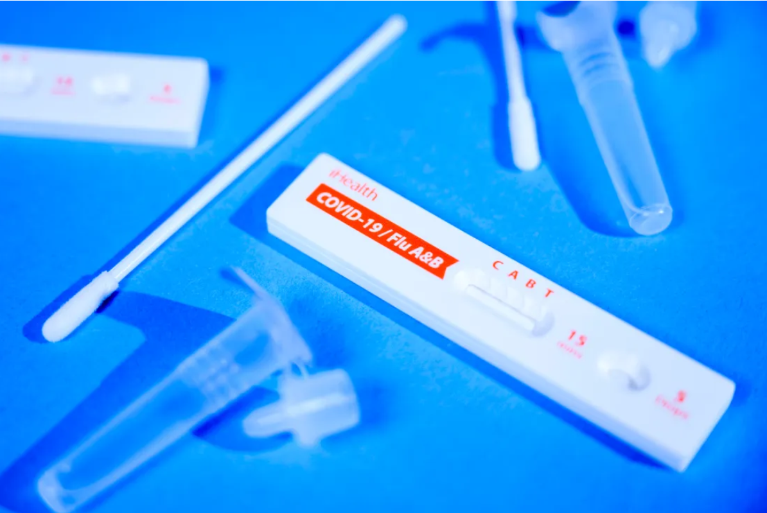
Caring for the Sick Signs and Symptoms
Many illnesses share in various signs and symptoms
Some present with mild cases others more severe
It may be difficult for a healthcare provider to diagnose an illness without a definitive test such as flu, COVID, strep, etc.
outrunningthehorses.com

Slide 24
Caring for the Sick Signs and Symptoms
Influenza Signs and Symptoms
Fever or feeling feverish/chills
Cough, sore throat
Congestion, runny or stuffy nose
Muscle or body aches
Chills
Headache
Fatigue (tiredness)
Nausea/vomiting/diarrhea
More common in children than adults
outrunningthehorses.com

Slide 25
Caring for the Sick Signs and Symptoms
Influenza Signs and Symptoms
Some Complications Include:
Bacterial infections
Pneumonia
Ear and sinus infections
Dehydration
Worsening of existing medical conditions
outrunningthehorses.com

Slide 26
Caring for the Sick Signs and Symptoms
Some pre-existing conditions to be concerned:
Heart condition
Congestive heart failure (CHF)
COPD
Asthma
Emphysema
Chronic bronchitis
Diabetes
Pregnancy
outrunningthehorses.com

Slide 27
Caring for the Sick Signs and Symptoms
Contact your healthcare provider if patient:
Is an infant
Is elderly
Has a condition that requires special care
Has a pre-existing condition
outrunningthehorses.com

Slide 28
Caring for the Sick Signs and Symptoms
Antiviral drugs may be a treatment option
They can make the illness milder and shorten the time of the illness
They may prevent some complications such as pneumonia
Must be taken early in the sickness, within two days symptoms begin
outrunningthehorses.com

Slide 29
Caring for the Sick Signs and Symptoms
COVID-19 Signs and Symptoms
Fever or chills
Sore throat
Congestion
Runny nose
Cough
Shortness of breath or difficulty breathing
Diarrhea
Fatigue
Muscle or body aches
Headache
New loss of taste or smell
outrunningthehorses.com

Slide 30
Caring for the Sick Signs and Symptoms
Influenza and COVID-19 – Key Differences
COVID-19 seems to:
Spread more easily than influenza
Cause more serious illnesses in some people
Take longer before people show symptoms
Enable people to be contagious for a longer period
outrunningthehorses.com

Slide 31
Caring for the Sick Signs and Symptoms
HPAI H5N1 Signs and Symptoms
Patients with the current strain of HPAI H5N1 circulating have presented with the following symptoms
These may change depending on any mutations the virus may have undergone at the time it becomes a pandemic
Notice many are similar to seasonal influenza
outrunningthehorses.com

Slide 32
Caring for the Sick Signs and Symptoms
HPAI H5N1 Signs and Symptoms
Genetic sequencing of a human H5N1 sample showed that the transmission results might involve the eyes
Notably, the patient reported only conjunctivitis with no respiratory symptoms
outrunningthehorses.com

Slide 33
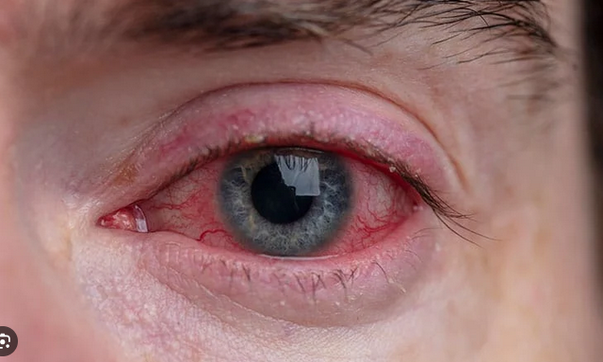
Caring for the Sick Signs and Symptoms
HPAI H5N1 Signs and Symptoms
Genetic sequencing of a human H5N1 sample showed that the transmission results might involve the eyes
The patient reported only conjunctivitis with no respiratory symptoms
outrunningthehorses.com

Slide 34
Caring for the Sick Signs and Symptoms
HPAI H5N1 Signs and Symptoms
Conjunctivitis
Fever (over 100.4° degrees F)
Cough
Sore throat
Headache
Aching bones, joints and muscles
Nasal congestion, and runny nose
Bleeding from the nose
Bleeding from the gums
Malaise
Loss of appetite/Nausea
Abdominal pain
Vomiting/Diarrhea
outrunningthehorses.com

Slide 35
Caring for the Sick Signs and Symptoms
HPAI H5N1 Signs and Symptoms
Neurological changes
Altered level of consciousness
Seizures
Cold sweats and chills
Headache
Sleeping difficulties
Lower respiratory tract infection
Pneumonia
Breathing difficulties
Sputum is sometimes bloody
Chest pain
Tachycardia
Myocardial infarction
outrunningthehorses.com

Slide 36
Caring for the Sick Signs and Symptoms
HPAI H5N1 Signs and Symptoms
Hypotension
Acute encephalitis
Acute Respiratory Distress
Crackling sound on inhalation
Respiratory failure
Multi-organ dysfunction
outrunningthehorses.com

Slide 37
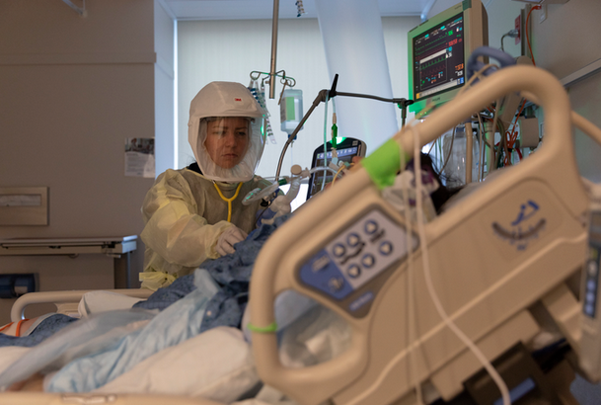
Caring for the Sick Signs and Symptoms
HPAI H5N1 Signs and Symptoms
Deterioration is rapid
outrunningthehorses.com

Slide 38
Caring for the Sick When to Seek Medical Attention
While many illnesses can be managed at home, there are some signs and symptoms that indicate the need for professional medical attention
Seek emergency medical attention for the following:
Chest pain
Severe muscle pain
Severe weakness or unsteadiness
outrunningthehorses.com

Slide 39
Caring for the Sick When to Seek Medical Attention
Seek emergency medical attention for the following:
Chest pain
Severe muscle pain
Severe weakness or unsteadiness
outrunningthehorses.com

Slide 40
Caring for the Sick When to Seek Medical Attention
Seek emergency medical attention for the following:
Chest Pain
Difficulty breathing or shortness of breath
Bluish lips or face
Persistent pain or pressure in the chest or abdomen
Persistent dizziness, confusion, inability to arouse
outrunningthehorses.com

Slide 41
Caring for the Sick When to Seek Emergency Care
Seek medical attention for the following:
Uncontrolled vomiting or diarrhea
Fever or cough that improve but then return or worsen
Worsening of chronic medical conditions
outrunningthehorses.com

Slide 42
Caring for the Sick When to Seek Emergency Care
Seek medical attention for the following:
Dehydration that results in:
Dizziness when standing
No urination
No tears in infants when crying
Seizures
Altered mental status, confusion, or less responsive
outrunningthehorses.com

Slide 43
Caring for the Sick
Conclusion
In caring for the sick it is important to know:
How to properly protect yourself
What it means to isolate and quarantine
Where to place the patient
The signs and symptoms of the disease
When to seek medical or emergency care
outrunningthehorses.com

Slide 44

outrunningthehorses.com

Slide 45


“If you have run with footmen, and they have tired you out,
then how can you compete with horses?
If you fall down in a land of peace,
how will you do in the thicket by the Jordan?”
Jeremiah 12:5

Slide 46
For more presentations like this
or for more information
please visit
outrunningthehorses.com

