Slide 1

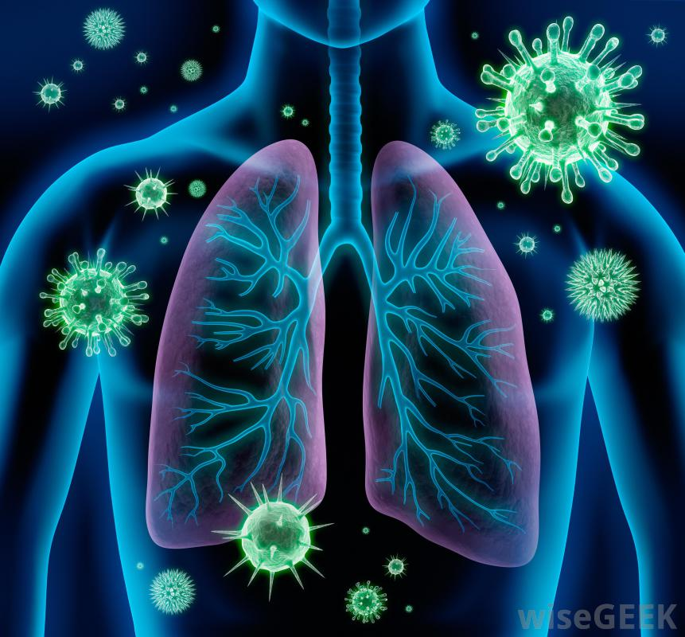
Pandemic Plan for the Church
Ministering to the Community in a Time of Crisis
How to Prevent Acute Respiratory Distress
What We’ve Learned From COVID-19
outrunningthehorses.com

Slide 2
How to Prevent Acute Respiratory Distress
Disclaimer
This material is meant as informative and not as medical advice
Please contact your doctor if you have these symptoms or any questions
outrunningthehorses.com

Slide 3
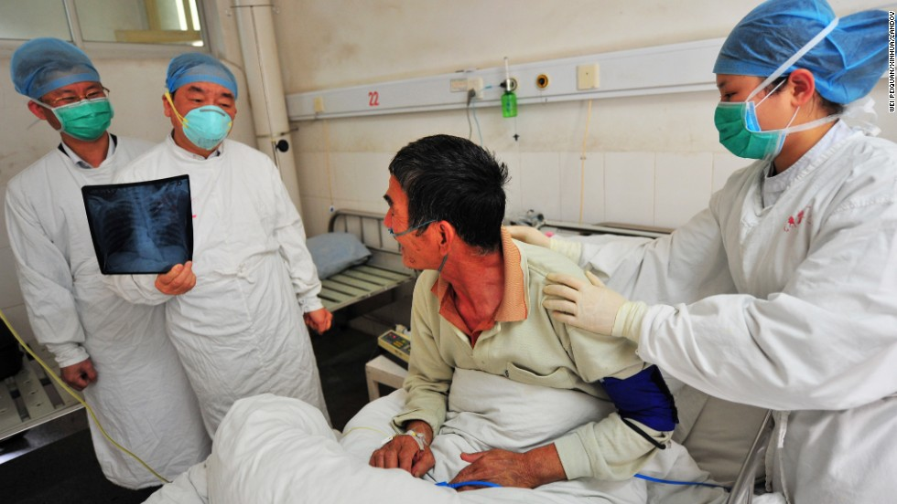
How to Prevent Acute Respiratory Distress
A “Cytokine Storm”
is what makes Avian Influenza so deadly
outrunningthehorses.com

Slide 4
How to Prevent Acute Respiratory Distress Syndrome
The inflammation triggered
by the immune response
can produce what is called a cytokine storm
which can progress into
Acute Respiratory Distress Syndrome
outrunningthehorses.com

Slide 5
How to Prevent Acute Respiratory Distress Syndrome
Introduction
Approximately 42% of patients hospitalized with COVID-19 pneumonia developed Acute Respiratory Distress Syndrome (ARDS)
ARDS involves severe inflammation, fluid buildup in the air sacs (alveoli) and low blood oxygen levels, requiring intensive care management
outrunningthehorses.com

Slide 6
How to Prevent Acute Respiratory Distress Syndrome
Introduction
Approximately 42% of patients hospitalized with COVID-19 pneumonia developed Acute Respiratory Distress Syndrome (ARDS)
ARDS involves severe inflammation, fluid buildup in the air sacs (alveoli) and low blood oxygen levels, requiring intensive care management
outrunningthehorses.com

Slide 7
How to Prevent Acute Respiratory Distress Syndrome
Introduction
Despite the better understanding of the pathophysiology of COVID-19, the search for new interventions remains ongoing.
Scientists have taken to study medicines and molecules with anti-inflammatory and strong antioxidant potentials.
outrunningthehorses.com

Slide 8
How to Prevent Acute Respiratory Distress Syndrome
Introduction
During COVID-19, studies have been documented on the role of pro-inflammatory cytokines, and related complications.
This presentation is a summary of some of the over the counter (OTC) medicines that have been put into practice during the COVID-19 Pandemic, in the effort of preventing a cytokine storm that may lead to ARDS.
outrunningthehorses.com

Slide 9
How to Prevent Acute Respiratory Distress Syndrome Cytokine Storm
Cytokines
Protein hormone like substances that act as messenger molecules and regulators in the immune system
Produced primarily in response to pathogens (any agent that can cause disease)
An excessive number amount can cause too much fluid build- up, this is called a cytokine storm
outrunningthehorses.com

Slide 10
How to Prevent Acute Respiratory Distress Syndrome Cytokine Storm
Cytokine Storm
An acute overproduction and uncontrolled release of pro-inflammatory markers, both locally and systemically
Triggering widespread inflammation that can damage organs and lead to multi-organ failure - A life-threatening condition
outrunningthehorses.com

Slide 11
How to Prevent Acute Respiratory Distress Syndrome Cytokine Storm
Cytokine Storm
A descriptive term to encompass the cascading events that can ultimately result in multi-organ failure and death.
It is this inflammation triggered by cytokines that causes the severe complication of Acute Respiratory Distress Syndrome (ARDS)
outrunningthehorses.com

Slide 12
How to Prevent Acute Respiratory Distress Syndrome Cytokine Storm
Cytokine Storm
Management of this inflammatory response prevents subsequent infections such as pneumonia or damage to the organs
The H5N1, SARS, MERS, COVID-19, and the seasonal flu have similar pathologies, and all can trigger cytokine storms
For more information see the document and PowerPoint presentation titled “Pathophysiology of Avian Influenza.”
outrunningthehorses.com

Slide 13
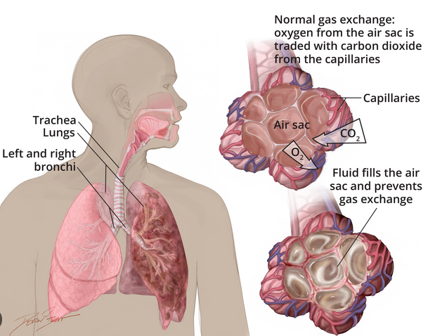
How to Prevent Acute Respiratory Distress Syndrome ARDS
Acute Respiratory Distress Syndrome (ARDS)
A severe, life-threatening lung condition that occurs in the alveoli and bronchial epithelial cells
outrunningthehorses.com

Slide 14
How to Prevent Acute Respiratory Distress Syndrome ARDS
Acute Respiratory Distress Syndrome (ARDS)
Fluid fills the alveoli preventing oxygen from entering the bloodstream
Leads to alveoli collapse
Leads to hypoxemia (below normal level of oxygen in the blood)
Leads to a cascade of problems which affect the body’s tissue and organs
outrunningthehorses.com

Slide 15

How to Prevent Acute Respiratory Distress Syndrome ARDS
Signs and Symptoms of ARDS
Severe shortness of breath
Rapid breathing
Fingernails, lips or skin may turn blue (cyanosis)
Extreme fatigue
Low blood pressure
Confusion
outrunningthehorses.com

Slide 16
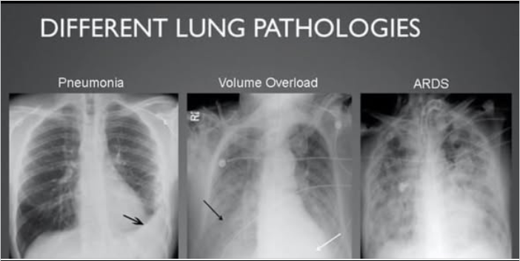
How to Prevent Acute Respiratory Distress Syndrome ARDS
ARDS vs Pneumonia
ARDS is a systemic inflammatory condition
Pneumonia is an infection that causes inflammation in one or both lungs
outrunningthehorses.com

Slide 17
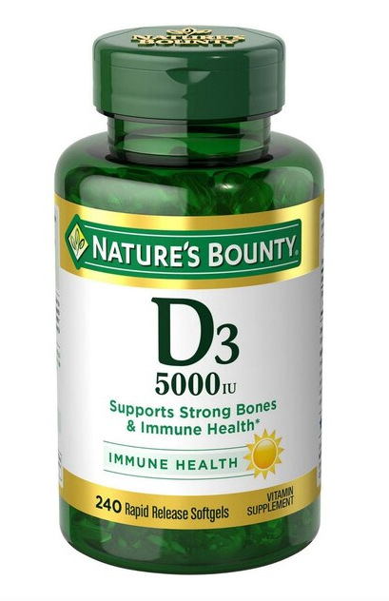
How to Prevent Acute Respiratory Distress Syndrome Vitamin D
Vitamin D is a fat-soluble-vitamin essential for:
Bone health
Immune function
Calcium absorption
outrunningthehorses.com

Slide 18
How to Prevent Acute Respiratory Distress Syndrome Vitamin D
Evidence that vitamin D may prevent or improve outcomes in many infectious and inflammatory conditions
Including acute and chronic respiratory infections
Those who received vitamin D therapy showed:
70% reduction in viral respiratory tract infections
outrunningthehorses.com

Slide 19

How to Prevent Acute Respiratory Distress Syndrome Vitamin D
Studies have shown there is a high prevalence of vitamin D deficiency worldwide
Low levels of vitamin D may:
Increase the risk of severe COVID-19 symptoms
Lengthen time of recovery
outrunningthehorses.com

Slide 20
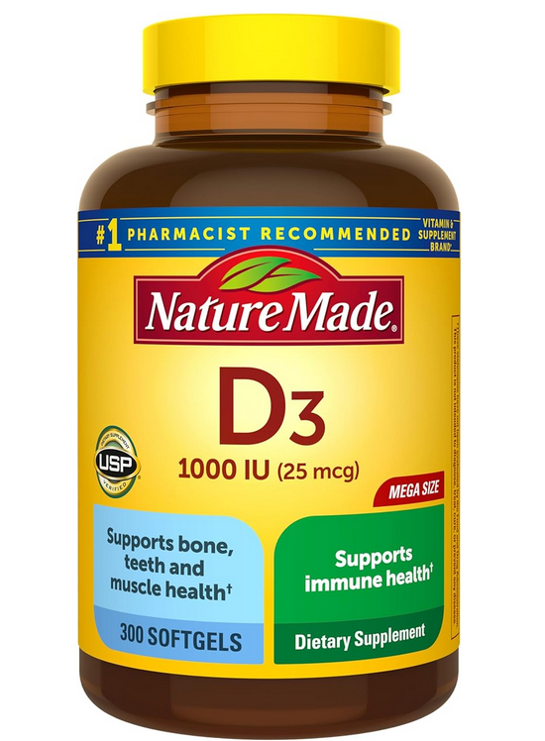
How to Prevent Acute Respiratory Distress Syndrome Vitamin D
These studies found other benefits to Vitamin D while treating COVID-19
Found to boost your immune system
Help control inflammation
outrunningthehorses.com

Slide 21
How to Prevent Acute Respiratory Distress Syndrome Vitamin D
“The benefits … are so clear and the risks so minimal that we believe physicians should be recommending supplemental Vitamin D right away…We already know from past studies that Vitamin D blunts cytokine storms in cases of flu. In cases of COVID-19, vitamin D therapy may allow time for a patient’s own immune defenses to kick in before it’s too late.”
Dr. James Mullin of Lankenau Inst. For Medical Research
outrunningthehorses.com

Slide 22

How to Prevent Acute Respiratory Distress Syndrome Vitamin D
Vitamin D and the Sun
Different from others in that a major source comes from the sun’s UV light
Exposure to the sun allows skin to convert vitamin D from cholesterol
Best way to get vitamin D
outrunningthehorses.com

Slide 23
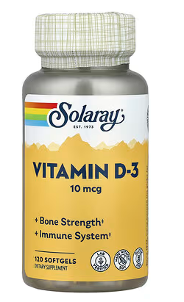
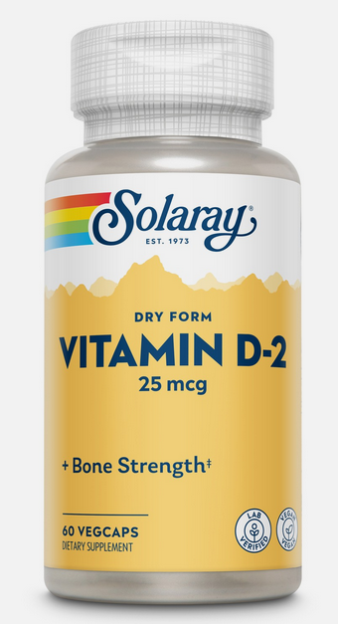
How to Prevent Acute Respiratory Distress Syndrome Vitamin D
Vitamin D₃ vs. Vitamin D₂
Vitamin D is found in two different forms
Vitamin D3(cholecalciferol)
Vitamin D2 (ergocalciferol)
outrunningthehorses.com

Slide 24
How to Prevent Acute Respiratory Distress Syndrome Vitamin D
Vitamin D₃
Found in the skin after sunshine converts cholesterol into pre-vitamin cholecalciferol (D₃)
Naturally found in the body and in normally manufactured supplements
Studies show that vitamin D₃ increases levels of calcidiol (molecule in blood to measure levels) more efficiently than vitamin D₂
outrunningthehorses.com

Slide 25
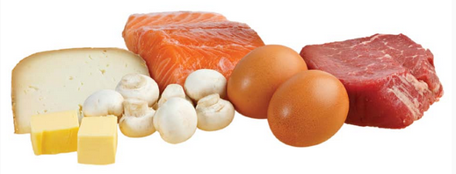
How to Prevent Acute Respiratory Distress Syndrome Vitamin D
Vitamin D₃ is found in animal products:
Egg yolks
Oily fish
Liver
Fortified foods
Some supplements
outrunningthehorses.com

Slide 26
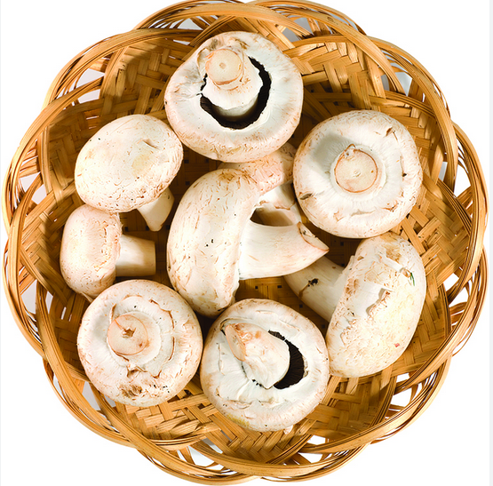
How to Prevent Acute Respiratory Distress Syndrome Vitamin D
Vitamin D₂ found in supplements that are derived from:
Plants
Mushrooms
Vegan supplements
outrunningthehorses.com

Slide 27
How to Prevent Acute Respiratory Distress Syndrome Vitamin D
Recommended Dietary Allowances for Vitamin D
Many people are deficient
Recommendations vary
Mayo Clinic recommends adult get at lease 600 IU
However, 1,000 to 2,000 IU per day is generally safe
outrunningthehorses.com

Slide 28
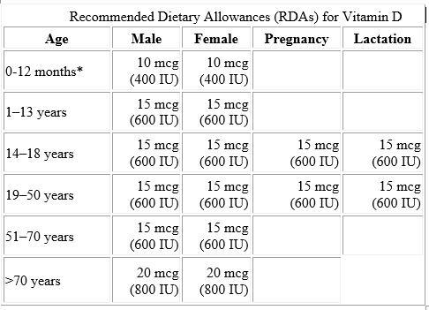
How to Prevent Acute Respiratory Distress Syndrome Vitamin D
outrunningthehorses.com

Slide 29
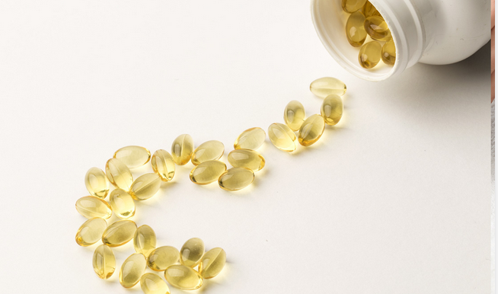
How to Prevent Acute Respiratory Distress Syndrome Vitamin D
If you acquire a respiratory illness
Increasing supplementation either 5,000 to 10,000 IUs a day (taken 5,000 IUs 2 times a day) is recommended
This will help correct or prevent deficiency
outrunningthehorses.com

Slide 30
How to Prevent Acute Respiratory Distress Syndrome Vitamin D
How to Take Vitamin D
Fat soluble
Does not dissolve in water
Best absorbed when taken with high fat foods
Some studies state taking vitamin K2 along with vitamin D will enhance bone and cardiovascular health
outrunningthehorses.com

Slide 31

How to Prevent Acute Respiratory Distress Syndrome Vitamin D
How to Get More Vitamin D
Get more sunlight
Exposure to sunlight 10 to 15 minutes three times a week
Be aware you will need more sunlight time in the winter
outrunningthehorses.com

Slide 32
How to Prevent Acute Respiratory Distress Syndrome Vitamin D
How to Get More Vitamin D
Foods rich in Vitamin D include:
Oily fish (salmon, rainbow trout, tuna, sardines
Red meat
Egg yolks
Fortified:
Orange Juice
Milk
Almond milk
Rice milk
outrunningthehorses.com

Slide 33
How to Prevent Acute Respiratory Distress Syndrome Antihistamines
A Cytokine Storm is the result of histamine activated pathways
A histamine is a chemical that’s released by white blood cells in your immune system
It sends messages between cells
Like cytokines it induces inflammation
outrunningthehorses.com

Slide 34
How to Prevent Acute Respiratory Distress Syndrome Antihistamines
Some functions of histamines in the body include:
Tells your stomach cells to make gastric acid
Helps your brain to stay awake
Increases blood flow and causes inflammation in nearby tissue
Widening of blood vessels (vascular permability)
Causing leaking
Causing tissues to swell
outrunningthehorses.com

Slide 35

How to Prevent Acute Respiratory Distress Syndrome Antihistamines
Some functions of histamines in the body include:
Helps protect us from foreign invaders (antigens) by expelling the antigen from the body
Runny nose
Causes sneezing
Watery eyes
Itchy skin
outrunningthehorses.com

Slide 36
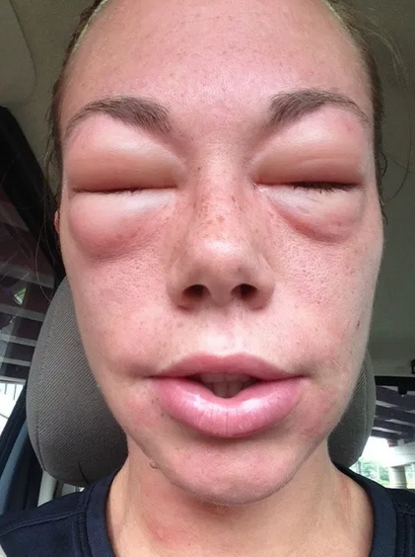
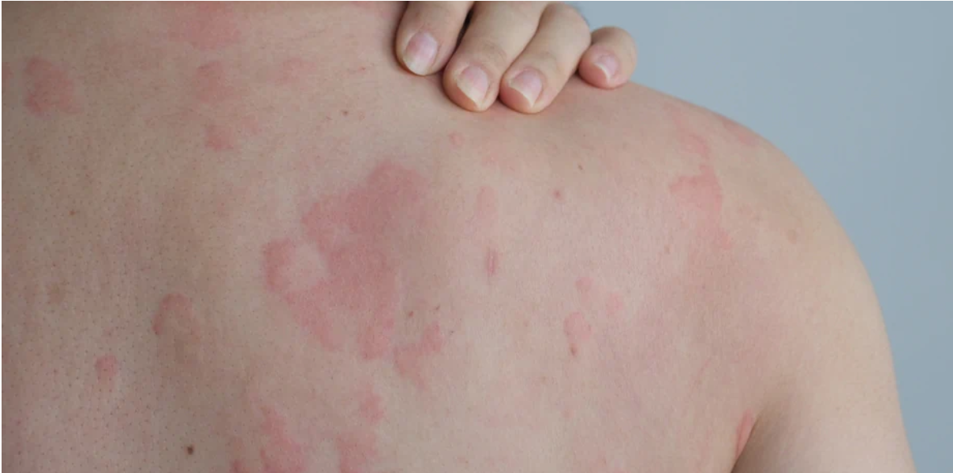
How to Prevent Acute Respiratory Distress Syndrome Antihistamines
Histamine effects also include:
Anaphylaxis
Rash/urticaria
Increase heart rate
outrunningthehorses.com

Slide 37
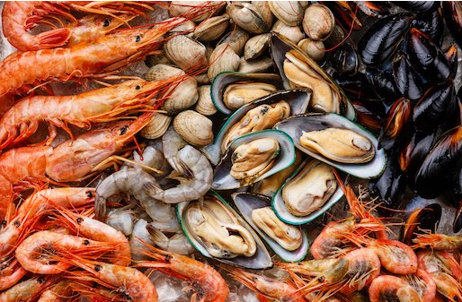

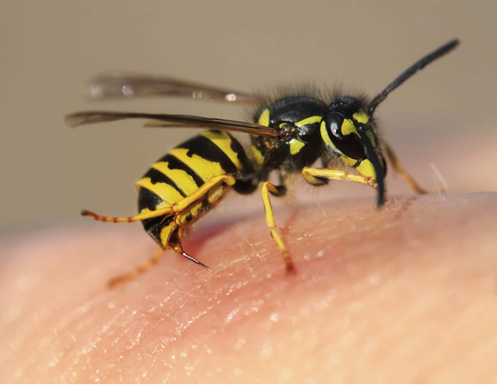

How to Prevent Acute Respiratory Distress Syndrome Antihistamines
Substances that may trigger overreaction include:
Food
Dust
Pollen
Venom
Antigens
outrunningthehorses.com

Slide 38
How to Prevent Acute Respiratory Distress Syndrome Antihistamines
Histamine pathways can trigger inflammation responses
Acute Respiratory Distress Syndrome (ARDS)
Deep vein thrombosis
Damage to organs
Four Classes of Histamines
H1, H2, H3, H4
H1 and H2 have gained the most clinical attention
outrunningthehorses.com

Slide 39
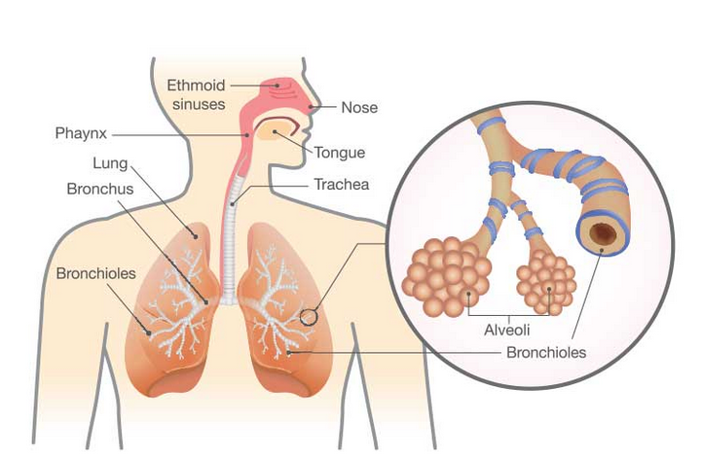
How to Prevent Acute Respiratory Distress Syndrome Antihistamines
H1 Receptors Mediate:
Allergic reactions
Inflammation
Respiratory tracts
Vascular permeability
outrunningthehorses.com

Slide 40
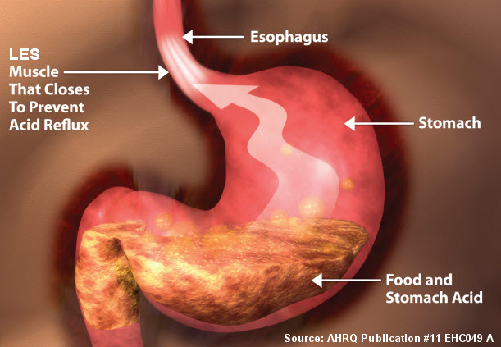
How to Prevent Acute Respiratory Distress Syndrome Antihistamines
H2 Receptors Mediate:
Gastric acid secretion
Mast cells that produce histamines and cytokines
Clinical strategy is to use both in combination
outrunningthehorses.com

Slide 41
How to Prevent Acute Respiratory Distress Syndrome Antihistamines
H1 Inhibitor Antihistamines
Start treatment with antihistamines every 12 hours at the first symptoms
Those recommended include:
Dexchlorpheniramine (Polaramine) 2 mg
Cetirizine (Zyrtec) 10 mg
Loratadine (Claritin) 10 mg
outrunningthehorses.com

Slide 42
How to Prevent Acute Respiratory Distress Syndrome Antihistamines
H2 Inhibitor Antihistamines
Famotidine (Pepcid AC) 80 mg three times per day for a maximum of 14 day
Side effects can include:
Headache
Constipation/diarrhea
Pregnant women should consult their doctor
Children younger than 12 should not take
Older adults may be more sensitive to side effects
outrunningthehorses.com

Slide 43
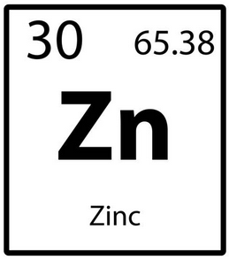
How to Prevent Acute Respiratory Distress Syndrome Zinc
Zinc is an essential mineral
Necessary for development and function of T cells in immune system
Responsible for fighting infections
Regulates cytokine expression suppressing inflammation
outrunningthehorses.com

Slide 44
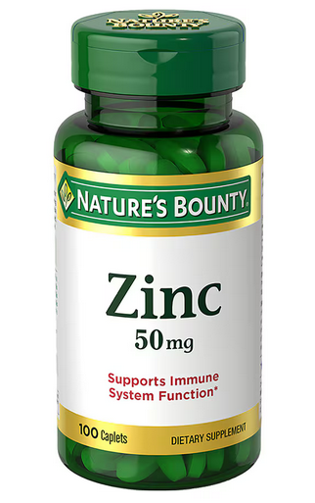
How to Prevent Acute Respiratory Distress Syndrome Zinc
Zinc is an essential mineral
Proven to have antiviral effects
Reduces replication of the influenza virus and COVID-19
Inactivation of RNA replication
Helps inhibit the viral load
outrunningthehorses.com

Slide 45
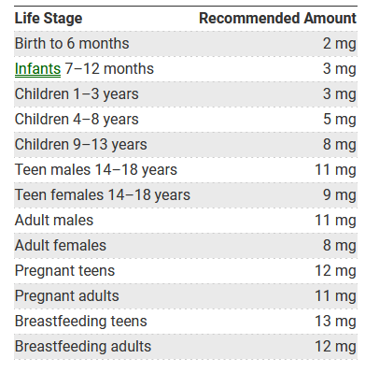
Daily Recommended Zinc Intake
outrunningthehorses.com

Slide 46
How to Prevent Acute Respiratory Distress Syndrome Zinc
Zinc dosage while experiencing symptoms
Consider increased daily amount as high as 50 mg 2 times a day for a short duration
Higher intakes can cause:
Nausea
Vomiting
loss of appetite
Stomach cramps
Diarrhea
Headaches
outrunningthehorses.com

Slide 47
How to Prevent Acute Respiratory Distress Syndrome Vitamin C
Vitamin C (ascorbic acid)
Essential organic water-soluble compound
Many roles in immune system
Repairing tissues
Skin
Blood vessels
Muscles
Bones
outrunningthehorses.com

Slide 48
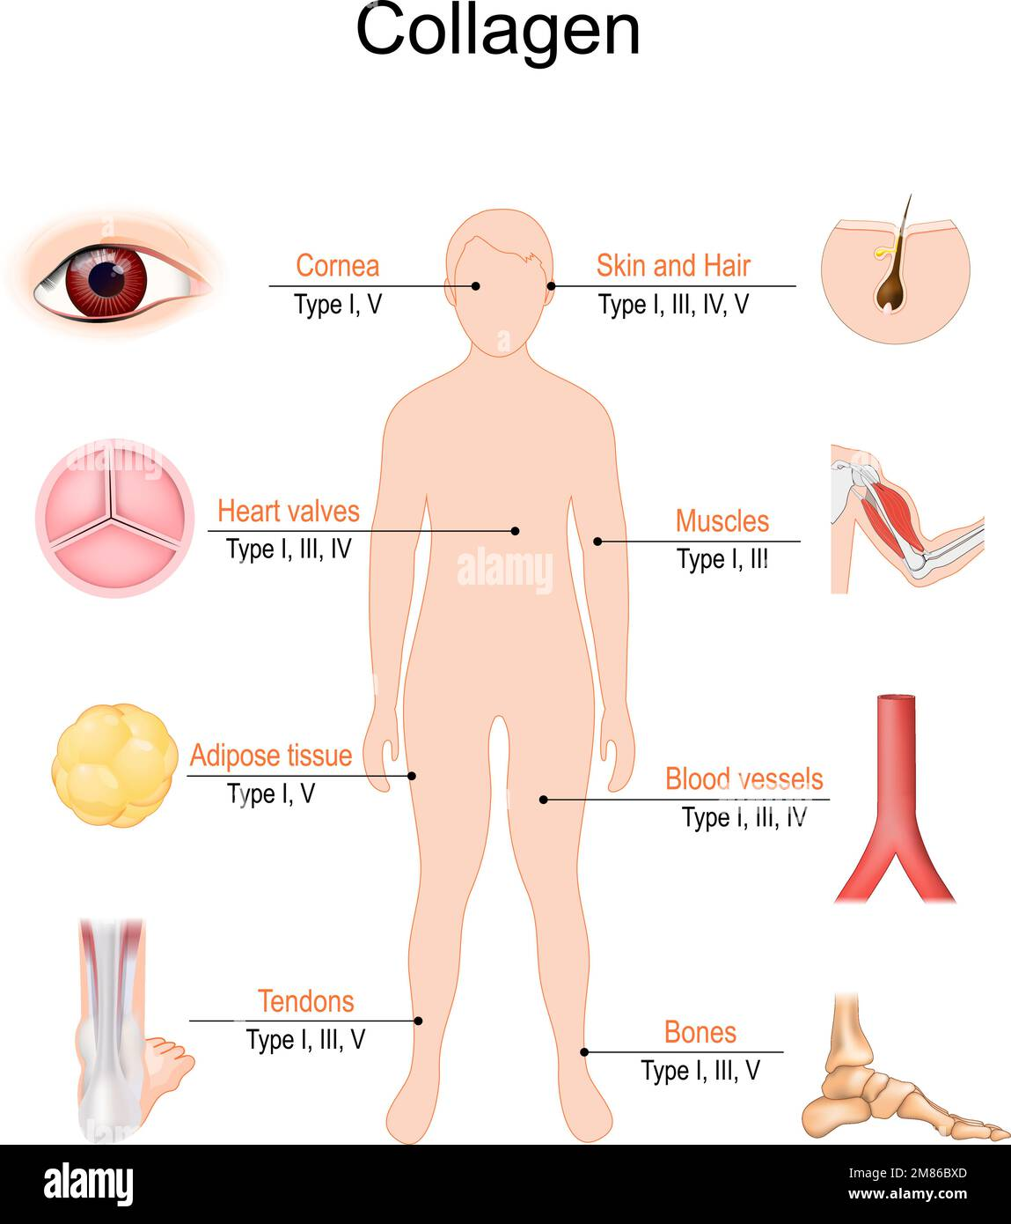
How to Prevent Acute Respiratory Distress Syndrome Vitamin C
Vitamin C (ascorbic acid)
Synthesis of collagen providing structure and repair and integrity to:
Skin
Bones
Blood vessels
Muscles
Connective Tissue
outrunningthehorses.com

Slide 49
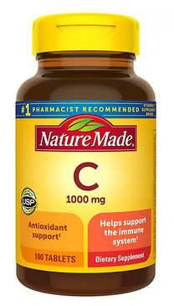
How to Prevent Acute Respiratory Distress Syndrome Vitamin C
Powerful antioxidant
Protects cells and DNA from free radical damage caused by
Stress
Damage
Chronic Disease
outrunningthehorses.com

Slide 50
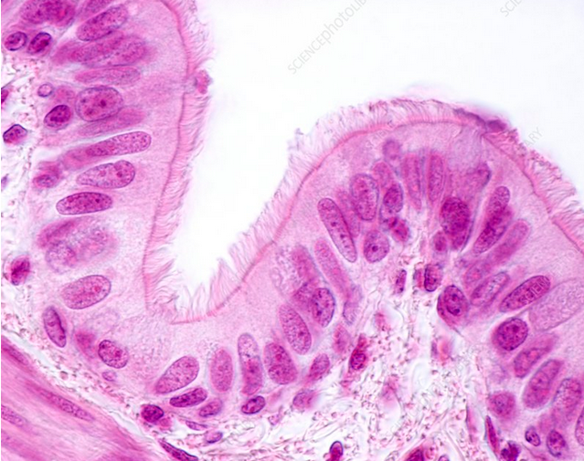
How to Prevent Acute Respiratory Distress Syndrome Vitamin C
Antiviral Properties
Stimulates interferon
Blocks replication of viruses
Enhances antiviral activity in epithelial cells of the lungs
outrunningthehorses.com

Slide 51
How to Prevent Acute Respiratory Distress Syndrome Vitamin C
Anti-inflammatory effects
Prevents hyperactivation of immune cells
Decreases inflammatory markers
Leads to lowering inflammatory cytokine production
Prevents ARDS
outrunningthehorses.com

Slide 52
How to Prevent Acute Respiratory Distress Syndrome Vitamin C
Vitamin C
Is water soluble
Not stored in the body
Side effects are rare
Amounts greater than 2,000 mg a day not recommended
Can lead to stomach upset, diarrhea
outrunningthehorses.com

Slide 53
How to Prevent Acute Respiratory Distress Syndrome Vitamin C
Found in fruits and vegetables
Citrus and peppers
Is water soluble
Not stored in the body
Deficiencies can lead to scurvy
Side effects are rare
Amounts greater than 2,000 mg a day not recommended
Can lead to stomach upset, diarrhea
outrunningthehorses.com

Slide 54

How to Prevent Acute Respiratory Distress Syndrome Vitamin C
Found in fruits and vegetables
Citrus and peppers
Is water soluble
Not stored in the body
Deficiencies can lead to scurvy
outrunningthehorses.com

Slide 55
How to Prevent Acute Respiratory Distress Syndrome Vitamin C
Vitamin C Recommended Daily Amount
Men: 90 mg a day
Women: 75 mg a day
During pregnancy: 85 – 120 mg a day
Smokers need an extra 35 mg per day
outrunningthehorses.com

Slide 56
How to Prevent Acute Respiratory Distress Syndrome Vitamin C
Vitamin C Recommended Daily Amount for Children
1-3 years: 15 mg
4-8 years: 25 mg
9-13 years: 45 mg
14-18 years: 75 mg (boys), 65 mg (girls)
outrunningthehorses.com

Slide 57
How to Prevent Acute Respiratory Distress Syndrome Vitamin C
Increase your daily dosage while experiencing symptoms
High-dose vitamin C supplementation can alleviate inflammatory response and hinder the aggravation of COVID-19 and Influenza
It is recommended to take 1,000 mg of Vitamin C per day
Spread supplementation throughout the day
outrunningthehorses.com

Slide 58
How to Prevent Acute Respiratory Distress Syndrome Vitamin C
Increase your daily dosage while experiencing symptoms
Serious side effects from too much vitamin C are rare
However, amounts greater than 2,000 mg a day are not recommended
High doses can lead to:
Stomach upset
Diarrhea
Kidney stones
outrunningthehorses.com

Slide 59
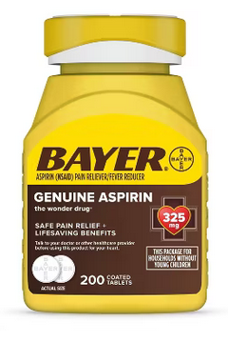
How to Prevent Acute Respiratory Distress Syndrome Aspirin
Aspirin (Acetylsalicylic acid)
Classified as a non-steroidal anti-inflammatory drug (NSAID)
Used to reduce pain and inflammation
outrunningthehorses.com

Slide 60

How to Prevent Acute Respiratory Distress Syndrome Aspirin
Aspirin uses
Reduce fever
Reduce inflammation
Relieve mild to moderate pain from:
Muscle aches
Toothaches
Common cold
Headaches
outrunningthehorses.com

Slide 61
How to Prevent Acute Respiratory Distress Syndrome Aspirin
Blocks and enzyme called cyclooxygenase
Cyclooxygenase produces hormones called prostanoids
Prostanoids cause platelets to stick together
Role of platelets is to stick together and block cuts and breaks in blood vessels
Blocking these reduces formation of clots
outrunningthehorses.com

Slide 62
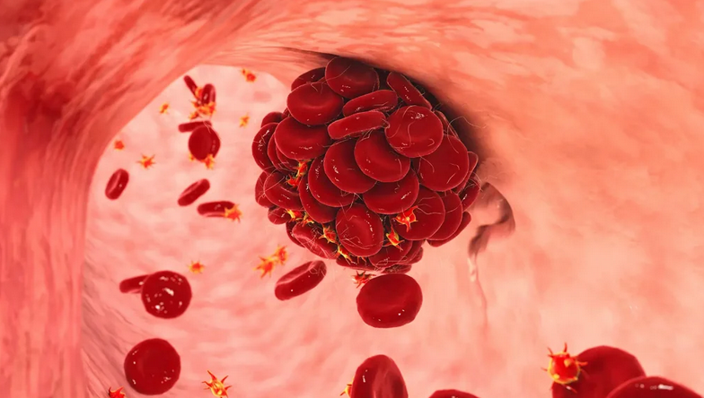
How to Prevent Acute Respiratory Distress Syndrome Aspirin
Blood Clots
The cascade of inflammatory mediators may cause some to develop blood clots
To prevent blood clots, take 325 mg per day
outrunningthehorses.com

Slide 63
How to Prevent Acute Respiratory Distress Syndrome Aspirin
Do not take aspirin if you experience the following:
Allergy to ibuprofen
Stomach ulcer
Stroke victim (unless doctor recommended)
Indigestion
Asthma
Gout
Heavy periods
Pregnant or trying to get pregnant
Breastfeeding
outrunningthehorses.com

Slide 64

How to Prevent Acute Respiratory Distress Syndrome Aspirin
Do not take give aspirin to children or teenagers without checking with your child’s doctor
It can cause a serious illness called Reye’s syndrome
outrunningthehorses.com

Slide 65
How to Prevent Acute Respiratory Distress Syndrome Conclusion
Scientists have a better understanding of the pathophysiology ARDS
Studies performed during the COVID-19 pandemic proved several over the counter (OTC) medicines have been found to have effects in preventing a cytokine storm
outrunningthehorses.com

Slide 66
How to Prevent Acute Respiratory Distress Syndrome Conclusion
The following OTC medicines are recommended in preventing a cytokine storm:
Vitamin D3
Antihistamines
Claritin
Pepcid AC
Zinc
Vitamin C
Aspirin
outrunningthehorses.com

Slide 67

outrunningthehorses.com

Slide 68


“If you have run with footmen, and they have tired you out,
then how can you compete with horses?
If you fall down in a land of peace,
how will you do in the thicket by the Jordan?”
Jeremiah 12:5

Slide 69
For more presentations like this
or for more information
please visit
outrunningthehorses.com

