Slide 1

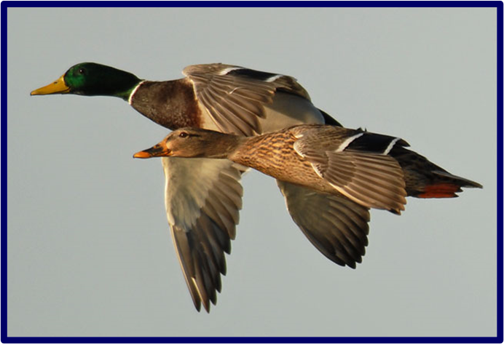
Pandemic Plan for the Church
Ministering to the Community in a Time of Crisis
Avian Influenza
outrunningthehorses.com

Slide 2
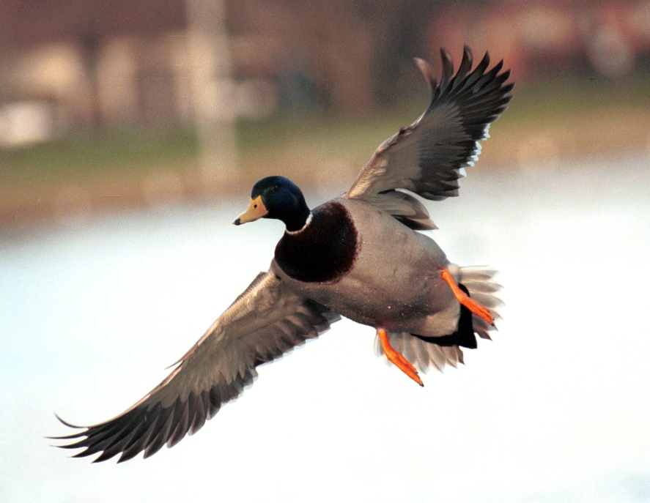
Avian Influenza
Ministering to the Community in a Time of Crisis
Avian Influenza also known as:
Highly pathogenic avian influenza (HPAI) H5N1
Bird Flu
Refers to Influenza A viruses that occur naturally among birds
Waterfowl (wild ducks) are a natural reservoir
The most resistant to infection
outrunningthehorses.com

Slide 3
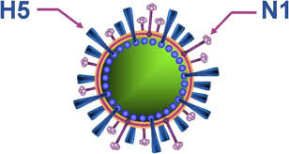
Avian Influenza
Ministering to the Community in a Time of Crisis
Type A Influenza
Surface glycoproteins (H5N1)
Hemagglutinin - 5
Neuraminidase – 1
Dictate viral entry and release in a host cell
Humans have no immunity
outrunningthehorses.com

Slide 4
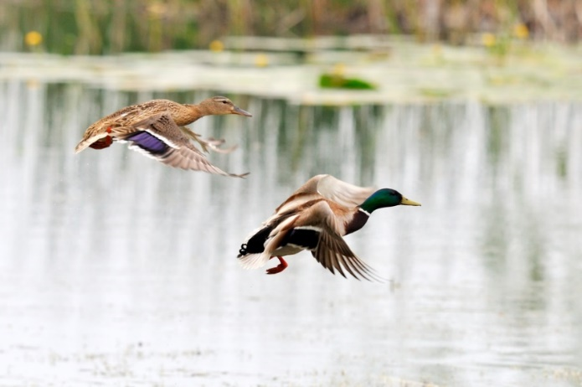
Avian Influenza
Ministering to the Community in a Time of Crisis
Classified into two categories by the severity of illness caused in birds
Low Pathogenic Avian Influenza (LPAI)
Mild or no illness
Highly Pathogenic Avian Influenza (HPAI)
Causes severe disease
Mortality up to 50 -100%
outrunningthehorses.com

Slide 5
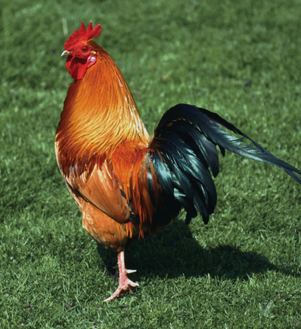
Avian Influenza
Ministering to the Community in a Time of Crisis
First identified in China in 1996
Spread by bird migration
Became the dominant strain in bird populations worldwide
Although it normally affects waterfowl it can now infect:
Domestic poultry – most susceptible to illness
Other birds
outrunningthehorses.com

Slide 6
Avian Influenza
Ministering to the Community in a Time of Crisis
H5N1 found in other species:
Both wild and captive mammals including:
Bears
Wild and domestic cats
Wild and domestic dogs
Marine mammals
Raccoons
Mice
Skunks
Opossums
Sheep
Alpacas
Cows
Swine
Ferrets
Foxes
outrunningthehorses.com

Slide 7
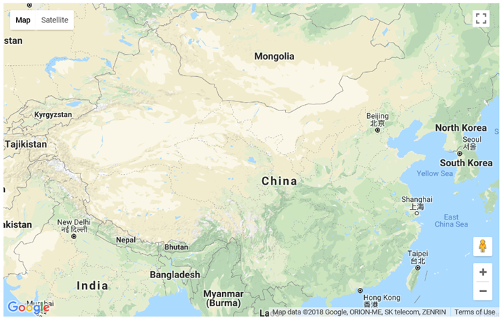
Avian Influenza Qinghai Lake, China
Ministering to the Community in a Time of Crisis
Qinghai Lake, China
In 2005 an outbreak of H5N1 appeared in Qinghai Lake, China.
China’s largest inland expanse of salt water
Known for its high diversity of migratory birds
A Breeding site
Qinghai Lake
outrunningthehorses.com

Slide 8
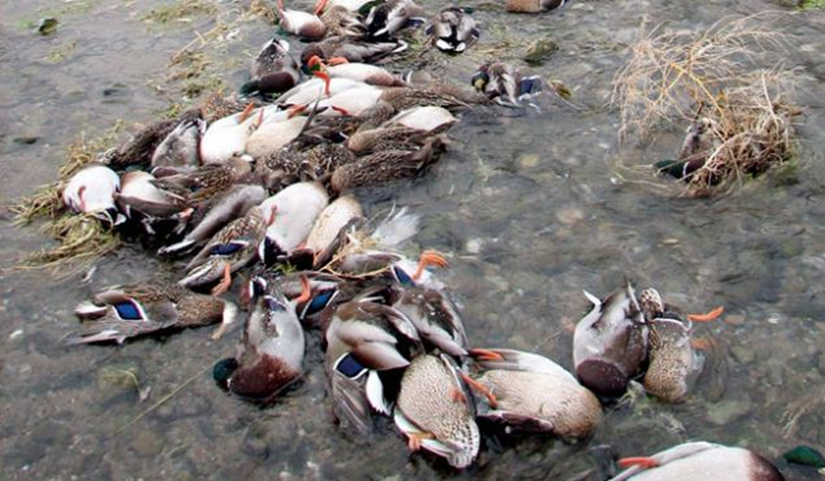
Avian Influenza Qinghai Lake, China
Ministering to the Community in a Time of Crisis
Qinghai Lake, China
More than 150,000 birds pass through this region
Sits within Central Asian flyway, a migration route from India to Russia
Birds densely congregate in confined, shallow water
Water contains contaminated fecal material
outrunningthehorses.com

Slide 9
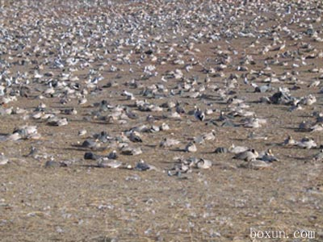
Avian Influenza Qinghai Lake, China
Ministering to the Community in a Time of Crisis
Qinghai Lake, China
In 2005 an outbreak of H5N1 appeared in Qinghai Lake
6500 birds died on the shores of the lake
Bird Island was placed under quarantine May 27, 2005
Photo taken June 3, 2005 after quarantine
outrunningthehorses.com

Slide 10
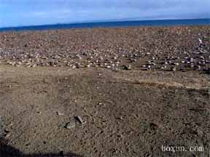
Avian Influenza Qinghai Lake, China
Ministering to the Community in a Time of Crisis
Qinghai Lake, China
Bird Island photo taken June 3, 2005 after quarantine
Photographer remains anonymous for consideration of his/her safety
outrunningthehorses.com

Slide 11
Avian Influenza China Prohibits News
Ministering to the Community in a Time of Crisis
Chinese prohibit news
Response to requesting permission to use photograph:
“May 27, 2005 – Bird Island blockade, the picture provided by insiders for safety reasons can not provide information on the person, you can understand the serious harm through the pictures of avian flu, almost the entire Bird Island birds of hell, we will try to collect … photographic evidence to refute the government's absurd remarks.”
outrunningthehorses.com

Slide 12
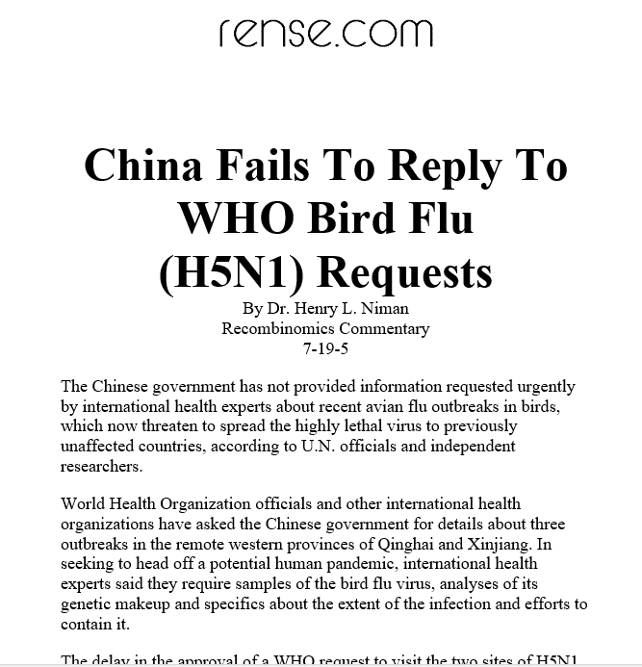
Avian Influenza China Prohibits News
Ministering to the Community in a Time of Crisis
Chinese denied the H5N1 outbreak July 19, 2005
outrunningthehorses.com

Slide 13
Avian Influenza China Prohibits News
Ministering to the Community in a Time of Crisis
Chinese authorities clamp down heavily on scientists whose research differs from their own
Originally stated the disease spread from outside China’s borders
Government has issued regulations restricting research into H5N1 to three government laboratories
Information that is released is closely guarded
Those who witness outbreaks are not allowed to speak to outside authorities
outrunningthehorses.com

Slide 14
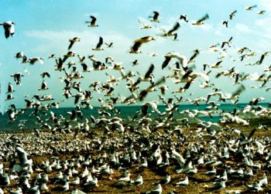
Avian Influenza Qinghai Lake, China
Ministering to the Community in a Time of Crisis
Qinghai Lake, China
From bird migration, it spread beyond Asia into Europe and Africa
Now it is worldwide
Epicenter of pandemics caused in 1957 and 1968
outrunningthehorses.com

Slide 15
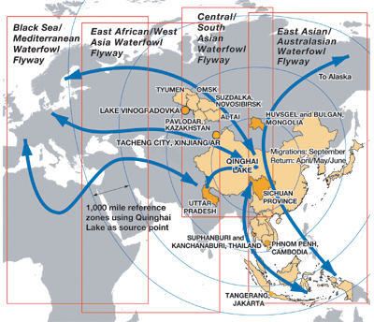
Avian Influenza Spread of Avian Influenza
Ministering to the Community in a Time of Crisis
Migratory Flyways
Migratory birds infected with H5N1 began carrying virus to other parts of the world
Birds can cover up to hundreds of miles per day
Can cross the borders of two or more countries
outrunningthehorses.com

Slide 16
Avian Influenza Spread of Avian Influenza
Ministering to the Community in a Time of Crisis
Spread of Influenza followed migration routes
Outbreaks ensued where birds migrated
India
Russia
Asia
Europe
Africa
Hong Kong
Southeast Asia
Canada
United States
outrunningthehorses.com

Slide 17
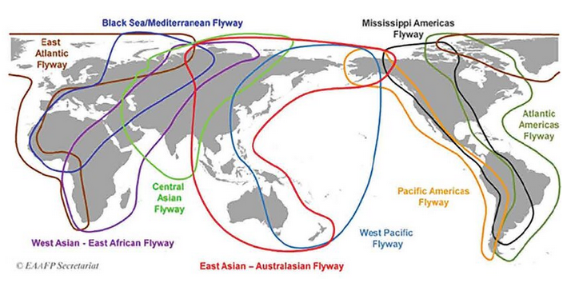
Avian Influenza Spread of Avian Influenza
Ministering to the Community in a Time of Crisis
A Crossroad of two international flyways
One on Asian side/one on North American side
Early 2015 the H5N1 reached North America through Alaska
outrunningthehorses.com

Slide 18
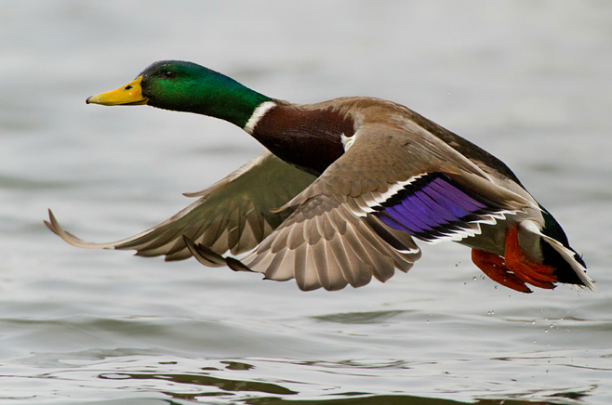
Avian Influenza Human Infection – Antigenic Mutation
Ministering to the Community in a Time of Crisis
Avian viruses primarily infect birds
Do not commonly infect humans
Due to antigenic mutation viruses have crossed species:
H5N1 (Bird Flu)
H7N9
H1N1 (Swine Flu)
1918 Influenza
outrunningthehorses.com

Slide 19
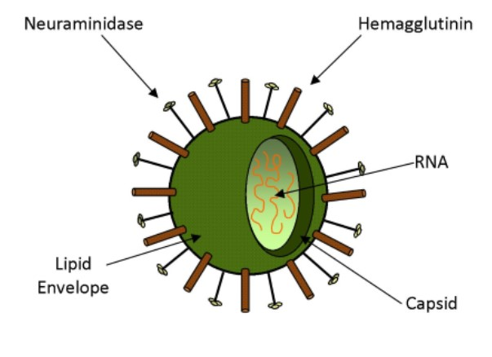
Avian Influenza Human Infection – Antigenic Mutation
Ministering to the Community in a Time of Crisis
Protein antigens on virus outer shell (Hs and Ns)
Hemagglutinin
Neuraminidase
Important structures for the spread of the virus
outrunningthehorses.com

Slide 20
Avian Influenza Human Infection – Antigenic Mutation
Ministering to the Community in a Time of Crisis
Protein antigens on virus outer shell (Hs and Ns)
Immune system recognizes virus by these
During replication mutation can take place
Normal part of the virus’ lifecycle
Can result in viruses jumping between species
Ability to infect humans
Ability to be cause human-to-human transmission
outrunningthehorses.com

Slide 21
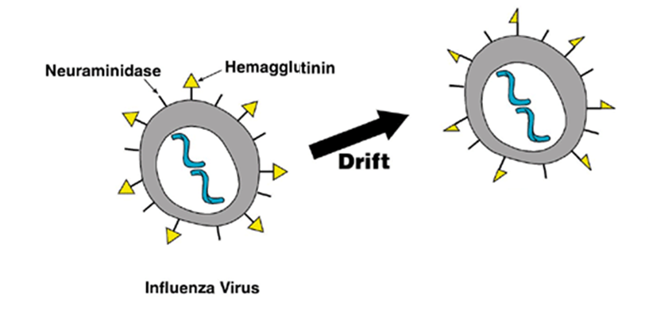
Avian Influenza Human Infection – Antigenic Mutation
Ministering to the Community in a Time of Crisis
Antigenic Drift
Small changes that happen continually over time
Produces new viral strains not recognized by immune system
Why a new seasonal flu vaccine is made every year
outrunningthehorses.com

Slide 22
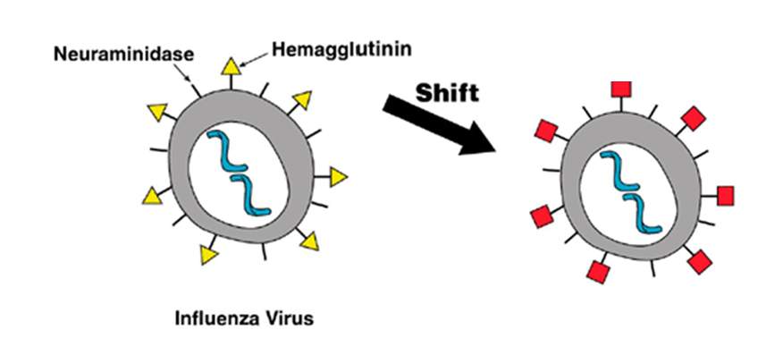
Avian Influenza Human Infection – Antigenic Mutation
Ministering to the Community in a Time of Crisis
Antigenic Shift
Significant change in the virus
Forms new hemagglutinin and/or neuraminidase
Resulting in a whole new influenza A virus subtype
outrunningthehorses.com

Slide 23
Avian Influenza Human Infection – Antigenic Mutation
Ministering to the Community in a Time of Crisis
Antigenic Drift (within species)
outrunningthehorses.com

Slide 24
Avian Influenza Human Infection – Antigenic Mutation
Ministering to the Community in a Time of Crisis
Antigenic Shift (jumps species)
outrunningthehorses.com

Slide 25
Avian Influenza Human Infection – Antigenic Mutation
Ministering to the Community in a Time of Crisis
Antigenic Shift – Human-to-Human Transmission
outrunningthehorses.com

Slide 26
Avian Influenza Human Infection – Antigenic Mutation
Ministering to the Community in a Time of Crisis
Antigenic Shift – Human-to-Human Transmission
outrunningthehorses.com

Slide 27
Avian Influenza Human Infection – Antigenic Mutation
Ministering to the Community in a Time of Crisis
Antigenic Shift
United States Dept. of Agriculture (USDA) has recorded up to 200 mammal species confirmed to be infected with H5N1 including:
Wild and domestic canines
Wild and domestic cats
Marine mammals
Cows
Sheep
Goats
Alpacas
Swine
Mice
Bears
Ferrets
Minks
Raccoons
Skunks
Foxes
outrunningthehorses.com

Slide 28
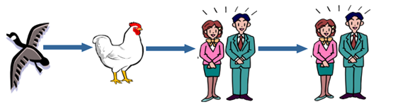
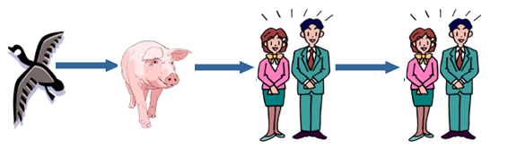
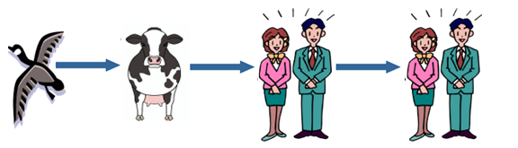

Human Infection – Antigenic Mutation
Ministering to the Community in a Time of Crisis
Antigenic Shift
outrunningthehorses.com

Slide 29
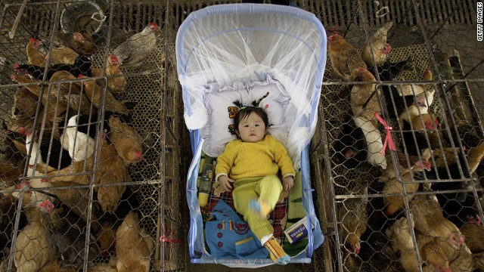
Avian Influenza Humans Infection – Antigenic Mutation
Ministering to the Community in a Time of Crisis
Due to humans living in close proximity to domestic poultry conditions are favorable for antigenic shift (mutation)
outrunningthehorses.com

Slide 30
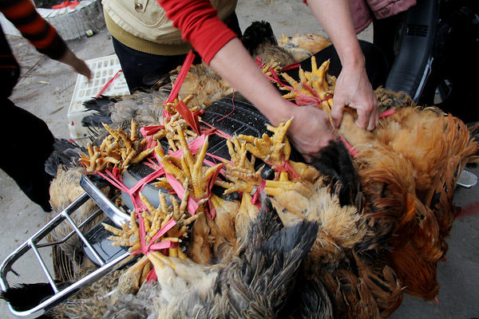
Avian Influenza Human Infection – Antigenic Mutation
Ministering to the Community in a Time of Crisis
Wet Markets in Asia are a source of concern
H5N1 is acquired by close contact with infected poultry
Touching surfaces contaminated with secretion or excretion
outrunningthehorses.com

Slide 31
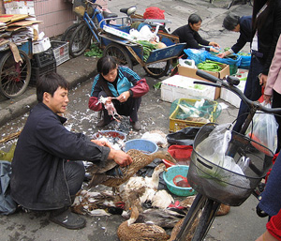
Avian Influenza Human Infection – Antigenic Mutation
Ministering to the Community in a Time of Crisis
Wet Markets in Asia are a source of concern
Handling infected birds
Touching secretions
Inhaling dried feces
Inhaling crystallized secretions
outrunningthehorses.com

Slide 32
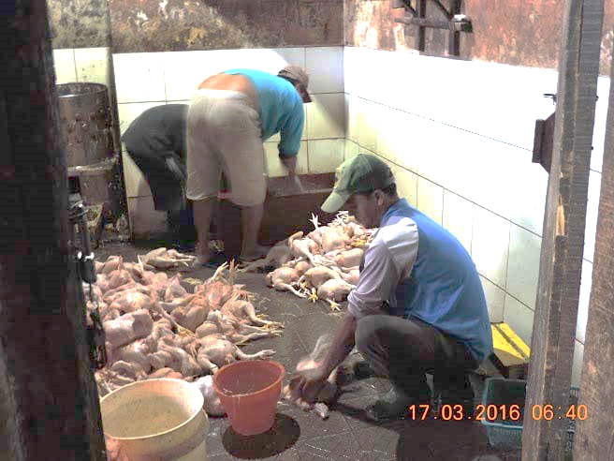
Human Infection – Antigenic Mutation
Ministering to the Community in a Time of Crisis
Wet Markets in Asia are a source of concern
Defeathering
Slaughtering or butchering infected bird
Consuming birds not fully cooked
outrunningthehorses.com

Slide 33
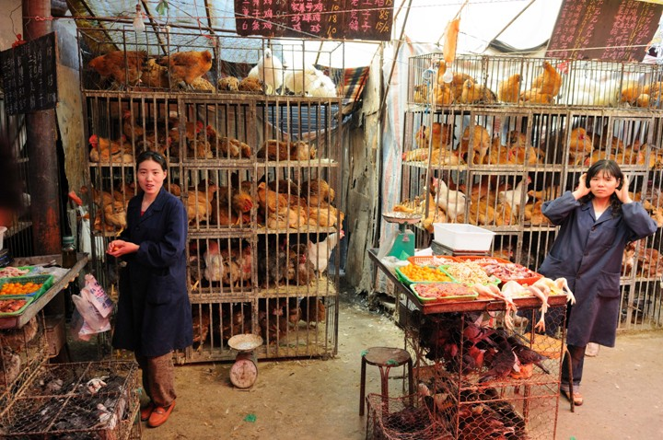
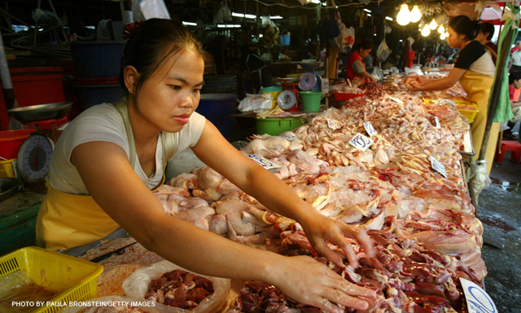
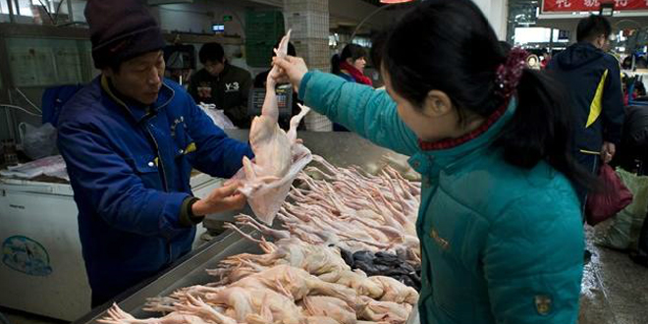
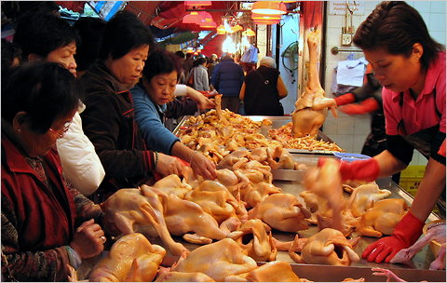
Avian Influenza Human Infection – Antigenic Mutation
Ministering to the Community in a Time of Crisis
Wet Markets in Asia are a source of concern
outrunningthehorses.com

Slide 34
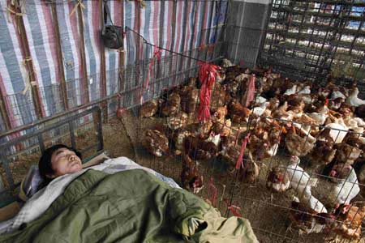
Avian Influenza Human Infection – Acquiring from Poultry
Ministering to the Community in a Time of Crisis
Backyard Poultry in Asia
Outbreaks reported in countries
Vietnam
Cambodia
China
Indonesia
Usually caused by exposure to sick birds in backyard poultry
outrunningthehorses.com

Slide 35
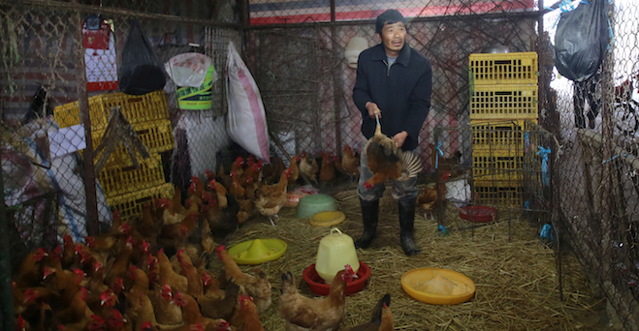
Avian Influenza Human Infection – Acquiring from Poultry
Ministering to the Community in a Time of Crisis
Backyard Poultry
Source of income for families
Part of local economy
Many do not report illness in flocks
Fear of government officials confiscating their flock for slaughter
outrunningthehorses.com

Slide 36
Avian Influenza Human Infection – Globally
Ministering to the Community in a Time of Crisis
Current Global Infections
At least 108 countries across 5 continents have reported H5N1 human infections
Since January 1, 2003, the WHO reports that as of July 1, 2025:
986 cases of human infections
473 deaths
48% case fatality rate
Global spread is significant threat to another pandemic
outrunningthehorses.com

Slide 37
Avian Influenza Human Infection – Globally
Ministering to the Community in a Time of Crisis
Current Global Infections
Since 2005 Cambodia reported 87 cases with 50 deaths (CFR 57.5%)
There have been 19 new human cases in 2025
Many involve children
Nearly all new cases have been linked to contact with sick or dead poultry
Those affected had severe or fatal infections
Part of a broader resurgence in Cambodia
outrunningthehorses.com

Slide 38
Avian Influenza North America
Ministering to the Community in a Time of Crisis
Avian Influenza – Poultry
January 2015 – HPAI H5N1 detected in Whatcom County, WA
February 2015 – Outbreak reported in British Columbia, Cananda, in a backyard flock
Virus began to mix with North American fowl
Spread to all 50 states
outrunningthehorses.com

Slide 39
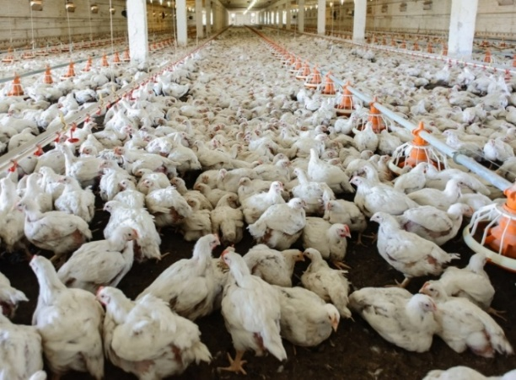
Avian Influenza North America
Ministering to the Community in a Time of Crisis
Avian Influenza – Poultry
Continues to impact commercial poultry farms
Has led to 300 million poultry and millions of wild birds being culled
Significantly impacted egg prices in poultry industry
outrunningthehorses.com

Slide 40
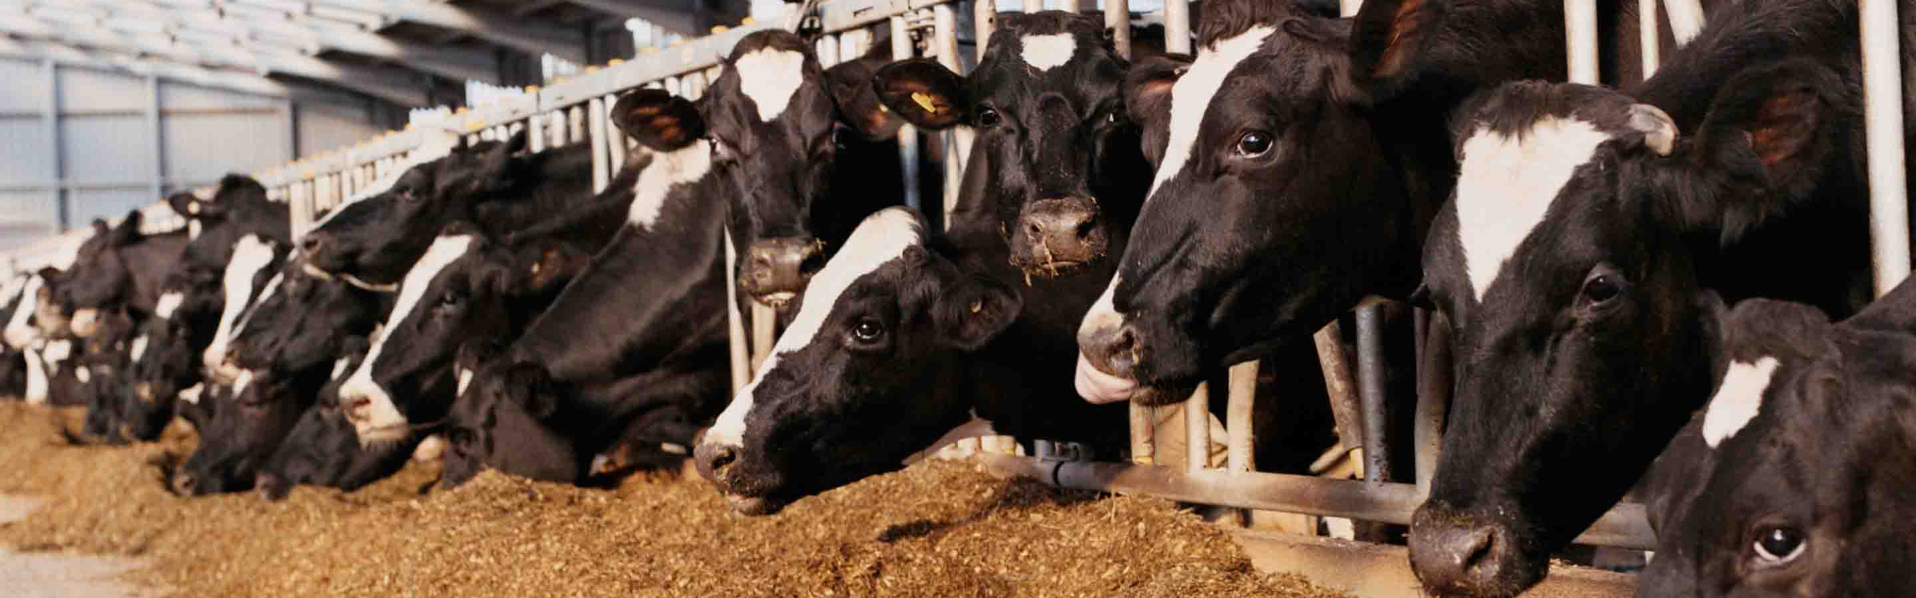
Avian Influenza North America
Ministering to the Community in a Time of Crisis
It has caused a multistate outbreak in dairy cows and other animals in the United States
outrunningthehorses.com

Slide 41
Avian Influenza North America
Ministering to the Community in a Time of Crisis
Dairy Cows
People can contract H5N1 from dairy cows through exposure to:
Infected animal products
Infected environments
Raw mild from infected cows
Ingested
Splashes into eyes, nose, or mouth
Direct contact with infected cows or contaminated surfaces
outrunningthehorses.com

Slide 42
Avian Influenza North America
Ministering to the Community in a Time of Crisis
Human Infection
There have been 71 confirmed human cases in the United States since April 2024 with two deaths
41 cases from exposure to infected dairy cows
24 cases from exposure to infected poultry
3 cases from other animal exposure
3 cases from an unknown source
outrunningthehorses.com

Slide 43
Avian Influenza North America
Ministering to the Community in a Time of Crisis
Human Infection
There have been two deaths in the United States from H5N1
January 6, 2025, the first person in Louisiana
November 21, 2025, the second person died in Washington State
Both were older with underlying conditions
Both suspected to have been exposed by backyard flocks
outrunningthehorses.com

Slide 44
Avian Influenza Current Research
Scientists are concerned that viruses could evolve to:
Recognize human cell receptors in the upper airways
Acquire the ability to infect people
Become human-to-human transmissible
outrunningthehorses.com

Slide 45
Avian Influenza Current Research
Dr. Jeffery Taubenberger
In 1997 the 1918 Influenza virus was obtained from the lung tissue from a corpse buried beneath the permafrost in Alaska
The tissue samples were sent to Dr. Jeffery Taubenberger (Armed Forces Institute of Pathology)
Ten years spent reconstructing the virus and sequencing the genome
Determine how the virus penetrates and infects the human cell
outrunningthehorses.com

Slide 46
Avian Influenza Current Research
Dr. Taubenberger discovered:
1918 virus had a close resemblance to H5N1
Both have human and bird origins
1918 virus adapted to humans without acquiring genes from existing human flu viruses
Several of the same mutations that differentiated 1918 virus from other avian viruses are found in the current H5N1 virus
outrunningthehorses.com

Slide 47
Avian Influenza Current Research
Dr. Taubenberger discovered:
Three of eight genes closely resemble each other
Differences are only a small number of amino acids
Proof that the 1918 virus was not human adapted but was entirely avian-like virus
Only ten amino acid changes in genes that distinguish the 1918 virus from current avian viruses
A number of the same changes have been found in the current H5N1 virus
outrunningthehorses.com

Slide 48

Avian Influenza Current Research
“1918 virus is the most bird-like of all mammalian flu viruses.”
Jeffrey Taubenberger Armed Forces Institute of Pathology
outrunningthehorses.com

Slide 49

Avian Influenza Current Research
2011 - Dr. Ron Fouchier, Erasmus Medical Center, Rotterdam, Netherlands
Genetically modified the H5N1 virus to become airborne between ferrets
Ferrets have similar pulmonary receptors to humans
outrunningthehorses.com

Slide 50
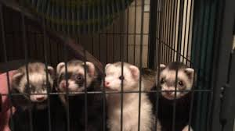
Avian Influenza Current Research
Dr. Ron Fouchier
Results were H5N1 viruses could acquire the ability to spread between mammals without mixing with other viruses or intermediate hosts such as pigs
Thus posed a risk of launching a pandemic
outrunningthehorses.com

Slide 51
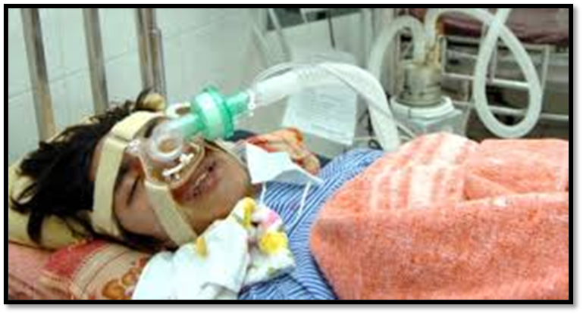
Avian Influenza Current Research
People who have died from the H5N1 today have died in a similar manner to those during the 1918 pandemic
The study of the 1918 influenza has given great insight into the pathogenesis as well as the societal effects this current virus will have if it ever becomes a pandemic
outrunningthehorses.com

Slide 52
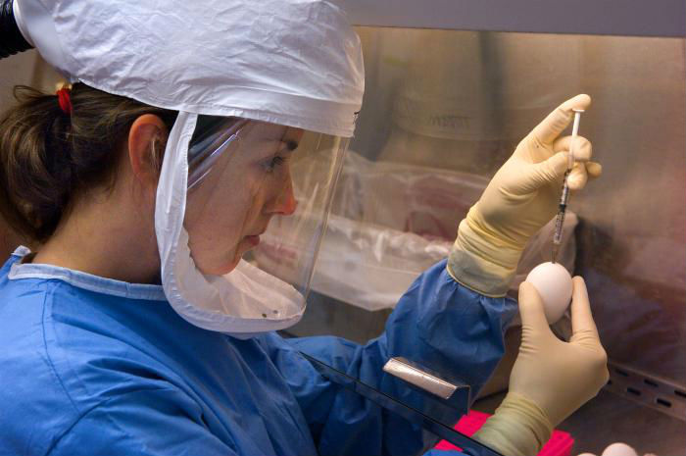
Avian Influenza Current Research
Ministering to the Community in a Time of Crisis
Genetic Sequencing
Researchers tested the binding capability of an H5N1 virus isolated from the first U.S. human death January 2025 in Louisianna. They found:
It only requires one mutation for the hemagglutinin protein to attach easier to human receptors
outrunningthehorses.com

Slide 53
Avian Influenza Current Research
Ministering to the Community in a Time of Crisis
Genetic Sequencing
These changes took place in the patient during infection, and were not found in the backyard flock or the wild
Does not necessarily mean we are on the verge of a pandemic
Additional mutations required to become human-to-human transmissible
outrunningthehorses.com

Slide 54
Avian Influenza Infections in Other Animals
Ministering to the Community in a Time of Crisis
Infections in Other Animals
Expanded range of hosts for H5N1 raises concerns
Introduces complexity if it were to cause a pandemic
The virus infects both humans and other animals
This would pose a significant challenge for mitigation and efforts to control the spread
outrunningthehorses.com

Slide 55
Avian Influenza Infections in Other Animals
Ministering to the Community in a Time of Crisis
Dr. Ed Hutchinson, professor of molecular and cellular virology at the University of Glasgow says:
“It’s now a global problem, as a disease of wild animals,
it’s completely out of control.
In a sense, the question about reassortment is not,
‘When is it going to happen?’,
but ‘Why isn’t it happening all the time?”
outrunningthehorses.com

Slide 56

outrunningthehorses.com

Slide 57
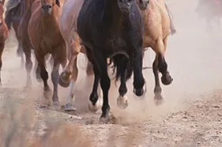
“If you have run with footmen, and they have tired you out,
then how can you compete with horses?
If you fall down in a land of peace,
how will you do in the thicket by the Jordan?”
Jeremiah 12:5
outrunningthehorses.com

Slide 58
For more presentations like this
or for more information
please visit
outrunningthehorses.com
outrunningthehorses.com

