Slide 1
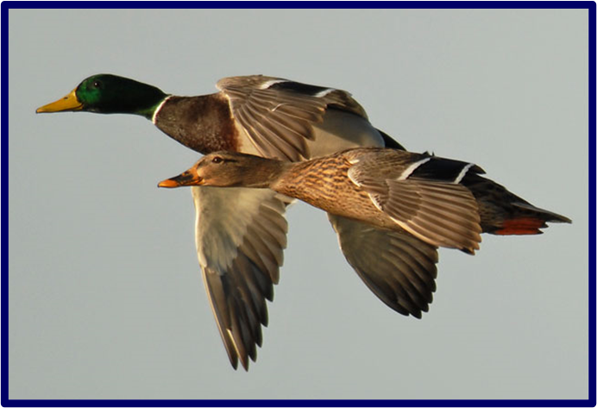
Pandemic Plan for the Church
Ministering to the Community in a Time of Crisis
Avian Influenza
Outrunningthehorses.com

Slide 2
Objectives
The following topics will be discussed
  Categories of Avian Influenza
  Aquatic birds
  Qinghai Lake, China
  Migratory birds
    Migration routes
  Where is H5N1 today
    Predicting outbreaks
  Human infection

Slide 3
Objectives continued
  Human infection continued
    Antigenic Drift
    Antigenic Shift
    Globally
  HPAI H5N1
  LPAI H7N9
  Avian Influenza in the United States
  Targeting the chickens
outrunningthehorses.com

Slide 4
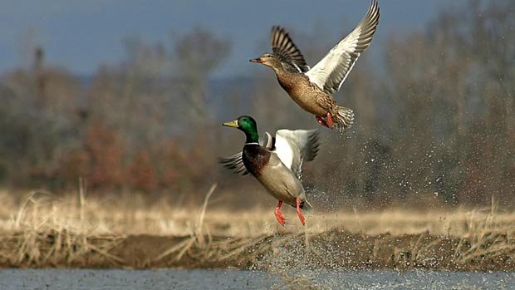
Avian Influenza
World health officials have been watching bird viruses for over two decades
Today extreme concern has been raised
outrunningthehorses.com

Slide 5
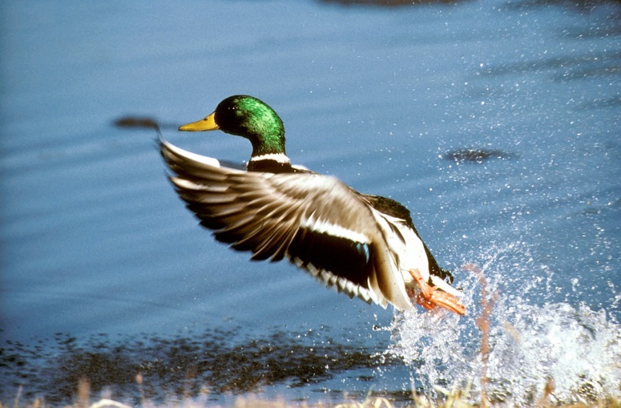
Avian Influenza
Over 75 countries are reporting outbreaks of Highly Pathogenic Influenza (HPAI) viruses
The infections caused have reached “unprecedented” levels
outrunningthehorses.com

Slide 6
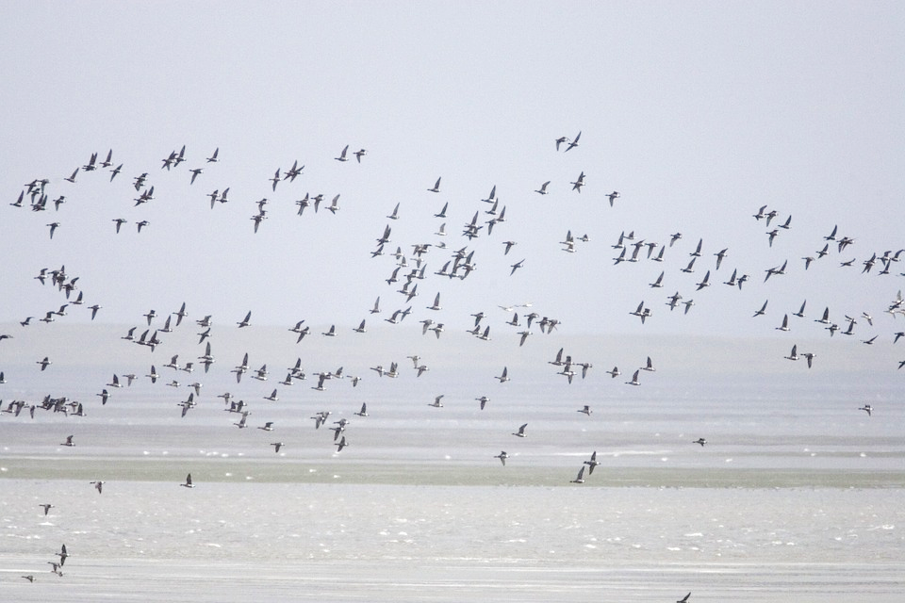
Avian Influenza
In February 2017
  Experts say we are facing the largest pandemic threat in 100 years

Slide 7
Avian Influenza
Avian Influenza also know as:
  Bird Flu
  Avian Flu
Refers to Influenza A viruses that occur naturally among birds

Slide 8
Avian Influenza
Classified into two categories
  Low Pathogenic Avian Influenza (LPAI)
    Mild or no illness
  Highly Pathogenic Avian Influenza (HPAI)
    Causes severe disease
    Mortality up to 50 -100%

Slide 9
Avian Influenza
HPAI and LPAI designations do not refer to severity in humans
  Refer to the severity of illness caused in birds
  Both have caused severe illness in humans

Slide 10
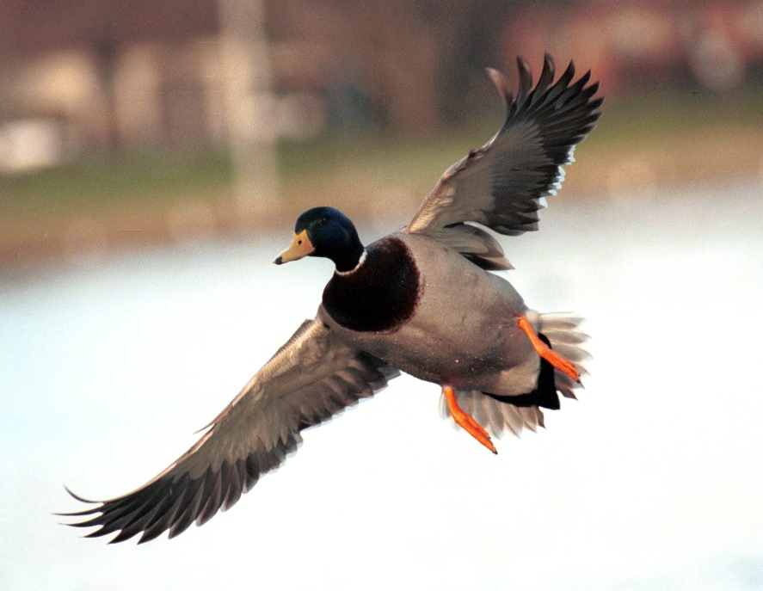
Avian Influenza
Migratory waterfowl
  Natural reservoir of avian influenza viruses
  The most resistant to infection

Slide 11
Avian Influenza
Causes asymptomatic or mild infection in birds
The wild bird population is not usually not affected

Slide 12
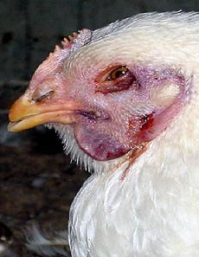
Avian Influenza
Domestic poultry very susceptible

Slide 13
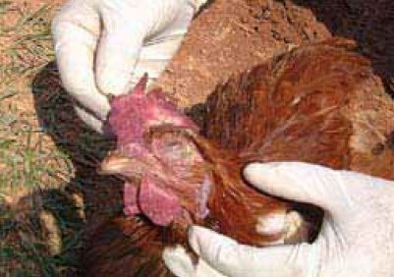
Avian Influenza
Epidemics can be rapidly fatal
  Chickens
  Turkeys

Slide 14
Avian Influenza
Resides in the intestines, present in:
  Droppings
  Respiratory droplets
  Secretions
  Blood
Highly contagious among the birds

Slide 15
Avian Influenza
Genetic differences determine
  If a virus can only infect birds
  If virus can infect birds and people
Currently subtypes H5N1 and H7N9 have caused serious infections in people
  Not yet transmissible from human-to-human

Slide 16
Avian Influenza
Qinghai Lake, China
Qinghai Lake, China – Epicenter
  China’s largest inland expanse of salt water
  Known for high diversity of migratory birds
  Every summer more than 150,000 birds
  Outbreaks reported since 2005

Slide 17
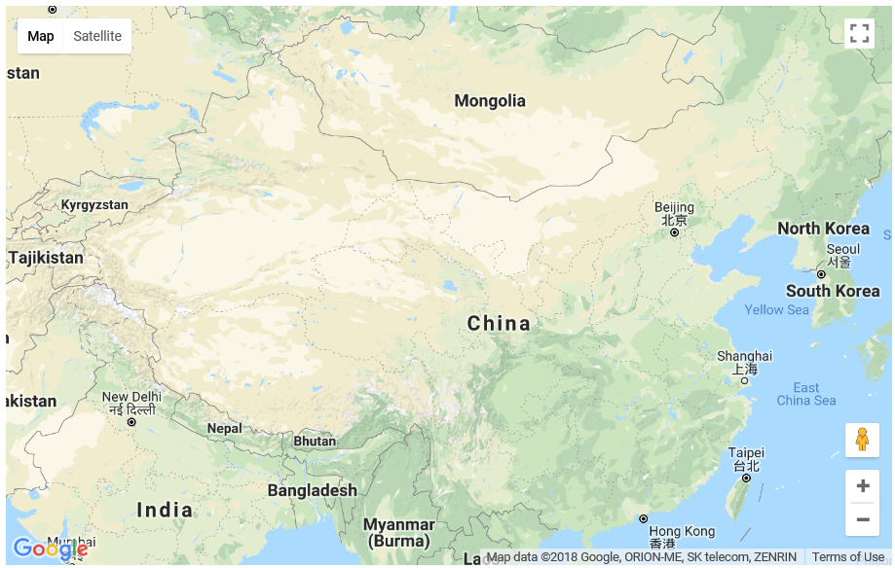

Slide 18
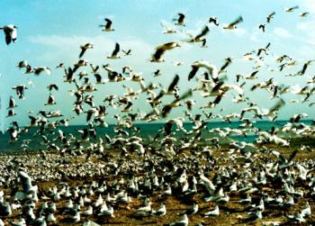
Migratory Birds
Qinghai Lake, China
High diversity of migratory birds
Every summer more than 150,000 birds

Slide 19
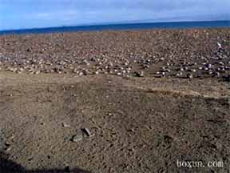
Avian Influenza
Qinghai Lake, China
    2005 unprecedented outbreak HPAI H5N1
    Killed thousands of birds

Slide 20
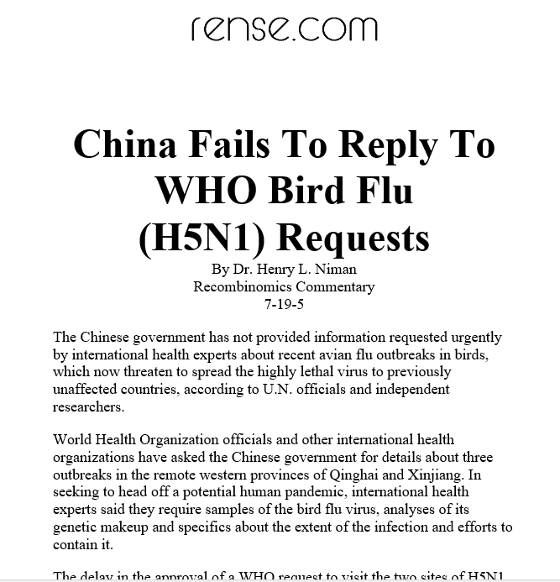
Avian Influenza
Qinghai Lake, China
Chinese deny H5N1 outbreak

Slide 21
Avian Influenza
Qinghai Lake, China
Chinese prohibit news
  “May 27, 2005 – Bird Island blockade, the picture provided by insiders for safety reasons can not provide information on the person, you can understand the serious harm through the pictures of avian flu, almost the entire Bird Island birds of hell, we will try to collect … photographic evidence to refute the government's absurd remarks.”

Slide 22
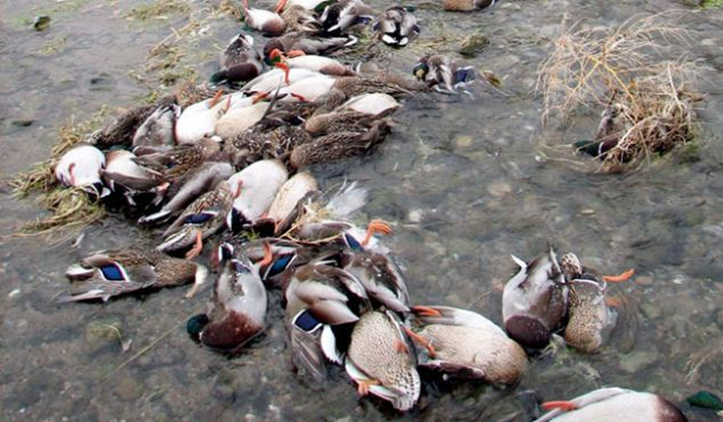
Avian Influenza
Qinghai Lake, China
    Birds densely congregate in confined, shallow water
    Water contains contaminated fecal material

Slide 23
Avian Influenza
Qinghai Lake, China
The Joint Influenza Research Centre - Published Study July 2005
  Showed strain of H5N1 virus in the Qinghai birds came from poultry farms in southern China
  Punishment was swift:
    The center closed
    Ministry of agriculture said it lacked biological safety standards

Slide 24
Avian Influenza
Qinghai Lake, China
Chinese authorities clamp down heavily on scientists whose research differs from their own
  Originally stated the disease spread from outside China’s borders
  Government has issued regulations restricting research into H5N1 to three government laboratories

Slide 25
Avian Influenza
Qinghai Lake, China
Chinese authorities clamp down heavily on scientists whose research differs from their own
  Information that is released is closely guarded
  Those who witness outbreaks are not allowed to speak to outside authorities

Slide 26
Avian Influenza
Qinghai Lake, China
Knowing routes of birds
  Prediction of Outbreaks
  Developing a database of migration patterns
  Satellite tracking of birds in Qinghai Lake revealed a migratory connection between epidemic sites

Slide 27
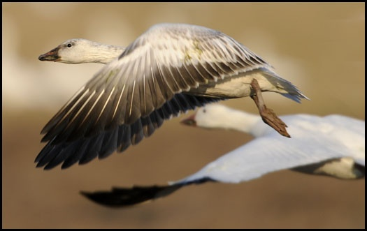
Avian Influenza – Migratory Birds

Slide 28
Avian Influenza and
Migratory Birds
Migratory foul travel between northern breeding areas and southern non-breeding areas
Birds can cover up to hundreds of miles per day
  Can cross the borders of two or more countries

Slide 29
Avian Influenza
Migratory Birds
Spread of Influenza follows migration routes
India
Russia
Asia
Europe
Africa
Hong Kong
Southeast Asia
Canada
United States

Slide 30
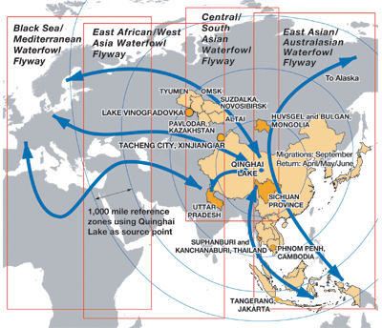
Avian Flu Virus
Where is it Today?
Prediction of Outbreaks
  Knowing the routes birds take
  Developing a database of migration patterns

Slide 31
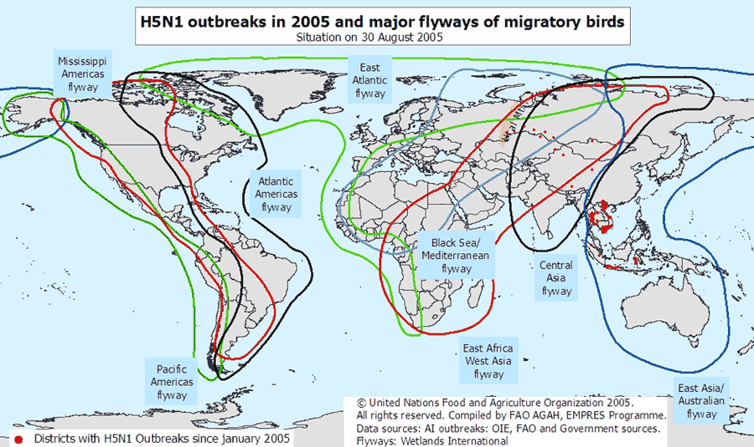
Notes:
a map of the world flyways. This includes the Western Hemisphere and is an example of what officials might use to help forecast when the Avian flu may come to the United States. Notice the East Atlantic Flyway shown in the green.

Slide 32
Avian Flu Virus
Where is it Today?
Prediction of Outbreaks
  Knowing the routes birds take
  Developing a database of migration patterns

Slide 33
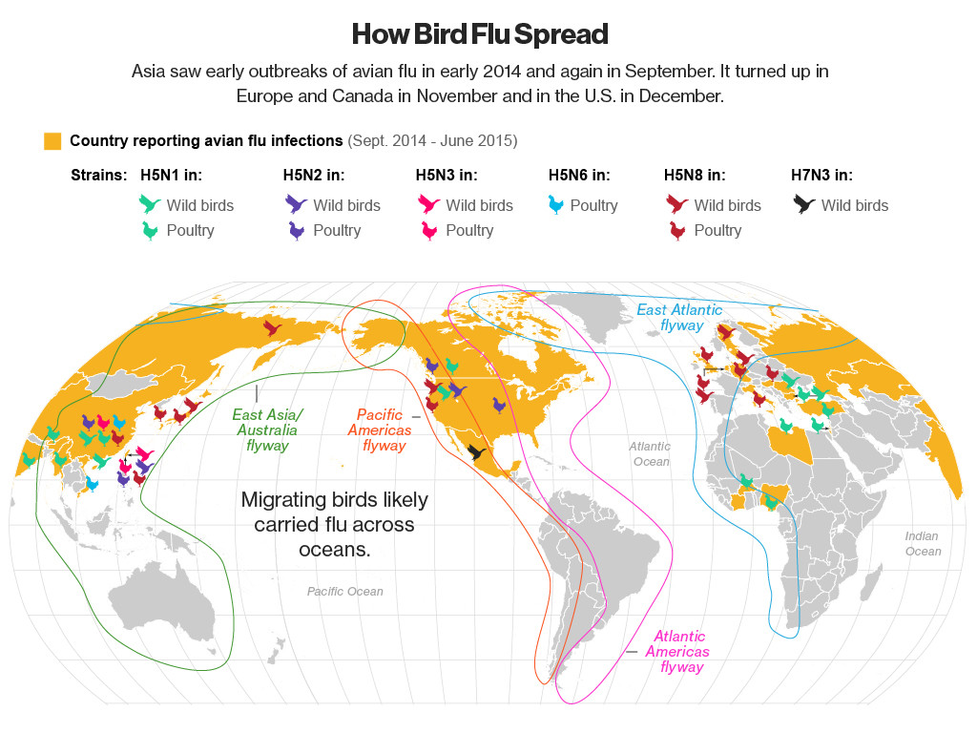
Notes:
a map of the world flyways. This includes the Western Hemisphere and is an example of what officials might use to help forecast when the Avian flu may come to the United States. Notice the East Atlantic Flyway shown in the green.

Slide 34
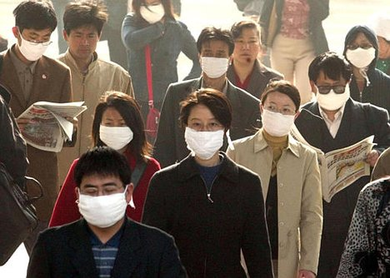
Avian Influenza – Human Infection

Slide 35
Avian Influenza – Human Infection
Avian viruses do not commonly infect humans
  H5N1 and H7N9 have crossed species barrier
  Little or no immune protection
  H5N1 more deadly than H7N9
    However more H7N9 human cases
  Both believed to be likely sources of a worldwide pandemic

Slide 36
Avian Influenza – Human Infection
Avian Influenza A viruses do not usually infect humans
Rare cases have been reported
Illness in humans range from mild to severe
  As of 7/15 - total 449 deaths due to H5N1
  As of 2/15 - total of 185 deaths due to H7N9 (difficult to get actual numbers from Chinese)

Slide 37
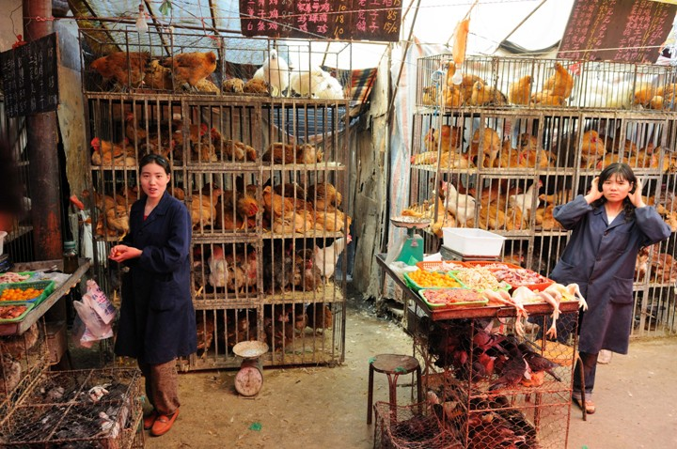
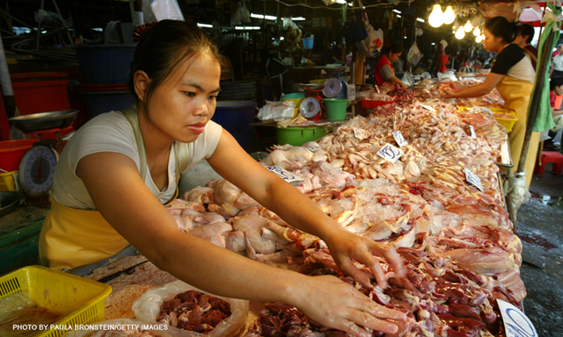
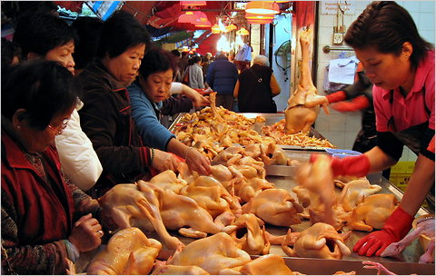
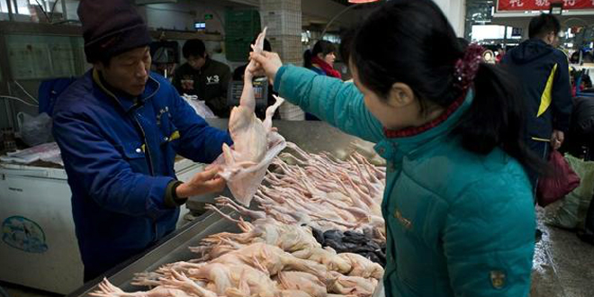
Avian Influenza – Human Infection
Wet markets in Asia are a source of concern

Slide 38
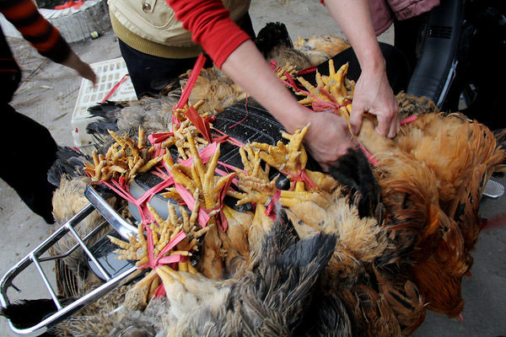
Avian Influenza – Human Infection
Acquired by close contact with infected poultry
  Touching surfaces contaminated with secretion or excretion

Slide 39
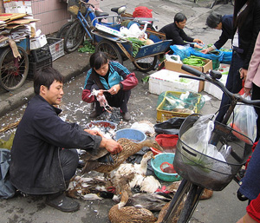
Avian Influenza – Human Infection
Acquired by close contact with infected poultry
  Handling infected birds
  Touching secretions
  Inhaling dried feces
  Inhaling crystallized secretions

Slide 40
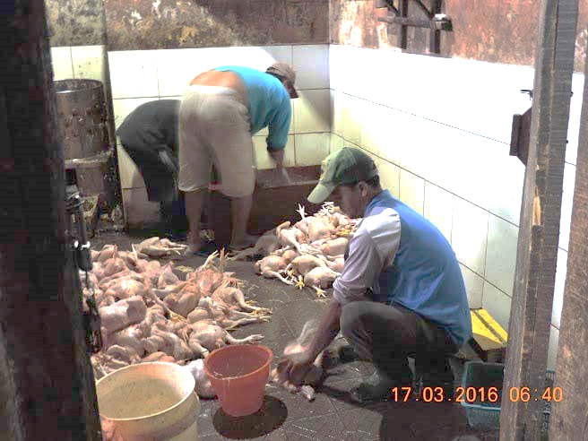
Avian Influenza – Human Infection
Infection acquired by:
  De-feathering
  Slaughtering or butchering infected bird
  Consuming birds not fully cooked

Slide 41
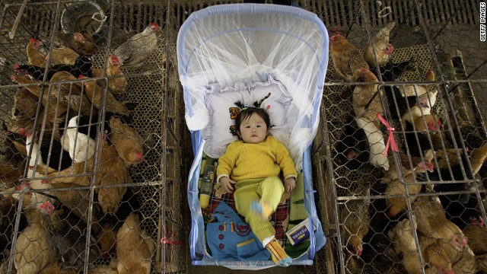
Avian Influenza – Human Infection
Due to humans living in close proximity to domestic poultry conditions are favorable for antigenic shift (mutation)

Slide 42
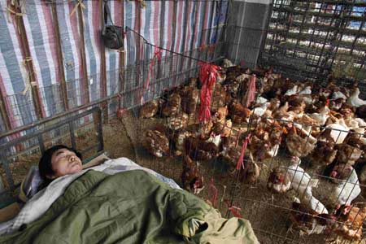
Avian Influenza – Human Infection
Due to humans living in close proximity to domestic poultry conditions are favorable for antigenic shift (mutation)

Slide 43
Avian Influenza – Human Infection
Antigenic Drift

Slide 44
Avian Influenza – Human Infection
Antigenic Drift

Slide 45
Avian Influenza – Human Infection
Antigenic Shift

Slide 46
Avian Influenza – Human Infection
Antigenic Shift

Slide 47
Avian Influenza – Human Infection
Human to Human Transmission

Slide 48
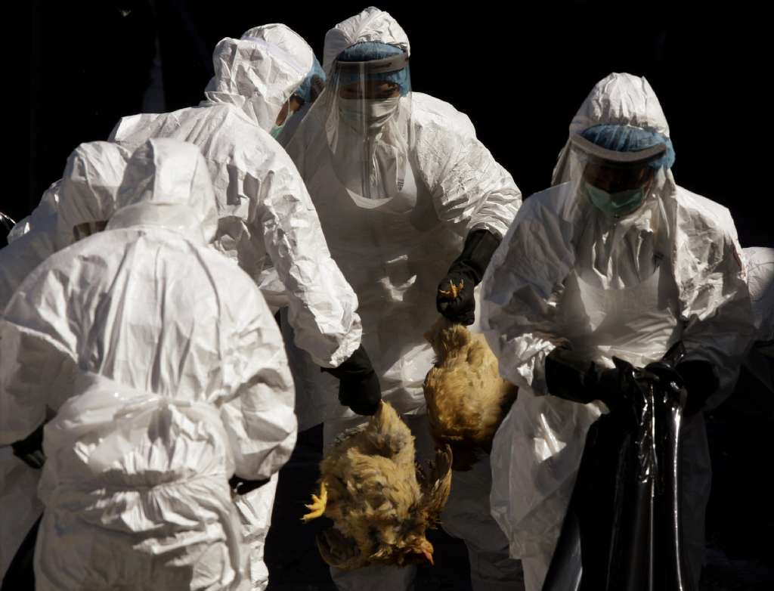
Avian Influenza – Globally

Slide 49
Avian Influenza – Globally
HPAI H5N1
  1997 – Human infections reported in Hong Kong
  Since 2003 – Spread from Asia to Europe and Africa
    Entrenched in poultry populations in some countries
    Millions of poultry infections
    Several hundred human cases and deaths

Slide 50
Avian Influenza – Globally
HPAI H5N1
  Mortality rate is about 60%
  Most cases linked to contact with infected poultry
  Currently does not transmit efficiently from person to person
  Some limited, non-sustained human-to-human transmission

Slide 51
Avian Influenza – Globally
HPAI H5N1
  Many corresponded to the seasonality of HPAI H5N1 outbreaks among poultry
  Outbreaks occur more often during cooler months
  Human cases happen any time
    Especially in countries where virus is endemic in poultry

Slide 52
Avian Influenza – Globally
LPAI H7N9
  2013 – Human infections reported in China
    Virus has spread in poultry population
    Virus is asymptomatic in birds
    1486 human infections as of May 23, 2017
    About 40% have died
    Past year almost twice amount than previous 4 years combined

Slide 53
Avian Influenza – Globally
LPAI H7N9
  Epidemics have expanded to affect larger geographic area in China
  Greatest potential to cause a pandemic of known emerging influenza A viruses
  Since October 2016 largest epidemic wave since 2013
  “Surge in numbers of human cases in China is definitely a concern”

Slide 54
Avian Influenza – Globally
LPAI H7N9
  Changes make the virus more dangerous to birds
  This can give a warning when the virus is spreading
China
  Publishing genetic sequences in public databases
  Has not shared actual sample of virus
  Not possible for U.S. labs to test or study virus
    Unable to determine it’s pathogenicity

Slide 55
Avian Influenza – Globally
Health official’s quote regarding local customs and the need to control the handling of sick poultry:
“In southern China, it's said that people will
eat everything with four legs except for the table. Whether it's a chicken, a goose or even a frog,
if its heart is still just beating
by the time you get it home, all the better.”

Slide 56
Avian Influenza – Globally
“Like most of China,
Hong Kong likes its chickens fresh.
Poultry in bamboo cages on street corners
is a common sight
and grandmothers can be regularly seen
blowing on chickens' anuses –
a common local method of checking
the bird's cloaca to gauge its age.”

Slide 57
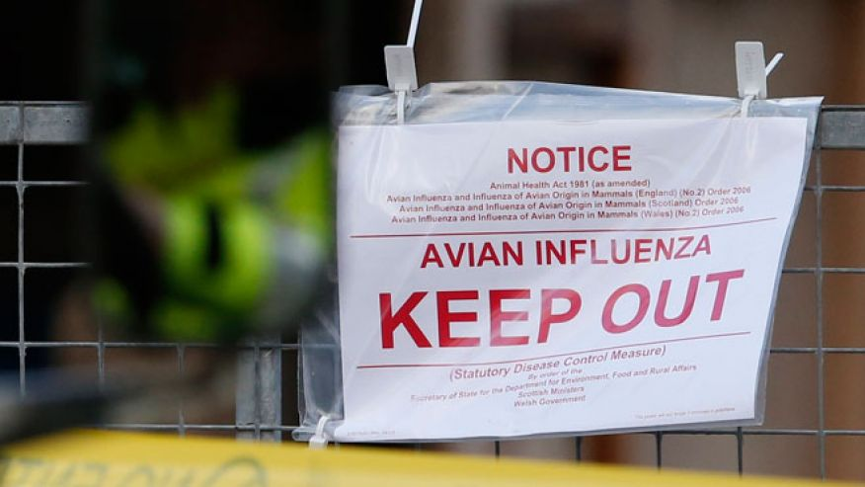
Avian Influenza – United States

Slide 58
Avian Influenza – United States
Avian Influenza in North America
  December, 2014 - British Columbia, Canada
  January, 2015 - Washington State
  Spring, 2015 – Midwest States
  June 11, 2015 – North Carolina

Slide 59
Avian Influenza – United States
Detections began December 2014
  21 states (December 2014-June 2015)
  January 2016 – Indiana
  March 2017 – Tennessee, Alabama, Kentucky, and Georgia

Slide 60
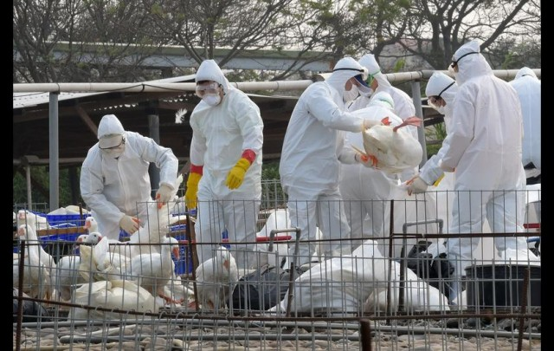
Avian Influenza – United States
Worst bird flu outbreak in U.S. history
  To date almost 50 million birds killed

Slide 61
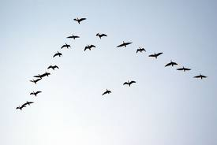
Avian Influenza – United States
Outbreaks linked to flyways
  Mississippi Flyway Migratory Pattern
    Tennessee and Georgia
  Atlantic Flyway Migratory Pattern
    North Carolina

Slide 62
Avian Influenza – United States
Outbreaks cause concerns for:
  LPAI H5 and H7 viruses to evolve to HPAI
  Rapid spread and significant illness and death among poultry
  Economic impact and trade restrictions from HPAI
  Avian influenza could be transmitted to humans

Slide 63
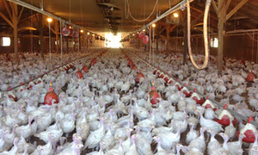
Avian Influenza – United States
When outbreaks occur
  Depopulation (culling) of infected flocks
  Surveillance of flocks that are nearby
  Quarantine of exposed flocks with culling

Slide 64
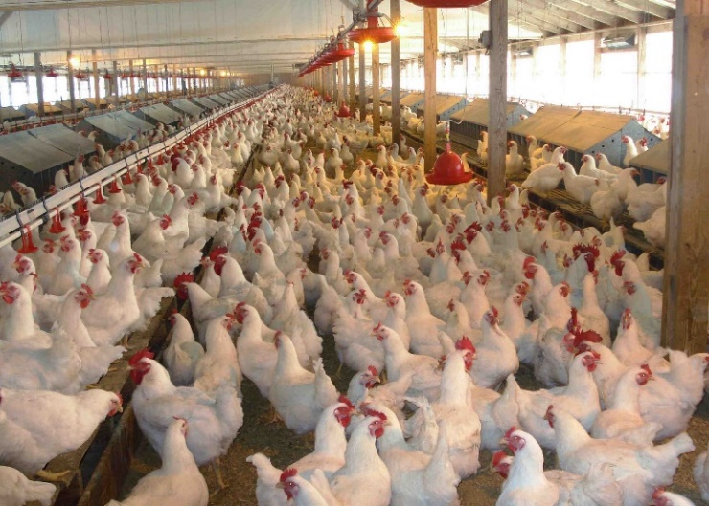
Avian Influenza – United States
As of June 2015:
  About 50 million chickens, turkeys, and other birds killed
  80% increase in egg price

Slide 65
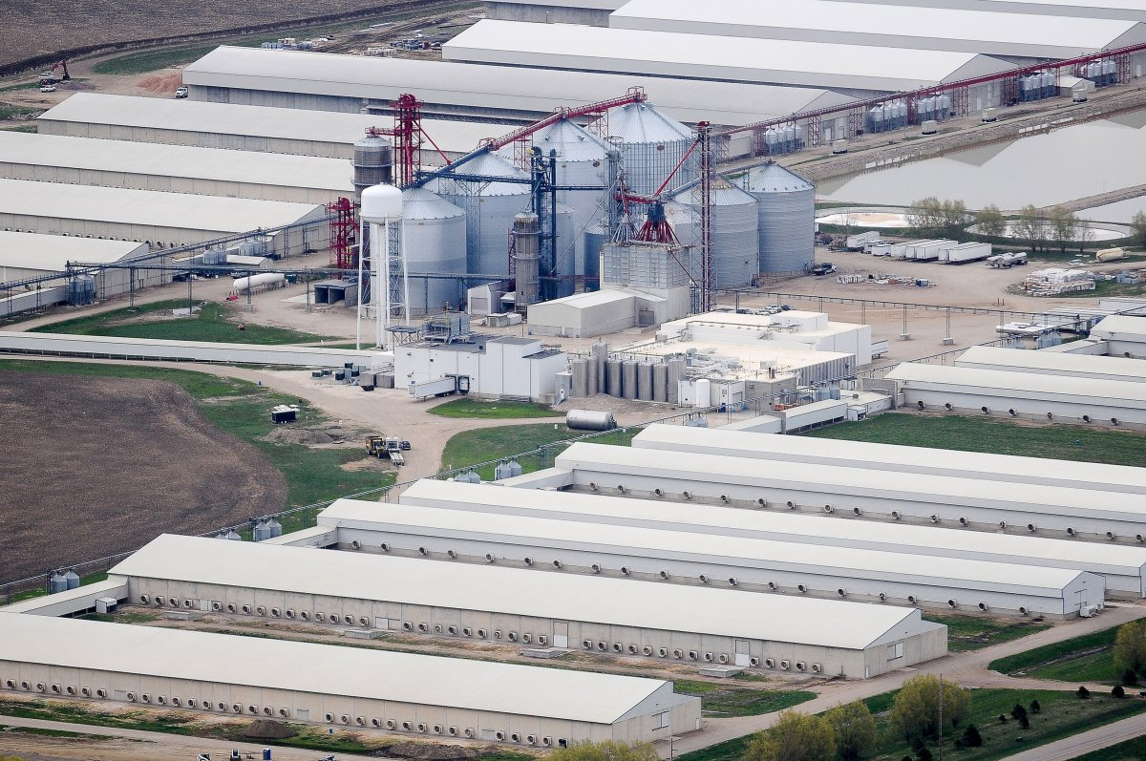
Avian Influenza – United States
Farmers still not sure how influenza entered flock
  Still not sure of transmission routes

Slide 66
Avian Influenza – United States
USDA concerned about outbreak
  Imminent migration of ducks and geese this fall
  July 22, 2015 – Chicken owners, no matter small the flock, must register according to NC Agriculture and Consumer Services
  Poultry shows shut down

Slide 67
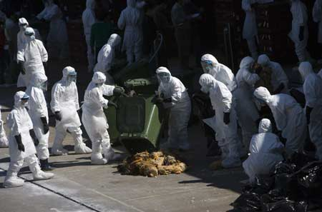
The Viruses – Targeting the Chickens

Slide 68

The Viruses – Targeting the Chickens
First outbreak of avian flu occurred in Hong Kong in 1997
  All poultry in the territory was culled
  Markets selling live poultry were regulated
  New outbreaks continued to occur

Slide 69
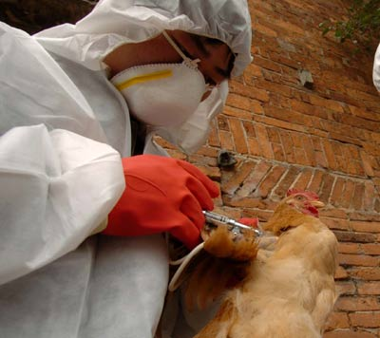
The Viruses – Targeting the Chickens
Vaccines do not completely protect birds from dying

Slide 70
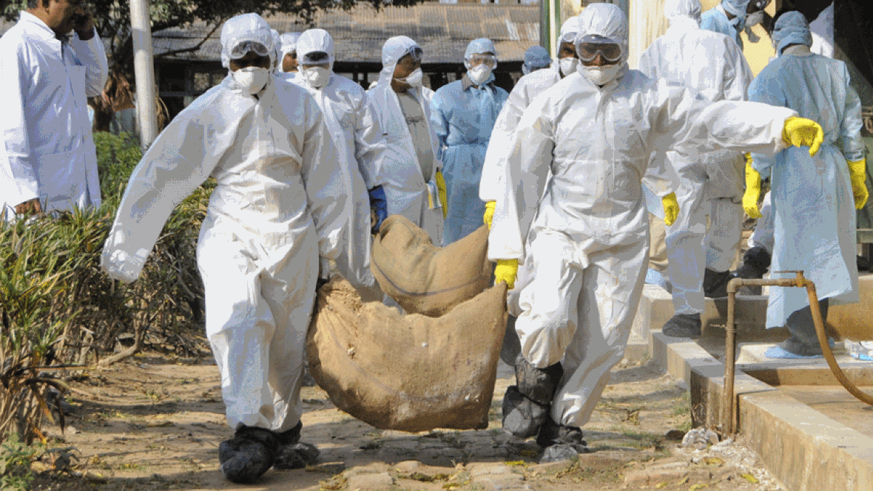
The Viruses – Targeting the Chickens
People are reluctant to report sick chickens
  Loss of livelihood
  Distrust of government
  Takeover of village

Slide 71
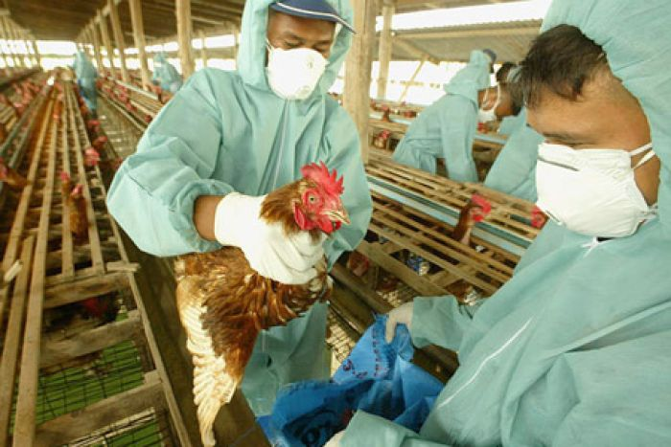
The Viruses – Targeting the Chickens
In China hundreds of millions of birds have been vaccinated, culled or killed to stop the spread of the virus
Outbreaks still occur

Slide 72
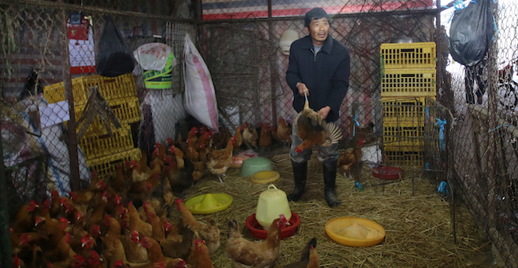
The Viruses – Targeting the Chickens
World Health Official dilemma
  Discussion of reimbursing people for loss of chickens
  Approved – but no money to do so

Slide 73

Questions?

Slide 74
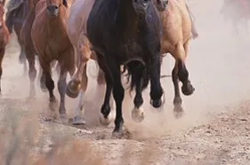
For more presentations like this
or for more information
please visit
outrunningthehorses.com
outrunningthehorses.com

