Slide 1
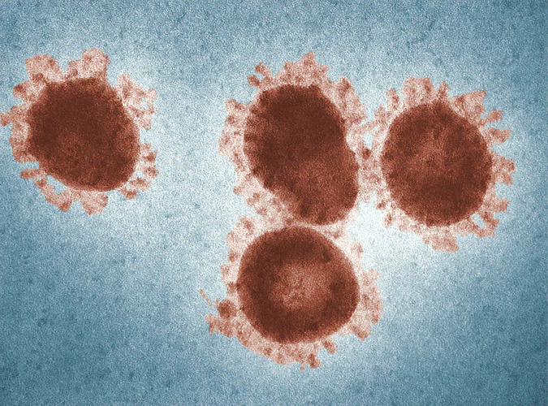
Pandemic Plan for the Church
Ministering to the Community in a Time of Crisis
The Threat of RNA Viruses
outrunningthehorses.com

Slide 2
The Threat of RNA Viruses
To first identify the structural parts of a virus and what role they play in the course of human infection will help in understanding the risk of mutations
This presentation will use the influenza virus as a model of what happens in the world of viruses
outrunningthehorses.com

Slide 3
The Threat of RNA Viruses
Objectives
The following topics will be discussed
  Influenza Viruses overview
    Protein Antigen Surface
      Hemagglutinins
      Neuraminidases
      Mutation
outrunningthehorses.com

Slide 4
The Threat of RNA Viruses
Objectives continued
  Coronaviruses overview
    Four structural proteins,
      Nucleocapsid (N)
      Membrane (M)
      Spike (S)
      Envelop (E) and several non-structural proteins
outrunningthehorses.com

Slide 5
The Threat of RNA Viruses
Viruses that carry RNA mutate much faster than a DNA virus
  Up to 1 million times faster
Influenza and Corona viruses are among those that mutate the fastest
outrunningthehorses.com

Slide 6
The Threat of RNA Viruses
Some viruses that contain RNA as their nucleotide material for replication include:
  Influenza (Seasonal, Bird Flu, H1N1, etc.)
  Coronavirus (COVID-19, SARS, MERS, etc)
  Ebola
  Nepah
  Rabies
  Polio
outrunningthehorses.com

Slide 7
The Threat of RNA Viruses
Objectives
Significance of DNA vs. RNA
  Mutation
    Antigenic Drift
    Antigenic Shift
    Genetic Reassortment
outrunningthehorses.com

Slide 8
The Threat of RNA Viruses
Influenza
Influenza – Italian (un influenza di freddo) “To be influenced by the stars”
Also known as seasonal flu
  Highly contagious
  Occurs in colder less humid months
    Fall through January or February (as late as May)
  Mainly affects the upper respiratory tract
outrunningthehorses.com

Slide 9
The Threat of RNA Viruses
Influenza
Influenza member of orthomyxoviruses
  Family of RNA viruses
  Classified by nucleoprotein antigen
  Three types that infect vertebrates
    Influenza A – humans, other mammals, birds
    Influenza B – humans, seals
    Influenza C – humans, pigs
outrunningthehorses.com

Slide 10
The Threat of RNA Viruses
Influenza
Seasonal influenza caused by Type A or B
  Most people have some immunity to circulating strains
  Severity of illness substantially less than during pandemics
  Trivalent vaccine prepared each year (two type A and one type B)
outrunningthehorses.com

Slide 11
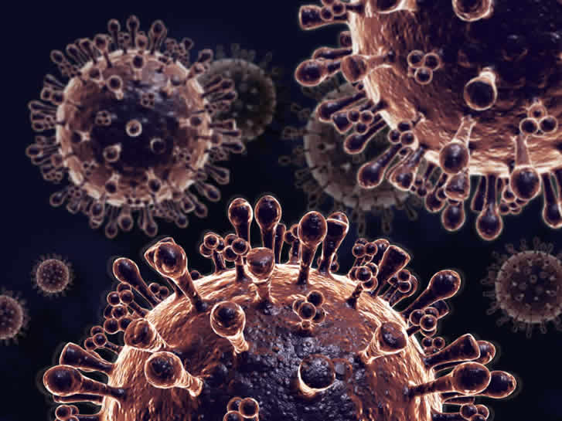
The Threat of RNA Viruses
Protein Antigen Surface
outrunningthehorses.com

Slide 12
The Threat of RNA Viruses
Protein Antigen Surface
Protein antigens on surface called Hemagglutinin (H) and Neuraminidase (N)
  Enable the virus to attach and invade host cells
  Undergo genetic variations (mutations)
  Immune system recognizes these antigens
    By this recognition people build immunity
    By mutations people become re-infected
outrunningthehorses.com

Slide 13
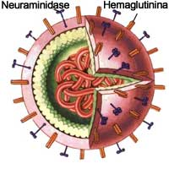
The Threat of RNA Viruses
Protein Antigen Surface
Hemagglutinin (H)
Neuraminidase
(N)
outrunningthehorses.com

Slide 14
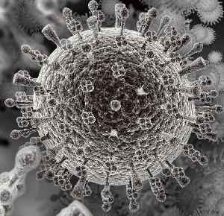
The Threat of RNA Viruses
Protein Antigen Surface
Hemagglutinin (H)
Neuraminidase
(N)
outrunningthehorses.com

Slide 15

The Threat of RNA Viruses
Protein Antigen Surface
Hemagglutinin
  Considered to be the “key”
  By the hemagglutinin’s shape the virus can attach and penetrate specific receptors on host cells
  Glycogen receptors in respiratory system especially susceptible to these proteins
outrunningthehorses.com

Slide 16

The Threat of RNA Viruses
Protein Antigen Surface
Neuraminidase
  Considered to be the “scalpel”
  Under an electron microscope, at top of each N, it appears that there are propellers similar to a helicopter
outrunningthehorses.com

Slide 17
The Threat of RNA Viruses
Protein Antigen Surface
Neuraminidase
  Blades allow Ns to destroy sialic acid in mucus enabling hemagglutinin to bind to receptor
  “Blades” prohibit sialic acid from binding to viruses when they burst from cell
  This ensures new viruses can break free to infect new host cells
outrunningthehorses.com

Slide 18
The Threat of RNA Viruses
Protein Antigen Surface
Subtypes of the Influenza A virus are categorized by these proteins (H1N1, H5N1, H7N9, etc..)
  Hemagglutinin (H)
    18 subtypes
  Neuraminidase (N)
    11 subtypes
outrunningthehorses.com

Slide 19
The Threat of RNA Viruses
Protein Antigen Surface
Type A viruses frequently mutate
Combinations of these protein subtypes lead to various strains
  (H1N1, H5N1, H7N9, H5N2, etc...)
Few people have immunity
How pandemics emerge
outrunningthehorses.com

Slide 20
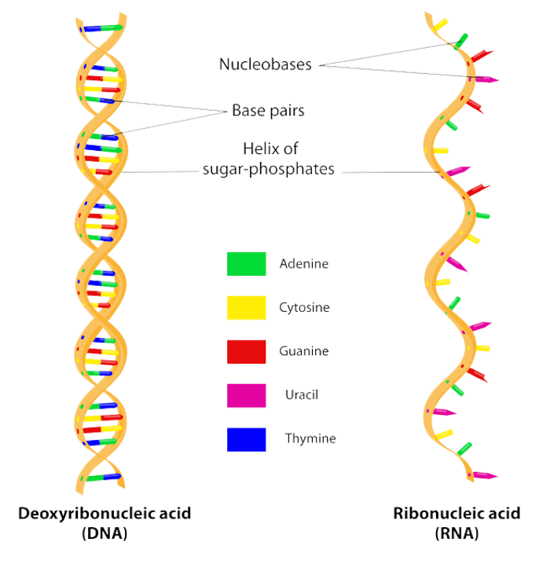
The Threat of RNA Viruses
Significance of DNA vs. RNA
outrunningthehorses.com

Slide 21
The Threat of RNA Viruses
Significance of DNA vs. RNA
Nucleic acid contains genetic material
  In most life forms it is made of Deoxyribonucleic Acid (DNA)
  Holds genetic instructions used in development and functioning of all known living organisms
  Like the blueprints for a building
Influenza viruses contain Ribonucleic Acid (RNA)
outrunningthehorses.com

Slide 22
The Threat of RNA Viruses
Significance of DNA vs. RNA
DNA (Deoxyribonucleic Acid)
  Double strand
  “Deoxy” means there are no hydroxyl groups (-OH)
  Absence of hydroxyl groups means chemical bonds are not easily broken down into water (H2O)
outrunningthehorses.com

Slide 23
The Threat of RNA Viruses
Significance of DNA vs. RNA
DNA is completely protected by the body
  The body destroys enzymes that attach to DNA
  DNA has smaller grooves where the damaging enzyme can attach which makes it harder for the enzyme to attack DNA
  Has a built-in proof-reading system when reproducing itself
outrunningthehorses.com

Slide 24
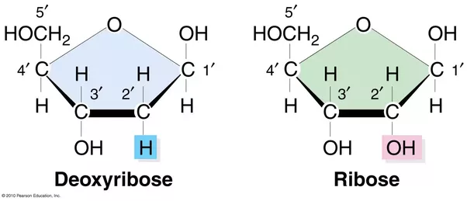
The Threat of RNA Viruses
Significance of DNA vs. RNA
Deoxyribose sugar in DNA is less reactive because of C-H bonds
Stable in alkaline conditions
outrunningthehorses.com

Slide 25
The Threat of RNA Viruses
Significance of DNA vs. RNA
RNA
  Single strand
  Contains hydroxyl groups
    Chemical bonds are easily broken into water (H2O) called hydrolysis
      More fragile
      Strands are easily broken
outrunningthehorses.com

Slide 26
The Threat of RNA Viruses
Significance of DNA vs. RNA
Ribose sugar is more reactive because of OH (hydroxyl) bonds
Not stable in alkaline conditions
Has larger grooves which makes it easier to be attacked by enzymes
outrunningthehorses.com

Slide 27
The Threat of RNA Viruses
Significance of DNA vs. RNA
RNA
  Contains no proof-reading system
    Mistakes happen called mutations
    One virus can produce many variations of itself
    RNA viruses can mutate up to 1 million times faster than DNA viruses
outrunningthehorses.com

Slide 28
The Threat of RNA Viruses
Mutation – Antigenic Drift and Shift
Hemagglutinin
Antigenic
Drift
Antigenic
Shift
Neuraminidase
outrunningthehorses.com

Slide 29
The Threat of RNA Viruses
Mutation – Antigenic Drift and Shift
Changes in a virus happen continually over time
Produces new strains not recognized by the host’s immune system
Known as Antigenic Shift or Drift
outrunningthehorses.com

Slide 30
The Threat of RNA Viruses
Mutation – Antigenic Drift and Shift
Antigenic Drift
  Small changes over time newer virus strains appear
  Antibodies against older strains no longer recognize the "newer" virus
  Reinfection can occur
    People can get the flu more than once
outrunningthehorses.com

Slide 31
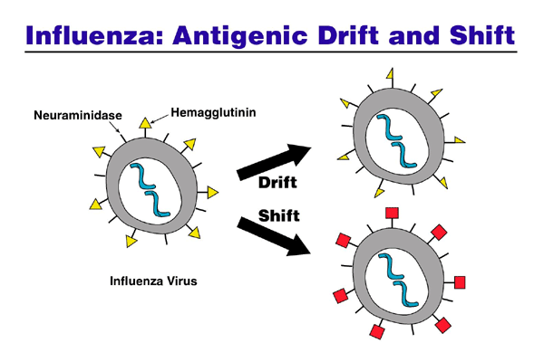
The Threat of RNA Viruses
Mutation – Antigenic Drift and Shift
outrunningthehorses.com

Slide 32
The Threat of RNA Viruses
Mutation – Antigenic Drift and Shift
Influenza vaccines are updated to keep up with circulating flu viruses
People who want to be protected need to get a flu shot every year
outrunningthehorses.com

Slide 33
The Threat of RNA Viruses
Mutation – Antigenic Drift and Shift
Antigenic Shift
  An abrupt, major change results in new H or H and N proteins
  Most people have little or no protection
  Leads to influenza epidemics/ pandemics
outrunningthehorses.com

Slide 34
The Threat of RNA Viruses
Mutation – Antigenic Drift and Shift
outrunningthehorses.com

Slide 35
The Threat of RNA Viruses
Mutation – Antigenic Drift and Shift
Antigenic Drift in Influenza viruses happens all the time
Antigenic Shift happens only occasionally
outrunningthehorses.com

Slide 36
The Threat of RNA Viruses
Mutation – Genetic Reassortment
Genetic Reassortment
  Influenza viruses from different species can swap or reassort genetic material
  Results in a new subtype different from both parent viruses
outrunningthehorses.com

Slide 37
The Threat of RNA Viruses
Mutation – Genetic Reassortment
Pigs susceptible to infection from both bird and human viruses
  Serve as a “Mixing Vessel” of genetic material
  Can result in a new viral subtype
outrunningthehorses.com

Slide 38
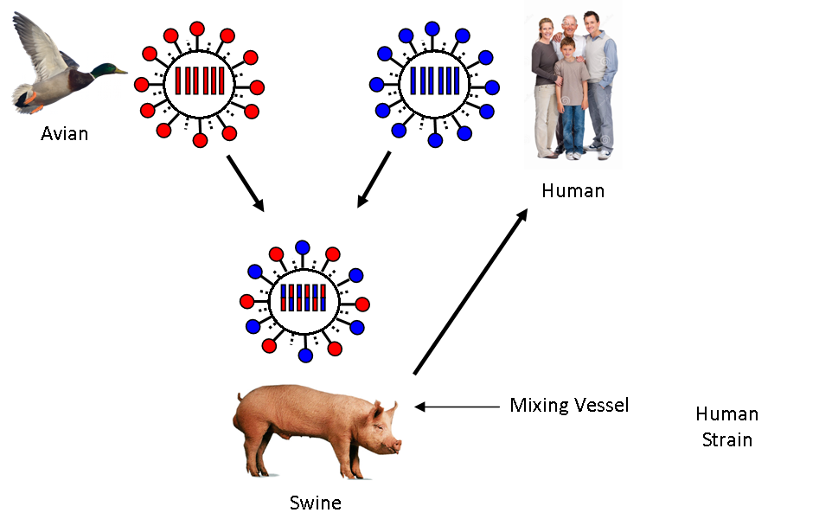
The Threat of RNA Viruses
Mutation – Genetic Reassortment
outrunningthehorses.com

Slide 39
The Threat of RNA Viruses
Mutation – Genetic Reassortment
Humans can also serve as mixing vessel
  Avian mixed with human virus can result in antigenic shift
  Result in a deadly transmissible person to person virus
outrunningthehorses.com

Slide 40

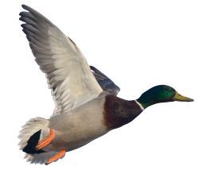
The Threat of RNA Viruses
Mutation – Genetic Reassortment
Highly Pathogenic
Avian Strain
Mixing
Vessel
New Highly Pathogenic
Human Strain
outrunningthehorses.com

Slide 41
The Threat of RNA Viruses
Conclusion
Viruses that pose the greatest threat to the world population are those that originate in animals (zoonotic) and jump to people
Viruses that carry RNA mutate up to 1 million times faster than DNA viruses
Influenza and Corona viruses are among those that mutate the fastest
outrunningthehorses.com

Slide 42
The Threat of RNA Viruses
Conclusion
Viruses that exist today (including SARS-CoV-2) such as H5N1, H7N9, MERS, Ebola, all continue to pose a threat to the world
outrunningthehorses.com

Slide 43

Questions?
outrunningthehorses.com

Slide 44
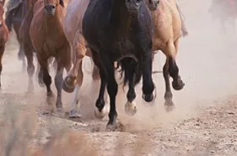
For more presentations like this
or for more information
please visit
outrunningthehorses.com
outrunningthehorses.com

