Slide 1

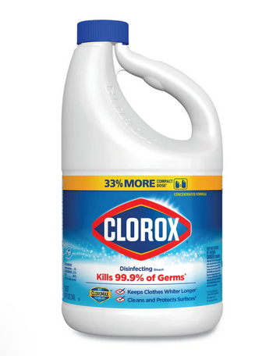
Pandemic Plan for the Church
Ministering to the Community in a Time of Crisis
Using Bleach as a Disinfectant
outrunningthehorses.com

Slide 2
Using Bleach as a Disinfectant
Introduction
Currently there are over one hundred disinfectant products registered with the EPA labeled with a claim to inactivate "avian influenza A" viruses on hard, non-porous surfaces
These solutions are available through medical supply companies, retailers supplying poultry farms and online suppliers
They are not necessarily easily obtainable to those outside of these industries
outrunningthehorses.com

Slide 3
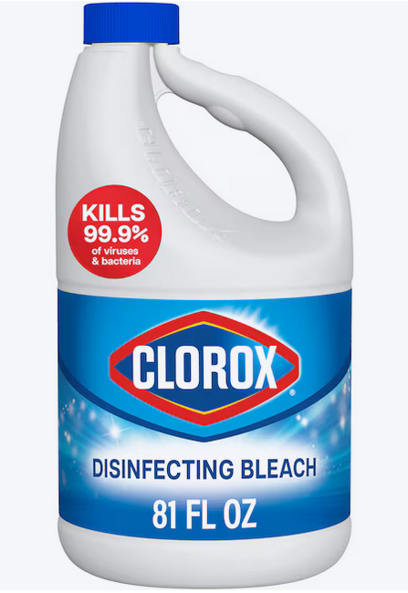
Using Bleach as a Disinfectant
Introduction
Due to the ease of availability and the ability to stockpile, we will discuss the use of bleach which is readily on hand at the local grocery
outrunningthehorses.com

Slide 4
Using Bleach as a Disinfectant
Introduction
The World Health Organization (WHO) and other public health agencies recommend using sodium hypochlorite (bleach / chlorine) to disinfect surfaces contaminated with H5N1 avian influenza
Particularly for cleaning up materials exposed to blood or body fluids
Bleach is effective at inactivating the virus on hard surfaces
outrunningthehorses.com

Slide 5
Using Bleach as a Disinfectant
Introduction
Hypochlorite solutions have been proven effective against microorganisms such as viruses, bacteria and fungi and is approved for decontamination at facilities that are a biosafety level of four (BSL-4)
A biosafety level is the level of precautions required to isolate dangerous biological agents in an enclosed facility
The levels of containment range from the lowest biosafety level one (BSL-1) to the highest at level 4 (BSL-4)
outrunningthehorses.com

Slide 6
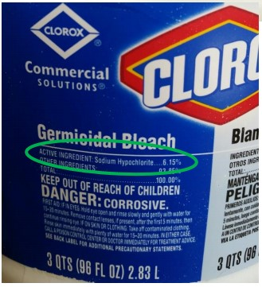
Using Bleach as a Disinfectant
Household bleach typically contains 5%-9% (often 5.25% or 8.25%) active sodium hypochlorite
Do not use a bleach product if the percentage is not in this range or is not specified
outrunningthehorses.com

Slide 7
Using Bleach as a Disinfectant Some Disadvantages to Using Bleach
Although bleach is readily available, and cheap, there are many disadvantages to using it, some include:
It has no detergent agent
It cannot penetrate soils, surfaces must first be cleaned prior to use
It is very caustic – it can burn skin and eyes
It is corrosive – it can eat away at surfaces or metal
It is poisonous if ingested
outrunningthehorses.com

Slide 8
Using Bleach as a Disinfectant Some Disadvantages to Using Bleach
Disadvantages to using bleach include:
It can create toxic fumes when mixed with other chemicals such as:
Ammonia
Hydrochloric acid (muriatic acid)
Phosphoric acid (rust remover)
Acetic acid (vinegar)
It can become carcinogenic if mixed with formaldehyde
outrunningthehorses.com

Slide 9
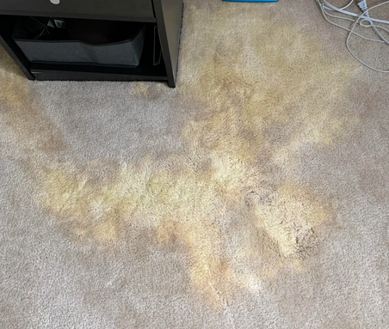
Using Bleach as a Disinfectant Some Disadvantages to Using Bleach
Disadvantages to using bleach include:
Fumes can be irritating and even toxic
Fumes can move to other areas of the building
It discolors colored items such as materials, carpets, countertops and floors
Diluted solutions cannot sit for long periods of time; they lose their effectiveness
outrunningthehorses.com

Slide 10
Using Bleach as a Disinfectant Precautions
When using bleach be sure to note:
Follow the manufacturer’s instructions for the surface application
This will ensure efficacy as well as prevent ill effects
Pay attention to concentration, temperature, and the time the product needs to remain on the surface to be effective
outrunningthehorses.com

Slide 11
Using Bleach as a Disinfectant Precautions
Precautions
Wear PPE such as gloves, mask, and eye protection
Be sure the concentration is in the 5.25% to 8.25% range for active sodium hypochlorite
Use a new bottle of bleach if possible
Bleach loses its efficacy if it sits on the shelf for a long period of time
It should smell strongly of chlorine for it to be effective
outrunningthehorses.com

Slide 12
Using Bleach as a Disinfectant Precautions
Precautions
Thick bleach solutions such as toilet bowel should not be used in dilution
Use plain bleach; do not use scented versions, as there are other additives that may affect the solution
Do not mix bleach with other chemicals as this can cause a reaction that can produce toxic fumes
outrunningthehorses.com

Slide 13
Using Bleach as a Disinfectant Precautions
Precautions
Surfaces must first be cleaned with a detergent before disinfecting with bleach
Apply solution to a surface with a moistened cloth
Allow it to remain on the surface for at least three to five minutes and even up to ten minutes
After time allowed, wipe again with another clean wet cloth
outrunningthehorses.com

Slide 14
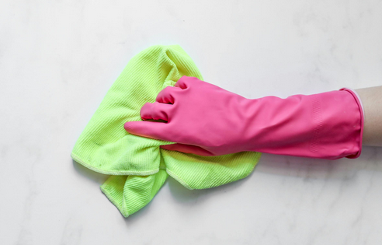
Using Bleach as a Disinfectant Precautions
Precautions
The chlorine must be wiped away from metal objects with a more dilute solution to prevent corrosion
This can be done with clean water or 70% alcohol
Set apart cloths just for this purpose
outrunningthehorses.com

Slide 15
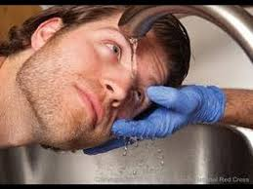
Using Bleach as a Disinfectant Precautions
If bleach gets into the eyes, immediately rinse with water for at least fifteen minutes and seek medical attention
outrunningthehorses.com

Slide 16
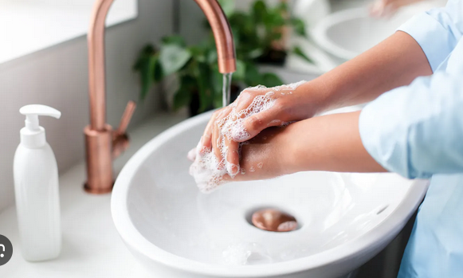
Using Bleach as a Disinfectant Precautions
Precautions
Bleach is not intended as a disinfectant for hands
The principal means for disinfecting hands is washing with soap and water, coupled with the use of a commercial hand sanitizer with alcohol
outrunningthehorses.com

Slide 17
Using Bleach as a Disinfectant Preparing Bleach Solutions
Preparing Bleach Solutions
Differing solution strengths are used for different purposes
A strong 1:10 bleach solution is used to disinfect items exposed to:
Blood
Urine or fecal material
Surfaces exposed to corpses
outrunningthehorses.com

Slide 18
Using Bleach as a Disinfectant Preparing Bleach Solutions
Differing solution strengths are used for different purposes
A weaker 1:100 bleach solution is used for:
Disinfecting surfaces
Medical equipment
Objects close to the patient
Bedding and other laundry
outrunningthehorses.com

Slide 19
Using Bleach as a Disinfectant Preparing Bleach Solutions
Diluted bleach solutions should be prepared fresh daily
Bleach solutions will not be as effective after being mixed with water for over 24 hours
Solutions should be prepared in a well-ventilated area (open windows)
Wear PPE, avoid direct contact with skin and eyes
outrunningthehorses.com

Slide 20
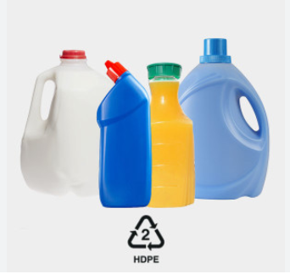
Using Bleach as a Disinfectant Preparing Bleach Solutions
Gather the necessary supplies
Use plastic containers because metal containers can corrode easily
Use a plastic grade of HDPE (high-density polyethylene) #2
High chemical resistance, able to withstand sodium hypochlorite
outrunningthehorses.com

Slide 21
Using Bleach as a Disinfectant Preparing Bleach Solutions
Gather the necessary supplies
Five-gallon buckets – example containers:
Cat liter buckets
Large dog and cat dry food buckets
Home Depot buckets
Milk containers
Chlorine bleach containing 5.25% active sodium hypochlorite
outrunningthehorses.com

Slide 22
Using Bleach as a Disinfectant Preparing Bleach Solutions
Gather the necessary supplies
One container that holds ten measures (e.g. ten cups) to make the base 1:10 bleach solution
One large or several smaller containers (One for each station) with covers or lids to hold the 1:100 bleach solutions
outrunningthehorses.com

Slide 23
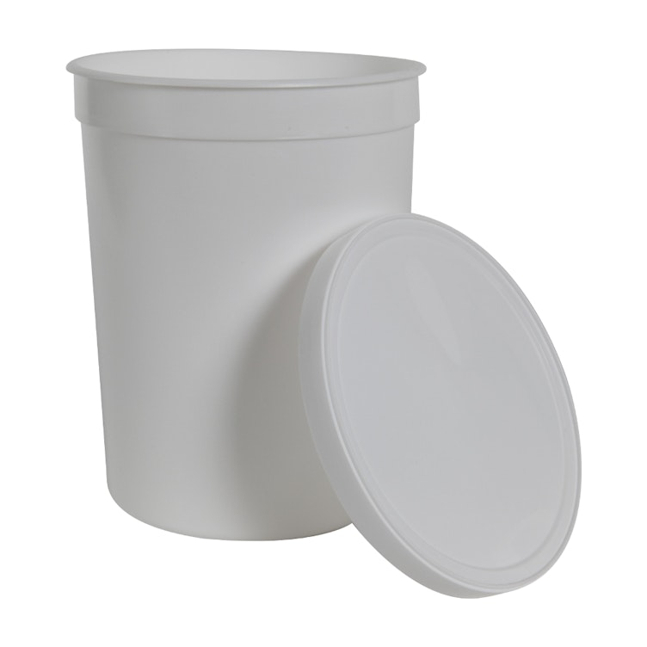
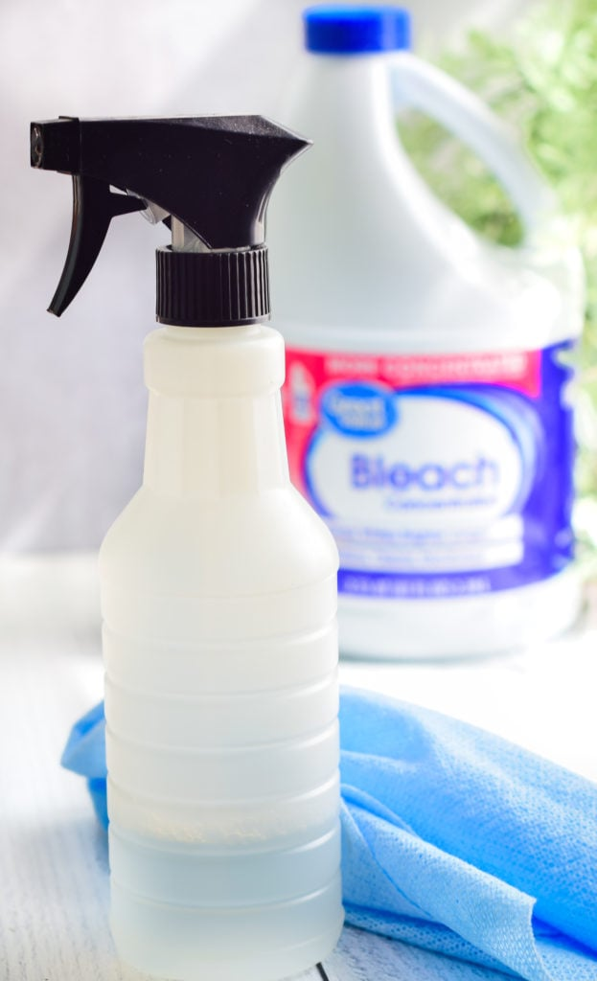
Using Bleach as a Disinfectant Preparing Bleach Solutions
Gather the necessary supplies
These containers should be labeled clearly of the different solutions
1:10 Bleach
1:100 Bleach
outrunningthehorses.com

Slide 24
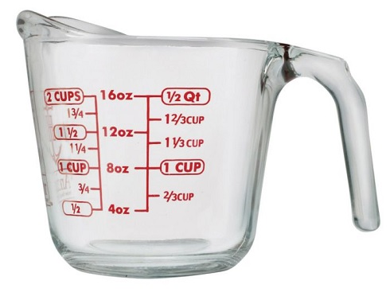
Using Bleach as a Disinfectant Preparing Bleach Solutions
Gather necessary supplies
Do not use dirty or used water because organic matter destroys chlorine
A measuring cup or other container
A bottle or jar marked with one cup, or one liter can be used
outrunningthehorses.com

Slide 25
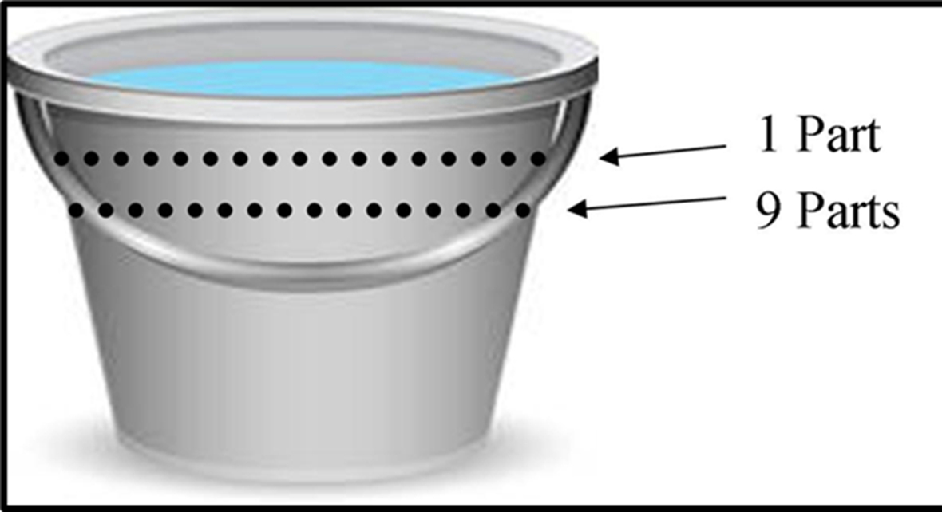
Using Bleach as a Disinfectant Preparing Bleach Solutions
To prepare 1:10 bleach solution
Pour nine measures of water into the container
Mark the outside
Use a permanent sharpie or scratch the plastic
Add one measure of bleach to the first nine parts
Mark a line at the total ten parts volume
outrunningthehorses.com

Slide 26
Using Bleach as a Disinfectant Preparing Bleach Solutions
Marking the container will shorten the process for future solutions
outrunningthehorses.com

Slide 27
Using Bleach as a Disinfectant Preparing Bleach Solutions
To prepare 1:100 bleach solution:
Measure and pour nine parts of water into another large container
Mark the container
Measure and pour one part of 1:10 bleach solution into the water to make a 1:100 bleach solution
Mark the container
outrunningthehorses.com

Slide 28
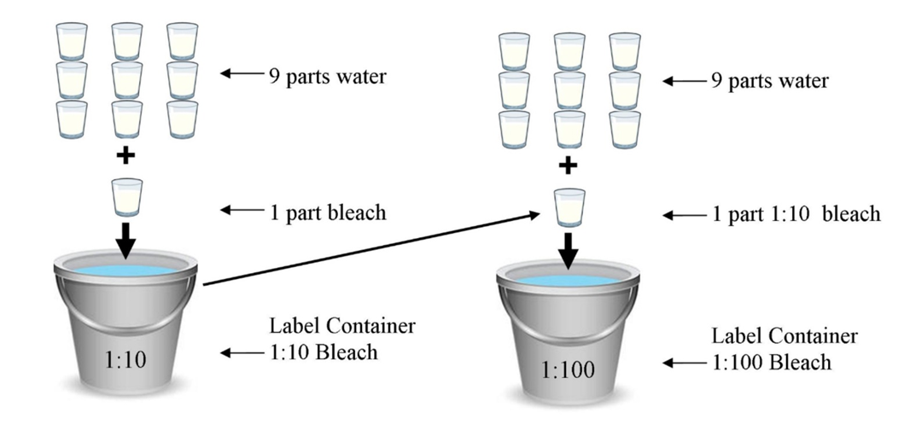
outrunningthehorses.com

Slide 29
Using Bleach as a Disinfectant Preparing Bleach Solutions
Place containers of appropriate solutions with clean cloths where they will be used
Be sure to label each container properly
Use the 1:10 bleach solution to clean after contamination with blood or body fluids
Use the 1:100 bleach solution to clean surface areas and laundry
When there is a large outbreak, make larger quantities
outrunningthehorses.com

Slide 30
Using Bleach as a Disinfectant Preparing Bleach Solutions
Remove the solutions every day or when solutions become cloudy or dirty
If you cannot smell chlorine in the bleach solution; the concentration is no longer strong enough for disinfection
Replace the solution with a fresh supply
outrunningthehorses.com

Slide 31
Using Bleach as a Disinfectant Cleaning and Disinfecting Surfaces
Always follow label instructions
If instructions are not available:
Leave the diluted bleach solution on the surface for at least 5 minutes before removing or wiping
This is known as the “contact time” for disinfection
The surface should remain visibly wet during the contact time
outrunningthehorses.com

Slide 32
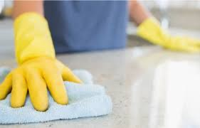
Using Bleach as a Disinfectant Cleaning and Disinfecting Surfaces
Apply bleach solution to the surface with a clean rag or sponge
Rinse the surface with warm water
Allow to air dry
outrunningthehorses.com

Slide 33
Using Bleach as a Disinfectant Cleaning and Disinfecting Surfaces
Be sure to include surfaces such as:
Doorknobs
Light switches
TV controls
Telephones
Keyboards
Dresser tops
Alarm clocks
Bathroom surfaces
Kitchen counter tops
Faucets
Floors
Any horizontal surface
outrunningthehorses.com

Slide 34
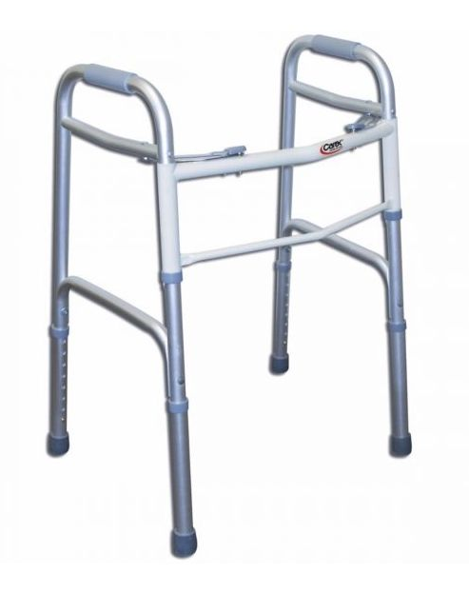
Using Bleach as a Disinfectant Cleaning and Disinfecting Surfaces
Clean items used for direct patient care:
Walker
Cane
Wheelchair
Grab bars/safety rails
Bed rails
Bedside commodes
outrunningthehorses.com

Slide 35
Using Bleach as a Disinfectant Cleaning Walls and Floors
Cleaning and Disinfecting Floors and Walls
Not generally involved in disease transmission
However, if a highly pathogenic situation or walls are visibly soiled clean as follows:
Wash the floor or wall with a detergent to remove any visible dirt
Use a sprayer or mop to wash the walls with 1:100 bleach solution
outrunningthehorses.com

Slide 36
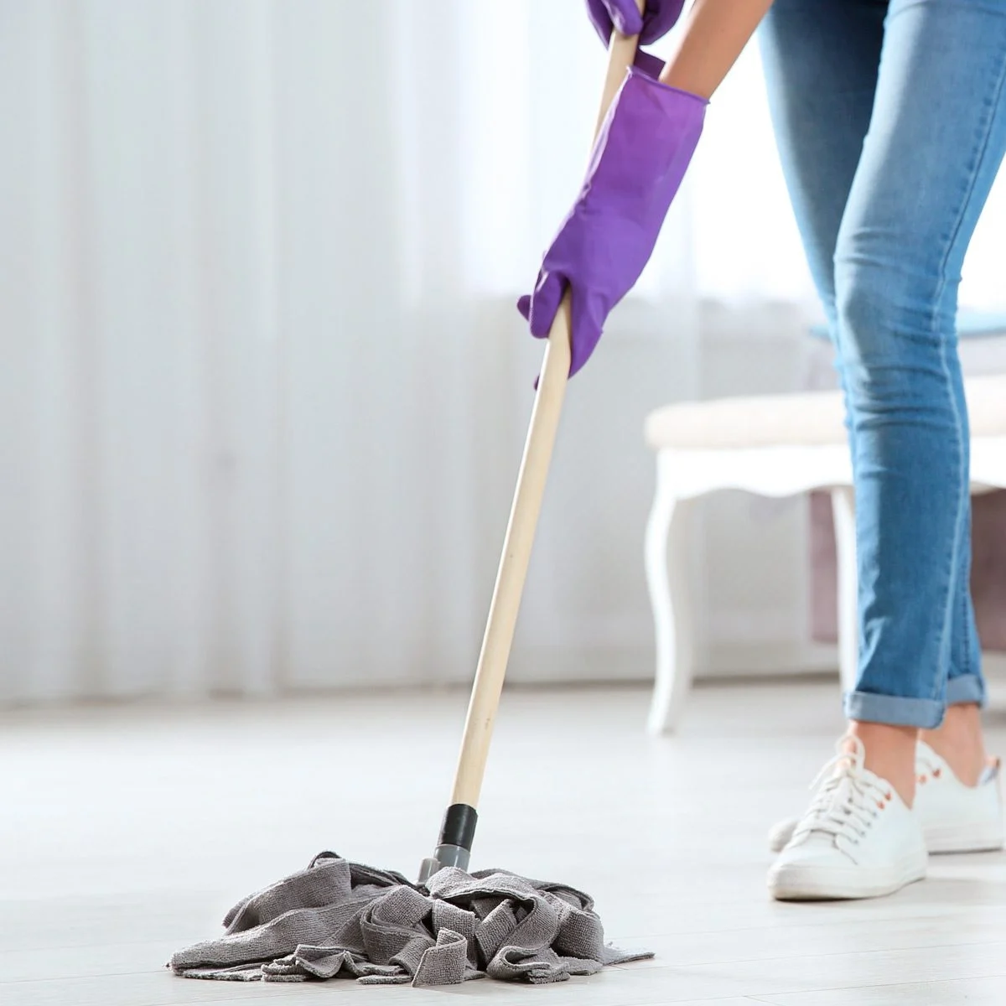
Using Bleach as a Disinfectant Cleaning Walls and Floor
Wipe the surface with a detergent to remove any visible dirt
Use a sprayer or mop to wash the walls or floor with a 1:100 bleach solution
Rinse the mop in a fresh supply of 1:100 bleach solution
If using a sprayer, apply the spray close to the surface to minimize splashing and aerosols
outrunningthehorses.com

Slide 37
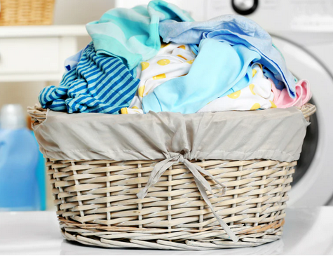
Using Bleach as a Disinfectant Laundry
Laundry
Viruses do not survive as easily on materials such as sheets, towels, and clothing
Laundry should still be handled with similar care as cleaning other items
There may be wet or dry bodily secretions or fluids, including respiratory droplets on the bedding
outrunningthehorses.com

Slide 38
Using Bleach as a Disinfectant Laundry
Use the following precautions when handling laundry:
Wear gloves and a mask when handling the laundry
Place dirty laundry into a laundry bag that is kept in the patient’s room
Keep the bag closed when taking to the laundry room
Don’t carry unpackaged soiled linens out of the sick room into a clean room
Keep soiled linen at arm’s length; don’t hold laundry close to your body, or to your face
outrunningthehorses.com

Slide 39
Using Bleach as a Disinfectant Laundry
Use the following precautions when handling laundry:
Do no shake or agitate the linens to unsettle any dried matter that has attached to the material
Place laundry of sick person directly into washer from laundry bag
Don’t place un-covered laundry in a basket for common use
outrunningthehorses.com

Slide 40
Using Bleach as a Disinfectant Laundry
Use the following precautions when handling laundry:
Set the washer and dryer controls to hot
Soak in 1:100 bleach solution for thirty minutes
Be sure all items are completely soaked
Wash items in soapy water
Items may be line dried if necessary
After handling soiled laundry, remove gloves and perform hand hygiene
outrunningthehorses.com

Slide 41
Using Bleach as a Disinfectant Conclusion
While person-to-person interaction is the primary way viruses spread, the virus can still be spread by touching contaminated surfaces
Health care professionals are still unsure how long viruses can live on surfaces
It is believed that viruses can survive on different materials anywhere between a few hours to several weeks
outrunningthehorses.com

Slide 42
Using Bleach as a Disinfectant Conclusion
Removing and killing an infectious agent on a surface effectively must be performed properly and methodically
Cleaning then disinfecting
Bleach is one of many EPA approved chemicals that are effective to kill the influenza and corona viruses
outrunningthehorses.com

Slide 43
Using Bleach as a Disinfectant Conclusion
Second to wearing PPE when caring for a patient with a pathogen causing a pandemic, is keeping all surfaces clean from the infectious agent
This is crucial to preventing the spread of the disease
outrunningthehorses.com

Slide 44

outrunningthehorses.com

Slide 45


“If you have run with footmen, and they have tired you out,
then how can you compete with horses?
If you fall down in a land of peace,
how will you do in the thicket by the Jordan?”
Jeremiah 12:5

Slide 46
For more presentations like this
or for more information
please visit
outrunningthehorses.com

