Slide 1

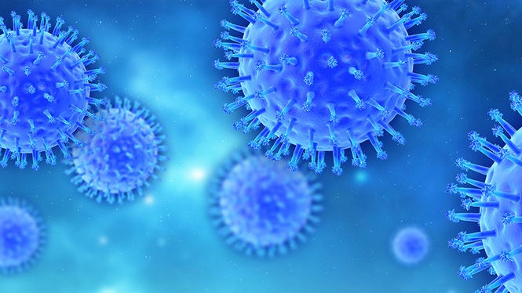
Pandemic Plan for the Church
Ministering to the Community in a Time of Crisis
Influenza Viruses
outrunningthehorses.com

Slide 2

Influenza Viruses
Ministering to the Community in a Time of Crisis
“Viruses are not plants,
animals, or bacteria,
but they are the quintessential
parasites of the living kingdoms”
Michael W. Davidson and The Florida State University
outrunningthehorses.com

Slide 3
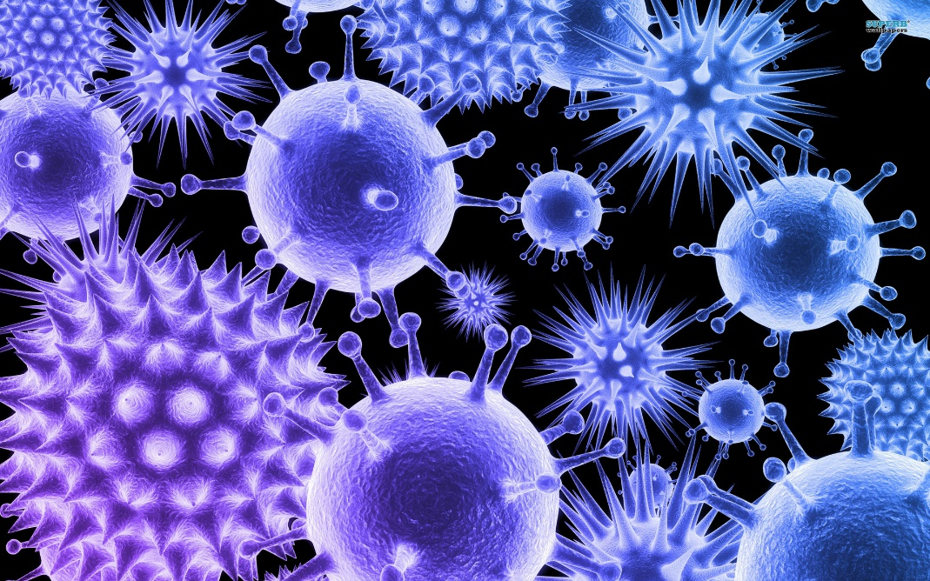
Influenza Viruses
Ministering to the Community in a Time of Crisis
Introduction
Viruses are not considered to be living organisms
Unable to metabolize energy
Unable to reproduce on their own
Acellular structure
They are unique in their ability to mutate and adapt to outmaneuver their hosts
outrunningthehorses.com

Slide 4
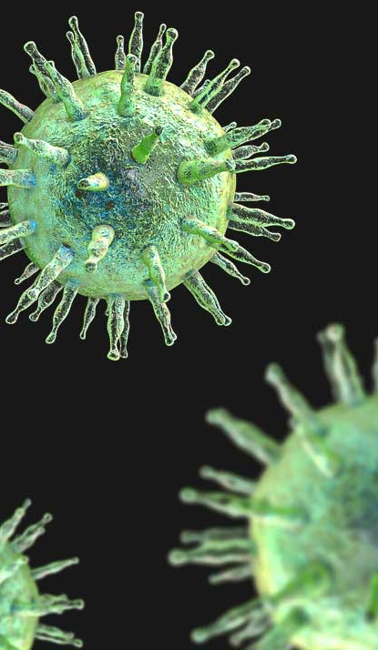
Influenza Viruses
Ministering to the Community in a Time of Crisis
Description of a virus
Very little known about them until recently
Most abundant biological entity on earth
Have had an enormous impact on humans and other organisms
All creatures of life are subject to a viral infection
outrunningthehorses.com

Slide 5
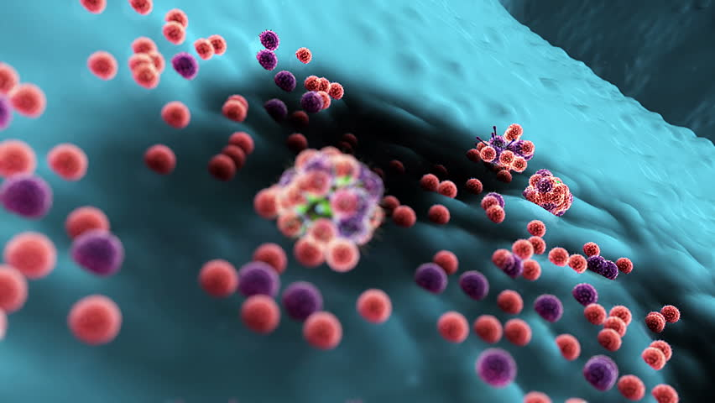
Influenza Viruses
Ministering to the Community in a Time of Crisis
Viruses are the smallest infectious agent
100 times smaller than a bacteria cell
Millions can fit inside one human cell
outrunningthehorses.com

Slide 6
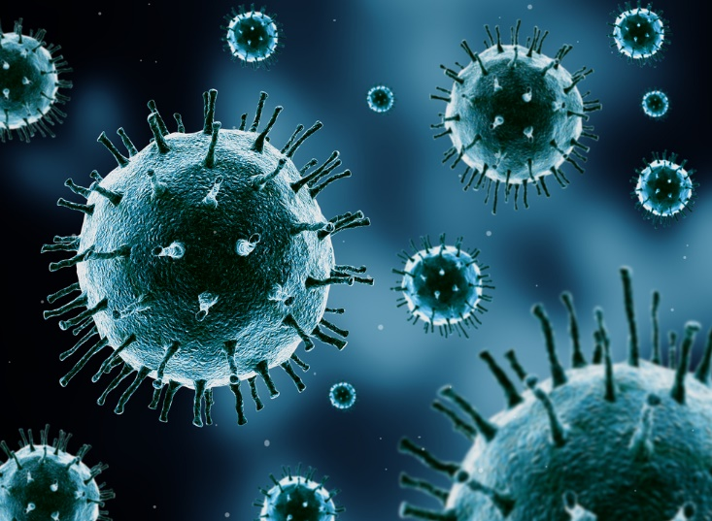
Influenza Viruses
Ministering to the Community in a Time of Crisis
Quintessential parasite
Unable to replicate on their own
Need to invade another organism to survive
Their invasion can result in mild to severe illness
outrunningthehorses.com

Slide 7
Influenza Viruses
Ministering to the Community in a Time of Crisis
There are 27 known human diseases caused by viruses. They include:
Common cold
Measles
Chicken pox
Hepatitis
Influenza
Polio
Rabies
HIV/AIDS
Ebola
COVID-19
SARS
Herpes
Mumps
Dengue
Respiratory Syncytial Virus
outrunningthehorses.com

Slide 8
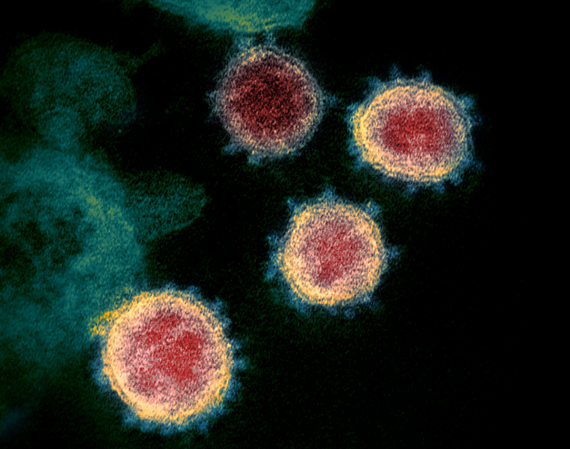
Influenza Viruses
Ministering to the Community in a Time of Crisis
Different from living organisms:
Do not have cell membranes – have protein shells
Do not have organelles
Do not eat or burn energy
Do not move around on their own
Must invade living cells to reproduce
outrunningthehorses.com

Slide 9
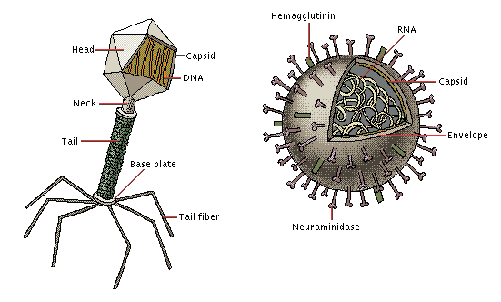
Influenza Viruses
Ministering to the Community in a Time of Crisis
Eighteen classifications grouped by similar characteristics
Nucleic acid
Capsid symmetry
Presence or absence of an envelope
Hosts they infect
Diseases caused
outrunningthehorses.com

Slide 10
Influenza Viruses
Ministering to the Community in a Time of Crisis
Influenza virus
Member of Orthomyxoviridae family.
RNA viruses
Classified as A, B, or C
Influenza A is the most virulent (severe) of the three
Causes the most serious illness
Can cause deadly outbreaks and pandemics
outrunningthehorses.com

Slide 11
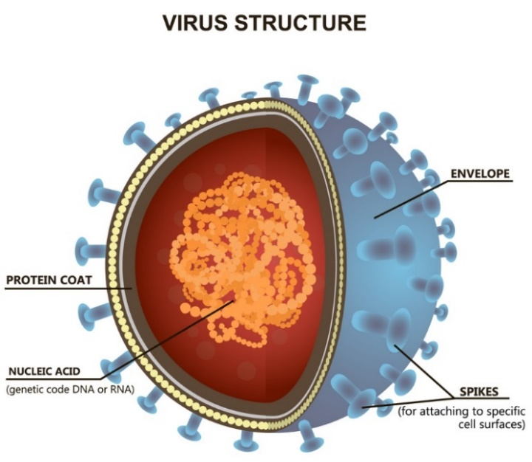
Structure of an Influenza Virus
Ministering to the Community in a Time of Crisis
A virion (virus particle) has three main parts:
Nucleic acid –core containing DNA or RNA
Protein Coat (capsid) – Covering and protection of nucleic acid
Lipid membrane (envelope) – covers the capsid
outrunningthehorses.com

Slide 12
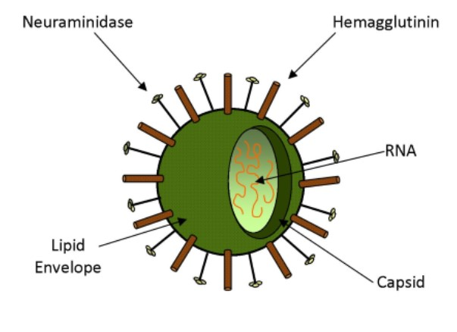
Structure of an Influenza Virus
Ministering to the Community in a Time of Crisis
Surface Proteins
Coming from the capsid
Also known as Antigens
Hemagglutinin (H or HA)
Neuraminidase (N or NA)
Enable the virus to mutate
outrunningthehorses.com

Slide 13
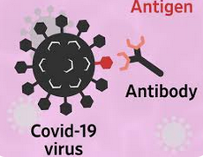
Structure of an Influenza Virus
Ministering to the Community in a Time of Crisis
Antigens
Proteins on the surface
Enables virus to attach to specific receptors on host cells
Immune system recognizes viruses by their antigens
outrunningthehorses.com

Slide 14
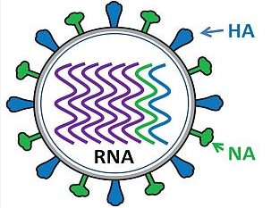
Structure of an Influenza Virus
Ministering to the Community in a Time of Crisis
Antigens
To date eighteen hemagglutinin subtypes (H1-H18)
To date eleven neuraminidase subtypes (N1-N11)
Many of the viruses are species specific
Some have crossed to infect other animal groups
outrunningthehorses.com

Slide 15
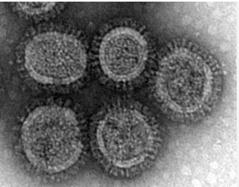
Structure of an Influenza Virus
Ministering to the Community in a Time of Crisis
Antigens
The H5N1 subtype has been able to cross over to the most species of animals including:
Birds
humans
Cattle
Swine
Cats
Dogs
Sheep
Goats
Alpacas
Seals
Ferrets
Minks
Mice
Foxes
Tigers
Leopards
Polar bears
Dolphin
Among others
outrunningthehorses.com

Slide 16
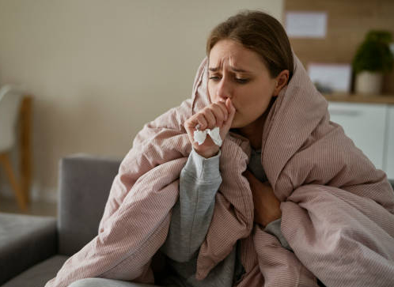
Influenza (Flu)
Ministering to the Community in a Time of Crisis
Influenza (Flu)
A highly contagious viral disease
Occurs in epidemics during the colder, less humid months of the year
Infection can easily spread in airborne droplets from coughs and sneezes.
outrunningthehorses.com

Slide 17

Influenza (Flu)
Ministering to the Community in a Time of Crisis
Symptoms are mainly
Fever
Cough
sore throat
Fatigue
body aches
Some may also experience
Nausea/Vomiting
Diarrhea
Complications can lead to pneumonia and dehydration
outrunningthehorses.com

Slide 18
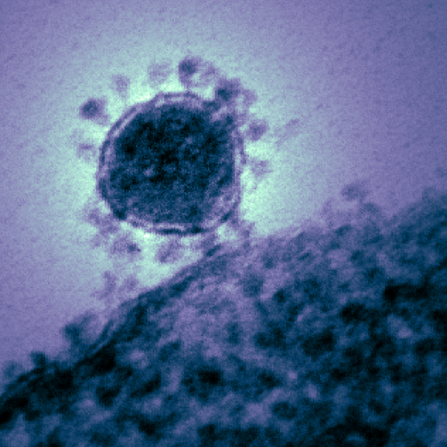
Influenza (Flu)
Ministering to the Community in a Time of Crisis
Infections
Mainly in respiratory tract
Respiratory tract receptors are the type which influenza viruses target and bond
outrunningthehorses.com

Slide 19
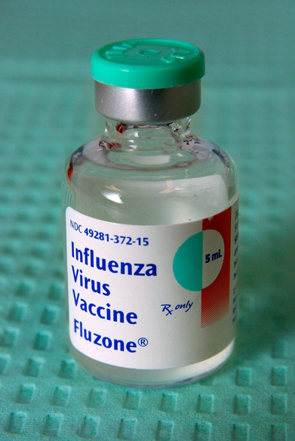
Influenza (Flu)
Ministering to the Community in a Time of Crisis
Infections
Most have immunity to circulating strains
Severity much less than during pandemics
Due to mutations, a trivalent vaccine is prepared in advance in anticipation of seasonal strain
outrunningthehorses.com

Slide 20
Pathogenesis of Viral Diseases
Ministering to the Community in a Time of Crisis
Pathogenesis
Pathogenesis is the process in which a disease develops
Understanding the lifecycle of a virus will shed light on the onset, progression, and maintenance of the clinical illness presenting in person
outrunningthehorses.com

Slide 21
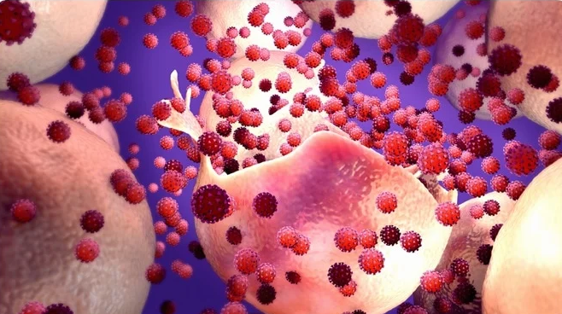
Pathogenesis of Viral Diseases
Ministering to the Community in a Time of Crisis
Viruses are unable to reproduce on their own
They must use the mechanisms of a host cell to replicate
Sole objective is to enter a host cell
Replicate
Breakout
Find another host cell to invade
outrunningthehorses.com

Slide 22
Pathogenesis of Viral Diseases
Ministering to the Community in a Time of Crisis
Once virus is in the host, it must gain entrance into cells
Some viruses replicate at point of entry
Respiratory
Gastrointestinal
Some viruses spread to distant sites then replicate
Enterovirus
Ebola
outrunningthehorses.com

Slide 23
Pathogenesis of Viral Diseases
Ministering to the Community in a Time of Crisis
Step One of Infectious Process – Entrance and attachment into susceptible host
May be accomplished by:
Skin
Nasal and Oral mucosa
Gastrointestinal System
Urogenital System
Conjunctiva of the Eye
Needle stick
Blood transfusions
Organ transplant
Insect vectors
outrunningthehorses.com

Slide 24
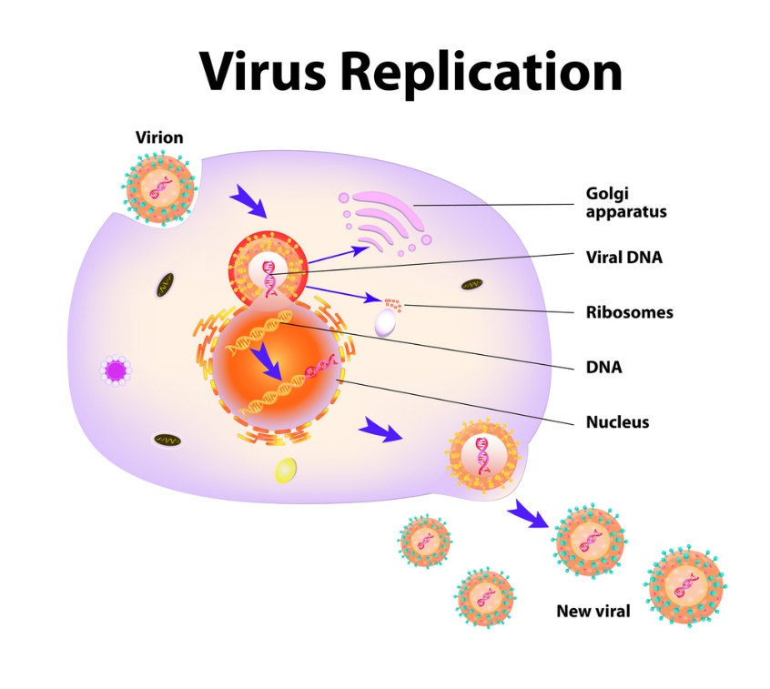
Pathogenesis of Viral Diseases
Ministering to the Community in a Time of Crisis
Lifecycle of a Virus
Step One – Adsorption
Step Two –Entry
Step Three – Replication
Step Four - Release
outrunningthehorses.com

Slide 25
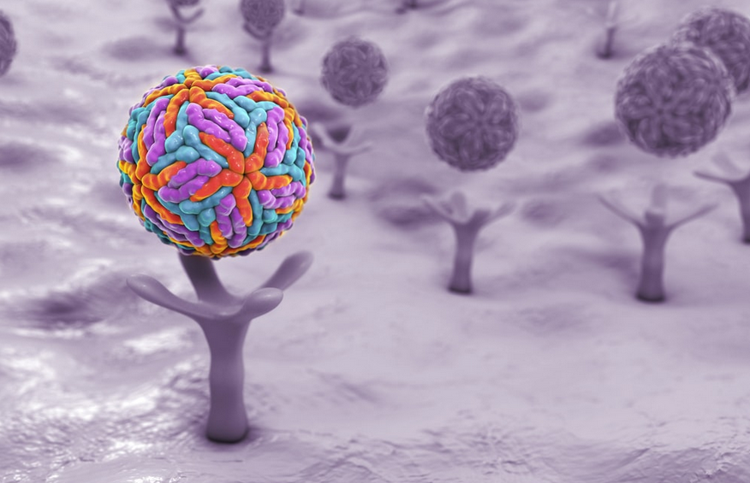
Pathogenesis of Viral Diseases
Ministering to the Community in a Time of Crisis
Lifecycle of a Virus
Step One – Adsorption
Virus must now gain entrance into the host’s cells
Not just taken into cells
Must first attach to a receptor on the surface
outrunningthehorses.com

Slide 26
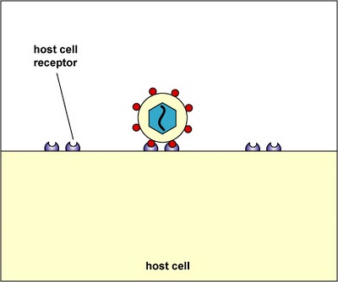
Pathogenesis of Viral Diseases
Ministering to the Community in a Time of Crisis
Lifecycle of a Virus
Step One – Adsorption (Attaching to Receptors)
Each virus has its own specific receptor
outrunningthehorses.com

Slide 27
Pathogenesis of Viral Diseases
Ministering to the Community in a Time of Crisis
Virus Receptors
A complementary structure on the surface of the host cell
Binds and attaches itself
Cold/Flu viruses target respiratory receptors
Enteroviruses target gastrointestinal tract
HIV targets T-cells
Polio viruses target central nervous system
Ebola – lymph tissue, endothelial cells
outrunningthehorses.com

Slide 28
Pathogenesis of Viral Diseases
Ministering to the Community in a Time of Crisis
Adsorption and Receptors
Receptor can be by:
Cell
Tissue
Organ
Specificity called “tropism”
Reflects the presence of specific cell surface receptors
Virus
Human Cell Surface
Cell Receptor
outrunningthehorses.com

Slide 29
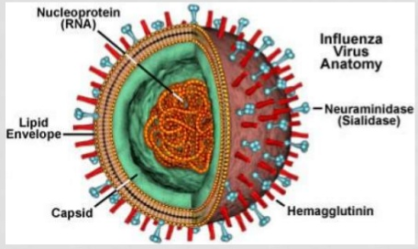
Pathogenesis of Viral Diseases
Ministering to the Community in a Time of Crisis
Adsorption and Receptors
Protein Antigens on Surface
Hemagglutinin (H)
Neuraminidase (N)
Each play a role in virus’ ability to infect host
outrunningthehorses.com

Slide 30

Pathogenesis of Viral Diseases
Ministering to the Community in a Time of Crisis
Adsorption and Receptors
Virus Receptors
Hemagglutinin (H)
Main antigen on virus surface
Considered the “key”
Binds to receptors then penetrates host cell
outrunningthehorses.com

Slide 31
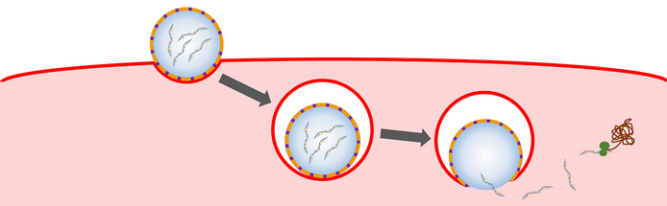
Pathogenesis of Viral Diseases
Ministering to the Community in a Time of Crisis
Lifecycle of a Virus
Step Two – Entry
Once binding is completed and virus has entered cell
RNA is injected into the host cell
outrunningthehorses.com

Slide 32
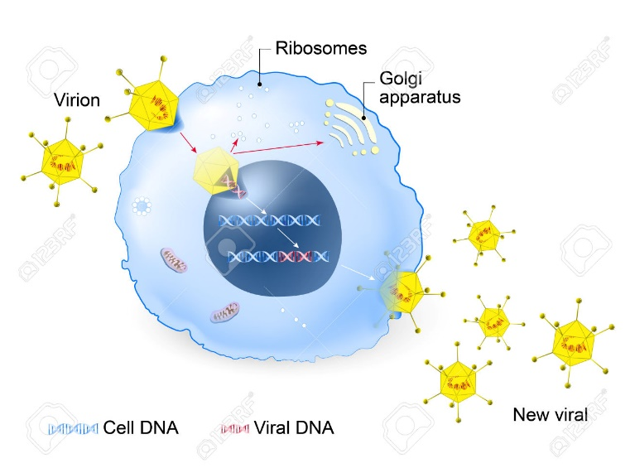
Pathogenesis of Viral Diseases
Ministering to the Community in a Time of Crisis
Lifecycle of a Virus
Step Three - Replication
The DNA or RNA takes over the machinery of the cell
Also known as Assembly
Makes it a little flu factory of the cell
outrunningthehorses.com

Slide 33
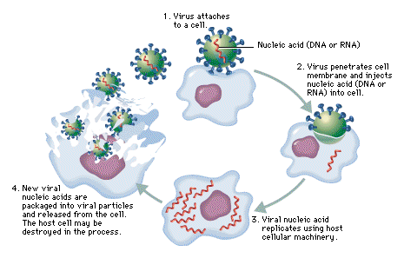
Pathogenesis of Viral Diseases
Ministering to the Community in a Time of Crisis
Lifecycle of a Virus
Step Four – Release
The host cell ruptures and dies
New viruses released to find new host cells
outrunningthehorses.com

Slide 34

Pathogenesis of Viral Diseases
Ministering to the Community in a Time of Crisis
Lifecycle of a Virus
Step Four – Release
Neuraminidase
Considered to be the “scalpel”
Under microscope looks like propeller blades
“Blades” prohibit sialic acid from binding to viruses when they burst from cell
outrunningthehorses.com

Slide 35
Pathogenesis of Viral Diseases
Ministering to the Community in a Time of Crisis
Lifecycle of a Virus
Step Four – Release
Neuraminidase
Antivirals are Neuraminidase Inhibitors
Focus on this protein to slow disease process
Oseltamivir (Tamiflu) – drug that is most stockpiled around the world for an influenza pandemic
outrunningthehorses.com

Slide 36
Pathogenesis of Viral Diseases
Ministering to the Community in a Time of Crisis
Clinical illness due to destruction of cells in target tissues produce the following:
Sore throat
Cough/Congestion
Muscle or body aches
Headache
Runny/stuffy nose/congestion
Fever
Chills
Fatigue
Nausea/Vomiting
Diarrhea
outrunningthehorses.com

Slide 37
Pathogenesis of Viral Diseases
Ministering to the Community in a Time of Crisis
Some may develop complications that include:
Bronchitis
Pneumonia
Sinus and ear infections
Inflammation of the heart, brain, and muscles
Worsening of chronic conditions
Multi-organ failure and death
outrunningthehorses.com

Slide 38
Pathogenesis of Viral Diseases
Ministering to the Community in a Time of Crisis
Complications can arise with anyone; however, the following are more at risk:
Pregnant women
Young children
The elderly
People with pre-existing conditions:
Asthma
Heart disease
Cancer
Diabetes
outrunningthehorses.com

Slide 39
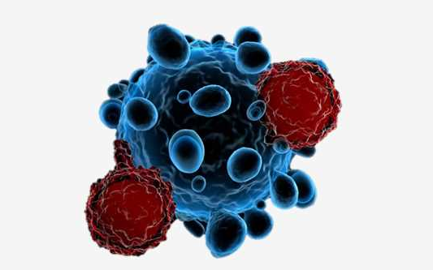
Pathogenesis of Viral Diseases
Ministering to the Community in a Time of Crisis
Recovery from infection– Immune System
Makes antibodies when there is an exposure to a new antigen
Antibodies bind to proteins on surface of virus
Prevents virus from continuing its cycle
Host’s immune system eventually destroys invading virus
outrunningthehorses.com

Slide 40
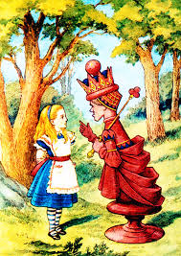
Pathogenesis of Viral Diseases
Ministering to the Community in a Time of Crisis
Immune System
“Red Queen” Dynamics
After the Red Queen in Lewis Carroll’s, The Looking Glass
“It takes all the running you can do, to keep in the same place.”
outrunningthehorses.com

Slide 41
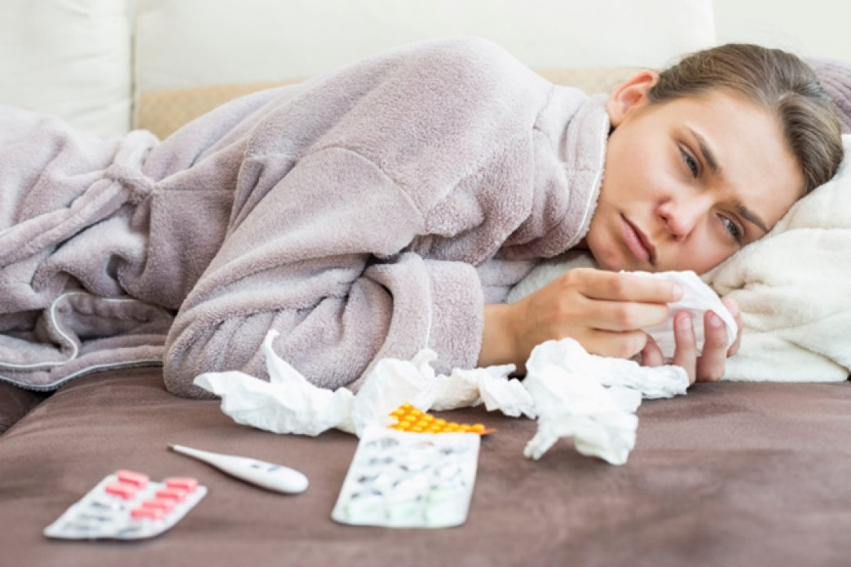
Pathogenesis of Viral Diseases
Ministering to the Community in a Time of Crisis
Recovery – Immune System
Will either kill or slow down the virus
Can make the difference between:
Fever and cough vs. pneumonia and death
outrunningthehorses.com

Slide 42
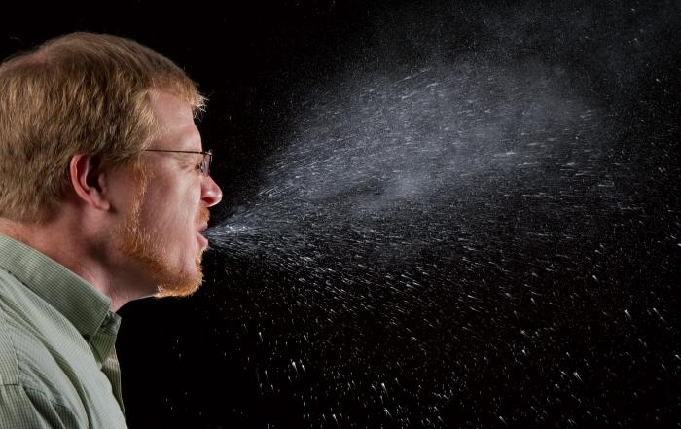
Pathogenesis of Viral Diseases
Ministering to the Community in a Time of Crisis
Shedding the Virus
Virus leaves host by way it entered
Sneezes
Coughs
Feces
Blood
Other body fluids
outrunningthehorses.com

Slide 43
Pathogenesis of Viral Diseases
Ministering to the Community in a Time of Crisis
Recovery of Target Tissue
Destruction of target cells and tissues and recovery
Intestinal Epithelium
Rapidly regenerates after viral attack
Able to withstand extensive damage
Nervous System Tissue
Not able to regenerate
Never resumes normal functioning
outrunningthehorses.com

Slide 44
Pathogenesis of Viral Diseases
Ministering to the Community in a Time of Crisis
Recovery of Target Tissue
Destruction of target cells and tissues and recovery
Respiratory Tissue
Recovery process can vary depending on age, overall health, and severity of the infection
Damaged epithelial cells are be replaced with cell division
Even after apparent recover, the lungs may show persistent inflammation
Some may experience long-term respiratory issues
outrunningthehorses.com

Slide 45
Virus Mutation – Antigenic Drift and Shift
Ministering to the Community in a Time of Crisis
Mutation
Protein antigens significant to the spread of the virus
The immune system recognizes viruses by these antigens
During replication new viruses vary
Normal part of lifecycle
outrunningthehorses.com

Slide 46
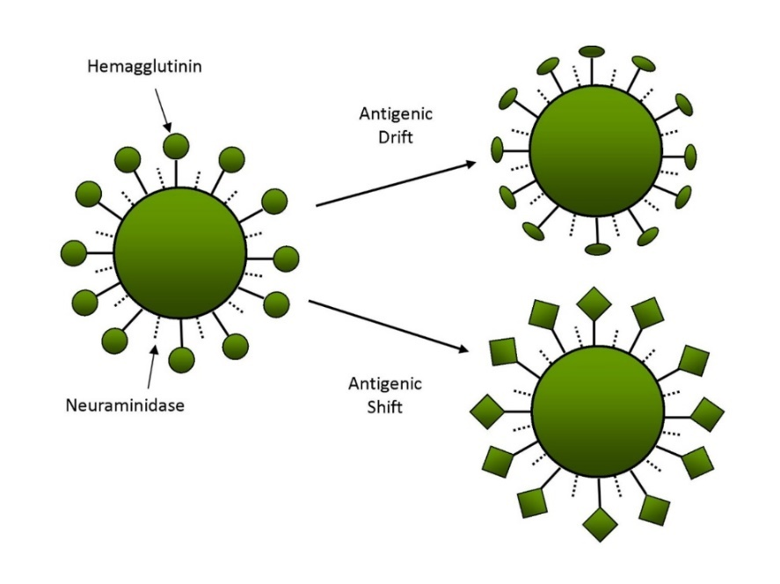
Virus Mutation – Antigenic Drift and Shift
Ministering to the Community in a Time of Crisis
Mutation
Helps prevent immune system from recognizing the virus
Slight changes – Antigenic Drift
Larger, abrupt changes – Antigenic Shift
These changes are called mutations
outrunningthehorses.com

Slide 47
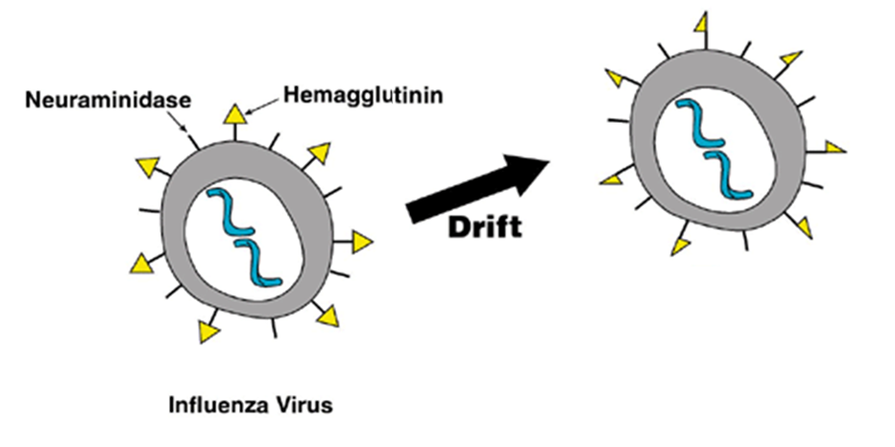
Virus Mutation – Antigenic Drift and Shift
Ministering to the Community in a Time of Crisis
Antigenic Drift
Small changes happen over time
Immune system no longer recognizes
The reason for yearly seasonal flu vaccines
outrunningthehorses.com

Slide 48
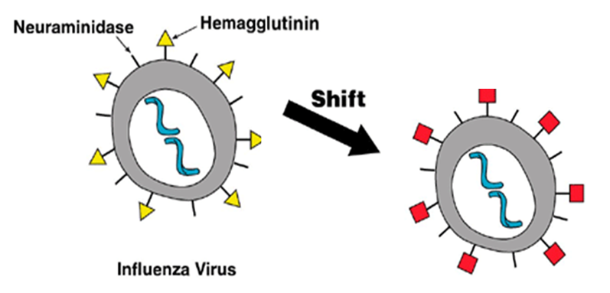
Virus Mutation – Antigenic Drift and Shift
Ministering to the Community in a Time of Crisis
Mutation
Antigenic Shift happens when there is an abrupt major change
A novel virus is formed
People have little or no protection against new virus
outrunningthehorses.com

Slide 49
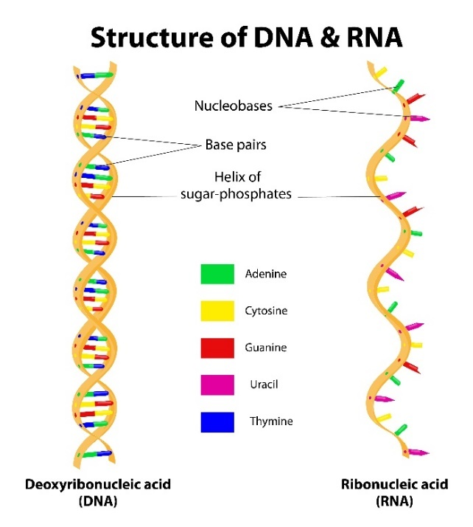
Virus Mutation – Antigenic Drift and Shift
Ministering to the Community in a Time of Crisis
Significance of RNA vs DNA
Most life forms, genes are of DNA (deoxyribonucleic acid)
Double stranded structure (double helix)
Carries information for making the cell’s proteins and characteristics
Implement all functions of a living organism
outrunningthehorses.com

Slide 50
Virus Mutation – Antigenic Drift and Shift
Ministering to the Community in a Time of Crisis
Significance of RNA vs DNA
When a cell reproduces, all information is passed to offspring
It must first replicate a copy of its DNA
DNA contains deoxyribose
Deoxy means there are no hydroxyl (-OH) groups
Chemical bonds are not easily broken into water (H2O)
outrunningthehorses.com

Slide 51
Virus Mutation – Antigenic Drift and Shift
Ministering to the Community in a Time of Crisis
Significance of RNA vs DNA
RNA (ribonucleic acid) consists of one strand of nucleotides
The ribose contains a hydroxy group (OH)
Makes it easier for bond to break down into water (H2O)
RNA is less stable than DNA
Influenza viruses have RNA
outrunningthehorses.com

Slide 52
Virus Mutation – Antigenic Drift and Shift
Ministering to the Community in a Time of Crisis
Significance of RNA vs DNA
DNA has a built-in proofreading mechanism
Errors or mutations rarely occur
RNA has no proofreading mechanism
Mutations happen up to one million times faster than DNA
Influenza, HIV, and the coronavirus (SARS, COVID-19) all contain RNA and mutate the fastest in the world of viruses
outrunningthehorses.com

Slide 53
Virus Mutation

Slide 54
Virus Mutation

Slide 55
Virus Mutation

Slide 56
Virus Mutation

Slide 57
Virus Mutation

Slide 58
Genetic Reassortment
Ministering to the Community in a Time of Crisis
Genetic Reassortment
The mixing of the genetic material of two species into new combinations producing a new virus
Takes place when a host is infected with two viruses
Pigs are susceptible to infection from both avian (bird) and mammalian (human viruses)
outrunningthehorses.com

Slide 59
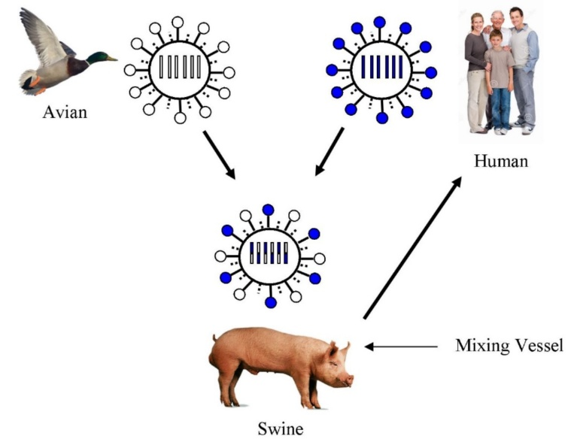
Genetic Reassortment
Ministering to the Community in a Time of Crisis
Genetic Reassortment with Swine as Mixing Vessel
outrunningthehorses.com

Slide 60
Genetic Reassortment
Ministering to the Community in a Time of Crisis
Genetic Reassortment
The mixing of the genetic material of a two species into new combinations producing a new virus
Takes place when a host is infected with two viruses
Pigs are susceptible to infection from both avian (bird) and mammalian (human viruses)
outrunningthehorses.com

Slide 61
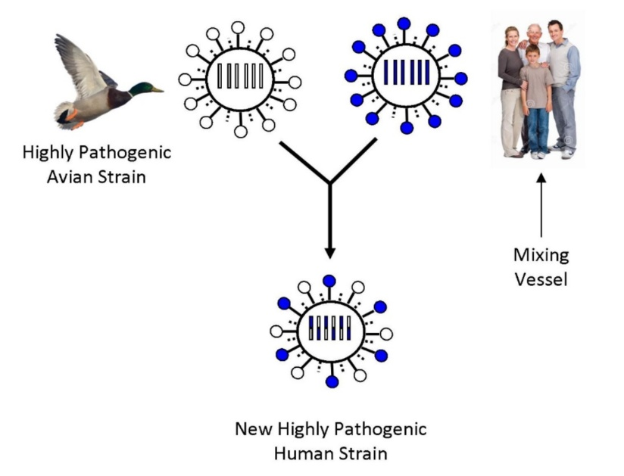
Genetic Reassortment
Ministering to the Community in a Time of Crisis
Genetic Reassortment with Humans as Mixing Vessel
outrunningthehorses.com

Slide 62
Genetic Reassortment
Ministering to the Community in a Time of Crisis
The HPAI H5N1, which primarily infects birds, is currently experiencing a concerning increase in its ability to jump between species, including mammals.
The virus is now infecting a wider range of animals, including dairy cattle, cats, dogs, foxes, dolphins, and even some humans.
The virus's ability to evolve and spread to new hosts raises significant public health concerns.
outrunningthehorses.com

Slide 63


Slide 64
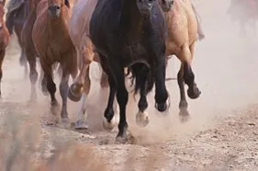
“If you have run with footmen, and they have tired you out,
then how can you compete with horses?
If you fall down in a land of peace,
how will you do in the thicket by the Jordan?”
Jeremiah 12:5
outrunningthehorses.com

Slide 65
For more presentations like this
or for more information
please visit
outrunningthehorses.com
outrunningthehorses.com

