Slide 1

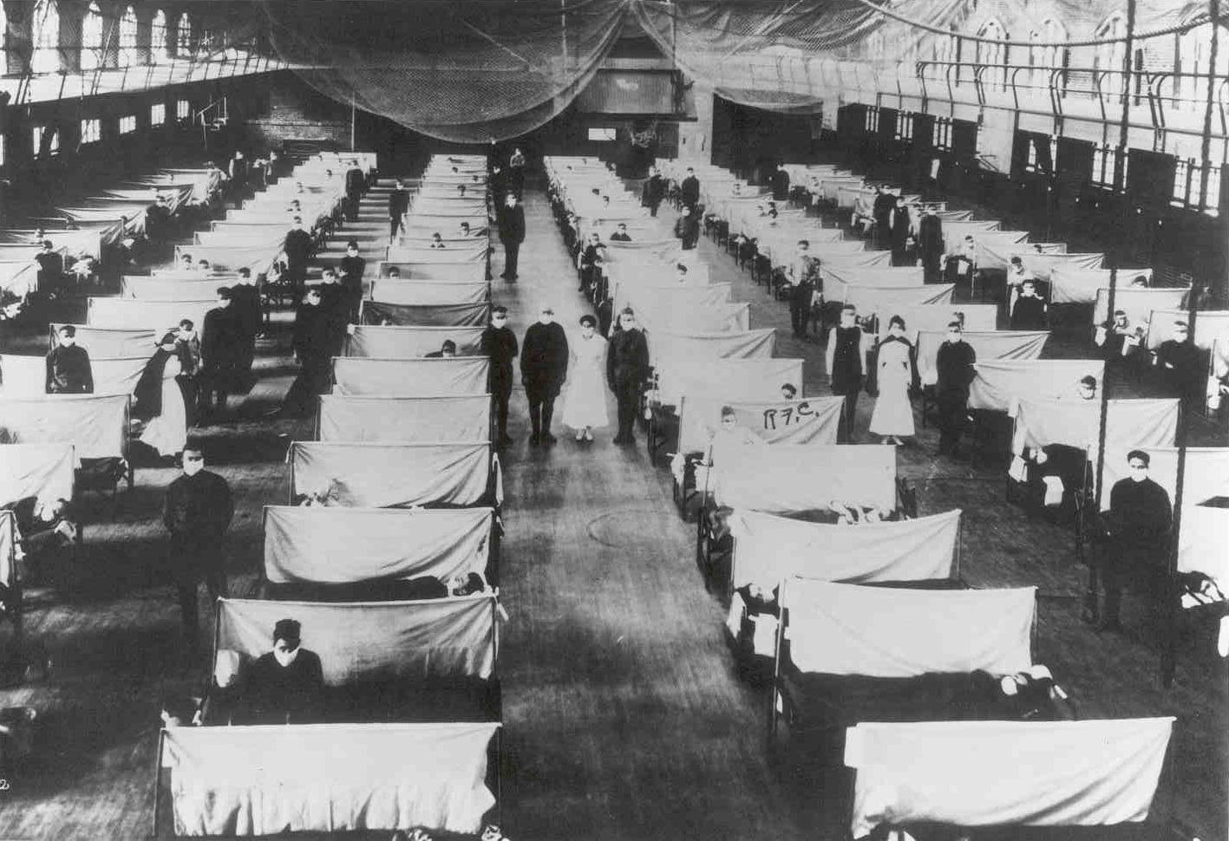
Pandemic Plan for the Church
Ministering to the Community in a Time of Crisis
The 1918 Influenza
outrunningthehorses.com

Slide 2
1918 Influenza
Ministering to the Community in a Time of Crisis
Introduction
  The 1918 Influenza was a global disaster. It was a subtype of an influenza virus H1N1 first hosted in birds. Nearly 20 % of the world population suffered from this pandemic, the results were tragic.
outrunningthehorses.com

Slide 3
1918 Influenza
Ministering to the Community in a Time of Crisis
Introduction
  Due to their similarity, the 1918 Influenza is used as a model for what to expect if the current Highly Pathogenic Avian Influenza (HPAI) H5N1 strain were to become human-to-human transmissible.
outrunningthehorses.com

Slide 4
1918 Influenza
Ministering to the Community in a Time of Crisis
1918 Influenza
  It is estimated that 20 to 100 million people died
  More people died in one year than in the four years of the Black Death Bubonic Plague combined
  Ten times as many Americans died of this influenza than in World War I
  Within months more people had succumbed to this virus than any other illness in recorded history
outrunningthehorses.com

Slide 5
1918 Influenza
Ministering to the Community in a Time of Crisis
1918 Influenza
  Also known as the Spanish Flu
    Spain was not in the war and did not censor their news
  The USA and other countries censored the news to keep morale up and focus on the war efforts
    Experts believe it very likely began in Haskell County, Kansas
    It spread across the US within seven days and around the world within three months
outrunningthehorses.com

Slide 6
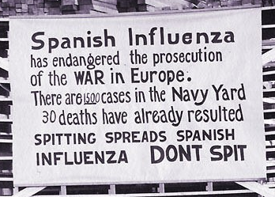
1918 Influenza
Ministering to the Community in a Time of Crisis
1918 Influenza
  Swept the United States, Europe, and Asia in three convulsive waves
  It lasted 18 months
outrunningthehorses.com

Slide 7
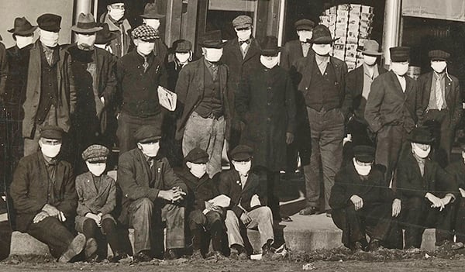
1918 Influenza
Ministering to the Community in a Time of Crisis
Society was Devasted
  Nearly 20% of the world population effected
  Many died within days of the first symptoms
  The high levels of illness and death resulted in great social disruption and economic loss
outrunningthehorses.com

Slide 8
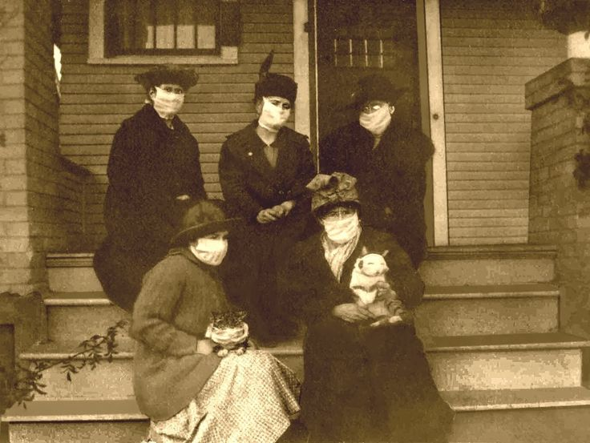
1918 Influenza
Ministering to the Community in a Time of Crisis
Society was Devasted
  Everyday life was disrupted
    Stores were closed
    Deliveries were not taking place
    Schools were closed
    People were out of work
    Emergency services were overwhelmed
outrunningthehorses.com

Slide 9
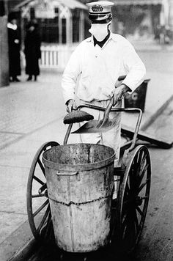
1918 Influenza
Ministering to the Community in a Time of Crisis
Society Devastated
  Basic services were hindered
    Garbage collection
    Mail delivery
    Not enough farmers to harvest crops
    State and local health department closed
      Hampering efforts to chronicle spread of virus
outrunningthehorses.com

Slide 10
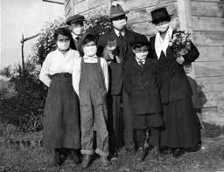
1918 Influenza
Ministering to the Community in a Time of Crisis
High Levels of Death
  Entire families were killed
    Horrifying scenes where sick patients were found in bed beside the deceased
    Homes piled up with bodies
outrunningthehorses.com

Slide 11
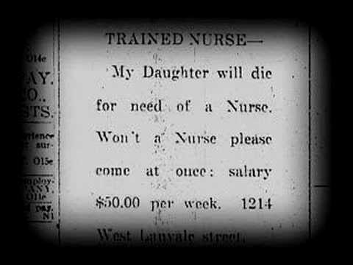
1918 Influenza
Ministering to the Community in a Time of Crisis
High Levels of Death
  Many people died for want of basic care
  Advertisements and announcements were put in the paper calling for help
outrunningthehorses.com

Slide 12
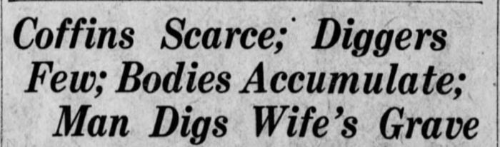
1918 Influenza
Ministering to the Community in a Time of Crisis
High Levels of Death
  Some had to dig graves for their own family members
outrunningthehorses.com

Slide 13
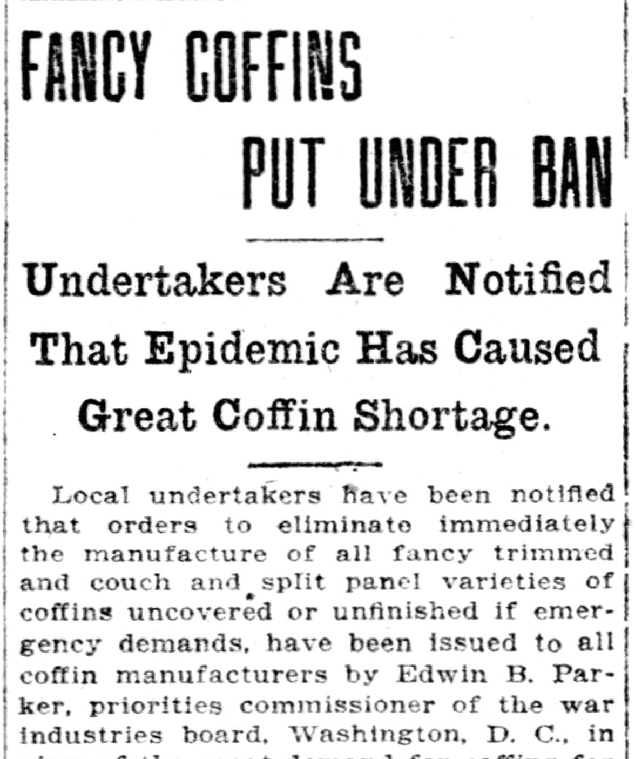
1918 Influenza
Ministering to the Community in a Time of Crisis
High Levels of Death
  Bodies piled up
  Funeral parlors were overwhelmed
  Mortuaries and cemeteries overwhelmed
  Many corpses remained unburied at home
outrunningthehorses.com

Slide 14
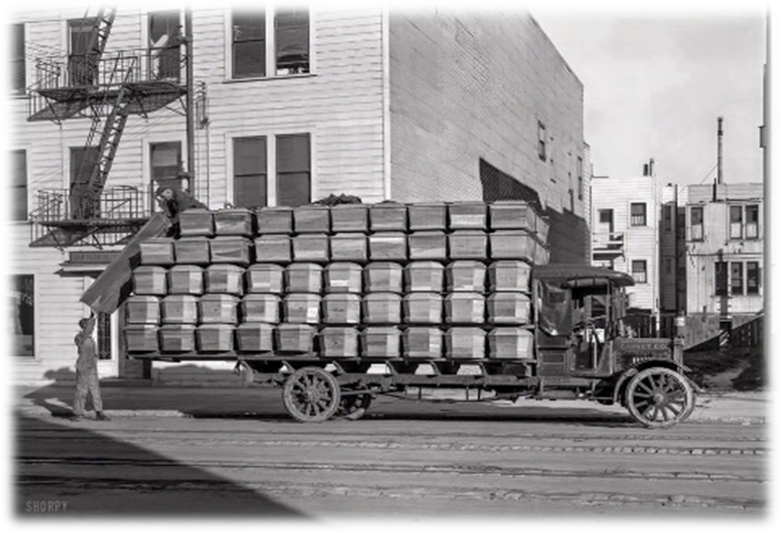
1918 Influenza
Ministering to the Community in a Time of Crisis
High Levels of Death
  Pounding of boards for coffins became a normal sound in cities
outrunningthehorses.com

Slide 15
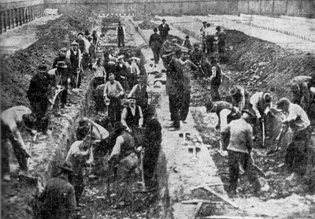
1918 Influenza
Ministering to the Community in a Time of Crisis
High Levels of Death
  Catastrophic effects on urban populations
  Civil groups formed to dig mass graves
outrunningthehorses.com

Slide 16
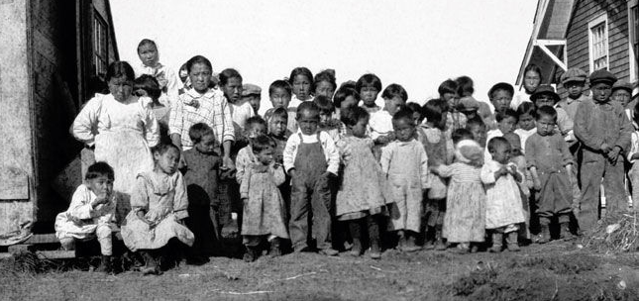
1918 Influenza
Ministering to the Community in a Time of Crisis
High Levels of Death
    Children in remote Alaskan village Nushagak survived – however, their parents did not
outrunningthehorses.com

Slide 17
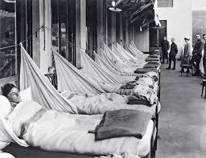
1918 Influenza
Ministering to the Community in a Time of Crisis
Healthcare was Overwhelmed
  Limited scientific knowledge
  No real prevention or effective treatment
  Many cities and public health officials were ill equipped to deal with the health crisis
outrunningthehorses.com

Slide 18
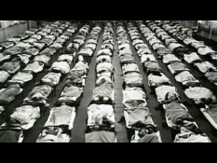
1918 Influenza
Ministering to the Community in a Time of Crisis
Healthcare was Overwhelmed
  Many healthcare workers were off serving in the war effort.
  Hospitals were inundated
  Workers were overwhelmed
outrunningthehorses.com

Slide 19
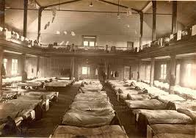
1918 Influenza
Ministering to the Community in a Time of Crisis
Healthcare was Overwhelmed
  Staff hours were lengthened
  Providers became ill themselves
  Many stayed home in fear
  Stressed doctors did not register cases timely
  Paperwork was not properly maintained
outrunningthehorses.com

Slide 20
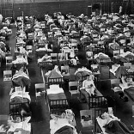
1918 Influenza
Ministering to the Community in a Time of Crisis
Healthcare was Overwhelmed
  There was a shortage of basic medicines and supplies
  People were turned away and the ill were discharged
  Many people languished at home
  People died for want of basic care
outrunningthehorses.com

Slide 21
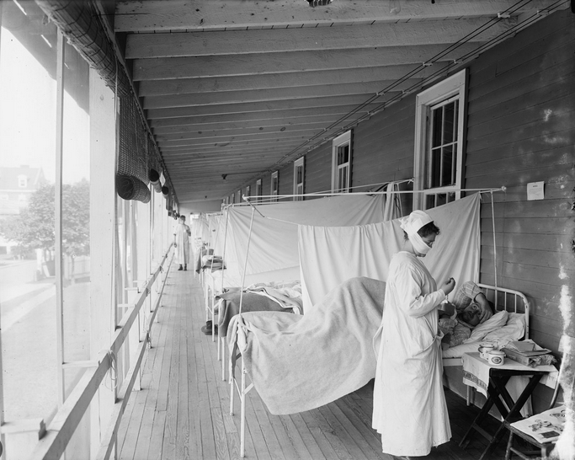
1918 Influenza
Ministering to the Community in a Time of Crisis
Healthcare was Overwhelmed
  Hallways, porches, churches, and gymnasiums became makeshift accommodations
outrunningthehorses.com

Slide 22
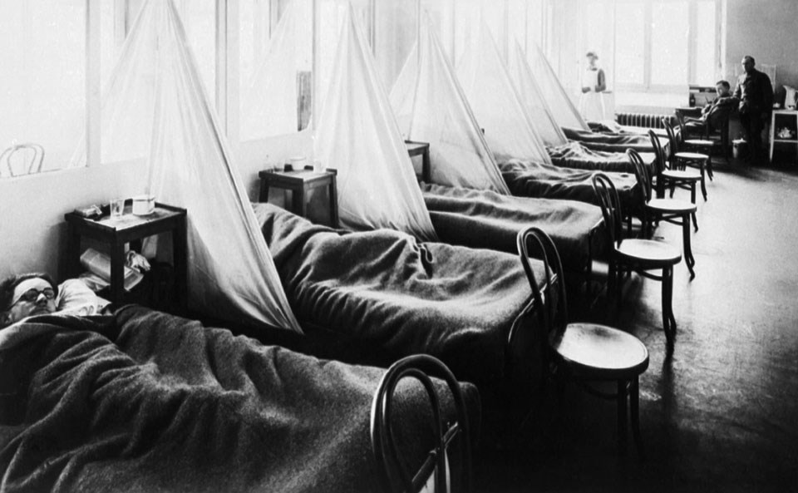
1918 Influenza
Ministering to the Community in a Time of Crisis
Healthcare was Overwhelmed
  Records and journals paint a grim picture
  The process of the disease depicted a miserable death
outrunningthehorses.com

Slide 23
“As their lungs filled…the patients became short of breath and increasingly cyanotic.
After gasping for several hours
they became delirious and incontinent,
and many died struggling to clear their airways
of a blood-tinged froth that sometimes
gushed from their nose and mouth.
It was a dreadful business.”
Issac Starr, 3rd year medical student,
University of Pennsylvania, 1918
outrunningthehorses.com

Slide 24
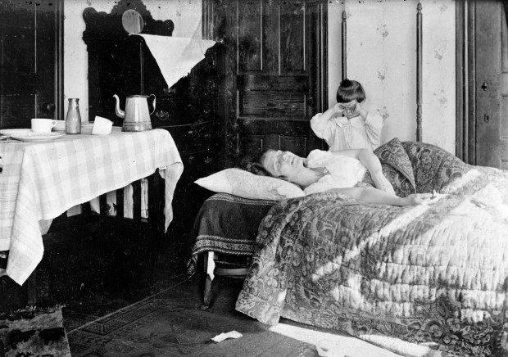
1918 Influenza
Ministering to the Community in a Time of Crisis
A Call to Volunteers
  Women were trained to become nurses
    Volunteers were often assigned to homes in which all the adults were incapacitated
outrunningthehorses.com

Slide 25
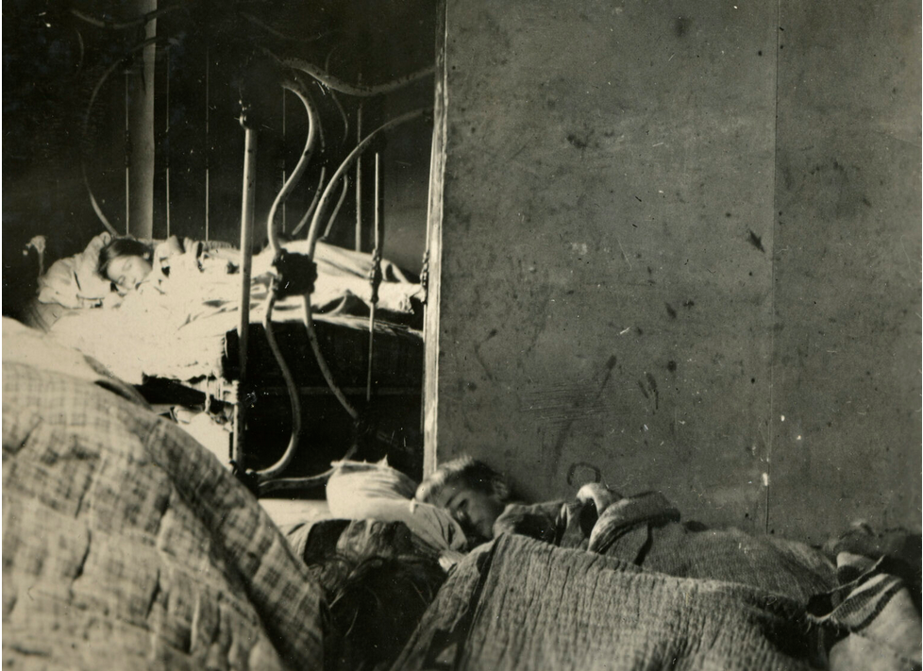
1918 Influenza
Ministering to the Community in a Time of Crisis
A Call to Volunteers
  Women were trained to become nurses
    With multiple family members sick, they found conditions appalling
outrunningthehorses.com

Slide 26
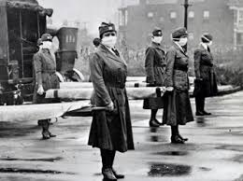
1918 Influenza
Ministering to the Community in a Time of Crisis
A Call to Volunteers
  Women volunteered for emergency transport
outrunningthehorses.com

Slide 27
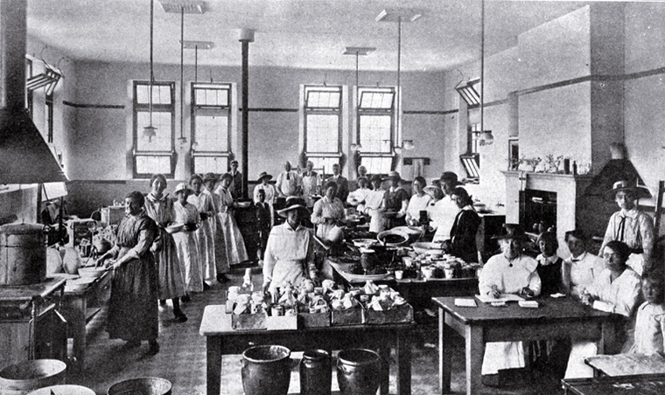
1918 Influenza
Ministering to the Community in a Time of Crisis
A Call to Volunteers
  Many women from various churches cooked meals and delivered them to families
outrunningthehorses.com

Slide 28
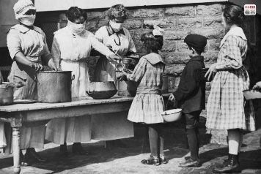
1918 Influenza
Ministering to the Community in a Time of Crisis
A Call to Volunteers
  It was determined that these efforts saved many lives
outrunningthehorses.com

Slide 29
1918 Influenza
Ministering to the Community in a Time of Crisis
The 1918 Influenza is said
to be the worst human disaster in recorded history
outrunningthehorses.com

Slide 30
1918 Influenza
Ministering to the Community in a Time of Crisis
Conclusion
  At its height, COVID-19 had a mortality rate of 1.2%. Those with comorbidities were at higher risk for severe complications and even death. Its difficult societal effects were caused more by the mitigations of lockdowns and social distancing mandated by the government.
  Conversely, experts state that the1918 Influenza Pandemic had a 50% death rate . It was the lethality of the virus itself that caused the devasting effects on society.
outrunningthehorses.com

Slide 31

outrunningthehorses.com

Slide 32
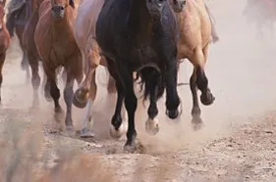

“If you have run with footmen, and they have tired you out,
then how can you compete with horses?
If you fall down in a land of peace,
how will you do in the thicket by the Jordan?”
Jeremiah 12:5

Slide 33
For more presentations like this
or for more information
please visit
outrunningthehorses.com

