Slide 1
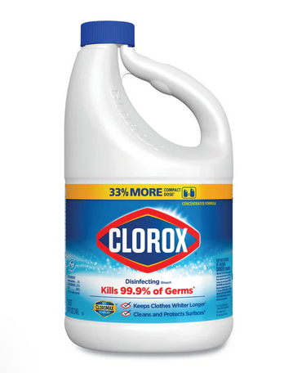
Pandemic Plan for the Church
Ministering to the Community in a Time of Crisis
Using Bleach as a Disinfectant
outrunningthehorses.com

Slide 2
Using Bleach
In non-health care settings, the World Health Organization (WHO) recommends sodium hypochlorite (bleach / chlorine)
  May be used at a concentration of 0.1% or 1,000ppm (1 part of 5% strength household bleach to 49 parts of water)
Alcohol at 70-90% can also be used for surface disinfection
  Surfaces must be cleaned first to remove dirt, followed by disinfection
outrunningthehorses.com

Slide 3
Using Bleach
The Centers for Diseases Control (CDC) states that bleach solutions can be used and will be effective against viruses when properly diluted
  Most household bleach contains 5%–9% sodium hypochlorite
  Do not use a bleach product if the percentage is not in this range or is not specified
outrunningthehorses.com

Slide 4
Using Bleach
Definitions
  Cleaning – done with soap, water, and scrubbing
    Removes germs, dirt, and impurities from surfaces
  Disinfecting Products – chemicals used to kill remaining germs on surfaces
outrunningthehorses.com

Slide 5
Using Bleach
Most situations cleaning alone can remove most germs
  Disinfecting is done to reduce the spread of diseases
  Bleach is effective at killing germs when properly diluted
outrunningthehorses.com

Slide 6
Using Bleach
Using Bleach
  Follow the manufacturer’s instructions for the surface application
  This will ensure efficacy as well as prevent ill effects
  Pay attention to concentration, temperature, and the time the product needs to remain on the surface to be effective
outrunningthehorses.com

Slide 7
Using Bleach
Using Bleach - Disadvantages
  Although bleach is cheap and readily available, there are disadvantages which include:
    It has no detergent agent
      It cannot penetrate soils – surfaces must first be cleaned
    It is inactivated when in contact with organic matter such as blood, tissue, and saliva
    It is very caustic – it can burn skin and eyes
outrunningthehorses.com

Slide 8
Using Bleach
Using Bleach - Disadvantages continued
    It is poisonous if ingested
    Fumes can be irritating and even toxic
    It is corrosive
    It discolors colored items such as materials, carpets, countertops and floors
    It can create toxic fumes when mixed with other chemicals
outrunningthehorses.com

Slide 9
Using Bleach
Using Bleach - Cautions
  Wear PPE such as gloves, mask, and eye protection
  Be sure the concentration is 5.25% active sodium hypochlorite
  Use a new bottle of bleach if possible
    Bleach loses its efficacy if it sits on the shelf for a long period of time
    It should smell strongly of chlorine for it to be effective
outrunningthehorses.com

Slide 10
Using Bleach
Using Bleach - Cautions continued
  Thick bleach solutions such as toilet bowel should not be used in dilution
  Use plain bleach; do not use scented versions, as there are other additives that may affect the solution
  Do not mix bleach with other chemicals as this can cause a reaction that can produce toxic fumes
outrunningthehorses.com

Slide 11
Using Bleach
Using Bleach - Cautions continued
  Surfaces must first be cleaned with a detergent before disinfecting with bleach
  Apply solution to a surface with a moistened cloth
    Allow it to remain on the surface for at least three to five minutes and even up to ten minutes
  After time allowed, wipe again with another clean wet cloth
outrunningthehorses.com

Slide 12
Using Bleach
Using Bleach - Cautions continued
  The chlorine must be wiped away from metal objects with a more dilute solution to prevent corrosion
    This can be done with clean water or 70% alcohol
    Set apart cloths just for this purpose
outrunningthehorses.com

Slide 13
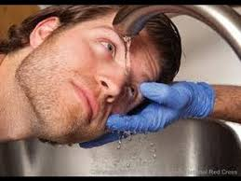
Using Bleach
Using Bleach - Cautions continued
  If bleach gets into the eyes, immediately rinse with water for at least fifteen minutes and seek medical attention
outrunningthehorses.com

Slide 14
Using Bleach
Using Bleach - Cautions continued
  Bleach is not intended as a disinfectant for hands
  The principal means for disinfecting hands is washing with soap and water, coupled with the use of a commercial hand sanitizer with alcohol
outrunningthehorses.com

Slide 15
Preparing Bleach Solutions
Preparing Bleach Solutions (continued)
  CDC recommends use 0.1% (1,000ppm) (1:10) chlorine solution to disinfect frequently touched surfaces and items
  Make new 0.1% (1:10) chlorine solution every day
    Throw away any leftover solution from the day before
outrunningthehorses.com

Slide 16
Preparing Bleach Solutions
Preparing Bleach Solutions
  Differing solution strengths are used for different purposes
    A strong 1:10 bleach solution is used to disinfect items exposed to:
      Blood
      Urine or fecal material
      Surfaces exposed to corpses
outrunningthehorses.com

Slide 17
Preparing Bleach Solutions
Preparing Bleach Solutions (continued)
  Differing solution strengths are used for different purposes
    A weaker 1:100 bleach solution is used for:
      Disinfecting surfaces
      Medical equipment
      Objects close to the patient
      Bedding and other laundry
outrunningthehorses.com

Slide 18
Preparing Bleach Solutions
Preparing Bleach Solutions (continued)
  Ensure proper ventilation during and after application (for example, open windows)
  Never mix household bleach (or any disinfectants) with any other cleaners or disinfectants
    This can release vapors that may be very dangerous
outrunningthehorses.com

Slide 19
Preparing Bleach Solutions
Preparing Bleach Solutions (continued)
  Make a new diluted bleach solution daily
    Bleach solutions will not be as effective after being mixed with water for over 24 hours
  If a strong smell of chlorine is not present, it has lost its efficacy
outrunningthehorses.com

Slide 20
Preparing Bleach Solutions
Preparing Bleach Solutions (continued)
  Use plastic containers because metal containers can corrode easily
    Use a plastic grade of HDPE (High-density polyethylene)
  Wear PPE, avoid direct contact with skin and eyes
  Start with household bleach that contain 5% sodium hypochlorite
outrunningthehorses.com

Slide 21
Preparing Bleach Solutions
Gather the necessary supplies:
    One container that holds ten measures (e.g. ten cups) to make the base 1:10 bleach solution
    One large or several smaller containers (One for each station) with covers or lids to hold the 1:100 bleach solutions
      These containers should be labeled clearly of the different solutions
outrunningthehorses.com

Slide 22
Preparing Bleach Solutions
Gather the necessary supplies (continued):
  Five-gallon buckets – example containers:
    Cat liter buckets
    Large dog and cat dry food buckets
    Home Depot buckets
  Chlorine bleach containing 5.25% active sodium hypochlorite
outrunningthehorses.com

Slide 23
Preparing Bleach Solutions
Gather the necessary supplies (continued):
  Use clean water
    Do not use dirty or used water because organic matter destroys chlorine
  A measuring cup or other container
    A bottle or jar marked with one cup, or one liter can be used
outrunningthehorses.com

Slide 24
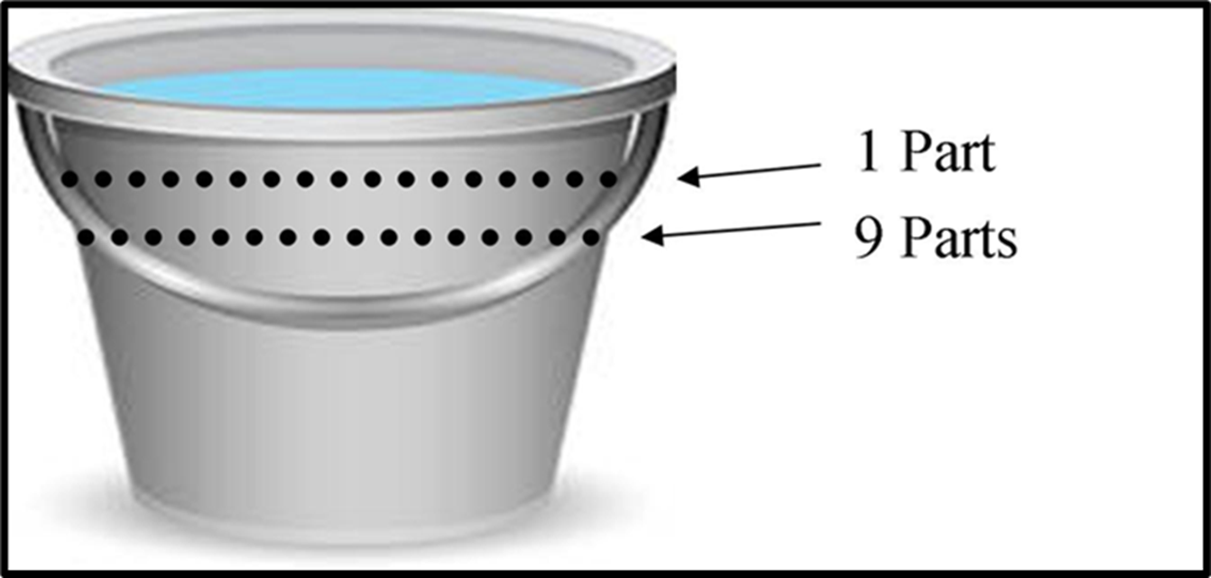
Preparing Bleach Solutions
To prepare 1:10 bleach solution
  Pour nine measures of water into the container then mark the outside
  Use a permanent sharpie or scratch the plastic
  Add one measure of bleach to the first nine parts then again mark a line at the total ten parts volume
outrunningthehorses.com

Slide 25

Preparing Bleach Solutions
  Marking the container will shorten the process for future solutions
outrunningthehorses.com

Slide 26
Preparing Bleach Solutions
To prepare 1:100 bleach solution:
  Measure and pour nine parts of water into another large container
  Then measure and pour one part of 1:10 bleach solution into the water to make a 1:100 bleach solution
outrunningthehorses.com

Slide 27
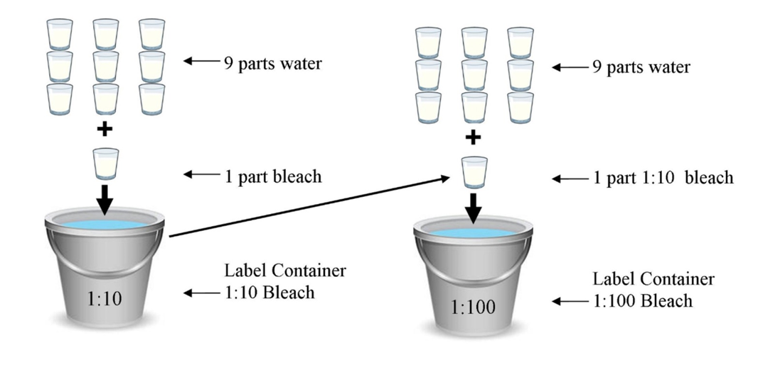
outrunningthehorses.com

Slide 28
Preparing Bleach Solutions
Use the 1:10 bleach solution to clean after contamination with body fluids
Use the 1:100 bleach solution to clean surface areas and laundry
When there is a large outbreak, make larger quantities
outrunningthehorses.com

Slide 29
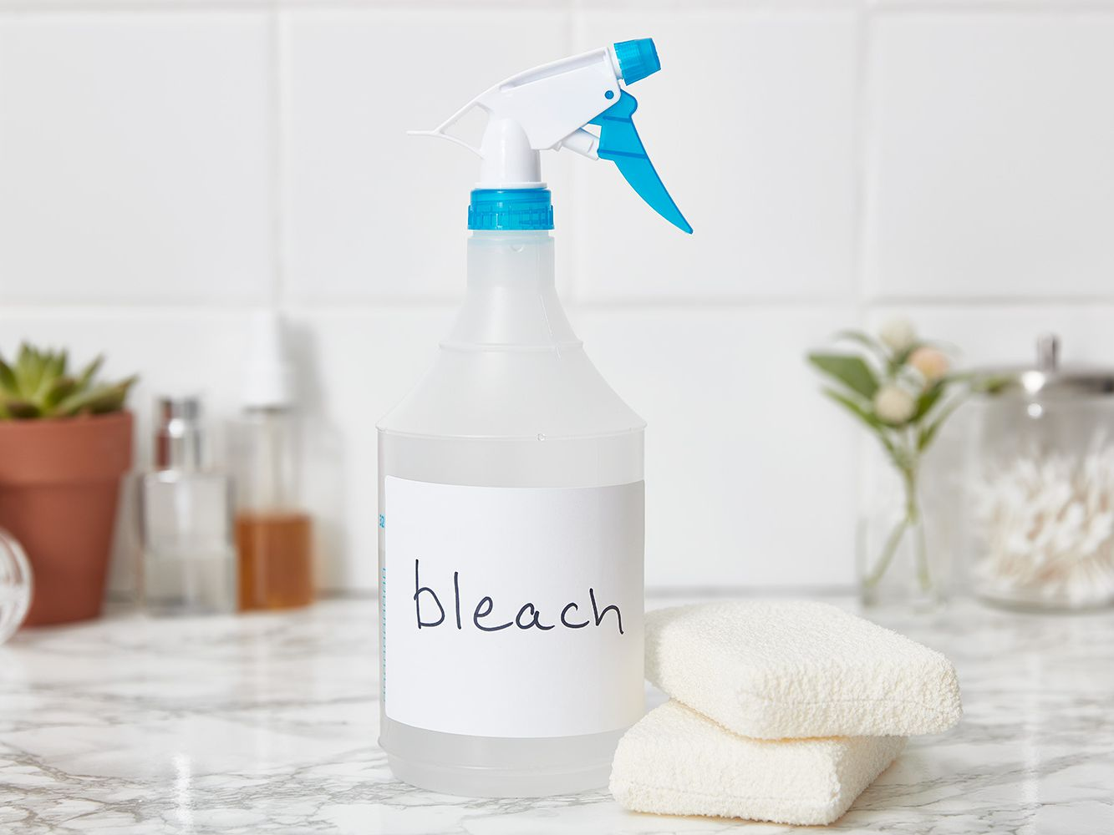
Preparing Bleach Solutions
Distribute a container of each solution to each station with clean cloths
Be sure to label each container properly
outrunningthehorses.com

Slide 30
Cleaning and Disinfecting Surfaces
Using Bleach continued
  Always follow label instructions
  If instructions are not available, leave the diluted bleach solution on the surface for at least 5 minutes before removing or wiping
  This is known as the “contact time” for disinfection
  The surface should remain visibly wet during the contact time
outrunningthehorses.com

Slide 31
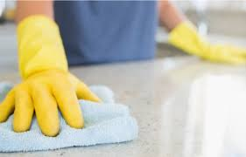
Cleaning and Disinfecting Surfaces
  Apply bleach solution to the surface with a clean rag or sponge
  Rinse the surface with warm water
  Allow to air dry
outrunningthehorses.com

Slide 32
Cleaning and Disinfecting Surfaces
Cleaning and Disinfecting Surfaces
  Use any EPA-registered detergent-disinfectant
  Be sure to include surfaces such as:
    Doorknobs
    Light switches
    TV controls
    Telephones
    Bathroom surfaces
    Kitchen counter tops
    Dresser tops
    Items used for direct care of the patient e.g. a blood pressure cuff
outrunningthehorses.com

Slide 33
Cleaning and Disinfecting Surfaces
Cleaning and Disinfecting Floors and Walls
  Not generally involved in disease transmission
    However, if either become visibly soiled clean as follows:
      Wash the floor or wall with a detergent to remove any visible dirt
      Use a sprayer or mop to wash the walls with 1:100 bleach solution
outrunningthehorses.com

Slide 34
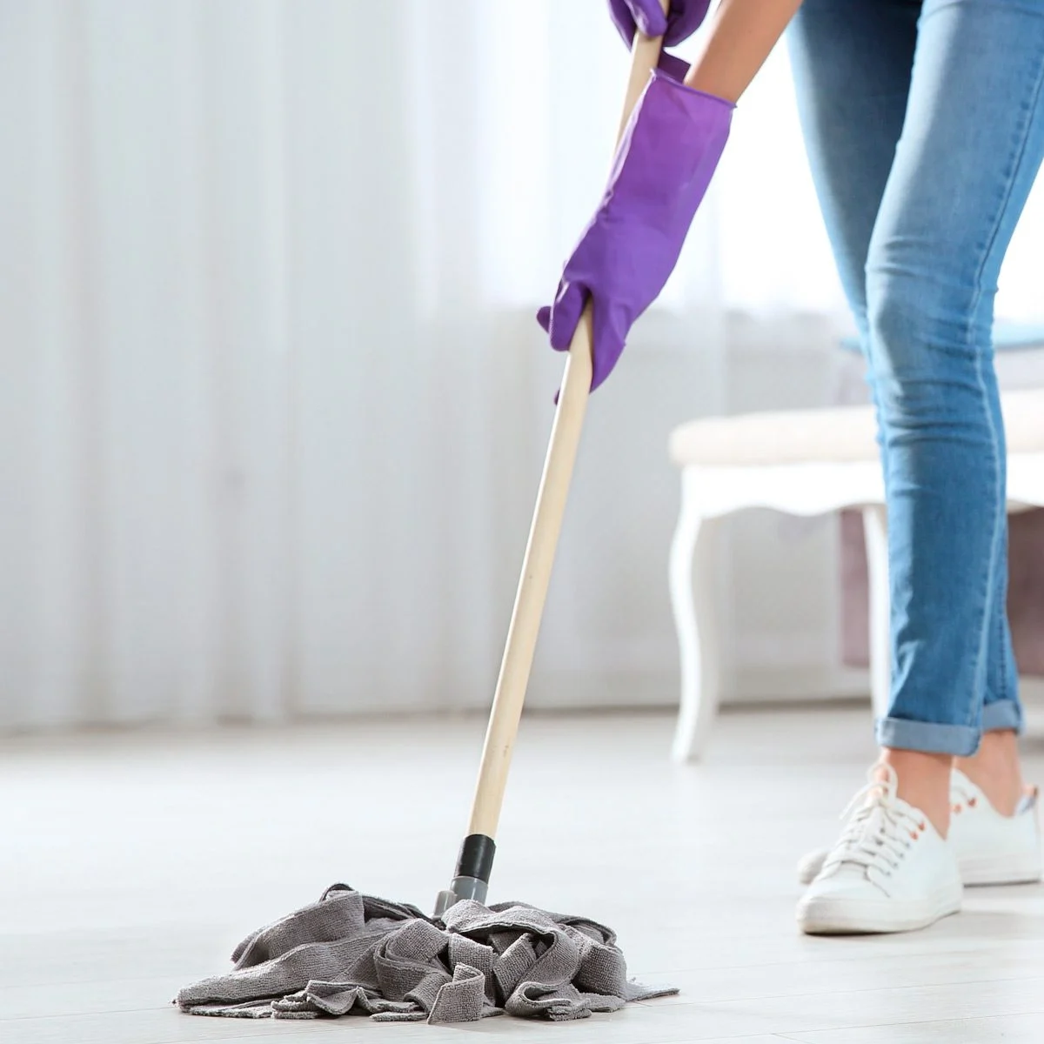
Cleaning and Disinfecting Surfaces
Cleaning and Disinfecting Floors and Walls
    Wipe the walls with a clean cloth
    Rinse the mop in a fresh supply of 1:100 bleach solution
    If using a sprayer, apply the spray close to the surface to minimize splashing and aerosols
outrunningthehorses.com

Slide 35
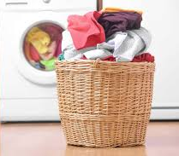
Laundry
Although viruses do not survive as easily on materials such as sheets, towels, and clothing – laundry should still be handled with similar care as other items
There may be wet or dry bodily secretions or fluids, including respiratory droplets on the bedding and pajamas
outrunningthehorses.com

Slide 36
Laundry
Use the following precautions:
  Wear gloves and a mask when handling the laundry of a sick person.
  Place the dirty laundry into a laundry bag that is kept in the patient’s room
    Keep bag closed when taking to the laundry room
    Don’t carry unpackaged soiled linens out of the sick room into a clean room
outrunningthehorses.com

Slide 37
Laundry
Use the following precautions:
  Keep soiled linen at arm’s length
    Don’t hold laundry close to your body or face
  Make every effort to not shake or agitate the linens
    This will keep any dried matter that has attached from unsettling
    This will prevent contaminated particles from becoming airborne
outrunningthehorses.com

Slide 38
Laundry
Use the following precautions when handling laundry:
  Place laundry of sick person directly into washer from laundry bag
    Don’t place uncovered laundry in a basket for common use
  Soak in 1:100 bleach solution for thirty minutes Be sure all items are completely soaked
  Set the washer and dryer controls to hot
outrunningthehorses.com

Slide 39
Laundry
Use the following precautions when handling laundry:
  Wash items in soapy water
  Items may be line dried if necessary
  After handling soiled laundry, remove gloves and perform hand hygiene
outrunningthehorses.com

Slide 40
Conclusion
While person-to-person interaction is the primary way viruses spread, the virus can still be spread by touching contaminated surfaces
Health care professionals are still unsure how long viruses can live on surfaces
  It is believed that viruses can survive on different materials anywhere between a few hours to several days
outrunningthehorses.com

Slide 41
Conclusion
Removing and killing an infectious agent on a surface effectively must be performed properly and methodically
  Cleaning then disinfecting
  Bleach is one of many EPA approved chemicals that are effective to kill the influenza and corona viruses
outrunningthehorses.com

Slide 42
Conclusion
Second to wearing PPE when caring for a patient with a pathogen causing a pandemic, is keeping all surfaces clean from the infectious agent
  This is crucial to preventing the spread of the disease
outrunningthehorses.com

Slide 43

Questions?
outrunningthehorses.com

Slide 44

For more presentations like this
or for more information
please visit
outrunningthehorses.com
outrunningthehorses.com

