Slide 1

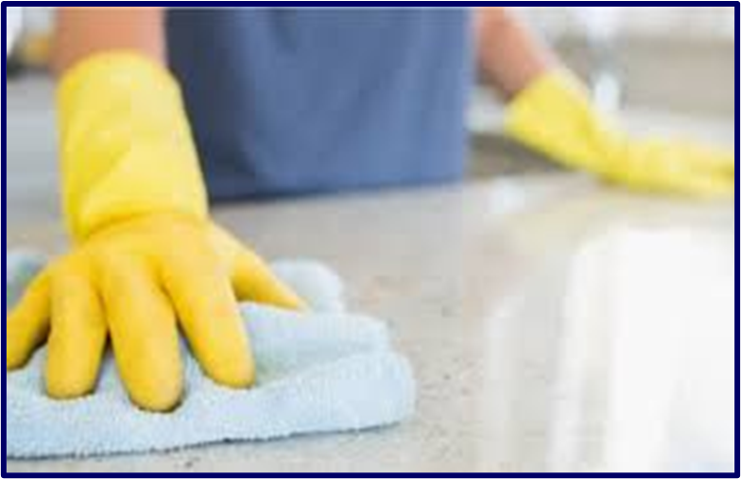
Pandemic Plan for the Church
Ministering to the Community in a Time of Crisis
Disinfecting Surfaces
outrunningthehorses.com

Slide 2

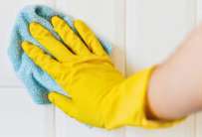
Disinfecting Surfaces
Second to wearing PPE when caring for a patient
with a pandemic virus,
is keeping all surfaces clean
from the infectious agent.
This is crucial to preventing
the spread of the disease.
outrunningthehorses.com

Slide 3
Disinfecting Surfaces
Introduction
Person-to-person transmission is the primary way viruses infect people
In addition, individuals can acquire a virus, bacteria, or other microorganism by touching a contaminated object then touching a mucus membrane such as their eyes, nose, or mouth
outrunningthehorses.com

Slide 4
Disinfecting Surfaces
Introduction
Until a virus has mutated and becomes human-to-human transmissible posing a threat to the world population, it is impossible to determine how it will conduct itself
The virus may spread more easily by droplets than aerosols
Studying characteristics of current viruses help in predicting what proper precautions to use and what disinfectants it is vulnerable.
This may change depending how the particular virus transmits
outrunningthehorses.com

Slide 5
Disinfecting Surfaces
Introduction
This presentation will focus on the three viruses that cause most concern
SARS-CoV-2 (COVID-19)
Seasonal Influenza
HPAI H5N1 (Avian Influenza)
The term virus or viruses throughout this document will include all these
outrunningthehorses.com

Slide 6

Disinfecting Surfaces Longevity of a Virus on a Surface
The Longevity of a Virus on a Surface
Dependent on several factors such as:
Humidity
Temperature
Porosity of the surface
Viruses tend to survive longer on surfaces in cooler temperatures and lower humidity
outrunningthehorses.com

Slide 7
Disinfecting Surfaces Longevity of a Virus on a Surface
COVID-19 can survive on the following surfaces:
Cardboard – eight to 24 hours
Packages received in the mail
Items purchased from store
Paper/tissue: 30 minutes to 3 hours
Non-porous surfaces: up to 72 hours (3 days)
Stainless steel/kitchen appliances, faucets
Countertops
Doorknobs
outrunningthehorses.com

Slide 8

Disinfecting Surfaces Longevity of a Virus on a Surface
COVID-19 can live on the following surfaces:
Plastic: up to 72 hours (3 days)
Cell phones
Computers
Skin: up to 9 hours
Fabric: several hours to several days
Clothing
Furniture
Linens
Remote control
Elevator buttons
Milk containers
Bus seats
outrunningthehorses.com

Slide 9
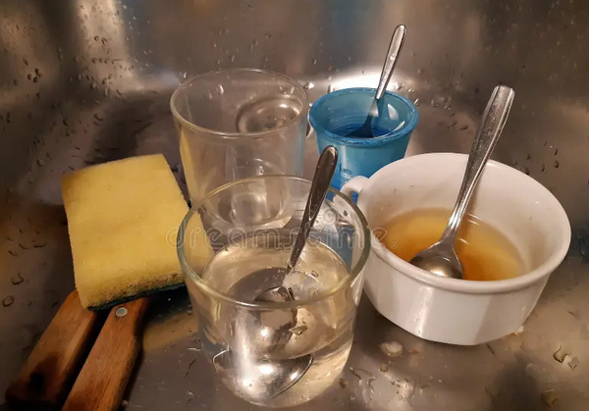
Disinfecting Surfaces Longevity of a Virus on a Surface
COVID-19 can live on the following surfaces:
Glass – 96 to 120 hours (4-5 days)
Glassware
Windows
Mirrors
Items from store
Wood – up to 96 hours (4 days)
Furniture
Decking
outrunningthehorses.com

Slide 10

Disinfecting Surfaces Longevity of a Virus on a Surface
February 2020, RNA from COVID-19 was found on the Princess Cruise ship, the Diamond Princess, 17 days after the passengers and crew disembarked off Japan
outrunningthehorses.com

Slide 11
Disinfecting Surfaces Longevity of a Virus on a Surface
CoV-2 RNA survives longer on hard surfaces compared to porous materials
Survival time decreases with higher temperatures and humidity
Survives longer in the wintertime
Disinfection significantly reduces its lifespan.
Regular cleaning, especially frequently touched surfaces, is recommended to minimize risk
outrunningthehorses.com

Slide 12

Disinfecting Surfaces Longevity of a Virus on a Surface
Seasonal Influenza survives on:
Hard surfaces for 24-48 hours
Plastic
Stainless steel
Porous materials less than 12 hours
Paper
Cloth
outrunningthehorses.com

Slide 13
Disinfecting Surfaces Longevity of a Virus on a Surface
HPAI H5N1
Tests conducted 2010 from a virus that originated in Viet Nam using different environmental conditions
Surfaces tested:
Glass
Wood
Galvanized metal
Topsoil
outrunningthehorses.com

Slide 14
Disinfecting Surfaces Longevity of a Virus on a Surface
HPAI H5N1 Survived:
At least 2 weeks and up to 2 months
Persists in cooler temperatures (39° F)
Low humidity, no sunlight
Glass and steel (8 weeks)
With sunlight
Soil and chicken feces (8 weeks)
outrunningthehorses.com

Slide 15
Disinfecting Surfaces Methods of Disinfecting Surfaces
Removing and killing an infectious agent on a surface effectively must be performed properly and methodically
Methods:
Cleaning – is the removal of visible soil from an object
Disinfection – eliminates many but not all pathogenic microorganisms
Sterilization – kills all microorganisms
outrunningthehorses.com

Slide 16
Disinfecting Surfaces Methods of Disinfecting Surfaces
Methods
Although sterilization would be the goal, this process is carried out in health care facilities
Examples of sterilization methods:
Steam under pressure
Dry heat
Ethylene oxide gas
Hydrogen peroxide gas plasma
Liquid chemicals
outrunningthehorses.com

Slide 17
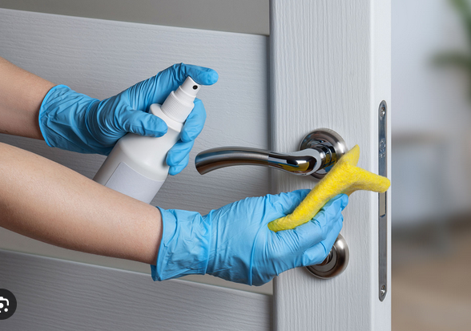
Disinfecting Surfaces Methods of Disinfecting Surfaces
Methods
This presentation will focus on:
Proper ways of cleaning and disinfecting surfaces outside of the healthcare setting
outrunningthehorses.com

Slide 18
Disinfecting Surfaces Proper Precautions
Proper Precautions should be taken
Donning proper PPE:
Wear gloves, either disposable or rubber
Wear a surgical mask in accordance with droplet precautions
Use a respirator when airborne precautions are warranted by the circumstances
outrunningthehorses.com

Slide 19
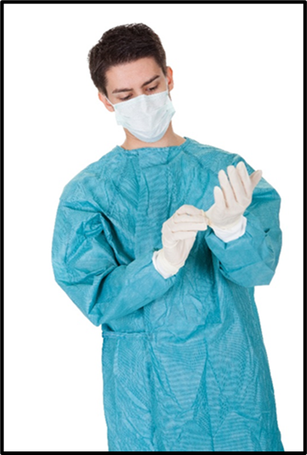
Disinfecting Surfaces Proper Precautions
Proper Precautions should be taken
Donning proper PPE:
Gown - if your clothes may be become exposed to the patient’s bodily fluids
Face and eye protection - if the patient is coughing
outrunningthehorses.com

Slide 20
Disinfecting Surfaces Proper Precautions
Proper Precautions should be taken
Keep unnecessary objects at least six feet away from the patient
Consider covering objects that are not necessary and not easily removed.
Cleaning and disinfection should be performed daily
outrunningthehorses.com

Slide 21
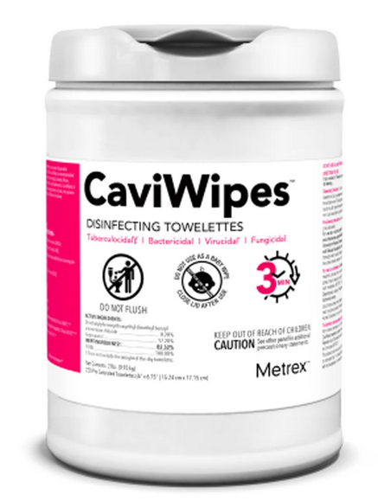
Disinfecting Surfaces Using Chemical Disinfectants
Choose the correct disinfectant
Healthcare facilities use germicidal agents
Antiseptics are for use on skin
Disinfectants are used on surfaces
These are not interchangeable
outrunningthehorses.com

Slide 22
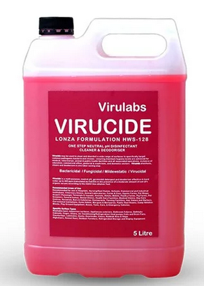
Disinfecting Surfaces Using Chemical Disinfectants
Choose the correct disinfectant
Suffix of “Cide” or “Cidal” in name
Virucide
Fungicide
Bactericide
Kills the type of microorganism identified by the prefix
outrunningthehorses.com

Slide 23
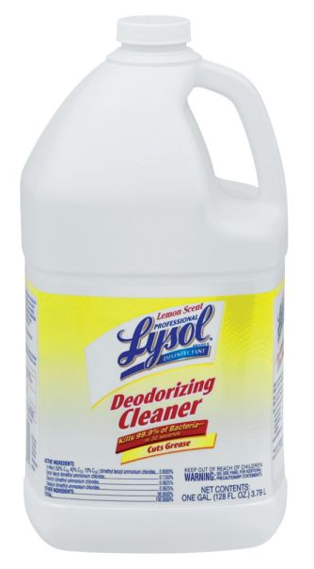
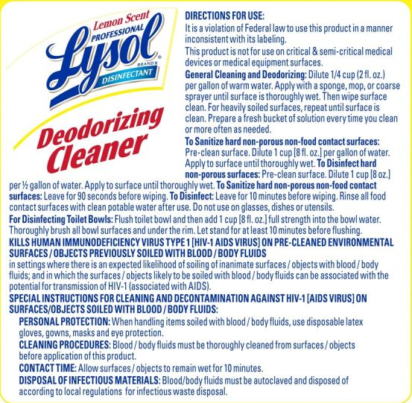
Disinfecting Surfaces Using Chemical Disinfectants
Choose the correct disinfectant
Read the labels and strictly follow instructions
Some disinfectants are only effective after being left on the surface for more than one minute and even up to twenty or more minutes
outrunningthehorses.com

Slide 24
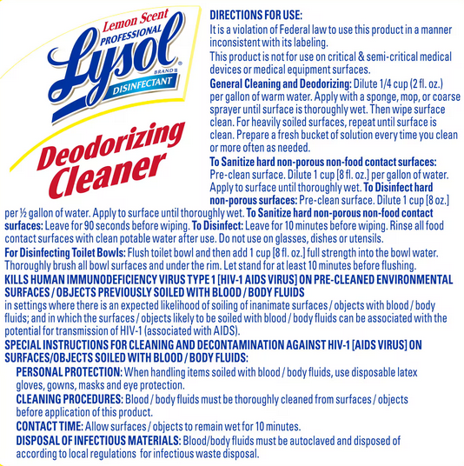

Slide 25
Disinfecting Surfaces Using Chemical Disinfectants
Influenza viruses can be eliminated by basic or intermediate level disinfectants containing any of the following ingredients:
Chlorine or hypochlorite
Aldehydes
Quaternary ammonium compounds [quats]
Phenolics
Alcohols
Peroxygen compounds
outrunningthehorses.com

Slide 26
Disinfecting Surfaces Using Chemical Disinfectants
A lists of registered disinfectants and their recommended uses are available from the U.S. Environmental Protection Agency (EPA)
Lists of all registered disinfectants can be found at:
www.epa.gov/oppad001/chemregindex.htm
outrunningthehorses.com

Slide 27
Disinfecting Surfaces Using Chemical Disinfectants
Cleaning the object thoroughly is the first step to disinfection
Obvious particles must be removed so not to hinder the disinfecting process
Can be done by using soap and water with wiping and rubbing to wash soil away
Methods other than routine cleansing are not necessary
outrunningthehorses.com

Slide 28
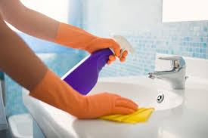
Disinfecting Surfaces Using Chemical Disinfectants
Some disinfectants are also disinfectant cleaners
If the disinfectant contains a detergent that allows it to penetrate soil, then the cleaning and disinfectant process can be completed in one step
outrunningthehorses.com

Slide 29
Disinfecting Surfaces Using Chemical Disinfectants
When using chemical disinfectants:
Always read and follow the directions on the label
Wear gloves and consider glasses or goggles for potential splash hazards to eyes
Ensure adequate ventilation (e.g. open windows)
Use only the amount recommended on the label
Use water at room temperature for dilution (unless stated otherwise on the label)
outrunningthehorses.com

Slide 30
Disinfecting Surfaces Using Chemical Disinfectants
When using chemical disinfectants:
Label diluted cleaning solutions
Store and use chemicals out of the reach of children and pets
Do not mix products or chemicals
Do not eat, drink, breathe, or apply directly to your skin as disinfection products can cause serious harm
outrunningthehorses.com

Slide 31
Disinfecting Surfaces Using Chemical Disinfectants
When using chemical disinfectants:
Do not wipe or bathe pets with any cleaning and disinfection products
Special considerations should be made for people with asthma
Some cleaning and disinfection products can trigger asthma
Use any EPA-registered detergent-disinfectant
outrunningthehorses.com

Slide 32
Disinfecting Surfaces Using Chemical Disinfectants
When using chemical disinfectants:
Dispose of mop heads, rags, and other cleaning materials properly
Keep mops, cloths, and buckets separate from other household items
Do not wipe surfaces using a dry cloth
This may shake up dust and scatter the pathogen into the air
outrunningthehorses.com

Slide 33
Disinfecting Surfaces Using Chemical Disinfectants
When using chemical disinfectants:
Use a vacuum with a HEPA filter.
Keep disinfecting wipes on hand for quick clean ups
To avoid further contamination of surfaces, practice good hand hygiene habits
The use of spray disinfectants to disinfect the air is not recommended
May induce coughing, especially if patient has asthma
outrunningthehorses.com

Slide 34
Disinfecting Surfaces Using Chemical Disinfectants
When using chemical disinfectants:
Be sure to include surfaces such as:
Doorknobs
Light switches
TV controls
Telephones
Keyboards
Dresser tops
Alarm clocks
Bathroom surfaces
Kitchen counter tops
Faucets
Floors
Any horizontal surface
outrunningthehorses.com

Slide 35
Disinfecting Surfaces Using Chemical Disinfectants
When using chemical disinfectants:
Clean items used for direct patient care:
Walker
Cane
Wheelchair
Read instructions for special equipment:
CPAP
BiPAP
Grab bars/safety rails
Bed rails
Bedside commodes
outrunningthehorses.com

Slide 36
Disinfecting Surfaces Special Equipment
Items used for patient care such as thermometers, stethoscopes, pulse oximeters, and glucometers need special care
Cleaning should be performed between each patient use to avoid transmission of infection
outrunningthehorses.com

Slide 37
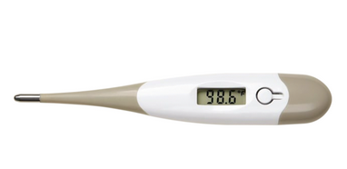
Disinfecting Surfaces Special Equipment
Thermometers
Clean with soap and warm water
Wipe the probe or sensor tip thoroughly with 70% isopropyl alcohol
Non-waterproof digital thermometers, avoid soaking the display
Waterproof and glass models can be sanitized with alcohol wipes
Allow the thermometer to air dry
outrunningthehorses.com

Slide 38
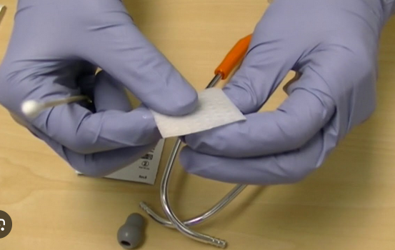
Disinfecting Surfaces Special Equipment
Stethoscopes
Wipe the diaphragm, bell, and headset with 70% isopropyl alcohol wipes
For contaminated or specific clinical situations use:
2% chlorhexidine
Hydrogen peroxide wipes
1:100 bleach solution
outrunningthehorses.com

Slide 39
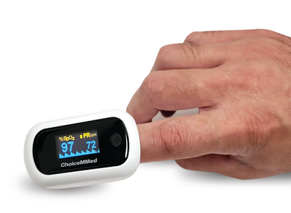
Disinfecting Surfaces Special Equipment
Pulse Oximeters
Wipe the outer surface and sensor with a soft cloth or cotton swab dampened with 75% isopropyl alcohol
Wipe with a clean dry cloth, and allow to air dry
Avoid allowing liquid in the interior
Also clean the finger that will be used for measurement before placing pulse oximeter
outrunningthehorses.com

Slide 40
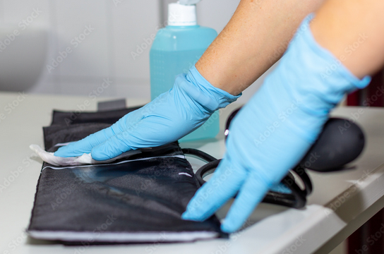
Disinfecting Surfaces Special Equipment
Blood pressure cuffs
To clean: Wipe the outer surface with a damp cloth and mild detergent
To disinfectant: use disinfectant wipes (70 % isopropyl alcohol) or use only a 1-2% bleach solution
Rinse with water and allow to air dry
No water should enter the tubing or inflated pump during cleaning
outrunningthehorses.com

Slide 41
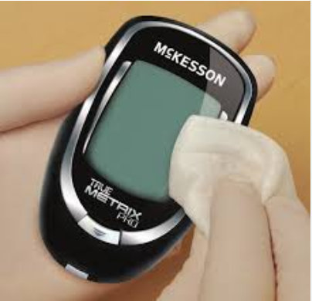
Disinfecting Surfaces Special Equipment
Glucometers
Wipe all exterior surfaces with a disinfectant wipe
Or a cloth dampened with 70% isopropyl alcohol
Avoid getting liquid in the test strip port or buttons
Let air dry completely
outrunningthehorses.com

Slide 42
Disinfecting Surfaces Conclusion
Removing and killing an infectious agent on a surface effectively must be performed properly and methodically
Cleaning then disinfecting
Read the label to ensure proper use and efficacy
Second to wearing PPE when caring for a patient with a pathogen causing a pandemic, is keeping all surfaces clean from the infectious agent
This is crucial to preventing the spread of the disease
outrunningthehorses.com

Slide 43

outrunningthehorses.com

Slide 44


“If you have run with footmen, and they have tired you out,
then how can you compete with horses?
If you fall down in a land of peace,
how will you do in the thicket by the Jordan?”
Jeremiah 12:5

Slide 45
For more presentations like this
or for more information
please visit
outrunningthehorses.com

