Slide 1
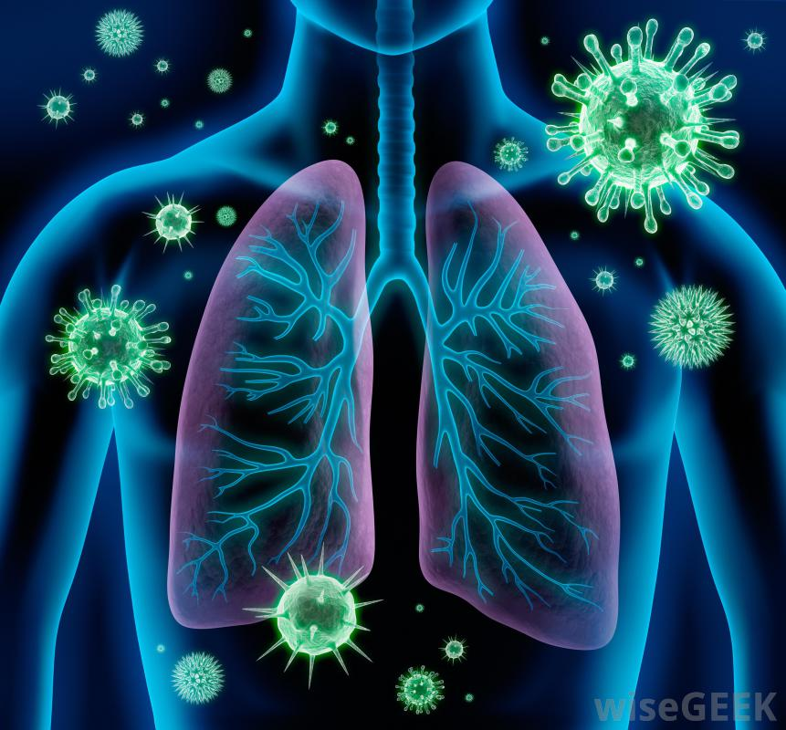
Pandemic Plan for the Church
Ministering to the Community in a Time of Crisis
Preventing a Cytokine Storm
What We’ve Learned From COVID-19
outrunningthehorses.com

Slide 2
Disclaimer
Disclaimer
  This information is for educational purposes only and does constitute professional medical advice or diagnosis.
  Consult your medical provider if there are any questions or concerns.
outrunningthehorses.com

Slide 3
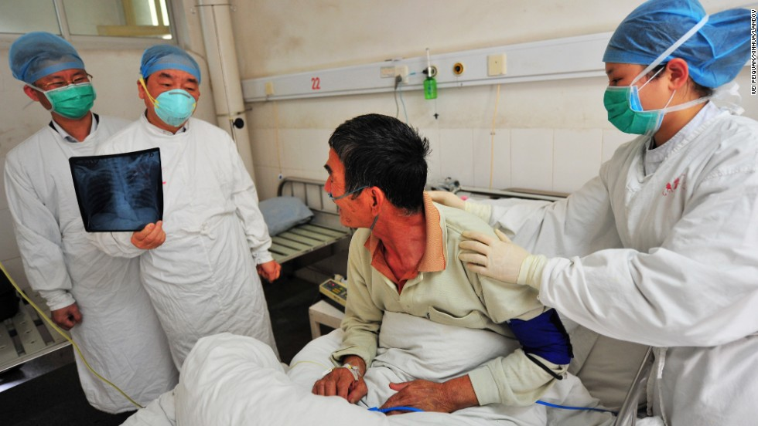
A “Cytokine Storm”
is what makes
Avian Influenza so deadly

Slide 4
Avian Influenza – Pathophysiology
Cytokine Storm
A cytokine storm (aka hypercytokinemia)
  Condition where body’s immune system releases too many inflammatory signaling molecules
  These are called cytokines
  Can lead to life threatening systemic inflammatory response with serious symptoms

Slide 5
Avian Influenza – Pathophysiology
Cytokine Storm
Avian Influenza causes a “Cytokine Storm”
  A pro-inflammatory cytokine response
  Occurs in alveoli and bronchial epithelial cells
  Levels reach more than 10 times higher than common flu virus
  Inflammation causes damage enough to cause acute respiratory distress (ARDS)

Slide 6
Preventing a Cytokine Storm
What We’ve Learned from COVID-19
Scientists have a better understanding of the pathophysiology of Avian Influenza and COVID-19
  However, the search for new interventions remain ongoing
  These include medicines with anti-inflammatory and strong antioxidant potentials
outrunningthehorses.com

Slide 7
Preventing a Cytokine Storm
What We’ve Learned from COVID-19
Antibiotics are commonly prescribed for respiratory tract infections (RTI)
This presentation will cover over the counter (OTC) medicines that have been put into practice
Disclaimer: This is for informational purposes and not meant as medical advice.
outrunningthehorses.com

Slide 8
Preventing a Cytokine Storm
What We’ve Learned from COVID-19
The National Institutes of Health (NIH) define a respiratory tract infection (RTI) as any infection disease of the upper or lower respiratory tract.
  Upper respiratory tract infections (URTIs) include the common cold, laryngitis, pharyngitis/tonsilitis, acute rhinitis, acute rhinosinusitis, and acute otitis media
  Lower respiratory tract infections (LRTIs) include acute bronchitis, bronchiolitis, pneumonia and tracheitis
outrunningthehorses.com

Slide 9
Vitamin D3 and Respiratory Health
Sunlight can boost serotonin levels and improve mental health
  This by increasing vitamin D production
  Studies have shown that:
    Low levels of vitamin D in your system may increase the risk of severe COVID-19 symptoms
    And even lengthen your recovery
outrunningthehorses.com

Slide 10
Vitamin D3 and Respiratory Health
Vitamin D is a fat-soluble-vitamin
  Major source comes from the sun’s UV light.
  Exposure to the sun allows skin to convert vitamin D from cholesterol
  Best way to get vitamin D
outrunningthehorses.com

Slide 11
Vitamin D3 and Respiratory Health
Vitamin D is a fat-soluble-vitamin
  Dietary sources include fortified foods and supplements
  Studies indicate a high prevalence of vitamin D deficiency worldwide
outrunningthehorses.com

Slide 12
Vitamin D3 and Respiratory Health
There is evidence that vitamin D may prevent or improve outcomes in many infectious and inflammatory conditions
  Including acute and chronic respiratory infections
  Increased understanding of its immunomodulatory and anti-inflammatory properties
outrunningthehorses.com

Slide 13
Vitamin D3 and Respiratory Health
A study found a 70% reduction in viral respiratory tract infections among persons with vitamin D deficiency receiving vitamin D treatment
  Benefits found to:
    Boost immune system
    Help control inflammation
outrunningthehorses.com

Slide 14
Dr. James Mullin of
Lankenau Inst. For Medical Research
“The benefits … are so clear and the risks so minimal that we believe physicians should be recommending supplemental Vitamin D right away…We already know from past studies that Vitamin D blunts cytokine storms in cases of flu. In cases of COVID-19, vitamin D therapy may allow time for a patient’s own immune defenses to kick in before it’s too late.”
outrunningthehorses.com

Slide 15
Vitamin D3 and Respiratory Health
Recommended Dietary Allowances for Vitamin D
  Many people are deficient
  Recommendations vary
  Mayo Clinic recommends adult get at lease 600 IU
    However, 1,000 to 2,000 IU per day is generally safe
outrunningthehorses.com

Slide 16
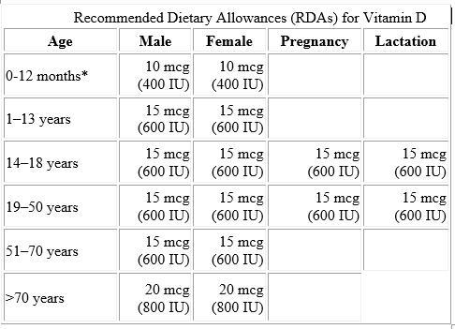
Vitamin D3 and Respiratory Health
outrunningthehorses.com

Slide 17
Vitamin D3 and Respiratory Health
If you acquire a respiratory illness
  Increasing supplementation either 5,000 to 10,000 IUs a day (taken 5,000 IUs 2 times a day) is recommended
  This will correct or prevent deficiency
outrunningthehorses.com

Slide 18
Vitamin D3 and Respiratory Health
How to Take Vitamin D
  Fat soluble
    Does not dissolve in water
    Best absorbed when taken with high fat foods
outrunningthehorses.com

Slide 19
Vitamin D3 and Respiratory Health
How to Get More Vitamin D
  More sunlight and foods rich in Vitamin D are the best ways
  Exposure to sunlight 10 to 15 minutes three times a week
  Be aware you will need more sunlight time in the winter
outrunningthehorses.com

Slide 20
Vitamin D3 and Respiratory Health
Foods rich in Vitamin D include:
  Oily fish (salmon, rainbow trout, tuna, sardines
  Red meat
  Egg yolks
  Fortified:
    Orange Juice
    Milk
    Almond milk
    Rice milk
outrunningthehorses.com

Slide 21
Antihistamines
A Cytokine Storm is the result of histamine activated pathways
  A histamine is a chemical that’s released by white blood cells in your immune system
  They are released when your immune system overreacts to a substance
outrunningthehorses.com

Slide 22
Antihistamines
Substances that may trigger overreaction include:
  Food
  Dust
  Pollen
  Venom
  Antigens
outrunningthehorses.com

Slide 23
Antihistamines
Histamines are responsible for many of the symptoms of allergies including:
  Runny nose
  Sneezing
  Itchy eyes
outrunningthehorses.com

Slide 24
Antihistamines
Histamines effect include:
  Widening of blood vessels
    Causes leaking
    Causes tissues to swell
  Increase in gastric acid production
  Increase in heart rate
outrunningthehorses.com

Slide 25
Antihistamines
Histamines act on:
  Eyes
  Nose
  Throat
  Lungs
  Skin
  Gastrointestinal tract
outrunningthehorses.com

Slide 26
Antihistamines
Four Classes of Histamines:
  H1, H2, H3, H4
  H1 and H2 have gained the most attention
  Can trigger inflammation responses
    Acute Respiratory Distress Syndrome (ARDS)
    Deep vein thrombosis
    Damage to organs
outrunningthehorses.com

Slide 27
Antihistamines
H1 Stimulates
  Smooth muscle contraction
    Respiratory tract
    Gastrointestinal tract
    Sneezing
    Pruritus (itching)
    Vascular permeability leading to edema
outrunningthehorses.com

Slide 28
Antihistamines
H2 Stimulates
  Gastric acid secretion
H2 Regulates gastrointestinal motility
outrunningthehorses.com

Slide 29
Antihistamines
H1 Inhibitor Antihistamines
  Modulate histamine pathways
  Suppress viral growth
outrunningthehorses.com

Slide 30
Antihistamines
H1 Inhibitor Antihistamines recommended:
  Dexchlorpheniramine (Polaramine) 2 mg
  Cetirizine (Zyrtec) 10 mg
  Loratadine (Claritin) 10 mg
outrunningthehorses.com

Slide 31
Antihistamines
H1 Inhibitor Antihistamines recommended:
  Start treatment at the first symptoms
  Every 12 hours
outrunningthehorses.com

Slide 32
Antihistamines
H2 Inhibitor Antihistamines
  Binds H2 receptors in the stomach
  Binds to Mast cells
    Mast cells responsible for releasing mediators that result in inflammation
    Reduces the proteins in the body can cause an inflammatory cascade
outrunningthehorses.com

Slide 33
Antihistamines
H2 Inhibitor Antihistamine recommended
  Pepcid AC aka Famotidine
  May improve symptoms by reducing histamine-induced cytokine release and inflammation
  Dosage adults and children 12 years and over 80 mg 3 times a day
outrunningthehorses.com

Slide 34
Zinc
Zinc is an essential mineral
  Helps immune system fight off invading bacteria and viruses
  Necessary for development and function of T cells in immune system
    Responsible for fighting infections
  Regulates cytokine expression suppressing inflammation
outrunningthehorses.com

Slide 35
Zinc
Zinc is an essential mineral
  Proven to have antiviral effects
    Reduces replication of the influenza virus and COVID-19
    Helps inhibit the viral load
outrunningthehorses.com

Slide 36
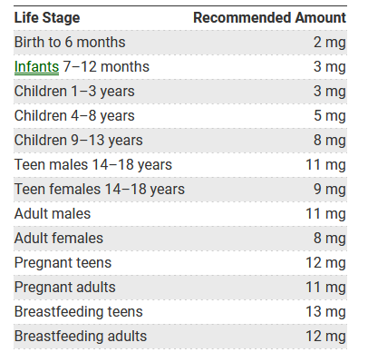
outrunningthehorses.com

Slide 37
Zinc
Zinc dosage while experiencing symptoms
  Consider increased daily amount as high as 50 mg 2 times a day for a short duration
outrunningthehorses.com

Slide 38
Vitamin C
Vitamin C
  Powerful antioxidant
    Protects cells from damage caused by free radicals
  Its effect on the immune system is complex
outrunningthehorses.com

Slide 39
Vitamin C
Vitamin C
  Has antiviral properties
    Stimulates interferon (blocks replication of viruses)
    Enhances antiviral activity in epithelial cells of the lungs
outrunningthehorses.com

Slide 40
Vitamin C
Vitamin C
  Has anti-inflammatory effects
    Prevents hyperactivation of immune cells
    Decreases inflammatory markers
    Leads to lowering inflammatory cytokine production
outrunningthehorses.com

Slide 41
Vitamin C
Vitamin C
  Is water soluble
    Not stored in the body
  Side effects are rare
    Amounts greater than 2,000 mg a day not recommended
    Can lead to stomach upset, diarrhea
outrunningthehorses.com

Slide 42
Vitamin C
Vitamin C Recommended Daily Amount
  Men – 90 mg a day
  Women – 75 mg a day
  During pregnancy - 120 mg a day
outrunningthehorses.com

Slide 43
Vitamin C
Vitamin C Recommended Daily Amount
  1–3 years: 15 mg
  4–8 years: 25 mg
  9–13 years: 45 mg
  14–18 years: 65 mg for girls and 75 mg for boys
outrunningthehorses.com

Slide 44
Vitamin C
Increase your daily dosage while experiencing symptoms
  High-dose vitamin C supplementation can alleviate inflammatory response and hinder the aggravation of COVID-19 and Influenza
  Do not exceed 2,000 mg per day
  Spread supplementation throughout the day
outrunningthehorses.com

Slide 45
Aspirin
Aspirin is acetylsalicylic acid
  Classified as a non-steroidal anti-inflammatory drug
  Used to reduce pain and inflammation
outrunningthehorses.com

Slide 46
Aspirin
Aspirin uses
  Reduce fever
  Reduce inflammation
  Relieve mild to moderate pain from
    Muscle aches
    Toothaches
    Common cold
    Headaches
outrunningthehorses.com

Slide 47
Aspirin
Aspirin
  Blocks and enzyme called cyclooxygenase
    Cyclooxygenase produces hormones called prostanoids
    Prostanoids cause platelets to stick together
      Role of platelets is to stick together and block cuts and breaks in blood vessels
    Blocking these reduces formation of clots
outrunningthehorses.com

Slide 48
Aspirin
The cascade of inflammatory mediators can cause some to develop blood clots
  To prevent blood clots, take 325 mg per day
outrunningthehorses.com

Slide 49
Aspirin
Do not take aspirin if you experience the following:
Allergy to ibuprofen
Stomach ulcer
Stroke victim (unless doctor recommended)
Indigestion
Asthma
Gout
Heavy periods
Pregnant or trying to get pregnant
Breastfeeding
outrunningthehorses.com

Slide 50
Aspirin
Do not take give aspirin to children or teenagers without checking with your child’s doctor
It can cause a serious illness called Reye’s syndrome
outrunningthehorses.com

Slide 51
Conclusion
Scientists have a better understanding of the pathophysiology of Avian Influenza and COVID-19
  Several Over the Counter (OTC) medicines have been found to have effects in preventing a cytokine storm
outrunningthehorses.com

Slide 52
Conclusion
The following OTC medicines are recommended in preventing a cytokine storm:
  Vitamin D3
  Antihistamines
    Claritin
    Pepcid AC
  Zinc
  Vitamin C
  Aspirin
outrunningthehorses.com

Slide 53

Questions?
outrunningthehorses.com

Slide 54

For more presentations like this
or for more information
please visit
outrunningthehorses.com
outrunningthehorses.com

