Slide 1

Pandemic Plan for the Church
Ministering to the Community in a Time of Crisis
Gain of Function Research
and Lab Mishaps
outrunningthehorses.com

Slide 2
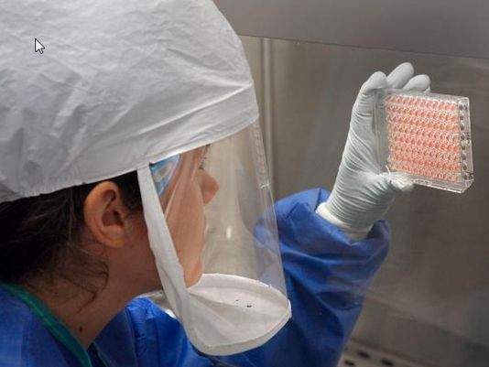
“More than 200 incidents
of loss or release of bioweapons agents
from U.S. laboratories are reported each year.
This works out to more than four per week.”
Richard Ebright, biosafety expert at Rutgers University
testifying before Congress in October 2014
outrunningthehorses.com

Slide 3
Objectives
The following topics will be discussed
  Lab Accident Reporting
  Bio-lab facilities
  Select agents
  Biosafety levels
  Lab mishaps
  Gain of Function Research
outrunningthehorses.com

Slide 4
Lab Accident Reporting
Hundreds of mishaps happen every year
  Missing vials
  Lab mistakes
  Equipment failures
  Safety violations
  Near-miss incidents
  Runaway infected rodents
outrunningthehorses.com

Slide 5
Lab Accident Reporting
Other than Centers for Disease Control and Prevention (CDC) other bio-lab facilities may include:
  Government
  University
  Military
  Private
outrunningthehorses.com

Slide 6
Lab Accident Reporting
No single agency tracks:
  Overall number of labs
  Location
  Pathogens
  Compliancy
  Lab Accidents
outrunningthehorses.com

Slide 7
Lab Accident Reporting
Lab Accident Reporting
  Kept secret due to:
    Security reasons
    Federal Bioterrorism laws
  Reporting done:
    Voluntarily
    Three years later
outrunningthehorses.com

Slide 8
Select Agents
Select Agents
  Bio-agent that has been declared to have the potential to pose a severe threat to public health and safety
  Federal Government has not identified all labs that work with “select agents”
outrunningthehorses.com

Slide 9

Select Agents
Select Agents Include:
  Bacteria
  Viruses
  Toxins
Bioterror pathogens
  Anthrax
  Plague
  Ebola
outrunningthehorses.com

Slide 10
Biosafety Levels
Biosafety Level
  Set of biocontainment precautions required to work with dangerous biological agents
  Levels range
    Lowest – Biosafety Level 1 (BSL-1)
    Highest – Biosafety Level 4 (BSL-4)
outrunningthehorses.com

Slide 11
Biosafety Levels
Biosafety Level 1
  Agents that do not cause disease in healthy humans
  Minimal hazard potential
  Work performed on standard laboratory benches
  Use of special containment equipment not necessary
    High schools
    Colleges
outrunningthehorses.com

Slide 12
Biosafety Levels
Biosafety Level 2
  Additional precautions
    Lab personnel have specific training
    Access is limited
    Extreme precautions taken with sharp items
  Work involving moderately potentially hazardous agents such as:
    Hepatitis A, B, and C Viruses
    HIV
outrunningthehorses.com

Slide 13
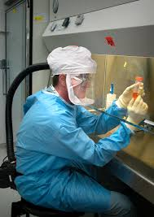
Biosafety Levels
Biosafety Level 3
  Windows are sealed, air from lab must be filtered
  Personnel provided medical surveillance
  Work performed in biological safety cabinet
outrunningthehorses.com

Slide 14
Biosafety Levels
Biosafety Level 3
  Work involving microbes which can cause serious potentially lethal diseases via inhalation such as:
    SARS
    Rift Valley fever
    Yellow fever
    West Nile
outrunningthehorses.com

Slide 15
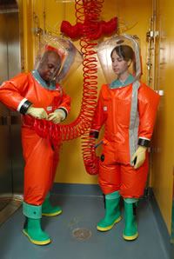
Biosafety Levels
Biosafety Level 4
  All work performed requires:
    Class II Biosafety Cabinet
    Personnel wearing a Positive Pressure Suit
outrunningthehorses.com

Slide 16
Biosafety Levels
Biosafety Level 4
  Used for diagnostic work and research
  Easily transmitted pathogens
    Viral Hemorrhagic fevers
      Marburg
      Ebola
      Lassa
    Smallpox
outrunningthehorses.com

Slide 17
Biosafety Levels
Avian Influenza
  Due to research creating human to human transmissible virus strains
    Certain strains are BSL-4
    Debate as to all strains should be BSL-4
outrunningthehorses.com

Slide 18
Lab Mishaps
1977 – Global Scale
  H1N1 strain known as Russian Flu
    Genetically similar to 1957 flu that disappeared
    Genetically “preserved” over the decades
    Virologists convinced it came from a frozen sample in a lab and released accidentally
outrunningthehorses.com

Slide 19
Lab Mishaps
1978 – University of Birmingham Medical School
  Janet Parker, medical photographer in anatomy department
    Accidentally exposed to a specimen grown in a research lab on the floor below her office
    Scientist in charge, Henry Bedson, so distraught took his own life
outrunningthehorses.com

Slide 20
Lab Mishaps
2001 – Fort Detrick, MD
  U.S. Army Medical Research Institute of Infectious Diseases
  Bruce Ivans, biologist, anthrax researcher
    Deliberately stole anthrax
      Killed 5 people
      Sickened 17
outrunningthehorses.com

Slide 21
Lab Mishaps
2004 – China
  National Institute of Virology of Bejiing
    Severe Acute Respiratory Syndrome (SARS)
      Small, deadly outbreak
      Traced to lab workers
outrunningthehorses.com

Slide 22
Lab Mishaps
2007 – England
  Outbreak of foot and mouth disease
    Led to herds being slaughtered
    Blamed on leaking drainage pipes at nearby research complex
outrunningthehorses.com

Slide 23
Lab Mishaps
February 2014 – University of Iowa
  Scientist conducting experiments with genetically manipulated strain of MERS
  No biosafety committee approval
  Worked on since September 2013
outrunningthehorses.com

Slide 24
Lab Mishaps
November 2014 – Tulane National Primate Research Center, LA
  Dangerous, deadly bacteria released from high-security laboratory
  Sickened monkeys living outside in cages
outrunningthehorses.com

Slide 25
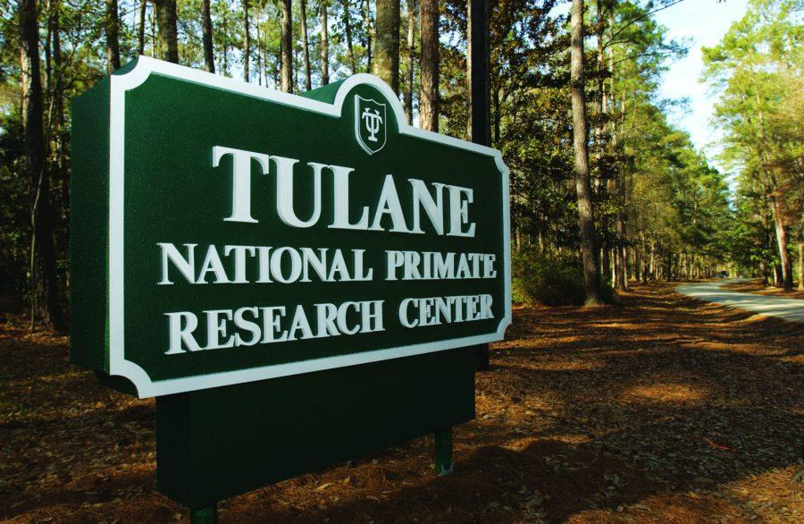
Lab Mishaps
November 2014 – Tulane National Primate Research Center, LA
  Tulane had to test for the following five years around their 500 acre facility:
    Outdoor monkey colony
    Wildlife
    Feral cats
outrunningthehorses.com

Slide 26
Lab Mishaps
2011 – FEMA Training
  Federal training facility exposed thousands of first responders to deadly ricin while training
  Vendor assured powder was an inactivated form of the poison
outrunningthehorses.com

Slide 27
Lab Mishaps
2011 – FEMA
  Powder actually contained ricin “greater than 90% pure”
    There is no antidote
    All trainees wore PPE
    Nobody was sickened
outrunningthehorses.com

Slide 28
Lab Mishaps
December 2013 – University of Iowa
  Imported a strain of MERS from Spain
  Began research without approval of University’s oversight committee
  Worked in a BSL-2 as opposed to a BSL-3 as required
outrunningthehorses.com

Slide 29
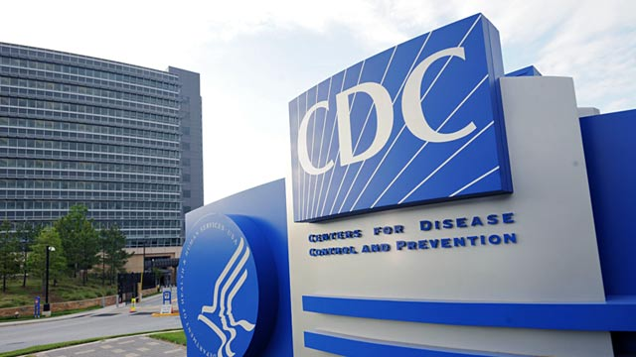
Lab Mishaps
December 2013 – CDC, Atlanta
  Lab accident occurred
    Report had every word redacted
    Experiment was to reconstruct 1918 Influenza
outrunningthehorses.com

Slide 30
Lab Mishaps
April 2014 – NC State Laboratory of Public Health
  Box shipped to CDC by regular UPS delivery
    Contained infectious materials
    Box was mangled with “gaping hole” in one corner
    No appropriate packing materials or labels
    Vials were broken
    Specimens included Typhoid fever
outrunningthehorses.com

Slide 31
Lab Mishaps
May 2014 – CDC, Atlanta
  Cross-contaminated a mild strain of avian influenza with a dangerous strain that can kill people
    Shipped to USDA laboratory
    Mistake discovered when birds unexpectedly died
outrunningthehorses.com

Slide 32
Lab Mishaps
July 2014 – National Institutes of Health, Bethesda, MD
  Vials discovered in a cold storage room
    Dated back to 1946-1964
    Contained vaccinia and smallpox viruses
outrunningthehorses.com

Slide 33
Lab Mishaps
December 22, 2014 – CDC, Atlanta
  Worker at BSL-4 lab confused specimens
    Sent an un-killed sample of Ebola to a BSL-2 lab
      With minimal protections
outrunningthehorses.com

Slide 34
Lab Mishaps
2015 – Army’s Dugway Proving Ground, Utah
  Mistakenly shipped specimens of live anthrax, labeled “killed” to labs and defense contractors around the world for a decade
  Scientists misjudged the effectiveness of lab’s kill procedures
outrunningthehorses.com

Slide 35
Lab Mishaps
2015 – CDC, Atlanta
  Scientist lost a box of deadly and highly regulated influenza specimens
outrunningthehorses.com

Slide 36
Lab Mishaps
June 2016 – USA Today Investigation
  Revealed more than 100 labs working with bioterror pathogens have faced secret federal sanctions for safety violations
  Regulators allow them to keep experimenting while failing inspections, sometimes for years
outrunningthehorses.com

Slide 37
Lab Mishaps
February 2017 – Canadian Science Centre for Human and Animal Health, Winnipeg
  While working on Ebola vaccine
  14 cases of employees exposed to pathogen
    Report stated issues with
      Biosafety suits
      Needle sticks
      Malfunctioning Equipment
outrunningthehorses.com

Slide 38
Lab Mishaps
November 2019 - Lanzhou Veterinary Research Institute (China)
  Unsterilized waste gas carried by the wind
    65 workers to become infected with brucellosis
    More than 10,000 residents were infected
outrunningthehorses.com

Slide 39
Lab Mishaps
November 2019 - Lanzhou Veterinary Research Institute (China)
  Unsterilized waste gas carried by the wind
    65 workers to become infected with brucellosis
    More than 10,000 residents were infected
outrunningthehorses.com

Slide 40
Lab Mishaps
House Select Subcommittee on the Coronavirus Pandemic released final report December 2, 2024
  Report states:
    SARS-CoV-2 virus “likely emerged because of laboratory or research related accident.”
outrunningthehorses.com

Slide 41
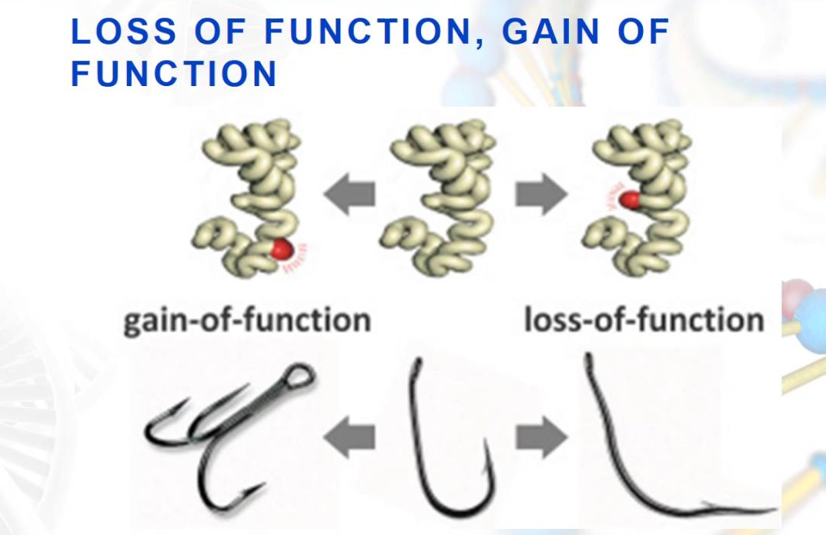
Gain of Function Research
Searching for a cure – Is it worth the risk?
outrunningthehorses.com

Slide 42
Gain of Function Research
“Gain of Function” Research
  Experiments that aim to increase the transmissibility and/or virulence of pathogens
  Improve understanding of pathogen
  Aid in public health and preparedness
  Benefit pharmacological and vaccine efforts
outrunningthehorses.com

Slide 43
Gain of Function Research
“Gain of Function” Research
  Poses risks to biosecurity and biosafety
    Pandemic could result from a lab accident
    It has been determined that COVID-19 was caused by a lab accident
  “Dual-use Research”
    Can be used for both beneficial and malevolent purposes
outrunningthehorses.com

Slide 44
Gain of Function Research
1979 – Sverdlovsk, Soviet Union
  Anthrax research during Cold War
    Isolated most potent strain
    Dried to produce a fine powder for use as an aerosol
    Accidentally released killing 100
outrunningthehorses.com

Slide 45
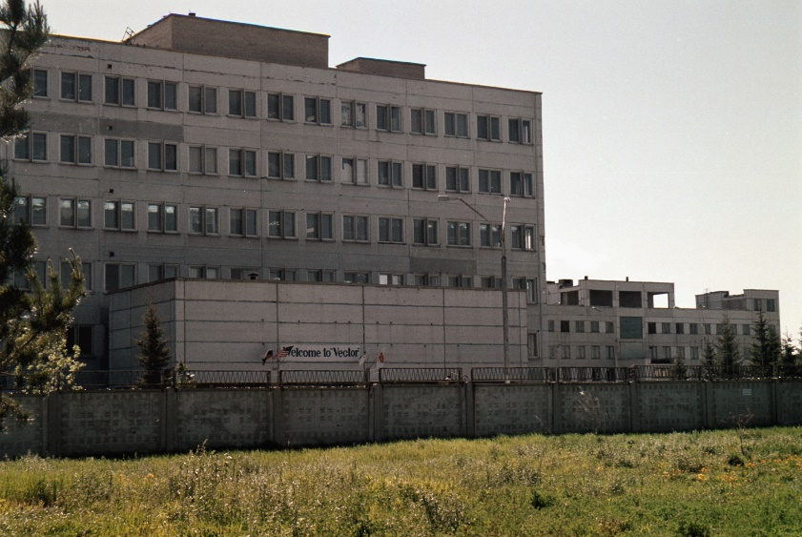
Gain of Function Research
1996 – Vector, Siberian Complex
outrunningthehorses.com

Slide 46
Gain of Function Research
1996 – Vector, Siberian Complex
  Lab worker contracted Ebola while drawing blood from infected animals
    She kept quiet in fear of getting in trouble
    When illness progressed it was too late
  2004 – Similar Accident
outrunningthehorses.com

Slide 47
Gain of Function Research
1996 – Vector, Siberian Complex
  Top Soviet research facility for bioweapons
  Today studies focused on Ebola
    Effort to assess Ebola as potential biological weapon
    Scientist attempt to manipulate genetic coding
      Attempt to aerosolize
outrunningthehorses.com

Slide 48
Gain of Function Research
“The bottom line is,
we don’t know what they’re doing
with any of the pathogens
in their possession.”
Amy Smithson, a biological weapons expert who has traveled to several of the labs and written extensively about the Soviet-era weapons complex.
outrunningthehorses.com

Slide 49
Gain of Function Research
Soviet Union - Current
  Biological weapons being developed:
    Marburg virus
    Ebola virus
    Machupo virus (hemorrhagic fever originating in Bolivia)
outrunningthehorses.com

Slide 50

Gain of Function Research
2011– South Africa
  Dr. Wouter Basson aka “Dr. Death”
    Worked on clandestine weapons program
    Genetically engineering dangerous organisms to create bioweapons
outrunningthehorses.com

Slide 51
Gain of Function Research
2011– South Africa - Dr. Wouter Basson aka “Dr. Death”
  Genetically engineered bioweapons included:
Ebola
Anthrax
Cholera
Botulinum
Marburg Virus
Rift Valley Virus
Nerve Gasses (Sarin)
Necrotizing fascititis
outrunningthehorses.com

Slide 52
Gain of Function Research
April 2014 – West Africa – Ebola
  Largest Ebola outbreak in history
  More cases and deaths than all previous outbreaks combined
outrunningthehorses.com

Slide 53
Gain of Function Research
December 2011
  Ron Fouchier, Dutch Virologist, Erasmus Medical Center, Rotterdam
    Reported that he created a highly contagious strain of the H5N1 virus
    It could adhere to human cells in the nose and throat
    He attempted to publish his findings in an international Science magazine
    A debate ensued
outrunningthehorses.com

Slide 54
Gain of Function Research
April 2014 – West Africa – Ebola
  Dr. Francis Boyle, professor international law, University of Illinois, College of Law
    Convinced Ebola outbreak was result of release from biowarfare research lab
    Ebola strain was much worse than those previously seen in the wild
outrunningthehorses.com

Slide 55
Gain of Function Research
April 2014 – West Africa – Ebola
  Receptor-binding domain of the virus has been the same since the first Ebola outbreak in 1976
  Genetic mutation GP-A82V likely responsible for 90% of Ebola cases
    28,000 infections
    11,300 deaths
outrunningthehorses.com

Slide 56
Gain of Function Research
April 2014 – West Africa – Ebola
  Mutation to outer glycoprotein responsible for virus’ ability to bind to human receptors
  New virus better fit with human host receptor
outrunningthehorses.com

Slide 57

Gain of Function Research
Ron Fouchier
  Manipulated the virus to be able to spread between ferrets
  Ferrets have similar respiratory glycogen receptors as humans
    Transmissibility would mimic that of humans
outrunningthehorses.com

Slide 58
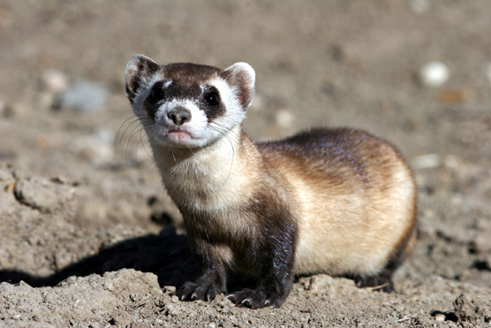
Gain of Function Research
Ron Fouchier
  After virus began to spread around the ferret cages
    Fouchier examined influenza samples
      There were only five genetic changes in two of virus’ eight genes
outrunningthehorses.com

Slide 59
Gain of Function Research
Ron Fouchier
  Each mutation had already been found circulating in influenza viruses in nature
    He placed all five mutations together in one virus
    Hoped to make the properties that make the virus so much deadlier than others
outrunningthehorses.com

Slide 60
Gain of Function Research
Scientific Community Concerns
  Fear of a natural pandemic
  Biological-weapons experts maintained that Fouchier’s bird flu posed a threat to hundreds of millions of people
  Many questioned how likely it is to escape the laboratory
outrunningthehorses.com

Slide 61
Gain of Function Research
Ron Fouchier and Scientific Community
  One of the world’s most persistent horror fantasies, expressed everywhere from Mary Shelley’s “Frankenstein” to “Jurassic Park,” had suddenly come to pass: a dangerous form of life, manipulated and enhanced by man, had become lethal.
outrunningthehorses.com

Slide 62
Gain of Function Research
January 20, 2012
  A moratorium was placed on H5N1 research
  Review gain of function research
  Implementation of safety guidelines
  Discussion of publication
outrunningthehorses.com

Slide 63
Gain of Function Research
“Most of us are unequivocal about the value of the research. But deciding what to do with these types of studies is complicated. At the moment, there are no official governing bodies to regulate such decisions. They rely on the good will of researchers.”
… Anthony Fauci
outrunningthehorses.com

Slide 64
Gain of Function Research
Scientific Community Concerns
  Michael T. Osterholm, the director of the Center for Infectious Disease Research and Policy at the University of Minnesota Health Center. Nation’s leading experts on influenza and bioterrorism
    Weighed heavily against publication
outrunningthehorses.com

Slide 65
Gain of Function Research
“Terror is not an unjustified reaction to knowing this virus exists. We have no room to be wrong about this. None. We can be wrong about other things. If smallpox got out, it would be unfortunate, but it has a fourteen-day incubation period, it’s easy to recognize, and we would stop it. Much the same is true with SARS. But with flu you are infectious before you even know you are sick. And when it gets out it is gone. Those researchers have all of our lives at the ends of their fingers.” … Michael T. Osterholm
outrunningthehorses.com

Slide 66
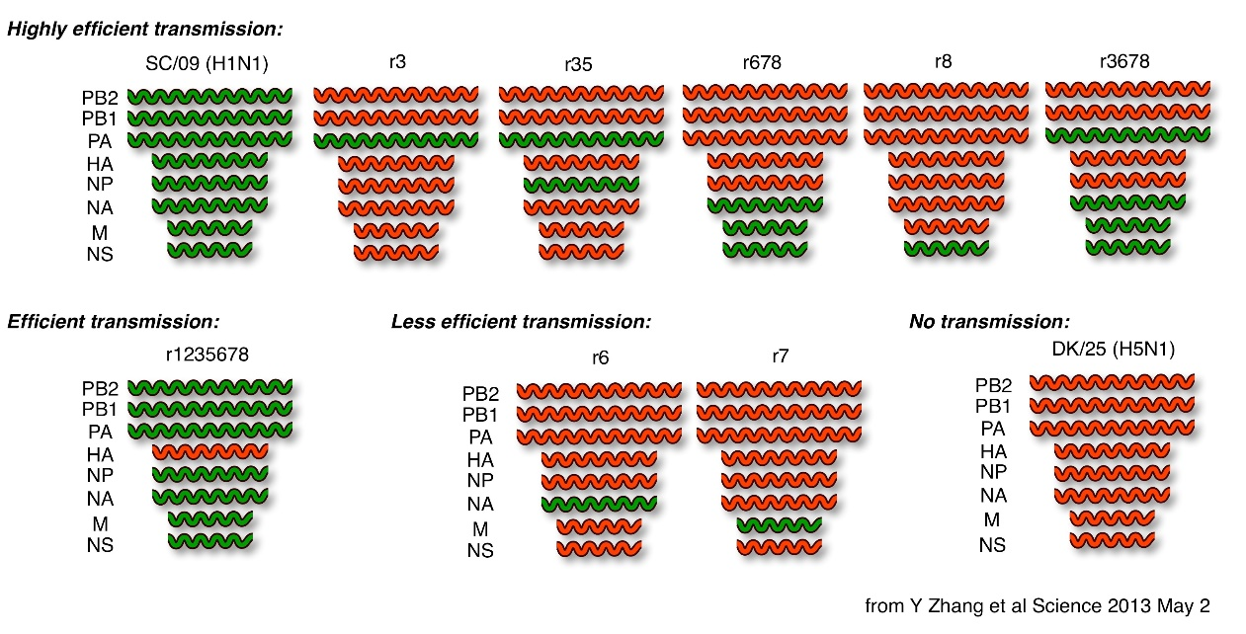
“I am not nearly as worried about terrorists as I am about an incredibly smart, smug kid at Harvard, or a lone crazy employee with access to these sequences.”
Michael T. Osterholm, the director of the Center for Infectious Disease Research and Policy at the University of Minnesota Health Center
outrunningthehorses.com

Slide 67
Gain of Function Research
  “There are warning signs, evidence in Afghanistan that Al Qaeda in the Arabian Peninsula made a call to arms for—and I quote—‘brothers with degrees in microbiology or chemistry to develop a weapon of mass destruction.’”
  … Hillary Clinton,
  Geneva Conference for Biological Weapons, 2012
outrunningthehorses.com

Slide 68
Gain of Function Research
“It’s just a bad idea for scientists to turn a lethal virus into a lethal and highly contagious virus. And it’s a second bad idea for them to publish how they did it, so others can copy it.”
…Thomas Inglesby, Bioterrorism expert, Director, Center for Biosecurity, University of Pittsburg Medical Center
outrunningthehorses.com

Slide 69
Gain of Function Research
Others say the research outweighs the risks
  The data could help scientists develop vaccines and drugs that are effective against such a virus
  Help in development of new medications
outrunningthehorses.com

Slide 70

Gain of Function Research
June 22, 2012
  Science Magazine published “Airborne Transmission of Influenza A/H5N1 Virus Between Ferrets”
outrunningthehorses.com

Slide 71
Gain of Function Research
January 23, 2013
  Moratorium lifted
    Gain of Function research has resumed
outrunningthehorses.com

Slide 72

Questions?
outrunningthehorses.com

Slide 73
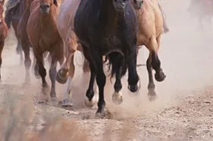
For more presentations like this
or for more information
please visit
outrunningthehorses.com
outrunningthehorses.com

