Slide 1
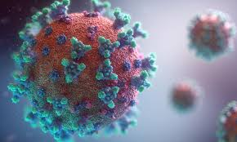
Ministering to the Community in a Time of Crisis
COVID-19
Second Wave
Outrunningthehorses.com

Slide 2
Outrunningthehorses.com
Ministering to the Community in a Time of Crisis
These PowerPoint Presentations are written and provided to prepare the Body of Christ for disasters such as the current pandemic
These trainings are meant to enable people to safely care for themselves and minister to their neighbors
By being properly equipped we are then able to bring the gospel of our Lord, Jesus Christ into the situation
For more information, please visit outrunningthehorses.com

Slide 3
Second wave: A phenomenon of infections that can develop during a pandemic. The disease infects one group of people first. Infections appear to decrease. And then, infections increase in a different part of the population, resulting in a second wave of infections.

Slide 4
According to health officials, waves of
infection describe the curve of an outbreak, reflecting a rise and fall in the number of cases.
With viral infections such as influenza or the common cold, cases typically crest in the cold winter months and recede as warmer weather reappears.

Slide 5
COVID-19 – Second Wave
The following topics will be discussed
Characteristics of waves
Past Pandemics
COVID-19
Immunity
Vaccine

Slide 6
COVID-19 – Second Wave
Ministering to the Community in a Time of Crisis
Introduction
Much discussion has taken place as to whether there will be a second wave of the circulating coronavirus
Dependent on the source of information you may get differing answers
This presentation does not speculate but instead is based on the history of past pandemic viruses

Slide 7
COVID-19 – Second Wave
Introduction
It is a mystery why illnesses come in waves
A characteristic of past pandemics has been multiple waves
Some possibilities are:
Behavioral changes in the virus
Its’ spread through sub-populations (e.g. elderly)
Virus mutation
Waning immunity
Population growing weary of mitigation measures

Slide 8
COVID-19 – Second Wave Waves of Past Pandemics
1918 Influenza
Came in three separate waves
The first was mild during Spring and Summer of 1918 (June through July)
The second was a more intense deadly wave in the fall of 1918 (October through January)
The last was a less intense wave following Spring 1919 (February through April)

Slide 9
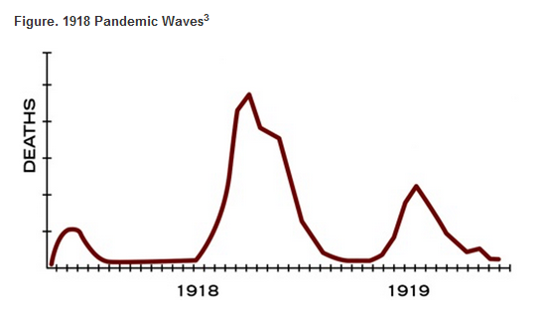
1918 Influenza Waves

Slide 10
COVID-19 – Second Wave Waves of Past Pandemics
1957 – 1958 H2N2 Influenza Pandemic (aka the Asian Flu)
Waves coincided with flu seasons
Wave peaked with children returning to school
Vaccine and invention of antibodies for secondary infection helped
1-2 million deaths or 2-4 million

Slide 11
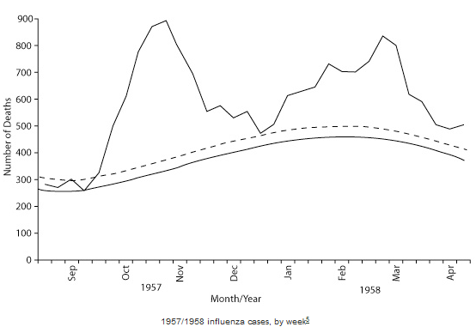
Asian Influenza Waves

Slide 12
COVID-19 – Second Wave Waves of Past Pandemics
1968 – 1969 H3N2 Influenza Pandemic (aka the Hong Kong Flu)
Killed estimate 4 million people
Came in 2 waves
Evidence of increased transmissibility between successive waves

Slide 13
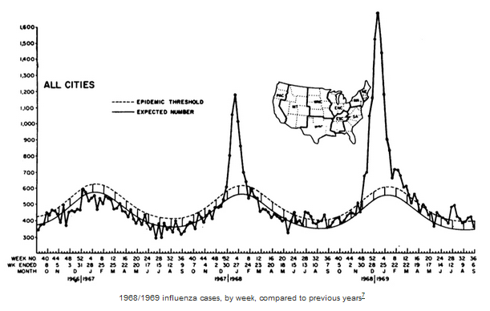
Hong Kong Flu Waves

Slide 14
COVID-19 – Second Wave Waves of Past Pandemics
2009 – H1N1 Influenza (aka Swine Flu) Pandemic
First wave peaked at 23 weeks then subsided
Second wave returned at 35 weeks
Peaked at week 41
Then subsided

Slide 15
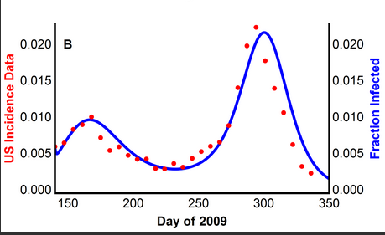
H1N1 Influenza Waves

Slide 16
COVID-19 – Second Wave
COVID-19
Three potential futures of COVID-19:
Recurring small outbreaks
Monster wave
A persistent crisis

Slide 17
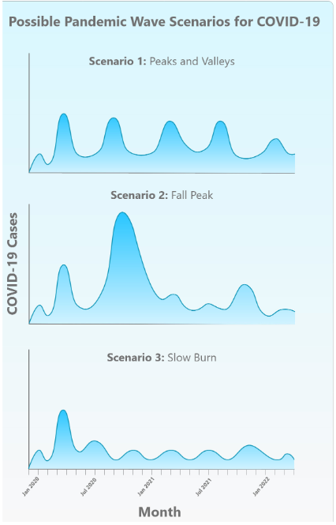

Slide 18
COVID-19 – Second Wave
COVID-19
There is an expectation of a second wave of COVID-19 due to the following:
Warmer weather may reduce transmissibility by 20%
Cooler weather will have increase due to usual pattern of coronaviruses
New transmission is expected to peak winter

Slide 19
COVID-19 – Second Wave
COVID-19
There is an expectation of a second wave of COVID-19 due to the following:
Harder time controlling in the cooler weather
Cooler temperatures harden the protective gel-like capsid of the virus particles while they are in the air
A stronger shell allows them to survive long enough to travel person to person

Slide 20
COVID-19 – Second Wave
COVID-19
There is an expectation of a second wave of COVID-19 due to the following:
People grow tired of mitigation measures
Social distancing
Handwashing
Mask Wearing
Schools may open

Slide 21
COVID-19 – Second Wave
The World Health Organization
COVID-19 may never go away due to:
It is endemic in all populations
It may return seasonally like other coronaviruses

Slide 22
COVID-19 – Second Wave
Immunity
Human immune system does not like to make antibodies for a glycoprotein
Immunity wanes
People can be re-infected
Clusters are reemerging in Wuhan, China, due to waning immunity

Slide 23
COVID-19 – Second Wave
Some viruses that have not “gone away”
H1N1
HIV
Enterovirus (polio)
Malaria
Measles
Rubella
Varicella Zoster (chicken pox)
Mumps

Slide 24
COVID-19 – Second Wave
Conclusion
History of pandemics tell us there will likely be a second wave
Second wave may be more intense
Three possible futures:
A monster wave
Recurring small outbreaks
A persistent crisis

Slide 25
Questions?

Slide 26
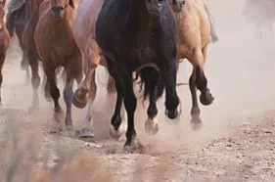
For more presentations like this
or for more information
please visit
outrunningthehorses.com

