Slide 1
Lessons Learned from
SARS and Ebola
Wendy J. Gade
Paramedic
Outrunningthehorses.com

Slide 2
Lessons Learned
The SARS (2003) and Ebola (2014) outbreaks taught us many lessons
Most prevalent was the lack of compliance of the healthcare workers in the use of Personal Protective Equipment (PPE) and good hand hygiene.
The COVID-19 pandemic requires similar precautions
This power point will stress the importance of strict adherence to the use of PPE and good hand hygiene for healthcare providers as well as those ministering at home or in the community.

Slide 3
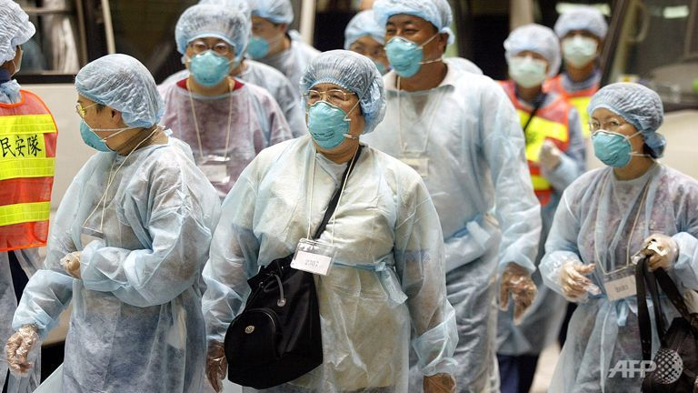
Healthcare workers were at the frontlines
during the battle against
the SARS epidemic in 2003.
Understanding their fears and concerns
may hold lessons for handling
the current and future outbreaks.

Slide 4
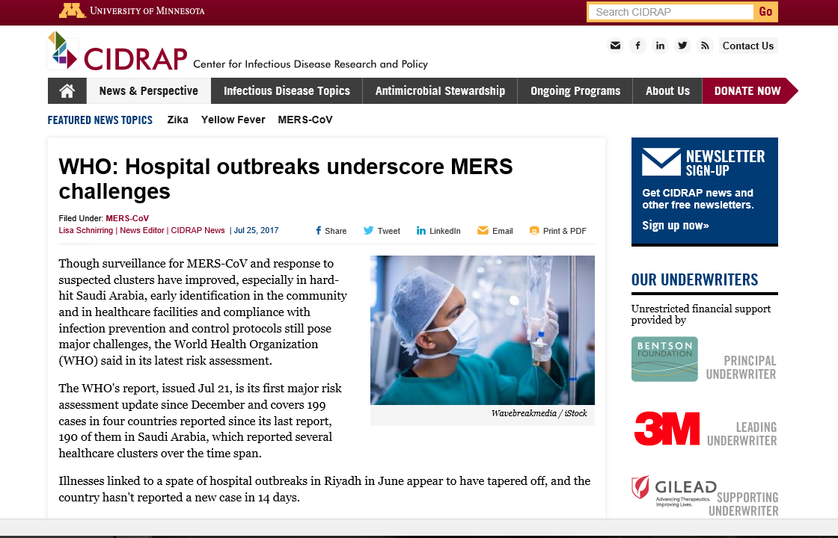
Currently, the greatest challenge in controlling the spread of MERS, is the compliance of healthcare providers practicing standard precautions

Slide 6
Lessons Learned – SARS
November 2002 – July 2003
An outbreak of a Severe Acute Respiratory Syndrome (SARS)
A viral respiratory illness caused by a coronavirus (SARS-CoV)
Started in southern China
Spread to 37 countries
Including North America

Slide 7
Objectives
The following topics will be discussed
Overview of SARS outbreak
Lessons learned
Overview of Ebola in USA
Lessons learned
Study findings

Slide 8
Lessons Learned – SARS
According World Health Organization (WHO)
Total of 8,098 people worldwide were infected
774 Died (9.6%)
1,707 Healthcare workers became ill (21%) of the cases
Number of fatal infections in healthcare workers is not reported by WHO

Slide 9
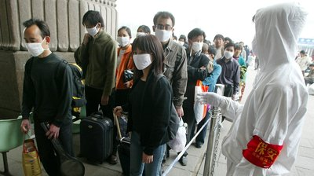
Lessons Learned – SARS
SARS – a Coronavirus
Similar to Middle East Respiratory Syndrome
MERS – Coronavirus (MERS-CoV)

Slide 10
Lessons Learned – SARS
February 21, 2003
Dr. Liu Jianlun
64 year old doctor who treated SARS cases in Guangdong
Arrived in Hong Kong to attend a wedding
Stayed in room 911 of Metropole Hotel

Slide 11
Lessons Learned – SARS
February 21, 2003
Dr. Liu Jianlun
Within 24 hour of checking in sixteen other guests had become infected
Within the following days five boarded planes to overseas destinations
Virus spread to Viet Nam, Singapore, and Canada

Slide 12
Lessons Learned – SARS
March 5, 2003
Mrs. K
78 year old woman
Attended the same wedding
Stayed at the same hotel
After returning home to Canada
Died at home
Suspected Heart Failure

Slide 13
Lessons Learned – SARS
March 7, 2003
Mr. T
Son of Mrs. K
Suffering from fever and respiratory illness
Waited in Emergency Room waiting room for 16 hours
He transmitted SARS to two other patients
Sparked chain of infection through Scarborough Grace Hospital

Slide 14
Lessons Learned – SARS
March, 2003
Scarborough Grace Hospital
First 84 cases linked to six members of index family
SARS spread rapidly
Largest group of victims was healthcare workers

Slide 15
Lessons Learned – SARS
March, 2003
Greater Toronto Area
Healthcare system seriously impacted
Thousands forced into quarantine
Healthcare workers and their families lived in fear

Slide 16
Lessons Learned – SARS
March, 2003
Greater Toronto Area
Hospitals closed
Cancer treatments and heart surgery postponed
Impact of delayed procedures unknown
Patients denied visitors
Sick and dying denied consolation of family members

Slide 17
Lessons Learned – SARS
March, 2003
Greater Toronto Area
The dead were disposed of quickly
In the absence of family and friends
Economic disaster for the whole country

Slide 18
Lessons Learned – SARS
March, 2003
The Ontario Nurses’ Association
Almost 2/3 felt their health and safety had been compromised
Many torn between staying and quitting
Felt their family life was devastated

Slide 19
Lessons Learned – SARS
March – July, 2003 – All lived in Fear
Respiratory Technicians
Doctors
Nurses
Hospital Workers
Paramedics
Home Health Care workers

Slide 20
Lessons Learned – SARS
Lessons Learned – Strain on Personnel
Healthcare workers on the front lines
Putting lives at risk
Watched friends and colleagues fall ill
At times had to care for them
Wondering if they would be next

Slide 21
Lessons Learned – SARS
“I said to my husband, ‘I’m going to go,’… and I saw his face and we both had tears in our eyes because I thought I was the next one to get it. I was just so emotional. I felt had to go in… but I thought I was going to be the next one, because all our nurses were falling down.”
Nurse from 4 West, North York General Hospital
(epicenter of second outbreak)
Weekend of May 24 and 25, 2003

Slide 22
Lessons Learned – SARS
375 people contracted SARS in Ontario
72% were infected in healthcare setting
45% were healthcare workers
Many brought illness and death home to their families

Slide 23
Lessons Learned – SARS
Lessons Learned
Lack of preparation
Lack of education and training against infectious disease
Decline of Public Health
Breaches in infection control and use of PPE
Non-compliance in standard precautions
Hand hygiene

Slide 24
Lessons Learned – SARS
Lessons Learned
Strict adherence to contact and droplet precautions including
Eye protection
Airborne precautions
Undetected cases of in staff, patients, and visitors contribute to rapid spread of the virus

Slide 25
Lessons Learned – SARS
Lessons Learned
Optimal control efforts require continuous analysis of the dynamics of SARS-CoV transmission in the facility and the community.
A response to SARS can strain the resources and capacity of a healthcare facility or agency

Slide 26
Lessons Learned – SARS
Lessons Learned
The social and psychological impact of SARS can be substantial, both during and after an outbreak.
The most effective systems for controlling a nosocomial outbreak are those that are developed and tested before an outbreak occurs.

Slide 27
Lessons Learned – SARS
Lessons Learned
Communication needs can overwhelm and paralyze response capacity; good information management strategies are essential to an efficient and effective response

Slide 28
Lessons Learned – SARS
Lessons Learned
Implementation and enforcement of all standard precautions, including appropriate use of facial (eyes, nose, and mouth) protection when caring for respiratory patients, should be prioritized in all healthcare facilities in order to mitigate pandemic influenza transmission

Slide 29
Lessons Learned – SARS
Lessons Learned
It is incumbent upon healthcare employers to educate employees about the hazards to which they are exposed and to provide reasonable means by which to abate those hazards

Slide 30
Lessons Learned – SARS
Lessons Learned
Although healthcare providers receive training during their education
Studies that show lapses in infection control practices and non-compliance with regular hand hygiene, it is recommended that further training and remediation be done periodically

Slide 31
Lessons Learned – Ebola
Monrovia – September 15, 2014
Marthalene Williams who had contracted Ebola was not able to call an ambulance
Thomas Eric Duncan, her neighbor, rode in a taxi with her, her father, and brother, to help her get to an Ebola treatment ward

Slide 32
Lessons Learned – Ebola
Monrovia – September 19, 2014
Thomas Eric Duncan went to Monrovia Airport
According to Liberia officials
Duncan lied about his history of contact with disease
Boarded a flight to Brussels
Later boarded a United Airlines flight to Dallas/Fort Worth

Slide 33
Lessons Learned – Ebola
Dallas, TX – September 20, 2014
Thomas Eric Duncan arrived in Dallas
Stayed with partner and her five children

Slide 34
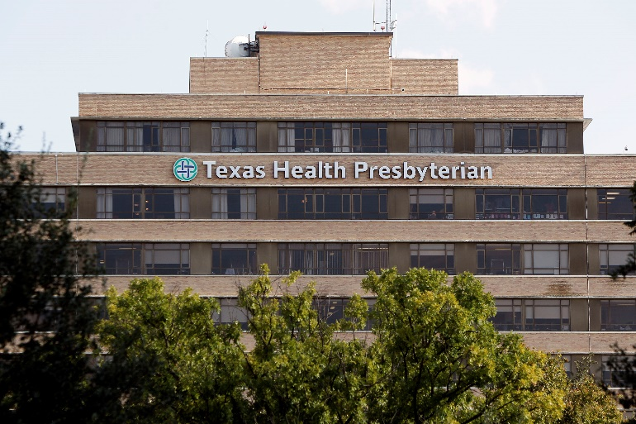
Lessons Learned – Ebola
Dallas, TX – September 24, 2014
Thomas Eric Duncan began experiencing symptoms
Went to Texas Heath Presbyterian Hospital emergency room at 10:37 p.m.

Slide 35
Lessons Learned – Ebola
Dallas, TX – September 25, 2014
Seen by a triage nurse - 11:36 p.m.
Reported abdominal pain, dizziness, nausea, headache
Fever of 100.1 F
She did not inquire as to his travel history
12:05 a.m. - He was admitted into a treatment area room

Slide 36
Lessons Learned – Ebola
Dallas, TX – September 26, 2014
After being seen by physician
Diagnosed with sinusitis and abdominal pain
Sent home at 3:37 a.m.

Slide 37
Lessons Learned – Ebola
Dallas, TX – September 28, 2014
Duncan’s condition worsened
Transported to same hospital by ambulance
Arrived at 10:07 a.m.
It was noted that Duncan had come from Liberia
He was tested for Ebola
“Strict CDC Protocol” was followed

Slide 38
Lessons Learned – Ebola
Dallas, TX – September 28, 2014
CDC Protocol included
Mask
Gown
Gloves
12:58 p.m. – Doctor called CDC directly
9:40 p.m. Duncan was experiencing explosive diarrhea and projectile vomiting

Slide 39
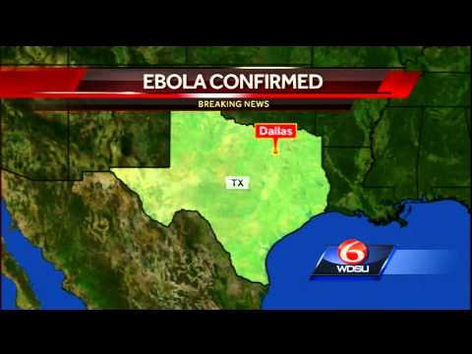
Lessons Learned – Ebola
Officials had to track over 50 people who may have been in contact with Duncan

Slide 40
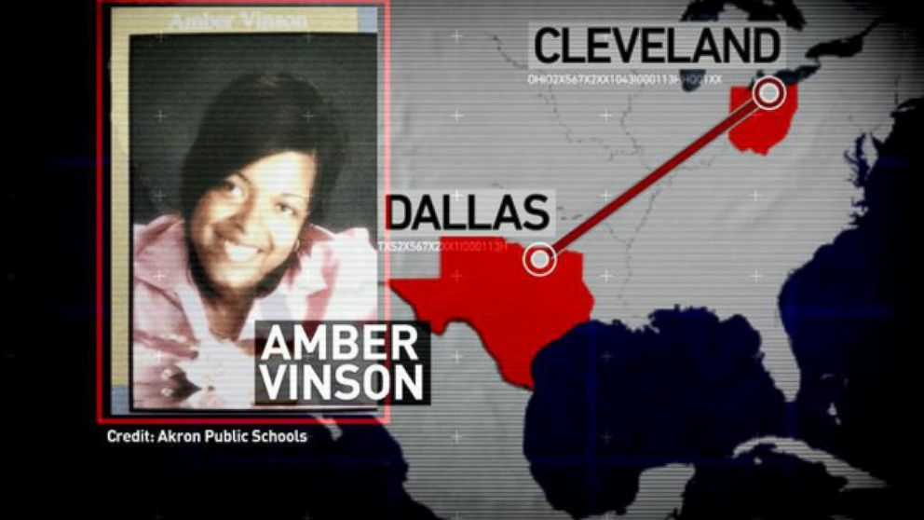
Lessons Learned – Ebola
Two nurses, Nina Pham and Amber Vinson, became infected while caring for him
Vinson had traveled to Ohio to make wedding plans

Slide 41
Lessons Learned – Ebola
Amber Vinson
A CDC official cleared Vinson to board
Her reported temperature 99.5 degrees
Below threshold set by agency
She had no symptoms
Ebola patients are not considered contagious until they have symptoms
Later CDC stated that she should never have been allowed to fly a commercial jetliner because she had been exposed to the virus

Slide 42
Lessons Learned – Ebola
March 4, 2015 – Lawsuit by Nina Pham stated
“Pham was a symbol of corporate neglect —
a casualty of a hospital system's failure to prepare for a known and
impending medical crisis."

Slide 43
Lessons Learned – Ebola
March 4, 2015 – Lawsuit by Nina Pham stated
She had never been trained to handle infectious diseases
Never told anything about Ebola
How to treat Ebola
How to protect herself as a nurse treating an Ebola patient
The hospital had never given her any training or guidance about Ebola

Slide 44
Lessons Learned – Ebola
March 4, 2015 – Lawsuit by Nina Pham stated
They followed the CDC protocol
“Never strayed”
“We weren’t the best prepared.”
“We did not have extensive training.”
“We did not have a level of feeling comfortable with putting on and taking off the protective equipment.”
“We didn’t have time to practice it.”

Slide 45
Lessons Learned – Ebola
March 4, 2015 – Lawsuit by Nina Pham stated
All she knew about Ebola was what they saw on television
Pham did not believe that her employer “would put her in any situation that was as dangerous as she feared”
Nurses at hospital said they were not sure what to do to protect themselves

Slide 46
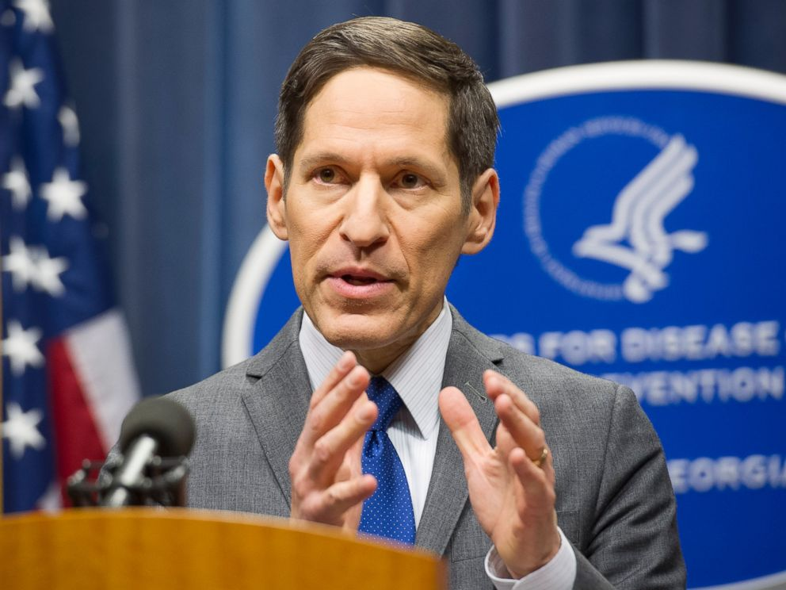
Lessons Learned – Ebola
At a news conference
Dr. Thomas Frieden – CDC
Reassured public that any hospital should be able to handle an Ebola patient
Dallas case contradicted him

Slide 47
Lessons Learned – Ebola
Records of CDC showed:
Variability in the use of PPE
Some health care workers were putting on three or four layers of protective equipment in the belief that this would be more protective
Handling of the first U.S. Ebola case was an embarrassment

Slide 48
Lessons Learned – Ebola
Soon after CDC reevaluated documents for guidance and managing Ebola
Hospital was also culpable
They were not prepared by utilizing what was available
They did not train their employees on how to use equipment properly

Slide 49
Lessons Learned Study Findings
Study Findings after SARS outbreak
Beijing – Healthcare workers experienced
Relatively high levels of PTSD symptoms (3 years later)
Significantly higher levels of anxiety
Social stigmatization
Ostracism by family members
Felt that the healthcare institutions have a duty to protect the healthcare workers

Slide 50
Lessons Learned Study Findings
Transmission of SARS to Healthcare workers was associated with:
Lack of infection control precautions
Inconsistent use of PPE
Less than two hours if infection control training
Patient care by non-medical staff

Slide 51
Lessons Learned Study Findings
Training must include:
Facts
Procedures
Protocols
Practice
Be tailored to occupational group
That the knowledge should not be assumed by any group

Slide 52
Lessons Learned Study Findings
Most frequently cited reason for employees unwillingness to report to work:
Fear and concern for the safety of their families and themselves

Slide 53
Lessons Learned Study Findings
Readiness training for healthcare workers should include:
Risk perceptions
Not just the factual or procedural elements

Slide 54
Lessons Learned Study Findings
Confronting fear associated with unwillingness to report to work
Personal safety
Safety of loved ones
Effective methods
Education
Provision of PPE

Slide 55
Lessons Learned Study Findings
Training can increase willingness
Consider a survey assessment
Confront barriers
Provide family preparedness training
Create child/elder care centers
Makeshift accommodations
Advise where to obtain info and updates
Care for the caregiver

Slide 56
Lessons Learned Preparedness
Healthcare workers need information before pandemic:
Absenteeism policy
Leave policy
Compensation policy
Employment policy
Employee support services

Slide 57
Lessons Learned Preparedness
Expectations must be made clear
Donning and removing PPE
Safe handling of contaminated PPE
Managing unprotected staff areas
Monitoring staff health
Quarantine of staff
High-risk use of respiratory equipment
Cleaning/disinfecting equipment & environment
(Other)

Slide 58
Lessons Learned Preparedness
Policies must be made clear
Absenteeism policies
Leave policies
Compensation policies
Employment policies
Employee support services

Slide 59
Lessons Learned Preparedness
Absenteeism Policies must be made clear
Not showing up/not calling in
Refusing to work
Not completing shift (unrelated to illness)
Coming to work late
Knowingly coming to work ill
Concern for lost wages is largest deterrent to self-isolation or quarantine

Slide 60
Lessons Learned Preparedness
Leave Policies must be made clear
Personal illness
Family member illness
School closure
Extended medical leave
Bereavement leave
Closure of your facility
Hospital-imposed quarantine
Social distancing as non-essential personnel

Slide 61
Lessons Learned Preparedness
Compensation Policies must be made clear
Compensation tied to absenteeism and leave policies
Overtime pay
Extended shift lengths
(Other)

Slide 62
Lessons Learned Preparedness
Employment Policies must be made clear
Cancellation of vacations
Approval of overtime
Redeployment of staff
Use of part-time or retired staff
Contracting out
Temporary staff
Work assignments for healthcare workers at high risk for complication of flu

Slide 63
Lessons Learned Preparedness
Employment Services must be provided
Mental health, stress counseling, social services for staff and family
Educational materials in different languages, as needed
Emergency Assistance Program (EAP)
Plans (if any) to house essential staff
(Other)

Slide 64
Lessons Learned Preparedness
Think About It
If a pandemic with a high mortality rate were declared, would you show for work?
If no – why not?
If yes – what would you insist your employer do in advance to ensure your safety and mental well being?
What other issues would prohibit you from going to work? i.e., childcare, family concerns, transportation, etc.

Slide 65
Questions?

