Slide 1

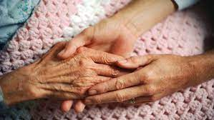
Pandemic Plan for the Church
Ministering to the Community in a Time of Crisis
Ministers of Grace
Part Two
outrunningthehorses.com

Slide 2
Ministers of Grace
“For I was hungry, and you gave Me something to eat;
I was thirsty, and you gave Me something to drink;
I was a stranger, and you invited Me in;
naked, and you clothed Me; I was sick, and you visited Me;
I was in prison, and you came to Me.
Truly I say to you, to the extent
that you did it for one of the least of these
brothers or sisters of Mine, you did it for Me.”
Matthew 25:35,36,40
outrunningthehorses.com

Slide 3
Ministers of Grace
Visiting the Sick
Visiting the Sick
  Visiting the sick is a common practice especially among Christians
  Not all visits are the same. Visiting the “sick” may include:
    Hospital Visits
    Home visit for common illness
    Pandemic virus
outrunningthehorses.com

Slide 4
Ministers of Grace
Visiting the Sick
  Not all visits are the same. Visiting the “sick” may include:
    Recovery from a hospital stay
    Surgery
    Illness
    Other health crisis
    Nursing Home visits
outrunningthehorses.com

Slide 5
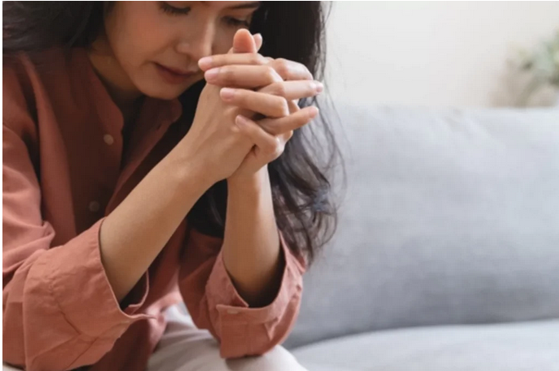
Ministers of Grace
Visiting the Sick
Suggestions for Visiting the Sick
  First and foremost, pray
    For wisdom and guidance
    For the person’s healing
    For the Lord to fill you and direct the visit
    For their salvation
outrunningthehorses.com

Slide 6

Ministers of Grace
Visiting the Sick
Due to the danger of a pandemic virus
  Precautions should be taken to ensure safety for the volunteer as well as those who are ill.
  Please see the chapters:
    “Infection Control and Proper Protection Equipment”
    “Caring for the Sick”
outrunningthehorses.com

Slide 7

Ministers of Grace
Visiting the Sick
Suggestions for Visiting the Sick
  Practice good hand hygiene
    Wash hands before and after visit
    Use hand sanitizer
    Don PPE
outrunningthehorses.com

Slide 8
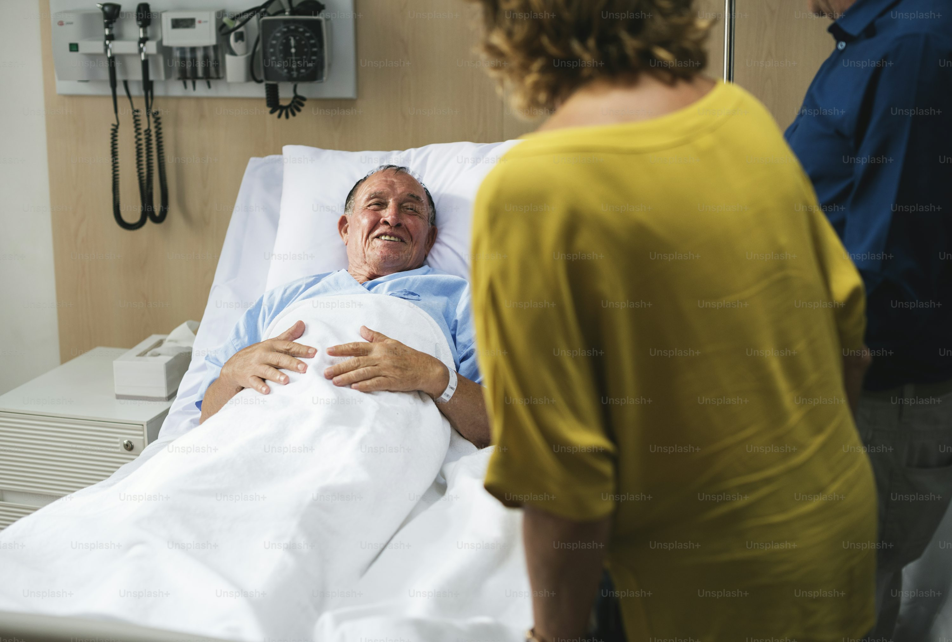
Ministers of Grace
Visiting the Sick
Suggestions for Visiting the Sick
  Keep good eye contact
  Speak softly
  Be an empathetic listener
  Allow the person to cry
outrunningthehorses.com

Slide 9
Ministers of Grace
Visiting the Sick
Things Not to Do
  Do not say things like, “I know how you feel”
  Do not stare at the patient’s monitors and tubes
  Do no sit on the patient’s bed, sit on the chair provided
  Do not remain in the room when a doctor or nurse enters
  Do not give medical advice
  Do not promise more than you can deliver
outrunningthehorses.com

Slide 10
Ministers of Grace
Visiting the Sick
Do not speculate what God may be doing in the person’s life! Remember Job’s friends! These things are discouraging, demeaning, and unbiblical! Do not say such things as:
  “You are already healed; you just need to receive your healing”
  “If you had enough faith, …”
  “The enemy has gotten into your life and had his way”
  “If you were living right than this wouldn’t have happened”
outrunningthehorses.com

Slide 11
Ministers of Grace
Visiting the Sick
Things to say:
  Ask: “Can I get you something?,” “What can I do for you?”
  “We’re concerned for you”
  “We’re thinking of you”
  “We’re praying for you”
  “We know you’re going through a difficult time”
outrunningthehorses.com

Slide 12

Ministers of Grace
Visiting the Sick
Determine if the person has special dietary needs such as:
  Diabetes – low carb, no sugar
  High Blood Pressure – low salt
  Heart Disease – No red meat, low salt
  Celiac Disease – Gluten Free
  Food allergies
outrunningthehorses.com

Slide 13

Ministers of Grace
Visiting the Sick
In addition to bringing a meal, other means of service:
  Pick up groceries/prescriptions
  Walk the dog, scoop the cat litter, etc.
  Do a load of laundry
  Do the dishes
  Vacuum or straighten up
  Take the garbage out
outrunningthehorses.com

Slide 14
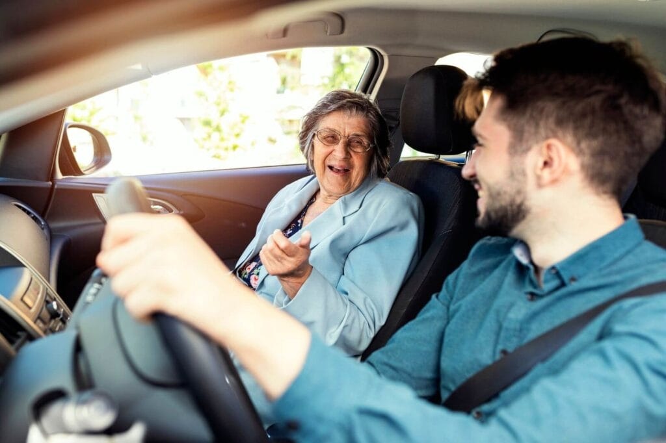
Ministers of Grace
Visiting the Sick
If the person is recovering from surgery
  Do they need a ride for a follow-up visit to the doctor?
  Do they need a ride to physical therapy/occupational therapy?
  Is their surgical wound healing? Do they need to go for wound care?
outrunningthehorses.com

Slide 15
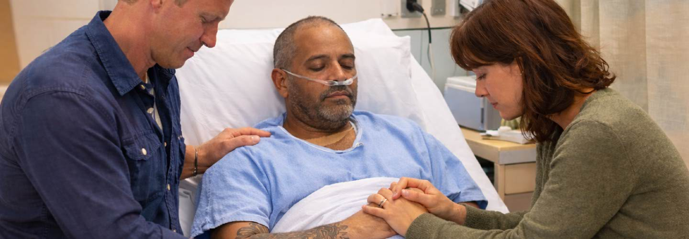
Ministers of Grace
Visiting the Sick
Always ask the person if you can pray for/with them
outrunningthehorses.com

Slide 16

Ministers of Grace
Visiting the Sick
If the person does not know Jesus as their Savior
  Spend time to share the hope of Jesus with them
  Please see attached section “Sharing Jesus”
  Learn ways of sharing the gospel with the unsaved
outrunningthehorses.com

Slide 17
Ministers of Grace
Visiting the Sick
At the end of the visit
  Always keep everything confidential
  If necessary, schedule the next visit
  Do not promise more than you can deliver
outrunningthehorses.com

Slide 18

Ministers of Grace
Visiting the Sick
When to Seek Emergency Care
  If any of the following signs or symptoms arise, call 9-1-1
    Chest pain
    Difficulty breathing
    Fast breathing
    Bluish or gray discoloration of the lips or skin
outrunningthehorses.com

Slide 19
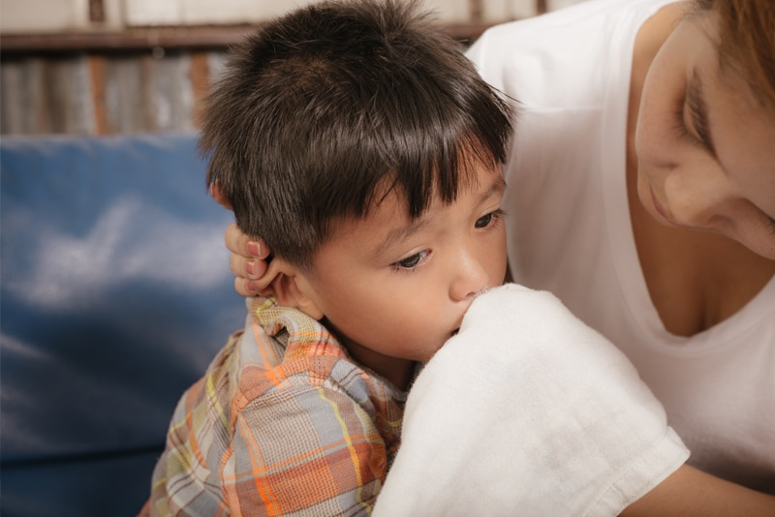
Ministers of Grace
Visiting the Sick
When to Seek Emergency Care
  If any of the following signs or symptoms arise, call 9-1-1
    Uncontrolled vomiting
    Uncontrolled diarrhea
outrunningthehorses.com

Slide 20
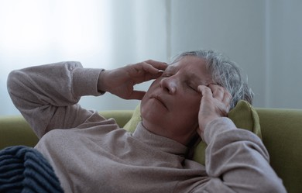
Ministers of Grace
Visiting the Sick
When to Seek Emergency Care
  If any of the following signs or symptoms arise, call 9-1-1
    Dehydration that results in:
      Dizziness when standing
      No urination
      No tears in infants when crying
    Seizures
    Altered mental status, confusion, or less responsive
outrunningthehorses.com

Slide 21

Ministers of Grace
Ministering in a Crisis
Ministering to those in a crisis
  A traumatic event is considered a life changing incident such as:
    The loss of a loved one
    A house fire
    A car accident
    Abuse
    Violence
    A disaster
outrunningthehorses.com

Slide 22

Ministers of Grace
Ministering in a Crisis
Ministering to those in a crisis
  Common reactions to trauma
    Emotional
    Cognitive
    Physical
    Behavioral
outrunningthehorses.com

Slide 23

Ministers of Grace
Ministering in a Crisis
Ministering to those in a crisis
  Coming alongside early is important for healing
  It is believed that early intervention can help prevent post traumatic stress disorder (PTSD)
outrunningthehorses.com

Slide 24

Ministers of Grace
Ministering in a Crisis
Ministering to those in a crisis
  Keep in mind this is not to counsel the hurting
  More like psychological first aid
  Before any attempt to talk or help someone - PRAY
outrunningthehorses.com

Slide 25
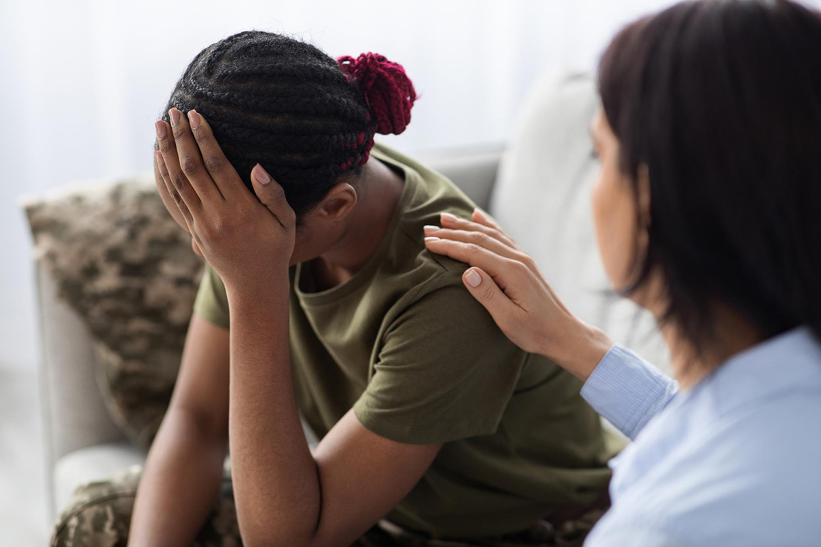
Ministers of Grace
Ministering in a Crisis
Ministering to those in a crisis
  Take that person aside to a quiet place
  Establish a rapport that encourages a safe environment
  Begin with an easy, open-ended question such as “How are you holding up?”
outrunningthehorses.com

Slide 26
Ministers of Grace
Ministering in a Crisis
  Be patient as the person may hesitate to share their thoughts and feelings
  Allow the person to share the event and personal reactions
  Ask open ended questions to encourage the person to talk about their concerns
  Allow them to vent, cry, or even just to sit quietly
  Be aware, they may display some anger (do not remain in a dangerous situation)
outrunningthehorses.com

Slide 27
Ministers of Grace
Ministering in a Crisis
  Be empathetic, let them know you understand
  Listen to them, do not allow yourself to be distracted
  Paraphrase what you are hearing back to them to let them know you are listening
  Do not judge or criticize what the person shares
  Tell the person that what they are experiencing is normal
  Do not rush the person
outrunningthehorses.com

Slide 28
Ministers of Grace
Ministering in a Crisis
  Pay close attention to identify any indications of self-inflictive harmful behavior
  Encourage the person that they are not at fault if they feel guilty that they survived the event
  Share scriptures, especially promises from the Bible that the Lord has not forsaken them
  Perhaps have books or tracts available to hand out that would help a person work through their crisis
outrunningthehorses.com

Slide 29

Ministers of Grace
Ministering in a Crisis
  Be sure to pray with the person, as well as promise to continue to pray for them
  If they do not know the Lord, share why you find hope in such situations
outrunningthehorses.com

Slide 30
Ministers of Grace
Ministering in a Crisis
  Encourage the person to:
    Seek support and speak with friends, family or other support groups to avoid isolation
    Maintain a normal routine as much as possible
    Focus on self-care including:
      - Healthy eating - Prayer
      - Rest - Bible reading
      - Exercise
outrunningthehorses.com

Slide 31
Ministers of Grace
Ministering in a Crisis
  Schedule a time for the two of you to follow up
  Be aware of other resources in your community that can be of benefit to the person
  If the person is in distress for more than a month or prevents daily functioning, seek professional help
outrunningthehorses.com

Slide 32
Ministers of Grace
Phone Calls/Cards/Note Writing
Other means of reaching out:
  Calling an individual and praying over the phone
    Use the same guidelines as listed for in person dialogue
    Ask if they are in need of anything
    Always pray with the person before ending the conversation
    Use encouraging scripture
outrunningthehorses.com

Slide 33

Ministers of Grace
Phone Calls/Cards/Note Writing
  Send a handwritten note or card
    Birthday
    Congratulations
    Condolence
    Get Well
    We’re thinking of you
    Praying for you
  Include Scripture
outrunningthehorses.com

Slide 34
Ministers of Grace
Code of Conduct
Code of Conduct
  Do not engage in discussions that could cause any level of stress or discord
    Politics
    Differences in theology
    Sharing unsolicited opinions
  Be aware that any disagreement can raise blood pressure
outrunningthehorses.com

Slide 35
Ministers of Grace
Code of Conduct
Code of Conduct
  Always follow the rules of the facility or the desire of the shut-in concerning rules and regulations regardless of your personal beliefs
    If a mask is required – Wear a mask at all times
    If social distancing is required – Stay 6 feet away
    Confidence should be strictly maintained
outrunningthehorses.com

Slide 36
Ministers of Grace
Preparing Meals
Preparing Meals
  This area requires little one on one contact
  Knowledge of dietary requirements and restrictions is necessary
outrunningthehorses.com

Slide 37

Ministers of Grace
Preparing Meals
Special dietary needs include:
  Diabetes – low carb, no sugar
  High Blood Pressure – low salt
  Heart Disease – no red meat, low salt
  Celiac Disease – gluten free
  Food allergies – nuts, shellfish, etc.
outrunningthehorses.com

Slide 38

Ministers of Grace
Preparing Meals
Preparing Meals
  Take time to learn recipes
  Use only food grade plastic containers
    Save disposable containers for this re-use
  Include a card
outrunningthehorses.com

Slide 39
Ministers of Grace
Keeping Records
Make notes of those who need a visit
  Name/Address
  Situation/Condition
  How many in the household
  Dietary needs
  Church affiliation
outrunningthehorses.com

Slide 40
Ministers of Grace
Keeping Records
Make notes of those who have received visits
  Name/Address
  Was a meal provided
  Condition/situation - any improvement or worsening
  Did they receive Christ
    Schedule a follow up visit
  Scheduled follow-up visit
outrunningthehorses.com

Slide 41
Ministers of Grace
Keeping Records
Make notes of those who have received phone calls/cards
  Names/Addresses
  Condition/situation
  Did they receive Christ
    Schedule follow up call
  Do they need a follow up call?
outrunningthehorses.com

Slide 42
Ministers of Grace
Keeping Records
Turn all records into group leader
  Confidentiality is to be strictly maintained
  Records will enable Pastor and church leadership to determine:
    Progress of ministry
    Allocation of funds
    Who needs spiritual discipling/counseling
outrunningthehorses.com

Slide 43

outrunningthehorses.com

Slide 44
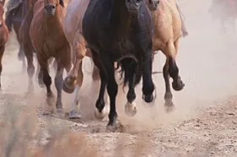

“If you have run with footmen, and they have tired you out,
then how can you compete with horses?
If you fall down in a land of peace,
how will you do in the thicket by the Jordan?”
Jeremiah 12:5

Slide 45
For more presentations like this
or for more information
please visit
outrunningthehorses.com

