Slide 1
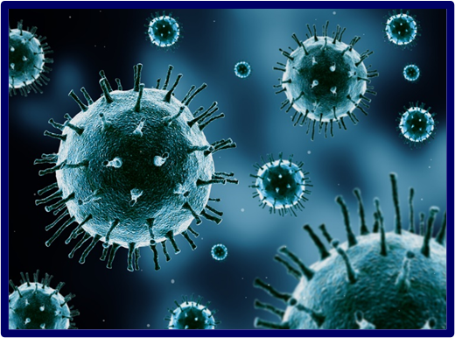
Pandemic Plan for the Church
Ministering to the Community in a Time of Crisis
Overview of a Virus
outrunningthehorses.com

Slide 2
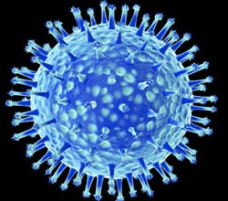
“Viruses are not plants,
animals, or bacteria,
but they are
the quintessential parasites
of the living kingdoms”
Michael W. Davidson and The Florida State University
outrunningthehorses.com

Slide 3
Objectives
The following topics will be discussed
  Overview of a virus
  Virus species
  Virus structure
    Virus vs. human cell
  Virus size
outrunningthehorses.com

Slide 4
Objectives continued
  Pathophysiology of viral diseases
    Entrance and receptors
    Life cycle of a virus
    Cell injury and clinical illness
    Recovery
    Shedding
outrunningthehorses.com

Slide 5
Objectives
Objectives continued
  The pathophysiology of viral diseases
  The significance of cell receptors and their relation to various viruses
  The lifecycle and its’ consequence to clinical illness
outrunningthehorses.com

Slide 6
Description of a Virus
Overview of a virus
  Have had an enormous impact on humans and other organisms
  Very little known about them until recently
  Unique group of infectious agents
  Quintessential parasite
outrunningthehorses.com

Slide 7
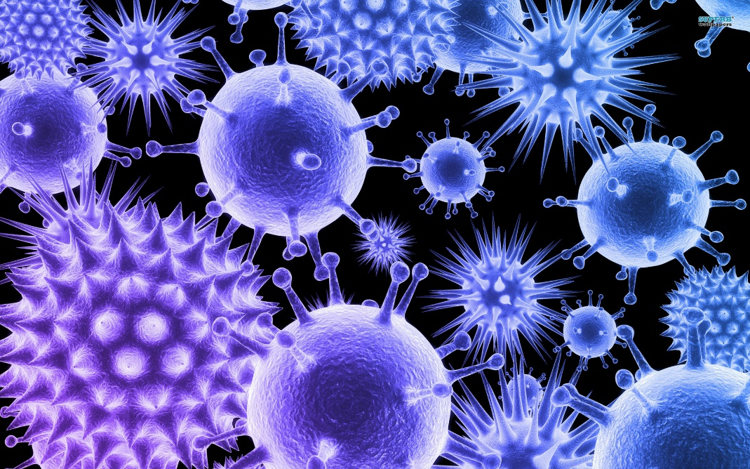
Description of a Virus
The most abundant biological entities on planet Earth
  All organisms of life are subject to viral infection
  Among most symmetric and beautiful of biological objects
outrunningthehorses.com

Slide 8
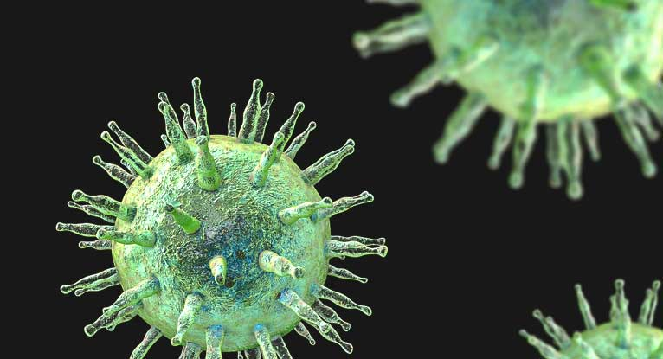
Description of a Virus
Viruses not considered to be living organisms (but can kill us)
  Do not have capability to metabolize energy for:
    Respiration
    Growth
    Reproduction
outrunningthehorses.com

Slide 9
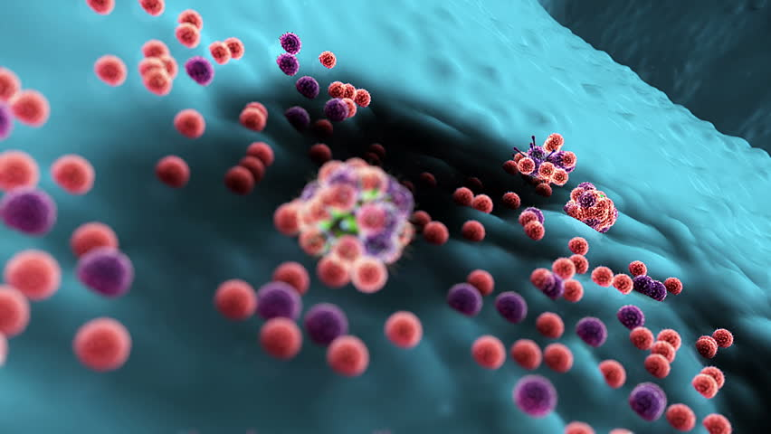
Description of a Virus
Consist of one or more molecules of DNA or RNA enclosed in a capsule
Smallest infectious organism
  100 times smaller than a bacteria cell
  Millions can fit inside one human cell
outrunningthehorses.com

Slide 10
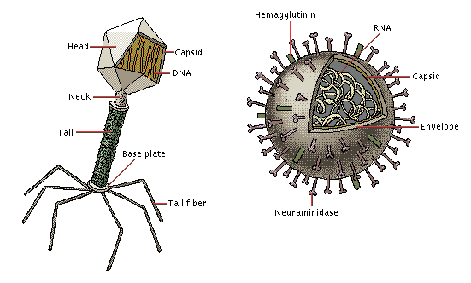
Description of a Virus
Species
Eighteen classifications grouped by similar characteristics
  Nucleic acid
  Capsid symmetry
  Presence or absence of an envelope
  Hosts they infect
  Diseases caused
outrunningthehorses.com

Slide 11
Description of a Virus
Species
Cause of at least 27 human diseases including:
Chickenpox
Influenza
Herpes
HIV/AIDS
Mumps, measles, rubella
Polio
Rabies
Hepatitis A
Hepatitis B
Colds
outrunningthehorses.com

Slide 12
Description of a Virus
Structure
Different from living organisms:
  Do not have cell membranes – have protein shells
  Do not have organelles
  Do not eat or burn energy
  Do not move around on their own
  Must invade living cells to reproduce
outrunningthehorses.com

Slide 13
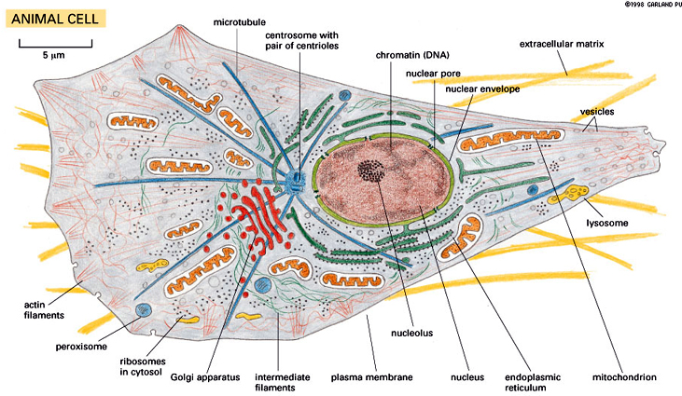
Structure of a Human Cell vs. a Virus
Animal Cell
Virus
outrunningthehorses.com

Slide 14
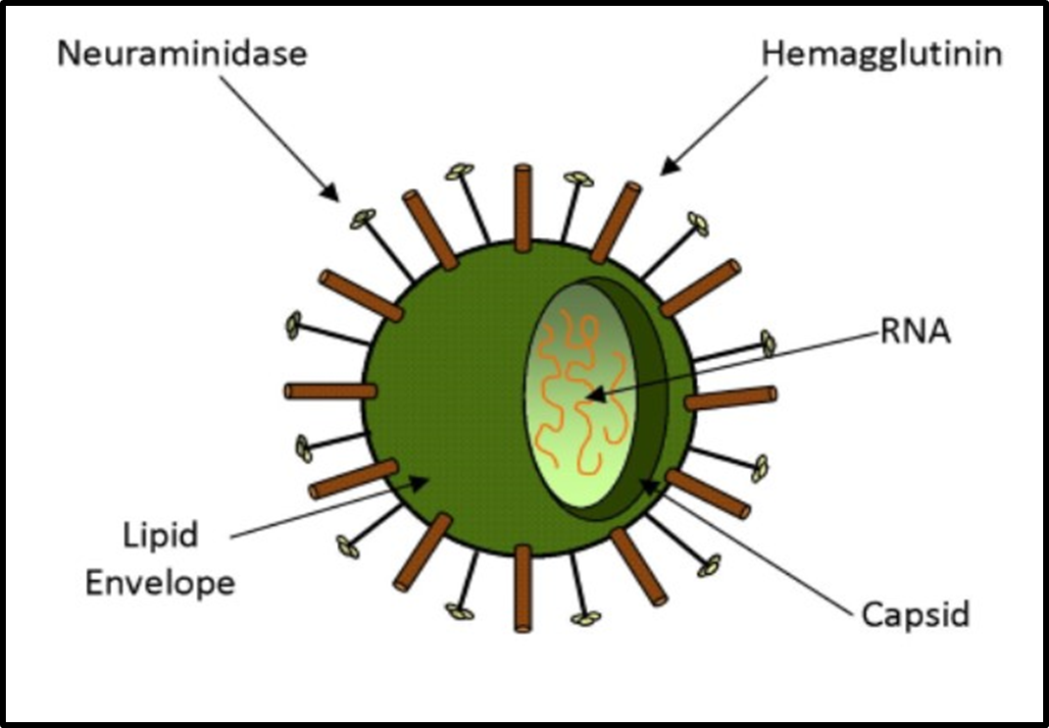
Description of a Virus Structure
A virion (virus particle) has three main parts:
  Protein Coat (capsid) – Covering and protection of nucleic acid
  Lipid membrane (envelope) – covers the capsid
  Nucleic acid –core containing DNA or RNA
outrunningthehorses.com

Slide 15
Description of a Virus
Size
Seen through an electron microscope
  100 times smaller than a single bacteria cell
  Bacteria cell 10 times smaller than a human cell
  Human cell is 10 times smaller than diameter of a single human hair
outrunningthehorses.com

Slide 16
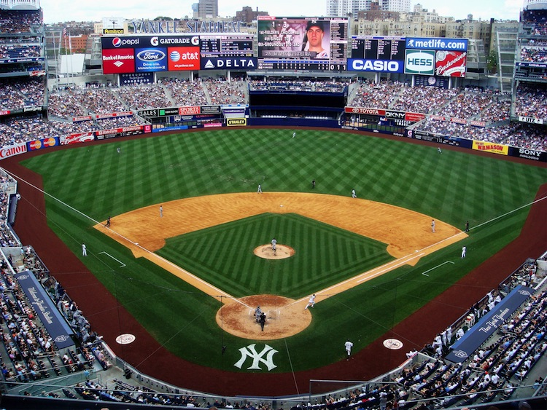
Description of a Virus
Size
If a cell were the size of a baseball stadium
  Bacteria the size of the pitchers mound
  Virus the size of the baseball
outrunningthehorses.com

Slide 17
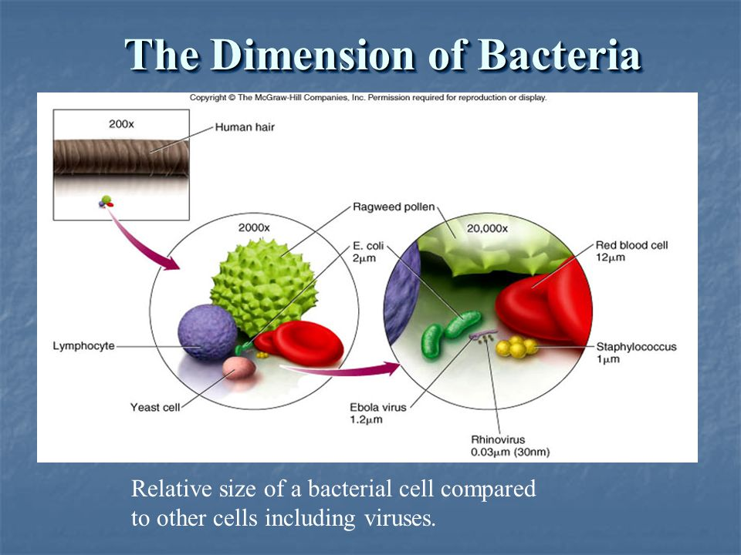
Relative Sizes of Cells and Viruses

Slide 18
Description of a Virus
Size
1 inch = 25,400,000 nanometers (nm)
1 micrometer (µm= 1000 nm)
Head of a pin = 2 mm (2,000,000 nm)
A human hair ≈ 80,000- 100,000 nm wide
A sheet of paper = 100,000 nm thick
Influenza virus = 100 nm (1/1000 sheet of paper)
outrunningthehorses.com

Slide 19
Pathophysiology of Viral Diseases
Life Cycle of a Virus
Virus’ only purpose is to replicate itself
  Only able to reproduce inside a living host cell
  Lack needed components to reproduce on their own
outrunningthehorses.com

Slide 20
Pathophysiology of Viral Diseases
Entrance and Receptors
Step One of Infectious Process – Entrance and attachment into susceptible host
  May be accomplished through body surfaces
    Skin
    Gastrointestinal System
    Urogenital System
    Conjunctiva of the Eye
  May be accomplished through other means
    Needle stick
    Blood transfusions
    Organ transplants
    Insect Vectors
outrunningthehorses.com

Slide 21
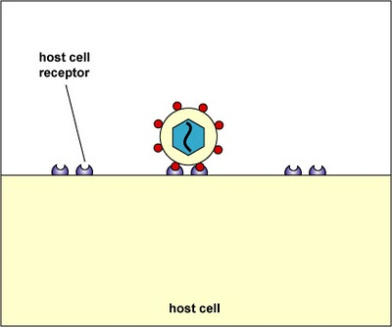
Pathophysiology of Viral Diseases
Entrance and Receptors
Step Two – Adsorption (Attaching to Receptors)
  Each virus has its own specific receptor
outrunningthehorses.com

Slide 22
Pathophysiology of Viral Diseases
Entrance and Receptors
Entrance into cells
  Receptor can be by:
    Cell
    Tissue
    Organ
Specificity called “tropism”
  Reflects the presence of specific cell surface receptors
Virus
Human Cell Surface
Cell Receptor
outrunningthehorses.com

Slide 23
Pathogenesis of Viral Diseases
Entrance and Receptors
Receptor molecules on specific a host cell determine preference of a specific virus:
  Cold/Flu viruses target respiratory receptors
  Enteroviruses target gastrointestinal tract
  HIV targets T-cells
  Polio viruses target central nervous system
outrunningthehorses.com

Slide 24
Pathophysiology of Viral Diseases
Entrance and Receptors
Some viruses replicate at point of entry
  Respiratory
  Gastrointestinal
Some viruses spread to distant sites then replicate
  Enterovirus
  Ebola
outrunningthehorses.com

Slide 25
Pathogenesis of Viral Diseases
Entrance and Receptors
Receptor molecules on specific a host cell determine preference of a specific virus:
  Cold/Flu viruses – Respiratory receptors
  Enteroviruses – Gastrointestinal tract
  HIV – T-cells
  Polio viruses – Central nervous system
  Ebola – Lymph tissue
outrunningthehorses.com

Slide 26
Pathophysiology of Viral Diseases
Life Cycle of a Virus
Step Three – Replication
Virus’ only purpose is to replicate itself
  Only able to reproduce inside a living host cell
  Lack needed components to reproduce on their own
outrunningthehorses.com

Slide 27
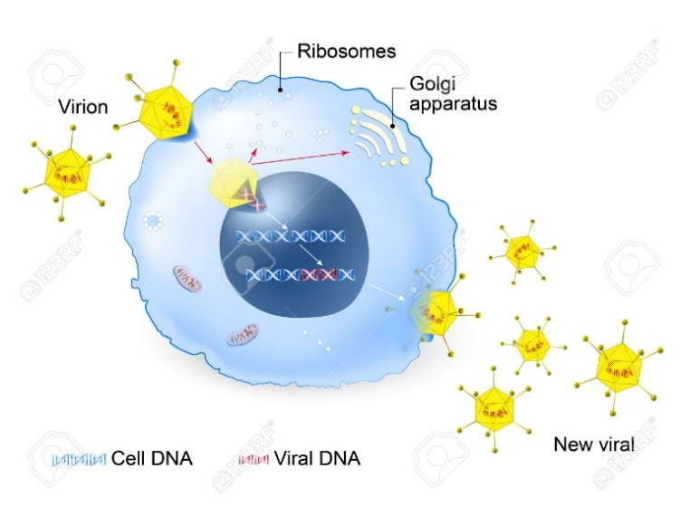
Pathophysiology of Viral Diseases
Life Cycle of a Virus
Virus injects its DNA or RNA into host cell
  RNA takes over the machinery of the cell
    Also known as Assembly
      Makes it a little flu factory of the cell
outrunningthehorses.com

Slide 28
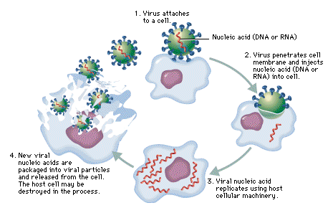
Pathophysiology of Viral Diseases
Life Cycle of a Virus
Step Four – Release
  The host cell ruptures and dies
  New viruses released to find new host cells
outrunningthehorses.com

Slide 29
Pathophysiology of Viral Diseases
Cell Injury and Clinical Illness
Clinical illness due to destruction of cells in target tissues produce the following:
  Fever
  Headache
  Body aches
  Fatigue
  Stuffy nose
  Sneezing
  Malaise
  Sore throat
  Chest congestion
  Nausea/Vomiting
  Diarrhea
  Paralysis
outrunningthehorses.com

Slide 30
Pathophysiology of Viral Diseases
Cell Injury and Clinical Illness
Destruction of target cells and tissues
  Intestinal Epithelium
    Rapidly regenerates after viral attack
    Able to withstand extensive damage
  Nervous System Tissue
    Not able to regenerate
    Never resume normal functioning
outrunningthehorses.com

Slide 31
Pathophysiology of Viral Diseases
Recovery
Step Four – Recovery – Immune System
  Makes antibodies every time there is an exposure to a new antigen
  Antibodies bind to H or N of virus
    “Gets in the way for new virus to complete life cycle”
  Host’s immune system eventually destroys invading virus
outrunningthehorses.com

Slide 32
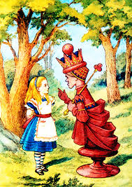
Pathophysiology of Viral Diseases
Recovery
Immune System
  “Red Queen” Dynamics
    After the Red Queen in Lewis Carroll’s, The Looking Glass
“It takes all the running you can do, to keep in the same place.”
outrunningthehorses.com

Slide 33
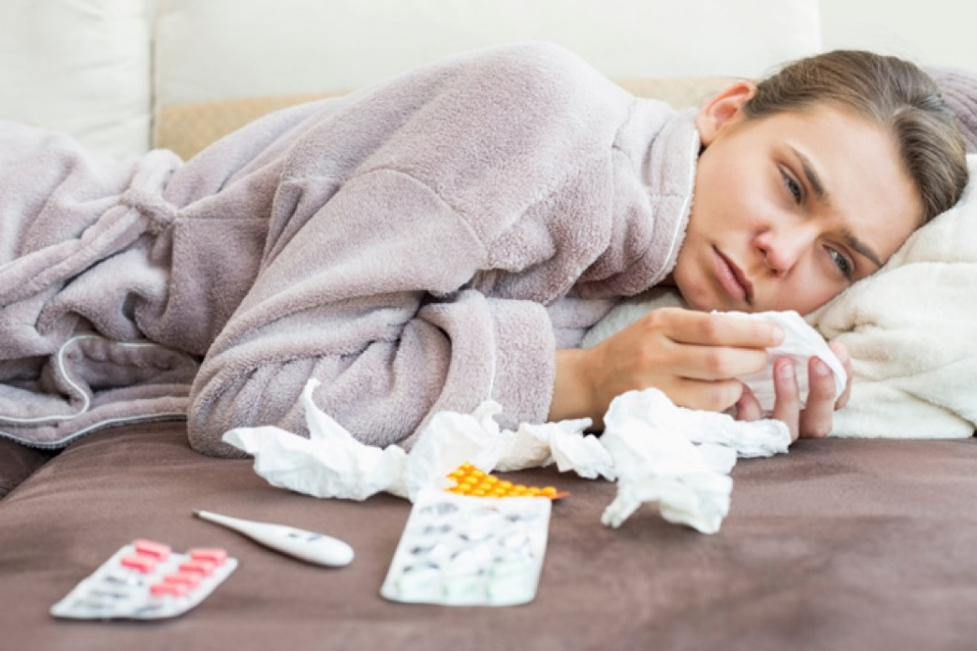
Pathophysiology of Viral Diseases
Recovery
Step Four – Recovery – Immune System
  Will either kill or slow down the virus
    Can make the difference between:
      Fever and cough vs. pneumonia and death
outrunningthehorses.com

Slide 34
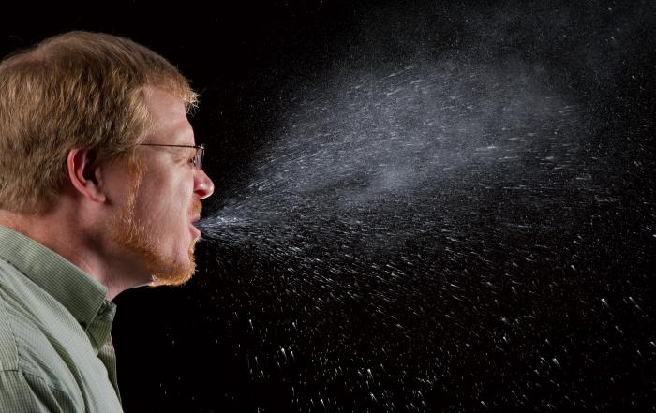
Pathophysiology of Viral Diseases
Shedding
Step Five – Shedding the Virus
Virus leaves host by way it entered
  Sneezes
  Coughs
  Feces
  Blood
  Other body fluids
outrunningthehorses.com

Slide 35

Pathophysiology of Viral Diseases
Shedding
Shedding the Virus
  Infected host is infectious (contagious)
  Even before signs and symptoms appear
outrunningthehorses.com

Slide 36

Questions?
outrunningthehorses.com

Slide 37
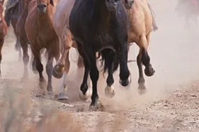
For more presentations like this
or for more information
please visit
outrunningthehorses.com
outrunningthehorses.com

