Slide 1

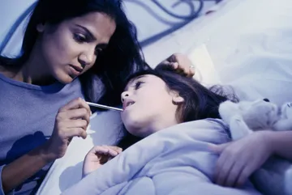
Pandemic Plan for the Church
Ministering to the Community in a Time of Crisis
Caring for the Sick
Part Two
outrunningthehorses.com

Slide 2
Caring for the Sick
Disclaimer
This information is for educational purposes only and does constitute professional medical advice or diagnosis.
Consult your medical provider if there are any questions or concerns.
outrunningthehorses.com

Slide 3
Caring for the Sick
Introduction
Studies have shown that even basic health care such as adequate water, food, and warmth can result in a much higher percentage rate of survival of a disease.
During the 1918 Influenza, it was determined that many died simply because there was no one to look after the sick and provide them these basic essential needs.
outrunningthehorses.com

Slide 4
Caring for the Sick
Introduction
The elements of caring for the sick may change dependent on the pathophysiology (the process of the disease in the human body) of the virus or disease.
COVID-19 and seasonal influenza present with similar symptoms, as well as the current strain of the circulating Avian H5N1 Influenza.
outrunningthehorses.com

Slide 5
Caring for the Sick
Introduction
Risks to Consider
Calling on Christians to care for people in a pandemic situation is asking them to put their own lives at risk dependent on the lethality of the circulating virus.
A deep, personal conviction must be present to serve in this manner
outrunningthehorses.com

Slide 6
Caring for the Sick Treatment for Fever
Topics to be discussed in Part Two:
Treatment for fever
Treatment for cough
Treatment for nausea and vomiting
Treatment for diarrhea
Treatment for dehydration
When to seek emergency care
outrunningthehorses.com

Slide 7
Caring for the Sick Treatment for Fever
For more information on preventing a Cytokine Storm see the document and PowerPoint presentation titled “Preventing a Cytokine Storm”
outrunningthehorses.com

Slide 8
Caring for the Sick Treatment for Fever
Body Temperature
The human body’s normal temperature is orally 98.6˚ F (37˚C) or 99˚F (37.2˚C) rectally.
These temperatures can vary as much as 1˚ F (0.6˚C) throughout the day.
These are average body temperatures
Someone’s normal temperature may be above or below that of the average.
outrunningthehorses.com

Slide 9
Caring for the Sick Treatment for Fever
Fever
The body’s defense mechanism to fight bacteria or viruses that cannot live in higher temperature
Not considered significant unless it is above 100.4˚ F (38˚C)
Low grade temperatures, fevers should be left untreated
Average person can tolerate fevers well
However, a fever of 103˚F (40˚C) or higher requires treatment and medical advice,
Especially in children and infants
outrunningthehorses.com

Slide 10
Caring for the Sick Treatment for Fever
Fever
A fever can last up to three to four days, come and go, and then gradually go away
Part of the healing process
However, if other symptoms such as: trouble breathing; stiff neck; lethargy; chest pain; delirium; or seizures occur; contact your healthcare provider immediately
outrunningthehorses.com

Slide 11
Caring for the Sick Treatment for Fever
Methods of treating a fever are:
Antipyretic drugs such as nonsteroidal anti-inflammatory drugs (NSAIDs) and aspirin
Be sure to read the labels for dosing
Dosages can vary depending on whether the medication is for an adult or a child
For children, dosing is often determined by weight
outrunningthehorses.com

Slide 12
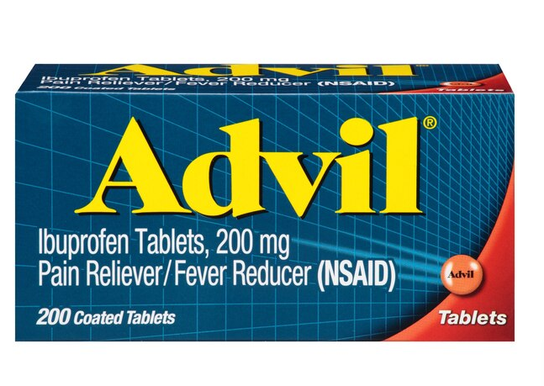
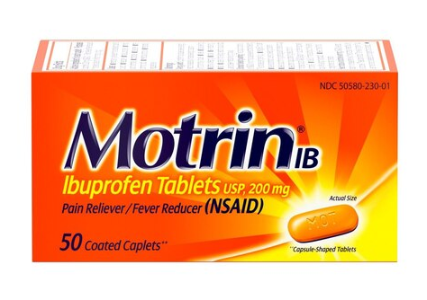
Caring for the Sick Treatment for Fever
Non-steroidal anti-inflammatory (NSAIDs) medication such as Ibuprofen (Advil, Motrin)
Adults - 200mg tablets take one to two tablets every four to six hours.
Children – 5mg/kg every six to eight hours (maximum 40 mg/kg/day).
outrunningthehorses.com

Slide 13
Caring for the Sick Treatment for Fever
NSAIDs - Ibuprofen
Taking an NSAID with food may help minimize the chance of stomach upset
In some cases, particularly with difficult-to-control fevers in children, healthcare providers may suggest alternating between ibuprofen and acetaminophen (Tylenol)
It is important to consult a pediatrician before using this method
outrunningthehorses.com

Slide 14
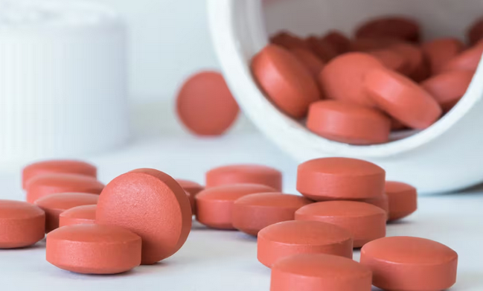
Caring for the Sick Treatment for Fever
NSAIDs - Ibuprofen
Common side effects include:
Nausea
Stomach pain
Gas
Headache
Dizziness
outrunningthehorses.com

Slide 15
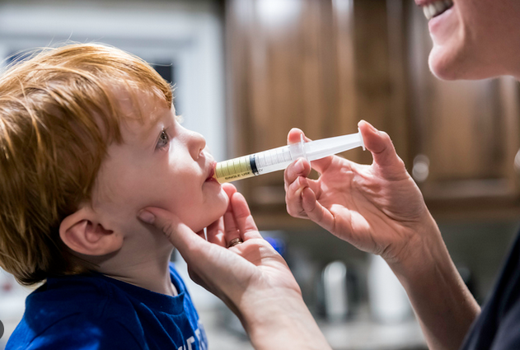
Caring for the Sick Treatment for Fever
NSAIDs - Ibuprofen
Do not use ibuprofen in children less than six months old unless your child’s doctor instructs you to
Measuring the dose for children is usually done in metric units
Consider using a syringe than a kitchen teaspoon
If the box does not come with one, ask your pharmacist
outrunningthehorses.com

Slide 16
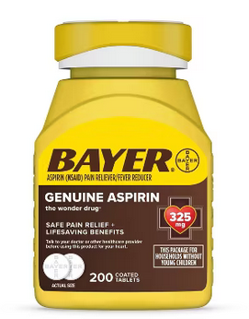
Caring for the Sick Treatment for Fever
NSAIDs - Aspirin
Adults - 325mg-650mg every four to six hours
Do not exceed 4,000 mg in 24 hours
Do not give aspirin to children less than eighteen years of age as it can cause Reye’s syndrome (a rare but serious disease affecting the liver and brain)
outrunningthehorses.com

Slide 17
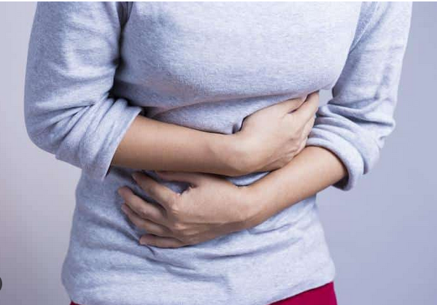
Caring for the Sick Treatment for Fever
NSAIDs – Aspirin
Should be taken with food
Adults should not take aspirin if they have:
A sensitivity
A history of gastrointestinal bleeding
Asthma
Nasal polyps
Kidney or liver disease
outrunningthehorses.com

Slide 18
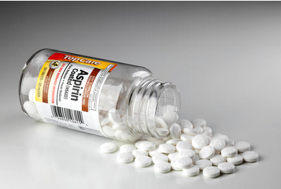
Caring for the Sick Treatment for Fever
NSAIDs – Aspirin
Common side effects:
Stomach upset
Heartburn
Nausea
Vomiting
outrunningthehorses.com

Slide 19
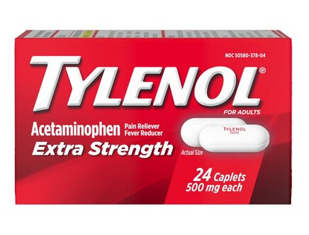
Caring for the Sick Treatment for Fever
Acetaminophen (Tylenol)
Adults – 325mg-500mg tablets, take one to two tablets every four to six hours
Children – 10-15 mg/kg every four to six hours (maximum 65mg/kg/day)
Follow label for dosing
Large doses can cause liver damage
outrunningthehorses.com

Slide 20
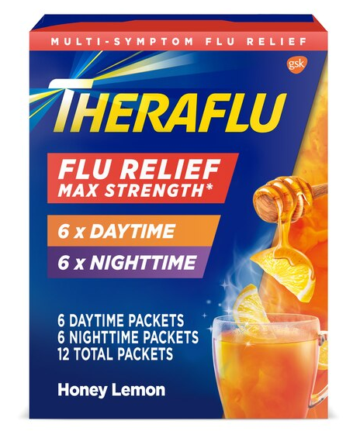
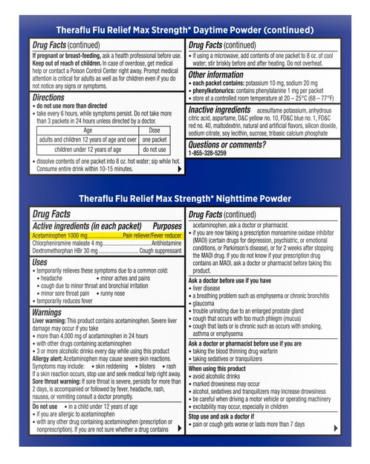
Caring for the Sick Treatment for Fever
If using a product for cold or flu symptoms, check the label to ensure it does not also contain ibuprofen to avoid taking too much
outrunningthehorses.com

Slide 21

Caring for the Sick Treatment for Fever
Acetaminophen (Tylenol)
Common side effects include:
Nausea
Vomiting
Stomach upset
Constipation
Rash
outrunningthehorses.com

Slide 22
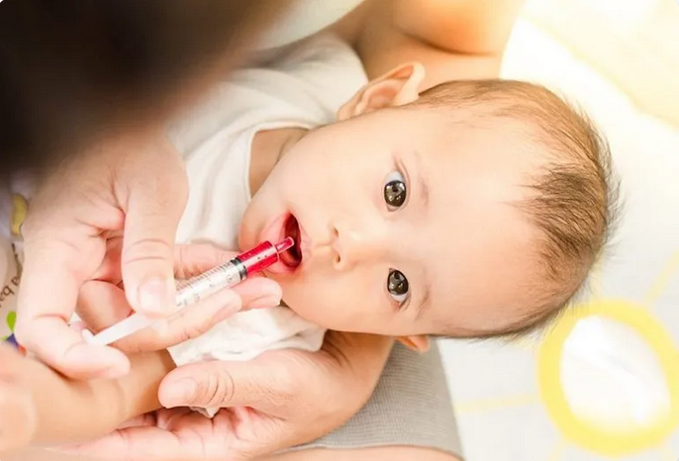
Caring for the Sick Treatment for Fever
Do not give any medication to babies before consulting your pediatrician
Always refer to medication labels when administering to children or infants
outrunningthehorses.com

Slide 23
Caring for the Sick Treatment for Fever
Non-pharmaceutical ways of treating a fever
Drink plenty of liquids – dehydration comes easily with fevers
Make sure patient gets plenty of rest
Keep room temperature at about 70˚ to 74˚F
Keep cool, loose, comfortable clothes on patient to prevent trapping of body heat
Allow child to have a blanket but remove it when chills stop
Shivering can raise the body temperature
outrunningthehorses.com

Slide 24
Caring for the Sick Treatment for Fever
If fever is high:
Consider a lukewarm bath to help lower temperature
Give antipyretic medications before the bath
If a bath is not an option, press damp wash cloths on the face, chest, back, wrists or legs
outrunningthehorses.com

Slide 25
Caring for the Sick Treatment for Fever
If fever is high:
Ensure patient doesn’t get chilled
Be careful not to allow temperature change to happen too quickly
This can induce seizures
Antibacterial medications may be needed as well as an antiviral medication to treat any condition that has developed such as bacterial pneumonia
outrunningthehorses.com

Slide 26
Caring for the Sick Treatment for Fever
When to Seek Medical Care
A child younger than 3 months with a 100.4°F (38°C) or higher fever
3 to 24 months old with 102°F (38.9°C) or higher fever that lasts more than a day
Any child with fever who is listless, irritable, or vomiting repeatedly
An adult with a 103°F (39.4°C) or higher fever
outrunningthehorses.com

Slide 27
Caring for the Sick Treatment for Fever
When to Seek Medical Care
Dehydration that results in:
Dizziness when standing
No urination
No tears in infants when crying
Seizures
Altered mental status, confusion, or less responsive
outrunningthehorses.com

Slide 28
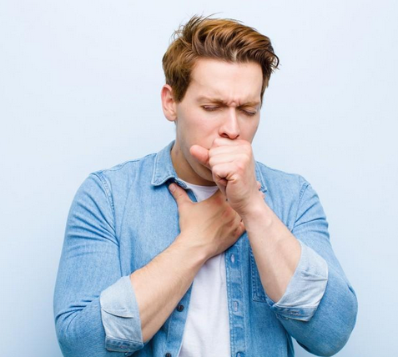
Caring for the Sick Treatment for Cough
A cough is our body’s way of removing mucus from our lungs and throat
Productive coughs are useful and should be encouraged to eliminate the mucus
However, coughs can cause breathing problems and keep the patient from resting6666;p
outrunningthehorses.com

Slide 29
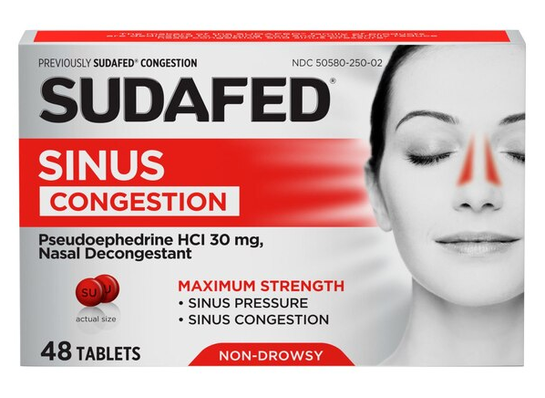
Caring for the Sick Treatment for Cough
Over the counter cough remedies include:
Decongestants
Relieve nasal congestion and dry up mucus in the lungs
Active ingredients: phenylephrine and pseudoephedrine
May increase blood pressure
Overuse can trigger a dry cough
outrunningthehorses.com

Slide 30
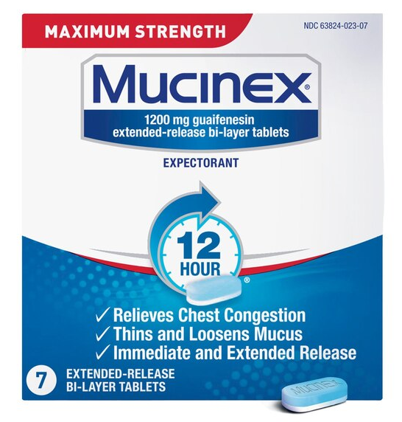
Caring for the Sick Treatment for Cough
Over the counter cough remedies include:
Expectorants
Help thin mucus to aid in coughing it up more easily
Active ingredient: guaifenesin
Drinking more fluids will aid the guaifenesin to thin mucus
outrunningthehorses.com

Slide 31
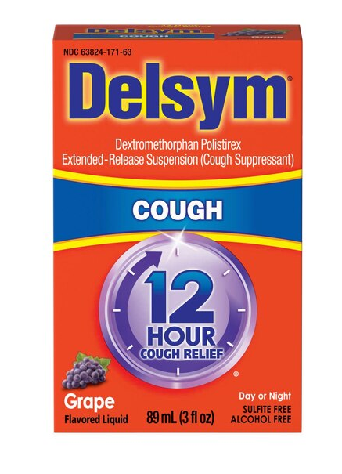
Caring for the Sick Treatment for Cough
Over the counter cough remedies include:
Suppressants
Use only if the patient’s chest hurts and they are not getting rest
Best to use only at night
Active ingredient: dextromethorphan
outrunningthehorses.com

Slide 32
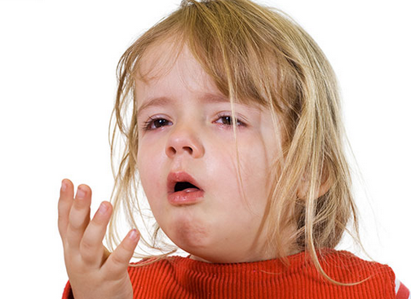
Caring for the Sick Treatment for Cough
Over the counter cough remedies
Do not give cough medicine to children under the age of four
Contact your pediatrician for advice on cough remedies
outrunningthehorses.com

Slide 33
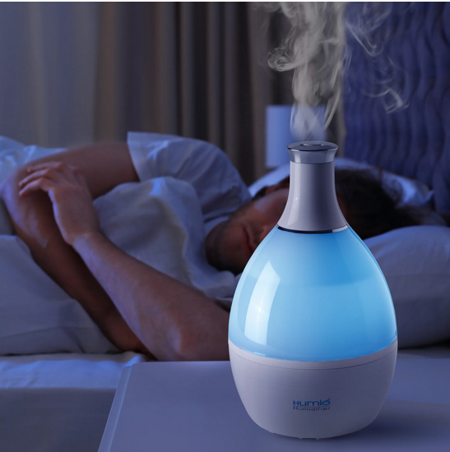
Caring for the Sick Treatment for Cough
Non-pharmaceutical remedies to soothe coughs include:
Use of a humidifier to:
Add moisture
Loosen secretions
Prevent dry coughs
outrunningthehorses.com

Slide 34

Caring for the Sick Treatment for Cough
Non-pharmaceutical remedies to soothe coughs include:
Cough drops to soothe an irritated throat
Avoid giving to children under six years of age due to choking risk
Gargle with salt water
Warm drinks
Tea or broth
outrunningthehorses.com

Slide 35

Caring for the Sick Treatment for Cough
Non-pharmaceutical remedies to soothe coughs include:
Take honey to soothe a sore throat
Do not give honey to children younger than 1 year old
Clostridium bacteria may cause infant botulism
Drink additional fluids to help thin mucus
Avoiding smoking and cigarette smoke
outrunningthehorses.com

Slide 36
Caring for the Sick Treatment for Cough
Seek medical attention if you have these symptoms with your cough:
Shortness of breath
Coughing up blood, bloody mucus, or pink foamy mucus
Coughing up green, tan, or yellow mucus
Fever, chills, or chest pain when you breathe deeply
outrunningthehorses.com

Slide 37
Caring for the Sick Treatment for Cough
Seek medical attention if you have a sore throat with any of these symptoms:
Lasts longer than a week
Severe pain
Trouble swallowing
Fever over 103 F in adults
Swollen glands
White patches on throat or tonsils
Rash
outrunningthehorses.com

Slide 38

Caring for the Sick Treatment for Cough
These signs and symptoms may indicate a bacterial infection that can be treated with antibiotics
May also indicate other conditions that require other treatments
outrunningthehorses.com

Slide 39
Caring for the Sick Treatment a Cytokine Storm
A cytokine storm is a severe complication of certain infectious diseases including seasonal influenza, COVID-19, and HPAI H5N1
It causes severe, systemic inflammation leading to rapid-onset symptoms
For more information on how to prevent a cytokine storm, please see the document and PowerPoint presentation titled “How to Prevent Acute Respiratory Distress Caused by a Cytokine Storm”
outrunningthehorses.com

Slide 40
Caring for the Sick Treatment for Nausea and Vomiting
Nausea is a sick feeling in the stomach that precedes vomiting
Vomiting is the body forcibly expelling the contents of the stomach
The causes of these can vary widely; however, this context is treating the complications of influenza and other viruses
outrunningthehorses.com

Slide 41
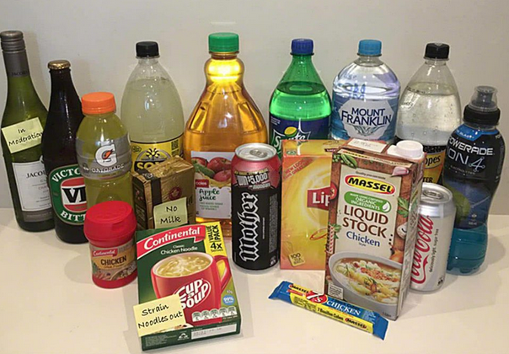
Caring for the Sick Treatment for Nausea and Vomiting
Some home treatments for nausea and vomiting include:
Drinking clear liquids
Water
Ginger ale
Fruit juices
Avoid milk and dairy products
Avoid solid foods until vomiting has passed
outrunningthehorses.com

Slide 42

Caring for the Sick Treatment for Nausea and Vomiting
Some home treatments for nausea and vomiting include:
Eat a BRAT Diet – foods low in fat and easy to digest
Bananas
Rice
Apple sauce
Toast
outrunningthehorses.com

Slide 43
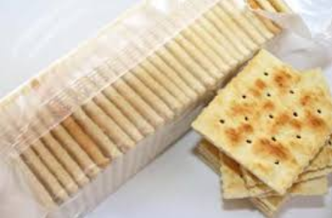
Caring for the Sick Treatment for Nausea and Vomiting
Some home treatments for nausea and vomiting include:
Eat small meals throughout the day; eat slowly
Crackers
Avoid hard to digest (meats) or fatty foods
outrunningthehorses.com

Slide 44
Caring for the Sick Treatment for Nausea and Vomiting
Over the counter remedies include:
Pepto-Bismol – coats inside of stomach and relieves feeling of nausea
Dramamine
Emetrol – relaxes stomach muscles and calms stomach activity (not for diabetics)
Kaopectate
Ginger
Peppermint oil
outrunningthehorses.com

Slide 45
Caring for the Sick Treatment for Nausea and Vomiting
Usually vomiting is harmless unless there are complications
If the following complications arise, contact your healthcare provider
Home treatment is not working, and dehydration is present.
Vomiting and diarrhea last more than twenty-four hours with signs of dehydration
outrunningthehorses.com

Slide 46
Caring for the Sick Treatment for Nausea and Vomiting
If the following complications arise, contact your healthcare provider
If an infant or child under six years show signs of dehydration, fever is present, and there is no urine output for six hours
There is blood in the vomit (frank blood or appearance of coffee grounds)
Lethargy, altered mental status
Severe abdominal pain
outrunningthehorses.com

Slide 47
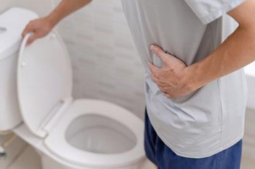
Caring for the Sick Treatment for Diarrhea
Diarrhea or loose bowel movements usually do not last long unless it is caused by an infection
It is the body’s way of expelling the infection
Giving medications to stop the diarrhea may interfere with body’s natural mechanisms
outrunningthehorses.com

Slide 48

Caring for the Sick Treatment for Diarrhea
Seek medical attention if:
Diarrhea is severe, and dehydration develops, then treatment should take place
There is blood or mucus in the stools, dehydration that causes weakness or change in mental status, seek medical attention
outrunningthehorses.com

Slide 49

Caring for the Sick Treatment for Diarrhea
Most viruses are found in feces
Can be spread by touching the feces and not properly washing your hands
Can occur when changing a diaper or using the bathroom
Be sure to use good hand hygiene when helping someone with diarrhea
Ensure the patient practices good hygiene as well
outrunningthehorses.com

Slide 50

Caring for the Sick Treatment for Diarrhea
In many cases of diarrhea, replacing fluids and salts lost is the only treatment needed
May be done by oral rehydration solutions
If necessary intravenous fluids
outrunningthehorses.com

Slide 51
Caring for the Sick Treatment for Diarrhea
Over the counter remedies for diarrhea include:
Kaopectate
Immodium
Pepto-Bismol
Take only the amount recommended
Do not use more than one anti-diarrheal remedy at the same time
outrunningthehorses.com

Slide 52
Caring for the Sick Treatment for Dehydration
We lose water every day in our sweat, urine, when we talk and exhale
This is replaced daily with fluids
However, if the amount of water lost outweighs what we take in – dehydration can occur
Dehydration can lead to death
outrunningthehorses.com

Slide 53

Caring for the Sick Treatment for Dehydration
Most causes of dehydration in adults are:
Fever
Heat exposure
Exercise
Vomiting and diarrhea
The best way to treat dehydration is to avoid it
outrunningthehorses.com

Slide 54

Caring for the Sick Treatment for Dehydration
Encourage the sick person to increase their intake of fluids
Diabetics are more at risk for dehydration
Avoid alcohol consumption and excess caffeine as these increases water loss
outrunningthehorses.com

Slide 55
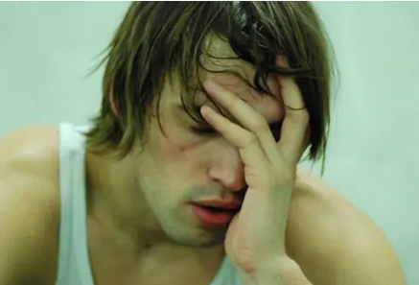
Caring for the Sick Treatment for Dehydration
Signs and symptoms of dehydration include:
Headache
Increased thirst
Dry mouth
Weakness/dizziness
Swollen tongue
Increased heart rate
outrunningthehorses.com

Slide 56
Caring for the Sick Treatment for Dehydration
Signs and symptoms of dehydration include:
Confusion
Decreased urine output
Color of urine is a dark yellow or amber
Hypotension (low blood pressure)
Seizure
outrunningthehorses.com

Slide 57

Caring for the Sick Treatment for Dehydration
Children are at greater risk in developing dehydration
In addition, they may not be able to communicate their symptoms
You must be aware of the signs
outrunningthehorses.com

Slide 58
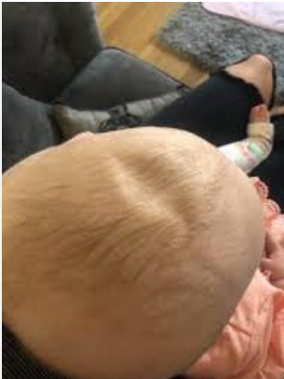
Caring for the Sick Treatment for Dehydration
Signs of dehydration in children
Dry lips and mouth
Sunken eyes
Rapid breathing
Rapid pulse
Decreased urination (dry diapers)
Sunken fontanelles
outrunningthehorses.com

Slide 59
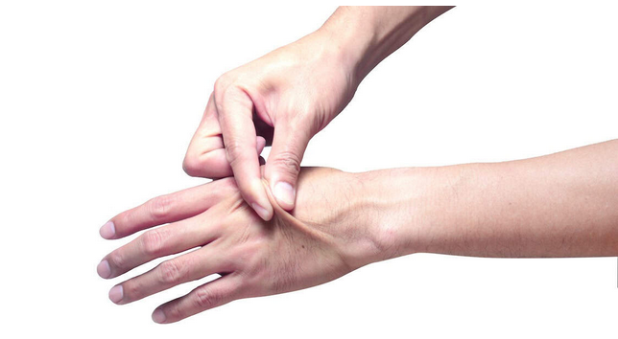
Caring for the Sick Treatment for Dehydration
Signs of dehydration in children
Increased irritation
Poor skin turgor (pinching the skin on the back of the hand, and it does not return to its original state)
outrunningthehorses.com

Slide 60
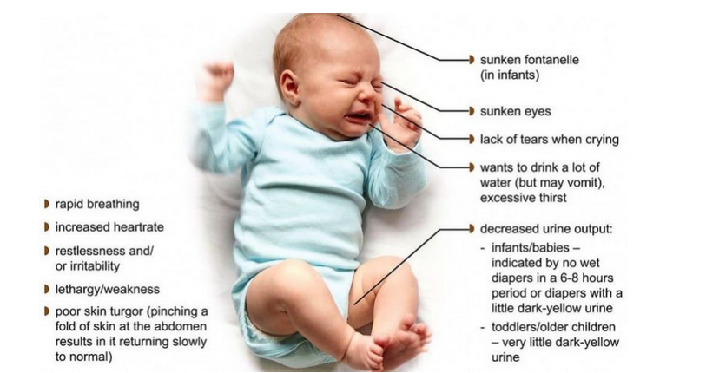
Caring for the Sick Treatment for Dehydration
Signs of dehydration in infants
outrunningthehorses.com

Slide 61
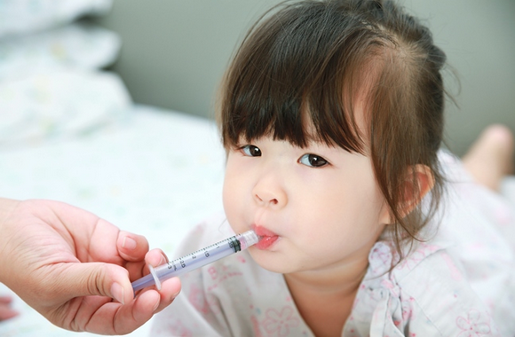
Caring for the Sick Treatment for Dehydration
Encourage those who are dehydrated to take in more fluids
Try giving small sips at first
With a child consider using a syringe
outrunningthehorses.com

Slide 62
Caring for the Sick Treatment for Dehydration
Some ways to increase fluids are:
Sipping small amounts of water
Popsicles, especially those made from fruit juices
Sucking on ice chips
Carbohydrate/electrolyte drinks such as Gatorade, PowerAde, and Pedialyte
Clear broths
Jello
outrunningthehorses.com

Slide 63
Caring for the Sick Oral Rehydration Solutions
Although water is necessary it does not contain the salts and electrolytes that are essential to body function
Oral rehydration solutions (ORS) are a way to replace fluids and nutrients lost through vomiting and diarrhea
Comes in several forms
A powder that can be mixed with water
Liquid form
outrunningthehorses.com

Slide 64
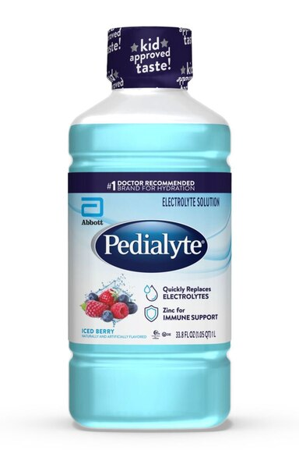
Caring for the Sick Oral Rehydration Solutions
Some ORS include:
Pedialyte
Ricelyte
Rehydralyte
outrunningthehorses.com

Slide 65
Caring for the Sick Oral Rehydration Solutions
Pedialyte vs Gatorade
Both popular drinks that help replenish fluids and electrolytes
Pedialyte is primarily used to treat dehydration caused by diarrhea or vomiting
Gatorade is marketed as a sports drink to help with exercise-induced dehydration
outrunningthehorses.com

Slide 66
Caring for the Sick Oral Rehydration Solutions
Pedialyte vs Gatorade
Pedialyte contains more sodium and potassium
Has a balance of sugar and sodium to help replenish fluids and electrolytes
Pedialyte also contains artificial sweeteners like sucralose and acesulfame potassium, which Gatorade doesn't have
outrunningthehorses.com

Slide 67
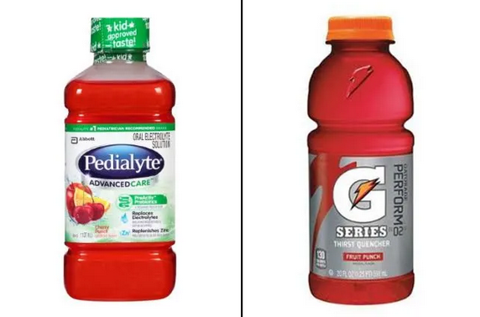
Caring for the Sick Oral Rehydration Solutions
Pedialyte vs Gatorade
Gatorade's high sugar content may help fuel athletic performance and duration
Pedialyte may be better for diarrhea because sugar can promote diarrhea
outrunningthehorses.com

Slide 68
Caring for the Sick Oral Rehydration Solutions
The World Health Organization (WHO) and UNICEF jointly maintain guidelines for the manufacture of ORS preparations
Commercial preparations are available as either pre-prepared fluids or packets of (ORS) ready for mixing with fluid
If you don’t have access to these at your local grocery store you can mix up an ORS at home
outrunningthehorses.com

Slide 69
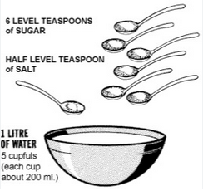
Caring for the Sick Oral Rehydration Solutions
A basic ORS is composed of:
Salt
Sugar
Water
Made using a standard ratio of ingredients
30 ml sugar/2.5 ml salt/1-liter fluid
6 teaspoons sugar/0.5 teaspoon salt/1-quart fluid
outrunningthehorses.com

Slide 70
Caring for the Sick Oral Rehydration Solutions
This ORS does not contain potassium. To add this essential element:
Add a cup of orange juice
Or have patient (if able) eat a banana
If the patient is vomiting, try giving small amounts of the ORS often, such as one teaspoon every minute

Slide 71
Caring for the Sick Oral Rehydration Solutions
By monitoring urine output, you can determine success of rehydration efforts
Medications may be used to prevent nausea, vomiting, and diarrhea
Intravenous fluids may be necessary if the patient is not able to replace fluids
outrunningthehorses.com

Slide 72
Caring for the Sick When to Seek Emergency Care
Seek medical attention if the following signs or symptoms arise for the patient:
Chest pain
Difficulty breathing
Fast breathing
Bluish or gray discoloration of the lips or skin
Uncontrolled vomiting
Uncontrolled diarrhea
outrunningthehorses.com

Slide 73
Caring for the Sick When to Seek Emergency Care
Seek medical attention if the following signs or symptoms arise for the patient:
Dehydration that results in:
Dizziness when standing
No urination
No tears in infants when crying
Seizures
Altered mental status, confusion, or less responsive
outrunningthehorses.com

Slide 74
Caring for the Sick
Conclusion
When caring for the sick it is important to know the following
Treatment for fever
Treatment for cough
Treatment for nausea and vomiting
Treatment for diarrhea
Treatment for dehydration
When to seek emergency care
outrunningthehorses.com

Slide 75

outrunningthehorses.com

Slide 76


“If you have run with footmen, and they have tired you out,
then how can you compete with horses?
If you fall down in a land of peace,
how will you do in the thicket by the Jordan?”
Jeremiah 12:5

Slide 77
For more presentations like this
or for more information
please visit
outrunningthehorses.com

