Slide 1
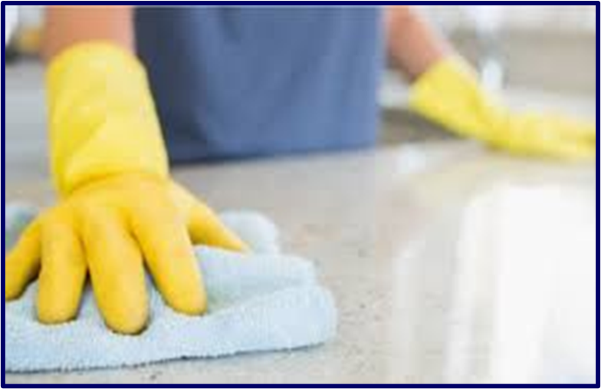
Pandemic Plan for the Church
Ministering to the Community in a Time of Crisis
Disinfecting Surfaces
outrunningthehorses.com

Slide 2
Disinfecting Surfaces
Person-to-person transmission is the primary way viruses infect people
In addition, individuals can acquire a virus, bacteria, or other microorganism by touching a contaminated object then touching a mucus membrane such as their eyes, nose, or mouth
outrunningthehorses.com

Slide 3
Disinfecting Surfaces
Second to wearing personal protective equipment (PPE) when caring for a patient with COVID-19 or Avian influenza is keeping all surfaces clean from the infectious agent
This is crucial to preventing the spread of the disease
outrunningthehorses.com

Slide 4
Disinfecting Surfaces
This presentation will focus on the three viruses that cause most concern
  SARS-CoV-2 (COVID-19)
  HPAI H5N1 (Avian Influenza)
  Seasonal Influenza
The term virus or viruses throughout this document will include all these
outrunningthehorses.com

Slide 5
Disinfecting Surfaces
Although there are existing viruses that still pose a threat to the world population, until one has mutated and become human-to-human transmissible, it is impossible to determine how it will conduct itself once loosed on people
outrunningthehorses.com

Slide 6
Disinfecting Surfaces
Items to be discussed
  The Longevity of a Virus on Various Surfaces
  Methods of Disinfecting Surfaces
  Proper Precautions
  Proper Cleaning of Objects
  Proper Disinfecting of Objects
  Laundry
  Using Bleach
outrunningthehorses.com

Slide 7
The Longevity of a Virus on a Surface
The Longevity of a Virus on a Surface
  The longevity of a virus is dependent on several factors such as humidity, temperature, and porosity of the surface
  Viruses tend to survive longer on surfaces in cooler temperatures and lower humidity
outrunningthehorses.com

Slide 8
The Longevity of a Virus on a Surface
The Longevity of a Virus on a Surface
  Studies show a virus can survive on different materials anywhere between a few hours to several days
  RNA from COVID-19 were found on the Princess Cruise ship up to 17 days after the passengers disembarked
outrunningthehorses.com

Slide 9
The Longevity of a Virus on a Surface
According to studies COVID-19 can live on the following surfaces :
  Cardboard – eight to 24 hours
    Packages received in the mail
    Items purchased from store
  Plastic – up to 72 hours (3 days)
    Cell phones
    Computers
    Remote Controls
Elevator buttons
Milk containers
Bus seats
outrunningthehorses.com

Slide 10
The Longevity of a Virus on a Surface
COVID-19 can live on the following surfaces :
  Stainless steel – up to 72 hours
    Kitchen appliances
    Faucets
    Door knobs
  Paper – a few minutes
    Mail
    Items from store
outrunningthehorses.com

Slide 11
Disinfecting Surfaces
The Longevity of a Virus on a Surface
COVID-19 can live on the following surfaces :
  Glass – 96 to 120 hours (4-5 days)
    Glassware
    Windows
    Mirrors
    Items from store
  Wood – up to 96 hours (4 days)
    Furniture
    Decking
outrunningthehorses.com

Slide 12
The Longevity of a Virus on a Surface
COVID-19 can live on the following surfaces :
  Fabric (room temperature) – Up to 48 hours (2 days)
    Clothing
    Furniture
    Linens
  Skin – up to 9 hours
outrunningthehorses.com

Slide 13
Disinfecting Surfaces
Tests were conducted to determine the environmental persistence of HPAI (H5N1) virus
  Four materials tested
    Glass
    Wood
    Galvanized metal
    Topsoil
outrunningthehorses.com

Slide 14
Disinfecting Surfaces
The tests showed the virus would be expected to persist appreciably beyond 13 days on these surfaces
It was most persistent at low relative humidity
Environmental Persistence of a Highly Pathogenic Avian Influenza (H5N1) Virus, Joseph P. Wood, Young W. Choi, et.al., ACS Publications, Environmental Science & Technology, Vol 44/Issue 19, September 3, 2010, https://pubs.acs.org/doi/10.1021/es1016153, accessed December 13, 2024
outrunningthehorses.com

Slide 15
Methods of Disinfecting Surfaces
Removing and killing an infectious agent on a surface effectively must be performed properly and methodically
There are several methods of performing this action; all following the steps of cleaning, disinfecting, and sterilizing
outrunningthehorses.com

Slide 16
Methods of Disinfecting Surfaces
Methods
  Cleaning – is the removal of visible soil from an object
  Disinfection – eliminates many but not all pathogenic microorganisms
  Sterilization – kills all microorganisms
outrunningthehorses.com

Slide 17
Methods of Disinfecting Surfaces
Methods
  Although sterilization would be the goal, this process is carried out in health care facilities
  Examples of sterilization methods:
    Steam under pressure
    Dry heat
    Ethylene oxide gas
    Hydrogen peroxide gas plasma
    Liquid chemicals
outrunningthehorses.com

Slide 18
Methods of Disinfecting Surfaces
Methods
  This presentation will focus on proper ways of cleaning and disinfecting surfaces outside of the healthcare setting
outrunningthehorses.com

Slide 19
Proper Precautions
Proper Precautions should be taken
  Donning proper PPE:
    Wear gloves, either disposable or rubber
    Wear a surgical mask in accordance with droplet precautions
    Use a respirator when airborne precautions are warranted by the circumstances
outrunningthehorses.com

Slide 20
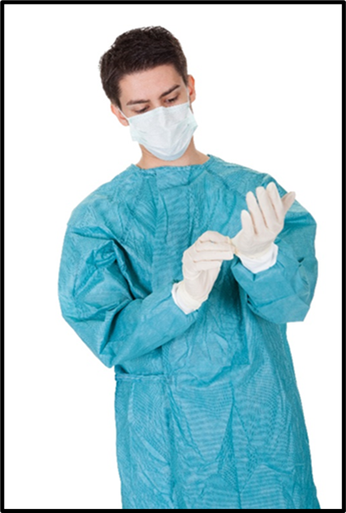
Proper Precautions
Proper Precautions should be taken
  Donning proper PPE:
    Gown - if your clothes may be become exposed to the patient’s bodily fluids
    Face and eye protection - if the patient is coughing
outrunningthehorses.com

Slide 21
Proper Precautions
Proper Precautions should be taken
  Keep unnecessary objects at least six feet away from the patient.
  Consider covering objects that are not necessary, and not easily removed.
  Cleaning and disinfection should be performed on a daily basis
outrunningthehorses.com

Slide 22
Using Chemical Disinfectants
When using chemical disinfectants:
  Always read and follow the directions on the label
    Wear gloves and consider glasses or goggles for potential splash hazards to eyes
    Ensure adequate ventilation (e.g. open windows)
    Use only the amount recommended on the label
    Use water at room temperature for dilution (unless stated otherwise on the label)
outrunningthehorses.com

Slide 23
Using Chemical Disinfectants
When using chemical disinfectants:
  Always read and follow the directions on the label
    Label diluted cleaning solutions
    Store and use chemicals out of the reach of children and pets
    Do not mix products or chemicals
    Do not eat, drink, breathe, or apply directly to your skin as disinfection products can cause serious harm
outrunningthehorses.com

Slide 24
Using Chemical Disinfectants
When using chemical disinfectants:
  Always read and follow the directions on the label
    Do not wipe or bathe pets with any cleaning and disinfection products
    Special considerations should be made for people with asthma. Some cleaning and disinfection products can trigger asthma
outrunningthehorses.com

Slide 25
Cleaning the Object
Cleaning the object thoroughly is the first step to disinfection
  Obvious particles must be removed so not to hinder the disinfecting process
  Can be done by using soap and water with wiping and rubbing to wash soil away
  Methods other than routine cleansing are not necessary
outrunningthehorses.com

Slide 26
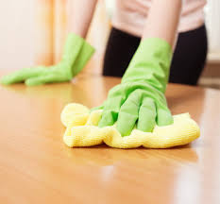
Cleaning the Object
Cleaning the object thoroughly is the first step to disinfection
  Soap can be a simple detergent or an enzymatic solution
  The temperature of the water should be what is recommended on the label
outrunningthehorses.com

Slide 27
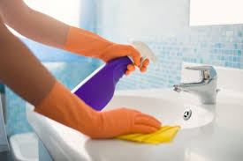
Cleaning the Object
Some disinfectants are also disinfectant cleaners
  If the disinfectant contains a detergent that allows it to penetrate soil, then the cleaning and disinfectant process can be completed in one step
outrunningthehorses.com

Slide 28
The Correct Disinfectant
Choose the correct disinfectant
  Healthcare facilities use germicidal agents that include both antiseptics and disinfectants
    Antiseptics are for use on skin
    Disinfectants are used on surfaces
    These are not interchangeable
outrunningthehorses.com

Slide 29
The Correct Disinfectant
Choose the correct disinfectant
  These agents may have the suffix cide or cidal in the name
    Virucide, fungicide, bactericide, sporicide, and tuberculocide can kill the type of microorganism identified by the prefix
    For example, a bactericide is an agent that kills bacteria (not viruses)
outrunningthehorses.com

Slide 30
The Correct Disinfectant
Choose the correct disinfectant
  Read the labels and strictly follow instructions
    For example, some disinfectants are only effective after being left on the surface for more than one minute and even up to twenty or more minutes
outrunningthehorses.com

Slide 31
The Correct Disinfectant
Influenza viruses can be eliminated by basic or intermediate level disinfectants containing any of the following ingredients:
  Chlorine or hypochlorite
  Aldehydes
  Quaternary ammonium compounds [quats]
  Phenolics
  Alcohols
  Peroxygen compounds
outrunningthehorses.com

Slide 32
The Correct Disinfectant
Use of disinfectants registered by the U.S. Environmental Protection Agency (EPA) is recommended whenever these are available.
  Lists of all registered disinfectants can be found at www.epa.gov/oppad001/chemregindex.htm
outrunningthehorses.com

Slide 33
Conclusion
Removing and killing an infectious agent on a surface effectively must be performed properly and methodically
  Cleaning then disinfecting
  Bleach is one of many EPA approved chemicals that are effective to kill the influenza and corona viruses
outrunningthehorses.com

Slide 34
Conclusion
Second to wearing PPE when caring for a patient with a pathogen causing a pandemic, is keeping all surfaces clean from the infectious agent
  This is crucial to preventing the spread of the disease
outrunningthehorses.com

Slide 35

Questions?
outrunningthehorses.com

Slide 36

For more presentations like this
or for more information
please visit
outrunningthehorses.com
outrunningthehorses.com

