Slide 1

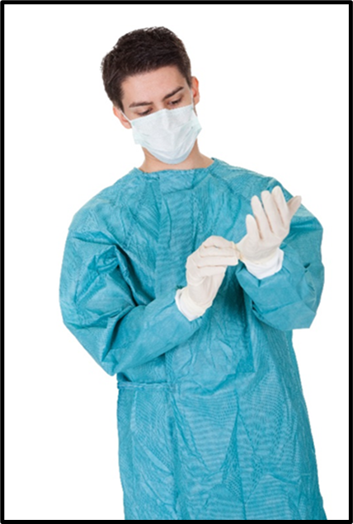
Pandemic Plan for the Church
Ministering to the Community in a Time of Crisis
Infection Control
Personal Protection Equipment
outrunningthehorses.com

Slide 2
Infection Control Objectives
The following will be discussed
Lessons learned from SARS, MERS, and Ebola
Universal ways to avoid infection
Standard Precautions
Proper Hand Hygiene
Respiratory Hygiene
Personal Protective Equipment
Ways Infection can spread
outrunningthehorses.com

Slide 3

Infection Control
Introduction
Disease is spread by the transmission of pathogens
A pathogen is a virus, bacteria or any other microorganism that can cause illness
Pathogens spread differently depending on their method of transmission
outrunningthehorses.com

Slide 4
Infection Control
Introduction
Infection Control is the discipline of preventing the spread of infection.
The wearing of Personal Protective Equipment (PPE) is essential
It will help minimize the spread of infection and help protect those delivering and receiving care
It is to be practiced without exception
outrunningthehorses.com

Slide 5
Lessons Learned (SARS, MERS, Ebola, COVID-19)
Severe acute respiratory syndrome (SARS)
Global outbreak in 2003
Infected 8,096 people
774 deaths worldwide
Observations found that healthcare workers displayed numerous violations in infection control
This led to the lack of containment in the spread of SARS
outrunningthehorses.com

Slide 6
Lessons Learned (SARS, MERS, Ebola, COVID-19)
Middle East Respiratory Syndrome (MERS)
A corona virus first reported 2012 in Saudi Arabia and spread to other countries
Has approximately a 35% death rate
Much of the spread in South Korea occurred in the hospital setting
Determined that healthcare workers lack compliance in practicing strict infection control
outrunningthehorses.com

Slide 7

Lessons Learned (SARS, MERS, Ebola, COVID-19)
Ebola
In 2014, Nina Pham, a nurse in Dallas, Texas acquired Ebola from a patient from Liberia.
The hospital did not provide proper PPE, nor did they provide instructions in its use.
Fortunately, although she acquired the disease, she recovered.
outrunningthehorses.com

Slide 8
Lessons Learned (SARS, MERS, Ebola, COVID-19)
COVID-19
Stockpiling is Crucial
Global demand and supply chain challenges led to shortages
Quality Matters
High quality PPE proved more effective in providing protection
Public Education is Essential
Correct usage significantly enhances effectiveness
Misuse and improper wearing negates benefits
outrunningthehorses.com

Slide 9
Lessons Learned (SARS, MERS, Ebola, COVID-19)
Lessons Learned from SARS, MERS, Ebola, COVID-19
These lessons should urge all those who care for the sick to maintain strict adherence to infection control measures
As the Church encourages those to reach out to our neighbors, we as leaders too must ensure proper procedures are followed
outrunningthehorses.com

Slide 10
Infection Control
Ways to avoid infection:
Avoid touching your face.
Cover your nose and mouth with a tissue when you cough or sneeze, throw the tissue away in a waste basket.
If a tissue is not available, cough or sneeze into the sleeve of your bent elbow.
Instruct others to use good sneeze and cough etiquette.

Slide 11
Infection Control
Ways to avoid infection:
Good hand hygiene – wash your hands often with soap and water, especially after you sneeze or cough.
Use disposable paper towels for hand washing, or designate cloth towels to family members.
Use an alcohol-based hand rub if soap is not available.
Avoid being close-up and face to face with someone who is sick – try to keep a six-foot distance between you and the patient.

Slide 12
Infection Control
Ways to avoid infection:
Place the chin of a small child on your shoulder in case they cough or sneeze.
Wear a facemask or respirator.
Place a facemask on the patient as well.
Contact your healthcare provider about taking antiviral medication for both the patient and yourself.

Slide 13
Infection Control Ways Infection Can Spread
The mode of transmission of the pathogen will determine the Personal Protection Equipment (PPE) used.
There are three types of transmission:
Contact
Droplet
Airborne
Some diseases require more than one type of transmission- based precautions
outrunningthehorses.com

Slide 14
Infection Control Ways Infection Can Spread
Contact Transmission
Can take place with direct contact with ill person
Skin-to-skin
Indirect Contact Transmission
Touching a contaminated surface or object then touching the mucous membranes of the eyes, nose and mouth
outrunningthehorses.com

Slide 15
Infection Control Ways Infection Can Spread
Contact Transmission
Pathogens may be carried in:
Draining wounds
Secretions
Pressure ulcers
Tubes such as ostomy or feeding tubes
Bags draining body fluids including Foley bags
Feces
Generalized rash/skin lesions
outrunningthehorses.com

Slide 16

Infection Control Ways Infection Can Spread
Contact Transmission
Contaminated surfaces can include:
Tops of furniture
Kitchen, and bathroom counter tops
Thermometers
Bed and linens, etc.
Patient’s belongings
outrunningthehorses.com

Slide 17
Infection Control Ways Infection Can Spread
Contact Transmission
Depending on the type of material, porosity, and environmental conditions:
COVID-19 can last on surfaces from hours to several days
It can last on human skin for approximately 9 hours
Seasonal Influenza can survive on hard surfaces 24-48 hours
On porous materials it lasts for less than 12 hours
H5N1 can survive on surfaces for 1-2 days at room temperature
It can last roughly 26 hours on plastic and 4 ½ hours on human skin
It can persist for weeks in cold, moist conditions
outrunningthehorses.com

Slide 18
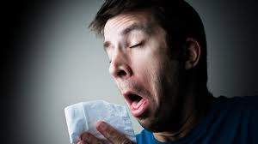
Infection Control Ways Infection Can Spread
Droplet Transmission
Occurs when pathogens are carried in large droplets within three feet or more of the infected person
This can occur with coughing, sneezing, and talking
outrunningthehorses.com

Slide 19
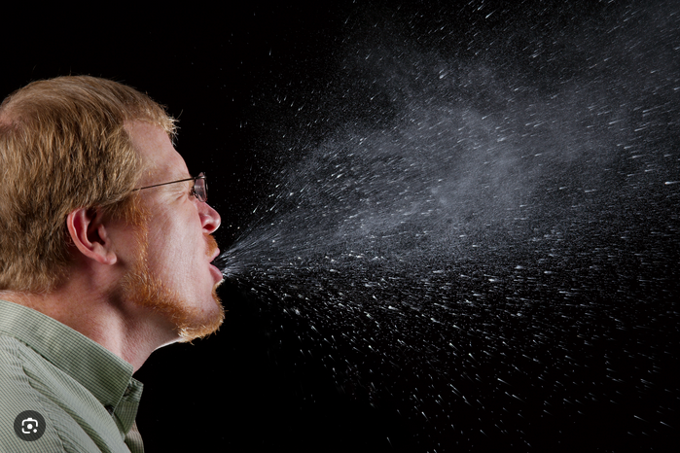
Infection Control Ways Infection Can Spread
Airborne Transmission
Occurs when the pathogen is contained in very small, fine particles of evaporated droplets or dusts
Because these particles are smaller and lighter, they can remain in the air for a longer length of time and can travel along currents farther than droplets.
outrunningthehorses.com

Slide 20
Infection Control Ways Infection Can Spread
Airborne Transmission
Examples of pathogens carried in airborne transmission are:
Influenza (Seasonal, H5N1, H7N9)
Coronavirus (SARS-CoV-2, MERS)
Tuberculosis
Measles
Chickenpox
outrunningthehorses.com

Slide 21
Infection Control Standard Precautions
Standard Precautions
The basic, minimum precautions to take to reduce the risk of spread of a disease
This basic level of infection control should be practiced in the care of ALL patients
outrunningthehorses.com

Slide 22
Infection Control Standard Precautions
Standard Precautions include:
Proper hand hygiene
Respiratory Hygiene
Personal Protective Equipment (PPE)
outrunningthehorses.com

Slide 23

Infection Control Standard Precautions
Proper Hand Hygiene
Viruses can be spread by touching a contaminated surface then touching mucous membranes
Eyes
Nose
Mouth
outrunningthehorses.com

Slide 24

Infection Control Standard Precautions
Proper Hand Hygiene
Proper hand hygiene is the best defense in controlling spread of infection
Requires good hand washing
outrunningthehorses.com

Slide 25
Infection Control Standard Precautions
Hand washing tips
Total amount of time should take about 40-60 seconds
Remove hand and arm jewelry
Jewelry is very hard to clean, and bacteria and viruses can hide beneath and in the crevices of rings and bracelets, even with good hand washing
Wet hands with warm water
outrunningthehorses.com

Slide 26
Infection Control Standard Precautions
Hand washing tips (continued)
Apply liquid or foam soap
Do not use bar soap as it may hold bacteria
Vigorously lather all surfaces of hands for a minimum of 15 – 30 seconds rubbing to remove dirt and bacteria
Pay particular attention to fingertips, between fingers, backs of hands and base of the thumbs
These are commonly missed areas
outrunningthehorses.com

Slide 27
Infection Control Standard Precautions
Hand washing tips (continued)
Using a rubbing motion, thoroughly rinse soap from hands
Dry hands by blotting hands gently with a paper towel
Turn off taps with a paper towel, to avoid recontamination of your hands
If you use a hand dryer, do not use your clean hands to press the buttons to turn it on
outrunningthehorses.com

Slide 28

Infection Control Standard Precautions
Proper Hand Hygiene
Alcohol-Based Hand Rub
Alcohol sanitizer is the preferred method for decontaminating hands
Hand washing with soap and running water should be performed when hands are visibly soiled
outrunningthehorses.com

Slide 29

Infection Control Standard Precautions
Proper Hand Hygiene
Indications for hand hygiene:
Before and after any direct patient contact and between patients
After touching blood, body fluids, secretions, excretions, non-intact skin, and contaminated items, even if gloves are worn
Immediately after gloves are removed
outrunningthehorses.com

Slide 30

Infection Control Standard Precautions
Proper Hand Hygiene
Indications for hand hygiene (cont’d):
During patient care, when moving from a contaminated to a clean body site of the patient
After handling any objects in the immediate vicinity of the patient
outrunningthehorses.com

Slide 31

Infection Control Standard Precautions
Proper Hand Hygiene
Indications for hand hygiene (cont’d):
After personal bodily functions, such as using the toilet or blowing one’s nose.
Before preparing, handling, serving or eating food
outrunningthehorses.com

Slide 32
Infection Control Standard Precautions
Respiratory Hygiene
Hand hygiene after contact with respiratory secretions should be performed
Respiratory etiquette should be practiced by all people, not just the patient
Masks and tissues should be in abundant supply
outrunningthehorses.com

Slide 33
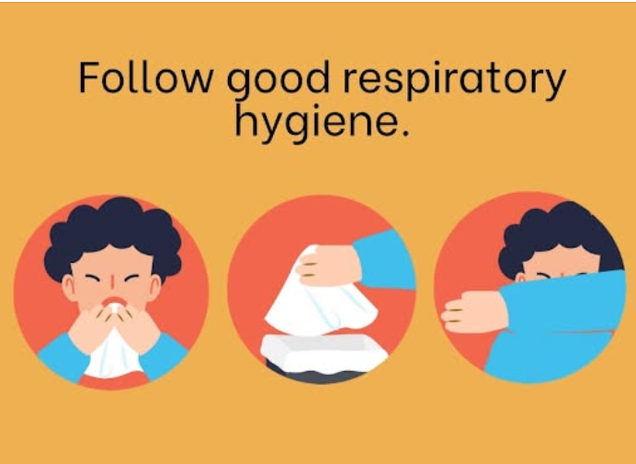
Infection Control Standard Precautions
Respiratory Hygiene
Instruct people with respiratory symptoms to cover their coughs and sneezes
They should do so into the bend of their elbow, not into their bare hands
Even better they should use a tissue
These should be properly disposed
outrunningthehorses.com

Slide 34
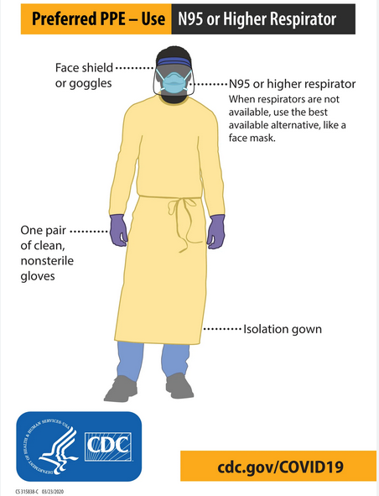
Infection Control Personal Protective Equipment (PPE)
Personal Protective Equipment (PPE)
PPE is designed to protect the wearer from injury or the spread of infection or illness
The type of illness and care should determine the type of PPE to be worn
outrunningthehorses.com

Slide 35
Infection Control Personal Protective Equipment (PPE)
Personal Protective Equipment (PPE)
Clean, non-sterile gloves
Face mask
Eye protection
Clean, non-sterile fluid resistant gown
outrunningthehorses.com

Slide 36

Infection Control Personal Protective Equipment (PPE)
Personal Protective Equipment (PPE)
First ASSESS THE RISK
Determine and don the necessary PPE
BEFORE any patient care takes place
outrunningthehorses.com

Slide 37
Infection Control Personal Protective Equipment (PPE)
Who should use Personal Protective Equipment?
All individuals who provide direct patient care
All family members coming in contact with a patient
All visitors coming in contact with patient
Anyone handling linens, utensils, equipment, trash that comes from the patient’s area
outrunningthehorses.com

Slide 38
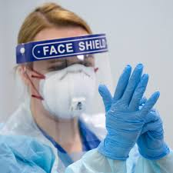
Infection Control Personal Protective Equipment (PPE)
Selection of Personal Protection Equipment
Determining the type of PPE is based on the type of care that will be provided.
outrunningthehorses.com

Slide 39
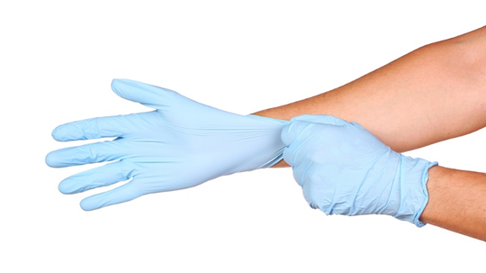
Infection Control Personal Protective Equipment (PPE)
Disposable Gloves
Use gloves made of
Latex
Vinyl
Nitrile
Or other synthetic materials as appropriate
outrunningthehorses.com

Slide 40
Infection Control Personal Protective Equipment (PPE)
Disposable Gloves
When there is contact with:
Blood and other bodily fluids
Secretions
Excretions
Mucous membranes
Including respiratory secretions
outrunningthehorses.com

Slide 41
Infection Control Personal Protective Equipment (PPE)
Disposable Gloves
Recommendations for use:
Change between tasks and procedures on the same patient after contact with potentially infectious material
Remove after use and discard, before touching non-contaminated items and surfaces, and before going to another patient
outrunningthehorses.com

Slide 42
Infection Control Personal Protective Equipment (PPE)
Disposable Gloves
Recommendations for use:
When gloves are torn, cut, or punctured they should be removed and replaced.
Gloves do not eliminate the need for hand washing
Perform hand hygiene immediately after removal.
They should be discarded and not washed or reused
outrunningthehorses.com

Slide 43

Infection Control Personal Protective Equipment (PPE)
Rubber Gloves
If during a pandemic, the supply of gloves become limited it may be necessary to reuse gloves
When using cleaning supplies, thick rubber gloves can be used in place of disposable gloves.
Must be cleaned properly to ensure sterility
outrunningthehorses.com

Slide 44
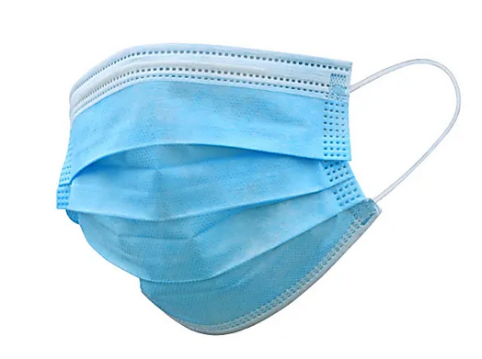
Infection Control Personal Protective Equipment (PPE)
Facial Protection
Face Masks
Disposable, loose-fitting face covering
Create a physical barrier to protect the wearer’s nose and mouth from large droplets, sprays, and fluids.
Can help lower the risk of respiratory virus transmission
Not designed to filter out viruses the size of 20-400 nanometers
outrunningthehorses.com

Slide 45
Infection Control Personal Protective Equipment (PPE)
Face Mask
A face mask does not provide the protection needed to safeguard the caregiver from a lethal virus
Requiring the sick person to wear a face mask will help keep the larger droplets from spreading
If an N95 mask is not available, a face shield is recommended with the face mask
outrunningthehorses.com

Slide 46
Infection Control Personal Protective Equipment (PPE)
Face Mask
A face mask does not provide the protection needed to safeguard the caregiver from a lethal virus
Requiring the sick person to wear a face mask will help keep the larger droplets from spreading
If an N95 mask is not available, a face shield is recommended with the face mask
outrunningthehorses.com

Slide 47
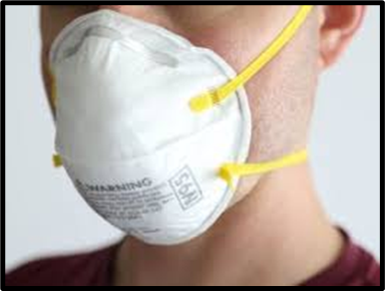
Infection Control Personal Protective Equipment (PPE)
NIOSH N95 Respirator
Respirators
National Institute for Occupational Safety and Health (NIOSH) certified N95
Filter at least 95% of airborne particles including dust, smoke, and viruses
Uses head straps to ensure a tight fit
For medical and industrial use
outrunningthehorses.com

Slide 48
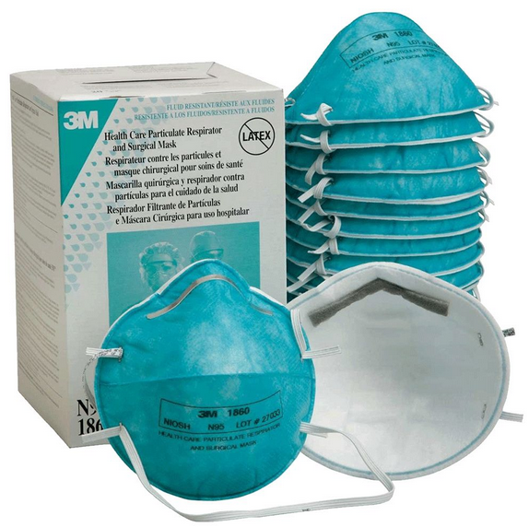
Infection Control Personal Protective Equipment (PPE)
NIOSH N95 Respirator
Respirators
The effective use of these face masks requires fit testing to ensure a proper fit
Contact your local health department, occupational medical provider, urgent care, or fire department to inquire about fit testing for your church
outrunningthehorses.com

Slide 49
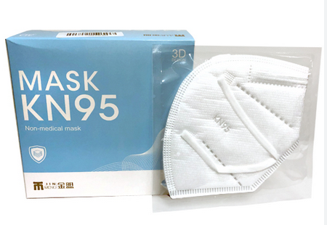
Infection Control Personal Protective Equipment (PPE)
N95 vs KN95
N95s are made to US standards for respirator masks
KN95s are made to Chinese standards
outrunningthehorses.com

Slide 50
Infection Control Personal Protective Equipment (PPE)
N95 vs KN95
Both made of several layers of synthetic material
Distinction is their certification
Both ratings require masks to be tested for filtration efficiency at capturing salt particles (NaCl)
outrunningthehorses.com

Slide 51
Infection Control Personal Protective Equipment (PPE)
N95 vs KN95
N95 masks have stricter requirements for pressure drop when inhaling and exhaling
Slightly more breathable
N95 masks have head straps for a tighter fit
KN95 masks have ear loops allowing more outside air to enter
outrunningthehorses.com

Slide 52
Infection Control Personal Protective Equipment (PPE)
N95 vs KN95
During COVID-19 there was shortage of N95 masks
KN95 masks were more available
KN95 masks do not meet NIOSH standards for use in hospital and healthcare settings
A larger supply of KN95 masks were available to the public
outrunningthehorses.com

Slide 53
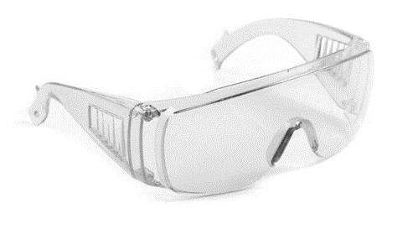
Infection Control Personal Protective Equipment (PPE)
Goggles/Face Shield
The mucous membranes surrounding the eyes can absorb fluids
Protective eyewear should be worn to prevent splashing, spraying, or splattering fluids to enter the eyes
Any caregiver within three feet of an infected patient is likely to encounter sprays of infectious material
outrunningthehorses.com

Slide 54
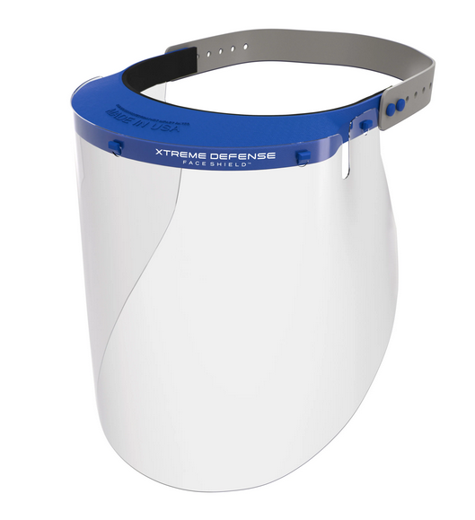
Infection Control Personal Protective Equipment (PPE)
Goggles/Face Shield
Eyeglasses worn daily are not as effective as goggles or a face shield
These protect the eyes from the front and the sides
outrunningthehorses.com

Slide 55
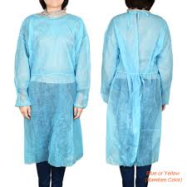
Infection Control Personal Protective Equipment (PPE)
Gowns
When it is anticipated that soiling of clothes with blood or other bodily fluids, including respiratory secretions
Most routine patient encounters do not necessitate the use of gowns
outrunningthehorses.com

Slide 56
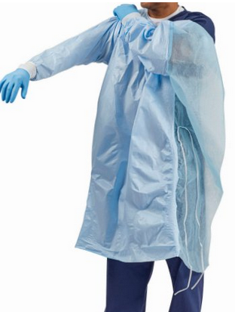
Infection Control Personal Protective Equipment (PPE)
Gowns – Recommendations for Use:
Can be disposable or reusable and made of washable cloth
Should be the appropriate size to fully cover the areas requiring protection
Any situation that requires a gown also requires gloves, a mask and goggles
outrunningthehorses.com

Slide 57
Infection Control Personal Protective Equipment (PPE)
Gowns – Recommendations for Use:
Remove soiled gown as soon as possible
When removing a gown, do so using extreme care so not to shake, rub, or splash and bodily fluids onto yourself
Place in a waste container
Hand hygiene should follow
Place washable gown a laundry receptacle designated for soiled gowns, do not mix with other laundry
For more information on laundry see the section on Disinfecting Surfaces
outrunningthehorses.com

Slide 58
Infection Control Conclusion
When performing any patient care standard precautions are to be used at all times
Dependent on the pathogen and its mode of transmission, additional PPE should be used to prevent spread of the disease
Assessing the risk will determine the type of PPE to use
outrunningthehorses.com

Slide 59
Infection Control Conclusion
The current COVID-19 and Avian Influenza viruses circulating can be transmitted through airborne droplets
The PPE required for performing patient care for this pathogen is:
Disposable gloves
Goggles/Face Shield
Surgical mask or N95
Gown
Face mask on the patient
outrunningthehorses.com

Slide 60
Infection Control Conclusion
Lessons learned from SARS, MERS, Ebola, and COVID-19 prove that non-compliance and not adhering to strict infection control guidelines and using proper precautions can cause further transmission of a pathogen and even an outbreak.
outrunningthehorses.com

Slide 61

outrunningthehorses.com

Slide 62


“If you have run with footmen, and they have tired you out,
then how can you compete with horses?
If you fall down in a land of peace,
how will you do in the thicket by the Jordan?”
Jeremiah 12:5

Slide 63
For more presentations like this
or for more information
please visit
outrunningthehorses.com

