Slide 1
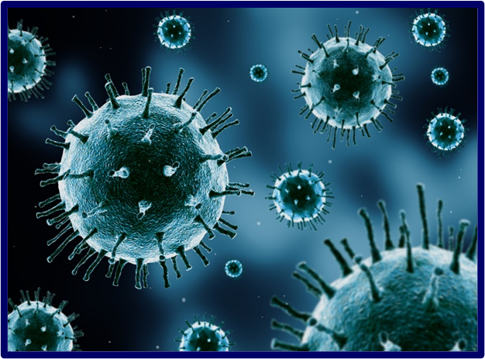
Pandemic Plan for the Church
Ministering to the Community in a Time of Crisis
Influenza Viruses
outrunningthehorses.com

Slide 2
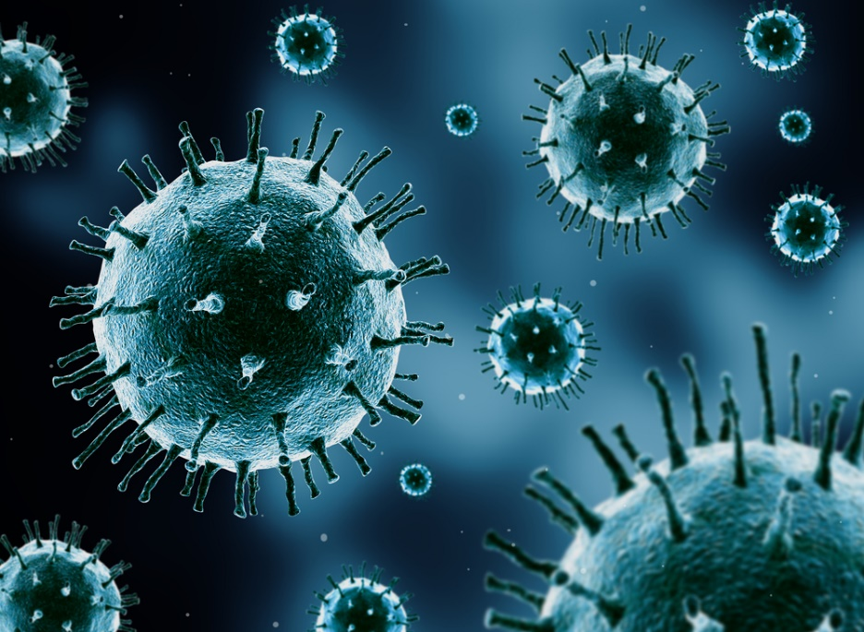
Viruses that carry RNA
mutate much faster than a DNA virus.
Up to 1 million times faster.
The influenza virus
is among those that
mutate the fastest in the world of viruses.
outrunningthehorses.com

Slide 3
Objectives
The following topics will be discussed
  Influenza Viruses overview
  Classifications
    Protein Antigen Surface
      Hemagglutinins
      Neuraminidases
      Mutation
outrunningthehorses.com

Slide 4
Objectives continued
  Significance of DNA vs. RNA
  Mutation
    Antigenic Drift
    Antigenic Shift
    Genetic Reassortment
outrunningthehorses.com

Slide 5
Influenza Viruses
Influenza – Italian (un influenza di freddo) “To be influenced by the stars”
Also known as seasonal flu
  Highly contagious
  Occurs in colder less humid months
    Fall through January or February (as late as May)
  Mainly affects the upper respiratory tract
outrunningthehorses.com

Slide 6
Influenza Viruses
Influenza member of orthomyxoviruses
  Family of RNA viruses
  Classified by nucleoprotein antigen
  Three types that infect vertebrates
    Influenza A – humans, other mammals, birds
    Influenza B – humans, seals
    Influenza C – humans, pigs

Slide 7
Influenza Viruses
Seasonal influenza caused by Type A or B
  Most people have some immunity to circulating strains
  Severity of illness substantially less than during pandemics
  Trivalent vaccine prepared each year (two type A and one type B)
outrunningthehorses.com

Slide 8
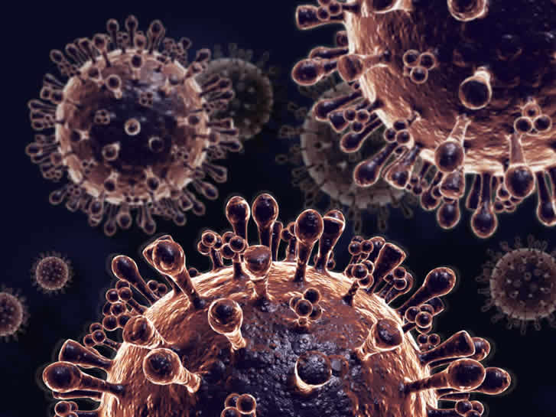
Influenza Viruses
Protein Antigen Surface
outrunningthehorses.com

Slide 9
Influenza Viruses
Protein Antigen Surface
Protein antigens on surface called Hemagglutinin (H) and Neuraminidase (N)
  Enable the virus to attach and invade host cells
  Undergo genetic variations (mutations)
  Immune system recognizes these antigens
    By this recognition people build immunity
    By mutations people become re-infected
outrunningthehorses.com

Slide 10
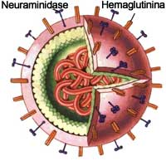
Influenza Viruses
Protein Antigen Surface
Hemagglutinin (H)
Neuraminidase
(N)
outrunningthehorses.com

Slide 11
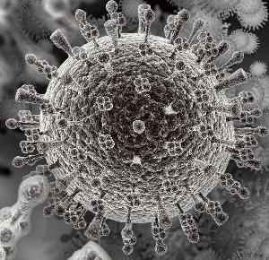
Influenza Viruses
Protein Antigen Surface
Hemagglutinin (H)
Neuraminidase
(N)
outrunningthehorses.com

Slide 12

Influenza Viruses
Protein Antigen Surface
Hemagglutinin
  Considered to be the “key”
  By the hemagglutinin’s shape the virus can attach and penetrate specific receptors on host cells
  Glycogen receptors in respiratory system especially susceptible to these proteins
outrunningthehorses.com

Slide 13

Influenza Viruses
Protein Antigen Surface
Neuraminidase
  Considered to be the “scalpel”
  Under an electron microscope, at top of each N, it appears that there are propellers similar to a helicopter
outrunningthehorses.com

Slide 14
Influenza Viruses
Protein Antigen Surface
Neuraminidase
  Blades allow Ns to destroy sialic acid in mucus enabling hemagglutinin to bind to receptor
  “Blades” prohibit sialic acid from binding to viruses when they burst from cell
  This ensures new viruses can break free to infect new host cells
outrunningthehorses.com

Slide 15
Influenza Viruses
Protein Antigen Surface
Subtypes of the Influenza A virus are categorized by these proteins (H1N1, H5N1, H7N9, etc..)
  Hemagglutinin (H)
    18 subtypes
  Neuraminidase (N)
    11 subtypes
outrunningthehorses.com

Slide 16
Influenza Viruses
Protein Antigen Surface
Type A viruses frequently mutate
Combinations of these protein subtypes lead to various strains
  (H1N1, H5N1, H7N9, H5N2, etc...)
Few people have immunity
How pandemics emerge
outrunningthehorses.com

Slide 17
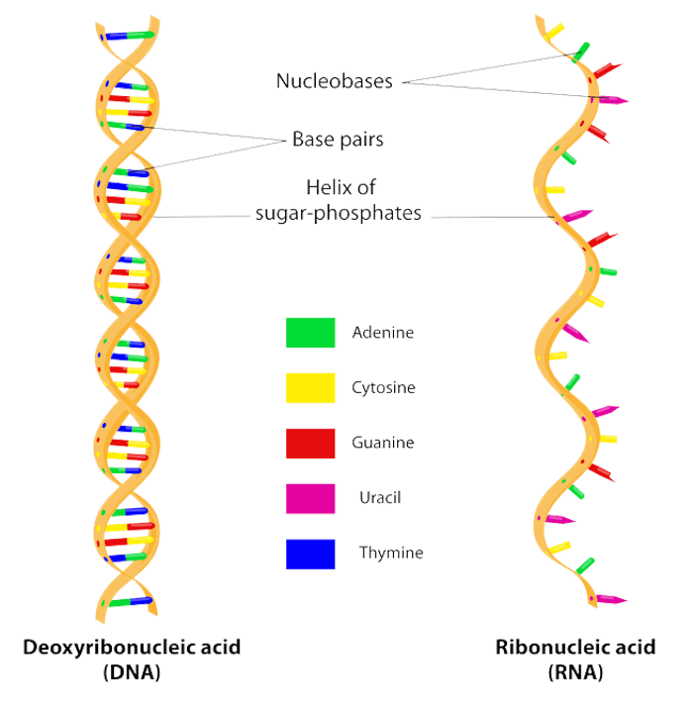
Influenza Viruses
Significance of DNA vs. RNA
outrunningthehorses.com

Slide 18
Influenza Viruses
Significance of DNA vs. RNA
Nucleic acid contains genetic material
  In most life forms it is made of Deoxyribonucleic Acid (DNA)
  Holds genetic instructions used in development and functioning of all known living organisms
  Like the blueprints for a building
Influenza viruses contain Ribonucleic Acid (RNA)
outrunningthehorses.com

Slide 19
Influenza Viruses
Significance of DNA vs. RNA
DNA (Deoxyribonucleic Acid)
  Double strand
  “Deoxy” means there are no hydroxyl groups (-OH)
  Absence of hydroxyl groups means chemical bonds are not easily broken down into water (H2O)
outrunningthehorses.com

Slide 20
Influenza Viruses
Significance of DNA vs. RNA
DNA is completely protected by the body
  The body destroys enzymes that attach to DNA
  DNA has smaller grooves where the damaging enzyme can attach which makes it harder for the enzyme to attack DNA
  Has a built-in proof-reading system when reproducing itself
outrunningthehorses.com

Slide 21
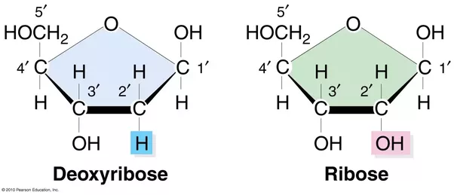
Influenza Viruses
Significance of DNA vs. RNA
Deoxyribose sugar in DNA is less reactive because of C-H bonds
Stable in alkaline conditions
outrunningthehorses.com

Slide 22
Influenza Viruses
Significance of DNA vs. RNA
RNA
  Single strand
  Contains hydroxyl groups
    Chemical bonds are easily broken into water (H2O) called hydrolysis
      More fragile
      Strands are easily broken
outrunningthehorses.com

Slide 23
Influenza Viruses
Significance of DNA vs. RNA
Ribose sugar is more reactive because of OH (hydroxyl) bonds
Not stable in alkaline conditions
Has larger grooves which makes it easier to be attacked by enzymes
outrunningthehorses.com

Slide 24
Influenza Viruses
Significance of DNA vs. RNA
RNA
  Contains no proof-reading system
    Mistakes happen called mutations
    One virus can produce many variations of itself
    RNA viruses can mutate up to 1 million times faster than DNA viruses
outrunningthehorses.com

Slide 25
Influenza Viruses
Mutation – Antigenic Drift and Shift
Hemagglutinin
Antigenic
Drift
Antigenic
Shift
Neuraminidase
outrunningthehorses.com

Slide 26
Influenza Viruses
Mutation – Antigenic Drift and Shift
Changes in a virus happen continually over time
Produces new strains not recognized by the host’s immune system
Known as Antigenic Shift or Drift
outrunningthehorses.com

Slide 27
Influenza Viruses
Mutation – Antigenic Drift
Antigenic Drift
  Small changes over time newer virus strains appear
  Antibodies against older strains no longer recognize the "newer" virus
  Reinfection can occur
    People can get the flu more than once
outrunningthehorses.com

Slide 28
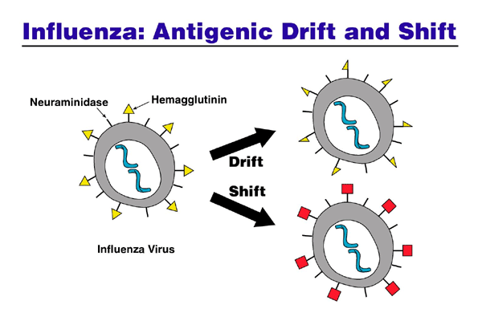
Influenza Viruses
Mutation – Antigenic Drift
outrunningthehorses.com

Slide 29
Influenza Viruses
Mutation – Antigenic Drift
Influenza vaccines are updated to keep up with circulating flu viruses
People who want to be protected need to get a flu shot every year
outrunningthehorses.com

Slide 30
Influenza Viruses
Mutation – Antigenic Shift
Antigenic Shift
An abrupt, major change results in new H or H and N proteins
Most people have little or no protection
Leads to influenza epidemics/ pandemics
outrunningthehorses.com

Slide 31
Influenza Viruses
Mutation – Antigenic Shift
outrunningthehorses.com

Slide 32
Influenza Viruses
Mutation
Antigenic Drift in Influenza viruses happens all the time
Antigenic Shift happens only occasionally
outrunningthehorses.com

Slide 33
Influenza Viruses
Mutation – Genetic Reassortment
Genetic Reassortment
  Influenza viruses from different species can swap or reassort genetic material
  Results in a new subtype different from both parent viruses
outrunningthehorses.com

Slide 34
Influenza Viruses
Mutation – Genetic Reassortment
Pigs as “Mixing Vessels”
  They are the ideal genetic “mixing vessel” to generate a human strain.
  Receptors in respiratory tracts which both avian and human flu viruses can bind to.
outrunningthehorses.com

Slide 35
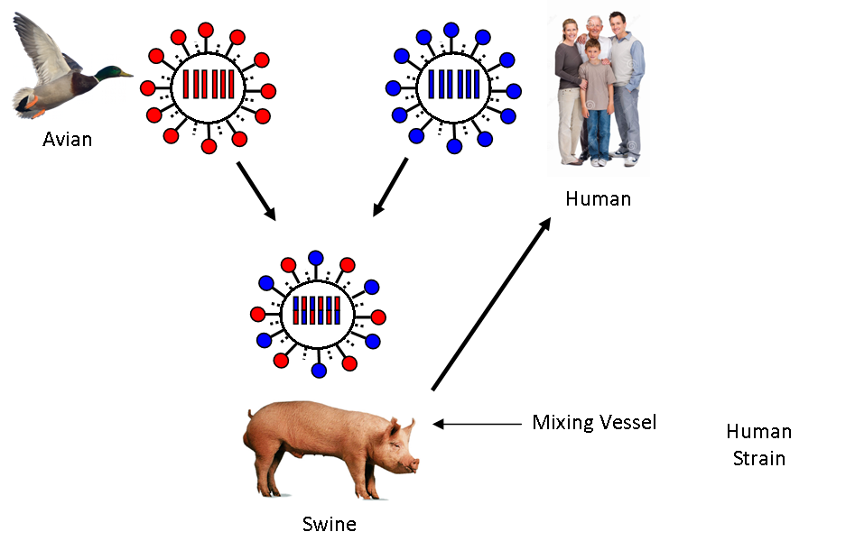
Influenza Viruses
Mutation – Genetic Reassortment

Slide 36
Influenza Viruses
Mutation – Genetic Reassortment
Pigs as “Mixing Vessels”
  Can be infected with bird flu and human flu at the same time
  Viruses can exchange genetic material to mutate become a new viral subtype
  Which will then be easily transmissible in humans.
outrunningthehorses.com

Slide 37
Influenza Viruses
Mutation – Genetic Reassortment
Pigs as “Mixing Vessels”
  A pig in a backyard farm in Oregon was reported to be infected with the bird flu.
  The strain is from wild birds and not the one that is widespread in US dairy cows.
  This, however, is a warning.
outrunningthehorses.com

Slide 38
Influenza Viruses
Mutation – Genetic Reassortment
Humans can also serve as mixing vessel
  Avian mixed with human virus can result in antigenic shift
  Resulting in a deadly transmissible person-to-person virus
outrunningthehorses.com

Slide 39

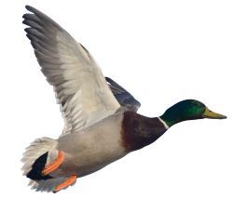
Influenza Viruses
Mutation – Genetic Reassortment
Highly Pathogenic
Avian Strain
Mixing
Vessel
New Highly Pathogenic
Human Strain
outrunningthehorses.com

Slide 40
Influenza Viruses
Conclusion
Viruses that pose the greatest threat to the world population are those that originate in animals (zoonotic) and jump to people.
Viruses that exist today such as H5N1, H7N9, MERS, Ebola, all continue to pose a threat to humans.
Researchers say the definitive origin of the circulating coronavirus (SARS-CoV-2) is still unknown.
outrunningthehorses.com

Slide 41
Influenza Viruses
Conclusion
Understanding the structure of viruses and how they mutate will help us to determine their origin, their threat to society, and how to prepare ourselves for the next pandemic.
outrunningthehorses.com

Slide 42
Influenza Viruses
Conclusion
The infection of a pig is a warning
If the virus enters commercial piggeries it would pose a far greater risk of a pandemic.
Especially as the US goes into winter when the season for human influenza starts to rise.
outrunningthehorses.com

Slide 43

Questions?
outrunningthehorses.com

Slide 44
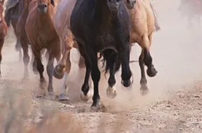
For more presentations like this
or for more information
please visit
outrunningthehorses.com
outrunningthehorses.com

