Slide 1

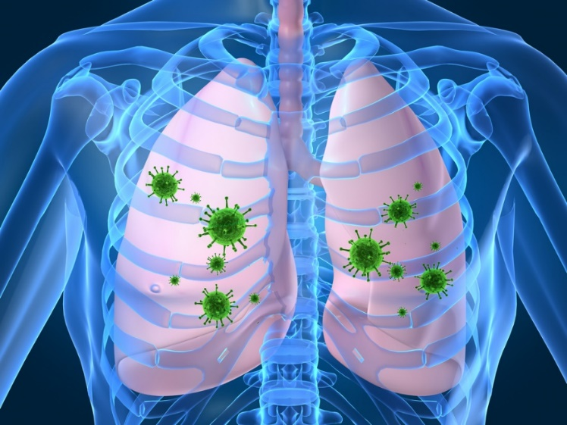
Pandemic Plan for the Church
Ministering to the Community in a Time of Crisis
Pathophysiology of H5N1 Avian Influenza
A Cytokine Storm
outrunningthehorses.com

Slide 2
Pathophysiology of H5N1 Avian Influenza A Cytokine Storm
The H5N1 strain of virus can trigger inflammatory proteins called cytokines to reach levels of more than ten times higher
than in the common human flu virus H1N1.
This inflammation can cause damage to a patient’s lungs to the extent that they are unable to breathe.
outrunningthehorses.com

Slide 3

Pathophysiology of H5N1 Avian Influenza A Cytokine Storm
Introduction
Pathogenesis of a disease describes the mechanisms by which it develops, progresses, and either persists or is resolved in its host
outrunningthehorses.com

Slide 4
Pathophysiology of H5N1Avian Influenza A Cytokine Storm
Introduction
The HPAI H5N1 is a highly pathogenic avian influenza virus
The H5N1 denotes its surface protein subtypes
It has been found in migratory birds across the globe
It has caused worldwide outbreaks in domestic poultry
It has crossed species and is now able to infect over 200 types of mammals
It is being watched closely for it to become the next pandemic
outrunningthehorses.com

Slide 5
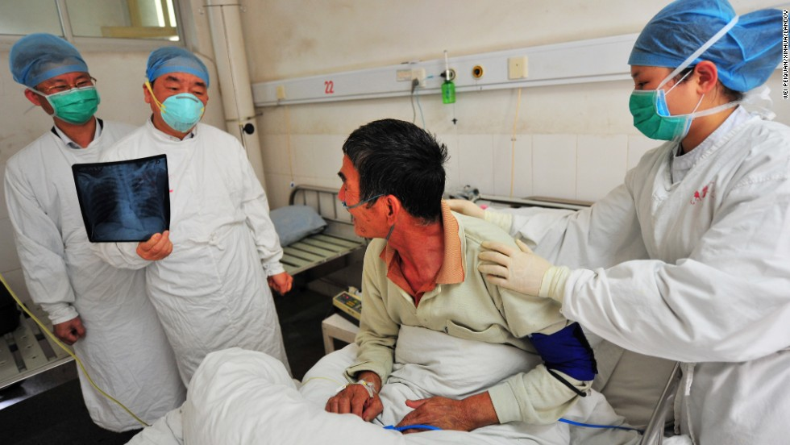
Pathophysiology of Avian Influenza A Cytokine Storm
Introduction
Although it is an avian disease, it can cause illness in humans
Most human cases have resulted from contact with infected poultry or dairy cows
Currently there is some evidence of limited human-to-human transmission
outrunningthehorses.com

Slide 6
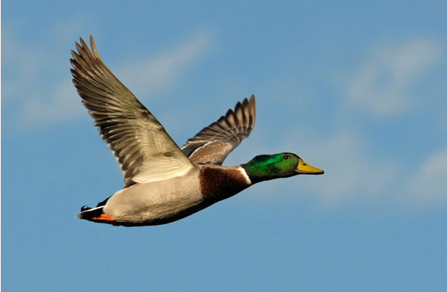
Pathophysiology of H5N1 Avian Influenza A Cytokine Storm
Introduction
Research shows when avian influenza viruses infect birds
The hemagglutinin protein is activated by sialic acid in the entry pathway inside the host cell
This enables the virus to invade the cell
In birds this acid is found in the gastrointestinal tract
outrunningthehorses.com

Slide 7
Pathophysiology of H5N1 Avian Influenza A Cytokine Storm
Sialic Acids and Host Cell Affinity
Attachment of all influenza A viruses require sialic acids
Different chemical forms of sialic acids
Found on very specific cells
Tissue sensitive
Influenza virus strains vary in their affinity to them
These differences may determine what animal species can be infected
outrunningthehorses.com

Slide 8
Pathophysiology of H5N1 Avian Influenza A Cytokine Storm
Sialic Acids and Host Cell Affinity
Avian influenza viruses prefer sialic acids in gastrointestinal tract of a duck
Human influenza viruses prefer sialic acids on human respiratory epithelial cells found in the lower respiratory tract
H5N1 influenza virus prefers this type of sialic acid
Explains acute lower respiratory tract disease in humans
outrunningthehorses.com

Slide 9
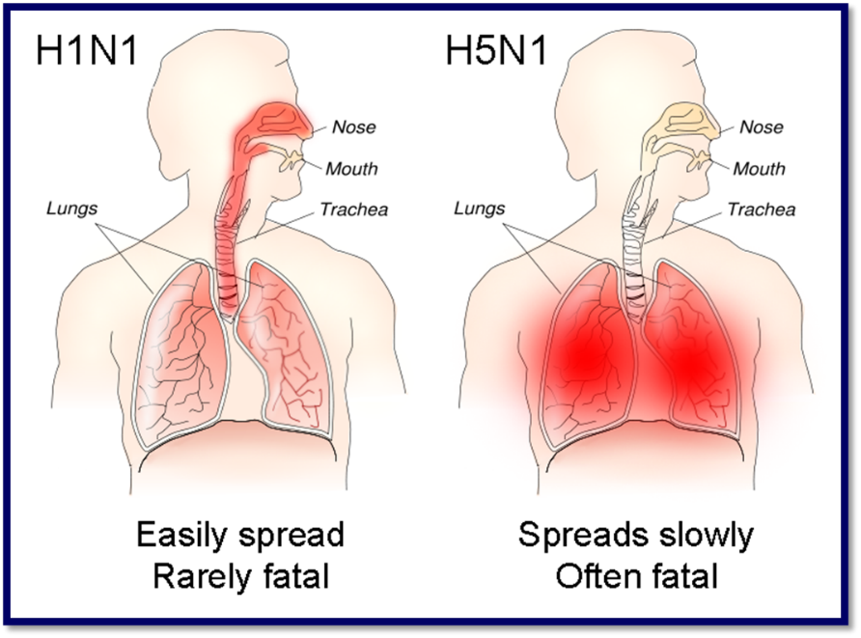
Pathophysiology of H5N1 Avian Influenza A Cytokine Storm
outrunningthehorses.com

Slide 10
Pathophysiology of H5N1 Avian Influenza A Cytokine Storm
Sialic Acids and Host Cell Affinity
Avian viruses not present in human upper respiratory tract
Not easily spread with sneezes
Not yet easily transmitted human-to-human
Research shows it would take only one mutation to render the hemagglutinin protein more adaptable to sialic acid in humans
outrunningthehorses.com

Slide 11
Pathophysiology of H5N1 Avian Influenza A Cytokine Storm
Inflammation
A normal response to injury or stress
Brings large amounts of white blood cells to the injured or infected area to aid in the healing process
Blood vessels in the affected tissue dilate and become more permeable
Allows fluids, white blood cells, and other healing molecules to enter the damaged tissue
outrunningthehorses.com

Slide 12
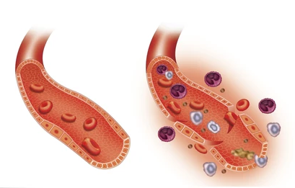
Pathophysiology of H5N1 Avian Influenza A Cytokine Storm
Inflammation
Arterial Inflammation with Components
outrunningthehorses.com

Slide 13
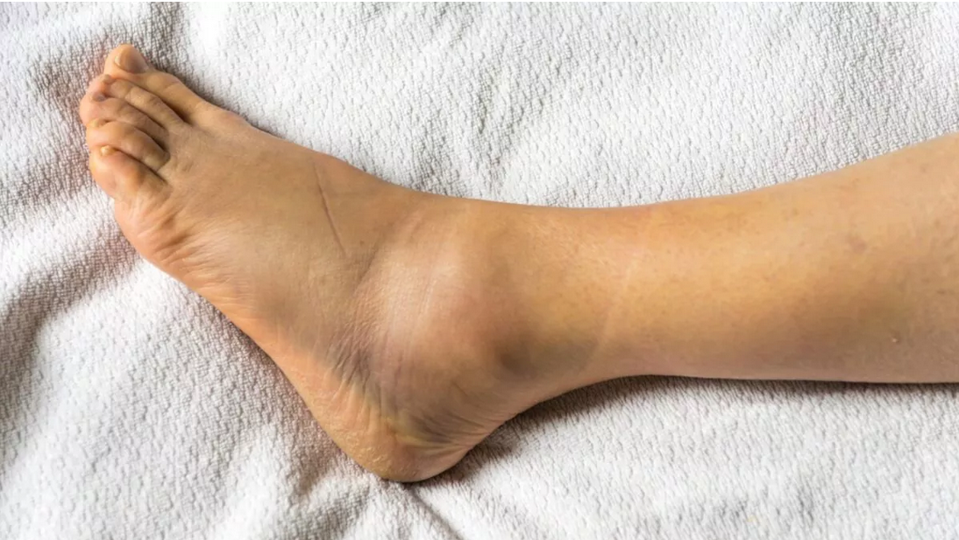
Pathophysiology of H5N1 Avian Influenza A Cytokine Storm
Inflammation
Area may become red, with swelling and heat
An example of this is the swelling of a joint after an injury
outrunningthehorses.com

Slide 14
Pathophysiology of H5N1 Avian Influenza A Cytokine Storm
Inflammation
White blood cells (WBC) accumulate at the sites of injury and inflammation
Some WBCs help control pathogens
In bacterial infections, mass of WBCs, bacterial cells, and damaged tissue may form a thick fluid called pus
When this accumulation of fluid and pus takes place in the alveoli of the lungs, gas exchange is greatly inhibited
outrunningthehorses.com

Slide 15
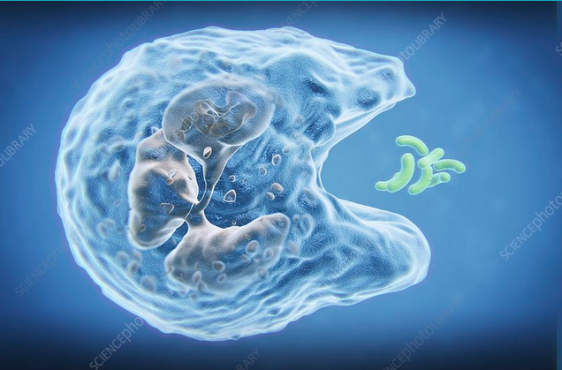
Pathophysiology of H5N1 Avian Influenza A Cytokine Storm
Inflammation
A normal response should last as long as the infection or injury exists
Once an infection is controlled, phagocytes remove dead cells and other debris from the site
outrunningthehorses.com

Slide 16
Pathophysiology of H5N1 Avian Influenza A Cytokine Storm
Human Immune System
Innate Immunity
We are born with this
Defense is general and non-specific
Protects against many types of pathogens
Functions the same way regardless of the type or number of times the same pathogen invades
outrunningthehorses.com

Slide 17

Pathophysiology of H5N1 Avian Influenza A Cytokine Storm
Human Immune System
Innate Immunity
Unleashes white blood cells to surround and attack pathogen
Can cause inflammation
Some people can get stuck in inflammation phase
Known as chronic inflammation
outrunningthehorses.com

Slide 18
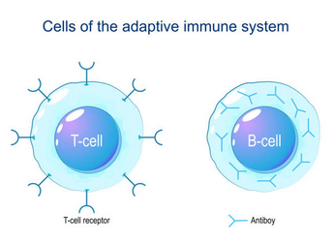
Pathophysiology of H5N1 Avian Influenza A Cytokine Storm
Human Immune System
Adaptive Immunity
Very precise in targeting certain pathogens
Carried out by specialized WBCs called lymphocytes
Consist of both T cells and B cells
outrunningthehorses.com

Slide 19
Pathophysiology of H5N1 Avian Influenza A Cytokine Storm
Human Immune System
Adaptive Immunity
Recognizes foreign molecules by their antigens and react against them
T cells attach to foreign cells such as the hemagglutinins and neuraminidases found on influenza viruses
Interact directly with the antigens and destroy them
outrunningthehorses.com

Slide 20
Pathophysiology of H5N1 Avian Influenza A Cytokine Storm
Human Immune System
Adaptive Immunity
B cells respond indirectly by producing antibodies
An antibody is a protein produced in response to a specific antigen that combines with that antigen to neutralize, inhibit or destroy it
After an infection, B cells develop into memory cells enabling a more rapid and robust immune response to future encounters with the same pathogen
outrunningthehorses.com

Slide 21
Pathophysiology of H5N1 Avian Influenza A Cytokine Storm
Cytokines
During the immune response chemicals are released including cytokines
Cytokines are protein substances
Act as messenger molecules and regulators
Act as hormones and can produce effects on cells close by
Promote an inflammatory response to infections
outrunningthehorses.com

Slide 22
Pathophysiology of H5N1 Avian Influenza A Cytokine Storm
Cytokines
Cytokines influence has varied cellular effects
They can act as synergists by enhancing the response to antigens and trigger inflammation
They can also act as antagonists by inhibiting signals and causing an anti-inflammatory response
outrunningthehorses.com

Slide 23
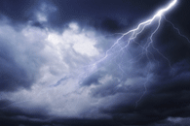
Pathophysiology of H5N1 Avian Influenza A Cytokine Storm
Cytokine Storm
When there is an excessive number of cytokines it can cause too much fluid to build up, this is called a cytokine storm
A descriptive term to encompass a variety of cascading events that can ultimately result in multi-organ failure and death
outrunningthehorses.com

Slide 24
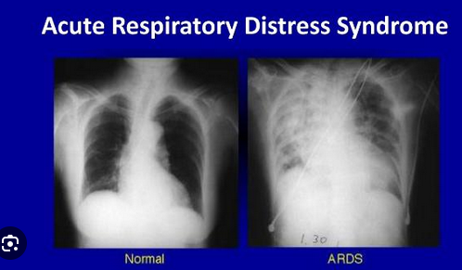
Pathophysiology of H5N1 Avian Influenza A Cytokine Storm
Cytokine Storm
An uncontrolled immune reaction
Releases excessive amounts of pro-inflammatory cytokines into bloodstream
Can cause acute respiratory distress syndrome (ARDS)
outrunningthehorses.com

Slide 25
Pathophysiology of H5N1 Avian Influenza A Cytokine Storm
Cytokine Storm
Not unique to Avian Influenza
Respiratory epithelial cells are primary target cell for influenza viruses
SARS, MERS, COVID-19 and seasonal flu have similar pathology
However, with the H5N1, the number of cytokines can reach levels more than ten times higher than human influenza
outrunningthehorses.com

Slide 26
Pathophysiology of H5N1 Avian Influenza A Cytokine Storm
H5N1 and Cytokine Storms
In addition to a cytokine storm
H5N1 also able to destroy the immune process
Its ability to disable the present immune system
It can block the body’s ability to build immunity against later infection by the same type of virus
Infection of the H5N1 shows an absence of antibodies, this suggests they are destroyed during the infection process
outrunningthehorses.com

Slide 27
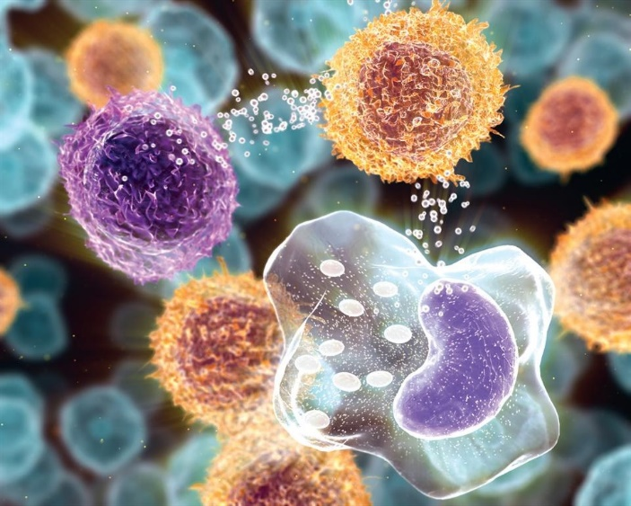
Pathophysiology of H5N1 Avian Influenza A Cytokine Storm
H5N1 and Cytokine Storms
Cytokines also contain components to inhibit stimulation
Contain both inflammatory and anti-inflammatory signals
H5N1 produces toxins that interfere with control mechanisms
outrunningthehorses.com

Slide 28

Pathophysiology of H5N1 Avian Influenza A Cytokine Storm
H5N1 and Cytokine Storms
It causes a surge in the release of these inflammatory chemicals
At the same time removes the control mechanisms to restrict their activity
In other words, it enhances the accelerator while impairing the brakes
The immune system basically goes out of control with no means of restraining it
outrunningthehorses.com

Slide 29
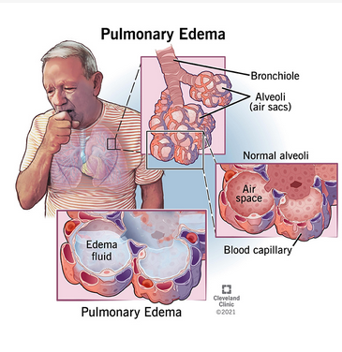
Pathophysiology of H5N1 Avian Influenza A Cytokine Storm
H5N1 and Cytokine Storms
When the virus comes in contact with cells of the trachea and alveoli in the lungs it stimulates inflammation with increased fluids
Fluid build up known as pulmonary edema leads to difficulty breathing and Acute Respiratory Distress Syndrome (ARDS)
outrunningthehorses.com

Slide 30
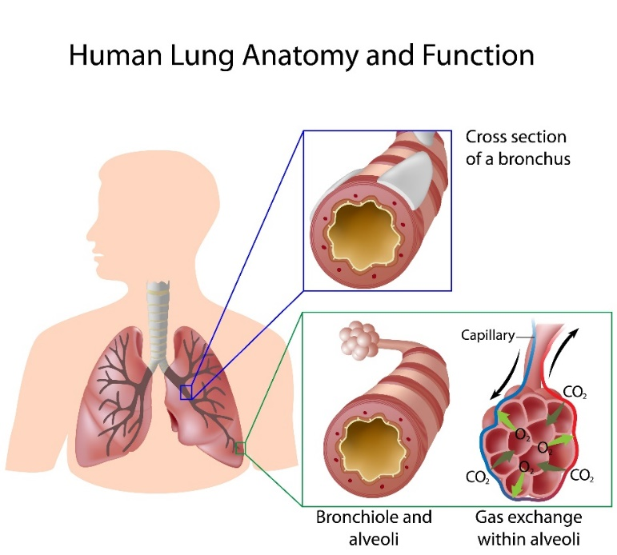
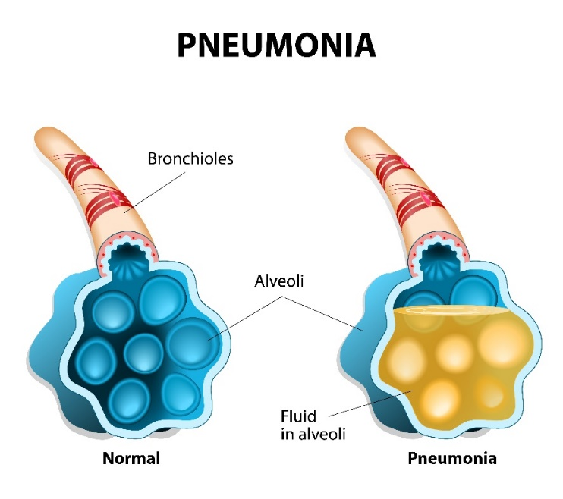
Pathophysiology of Avian Influenza A Cytokine Storm
H5N1 and Cytokine Storms
outrunningthehorses.com

Slide 31
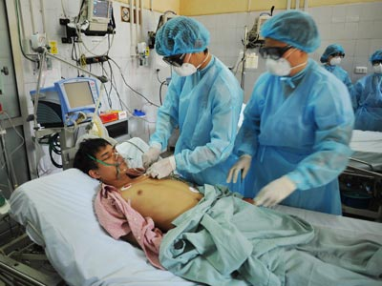
Pathophysiology of Avian Influenza A Cytokine Storm
H5N1 average timeline of pathogenesis
Day 1
Severe bronchiolar and alveolar damage
Day 3-5
Respiratory distress/failure
Day 7
Hardly any viable tissue left to infect
Still very strong viral replication
outrunningthehorses.com

Slide 32
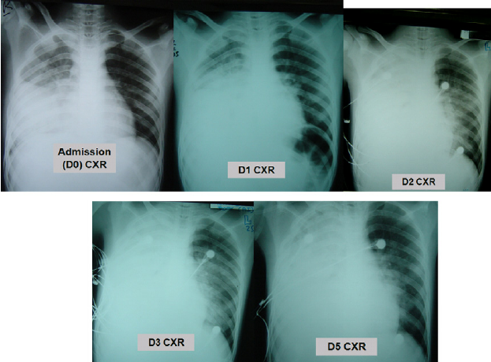
Pathophysiology of Avian Influenza A Cytokine Storm
Chest X-ray Series of Adult Male with Fatal H5N1
outrunningthehorses.com

Slide 33
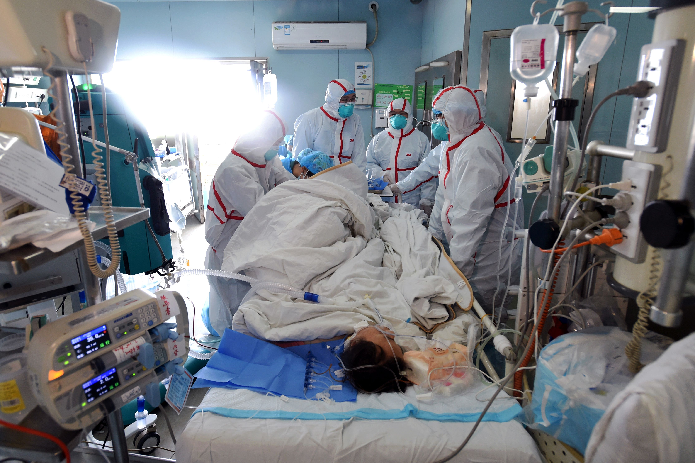
Pathophysiology of Avian Influenza A Cytokine Storm
H5N1 and Cytokine Storms
Final Result of Cytokine Storm
Sepsis
Multiple Organ Dysfunction Syndrome
Hypotension
Tachycardia
ARDS
Ischemia
Uncontrollable hemorrhage
Multisystem Organ Failure
outrunningthehorses.com

Slide 34
Pathophysiology of Avian Influenza A Cytokine Storm
H5N1 and Cytokine Storms
The excessive production of cytokines is what leads to the death of those infected with the avian flu virus
By stimulating excessive inflammation thus causing the airways to become blocked
In addition to the H5N1, scientists believe this explains how the 1918 Influenza was so deadly
As well as the high death rate of the SARS outbreak in 2003
outrunningthehorses.com

Slide 35
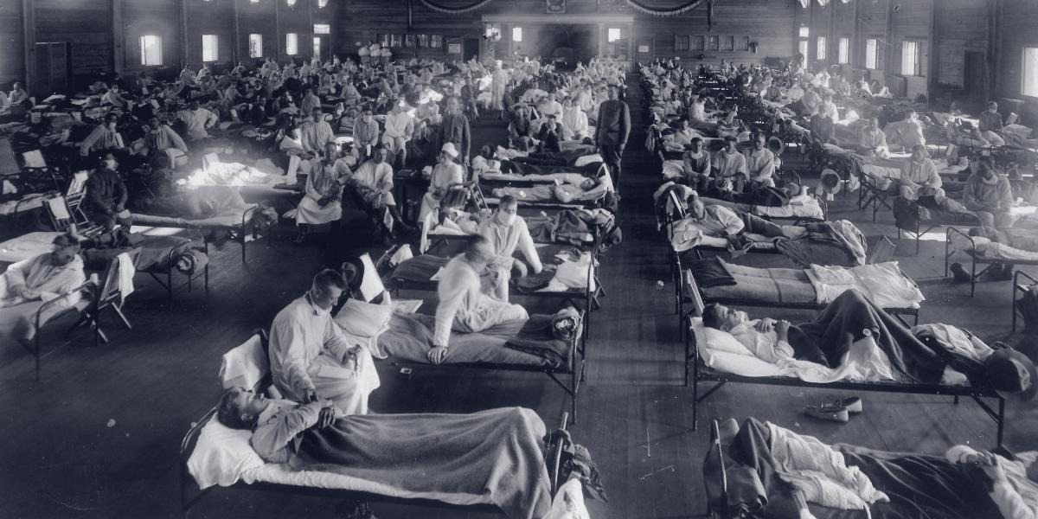
Pathophysiology of Avian Influenza A Cytokine Storm
Pathogenesis of the 1918 Influenza Virus
Scientists believe that the 1918 Pandemic was so deadly because it triggered a cytokine storm
Most patients succumbed to severe respiratory complications secondary to rapidly progressing pneumonia
outrunningthehorses.com

Slide 36
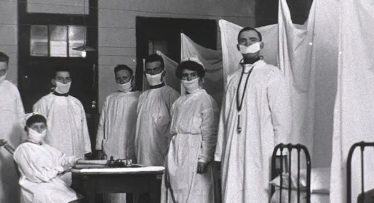
Pathophysiology of Avian Influenza A Cytokine Storm
Pathogenesis of the 1918 Influenza Virus
Records from healthcare providers and journals of family members paint a grim picture of how a patient responded to the virus
Archives of notes written by doctors and medical students depicted miserable deaths
outrunningthehorses.com

Slide 37
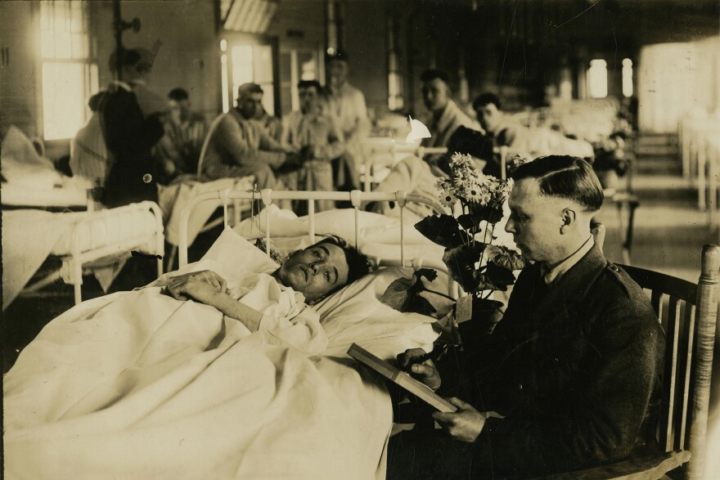
Pathophysiology of Avian Influenza A Cytokine Storm
Pathogenesis of the 1918 Influenza Virus
Their notes described how patients:
Became short of breath
Appeared blue from cyanosis
Gasped for hours struggling for breath
Lungs filled with fluid from the inflammation
outrunningthehorses.com

Slide 38

Pathophysiology of Avian Influenza A Cytokine Storm
Pathogenesis of the 1918 Influenza Virus
Their notes described how:
A blood- tinged froth would come from patients’ noses and mouths
Some would hallucinate and have an altered level of consciousness as their system was starved for air
Many bled through the nose due to irritated mucous membranes
Secondary infections of bacterial pneumonia and bronchitis contributed to the cause of death
outrunningthehorses.com

Slide 39
“As their lungs filled … the patients became short of breath
and increasingly cyanotic.
After gasping for several hours,
they became delirious and incontinent,
and many died struggling to clear their airways
of a blood-tinged froth that sometimes gushed
from their nose and mouth.
It was a dreadful business.”
Isaac Starr, 3rd year medical student
University of Pennsylvania, 1918
outrunningthehorses.com

Slide 40
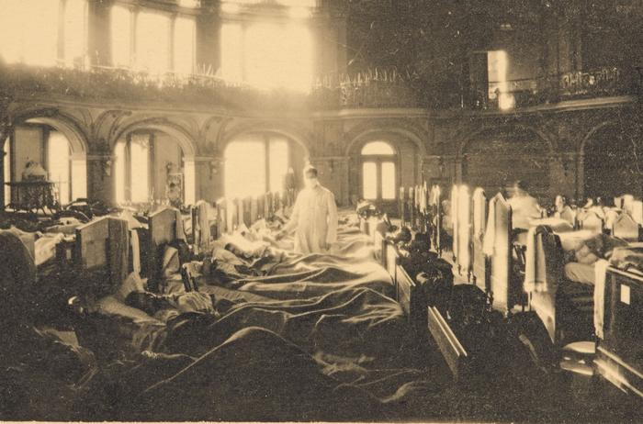
Pathophysiology of Avian Influenza A Cytokine Storm
Pathogenesis of the 1918 Influenza Virus
Patients first presented with:
Headache
Sore throat
Body and muscle aches
An unproductive cough
Most common sign was a fever that lasted for several days
These symptoms are eerily similar to seasonal influenza
outrunningthehorses.com

Slide 41
Pathophysiology of Avian Influenza A Cytokine Storm
HPAI H5N1 Compared to 1918 Influenza
In 1997 the 1918 Influenza virus was obtained from the lung tissue from a corpse buried beneath the permafrost in Alaska
The tissue samples were sent to Dr. Jeffery Taubenberger (Armed Forces Institute of Pathology)
Ten years spent reconstructing the virus and sequencing the genome
Determine how the virus penetrates and infects the human cell
outrunningthehorses.com

Slide 42
Pathophysiology of Avian Influenza A Cytokine Storm
HPAI H5N1 Compared to 1918 Influenza
Dr. Taubenberger discovered:
1918 virus had a close resemblance to H5N1
Both have human and bird origins
1918 virus adapted to humans without acquiring genes from existing human flu viruses
Several of the same mutations that differentiated 1918 virus from other avian viruses are found in the current H5N1 virus
outrunningthehorses.com

Slide 43
Pathophysiology of Avian Influenza A Cytokine Storm
HPAI H5N1 Compared to 1918 Influenza
Dr. Taubenberger discovered:
Three of eight genes closely resemble each other
Differences are only a small number of amino acids
Proof that the 1918 virus was not human adapted but was entirely avian-like virus
Only ten amino acid changes in genes that distinguish the 1918 virus from current avian viruses
A number of the same changes have been found in the current H5N1 virus
outrunningthehorses.com

Slide 44

Pathophysiology of Avian Influenza A Cytokine Storm
“1918 virus is the most bird-like of all mammalian flu viruses.”
Jeffrey Taubenberger Armed Forces Institute of Pathology
outrunningthehorses.com

Slide 45
Pathophysiology of Avian Influenza A Cytokine Storm
HPAI H5N1 Compared to 1918 Influenza
Dr. Taubenberger’s mice experiments determined:
The H5N1 has a more rapid onset, with an overwhelming induction of cytokines
The H5N1 has a longer sustained replication with wider distribution in the lungs
The H5N1 Mice died in as little as three days, eventually all dying
Each virus attacked respiratory cells called pneumocytes
outrunningthehorses.com

Slide 46
Pathophysiology of Avian Influenza A Cytokine Storm
HPAI H5N1 Compared to 1918 Influenza
Dr. Taubenberger’s mice experiments determined:
The 1918 virus showed preference for Type 1 pneumocytes, responsible for air exchange
The H5N1 infects Type 2 pneumocytes, causing the loss of surfactant, and the collapse of the alveoli, making breathing impossible
The lung tissue is unable to repair itself
outrunningthehorses.com

Slide 47
Pathophysiology of Avian Influenza A Cytokine Storm
HPAI H5N1 Compared to 1918 Influenza
Dr. Taubenberger’s mice experiments determined:
In addition to lung disease, the immune systems of the mice responded ferociously to the infection
Most of the mice became seriously ill within twenty-four hours and died within five days
It proved to researchers that the host’s inflammatory response is highly activated by the virus, causing severe damage and consequentially killing the host
outrunningthehorses.com

Slide 48

Pathophysiology of Avian Influenza A Cytokine Storm
HPAI H5N1 Compared to 1918 Influenza
2011 - Dr. Ron Fouchier, Erasmus Medical Center, Rotterdam, Netherlands
Genetically modified the H5N1 virus to become airborne between ferrets
Ferrets have similar pulmonary receptors to humans
outrunningthehorses.com

Slide 49
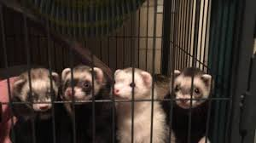
Pathophysiology of Avian Influenza A Cytokine Storm
HPAI H5N1 Compared to 1918 Influenza
2011 - Dr. Ron Fouchier, Erasmus Medical Center, Rotterdam, Netherlands
Results were H5N1 viruses could acquire the ability to spread between mammals without mixing with other viruses or intermediate hosts such as pigs
Thus posed a risk of launching a pandemic
outrunningthehorses.com

Slide 50
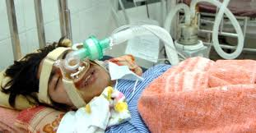
Pathophysiology of Avian Influenza A Cytokine Storm
HPAI H5N1 Today
People who have died from the H5N1 today have died in a similar manner to those during the 1918 pandemic
The study of the 1918 influenza has given great insight into the pathogenesis as well as the societal effects this current virus will have if it ever becomes a pandemic
outrunningthehorses.com

Slide 51
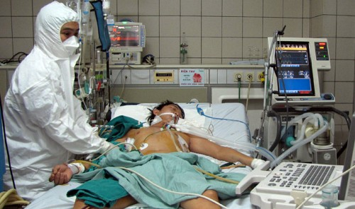
Pathophysiology of Avian Influenza A Cytokine Storm
HPAI H5N1 Today
Known pathogenicity is only tip of the iceberg
Likely to be additional pathogenetic mechanisms
outrunningthehorses.com

Slide 52
Pathophysiology of Avian Influenza A Cytokine Storm
HPAI H5N1 Today
The virulence, structure, and origin of the HPAI H5N1 are very similar to the virus that caused the 1918 Influenza Pandemic
Due to these similarities, the 1918 Influenza is used as a model for what to expect if the current H5N1 Influenza strain were to become human-to-human transmissible
It is suspected that a similar pandemic will take place if the H5N1 mutates as the H1N1 strain did nearly one hundred years ago
outrunningthehorses.com

Slide 53
Pathophysiology of Avian Influenza A Cytokine Storm
HPAI H5N1 Today
The virulence, structure, and origin of the HPAI H5N1 are very similar to the virus that caused the 1918 Influenza Pandemic
Due to these similarities, the 1918 Influenza is used as a model for what to expect if the current H5N1 Influenza strain were to become human-to-human transmissible
It is suspected that a similar pandemic will take place if the H5N1 mutates as the H1N1 strain did nearly one hundred years ago
outrunningthehorses.com

Slide 54


Slide 55


“If you have run with footmen, and they have tired you out,
then how can you compete with horses?
If you fall down in a land of peace,
how will you do in the thicket by the Jordan?”
Jeremiah 12:5

Slide 56
For more presentations like this
or for more information
please visit
outrunningthehorses.com

