Slide 1
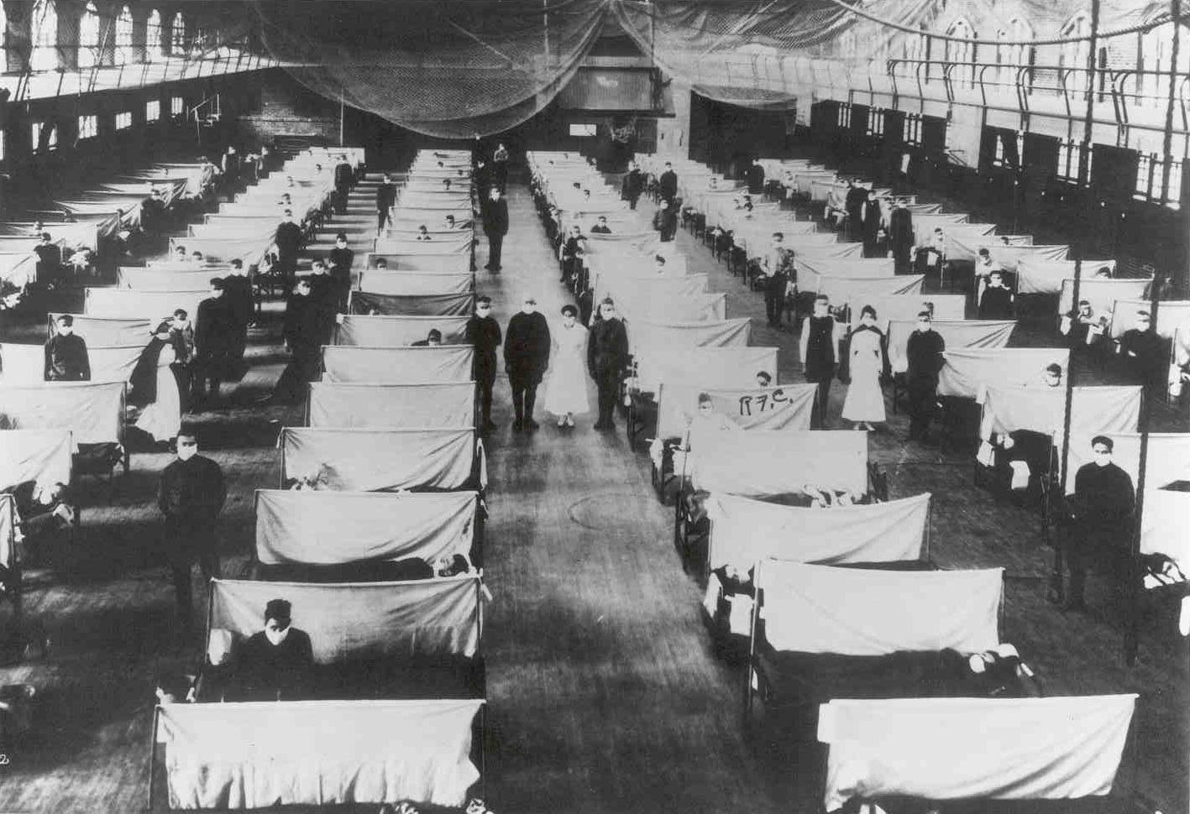
Pandemic Plan for the Church
Ministering to the Community in a Time of Crisis
1918 Influenza
outrunningthehorses.com

Slide 2
Objectives
The following topics will be discussed
  What was the 1918 Influenza
  High levels of death
  Social Distancing
  Society devastated
  Healthcare overwhelmed
  1918 Influenza genome
outrunningthehorses.com

Slide 3
1918 Influenza
An Avian flu first hosted in birds
Known as the 1918 Spanish Influenza
  Due to early news reports
  Severity in Spain
H1N1 – Influenza A virus
A similar strain to H5N1
Killed via cytokine storm
outrunningthehorses.com

Slide 4
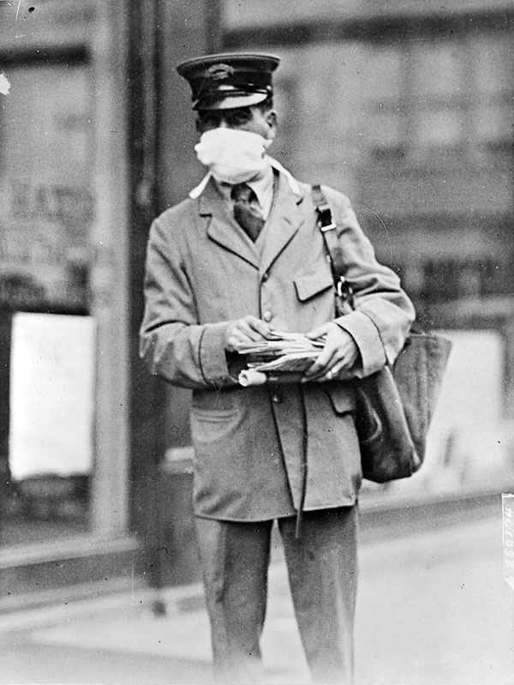
1918 Influenza
Swept the United States, Europe and Asia in three convulsive waves
Pandemic lasted 18 months
outrunningthehorses.com

Slide 5
1918 Influenza
H1N1
  Hemagglutinins (H) and Neuraminidases (N) mutated to be transmitted to humans
  Further mutation allowed it to be transmitted human-to-human
outrunningthehorses.com

Slide 6
1918 Influenza
50 to 100 million people worldwide were killed
  Population only 1/3 of what it is today
Nearly 20% of the world population effected
Many died within days of the first symptoms
outrunningthehorses.com

Slide 7
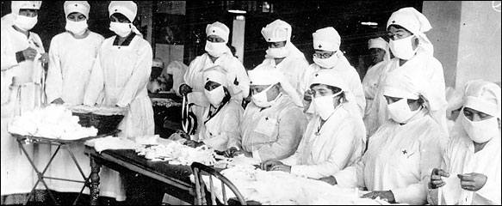
1918 Influenza
Killed more people than World War I
More died in one year than in the four years of the Black Death of the Bubonic Plague from 1347 to 1351
outrunningthehorses.com

Slide 8
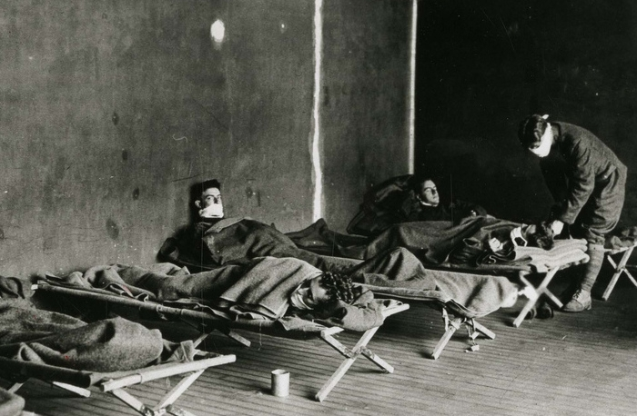
1918 Influenza
Most succumbed to severe respiratory complications secondary to rapidly progressing pneumonia
outrunningthehorses.com

Slide 9
“As their lungs filled … the patients became short of breath and increasingly cyanotic. After gasping for several hours they became delirious and incontinent, and many died struggling to clear their airways of a blood-tinged froth that sometimes gushed from their nose and mouth. It was a dreadful business.”
--Isaac Starr, 3rd year medical student,
University of Pennsylvania, 1918. (The Influenza)
outrunningthehorses.com

Slide 10
1918 Influenza
Social Distancing
  Philadelphia
    Did not put into place social distancing measures
      Allowed public gatherings
      Highest death rate
      Highest rate of disruption
outrunningthehorses.com

Slide 11
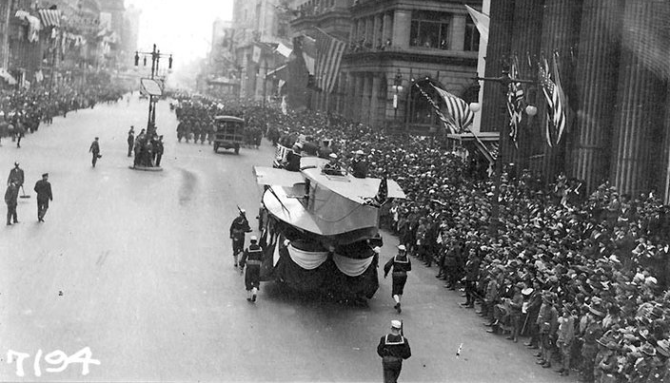
1918 Influenza
Social Distancing
  Philadelphia – September 28, 1918
    Liberty Loan parade
    Prompted huge outbreak of flu in the city
outrunningthehorses.com

Slide 12
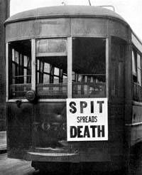
1918 Influenza
Social Distancing
  New Laws Enforced
    Had to wear masks
    No spitting
    No holding of hands
    No public gatherings
outrunningthehorses.com

Slide 13
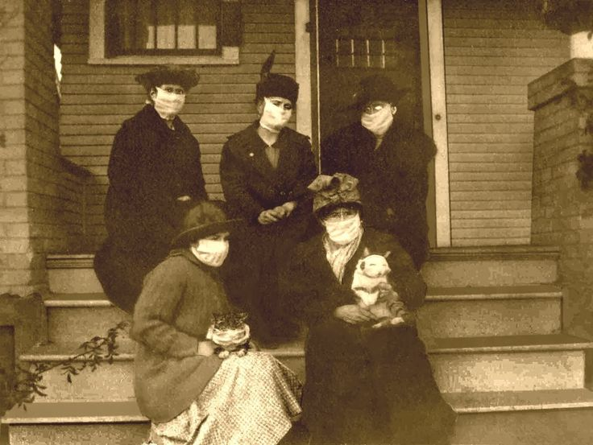
1918 Influenza
Society Devastated
  Everyday life was disrupted
    Stores were closed
    Deliveries were not taking place
    Schools were closed
    People were out of work
    Emergency services were overwhelmed
outrunningthehorses.com

Slide 14
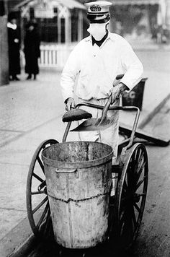
1918 Influenza
Society Devastated
  Everyday life was disrupted
    Basic services were hindered
      Garbage collection
      Mail delivery
      Not enough farmers to harvest crops
      State and local health department closed
        Hampering efforts to chronicle spread of virus
outrunningthehorses.com

Slide 15
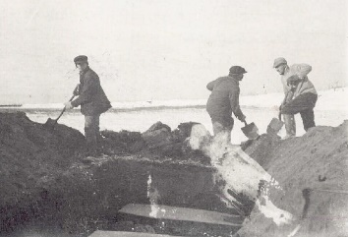
1918 Influenza
Society Devastated
  High levels of death
    Catastrophic effects upon urban populations
    There were no funeral services
    Difficult to keep up with burials
outrunningthehorses.com

Slide 16
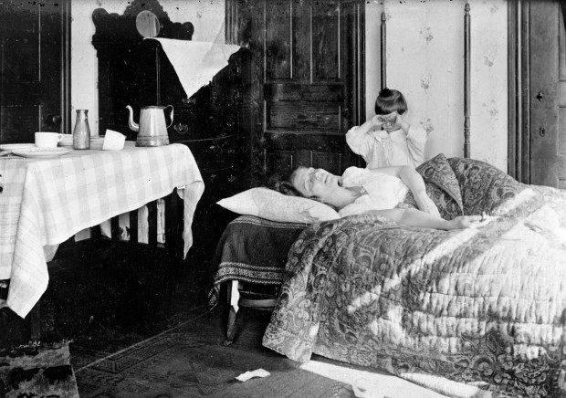
1918 Influenza
Society Devastated
  Entire families were wiped out
    Countless widows
    Countless orphans
outrunningthehorses.com

Slide 17
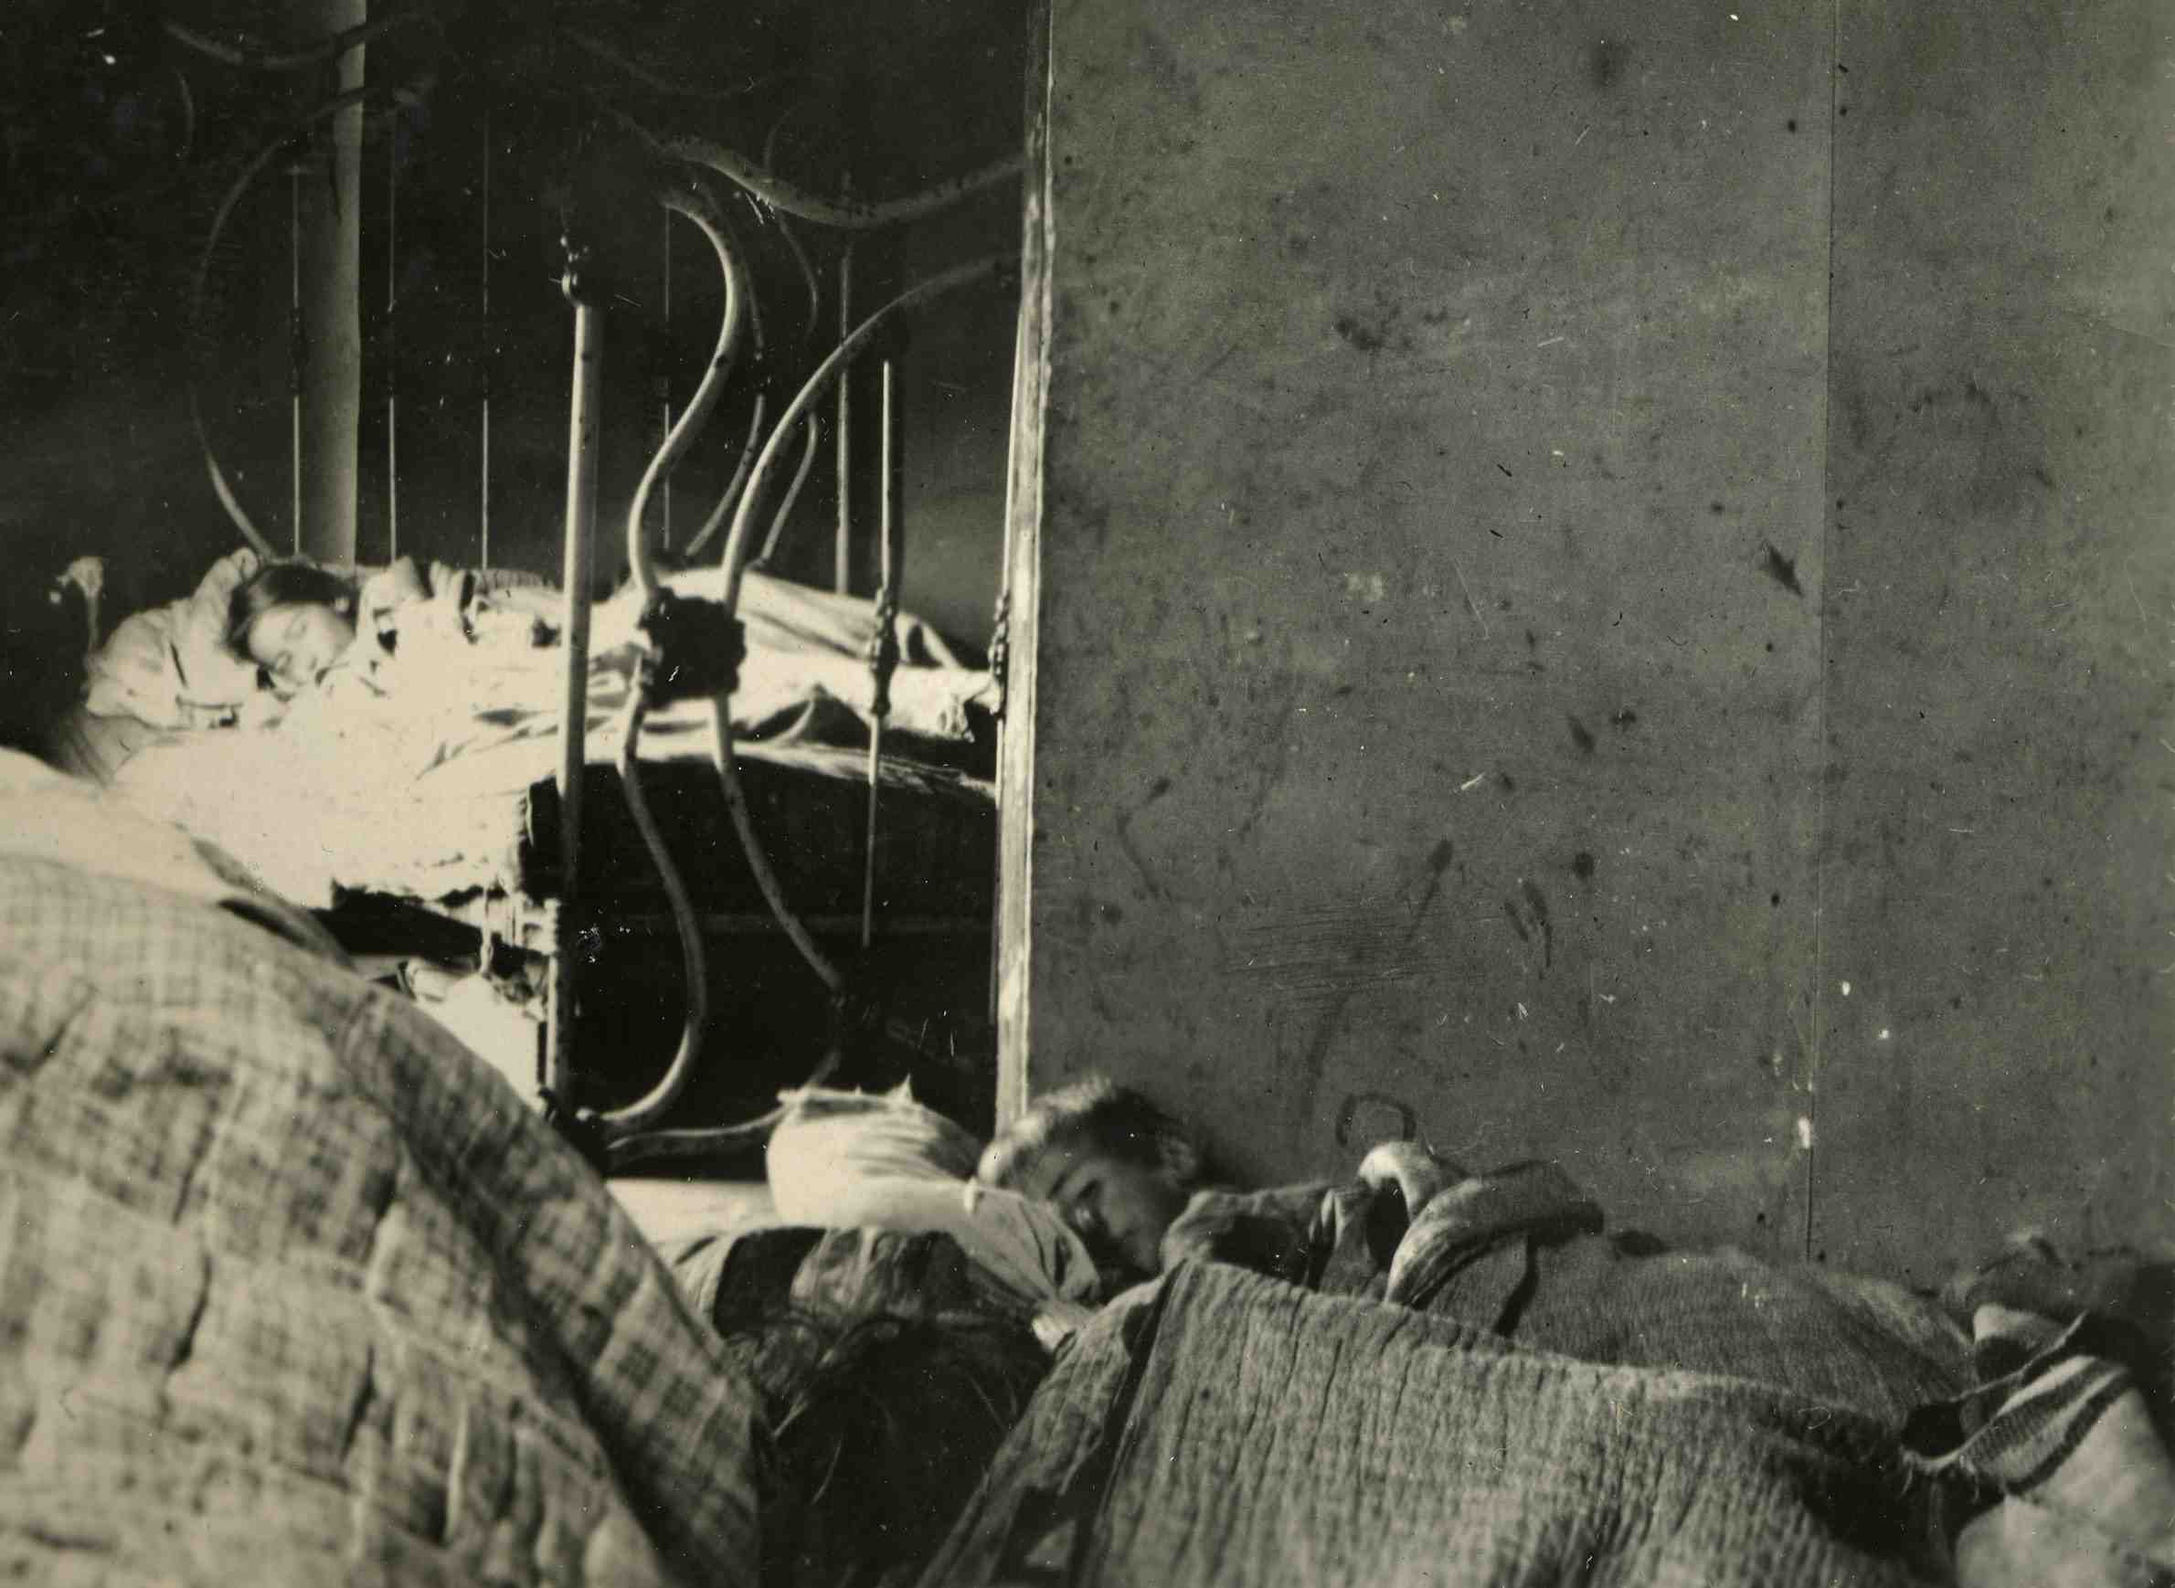
1918 Influenza
Society Devastated
  People were dying sometimes two in a bed
outrunningthehorses.com

Slide 18
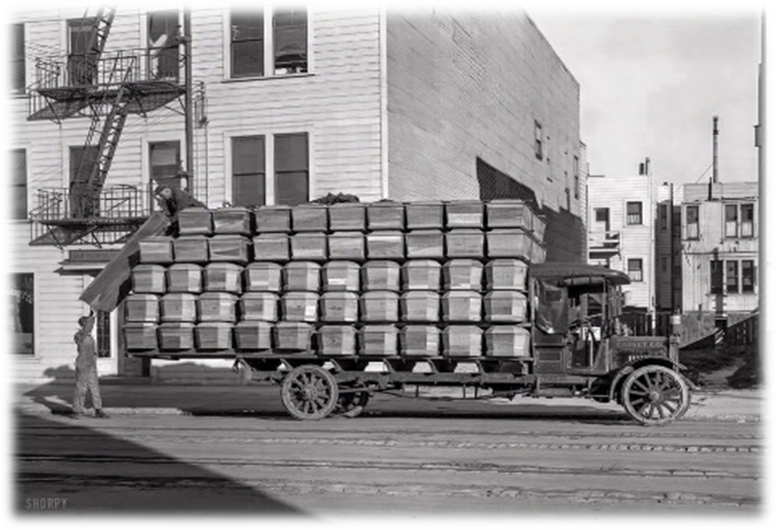
1918 Influenza
Society Devastated
  High levels of death
    Funeral parlors were overwhelmed
    Not enough grave diggers
outrunningthehorses.com

Slide 19
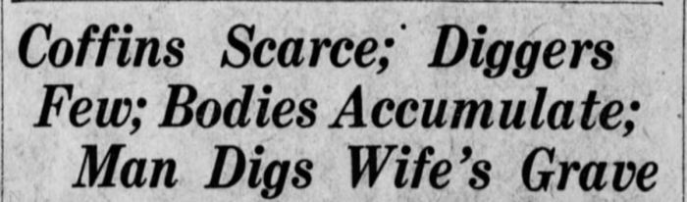
1918 Influenza
Society Devastated
  High levels of death
Some had to dig graves for their own family members
outrunningthehorses.com

Slide 20
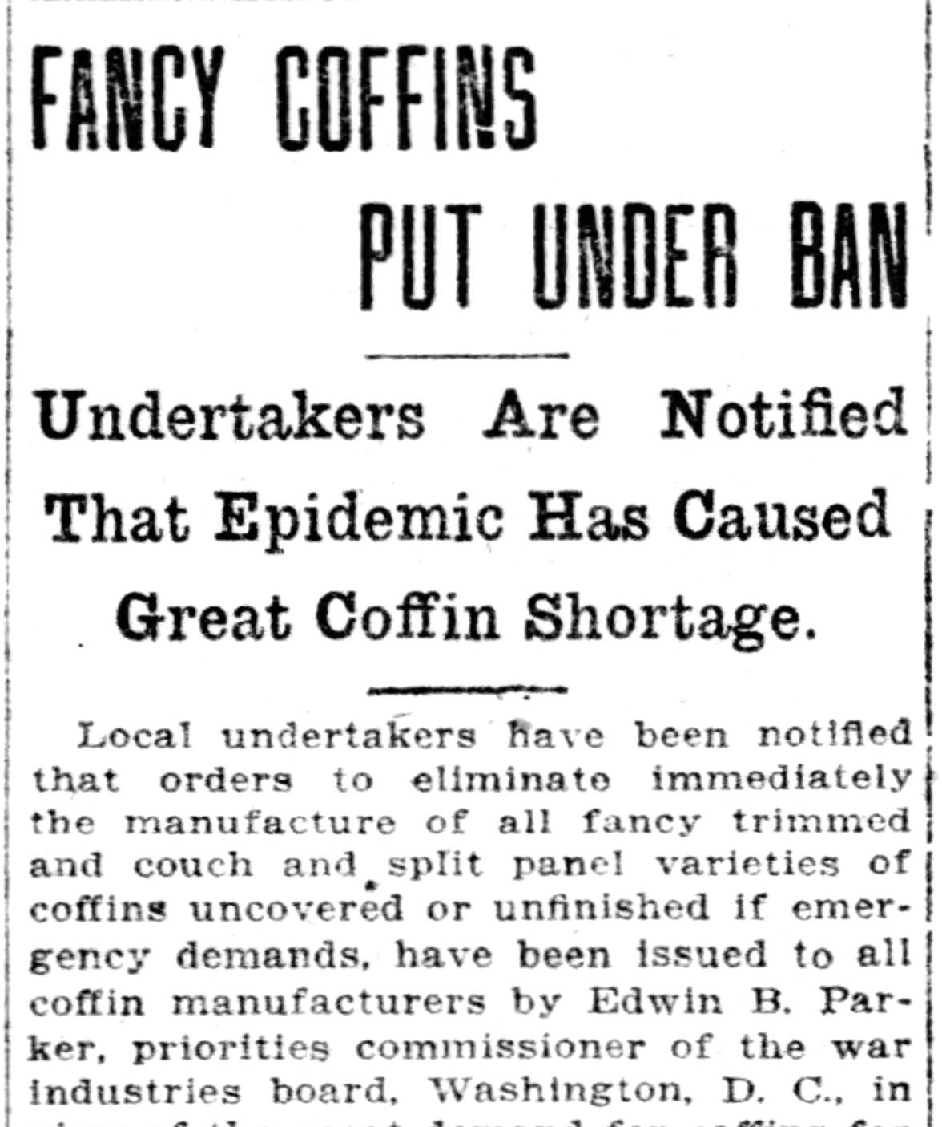
1918 Influenza
Society Devastated
  Pounding of boards for coffins became a normal sound in cities
outrunningthehorses.com

Slide 21
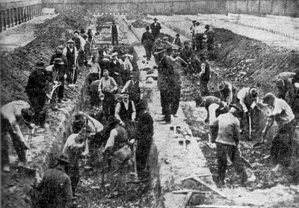
1918 Influenza
Civil groups formed to dig mass graves
outrunningthehorses.com

Slide 22
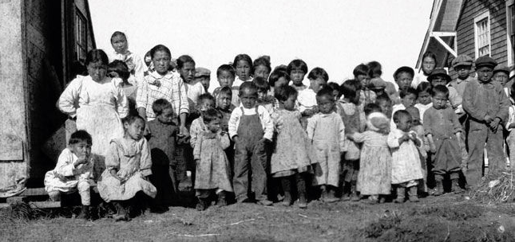
1918 Influenza
Society Devastated
  High levels of death
    Children in remote Alaskan village Nushagak survived – however, their parents did not
outrunningthehorses.com

Slide 23
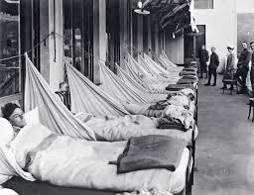
1918 Influenza
Healthcare Overwhelmed
outrunningthehorses.com

Slide 24
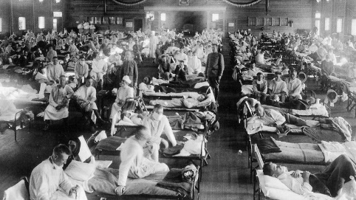
1918 Influenza
Healthcare Overwhelmed
  High levels of death
      Large numbers frightened
      Critically ill overwhelmed healthcare providers
      Bodies piled up
      Mortuaries and cemeteries overwhelmed
      Many corpses remained unburied at home
outrunningthehorses.com

Slide 25
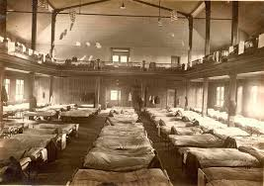
1918 Influenza
Healthcare Overwhelmed
  Many doctors and nurses were serving in war effort
  Limited scientific knowledge
    Effective treatment and prevention methods not fully utilized
  Many cities and public health officials were ill equipped to deal with the health crisis
outrunningthehorses.com

Slide 26
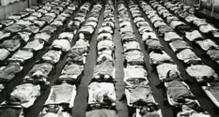
1918 Influenza
Healthcare Overwhelmed
  The healthcare providers who remained
    Became ill themselves treating the sick, and some died
    Stayed home in fear and to care for their own families
    Medical students were engaged
    Some hospitals had beds available, but no nurses
outrunningthehorses.com

Slide 27
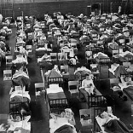
1918 Influenza
Healthcare Overwhelmed
  Stressed doctors did not register cases quickly
    Paperwork was not maintained properly
    Cause of death not always correct on death certificate
  Shortage of basic supplies (linens, mattresses, bedpans, etc.)
  Gymnasiums, churches, other spaces served as emergency hospitals
  Many people languished at home
outrunningthehorses.com

Slide 28
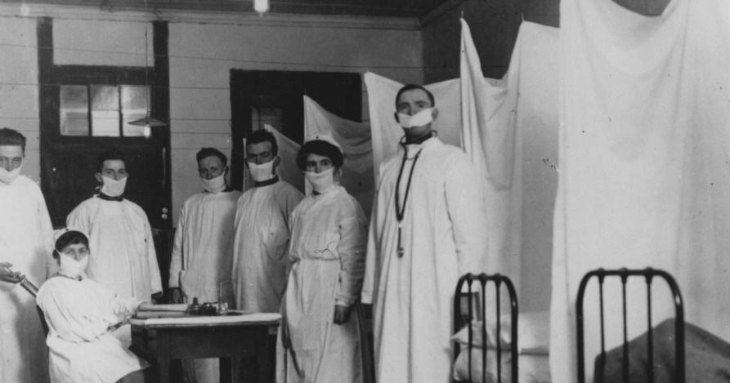
1918 Influenza
Healthcare Overwhelmed
  Hospitals inundated with patients
    Frequently turned people away
    Lengthened staff hours
    Tasked students with professional duties
    Discharged the ill
    Accepted only urgent admissions
    Makeshift accommodations (hallways, porches, offices, etc…)
outrunningthehorses.com

Slide 29
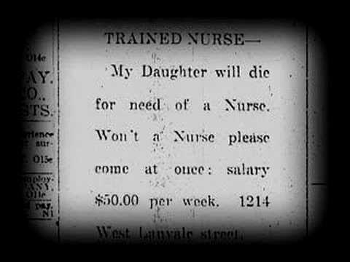
1918 Influenza
Healthcare Overwhelmed
  Many people died for want of good, basic nursing care
outrunningthehorses.com

Slide 30
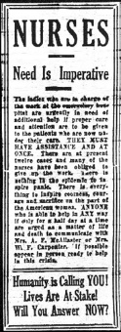
1918 Influenza
Healthcare Overwhelmed
  A call to volunteers
    Civilian doctors unable to serve oversees
    Dentists authorized to practice as physicians
    Medical students graduated early
    Retired doctors/nurses called upon
    Student nurses
    Lay people instructed
outrunningthehorses.com

Slide 31
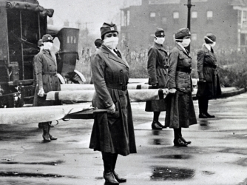
1918 Influenza
Healthcare Overwhelmed
  A call to volunteers
    Many women rose to the challenge
    Put their lives on the line
outrunningthehorses.com

Slide 32
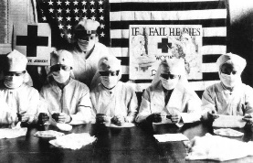
1918 Influenza
Healthcare Overwhelmed
  A call to volunteers
  Local chapters of American Red Cross
    Established kitchens
    Houses for convalescence
    Transported the sick
    Transported supplies
    Transported bodies
    Recruited more than 18,000 nurses and volunteers
outrunningthehorses.com

Slide 33
1918 Influenza
Healthcare Overwhelmed
  A call to volunteers
  Local chapters of American Red Cross
    Distributed pamphlets and circulars on prevention and care
    Directed chapters to form committees to work with local authorities
    Provided more than $2 million in equipment and supplies to hospitals
outrunningthehorses.com

Slide 34
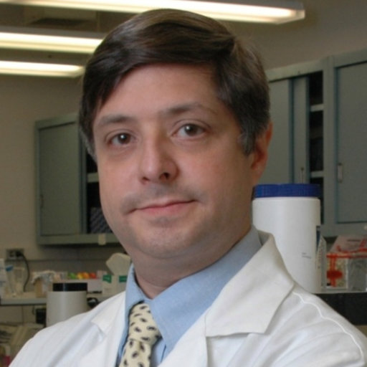
1918 Influenza
1918 Influenza Genome
  Jeffery Taubenberger, MD, PhD, NIAID
    American virologist
    Sequenced entire genome
    Took ten years
    Very “bird like virus”
    Similar to H5N1 virus today
outrunningthehorses.com

Slide 35
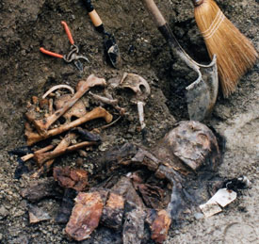
1918 Influenza
1918 Influenza Genome
  Jeffery Taubenberger, MD, PhD, NIAID
    Sequenced genome from specimens dug up from below the permafrost in 1997
    Specimen from an obese woman whose extra fat protected lungs
outrunningthehorses.com

Slide 36
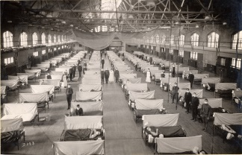
1918 Influenza
1918 Influenza Pandemic has been cited as the most devastating epidemic in recorded world history
outrunningthehorses.com

Slide 37
1918 Influenza
Think About It
  The circulating Avian Influenza – HPAI H5N1 has been said to be similar in virulence to the 1918 Influenza
  The death rate of COVID-19 at its height was 1.2%
  The death rate of HPAI H5N1 globally January 1, 2003, to July 19, 2024, is 52%
outrunningthehorses.com

Slide 38

Questions?
outrunningthehorses.com

Slide 39
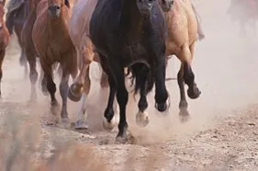
For more presentations like this
or for more information
please visit
outrunningthehorses.com
outrunningthehorses.com

