Slide 1

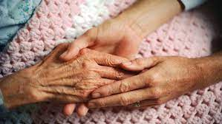
Pandemic Plan for the Church
Ministering to the Community in a Time of Crisis
Ministers of Grace
Part One
outrunningthehorses.com

Slide 2
Ministers of Grace
“For I was hungry, and you gave Me something to eat;
I was thirsty, and you gave Me something to drink;
I was a stranger, and you invited Me in;
naked, and you clothed Me; I was sick, and you visited Me;
I was in prison, and you came to Me.
Truly I say to you, to the extent
that you did it for one of the least of these
brothers or sisters of Mine, you did it for Me.”
Matthew 25:35,36,40
outrunningthehorses.com

Slide 3
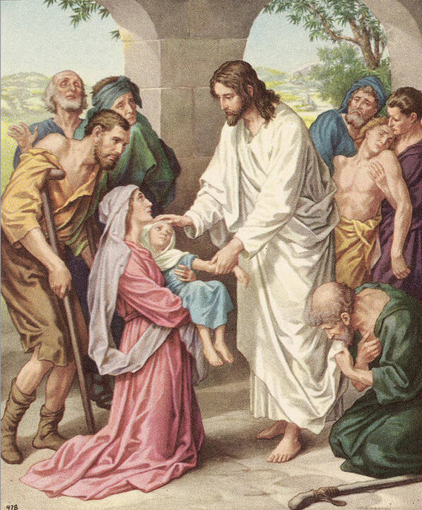
Ministers of Grace
Introduction
Caring for the sick is a ministry that Christ exemplified and calls us to perform
Jesus said caring for one of these is as though caring for Him personally
outrunningthehorses.com

Slide 4
Ministers of Grace
Introduction
Church history tells us that Christianity grew and thrived during difficult times such as persecution and plagues
During pandemics Christians offered a more satisfactory explanation of the catastrophic events
Christian values of love and charity were expressed by the practices of social service in the times of crisis, thereby creating a network of medical care
outrunningthehorses.com

Slide 5
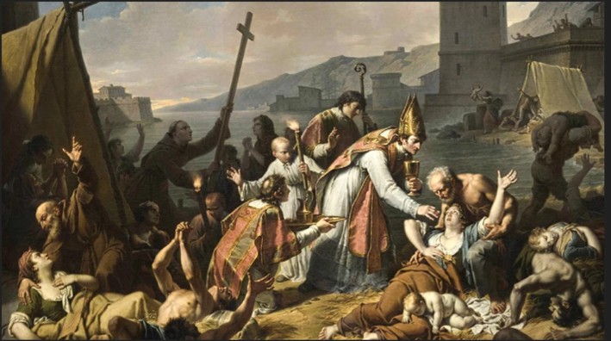
Ministers of Grace
Introduction
With even minimal medical attention, the survival rate among the Christians (and any of their pagan neighbors whom they treated) was substantially higher than that in the general population
Over time, the proportion of Christians in the total population was thereby dramatically increased
outrunningthehorses.com

Slide 6

“It is our care of the helpless,
our practice of loving kindness that brands us
in the eyes of many of our opponents.
‘Only look,’ they say, ‘look how they love one another!’”
Tertullian
outrunningthehorses.com

Slide 7
Ministers of Grace
Introduction
Studies have shown that even basic health care such as adequate water, food, and warmth can result in a much higher percentage rate of survival from a disease
During the 1918 Influenza, it was determined that many died simply because there was no one to look after the sick and provide them these basic essential needs
outrunningthehorses.com

Slide 8
Ministers of Grace
Introduction
The purpose of this ministry is to train and equip the Body of Christ to safely and effectively care for the sick in the event of a lethal pandemic such as the one that occurred in 1918
In doing so, we will be enabled to share the hope of our Lord, Jesus Christ, with those who are hurting.
outrunningthehorses.com

Slide 9
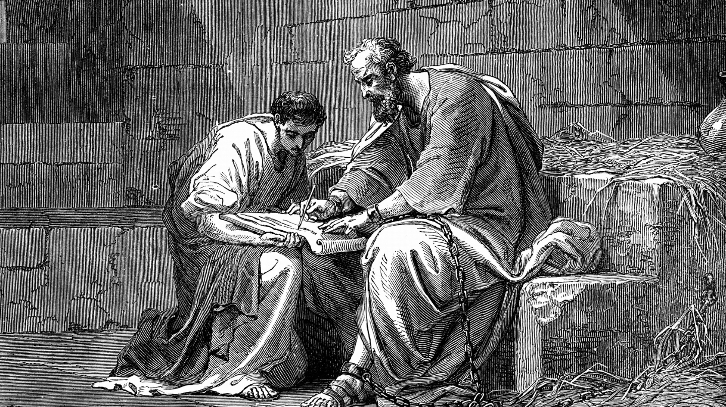
Ministers of Grace Biblical Times
Epaphrodititus
Epaphroditus had become sick to the point of death, risking his life in his service to Paul and for the work of Christ
outrunningthehorses.com

Slide 10
But I thought it necessary to send to you Epaphroditus,
my brother and fellow worker and fellow soldier,
who is also your messenger and minister to my need.
Receive him then in the Lord with all joy,
and hold people like him in high regard,
because he came close to death for the work of Christ,
risking his life to compensate
for your absence in your service to me.”
Philippians 2:25, 29-30
,
outrunningthehorses.com

Slide 11
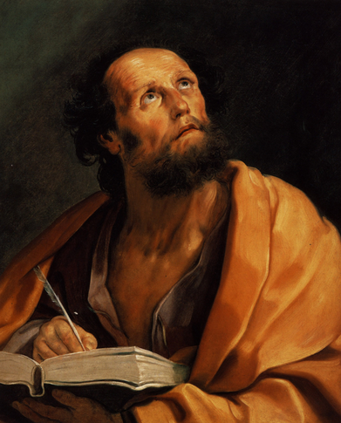
Ministers of Grace Biblical Times
Luke
Paul’s final letter before his death
Tells how he was deserted
Implores for Timothy to come
He stated only Luke (the physician) was with him
outrunningthehorses.com

Slide 12
“For I am already being poured out as a drink offering,
and the time of my departure has come.
Make every effort to come to me soon.
Only Luke is with me.”
2 Timothy 4: 6,9,11
,
outrunningthehorses.com

Slide 13
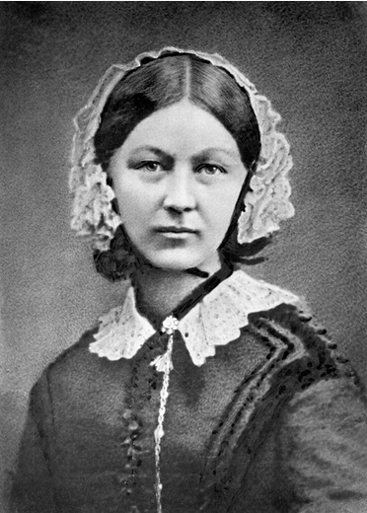
Ministers of Grace Florence Nightingale
Florence Nightingale
Felt faith should manifest in active care and love for others
Reports of the conditions for the wounded at the military hospital in Scutari during the Crimean War got back to Britain
Florence Nightingale petitioned the government to allow her to go
outrunningthehorses.com

Slide 14
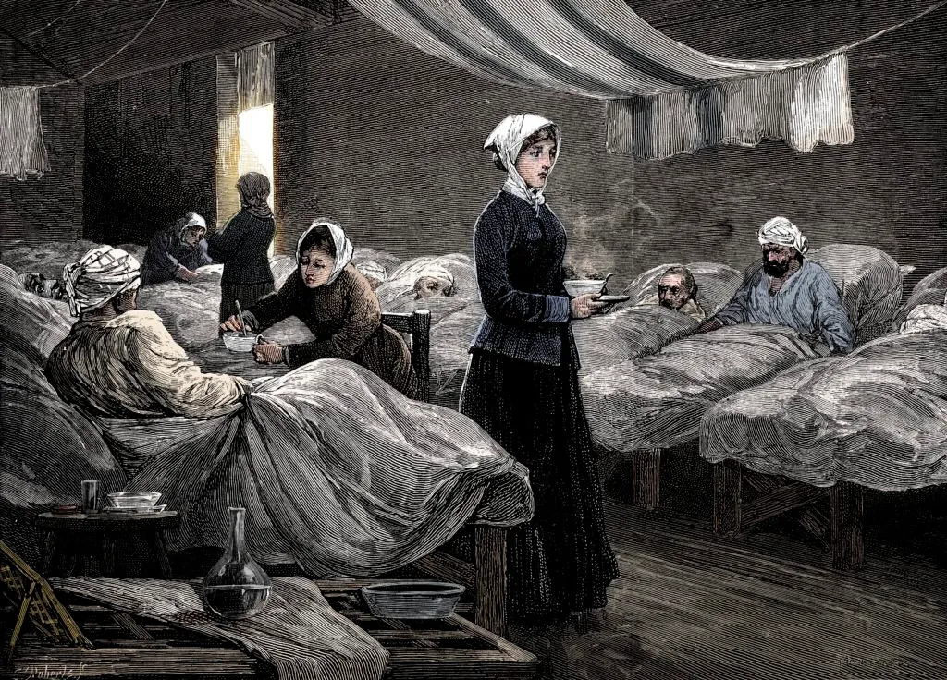
Ministers of Grace Florence Nightingale
She brought with her a staff of 38 women volunteer nurses including 15 Catholic nuns
outrunningthehorses.com

Slide 15
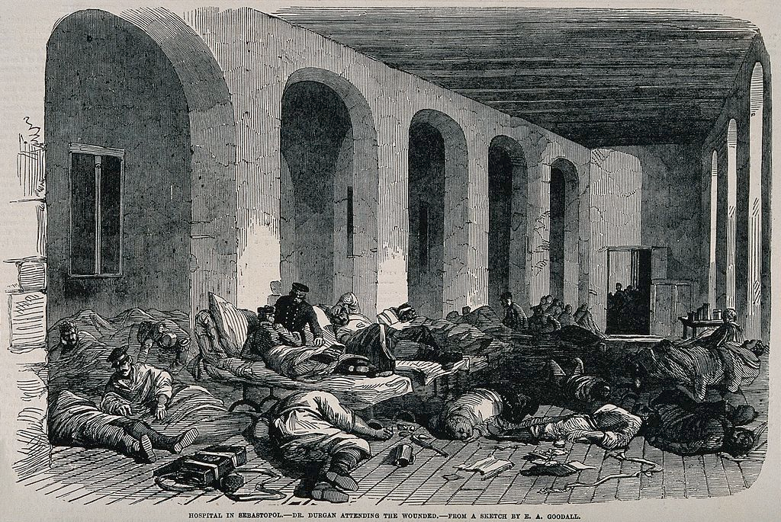
Ministers of Grace Florence Nightingale
The army hospital was filthy and rat infested
It was severely overcrowded with 2,000 to 4,000 soldiers crammed into the building
Conditions were catastrophic
Medical staff were overwhelmed
Medicines were in short supply
Hygiene was neglected
Many died from infections
outrunningthehorses.com

Slide 16
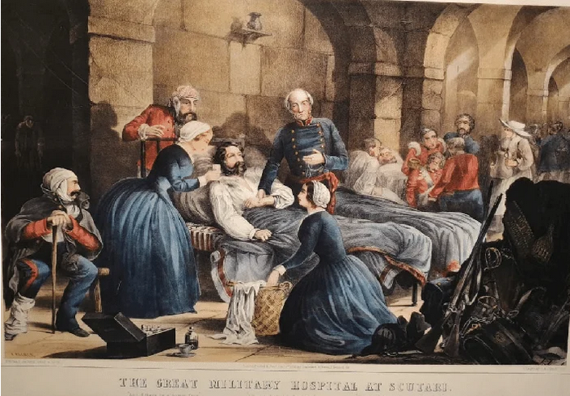
Ministers of Grace Florence Nightingale
She and her team got right to work
Cleaning
Improving ventilation
Caring properly for the wounded
The death rate went from 50% to 1 %
outrunningthehorses.com

Slide 17
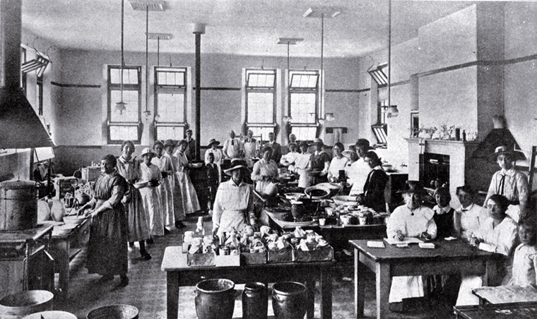
Ministers of Grace 1918 Influenza
Women from various churches daily would:
Enquire of the worst cases
Go to their fellowship halls in their church buildings
Cook meals and deliver them
It was determined these efforts saved many lives
outrunningthehorses.com

Slide 18
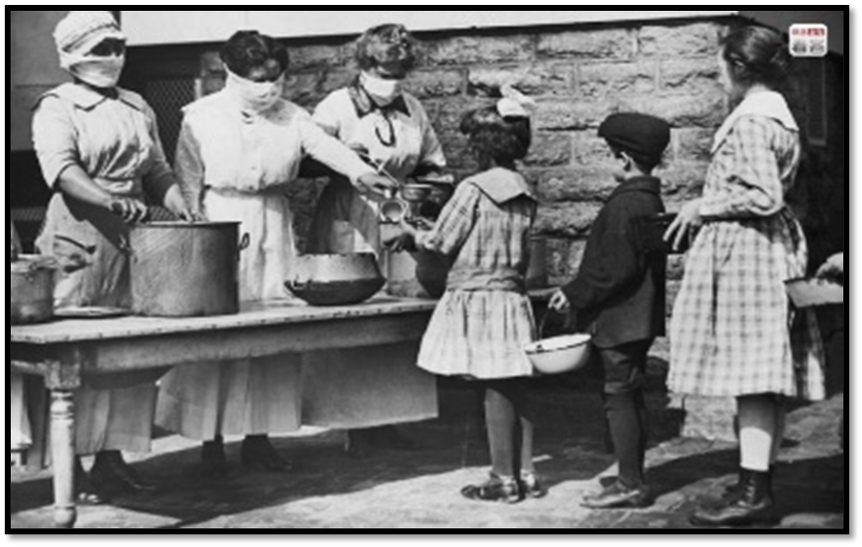
Ministers of Grace 1918 Influenza
It was determined these efforts saved many lives
outrunningthehorses.com

Slide 19
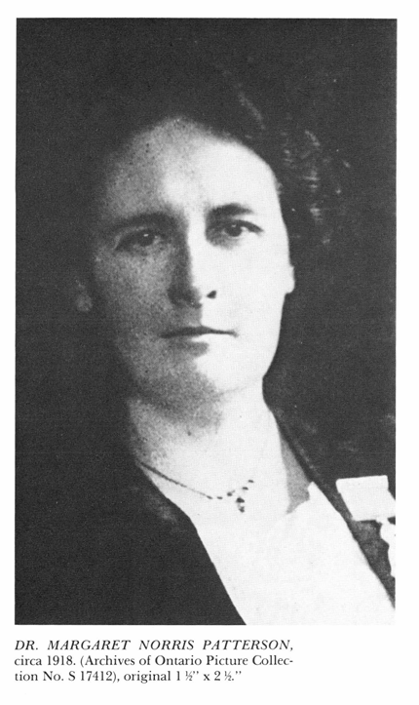
Ministers of Grace 1918 Influenza
Dr. Margaret Patterson
There was a growing demand for nursing care within homes
Began a lecture series to train women in basic patient care
Volunteers packed the auditorium
Many listened in adjacent corridors
Four lectures delivered to over 1,000 female volunteers
outrunningthehorses.com

Slide 20
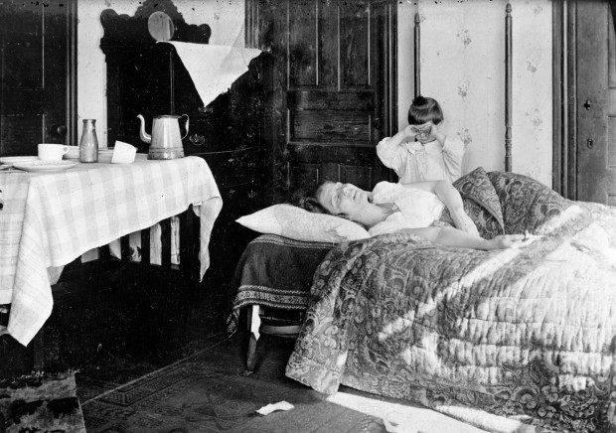
Ministers of Grace 1918 Influenza
Dr. Margaret Patterson
Graduates called “Sisters of Service”
This program proved effective
In Toronto care was provided to over 1,000 families
outrunningthehorses.com

Slide 21
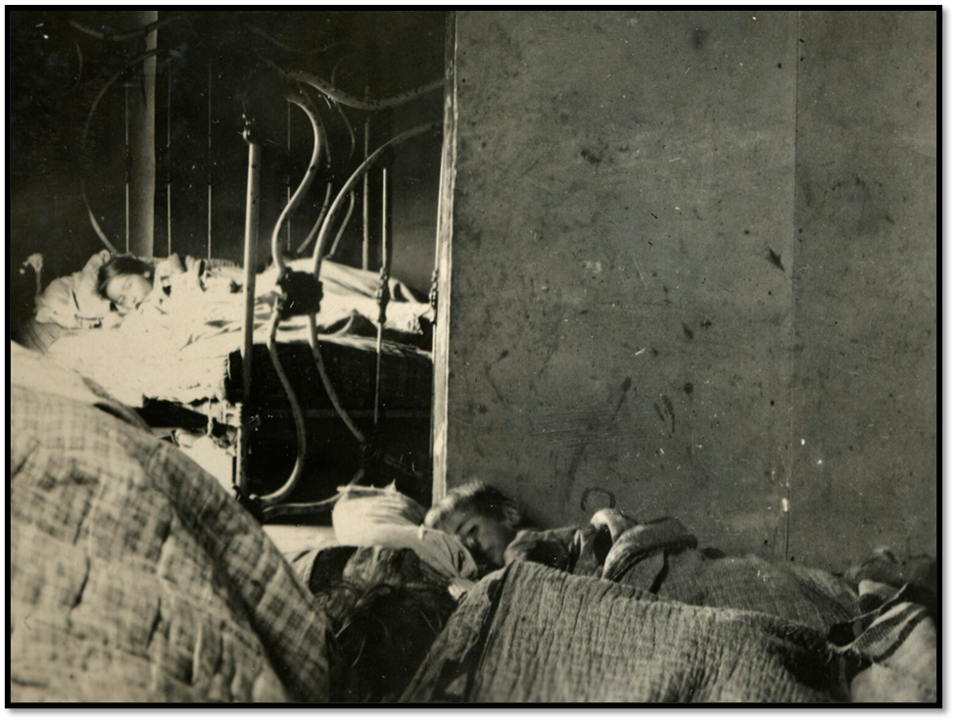
Ministers of Grace 1918 Influenza
Dr. Margaret Patterson
Sisters of Service provided care to approximately 1000 families in need
outrunningthehorses.com

Slide 22
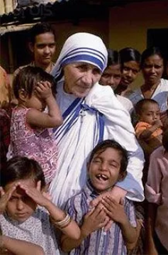
Ministers of Grace Mother Teresa
Mother Teresa
Responded to a “Call within a Call”
She went to the slums and:
Visited families
Washed sores of children
Cared for those lying sick in the road
Nursed those dying of hunger
outrunningthehorses.com

Slide 23
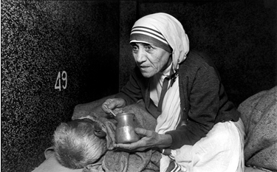
Ministers of Grace Mother Teresa
Mother Teresa
Believed that by serving these she was serving Jesus
Others joined her one by one
Established Missionaries of Charity
outrunningthehorses.com

Slide 24
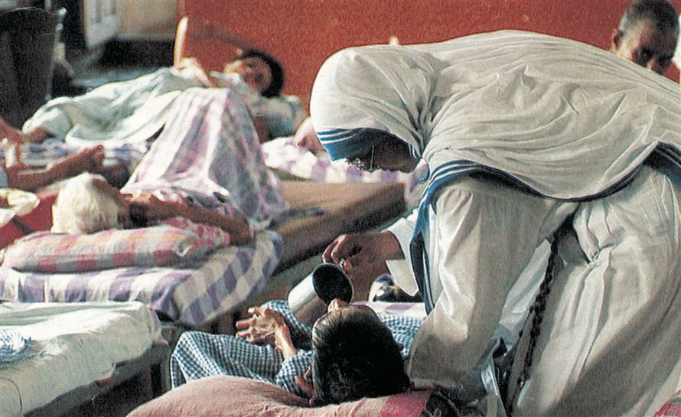
Ministers of Grace Mother Teresa
Mother Teresa
By the time of her death in 1997, Missionaries of Charity grew from a single school to a large international network
Today over 5,000 nuns, 300 brothers, and over 100,000 lay volunteers
outrunningthehorses.com

Slide 25
Ministers of Grace
Mission
The purpose of this ministry is to train and equip those willing to stand in the gap and be able to care for themselves and their community in the event of a devastating pandemic, bringing the gospel into the crisis
outrunningthehorses.com

Slide 26
Ministers of Grace Education and Training
April 24, 2013, China – H7N9 outbreak
A hospital employee broke the news of a fatality of the novel flu
Expressing fear, he stated the hospital did not warn the employees, nor did they supply the staff with the proper equipment or precautions
The employee expressed fear for catching the mystery disease.
outrunningthehorses.com

Slide 27
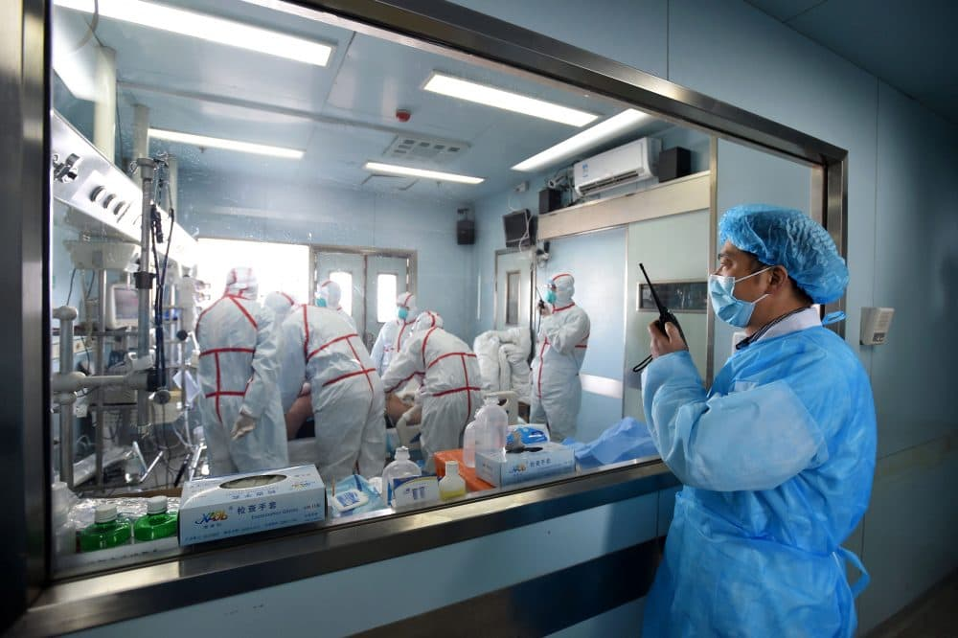
Ministers of Grace Education and Training
Education and Training
Employee became known as ‘Hospital No. 5 employee’
A good example of what can occur if you are not watching circumspectly for an outbreak of a “mystery disease”
And are you properly prepared for it
outrunningthehorses.com

Slide 28
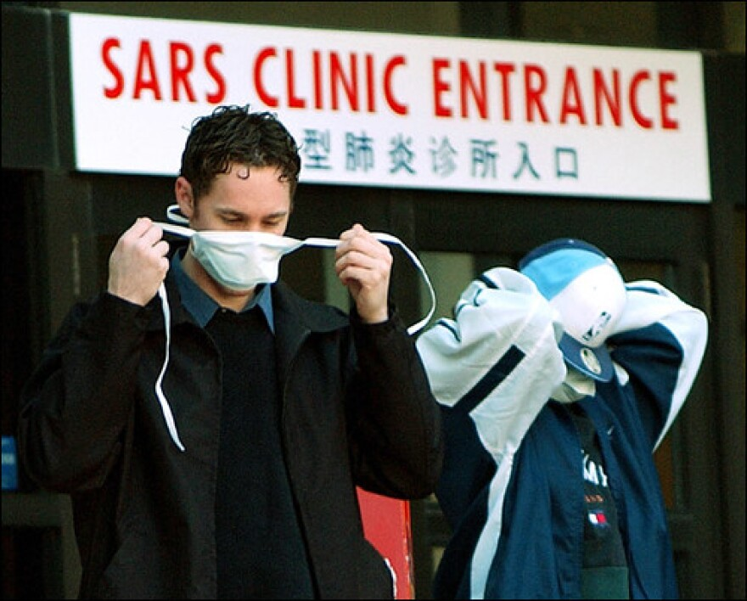
Ministers of Grace Education and Training
2002-2003 International SARS Outbreak
Despite infection control many healthcare workers became ill
It was determined that those having less than two hours of training and understanding the disease and its transmission and proper procedures were more likely to become infected with the disease
outrunningthehorses.com

Slide 29
Ministers of Grace Education and Training
During a pandemic event
The internet becomes a source of information for the public
In addition to the panic and confusion, discerning and proper information can be difficult
It is best to educate yourself before such an event
You will be well informed
Able to distinguish what is reliable information
It is proven that education and training before the crisis is vital to ensure safety and the provision of effective care
outrunningthehorses.com

Slide 30
Ministers of Grace Education and Training
Information and training are provided by this ministry for the highly pathogenic avian influenza (HPAI) H5N1 virus
Awareness of the pathophysiology (process of the disease) of the disease in the human body
How it transmits
How to properly protect yourself
How to effectively care for the sick
outrunningthehorses.com

Slide 31

Ministers of Grace Education and Training
Requirements for the Volunteer
To safely and effectively serve in this ministry all leaders and volunteers must participate in the training for their respective levels
outrunningthehorses.com

Slide 32
Ministers of Grace Education and Training
Requirements for the Volunteer
Background Checks
Volunteers would be going into the homes of those needing care
Screenings would verify:
Trustworthiness
Protect against sexual predators, violent offenders, financial misconduct
outrunningthehorses.com

Slide 33
Ministers of Grace Education and Training
Requirements for the Volunteer
Background Checks
Ensures the safety of children
Vulnerable adults
Helps to mitigate any legal liability for negligence
Unless the Church chooses to pay for the background check, the participant will be responsible for the cost
outrunningthehorses.com

Slide 34
Ministers of Grace Education and Training
Levels of Participation
This ministry has many facets
Delineate levels of participation
Ensures:
Anyone with a heart for this ministry can participate at their level of knowledge, experience, and capability
The safety and well-being of all parties are protected
outrunningthehorses.com

Slide 35
Ministers of Grace Education and Training
Levels of Participation
Administrator/Leader
A person who oversees the Ministry of Grace volunteers,
Keeps records of volunteers, training, visits
Determines those who need a visit and/or a meal.
This person may be a leader in the Church
May not even have contact with the sick
outrunningthehorses.com

Slide 36
Ministers of Grace Education and Training
Levels of Participation
Level One
A person who has attended and participated in all required training
They are prepared and equipped to safely and effectively visit and care for the sick and share the gospel of Jesus Christ
outrunningthehorses.com

Slide 37
Ministers of Grace Education and Training
Levels of Participation
Level Two
A person who has the desire to participate in the ministry but is unable to meet requirements of Level One, or is in the process of completing the training
They can prepare and deliver meals, make telephone calls, and write and send cards
outrunningthehorses.com

Slide 38
Ministers of Grace Education and Training
Training and Equipping Resources
Available for free on website www.outrunningthehorses.com
PDF documents
Coordinating PowerPoint Presentations
Actual training should be performed by a professional
Doctor, physician assistant, nurse practitioner, nurse, or paramedic
For more information on Train the Trainer please see that section
outrunningthehorses.com

Slide 39
Ministers of Grace Education and Training
Training and Equipping Resources
Each training section should take approximately 1 – 1 ½ hours
Please take the training sessions as a means of properly being prepared to safely and effectively care for the sick in the event of a lethal pandemic such as occurred in 1918
outrunningthehorses.com

Slide 40
Ministers of Grace Education and Training
Required sections for a Leader/Administrator
The Role of the Church in a Pandemic
1918 Influenza Pandemic
Avian Influenza
Caring for the Sick – Part One
Infection Control – PPE
outrunningthehorses.com

Slide 41
Ministers of Grace Education and Training
Required sections for a Leader/Administrator (Continued)
Ministering to Vulnerable People
Government Mitigations
Church and Community Mitigation Strategies
Caring for the Worker
outrunningthehorses.com

Slide 42
Ministers of Grace Education and Training
Required sections for a Level One Volunteer
The Role of the Church in a Pandemic
1918 Influenza Pandemic
Avian Influenza
Respiratory Anatomy and Physiology
Influenza Viruses and the Pathogenesis of Viral Diseases
Pathophysiology of H5N1 and 1918 Influenza
outrunningthehorses.com

Slide 43
Ministers of Grace Education and Training
Required sections for a Level One Volunteer (Continued)
Caring for the Sick – Part One
Caring for the Sick – Part Two
How to Prevent ARDS
Infection Control – Personal Protection Equipment (PPE)
Disinfecting Surfaces
Using Bleach as a Disinfectant
outrunningthehorses.com

Slide 44
Ministers of Grace Education and Training
Required sections for a Level One Volunteer (Continued)
Ministers of Grace
Sharing the Hope of Jesus
outrunningthehorses.com

Slide 45
Ministers of Grace Education and Training
Required sections for a Level Two Volunteer
The Role of the Church in a Pandemic
1918 Influenza Pandemic
Avian Influenza
Ministers of Grace
Sharing the Hope of Jesus
outrunningthehorses.com

Slide 46
Ministers of Grace Education and Training
Completion of Training
Upon completion of training
Level One participant will receive a diploma
Level Two participant will receive a certificate of completion
Both will be inducted into the ministry as a “Minister of Grace”
outrunningthehorses.com

Slide 47
Ministers of Grace Education and Training
Continuing Education
Due to the high level of training and the brevity and amount of information presented
Regular monthly meetings are to be held to review information or present new information
These meetings should be required to maintain the Level One status for a volunteer to be named a “Minister of Grace”
outrunningthehorses.com

Slide 48
Ministers of Grace
Conclusion
With the re-emergence of the HPAI H5N1, scientists are watching and some expecting it will cause a pandemic in 2026
The pathophysiology of this virus is very similar to that of the one that caused the 1918 Influenza
This mission of this ministry is to train and equip the Body of Christ to minister to the community in a pandemic similar to the 1918 Influenza
outrunningthehorses.com

Slide 49
Ministers of Grace
Conclusion
After completing the training courses provided, a participant will learn to safely and effectively care for the sick
The resources for these trainings are available on the website: www.outrunningthehorses.com
outrunningthehorses.com

Slide 50

outrunningthehorses.com

Slide 51
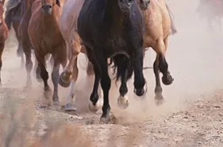

“If you have run with footmen, and they have tired you out,
then how can you compete with horses?
If you fall down in a land of peace,
how will you do in the thicket by the Jordan?”
Jeremiah 12:5

Slide 52
For more presentations like this
or for more information
please visit
outrunningthehorses.com

