Slide 1
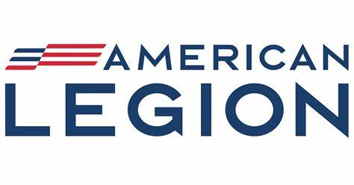
History & Organization

Slide 2
”No one man can claim to be the founder of the American Legion” – Theodore Roosevelt, Jr.
Theodore Roosevelt Jr. envisioned as early as 1915 a national network of U.S. military veterans and skilled specialists who would be ready to serve in the event of war.
The first American Legion was incorporated that year in the state of New York and grew to more than 25,000 members nationwide whose military and technical skills, as well as willingness to serve, were documented for potential wartime use.
Roosevelt Jr. and several founders of the future American Legion were members. The administration declined the organization’s offer to help the federal government on its war preparedness program but took over the organization’s records for use by the Council of National Defense.
The first American Legion was out of business in late 1916. But the idea was merely on hold. The American Legion name, Roosevelt Jr. later said, had earlier been coined by his father, in reference to U.S. citizens he had assembled who were qualified to serve in the military in case of emergency.

Slide 3
Paris Caucus, March 1919
In late January 1919, Roosevelt Jr. and three other line officers of the American Expeditionary Forces met casually in Paris to discuss their imminent homecoming, the Bolshevik revolution and its threat to the United States, along with the need to form an organization of veterans specifically to help those who had served in the Great War.
The four in attendance were Roosevelt Jr., Lt. Col. George S. White, Col. William Donovan and Maj. Eric Fisher Wood.
Gen. John Pershing, commander of the AEF, later called a personal meeting with Roosevelt Jr. to discuss low morale among the troops still occupying postwar Europe. Roosevelt’s solution was to call a morale-building conference in Paris, an event that would be the first caucus that gave birth to The American Legion. To set up the conference, Pershing authorized a meeting of 20 officers in mid-February 1919 and, following that, granted travel orders for the March gathering.
Officers and enlisted personnel alike would be invited from their duty stations across Europe. The number of those in attendance is unknown. Only a fraction of those who came to Paris for the caucus signed attendance sheets.

Slide 4
St Louis Caucus, May 1919
While other founders were organizing and running the Paris Caucus, Roosevelt Jr. returned to the United States to promote a follow-up gathering of veterans in St. Louis in May.
At what would become known as the St. Louis Caucus May 8-10, 1919, The American Legion’s Constitution was drafted.
On Sept. 16, 1919, the fast-growing veterans organization received a federal charter from Congress.
By the time of the first American Legion National Convention in Minneapolis in November, the organization numbered more than 684,000.

Slide 5
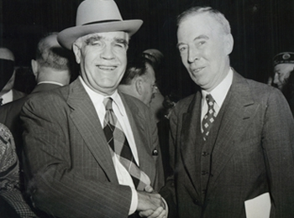
Franklin D'Olier of Pennsylvania was elected to serve as the first national commander, and Lemuel Bolles of Washington was appointed as the first national adjutant.
Indianapolis won the bid in a competition with four other cities – Minneapolis, Detroit, Kansas City, Mo., and Washington, D.C. – to become the permanent home of The American Legion National Headquarters.
In less than a year, The American Legion had emerged from an idea built on a few general values into a federally chartered and fast-growing force of patriotic veterans
Lemuel Bolles, left, and Franklin D'Olier

Slide 6
Among the founding principles that have guided The American Legion since its birth include:
Military rank in the service would be irrelevant for American Legion membership and officer positions.
Wartime veterans who served stateside duty were eligible for membership.
Gender and race were not to be considered for membership eligibility, nearly a year before women had the right to vote and 45 years before the Civil Rights Act was passed.
Policies and positions of the organization would come from the grassroots level upward, through a resolution process designed to begin at the local post and move through the department and then to the National Executive Committee and/or National Convention.

Slide 7
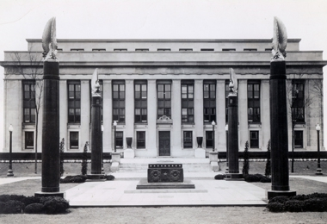
The four pillars of American Legion service began to take shape under National Commander D'Olier's leadership:
Veterans
Defense
Americanism
Youth
These words are now engraved on the limestone pillars of National Headquarters in Indianapolis
The original National Headquarters building in Indianapolis

Slide 8
Foremost on the minds of the founders was the organization's need to help veterans and their families
Those who fought in World War I had been exposed to combat tactics never before encountered. They faced chemical warfare in the trenches of Europe. Tanks, heavy artillery, air combat and machine guns had changed the face of war.
Such innovations also produced new types of veteran disabilities. Those who survived the war often came home physically or mentally afflicted, frequently as a result of chemical warfare.
The war also had created a massive number of widowed spouses and fatherless children. At the time, the U.S. government had no comprehensive health-care program to address the unique needs of service-disabled veterans, and the need for a unified system to treat them became profound.

Slide 9
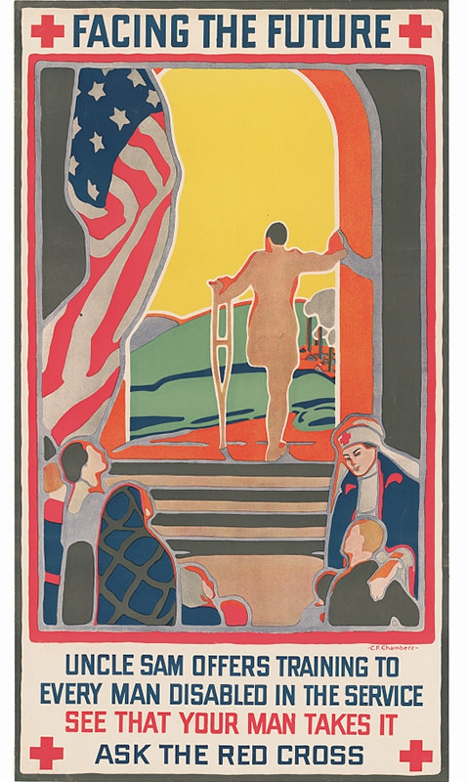
Vocational training and employment assistance for veterans also were not available at the time.
In short, federal benefits and health-care services for veterans and their families were scant, and Veterans Rehabilitation became a pillar value and urgent priority.
One of the first organizations to address the problem, The American Legion immediately began reaching out to veterans and their families directly to help them understand what few government benefits they were due and how to apply for them

Slide 10
A precursor to the modern-day network of American Legion-accredited service officers that assists veterans today,
a national American Legion War Risk Insurance Division helped thousands of veterans and their families file for disability claims, insurance payments and other benefits in the organization's earliest months.
The Legion also offered vocational training for those whose ability to support their families had been compromised by physical or mental conditions related to military service.
The American Red Cross provided financial assistance as the Legion established a service division, performing outreach through a fast-multiplying galaxy of local American Legion posts, and the era of the service officer began

Slide 11
American Legion youth programs began to take shape during the organization’s first two decades
Support for Boy Scouts of America, passed by resolution at the First American Legion National Convention in 1919, was the initial youth program officially sanctioned by the organization, which would go on to become the nation’s largest non-denominational sponsor of Scouting units.
American Legion Baseball was started in 1925 in South Dakota.
American Legion Boys State was founded in 1935 in Illinois to counter a rising tide of subversive anti-American youth camps popping up across the country.
In 1938, the National High School Oratorical Contest debuted as an American Legion program to instill leadership and knowledge of the U.S. Constitution
Prominent past alumni of the Boys State and Boys Nation programs include former U.S. President William Clinton, Neil Armstrong, Alan Keyes, Lou Dobbs, Sam Nunn, Rush Limbaugh, Phil Jackson, Michael Jordan, Jon Bon Jovi, Samuel Alito, James Gandolfini, Bruce Springsteen, Richard Cheney, Tom Brokaw, Joseph Lieberman, Richard Lugar, Michael Dukakis, Scott Bakula and Chris Christie.

Slide 12
As a lobbying organization, The American Legion set in motion many reforms to provide compassionate care, benefits, training and support for veterans and their families.
A survey conducted by the Legion in 1923 revealed that many veterans of the Great War had plummeted into homelessness and despair after discharge.
Many suffered from puzzling mental illnesses known at the time as "shell shock" (today diagnosed as post-traumatic stress). As the 1920s unfolded, it was not uncommon to see blind, limbless or mentally ill former doughboys selling pencils and apples on street corners, just trying to survive.

Slide 13
The American Legion's relentless work on behalf of disabled veterans led to passage of the World War Veterans Act of 1924, linking military service to several classes of physical disability.
The federal government's disorganized and often-corrupt collection of agencies to help veterans was consolidated first into the Veterans Bureau in 1921, which also became entangled in corruption, before services were greatly improved under the Legion-urged creation of the Veterans Administration in 1930. As the early VA took shape, The American Legion began fighting for adequate funding for the agency so it could provide quality care.
Members of the Legion began volunteering in VA health-care facilities where they could provide firsthand oversight, adding credibility to their lobbying efforts.

Slide 14
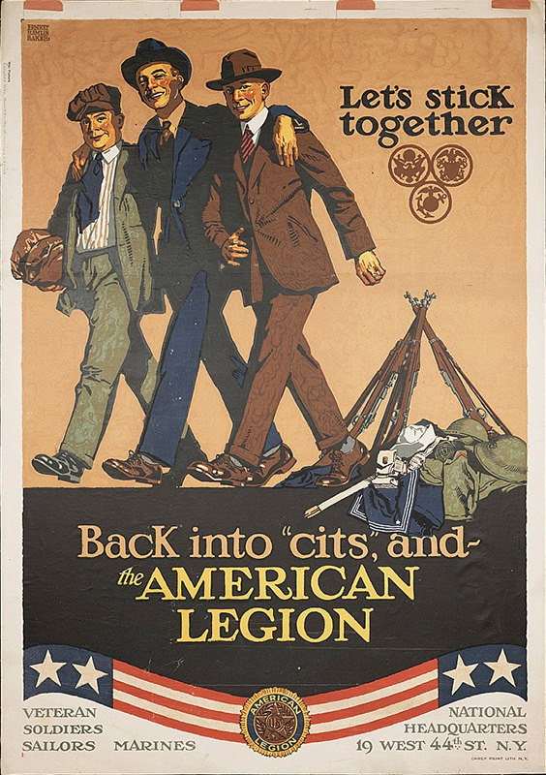
The Veterans Affairs & Rehabilitation Commission of The American Legion became the most prominent stakeholder voice on all the service arms of the Veterans Administration that it helped create:
Health care
Pensions and benefits
Education
Homelessness prevention
Employment opportunities
Cemetery benefits

Slide 15
On June 14, 1923, The American Legion’s Americanism Commission led a conference in Washington bringing together no less than 68 other organizations, military groups, educators and others for the first of two national flag conferences that would lay the groundwork for U.S. Flag Code.
President Warren G. Harding was the keynote speaker at the 1923 conference.
By the time of the 1924 Flag Conference, 32 states had agreed to adopt the code for their schools after some adjustments were made.
The American Legion would lobby Congress for the next 18 years to adopt into law U.S. Flag Code.

Slide 16
The American Legion Endowment Fund, established in 1925
created the Temporary Financial Assistance program to provide financial support for minor children of eligible veterans.
The fund was also dedicated to provide training and support for American Legion service officers.
The TFA program was augmented in 1990 during Operation Desert Storm with the Family Support Network, which connected American Legion volunteers with military families in need of support during deployments.
Renamed The American Legion Veterans & Children Foundation in 2018, the fund continues to support service officers and military/veteran families with children at home, who are facing emergency financial hardships.

Slide 17
The nation's economic descent in the Great Depression presented profound challenges for veterans and their families. The Economy Act of 1933 threatened to unravel many of the Legion's hard-fought gains on behalf of disabled veterans and their families.
On March 28, 1934, the Legion recorded one of its most significant victories ever by driving forward Public Law 141, which was vetoed by the president but later overridden by Congress, to protect disabled veterans and their benefits from federal budget cuts proposed under the Economy Act.
That accomplishment on Capitol Hill not only preserved benefits for needy veterans and their families, it also firmly established The American Legion's might in Washington.

Slide 18
In the decades to come, The American Legion's continuous efforts to improve the lives of veterans led to some of the most significant developments in U.S. society, most notably passage of the Servicemen's Readjustment Act of 1944, better known as the "GI Bill."
The original language of the bill, written in longhand by American Legion Past National Commander Harry Colmery, was the cornerstone of a half-century of American prosperity after World War II.
Millions of veterans received college educations, bought homes with affordable VA loans, and created what became the American middle class as the century's second half unfolded. Some have described the GI Bill as the nation's most significant social legislation of the 20th century.
Through the years, The American Legion has fought to protect GI Bill benefits from federal budget cuts and to extend them to veterans seeking different types of educations after discharge, such as certification for trades, apprenticeships and online classes.

Slide 19
The post-World War II American Legion grew and expanded, reaching record membership of 3,326,556 in 1946 and adding 2,600 new posts in a 12-month period ending in January 1947
The organization, fresh off of its success in getting the GI Bill passed, was well-positioned to ensure that the benefits promised in the legislation were fulfilled.
Hundreds of new VA health-care facilities were built in the post-World War II era, and the Legion strongly urged a VA-medical school affiliation program to make sure those facilities were properly staffed and equipped; medical school affiliations flourished in the years that followed to strengthen VA hospitals and clinics.

Slide 20
During the Korean War, The American Legion fought to expand VA eligibility to all who had honorably served in the U.S. Armed Forces, not just those who served during wartime
Along with that came the need to lobby for adequate VA funding, which proved to be a consistent and persistent battle for The American Legion over the decades to come.
The American Legion Child Welfare Foundation was formed in 1954 to provide grant money for nonprofit organizations that serve to improve the lives of children and youth; the foundation now issues over $600,000 a year to worthy organizations.
The Legion also provides support for Special Olympics, Junior ROTC, high school rodeo, after-school tutoring and many other activities at the national, state and local levels.

Slide 21
The Vietnam War era produced another new generation of eligible veterans in an organization that was designed to expire after those who fought in World War I were gone.
Led by veterans of the first two world wars, The American Legion was positioned through the 1960s to stand for patriotism, flag respect and traditional values at a time of major social shifts in the nation, including strong public opposition to the war.
Due to the Vietnam War, The American Legion pressed to the forefront two major developments in the treatment of veterans: proving the link between Agent Orange exposure and adverse health conditions suffered by veterans of the Vietnam War and gaining acceptance of post-traumatic stress disorder as a compensable VA condition and disability.
The American Legion worked with Columbia University researchers to refute a federal study and conclusion finding no connection between Agent Orange and adverse health conditions of Vietnam War veterans.
Also in the aftermath of the Vietnam War, The American Legion was instrumental in gaining diagnostic acceptance of PTSD, thus beginning a long and difficult journey in proper treatment for veterans confronting it.

Slide 22
The Citizens Flag Alliance
A 5-4 U.S. Supreme Court ruling in the 1989 case Texas v. Johnson defined deliberate desecration of the U.S. flag as a constitutionally protected act of free speech.
The ruling led The American Legion to assemble the Citizens Flag Alliance, a collaboration of more than 140 organizations, to seek a constitutional amendment that would return to the states the power to enact and enforce laws to protect the flag from such acts.
In nearly every session of Congress since 1990, The American Legion has pushed for passage of an amendment that would simply read: "The Congress shall have power to prohibit the physical desecration of the flag of the United States." In 2005, the measure came within one Senate vote of passing with the supermajority required for a constitutional amendment.

Slide 23
American Legion Riders
In 1993, The American Legion Riders program was launched at Garden City, Mich., Post 396 to bring veteran motorcycle enthusiasts together.
In the months and years that followed, the Legion Riders grew to more than 120,000 members and more than 2,200 chapters nationwide.
The group is the driving fundraising force for the Legacy Scholarship program, which provides college money for the children of military men and women who lost their lives while serving on active duty or have a combined VA disability rating of 50 percent or greater assigned on or after Sept. 11, 2001.
The main event of the group is the annual American Legion Legacy Run, which typically starts in Indianapolis and proceeds to the national convention city where Legacy Scholarship funds are delivered to the national commander.

Slide 24
The terrorist attacks of Sept. 11, 2001, led to a surge in patriotism and support for those serving in the U.S. Armed Forces.
The American Legion quickly went to work reviving the Blue Star Banner program, identifying homes with loved ones serving in the war.
Within months of the attacks, The American Legion launched the Legacy Scholarship Fund to provide college scholarships to the children of military men and women who lost their lives on duty during or after the attacks; scholarship eligibility was later expanded to include the children of veterans with combined disability ratings of 50 percent or greater.
The Legion lobbied vigorously against defense budget cuts as the war progressed and in 2005 passed Resolution 169 proclaiming the organization's support for the service members and their mission alike to defeat terrorism around the planet.
In May 2014, American Legion National Commander Daniel Dellinger called for the resignation of VA's top officials amid a nationwide scandal where medical center directors were falsifying records and failing to make appointments for veteran patients, many of whom died waiting to see doctors. The call led to the resignation of VA Secretary Eric Shinseki and emergency legislation to improve accountability at VA and begin the restoration of trust among veterans. The American Legion conducted more than 20 Veterans Crisis Command Center and Veterans Benefit Center events and town hall meetings in the months following the scandal.

Slide 25
100 Years and Counting!
The American Legion celebrated its 100th anniversary between August 2018 and November 2019.
Thousands of state and local activities were conducted to honor the organization's first century of service.
The motto of the centennial program was "Legacy & Vision" to concentrate both on the organization's many accomplishments of the past and its mission of the future as the post-9/11 generation of veterans began to assume leadership of the organization.
The 101st American Legion National Convention was conducted in Indianapolis, home of American Legion National Headquarters.

Slide 26
Pandemic
The COVID-19 pandemic, declared global in March 2020, set The American Legion in motion worldwide. Buddy Checks, blood donations, food-collection and distribution, procurement and delivery of personal protective equipment and more became community, state and national priorities during the crisis.
The pandemic suspended plans for national youth program championships in 2020, as well as the 102nd American Legion National Convention, and for the first time in history, a national commander, James W. "Bill" Oxford of North Carolina, served a second term.
The American Legion also launched a nationwide 100 Miles for Hope program to get American Legion Family members exercising during the pandemic and raise funds and awareness about the American Legion Veterans & Children Foundation.

Slide 27
The PACT Act
Years of persistent advocacy on behalf of veterans exposed to poisons of burn pits in Iraq and Afghanistan, as well as Agent Orange in locations previously unrecognized and atomic radiation at cleanup sites around the world led to the Aug. 10, 2022, signing into law of the Sergeant First Class Heath Robinson Honoring Our Promise to Address Comprehensive Toxics (PACT) Act.
The American Legion-supported measure, most comprehensive contamination-relief package in history, stood to help some 3.5 million veterans of the Global War on Terrorism, along with others dating back to the Vietnam War.

Slide 28
Organization
The range of opportunities in The American Legion can be linked to its organizational structure, which was established clearly and early to be democratic in nature, non-partisan and built from the grassroots up. In most cases, resolutions of the national organization start at the local post level, pass through the department and then are advanced through a commission for adoption by the National Executive Committee or the national convention.

Slide 29
Organization
Posts, districts, departments and the national headquarters are composed of nearly identical commissions, committees and offices to address the diverse interests of the organization.
The commander is the top elected official and spokesperson at each level; the adjutant is an appointed officer who handles day-to-day leadership.
The officer corps also consists of a judge advocate, treasurer, sergeant at arms, historian and chaplain.

Slide 30
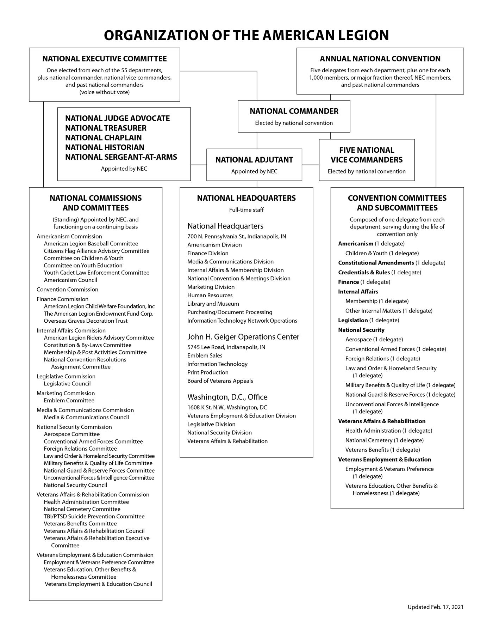

Slide 31
Organization Flow
The American Legion primarily consists of three separate but interconnected entities: posts, state departments and a national headquarters. Departments have authority to create and charter intermediate groups, which may be referred to as districts, counties, divisions or zones, between the posts and departments. In no event may they invade the prerogatives vested within the post, department or national organization.
At the post level, committees typically include, but are not limited to:
Americanism
Children & Youth
Education and Employment
Finance
House
Legislative
Membership & Post Activities
Public Relations
Veterans Affairs & Rehabilitation
Security
Graves Registration
Sons of The American Legion

Slide 32
Organization Flow Cont’d
Post committees report and recommend directives and initiatives to elected post officers who then report and recommend them to the Post Executive Committee.
The Post Executive Committee reports to, works with, and provides directives to the post commander, an elected officer, and the post adjutant, an appointed officer, and to the post as a whole.
Posts provide information and coordinate efforts with district/county leadership.
District/county officers, such as district commanders and district executive committees, coordinate, inform and work with posts in specific geographic regions. They then inform and coordinate with department headquarters.
Departments, also composed of committees and officers, coordinate and work with National Headquarters, which also consists of commissions and committees with specific roles and purposes, an elected national commander and vice commanders, and appointed officers. The National Executive Committee (NEC) is the equivalent to a board of directors of the national organization. The NEC and the National Convention (similar to a stockholders meeting) are uniquely responsible for national resolutions decisions.

Slide 33
At the national level, the commander appoints chairpersons to lead commissions, including:
Americanism
Convention
Finance
Internal Affairs
Legislative
Marketing
Media & Communications
National Security
Veterans Affairs & Rehabilitation
Veterans Employment & Education

Slide 34
The national commissions oversee committees, task forces, councils and divisions.
Commissions are authorized to draft and submit resolutions to the National Executive Committee.
The Legion's resolutions:
Establish positions
Formalize contracts
Chart the organization's course
Set policy
Sanction relationships
The National Executive Committee meets in May, within 24 hours before and after each national convention, and within 45 days following the adjournment of the national convention.
The same organizational format is mirrored at the department and district levels. At the post level, chairpersons are more commonly assigned to run programs, like Membership, Boys State, Oratorical Contest or American Legion Baseball, depending on the size and interests of the post.

Slide 35
The American Legion Resolution Process
Resolutions of The American Legion can begin at any level of the organization. They may advance to the next level depending on the nature of the subject addressed.
A post resolution may stay within the post or advance to the district/county or department. A resolution may advance from the department to the national level for consideration after approval by the Department Executive Committee or the Department Convention.
Departments, after approval by the DEC or the Department Convention, may then forward approved resolutions for consideration at the national level.
A department resolution may be advanced to a national standing commission or committee for consideration, followed by review of the National Executive Committee’s Subcommittee on Resolutions, prior to consideration by the National Executive Committee. All fiscal matters of national effect, excluding dues, must come before the National Executive Committee. Changes in national dues must come before the National Convention.
Department resolutions that call for consideration by the National Convention must be reviewed by the Resolutions Assignment Committee and, following that, approved by the appropriate National Convention Committee before reaching the National Convention floor for a vote.
The National Convention considers resolutions once a year. It is the only body that can set dues or amend the national constitution. Resolutions can originate in the departments, national convention committees or the National Executive Committee for consideration by the National Convention.

Slide 36
Each American Legion post and department is an autonomous nonprofit organization with the ability to set dues, determine priorities and operate programs that best meet the needs of its state or community. For instance, the Department of Wyoming has a leadership role in the state's high-school rodeo program, and the Department of Montana operates a program to install white crosses alongside highways where traffic fatalities have occurred. These specific interests require their own organizational structures, to go along with the standard committees of the Legion.
The founders of The American Legion were crystal clear that the national headquarters, a separately incorporated nonprofit organization, would not dictate orders to departments, districts and posts.

Slide 37
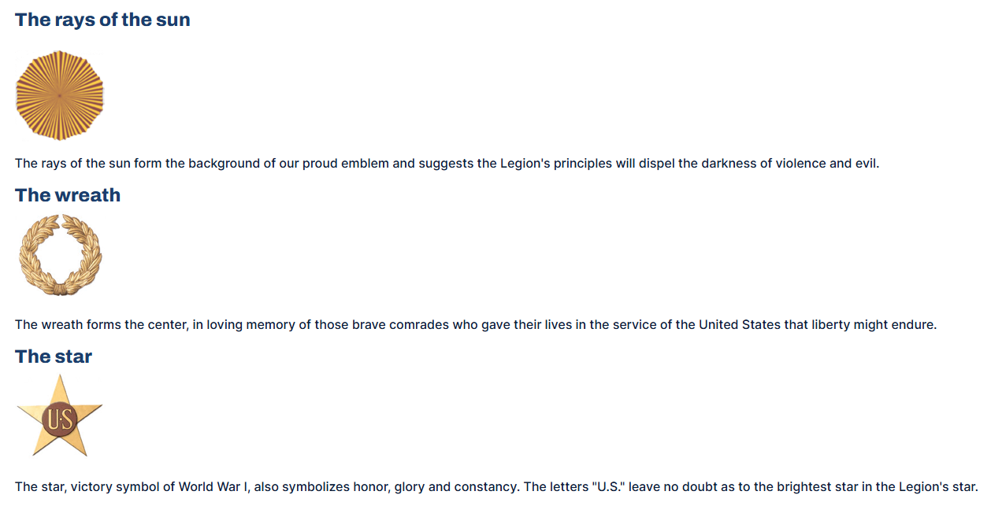
The Emblem

Slide 38
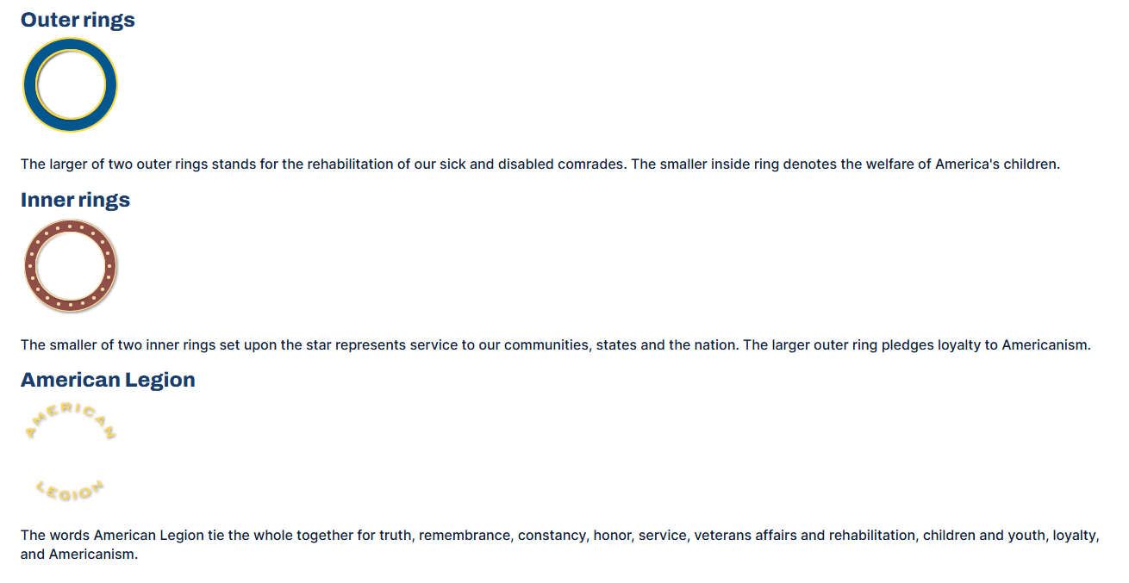
The Emblem

