Slide 1
A Whirlwind History of the Commercialization of Electricity
Kathy Joseph

Slide 2
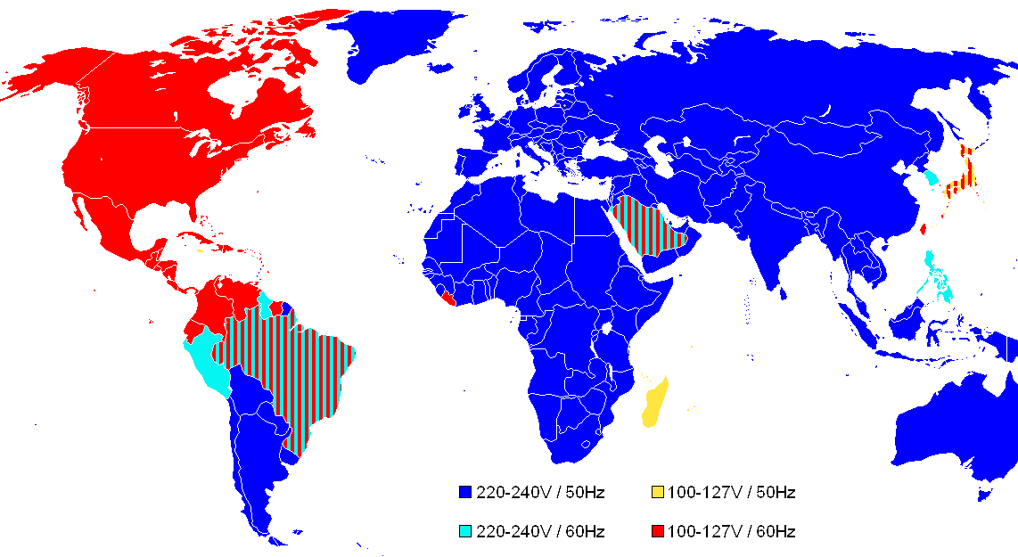
?
?

Slide 3
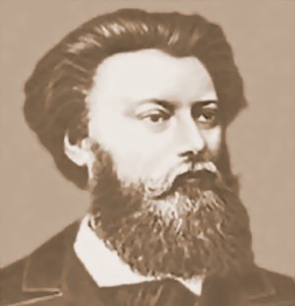
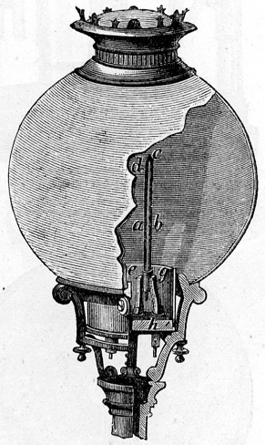
April 15, 1876
Pavel Yablochkov

Slide 4
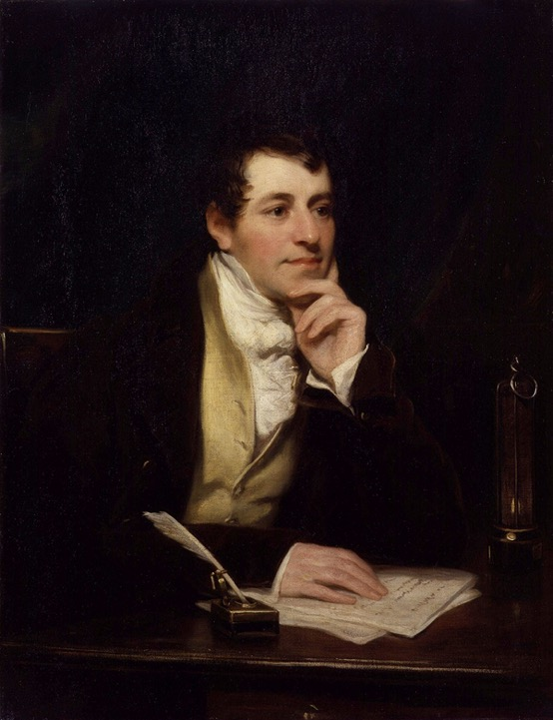
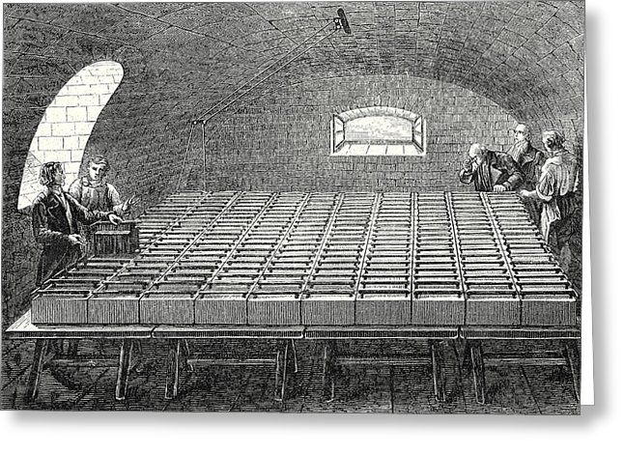
Humphry Davy

Slide 5
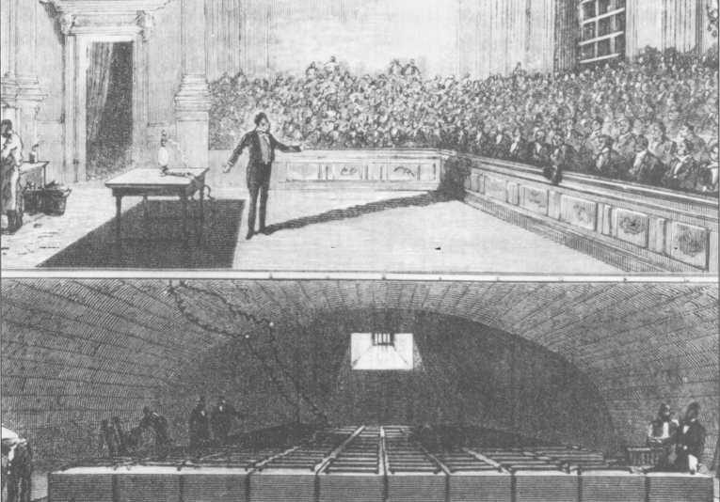
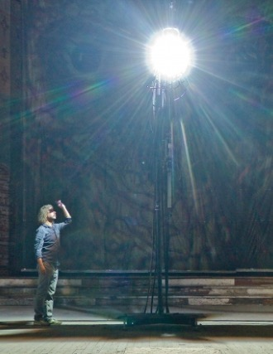
Humphry Davy - 1806

Slide 6
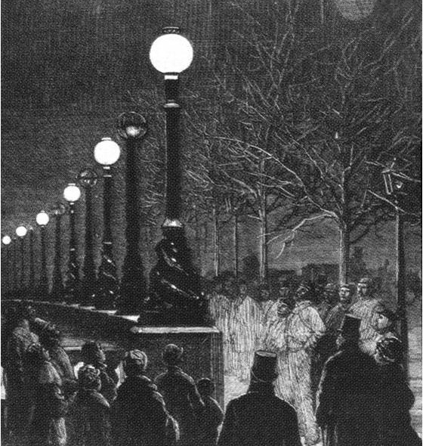
April 15, 1876
Pavel Yablochkov

Slide 7
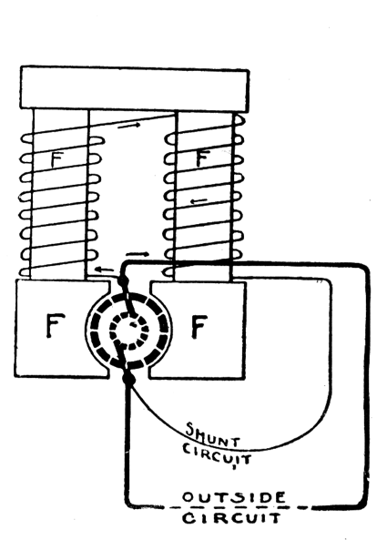
Problem: Worked with AC Current
Best Generators (dynamos) were “self excited”
Without diode: only worked with DC

Slide 8
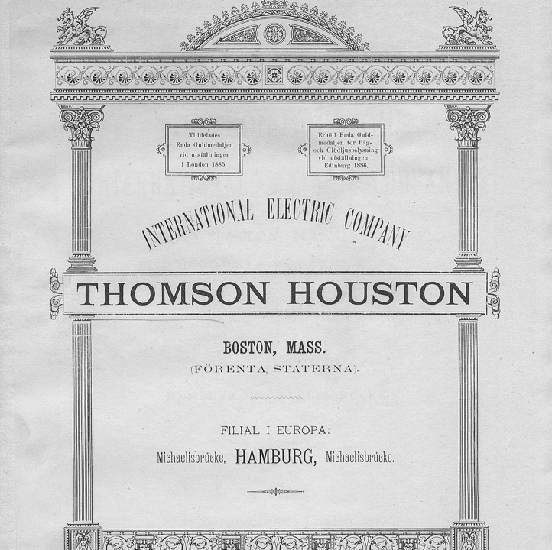
Some used inferior AC generators w/superior AC arc Lamps
Elihu Thomson &
his high school teacher Edwin Houston:
Thomson-Houston Electric Company in 1882

Slide 9
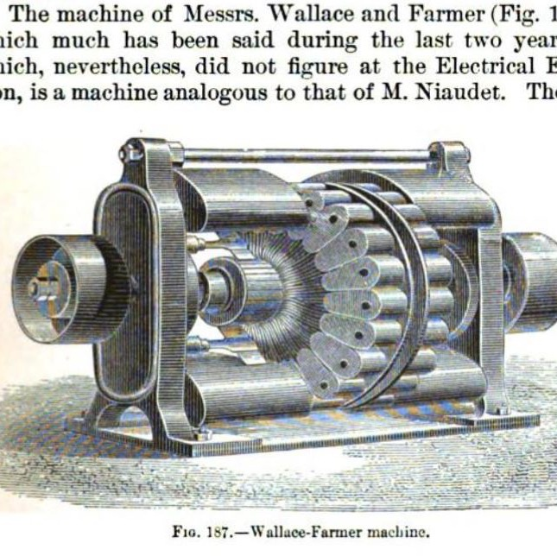
Some used superior DC Dynamos w/inferior DC arc Lamps
Moses Farmer & William Wallace
Wallace-Farmer 500 hp Dynamo
110 Volts (1876)
The Electric Light (1884) p. 242

Slide 10
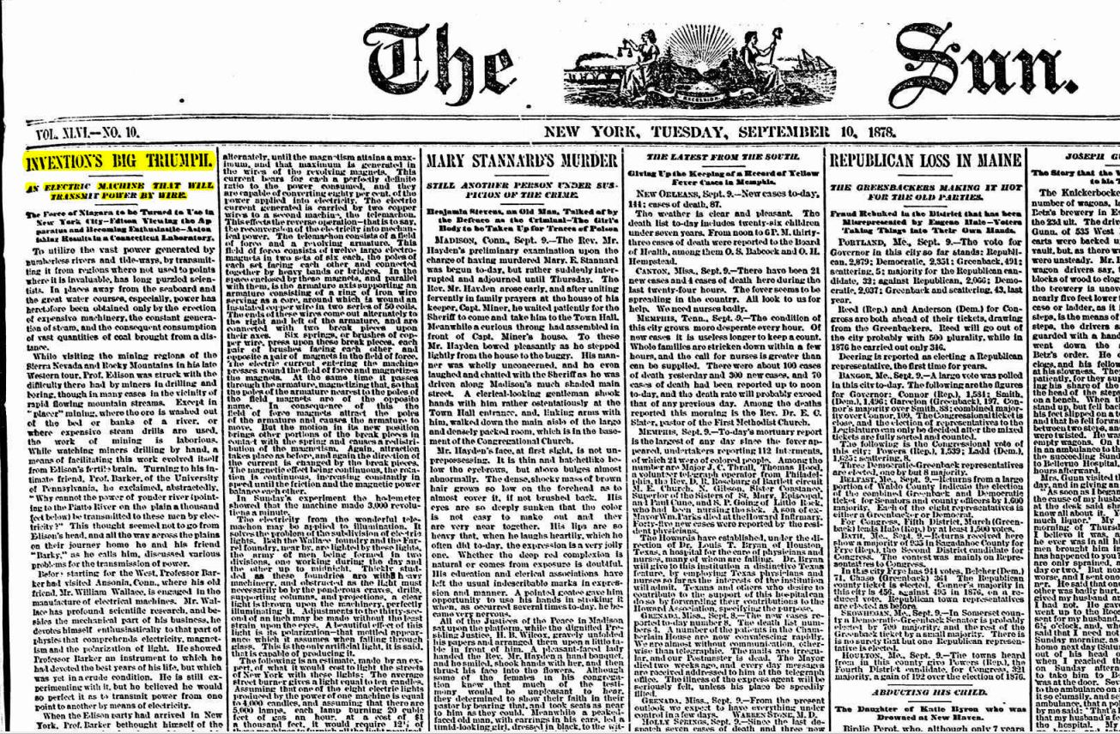
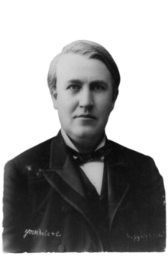
September 8, 1878
Wallace-Farmer 8 hp Dynamo 110 Volts (1876)
“Edison was enraptured”

Slide 11
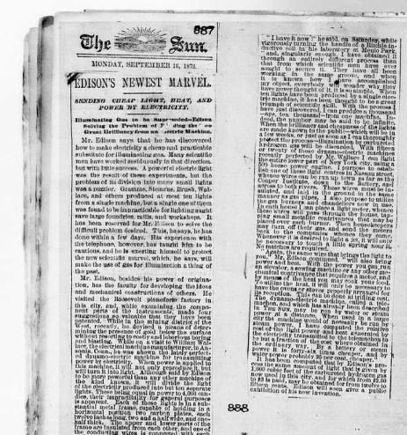
September 8, 1878
“With 15 or 20 of those dynamo-electric machines recently perfected by Mr. Wallace I can light the entire lower part of New York City, using a 500-horsepower engine.”

Slide 12
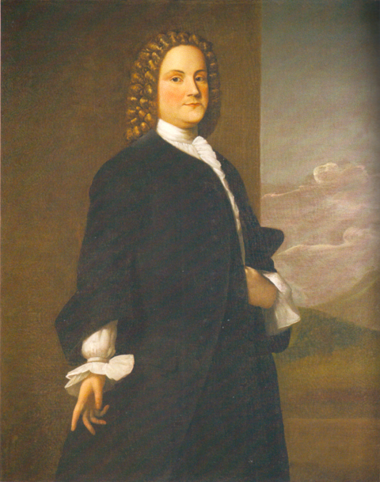
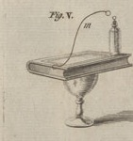
Benjamin Franklin (1748)

Slide 13
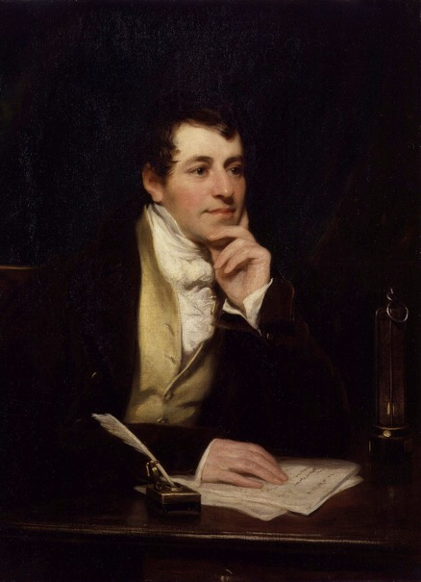
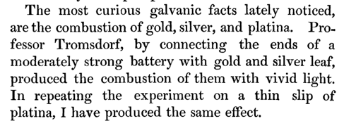
Humphry Davy

Slide 14
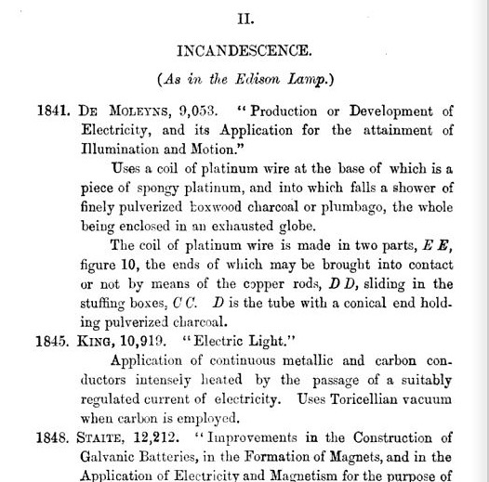
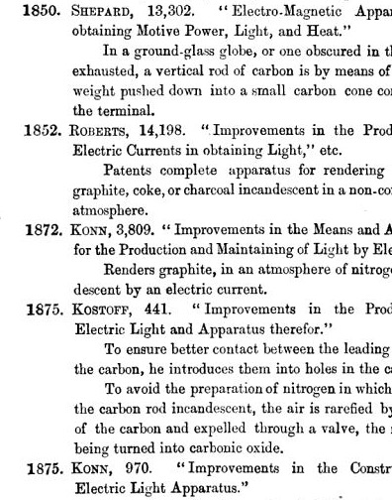

Slide 15
Late 1878 – Early 1879
Thermocouple didn’t work -> better vacuum + new filament
Wallace-Farmer Dynamo’s weren’t good enough
Bought every DC dynamo in production and made their own

Slide 16
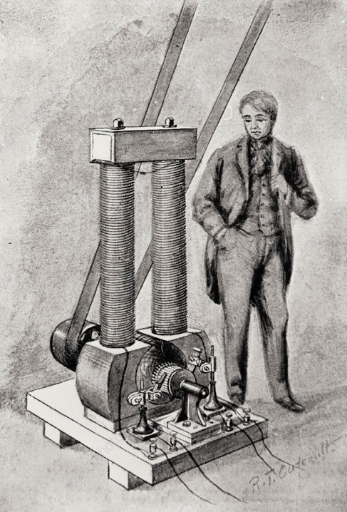
March, 1879 Long Legged Mary-Ann
5 kW DC Dynamo
110 Volts

Slide 17
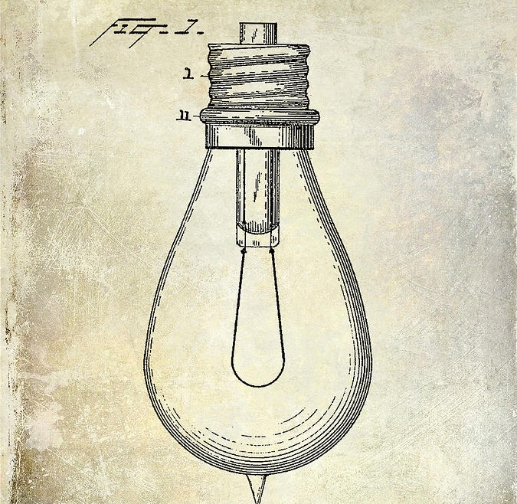
Light Bulb Patent – Jan 27, 1880 (Cotton Filament)

Slide 18
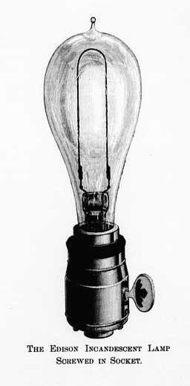
July, 1880 Switched to Mandrake Bamboo

Slide 19
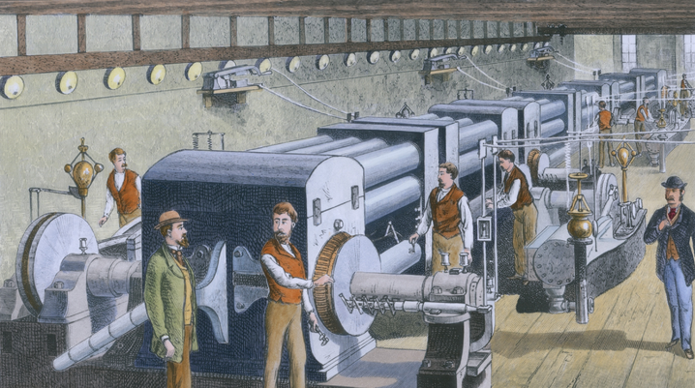
First US Commercial Electrical Power Station:
Sept 4, 1882

Slide 20
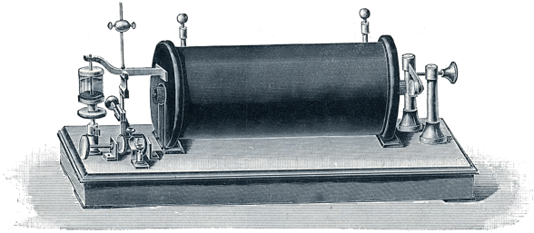
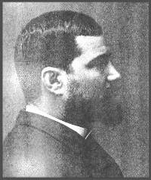
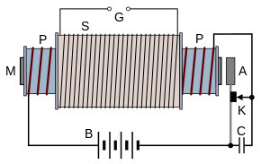
Lucien Gualard (1881)

Slide 21
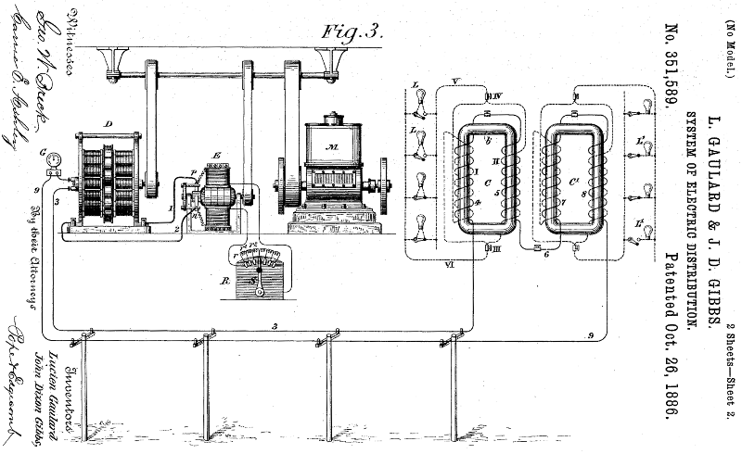
1st Patent was September 13, 1882

Slide 22
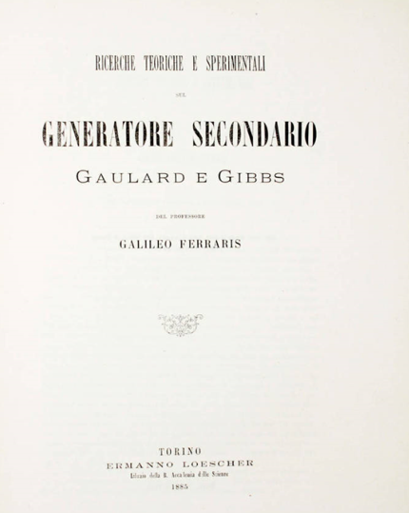
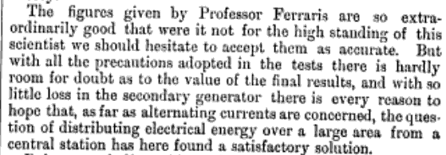
First demonstration, 1884, Turin, Italy (Judged by Galileo Ferraris)

Slide 23
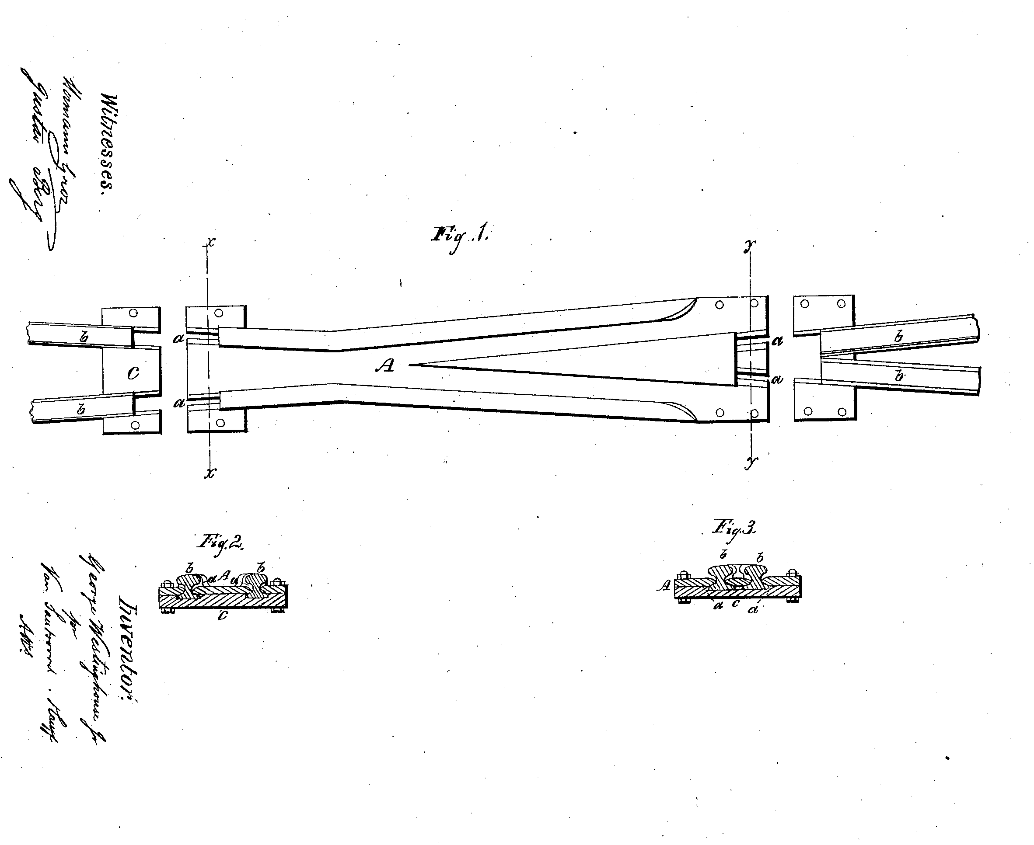
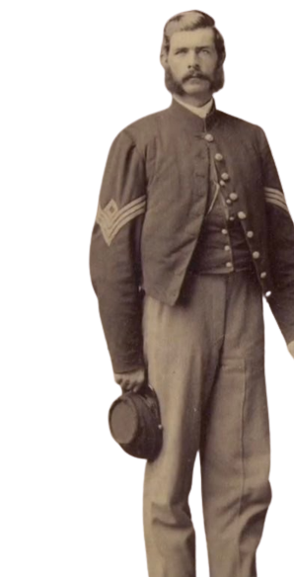

Slide 24
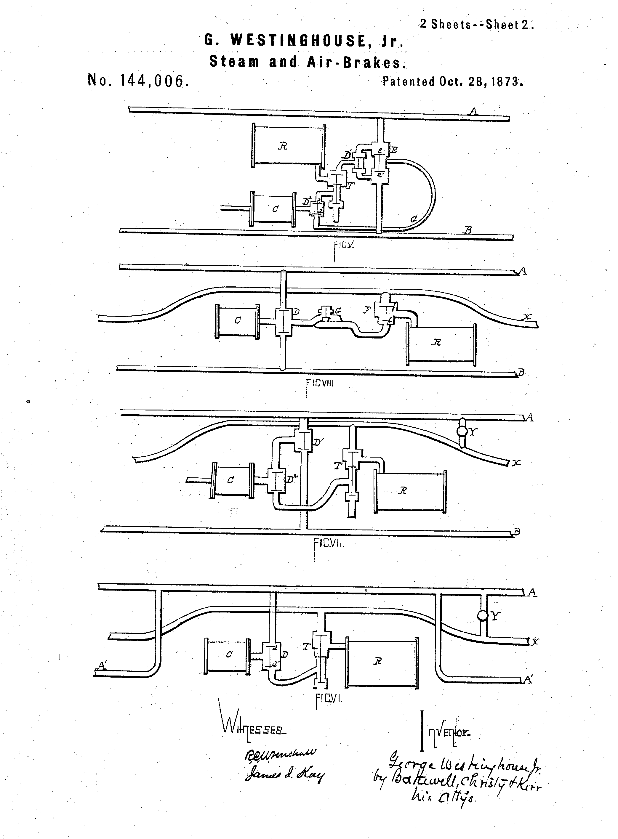
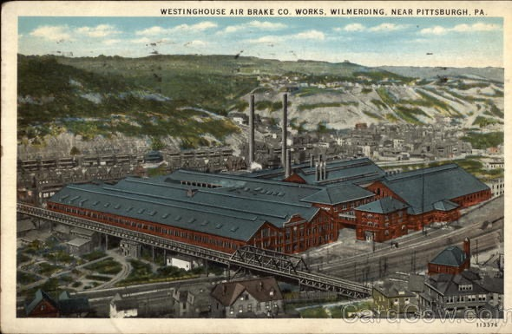
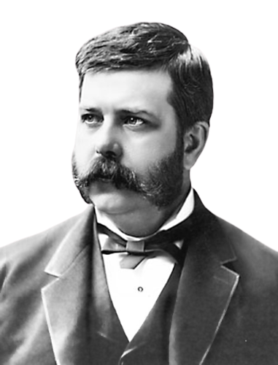

Slide 25
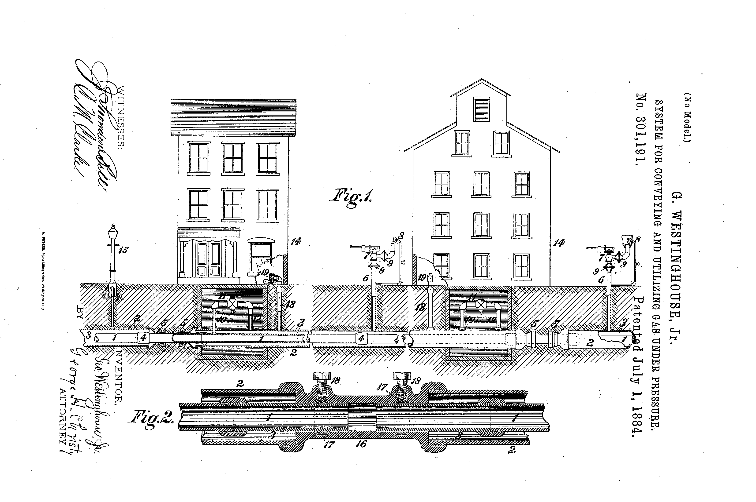
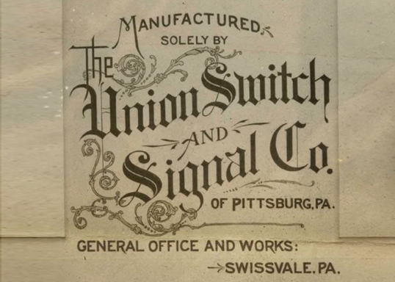
1881 – electric signals
1884 – natural gas

Slide 26
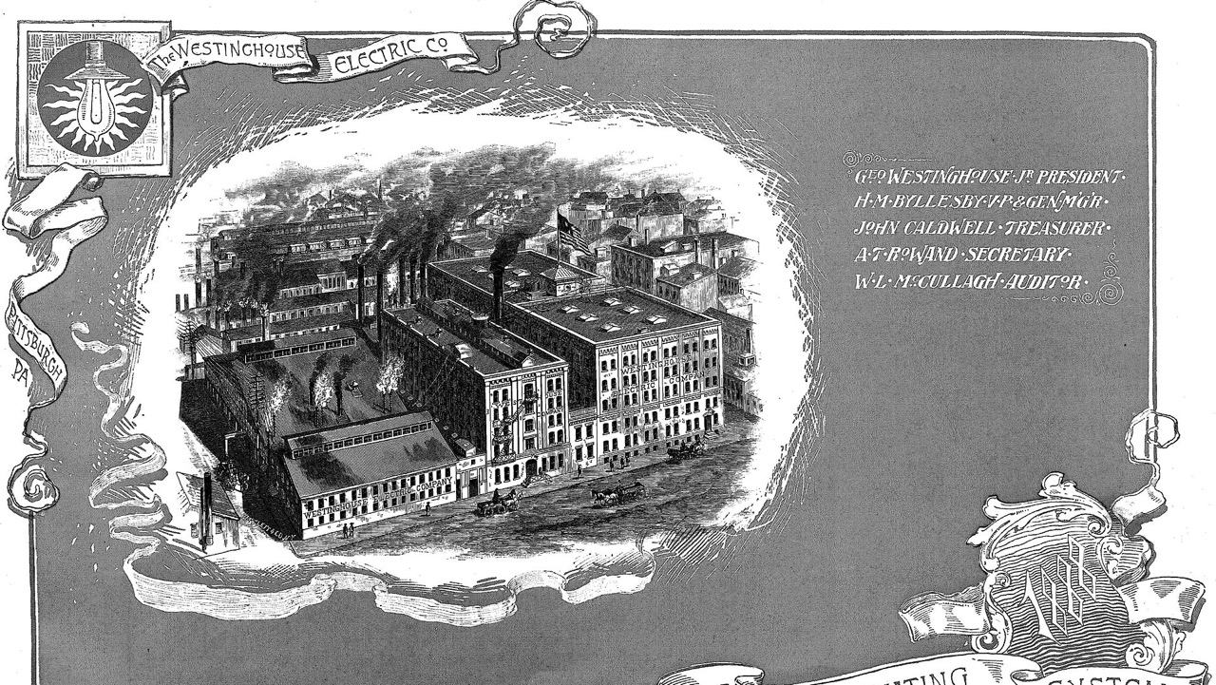
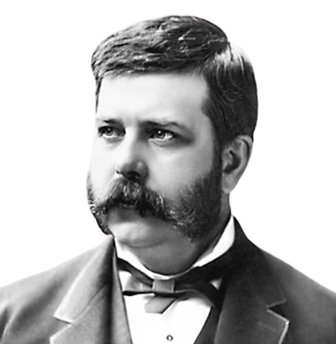
January 8, 1886: Westinghouse Electric Company 1st Major all-AC Company for Incandescent Lights

Slide 27
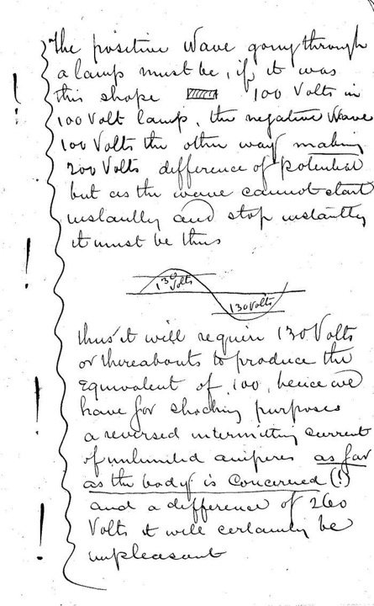
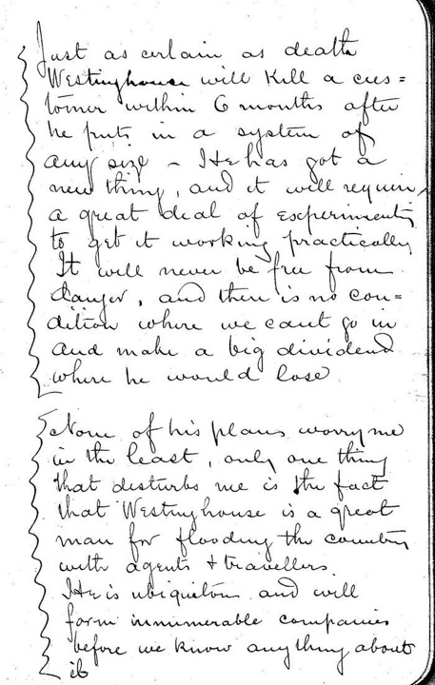
Nov, 1886

Slide 28
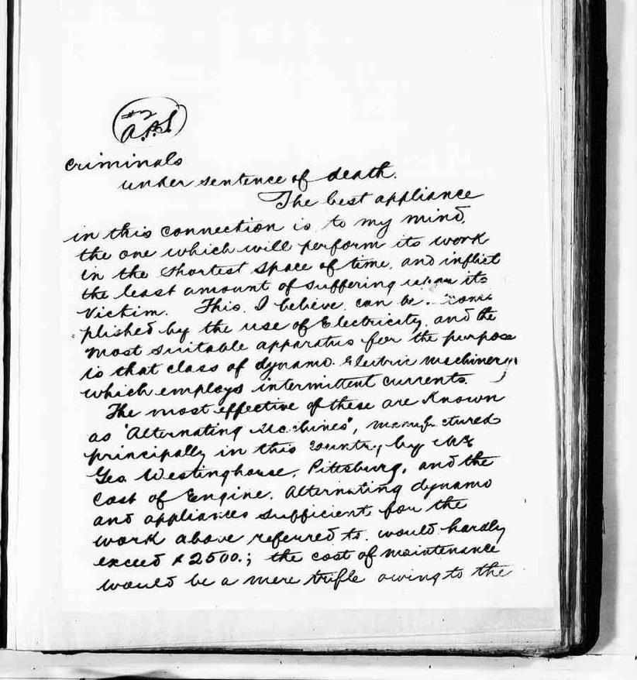
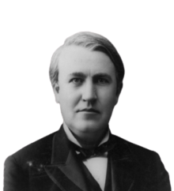
Dec 18, 1887
“The most effective of these are known as ‘Alternating Machines,’ manufactured principally in this country by Mr. George Westinghouse, Pittsburg”

Slide 29
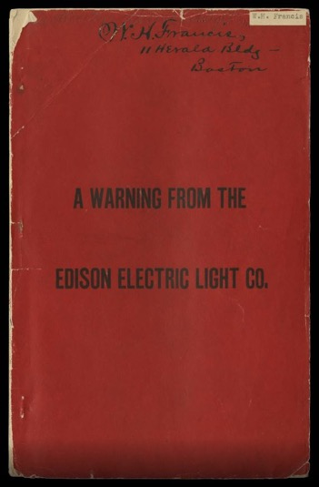
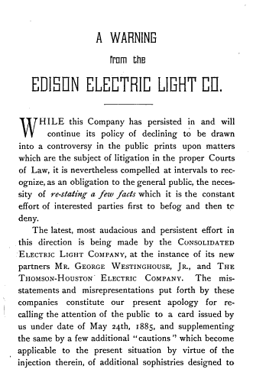
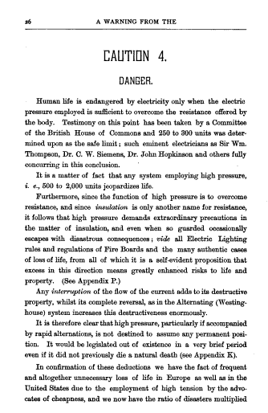
Feb, 1888

Slide 30
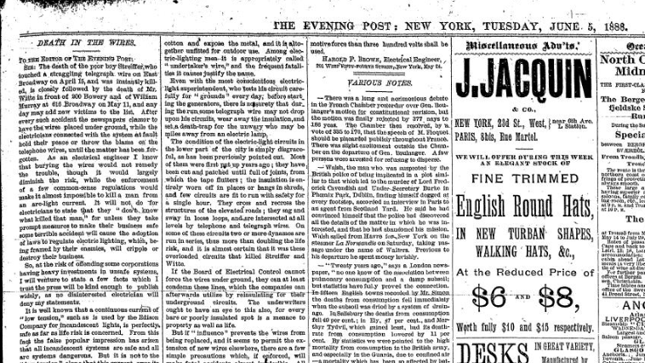
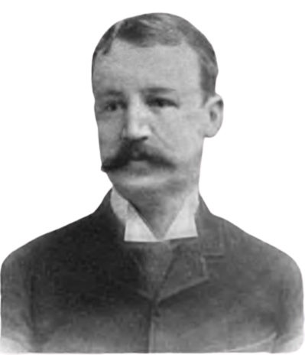
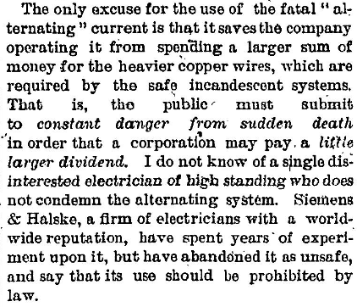

Slide 31
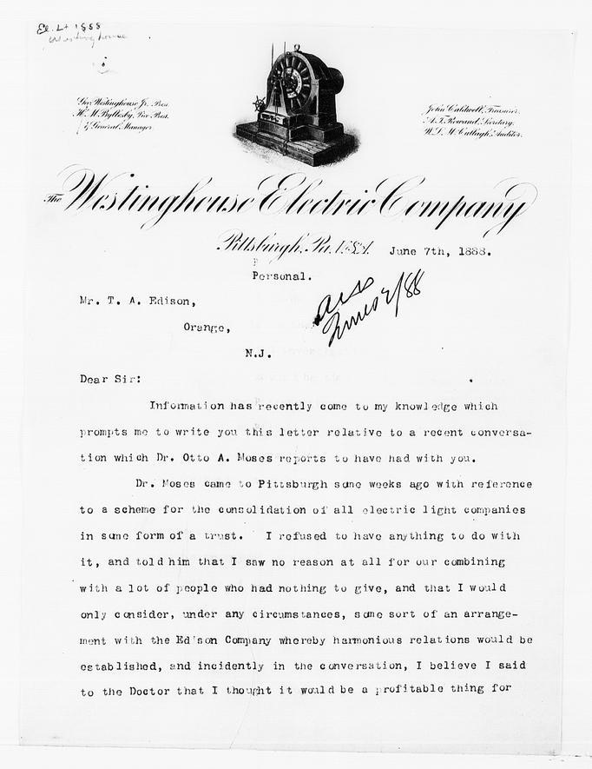

Slide 32
"I have lately been trying various experiments on dogs with a view to finding how great a pressure and quantity of electricity it takes to kill them with the view not only of determining the physiological data the question involves but also to arrive at the best means of safeguard to the lives of men engaged in electric lighting business I already know how much current is required to produce instant death within certain rough limits that I am desirous of narrowing. Can you therefore aid me to obtain some good-sized animals for the purpose of completing these experiments as early as possible."
Yours very truly,
Thomas Edison

Slide 33
Brown
20 Volts

Slide 35
Aug 6, 1890:

Slide 37
Westinghouse’s Goals 1) Increase public recognition reject JP Morgan 2) Increase interest in electric lights 3) Promote 2-phase generators to sell Tesla 2-phase motors

Slide 38
May, 1891 Nikola Tesla displays Tesla Coil

Slide 39
Columbian Exposition 1893
One of the Most Influential
+ Misunderstood Signs Ever

Slide 40
After Columbian World’s Exposition everyone in America wanted lights + 2-phase electricity

Slide 41
Masonic Building, 1892

Slide 42
February, 1894

Slide 43
Majority Electrical Systems 1894-1904
In US (only GE & Westinghouse)
60 Hz (to match Westinghouse’s Tesla motor)
110 V for lamps
In Europe (lots of companies, one of biggest AEG)
50 Hz
110 V for lamps

Slide 44
Dec 13, 1904: Franjo Hanaman & Alexander Just Tungsten Lamp higher than 110 Volts
In Europe, many companies replaced all old lightbulbs and doubled the voltage to 220 V to save money on wiring
In US, we (mostly) did not.

Slide 46
Bulletin 165: General Electric (FJ Gray & EB Fox)

Slide 47
Over time, many countries snuck up the voltage + split phase in US

Slide 48
Want to know more?
I am signing/selling my book “The Lightning Tamers” at this conference
I will be at the 5 pm after party
You can check out my YouTube channel “Kathy Loves Physics”

