Slide 1
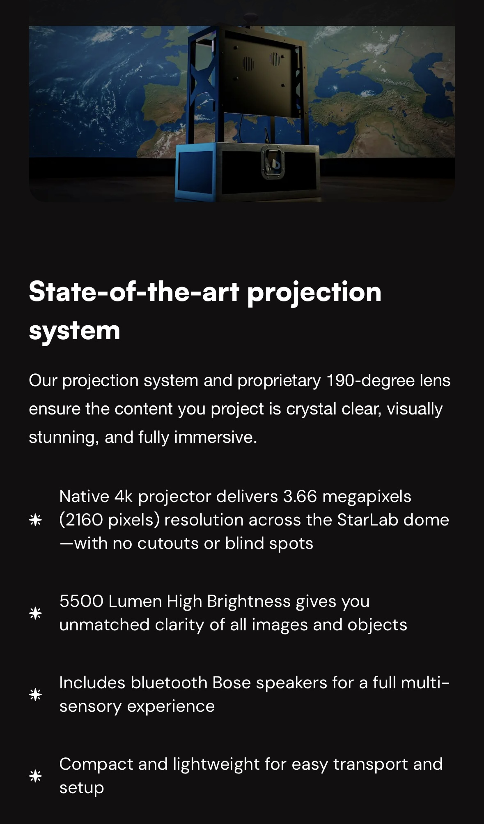
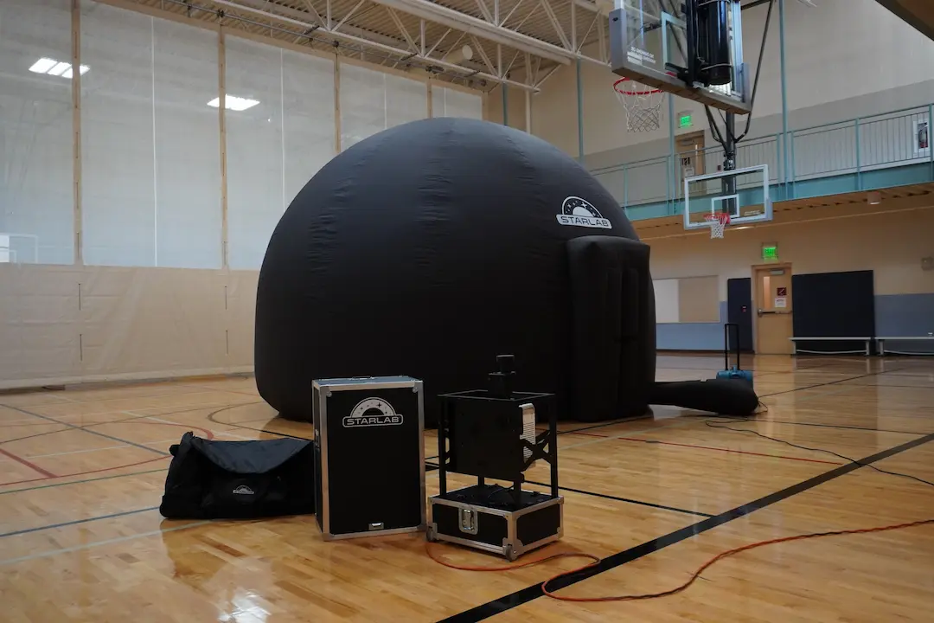
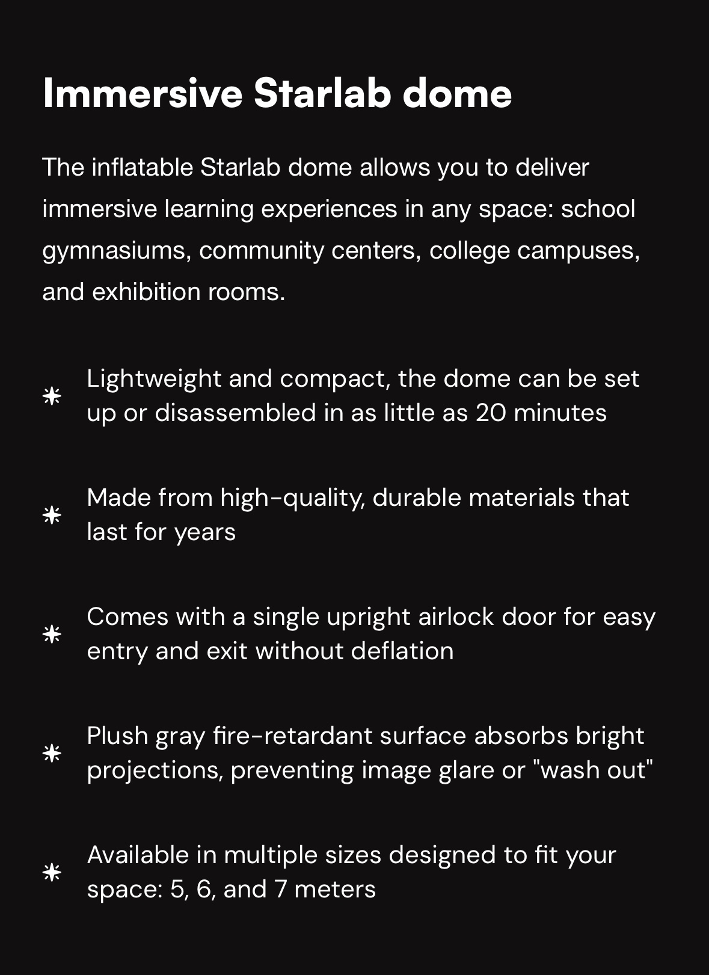
What Is a starlab?
A portable dome projection system fully accessible to ALL PMES students
Supports a wide variety of AKS objectives for ALL grades K-5 including Astronomy, Geology, Meteorology and more!

