Slide 1
HOA/PROPERTY MANAGEMENT
NOTIFICATION FOR NETWORK
UPGRADES BY AT&T
Materials Used
Fiber Optic Cable
1.5” Orange Pipe (Innerduct)
10”x 15” Handholes (Water Meter Boxes)
17”x 30” Handholes
30”x 48” Handholes

Slide 2
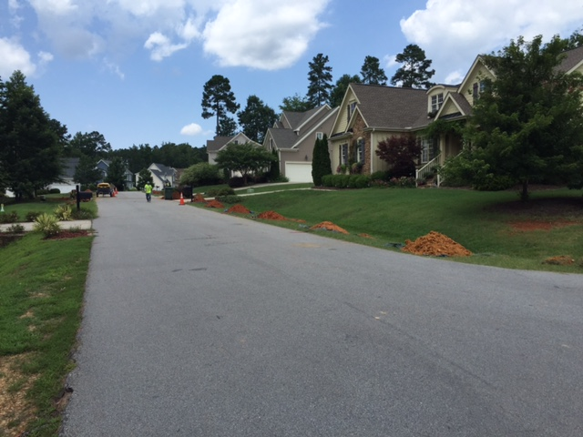
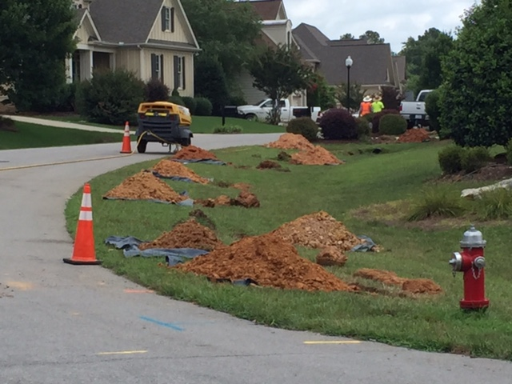
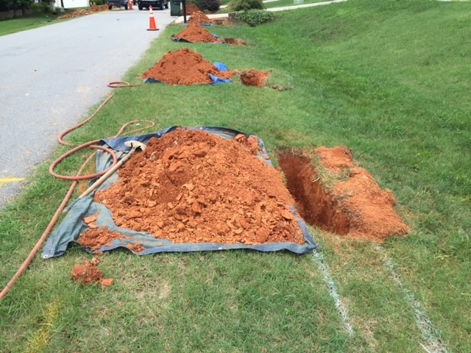
STITCH BORING - MISSILE BORING
The fiber optic cables and pipe that is placed is done with a process called “stitch boring” or “missile boring”. Our contractor will dig 15” wide x 72” long x 27” deep holes every 20 to 50 feet depending upon conditions and will drill holes between the holes to pull in the cable and pipe. When they dig the holes they first cut the sod and set it aside to save. Then they spread a tarp on the ground to protect the grass from the dirt as the hole is dug out. All of the dirt removed from the hole is placed on the tarp.

Slide 3
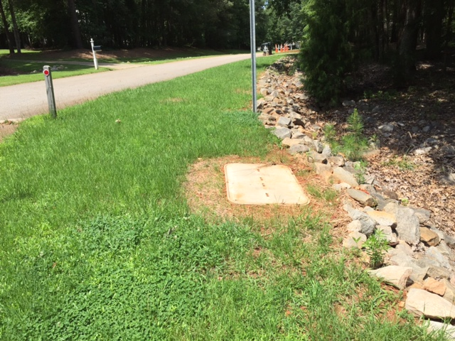
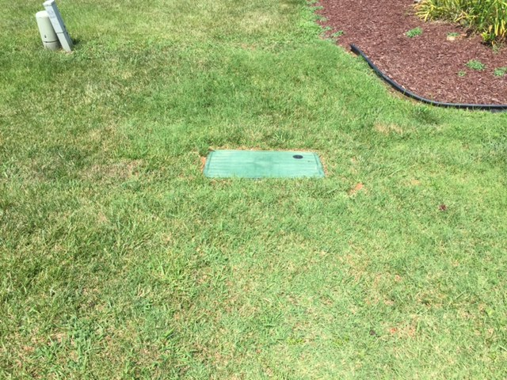
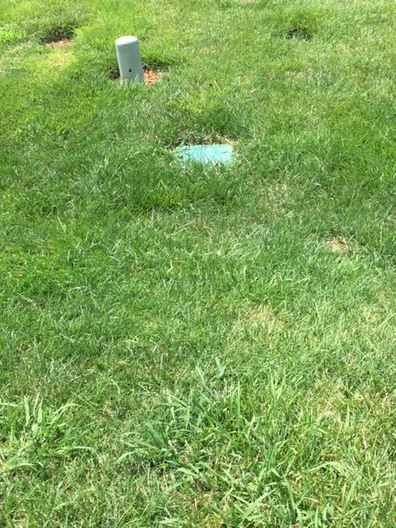
PLACED HANDHOLES
30”x48”
17”x30”
10”x15”
Once all of the cable is placed the holes are filled in and tamped. Then the sod is replaced. In the areas around the handholes we will also place grass seed and straw if necessary.

