Slide 1
Scrap It Down: Metacity

Slide 2
Player Flow
Spawn → Find Scrap → Haul → Drop → Earn SP → Rank Up → Compete

Slide 3
System Architecture
Player → Backend → PDA Vault → Treasury → Raydium

Slide 4
Economy Flow
Buy ScrapCoins → Spend → Backend tracks → Convert → Treasury

Slide 5
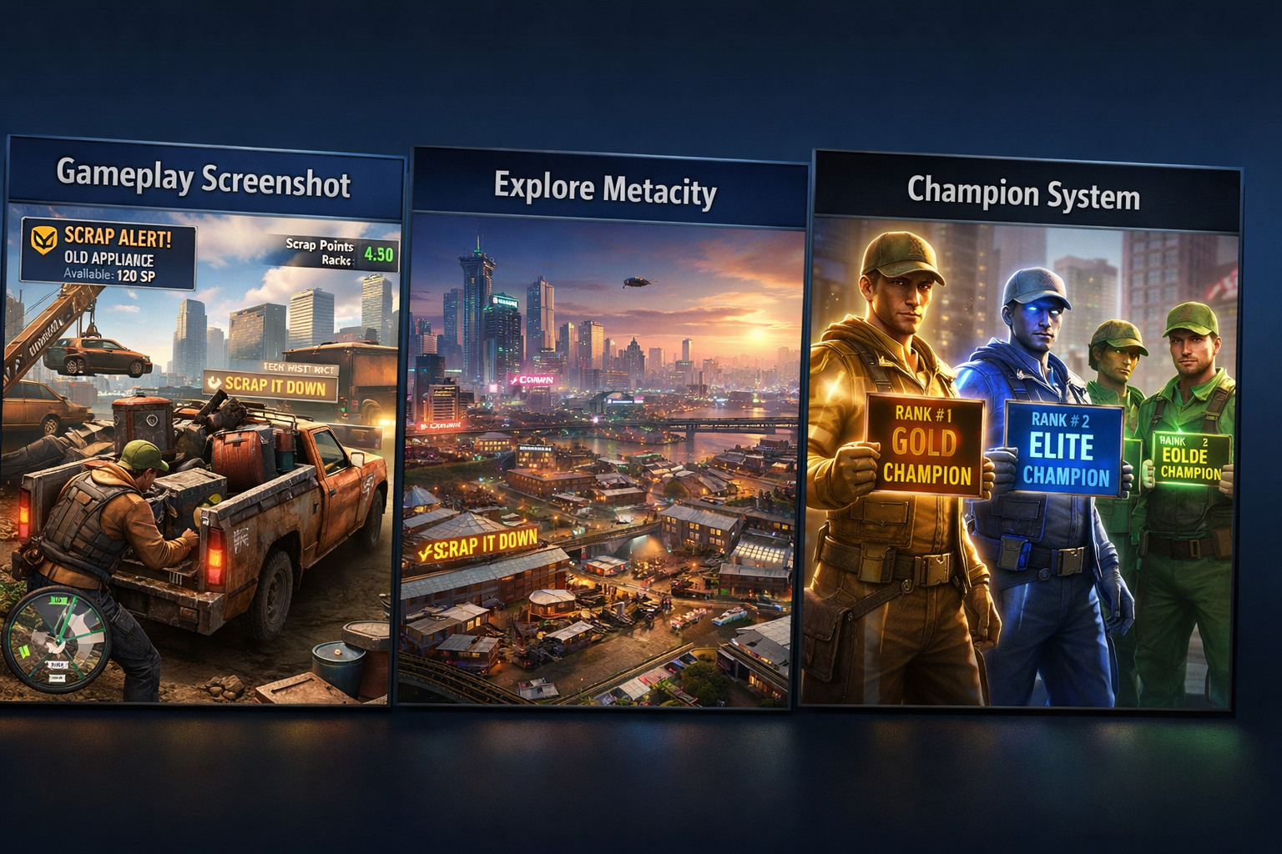
Gameplay Screenshot

Slide 6
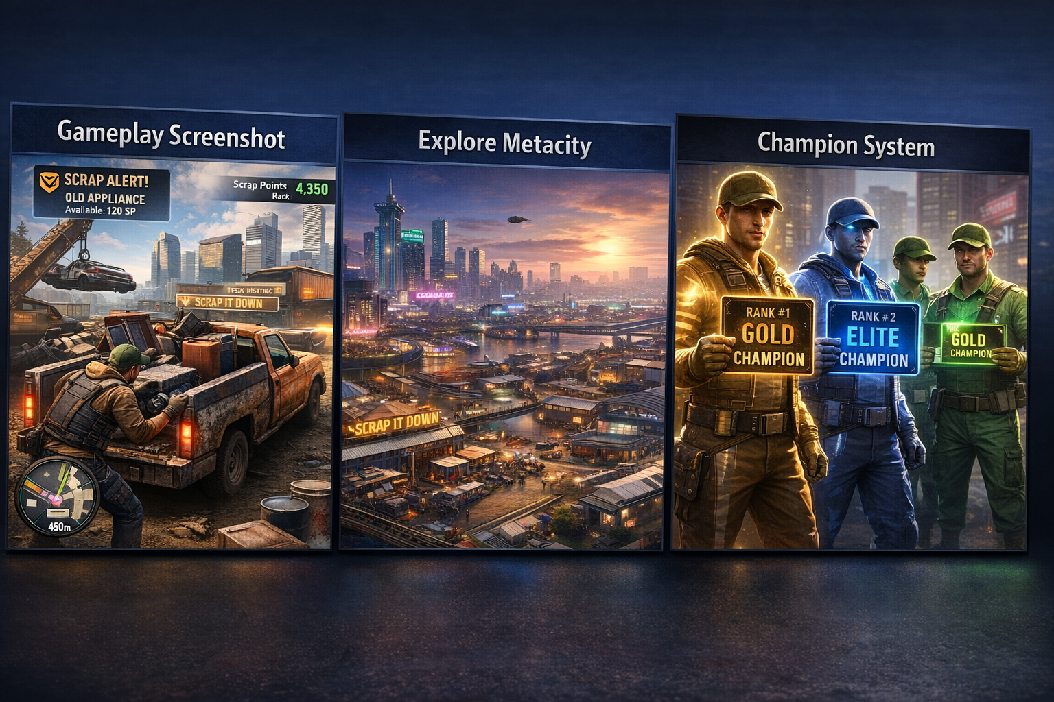
City Overview

Slide 7
Champion System
Gold #1, Blue #2, Green others

