Slide 1

HTML5

Slide 2
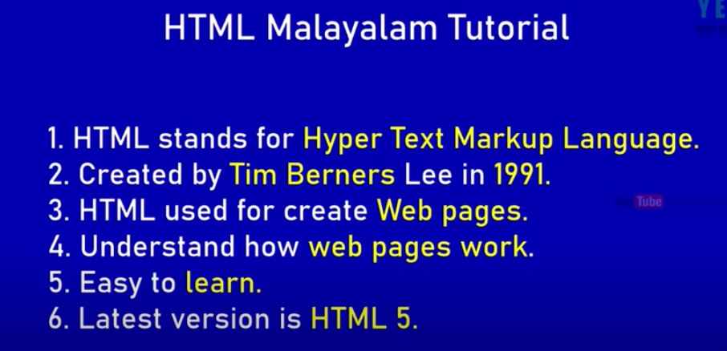

Slide 3
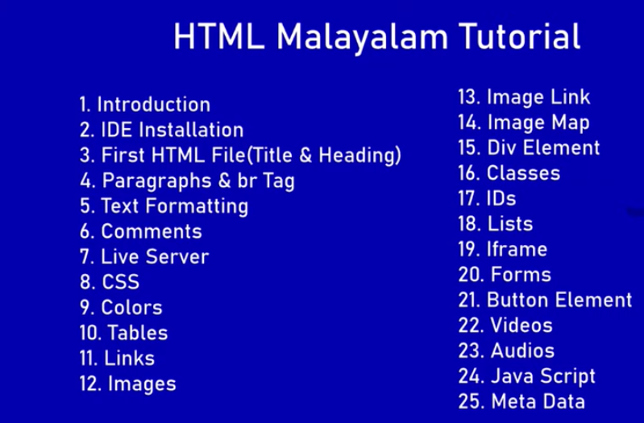

Slide 4
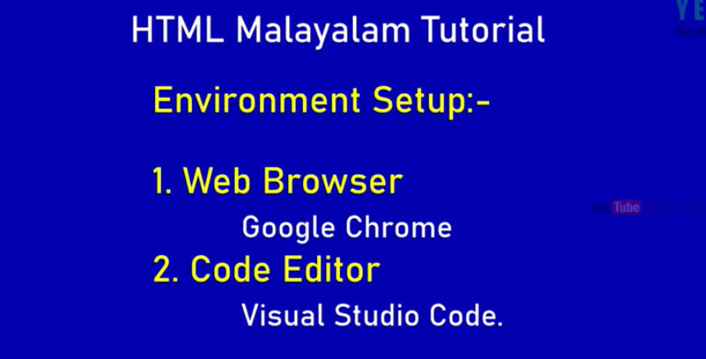

Slide 5

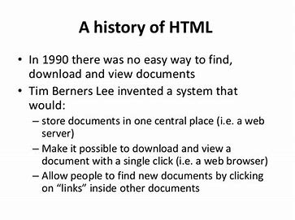
…..HISTORY…..

Slide 6

Logo

Slide 7



We can make a website

Slide 8

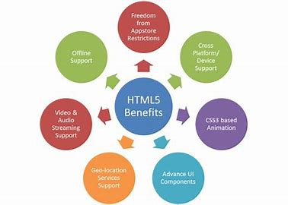
Features
Look in the slide notes below for topics to consider talking about
Notes:
Consider talking about:
Markup
New APIs
XHTML 5 (XML-serialized HTML 5)
Error handling
Popularity

